Slide 1
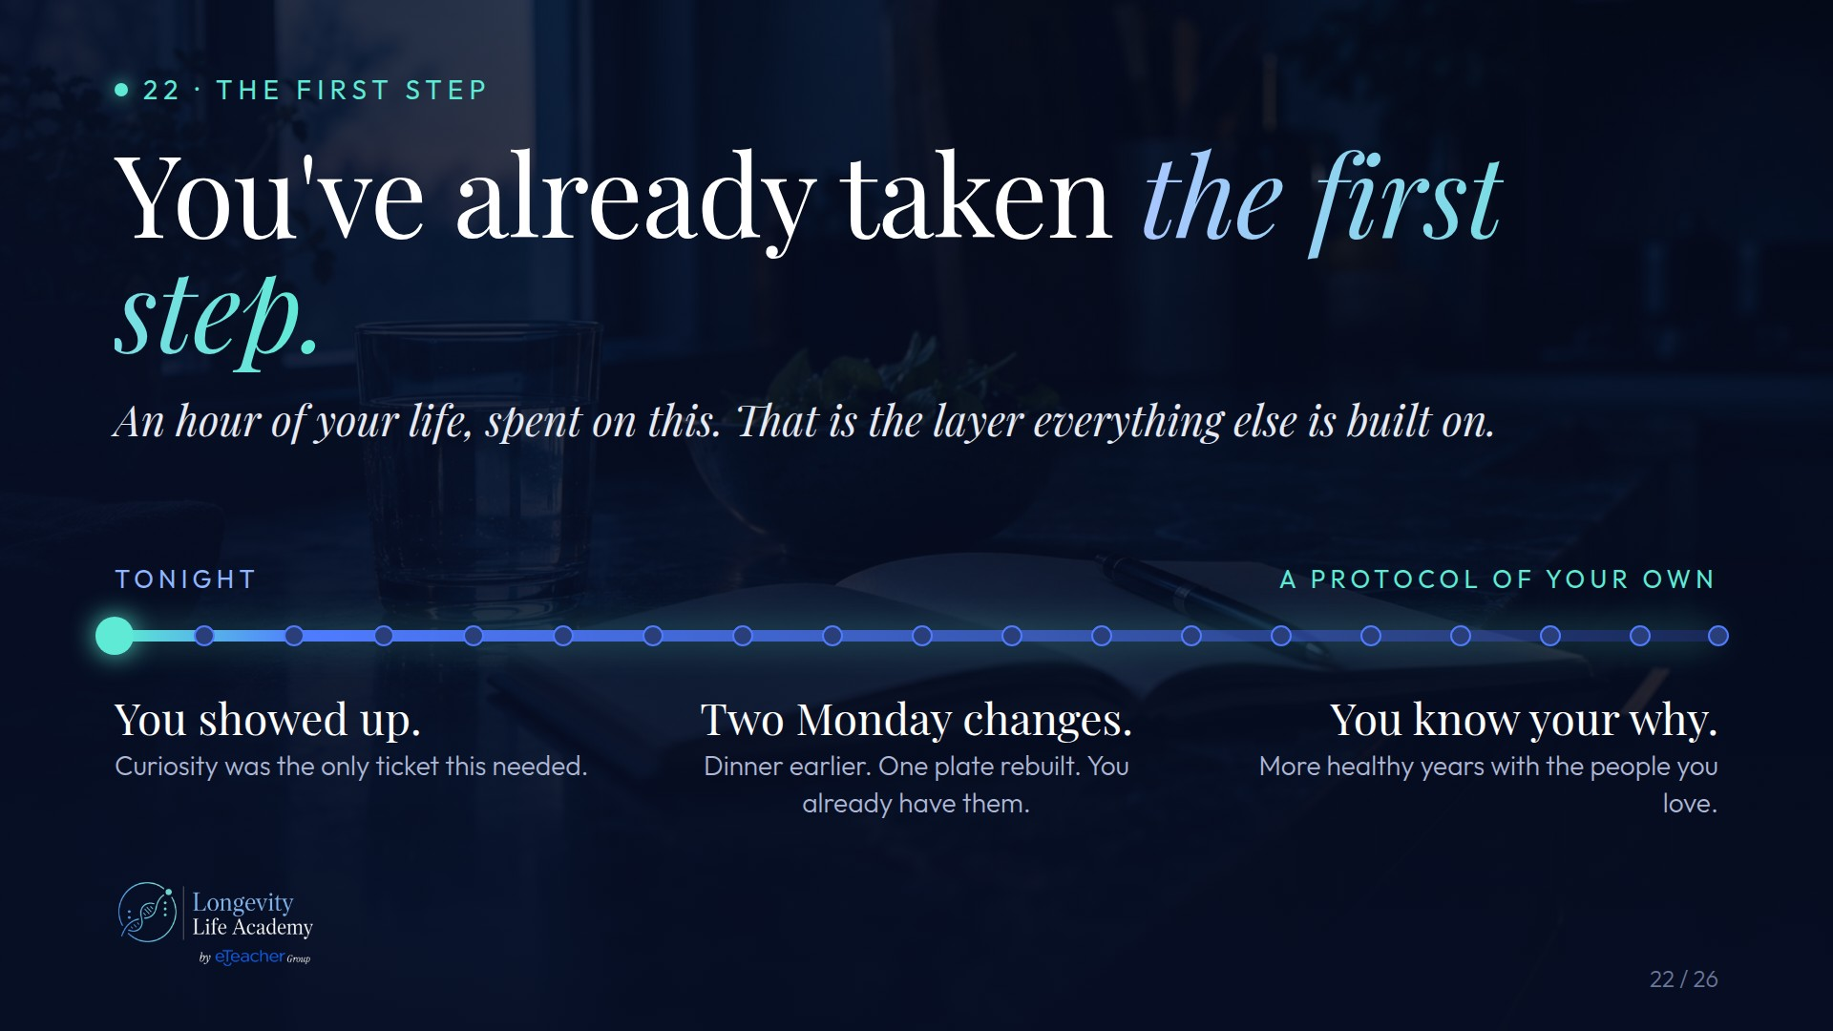
Notes:
Preserved original slide artwork, not editable text. c22
Original dimensions: 1920 × 1080 pixels.
Git commit 8d0635b19b0314bc9c849a5af6567988517a0ab7; slide-canvas/closers/frames/c22.jpg

Slide 2

Notes:
Preserved original slide artwork, not editable text. c23
Original dimensions: 1920 × 1080 pixels.
Git commit 8d0635b19b0314bc9c849a5af6567988517a0ab7; slide-canvas/closers/frames/c23.jpg

Slide 3
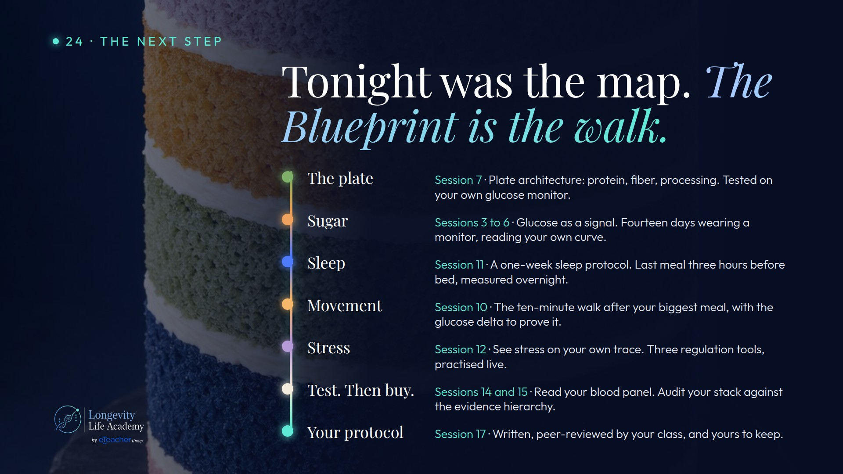
Notes:
Preserved original slide artwork, not editable text. c24
Original dimensions: 1920 × 1080 pixels.
Git commit 8d0635b19b0314bc9c849a5af6567988517a0ab7; slide-canvas/closers/frames/c24.jpg

Slide 4
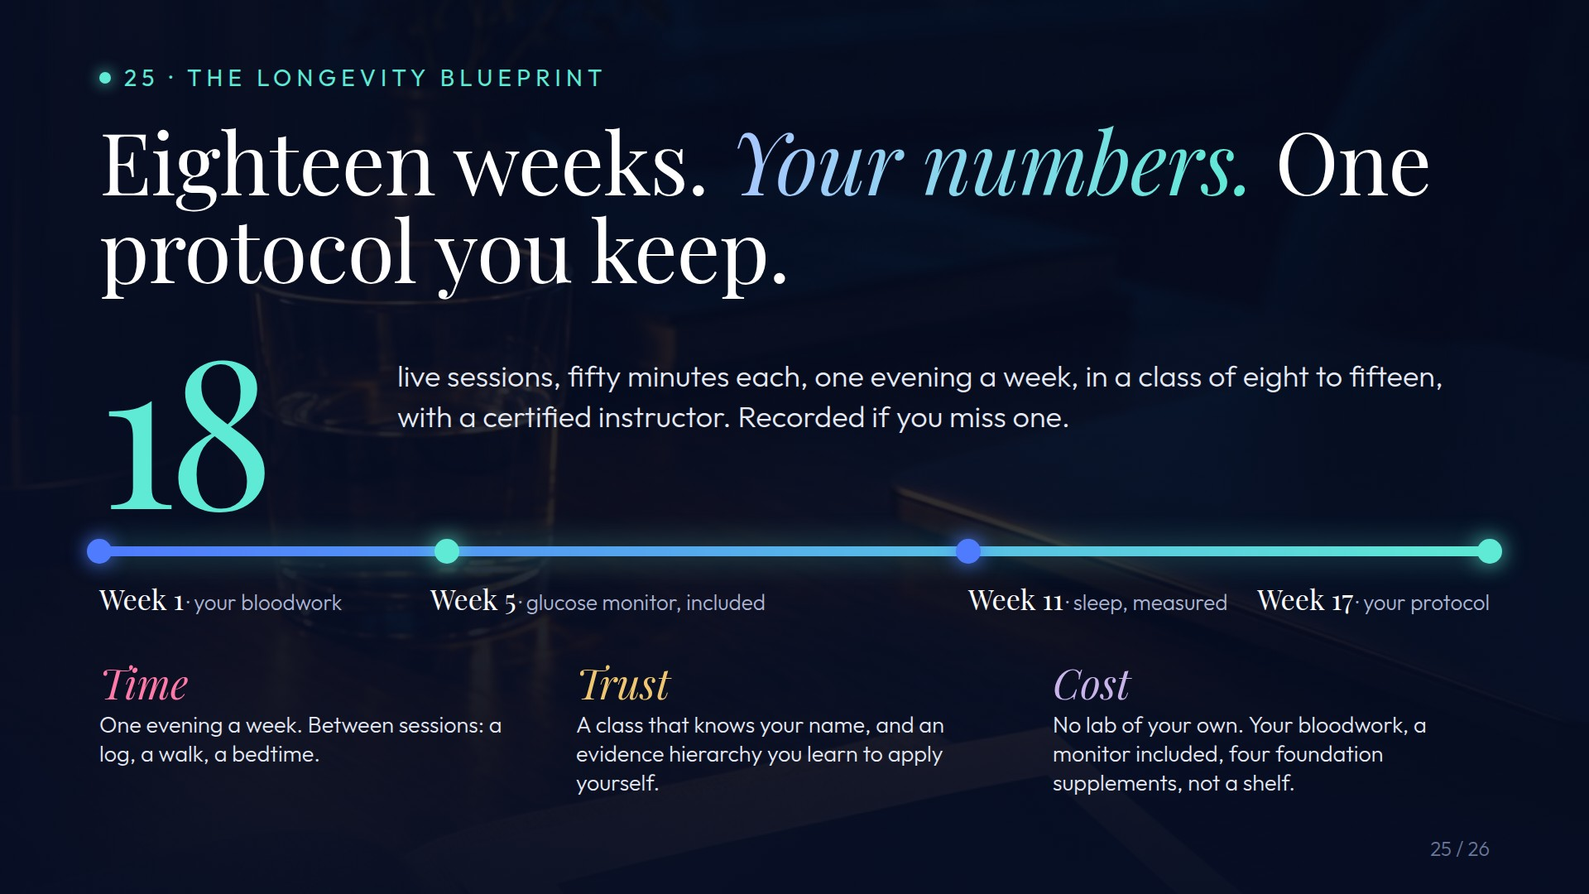
Notes:
Preserved original slide artwork, not editable text. c25
Original dimensions: 1920 × 1080 pixels.
Git commit 8d0635b19b0314bc9c849a5af6567988517a0ab7; slide-canvas/closers/frames/c25.jpg

Slide 5

Notes:
Preserved original slide artwork, not editable text. c26
Original dimensions: 1920 × 1080 pixels.
Git commit 8d0635b19b0314bc9c849a5af6567988517a0ab7; slide-canvas/closers/frames/c26.jpg

