Slide 1

Notes:
Preserved original slide artwork, not editable text. act3-a
Original dimensions: 1920 × 1080 pixels.
Git commit 8258a553c39d48e868e7e48e856502b9e7552281; slide-canvas/closers/frames/act3-a.jpg

Slide 2

Notes:
Preserved original slide artwork, not editable text. act3-b
Original dimensions: 1920 × 1080 pixels.
Git commit 8258a553c39d48e868e7e48e856502b9e7552281; slide-canvas/closers/frames/act3-b.jpg

Slide 3

Notes:
Preserved original slide artwork, not editable text. act3-c
Original dimensions: 1920 × 1080 pixels.
Git commit 8258a553c39d48e868e7e48e856502b9e7552281; slide-canvas/closers/frames/act3-c.jpg

Slide 4

Notes:
Preserved original slide artwork, not editable text. act2-a
Original dimensions: 1920 × 1080 pixels.
Git commit 4b5b73be3493deed46e4a2af2c6c2bcaa11fc63e; slide-canvas/closers/frames/act2-a.jpg

Slide 5

Notes:
Preserved original slide artwork, not editable text. act2-d
Original dimensions: 1920 × 1080 pixels.
Git commit 4b5b73be3493deed46e4a2af2c6c2bcaa11fc63e; slide-canvas/closers/frames/act2-d.jpg

Slide 6
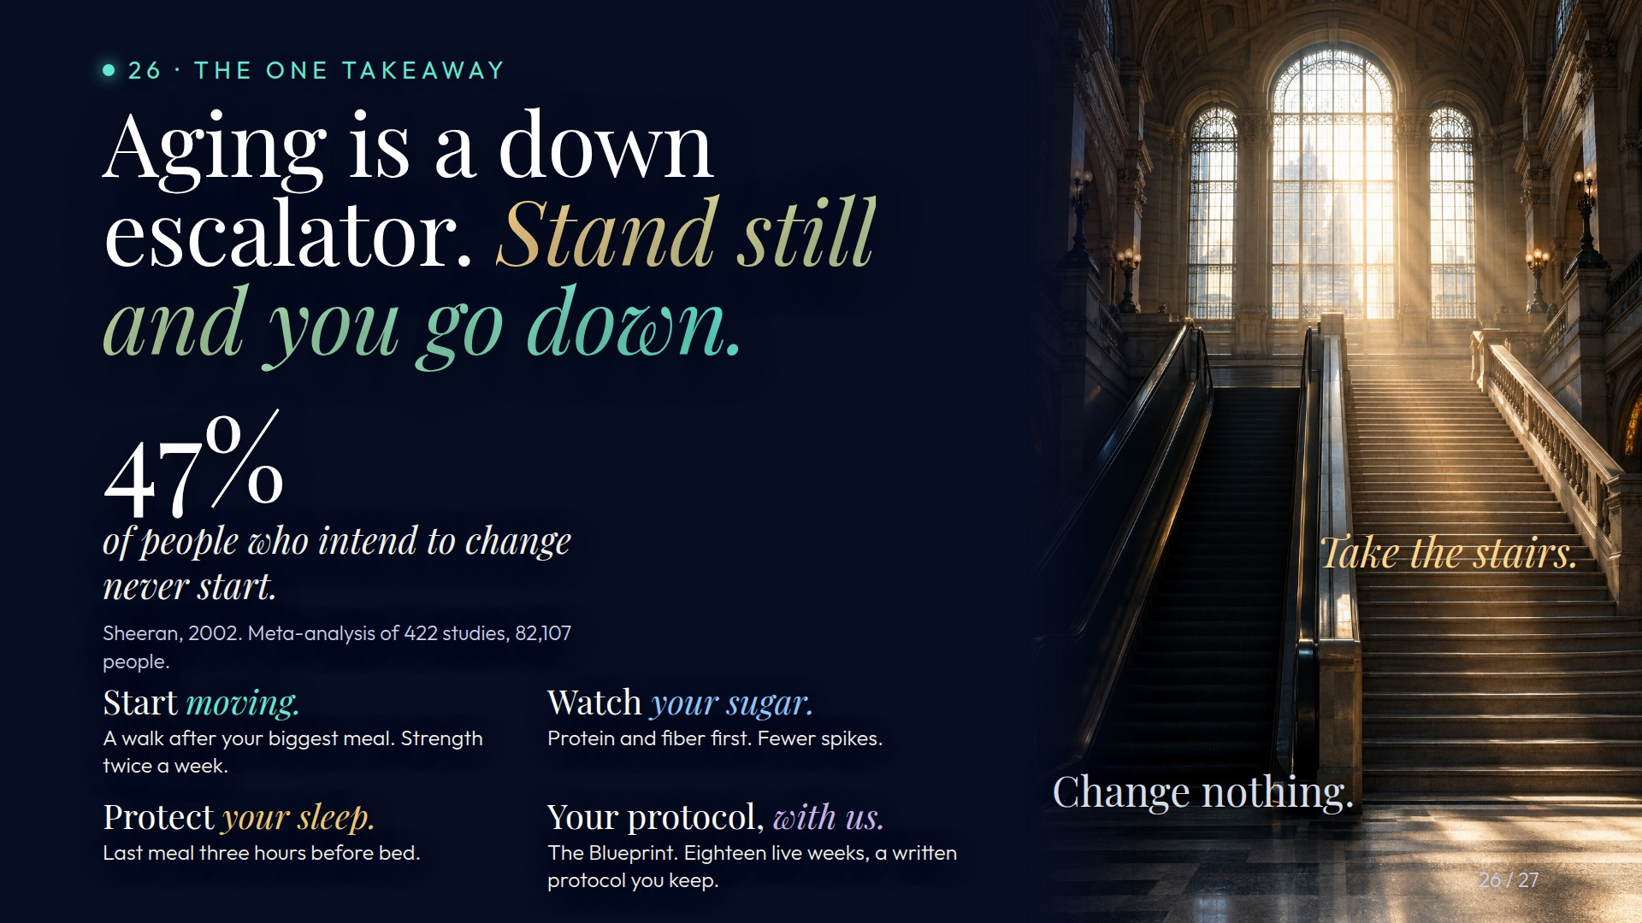
Notes:
Preserved original slide artwork, not editable text. act2-e
Original dimensions: 1920 × 1080 pixels.
Git commit 4b5b73be3493deed46e4a2af2c6c2bcaa11fc63e; slide-canvas/closers/frames/act2-e.jpg

Slide 7
Notes:
Preserved original slide artwork, not editable text. act2-a
Original dimensions: 1920 × 1080 pixels.
Git commit 6e32e4c92a862c7fdefd54e1b7c9f747eef1efb1; slide-canvas/closers/frames/act2-a.jpg

Slide 8

Notes:
Preserved original slide artwork, not editable text. act2-b
Original dimensions: 1920 × 1080 pixels.
Git commit 6e32e4c92a862c7fdefd54e1b7c9f747eef1efb1; slide-canvas/closers/frames/act2-b.jpg

Slide 9

Notes:
Preserved original slide artwork, not editable text. act2-c
Original dimensions: 1920 × 1080 pixels.
Git commit 6e32e4c92a862c7fdefd54e1b7c9f747eef1efb1; slide-canvas/closers/frames/act2-c.jpg

Slide 10

Notes:
Preserved original slide artwork, not editable text. act-a
Original dimensions: 1920 × 1080 pixels.
Git commit 93ceffeb55299a76be5ff795e1360267bfd642cd; slide-canvas/closers/frames/act-a.jpg

Slide 11

Notes:
Preserved original slide artwork, not editable text. act-b
Original dimensions: 1920 × 1080 pixels.
Git commit 93ceffeb55299a76be5ff795e1360267bfd642cd; slide-canvas/closers/frames/act-b.jpg

Slide 12

Notes:
Preserved original slide artwork, not editable text. act-c
Original dimensions: 1920 × 1080 pixels.
Git commit 93ceffeb55299a76be5ff795e1360267bfd642cd; slide-canvas/closers/frames/act-c.jpg

