Slide 1
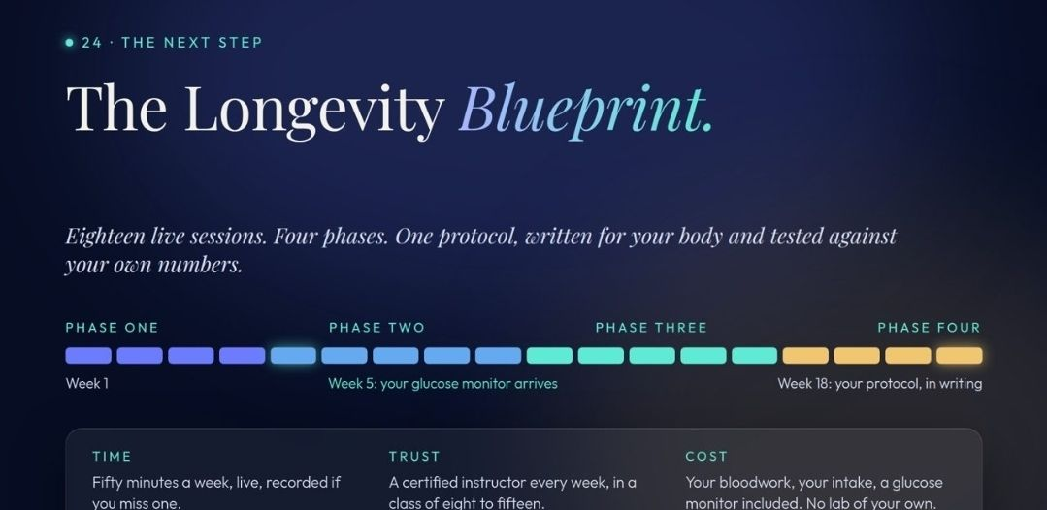
Notes:
Preserved original slide artwork, not editable text. 216112.jpg
Original dimensions: 1079 × 526 pixels.
Original user upload recovered from the design conversation. Original filename preserved; turn association not exposed by transcript export.

Slide 2
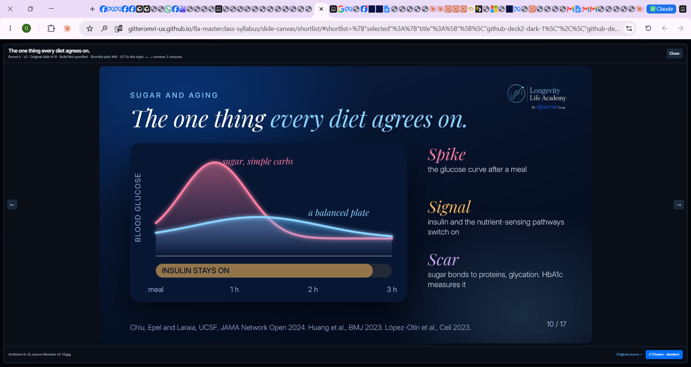
Notes:
Preserved original slide artwork, not editable text. image-2.png
Original dimensions: 1920 × 1020 pixels.
Original user upload recovered from the design conversation. Original filename preserved; turn association not exposed by transcript export.

Slide 3
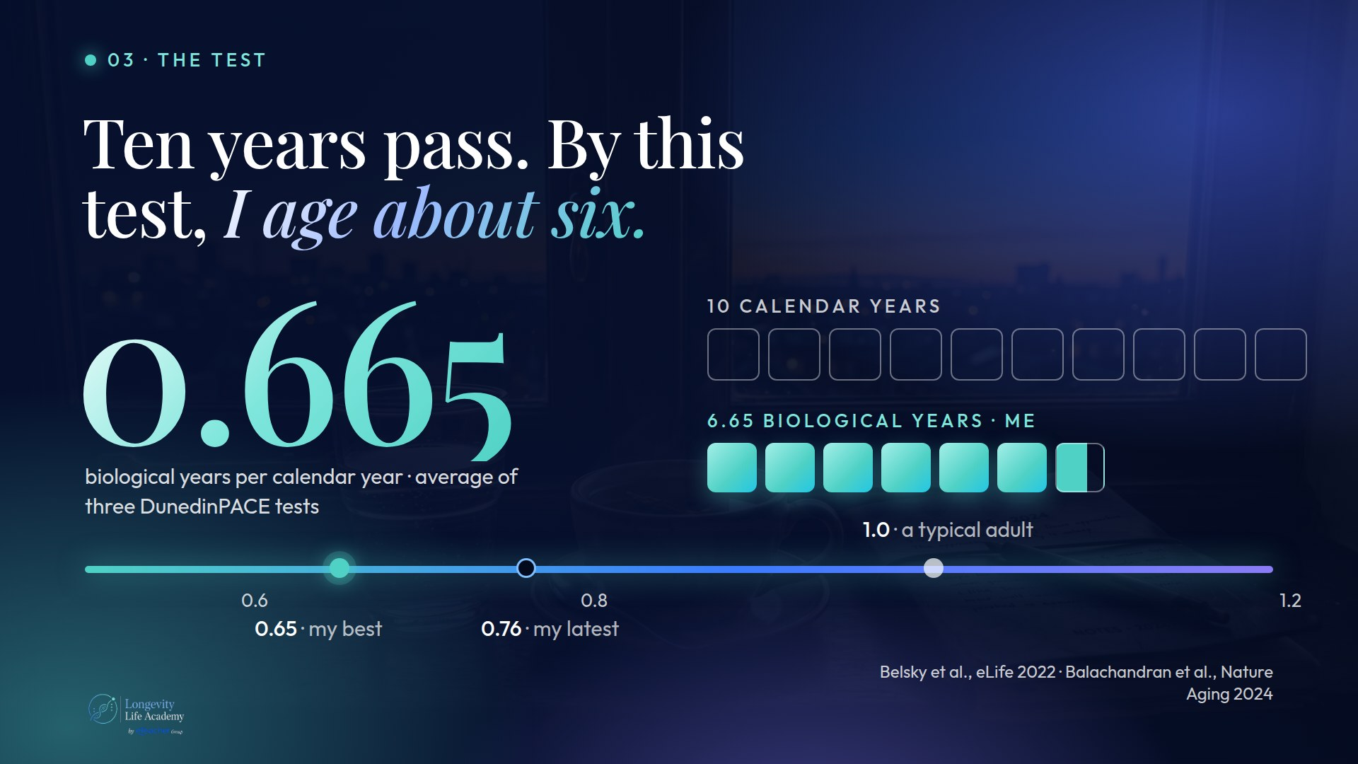
Notes:
Preserved original slide artwork, not editable text. image-3.png
Original dimensions: 1920 × 1080 pixels.
Original user upload recovered from the design conversation. Original filename preserved; turn association not exposed by transcript export.

Slide 4
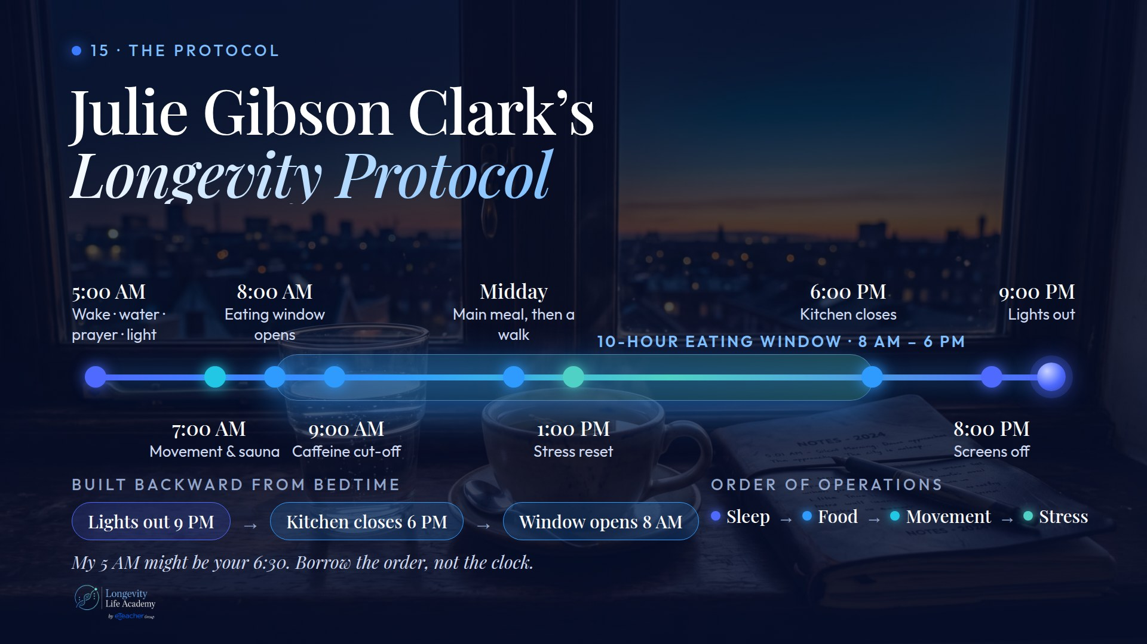
Notes:
Preserved original slide artwork, not editable text. image-4.png
Original dimensions: 1920 × 1080 pixels.
Original user upload recovered from the design conversation. Original filename preserved; turn association not exposed by transcript export.

Slide 5
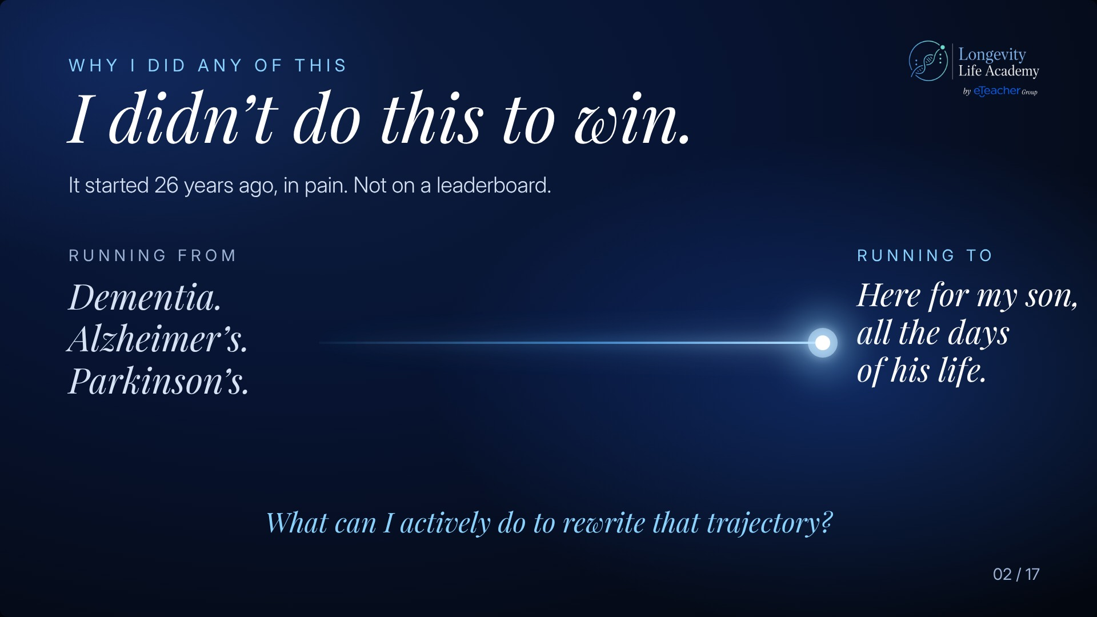
Notes:
Preserved original slide artwork, not editable text. image-5.png
Original dimensions: 1920 × 1080 pixels.
Original user upload recovered from the design conversation. Original filename preserved; turn association not exposed by transcript export.

Slide 6
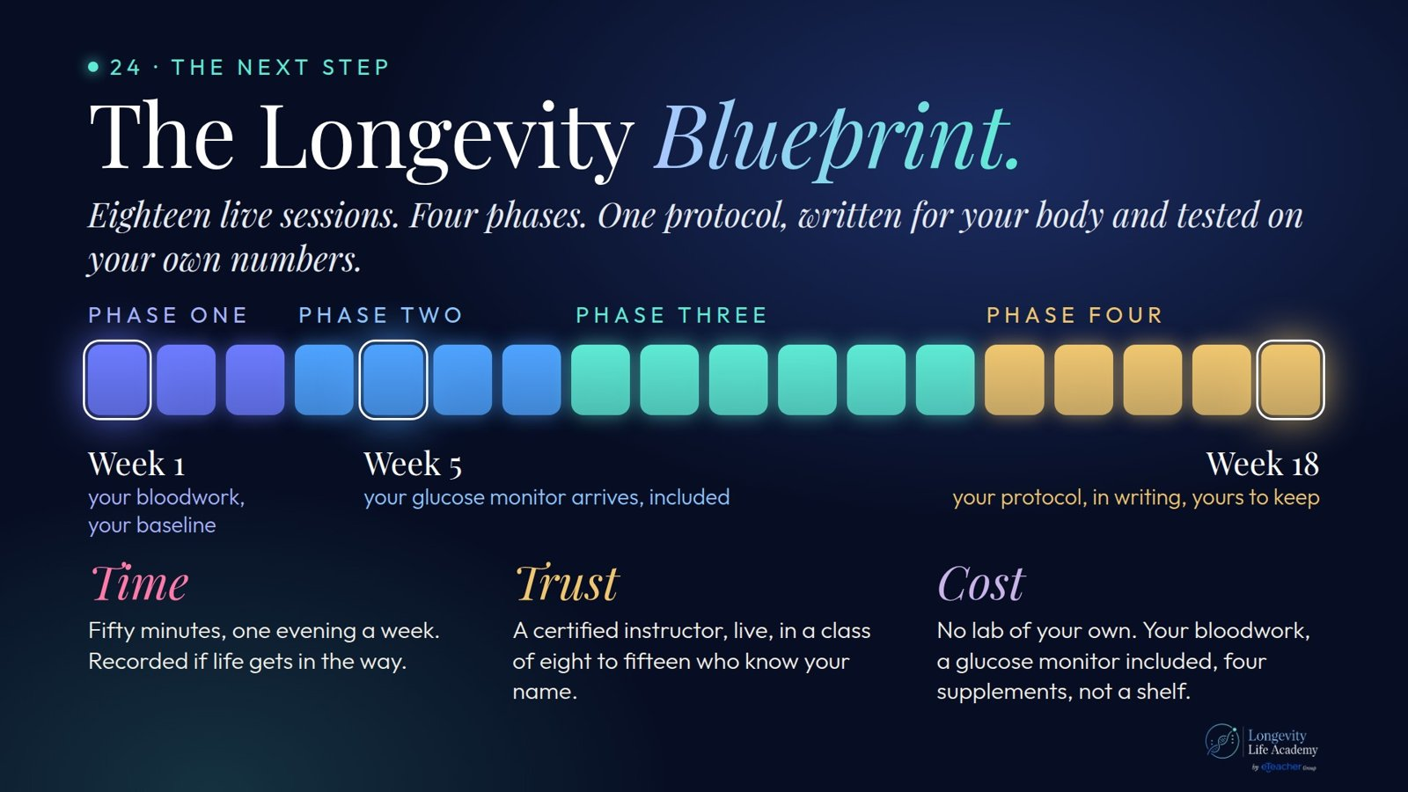
Notes:
Preserved original slide artwork, not editable text. image.png
Original dimensions: 1600 × 900 pixels.
Original user upload recovered from the design conversation. Original filename preserved; turn association not exposed by transcript export.

Slide 7
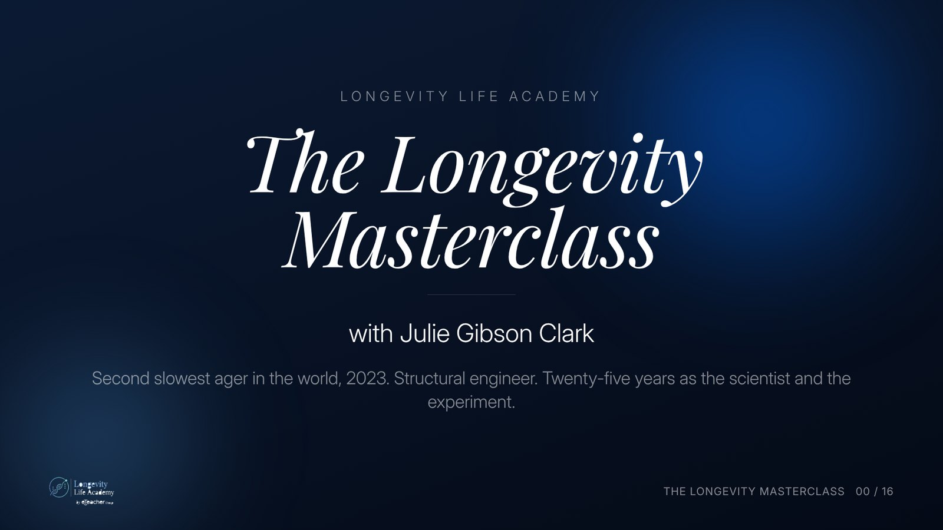
Notes:
Preserved original slide artwork, not editable text. The Longevity Masterclass
Original dimensions: 1600 × 900 pixels.
User-shared shortlist reference. Deck 2 · v2.2 · dark. Original: https://gitteromri-ux.github.io/lla-masterclass-syllabus/deck2/index.html

Slide 8
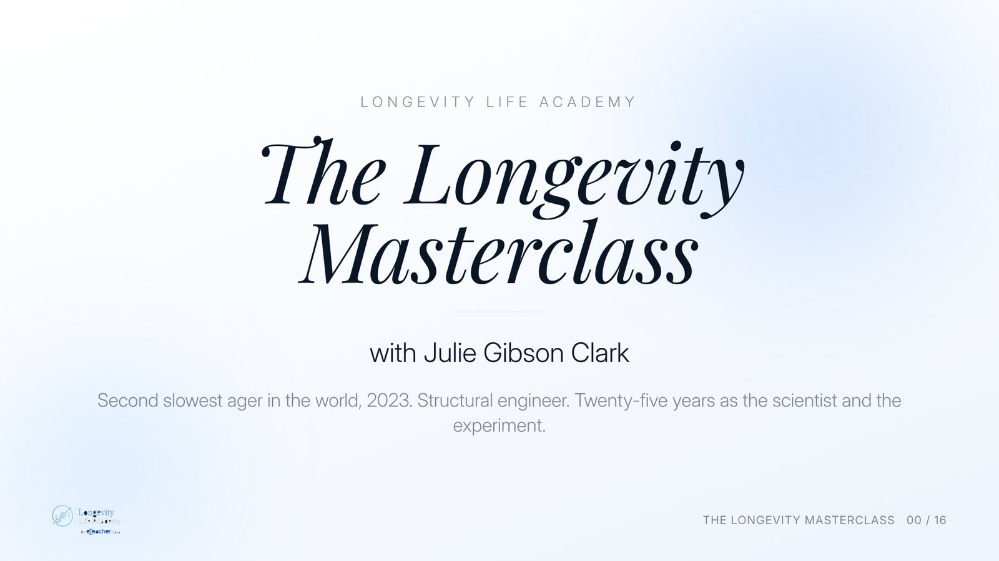
Notes:
Preserved original slide artwork, not editable text. The Longevity Masterclass
Original dimensions: 1600 × 900 pixels.
User-shared shortlist reference. Deck 2 · v2.2 · light. Original: https://gitteromri-ux.github.io/lla-masterclass-syllabus/deck2/index.html

Slide 9
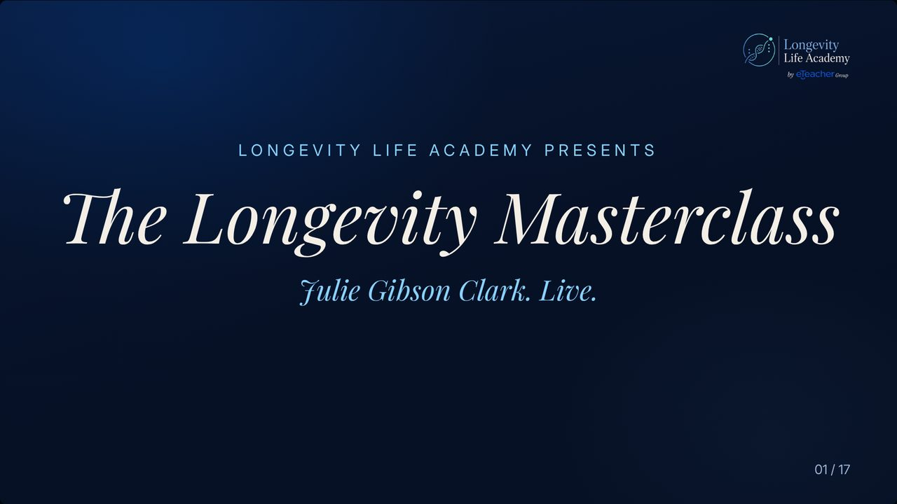
Notes:
Preserved original slide artwork, not editable text. LONGEVITY LIFE ACADEMY PRESENTS The Longevity Masterclass
Original dimensions: 1280 × 720 pixels.
User-shared shortlist reference. Round 8 : Last version. Original: https://gitteromri-ux.github.io/lla-masterclass-syllabus/backup-deck/index.html

Slide 10
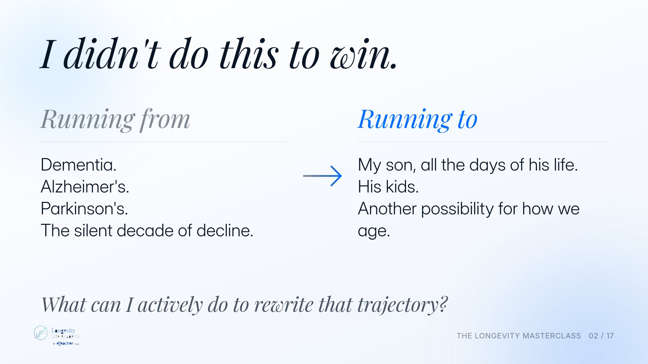
Notes:
Preserved original slide artwork, not editable text. I didn't do this to win.
Original dimensions: 1920 × 1080 pixels.
User-shared shortlist reference. Original deck · light. Original: https://gitteromri-ux.github.io/lla-masterclass-syllabus/deck/index.html

Slide 11
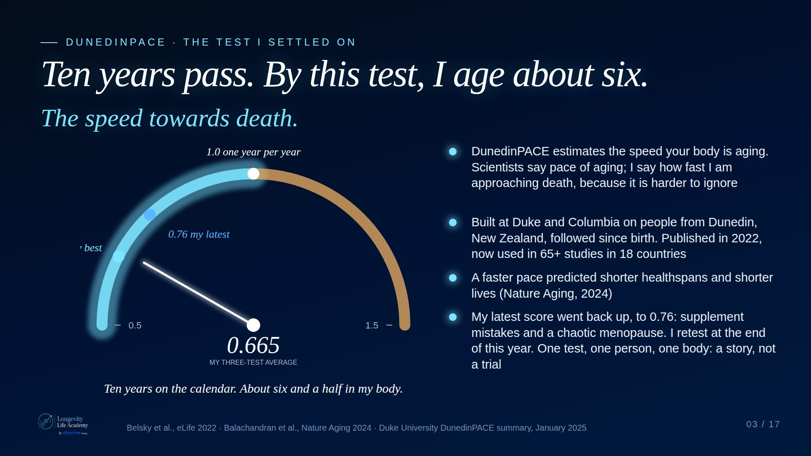
Notes:
Preserved original slide artwork, not editable text. Ten years pass. By this test, I age about six.
Original dimensions: 1920 × 1080 pixels.
User-shared shortlist reference. Claude A · Dark. Original: https://claude.ai/artifact/DMx1Uj3YCvVhtDEXAcJRZc

Slide 12
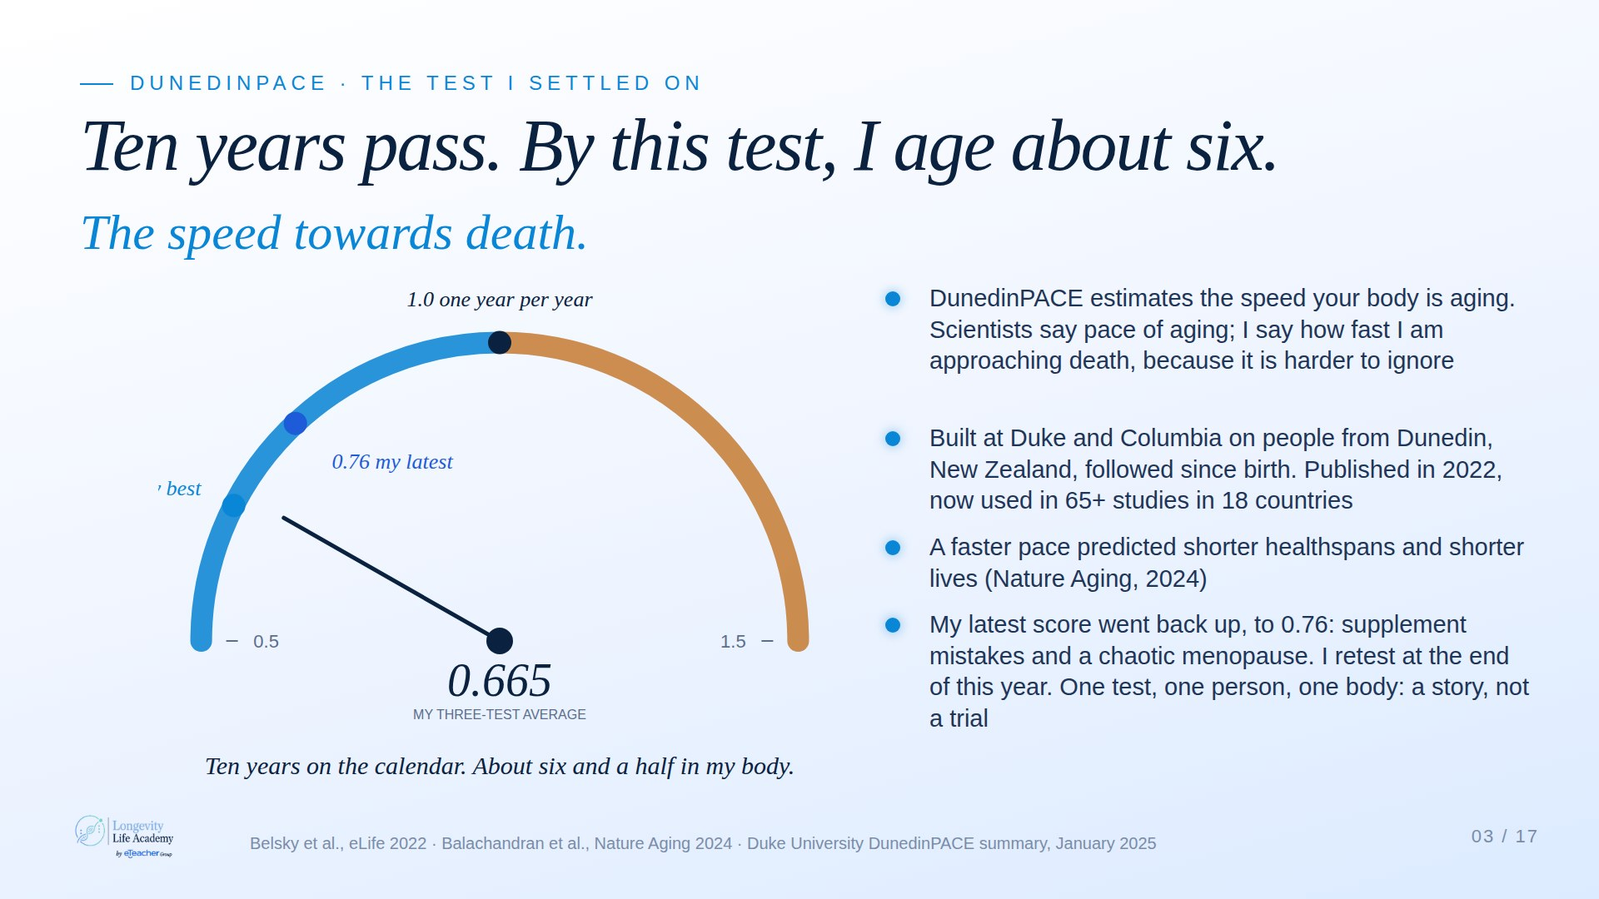
Notes:
Preserved original slide artwork, not editable text. Ten years pass. By this test, I age about six.
Original dimensions: 1920 × 1080 pixels.
User-shared shortlist reference. Claude A · Light. Original: https://claude.ai/artifact/DMx1Uj3YCvVhtDEXAcJRZc

Slide 13
Notes:
Preserved original slide artwork, not editable text. The test
Original dimensions: 1920 × 1080 pixels.
User-shared shortlist reference. Claude B · Protocol. Original: https://claude.ai/artifact/JWRnnvBCWXs5cdCwsGGdMb

Slide 14
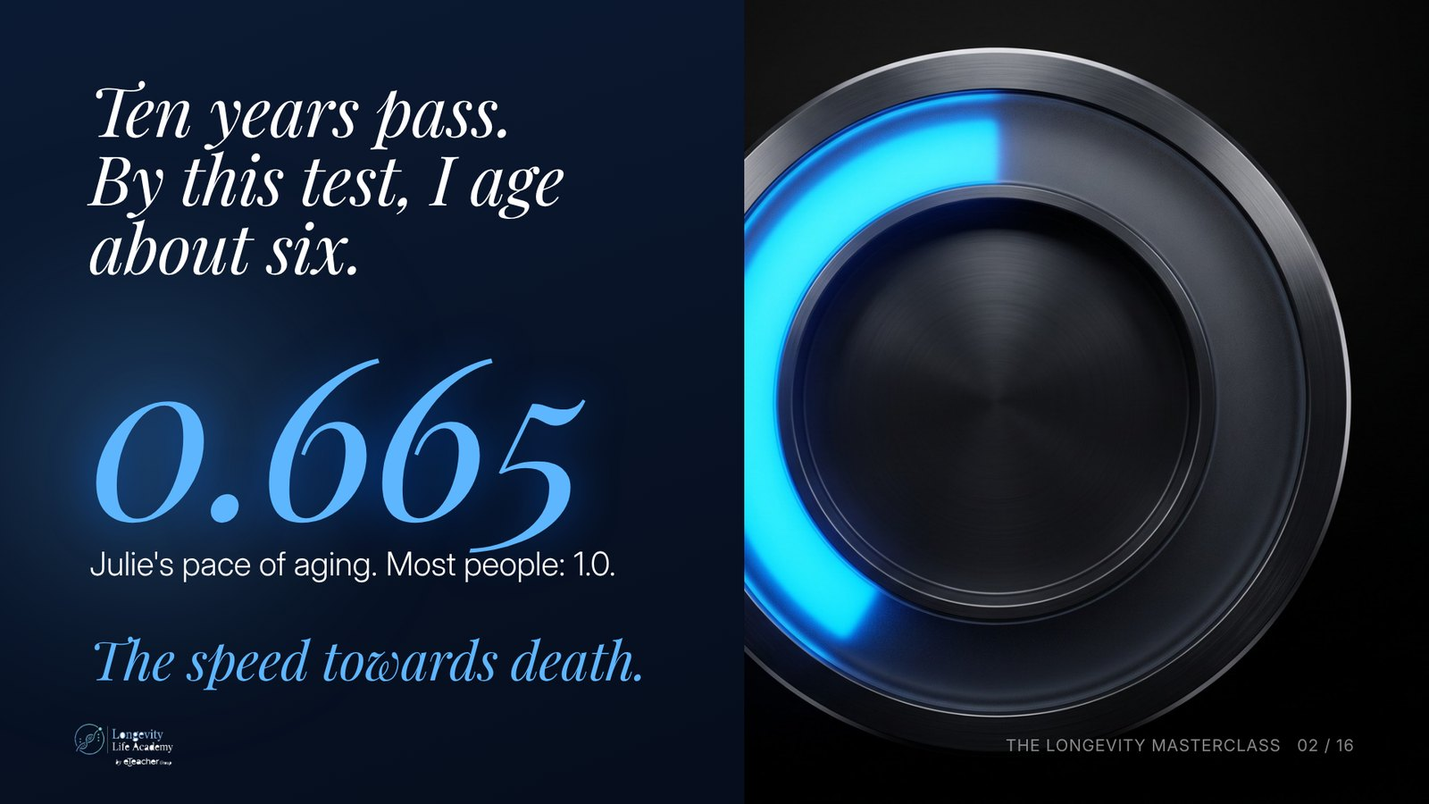
Notes:
Preserved original slide artwork, not editable text. Ten years pass. By this test, I age about six.
Original dimensions: 1600 × 900 pixels.
User-shared shortlist reference. Deck 2 · v2.2 · dark. Original: https://gitteromri-ux.github.io/lla-masterclass-syllabus/deck2/index.html

Slide 15
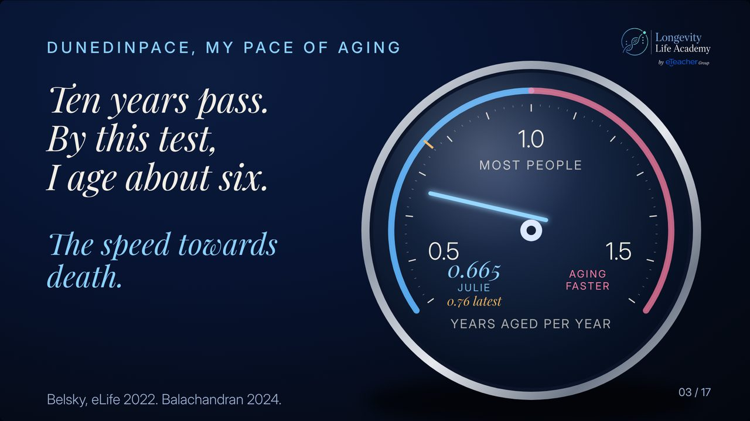
Notes:
Preserved original slide artwork, not editable text. Ten years pass. By this test, I age about six.
Original dimensions: 1280 × 720 pixels.
User-shared shortlist reference. Round 10. Original: https://gitteromri-ux.github.io/lla-masterclass-syllabus/backup-deck/round-10/index.html

Slide 16
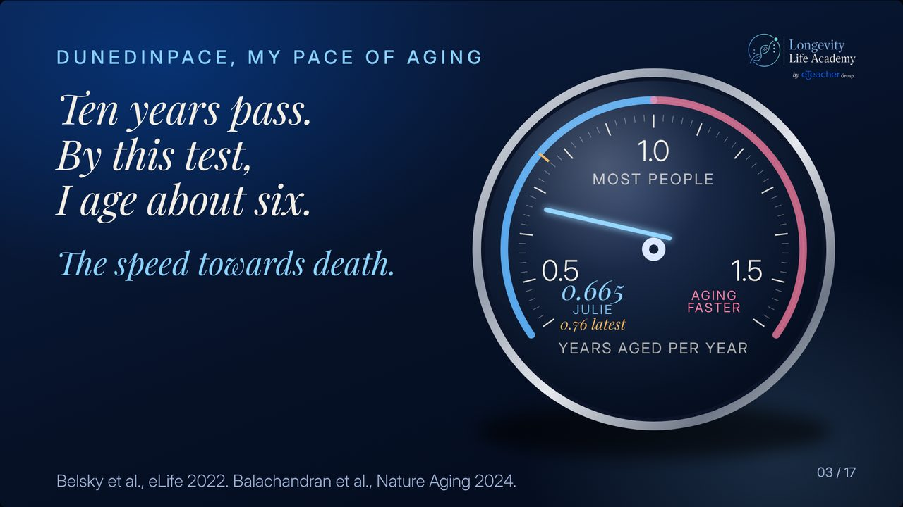
Notes:
Preserved original slide artwork, not editable text. Ten years pass. By this test, I age about six.
Original dimensions: 1280 × 720 pixels.
User-shared shortlist reference. Round 9. Original: https://gitteromri-ux.github.io/lla-masterclass-syllabus/backup-deck/round-9/index.html

Slide 17
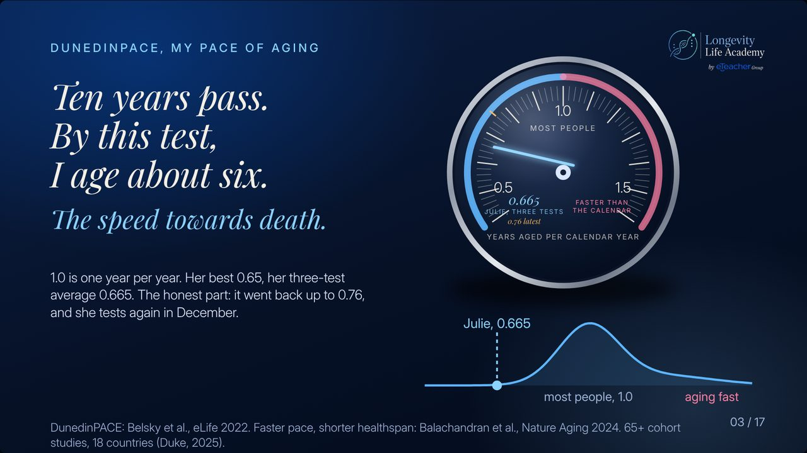
Notes:
Preserved original slide artwork, not editable text. Ten years pass. By this test, I age about six.
Original dimensions: 1280 × 720 pixels.
User-shared shortlist reference. Round 7 · last. Original: https://gitteromri-ux.github.io/lla-masterclass-syllabus/backup-deck/rounds/r7/last-06.jpg

Slide 18
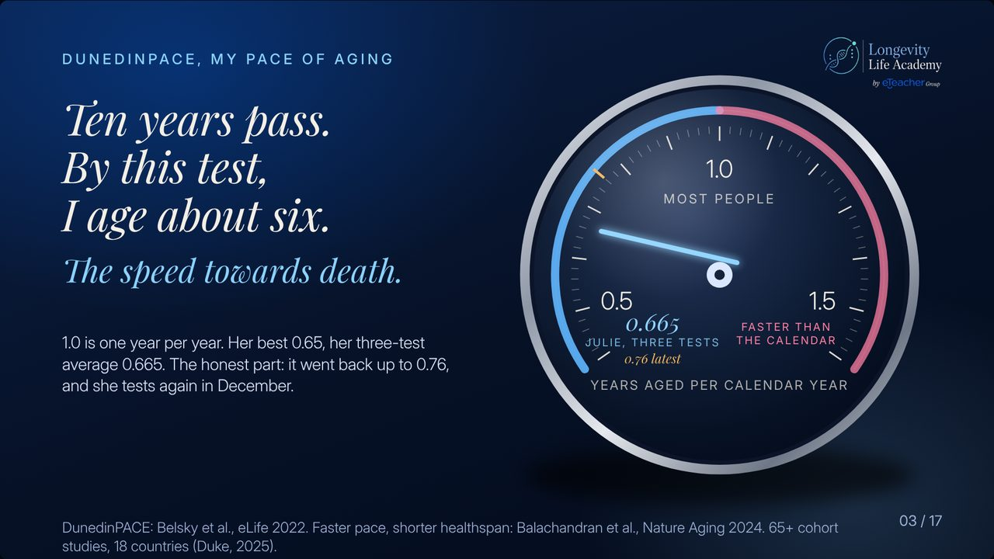
Notes:
Preserved original slide artwork, not editable text. Ten years pass. By this test, I age about six.
Original dimensions: 1280 × 720 pixels.
User-shared shortlist reference. Round 7 · last. Original: https://gitteromri-ux.github.io/lla-masterclass-syllabus/backup-deck/rounds/r7/last-05.jpg

Slide 19
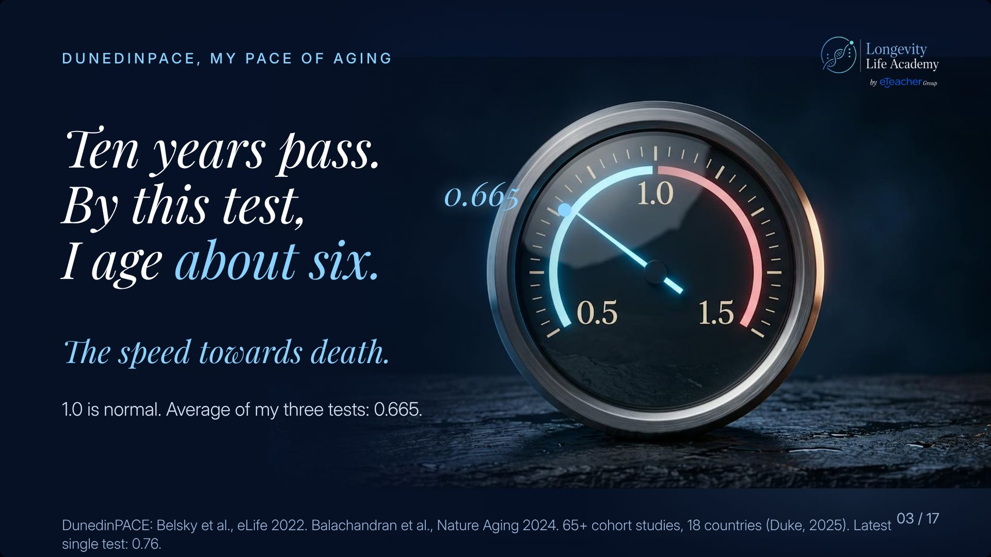
Notes:
Preserved original slide artwork, not editable text. Ten years pass. By this test, I age about six.
Original dimensions: 1920 × 1080 pixels.
User-shared shortlist reference. Round 5 · v2. Original: https://gitteromri-ux.github.io/lla-masterclass-syllabus/backup-deck/rounds/r5/v2-03.jpg

Slide 20
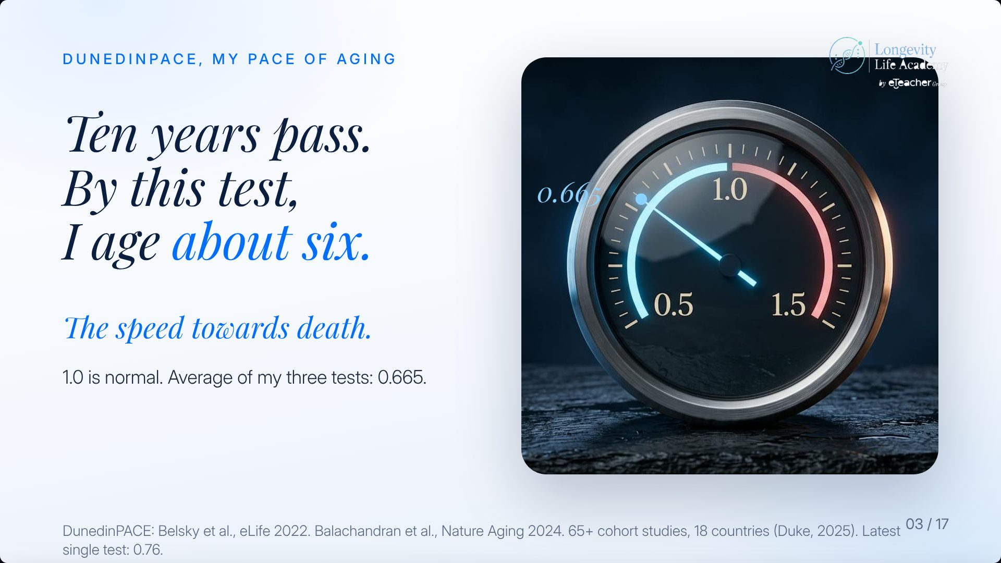
Notes:
Preserved original slide artwork, not editable text. Ten years pass. By this test, I age about six.
Original dimensions: 1920 × 1080 pixels.
User-shared shortlist reference. Round 4 · v1. Original: https://gitteromri-ux.github.io/lla-masterclass-syllabus/backup-deck/rounds/r4/v1-03.jpg

Slide 21
Notes:
Preserved original slide artwork, not editable text. Ten years pass. By this test, I age about six.
Original dimensions: 1920 × 1080 pixels.
User-shared shortlist reference. Round 3 · v1. Original: https://gitteromri-ux.github.io/lla-masterclass-syllabus/backup-deck/rounds/r3/v1-03.jpg

Slide 22
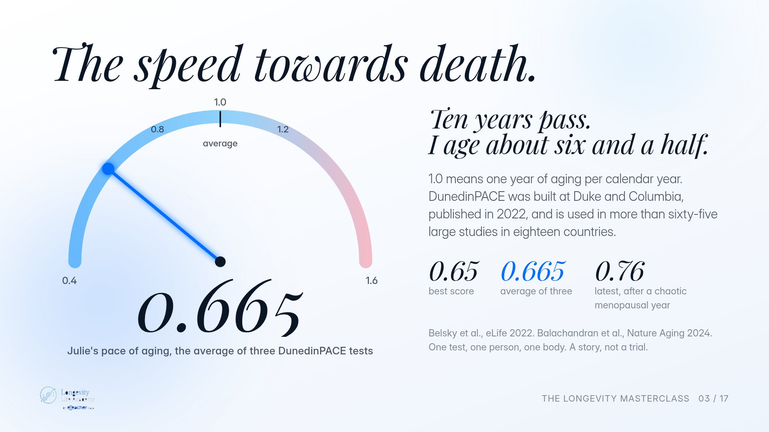
Notes:
Preserved original slide artwork, not editable text. The speed towards death.
Original dimensions: 1920 × 1080 pixels.
User-shared shortlist reference. Original deck · light. Original: https://gitteromri-ux.github.io/lla-masterclass-syllabus/deck/index.html

Slide 23
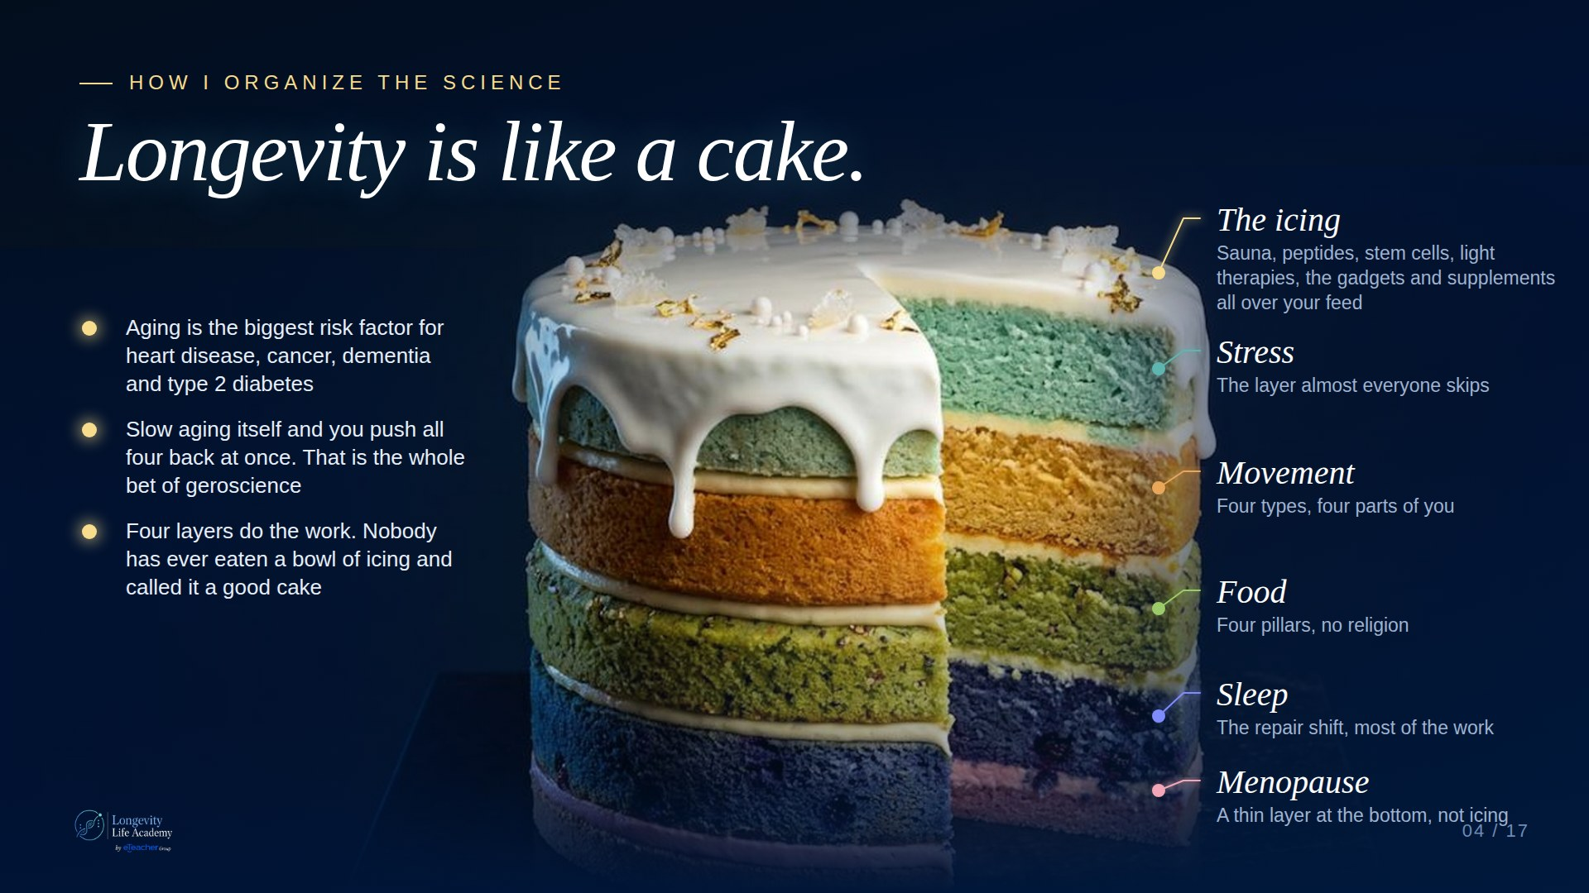
Notes:
Preserved original slide artwork, not editable text. Longevity is like a cake.
Original dimensions: 1920 × 1080 pixels.
User-shared shortlist reference. Claude A · Dark. Original: https://claude.ai/artifact/DMx1Uj3YCvVhtDEXAcJRZc

Slide 24
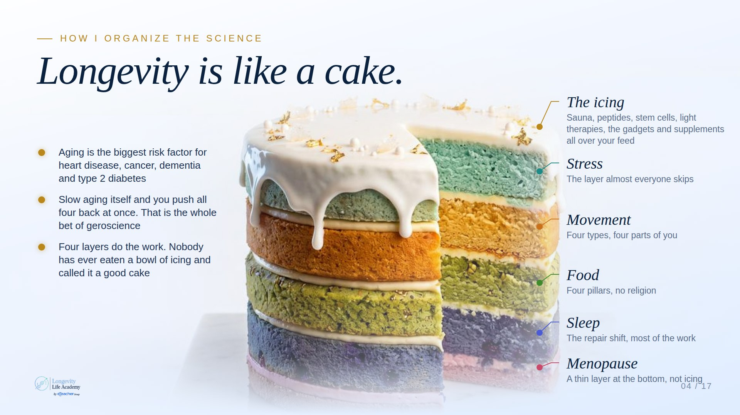
Notes:
Preserved original slide artwork, not editable text. Longevity is like a cake.
Original dimensions: 1920 × 1080 pixels.
User-shared shortlist reference. Claude A · Light. Original: https://claude.ai/artifact/DMx1Uj3YCvVhtDEXAcJRZc

Slide 25
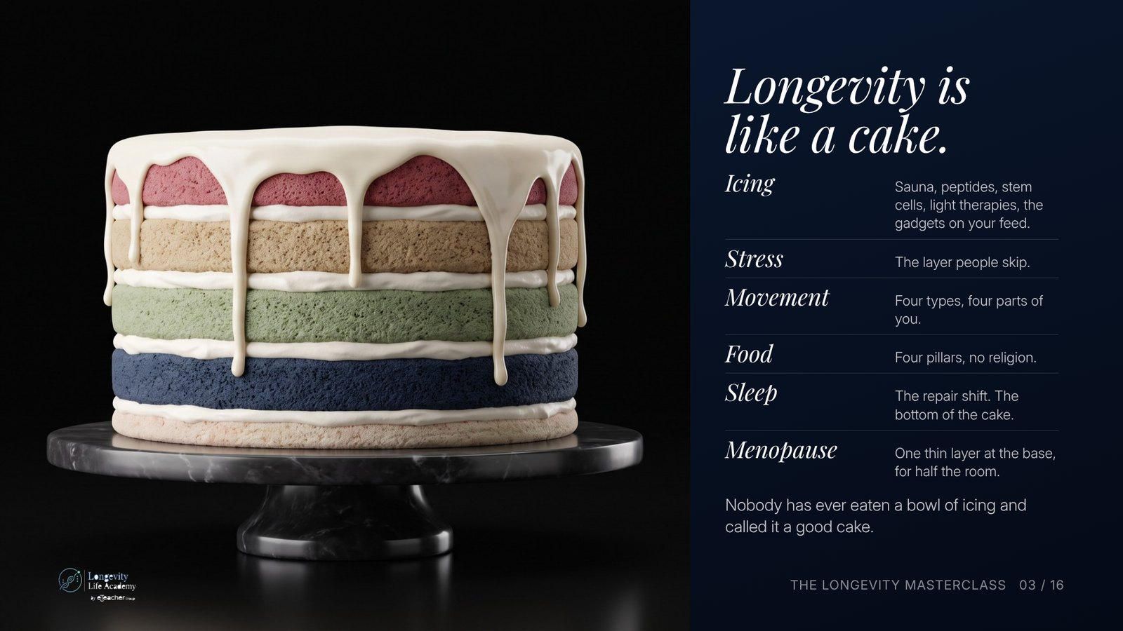
Notes:
Preserved original slide artwork, not editable text. Longevity is like a cake.
Original dimensions: 1600 × 900 pixels.
User-shared shortlist reference. Deck 2 · v2.2 · dark. Original: https://gitteromri-ux.github.io/lla-masterclass-syllabus/deck2/index.html

Slide 26
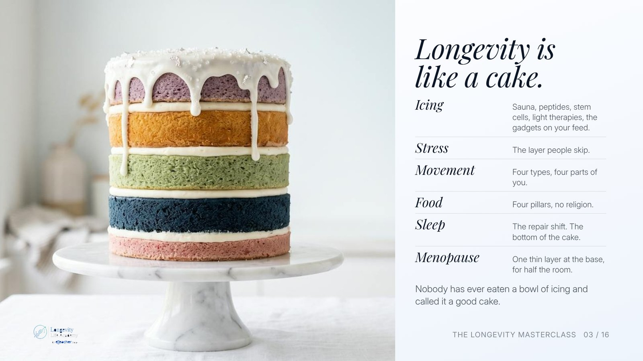
Notes:
Preserved original slide artwork, not editable text. Longevity is like a cake.
Original dimensions: 1600 × 900 pixels.
User-shared shortlist reference. Deck 2 · v2.2 · light. Original: https://gitteromri-ux.github.io/lla-masterclass-syllabus/deck2/index.html

Slide 27
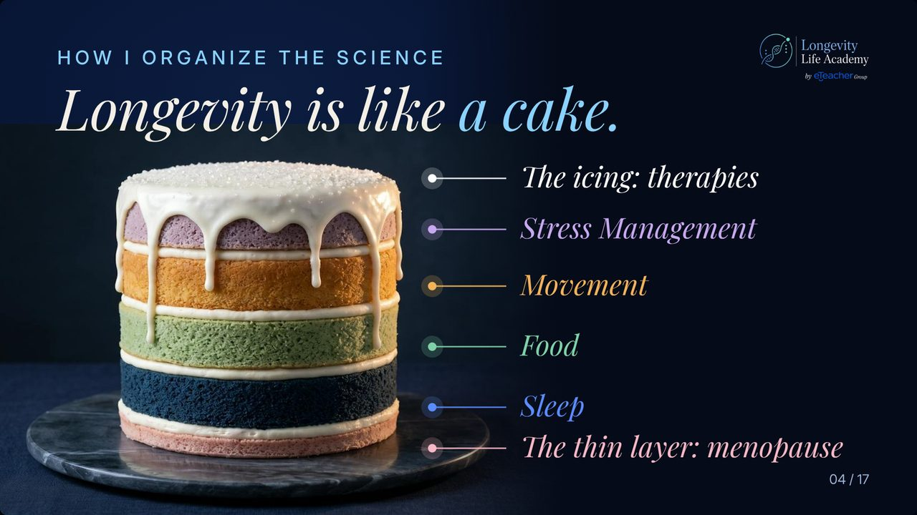
Notes:
Preserved original slide artwork, not editable text. Longevity is like a cake.
Original dimensions: 1280 × 720 pixels.
User-shared shortlist reference. Round 10. Original: https://gitteromri-ux.github.io/lla-masterclass-syllabus/backup-deck/round-10/index.html

Slide 28
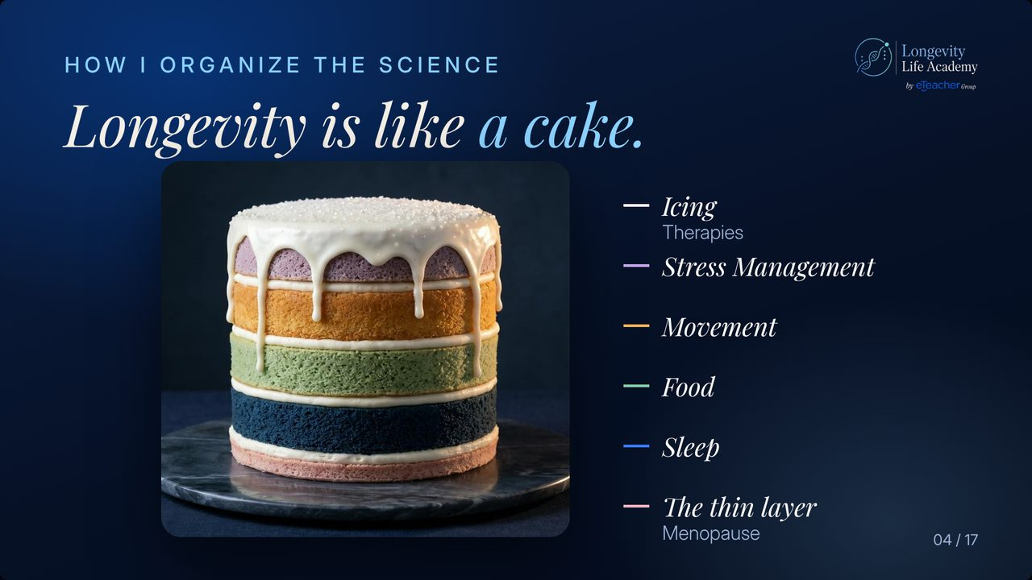
Notes:
Preserved original slide artwork, not editable text. Longevity is like a cake.
Original dimensions: 1280 × 720 pixels.
User-shared shortlist reference. Round 9. Original: https://gitteromri-ux.github.io/lla-masterclass-syllabus/backup-deck/round-9/index.html

Slide 29
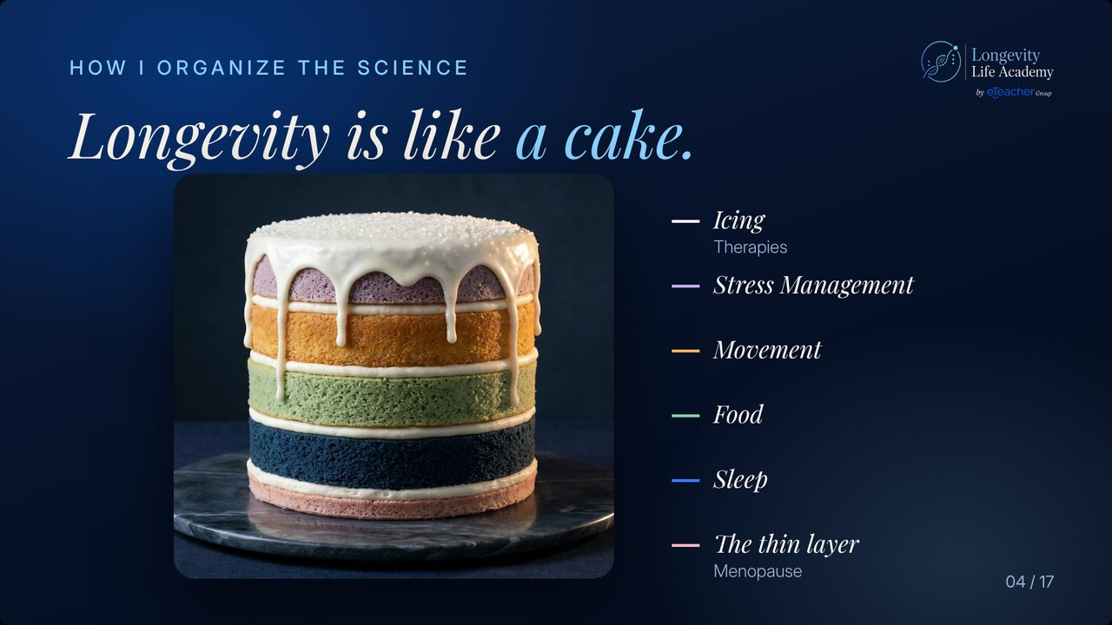
Notes:
Preserved original slide artwork, not editable text. Longevity is like a cake.
Original dimensions: 1280 × 720 pixels.
User-shared shortlist reference. Round 8 : Last version. Original: https://gitteromri-ux.github.io/lla-masterclass-syllabus/backup-deck/index.html

Slide 30
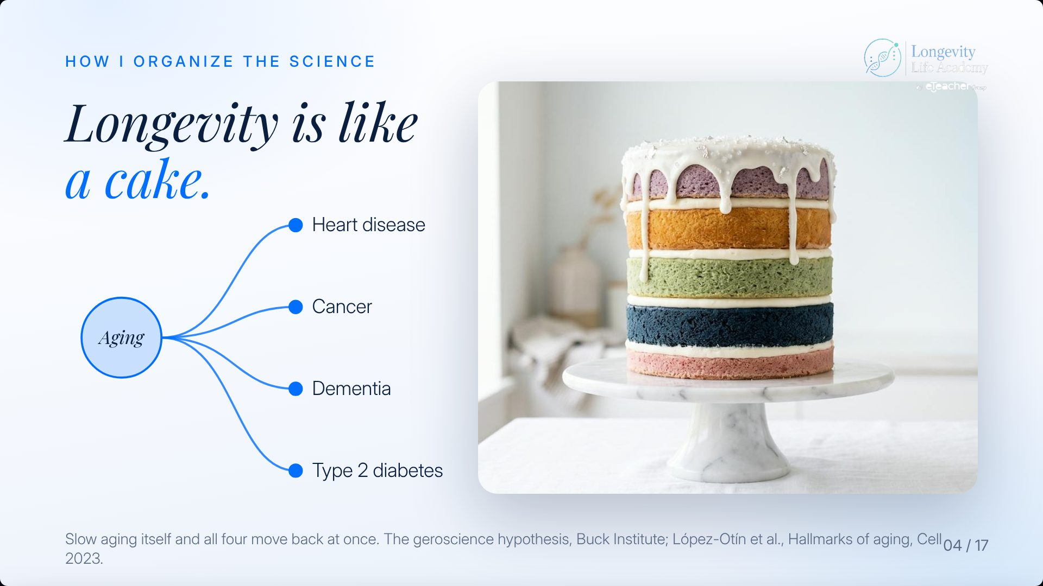
Notes:
Preserved original slide artwork, not editable text. Longevity is like a cake.
Original dimensions: 1920 × 1080 pixels.
User-shared shortlist reference. Round 4 · v1. Original: https://gitteromri-ux.github.io/lla-masterclass-syllabus/backup-deck/rounds/r4/v1-04.jpg

Slide 31
Notes:
Preserved original slide artwork, not editable text. Longevity is like a cake.
Original dimensions: 1920 × 1080 pixels.
User-shared shortlist reference. Round 3 · v1. Original: https://gitteromri-ux.github.io/lla-masterclass-syllabus/backup-deck/rounds/r3/v1-04.jpg

Slide 32
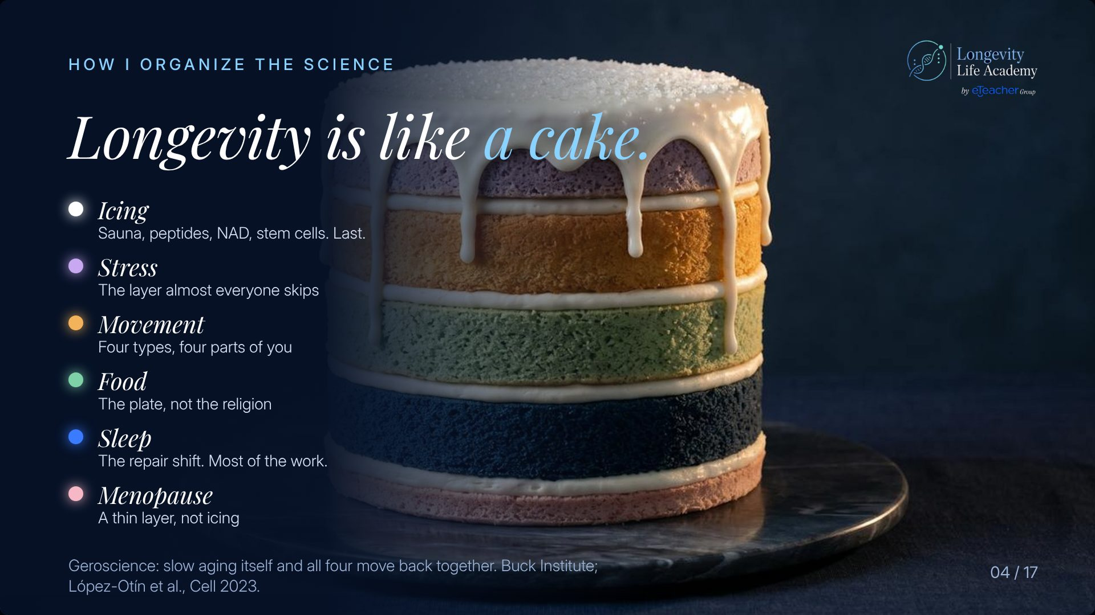
Notes:
Preserved original slide artwork, not editable text. Longevity is like a cake.
Original dimensions: 1920 × 1080 pixels.
User-shared shortlist reference. Round 3 · v2. Original: https://gitteromri-ux.github.io/lla-masterclass-syllabus/backup-deck/rounds/r3/v2-04.jpg

Slide 33
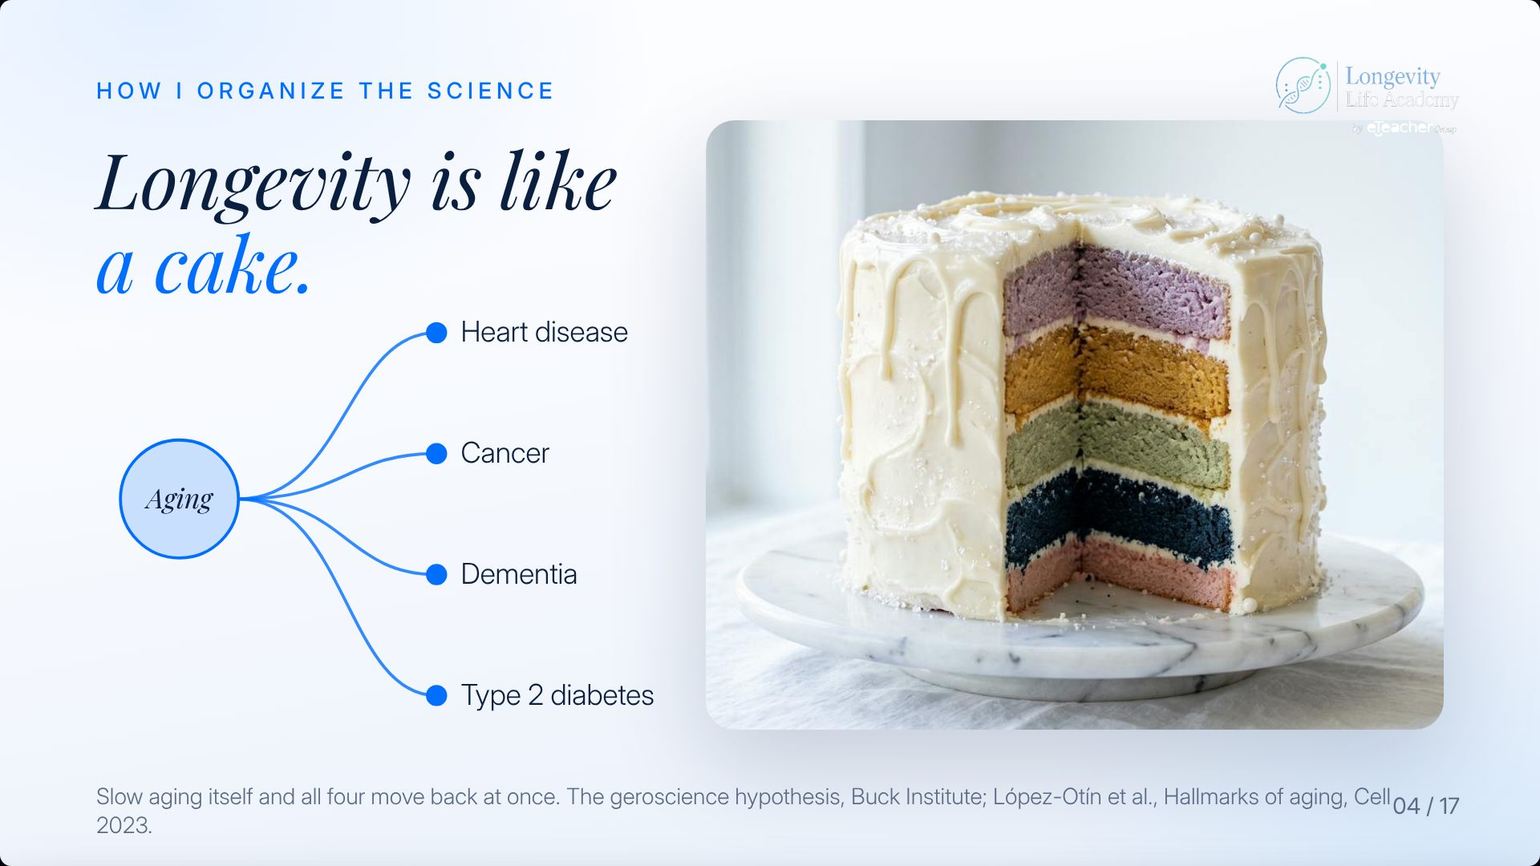
Notes:
Preserved original slide artwork, not editable text. Longevity is like a cake.
Original dimensions: 1920 × 1080 pixels.
User-shared shortlist reference. Round 1 · v1. Original: https://gitteromri-ux.github.io/lla-masterclass-syllabus/backup-deck/rounds/r1/v1-04.jpg

Slide 34
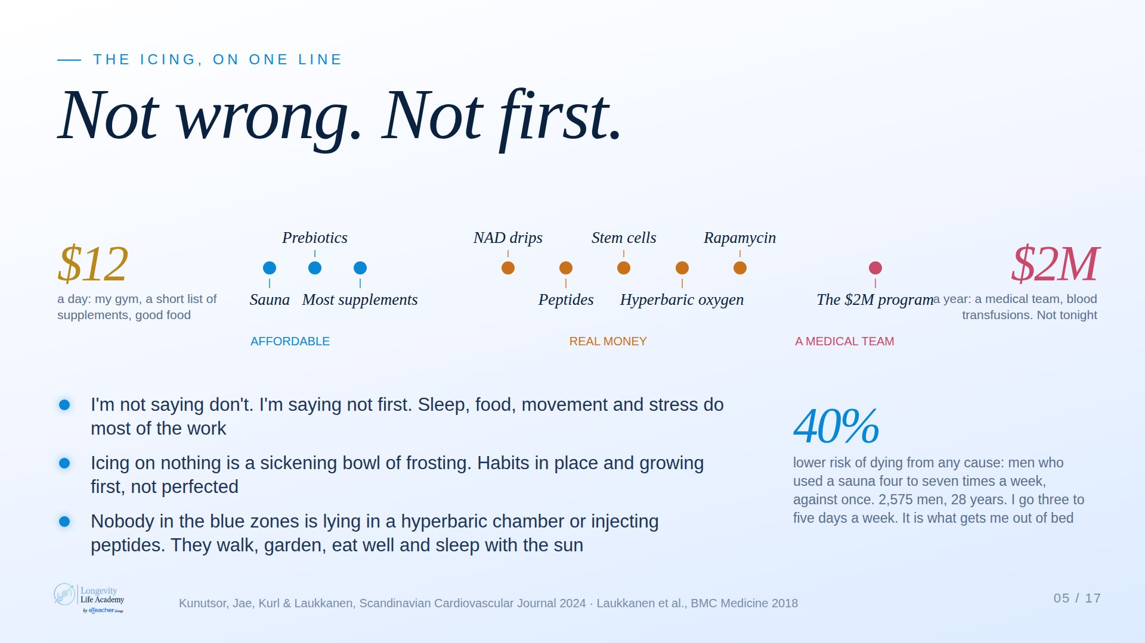
Notes:
Preserved original slide artwork, not editable text. Not wrong. Not first.
Original dimensions: 1920 × 1080 pixels.
User-shared shortlist reference. Claude A · Light. Original: https://claude.ai/artifact/DMx1Uj3YCvVhtDEXAcJRZc

Slide 35
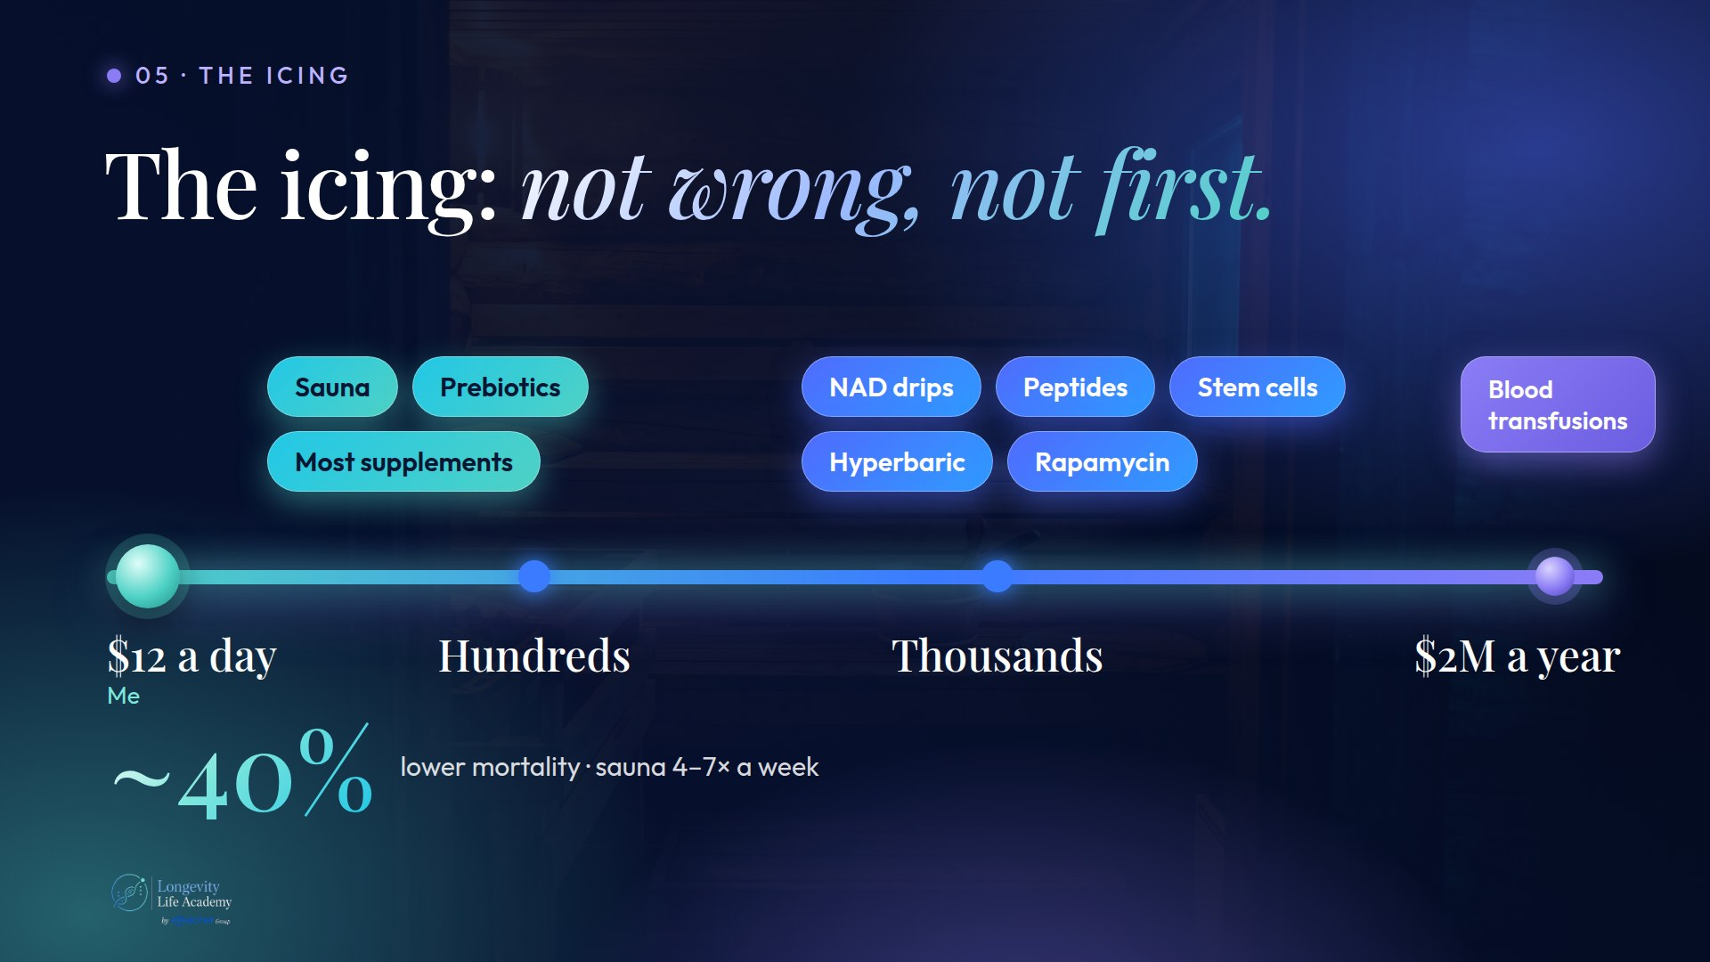
Notes:
Preserved original slide artwork, not editable text. The icing
Original dimensions: 1920 × 1080 pixels.
User-shared shortlist reference. Claude B · Protocol. Original: https://claude.ai/artifact/JWRnnvBCWXs5cdCwsGGdMb

Slide 36
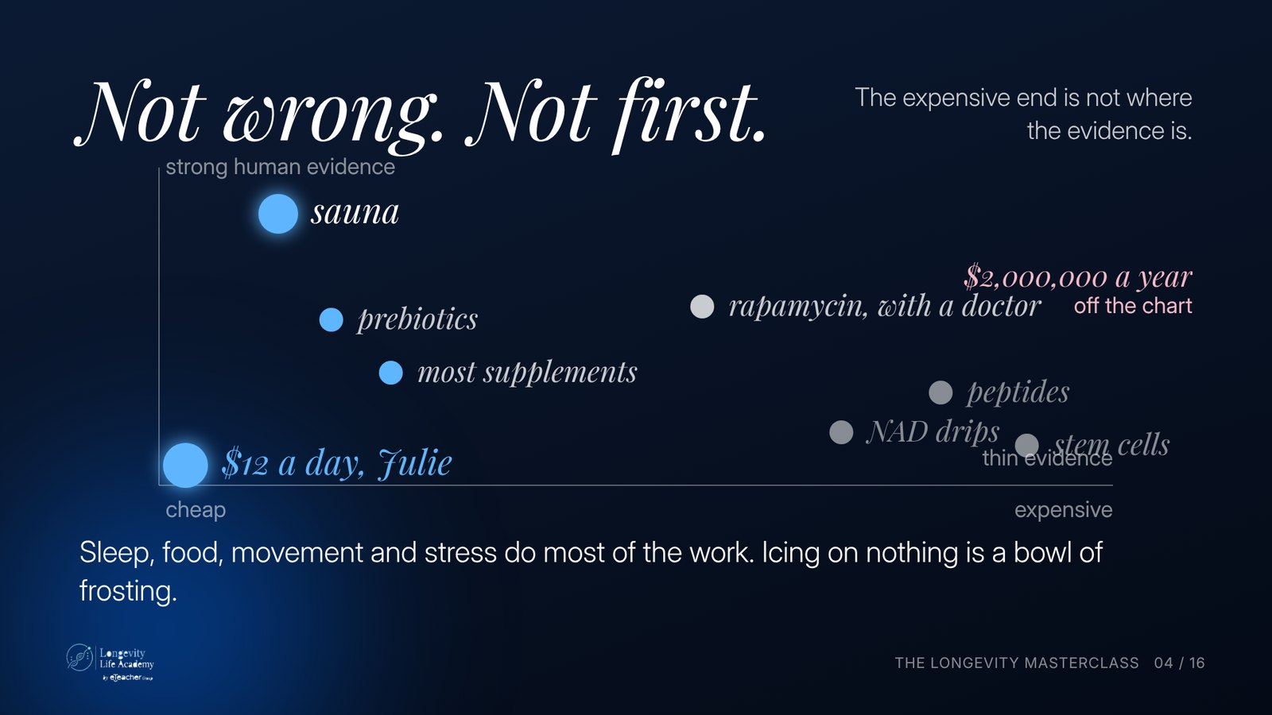
Notes:
Preserved original slide artwork, not editable text. Not wrong. Not first.
Original dimensions: 1600 × 900 pixels.
User-shared shortlist reference. Deck 2 · v2.2 · dark. Original: https://gitteromri-ux.github.io/lla-masterclass-syllabus/deck2/index.html

Slide 37
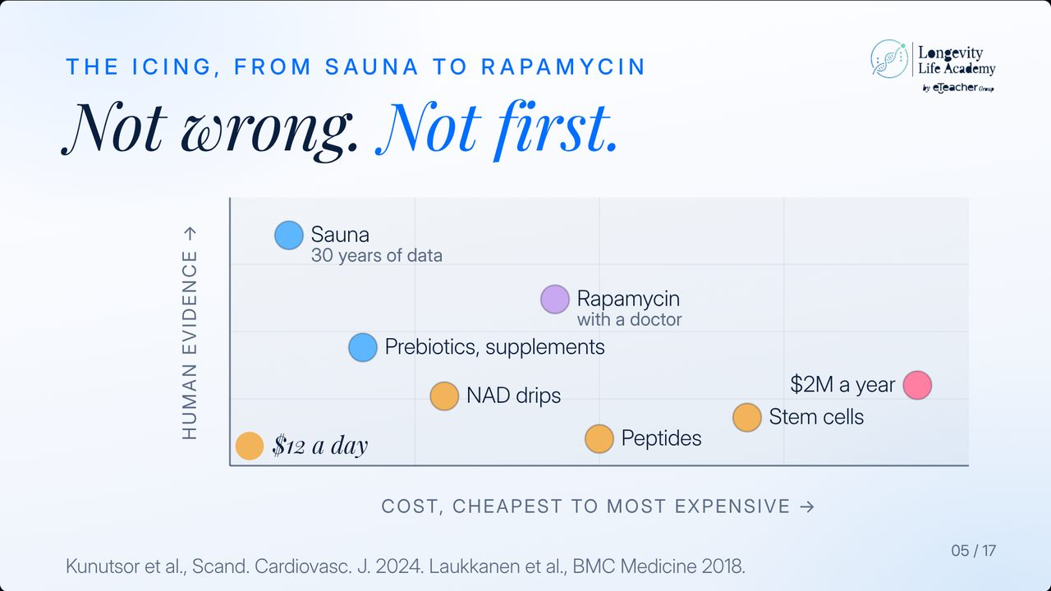
Notes:
Preserved original slide artwork, not editable text. Not wrong. Not first.
Original dimensions: 1280 × 720 pixels.
User-shared shortlist reference. Round 10. Original: https://gitteromri-ux.github.io/lla-masterclass-syllabus/backup-deck/round-10/index.html

Slide 38
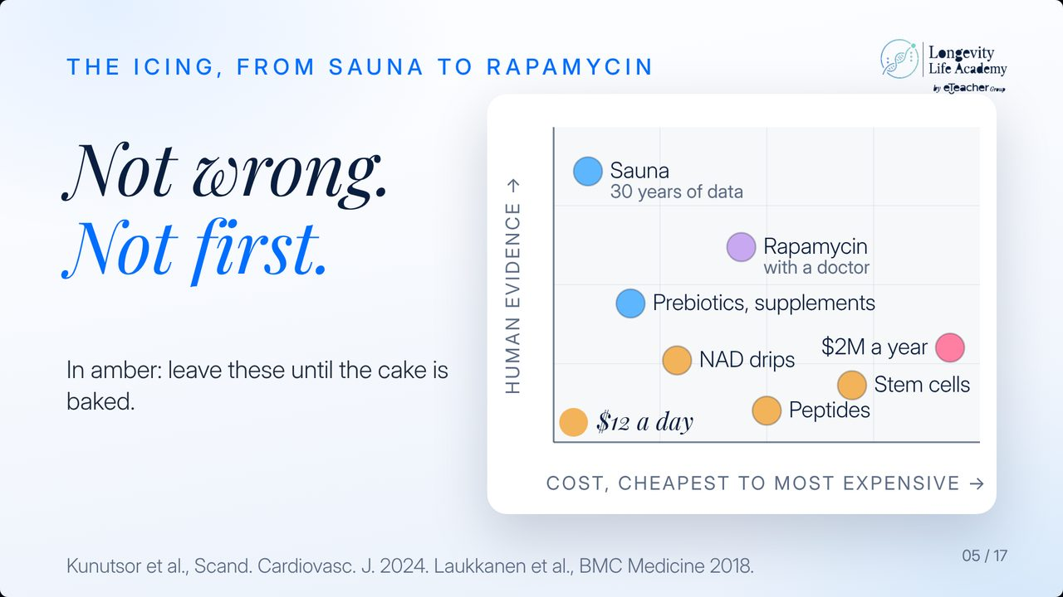
Notes:
Preserved original slide artwork, not editable text. Not wrong. Not first.
Original dimensions: 1280 × 720 pixels.
User-shared shortlist reference. Round 9. Original: https://gitteromri-ux.github.io/lla-masterclass-syllabus/backup-deck/round-9/index.html

Slide 39
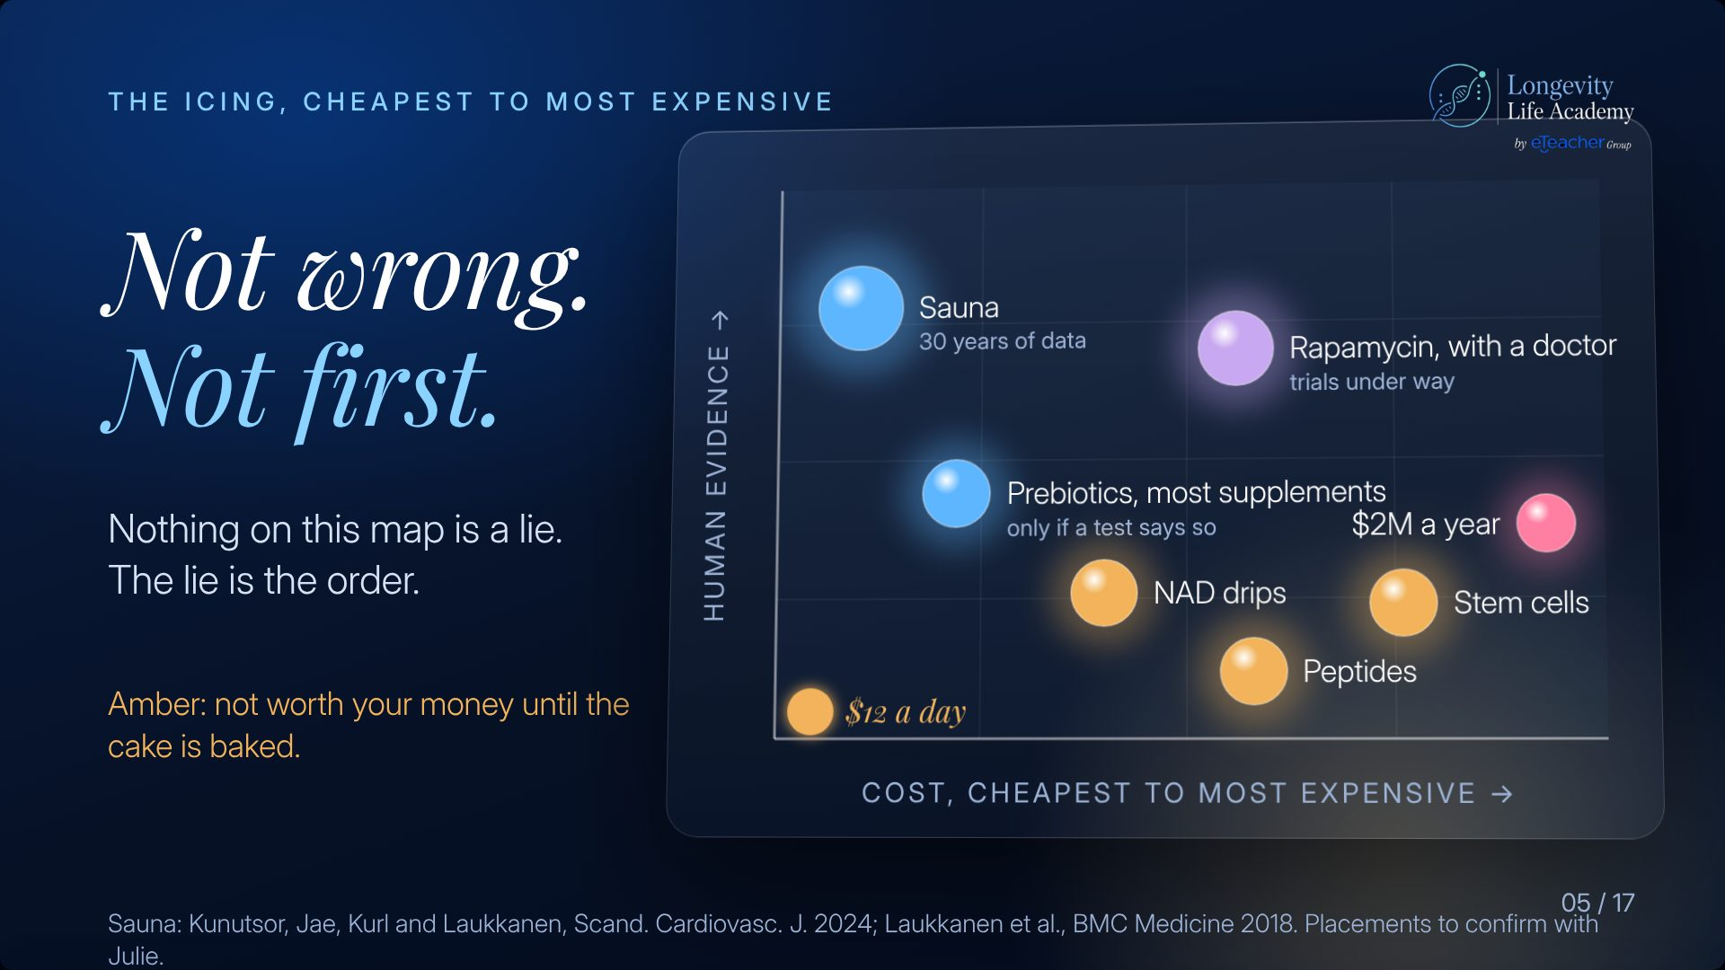
Notes:
Preserved original slide artwork, not editable text. Not wrong. Not first.
Original dimensions: 1920 × 1080 pixels.
User-shared shortlist reference. Round 4 · v1. Original: https://gitteromri-ux.github.io/lla-masterclass-syllabus/backup-deck/rounds/r4/v1-05.jpg

Slide 40
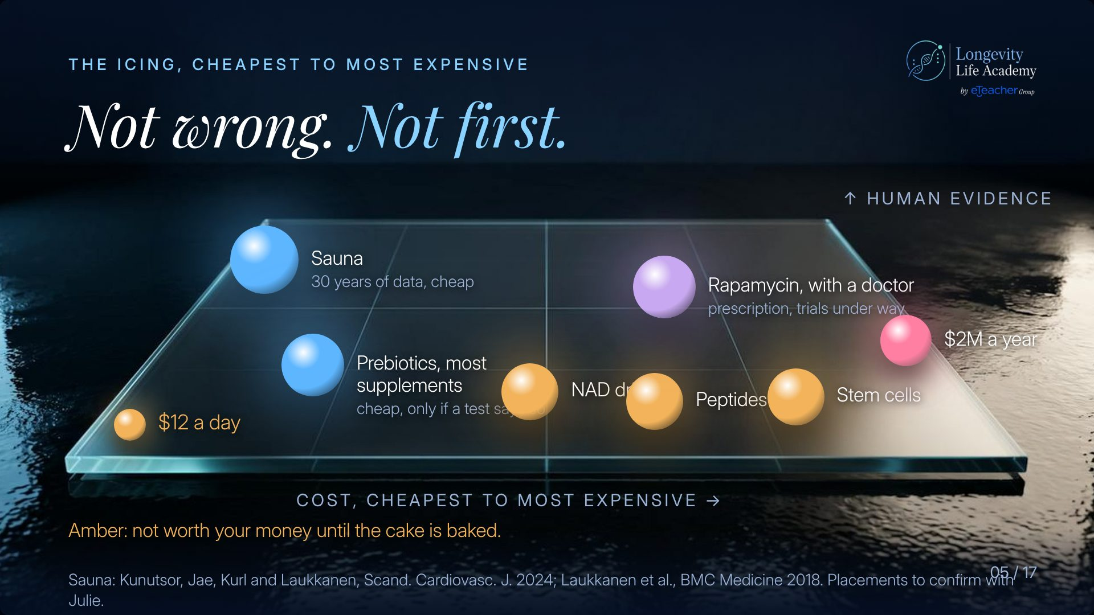
Notes:
Preserved original slide artwork, not editable text. Not wrong. Not first.
Original dimensions: 1920 × 1080 pixels.
User-shared shortlist reference. Round 3 · v1. Original: https://gitteromri-ux.github.io/lla-masterclass-syllabus/backup-deck/rounds/r3/v1-05.jpg

Slide 41
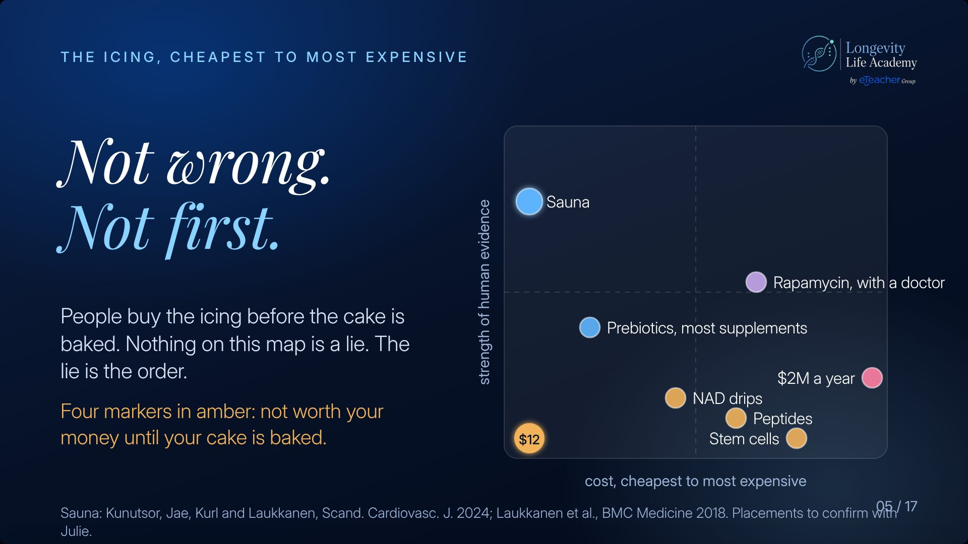
Notes:
Preserved original slide artwork, not editable text. Not wrong. Not first.
Original dimensions: 1920 × 1080 pixels.
User-shared shortlist reference. Round 1 · v2. Original: https://gitteromri-ux.github.io/lla-masterclass-syllabus/backup-deck/rounds/r1/v2-05.jpg

Slide 42
Notes:
Preserved original slide artwork, not editable text. Not wrong. Not first.
Original dimensions: 1920 × 1080 pixels.
User-shared shortlist reference. Archived Last version · v1. Original: https://gitteromri-ux.github.io/lla-masterclass-syllabus/backup-deck/rounds/last/v1-05.jpg

Slide 43
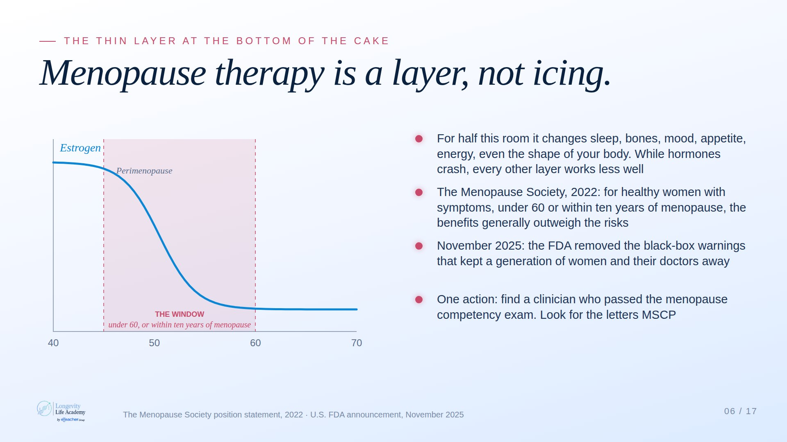
Notes:
Preserved original slide artwork, not editable text. Menopause therapy is a layer, not icing.
Original dimensions: 1920 × 1080 pixels.
User-shared shortlist reference. Claude A · Light. Original: https://claude.ai/artifact/DMx1Uj3YCvVhtDEXAcJRZc

Slide 44
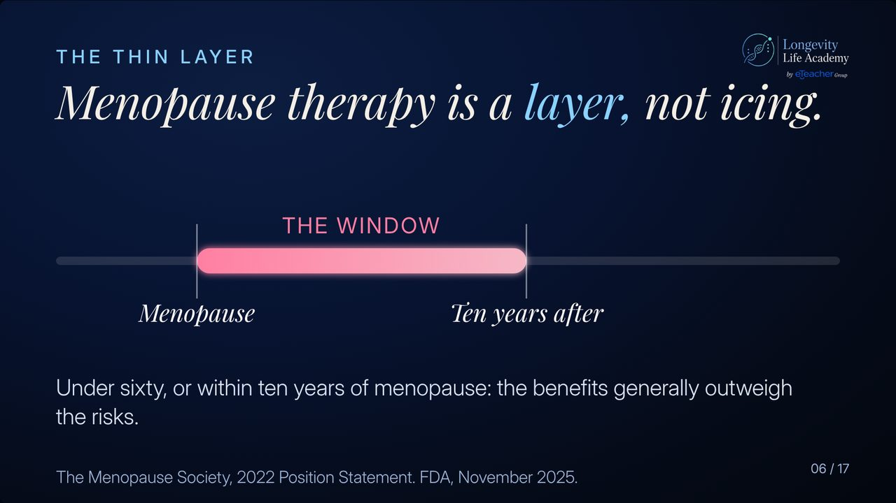
Notes:
Preserved original slide artwork, not editable text. Menopause therapy is a layer, not icing.
Original dimensions: 1280 × 720 pixels.
User-shared shortlist reference. Round 10. Original: https://gitteromri-ux.github.io/lla-masterclass-syllabus/backup-deck/round-10/index.html

Slide 45
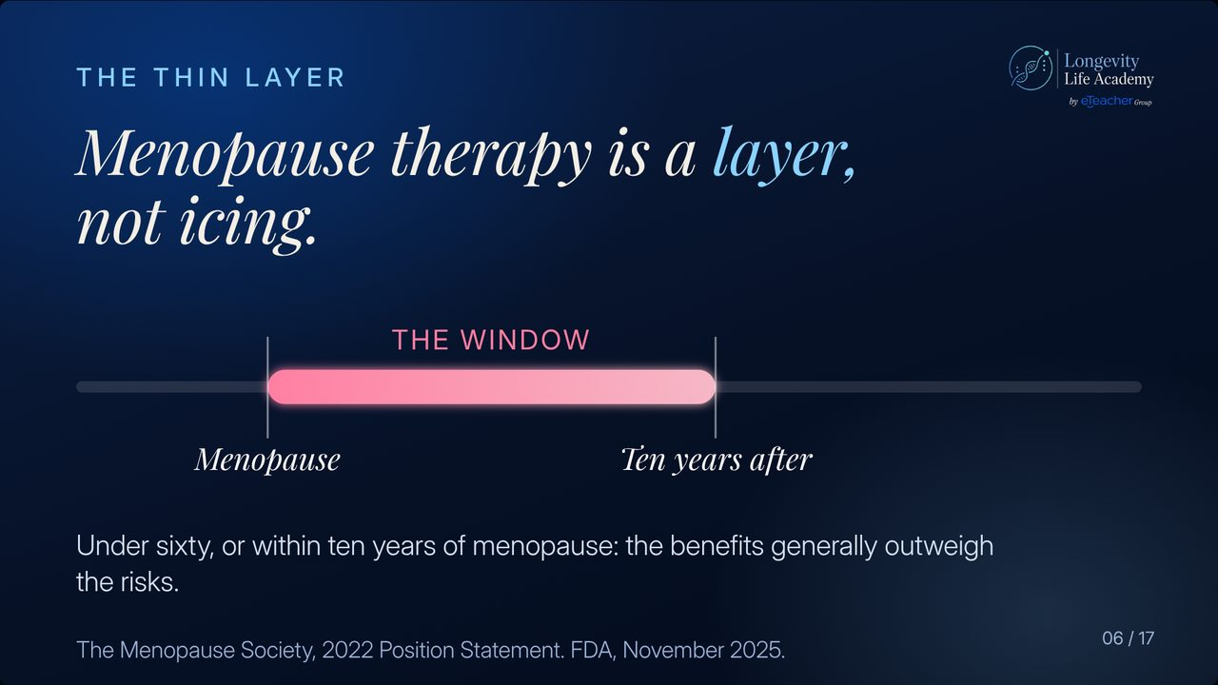
Notes:
Preserved original slide artwork, not editable text. Menopause therapy is a layer, not icing.
Original dimensions: 1280 × 720 pixels.
User-shared shortlist reference. Round 9. Original: https://gitteromri-ux.github.io/lla-masterclass-syllabus/backup-deck/round-9/index.html

Slide 46
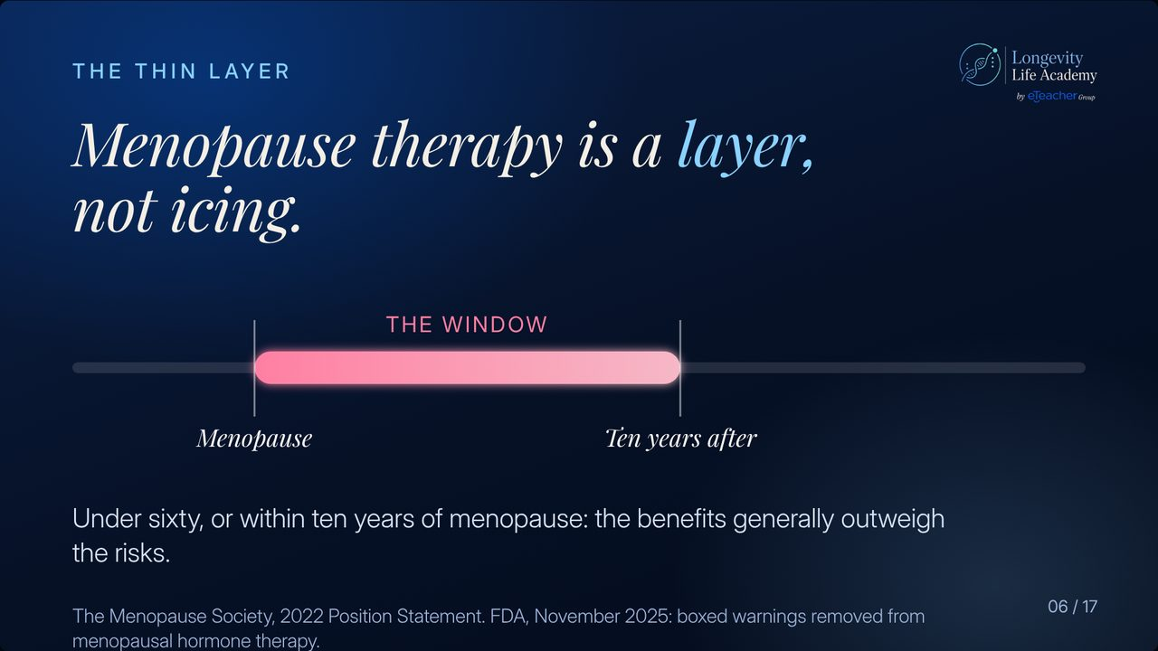
Notes:
Preserved original slide artwork, not editable text. Menopause therapy is a layer, not icing.
Original dimensions: 1280 × 720 pixels.
User-shared shortlist reference. Round 8 : Last version. Original: https://gitteromri-ux.github.io/lla-masterclass-syllabus/backup-deck/index.html

Slide 47
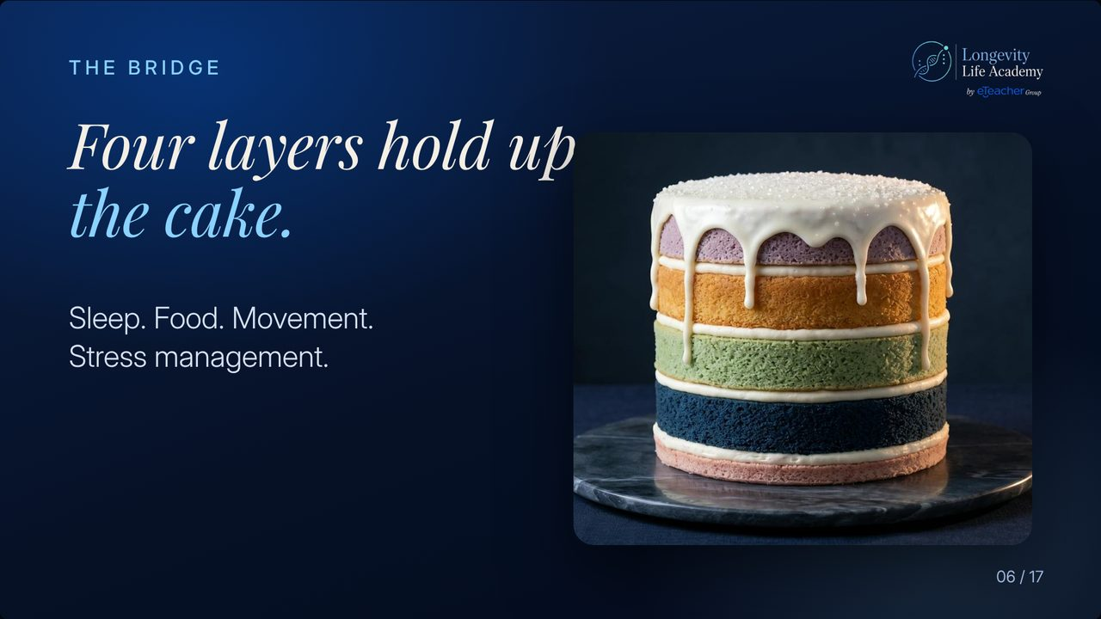
Notes:
Preserved original slide artwork, not editable text. Four layers hold up the cake.
Original dimensions: 1280 × 720 pixels.
User-shared shortlist reference. Round 8 : Last version. Original: https://gitteromri-ux.github.io/lla-masterclass-syllabus/backup-deck/index.html

Slide 48
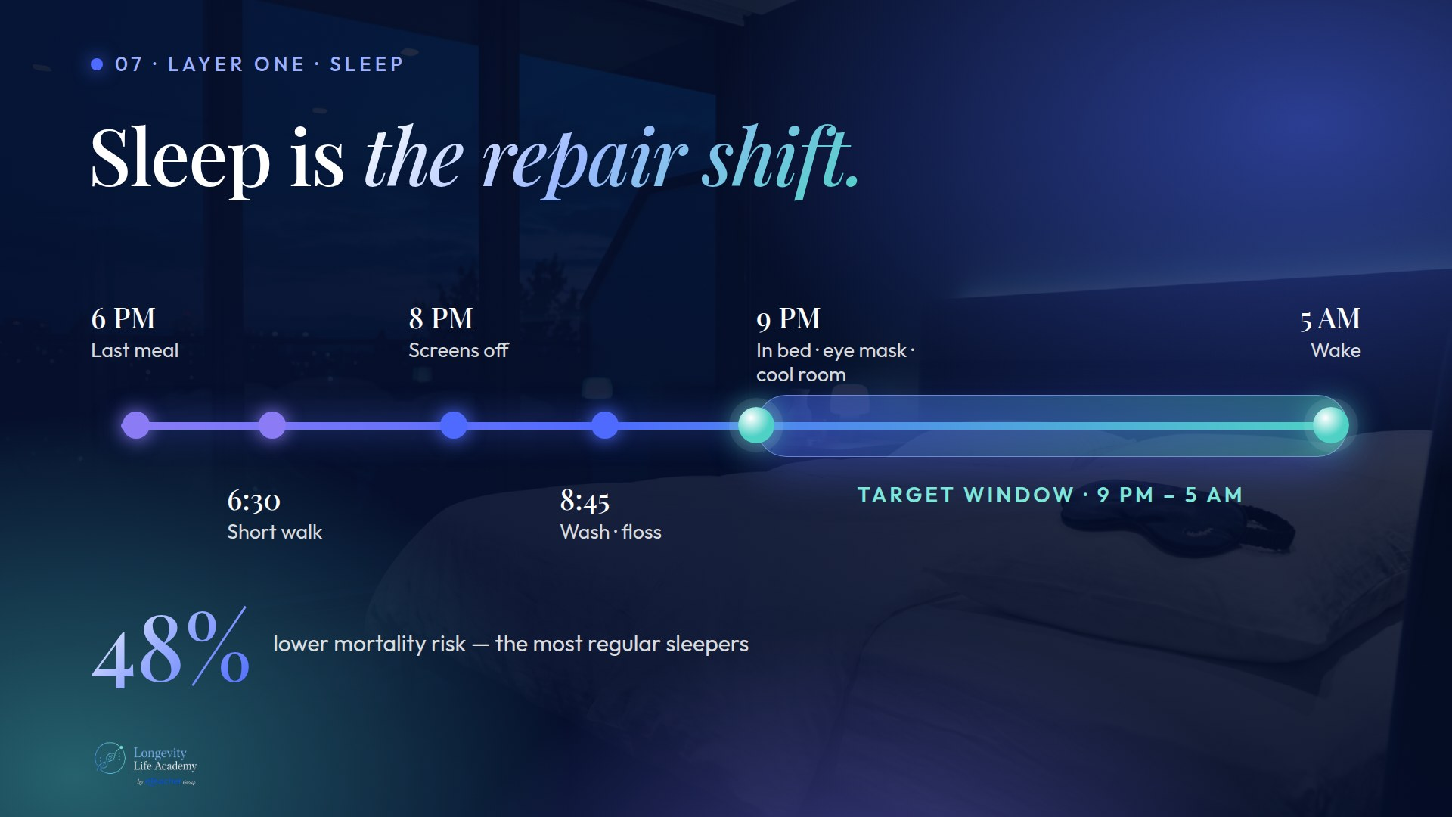
Notes:
Preserved original slide artwork, not editable text. Sleep
Original dimensions: 1920 × 1080 pixels.
User-shared shortlist reference. Claude B · Protocol. Original: https://claude.ai/artifact/JWRnnvBCWXs5cdCwsGGdMb

Slide 49
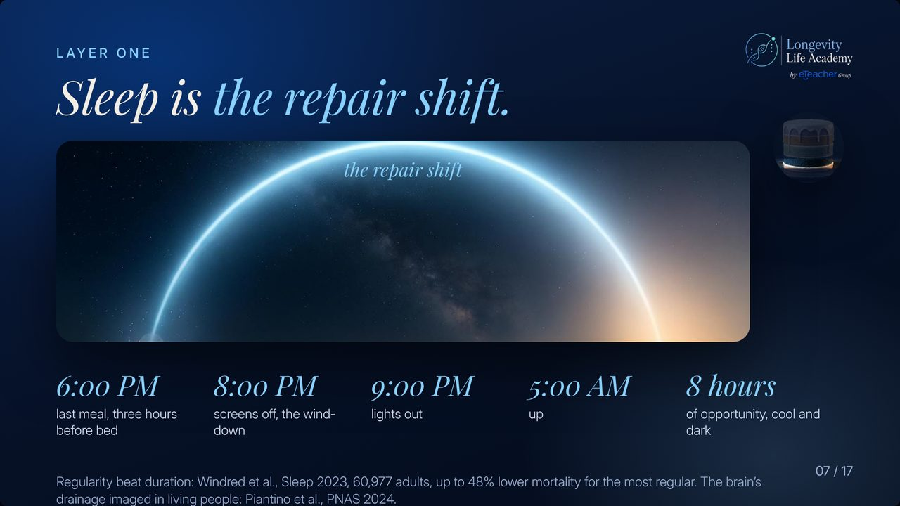
Notes:
Preserved original slide artwork, not editable text. Sleep is the repair shift.
Original dimensions: 1280 × 720 pixels.
User-shared shortlist reference. Round 7 · last. Original: https://gitteromri-ux.github.io/lla-masterclass-syllabus/backup-deck/rounds/r7/last-13.jpg

Slide 50
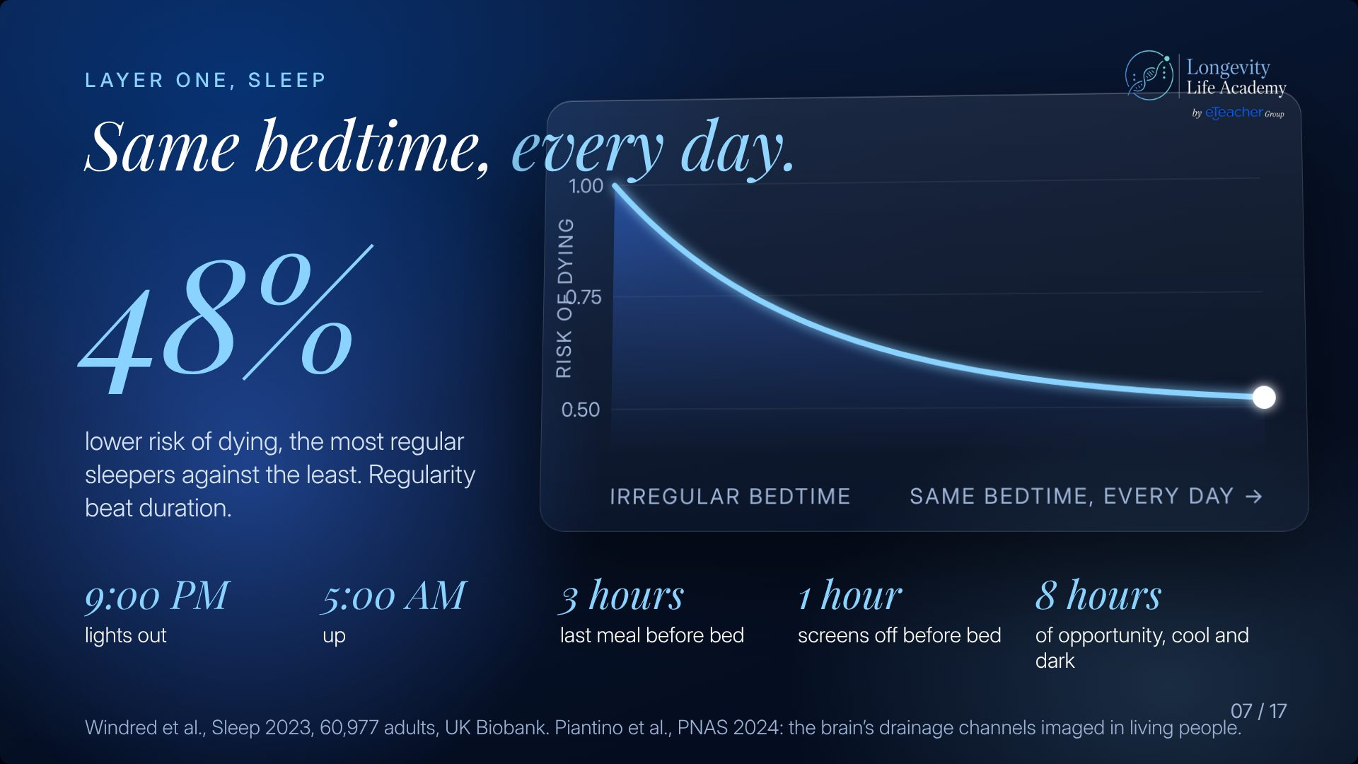
Notes:
Preserved original slide artwork, not editable text. Same bedtime, every day.
Original dimensions: 1920 × 1080 pixels.
User-shared shortlist reference. Round 4 · v1. Original: https://gitteromri-ux.github.io/lla-masterclass-syllabus/backup-deck/rounds/r4/v1-07.jpg

Slide 51
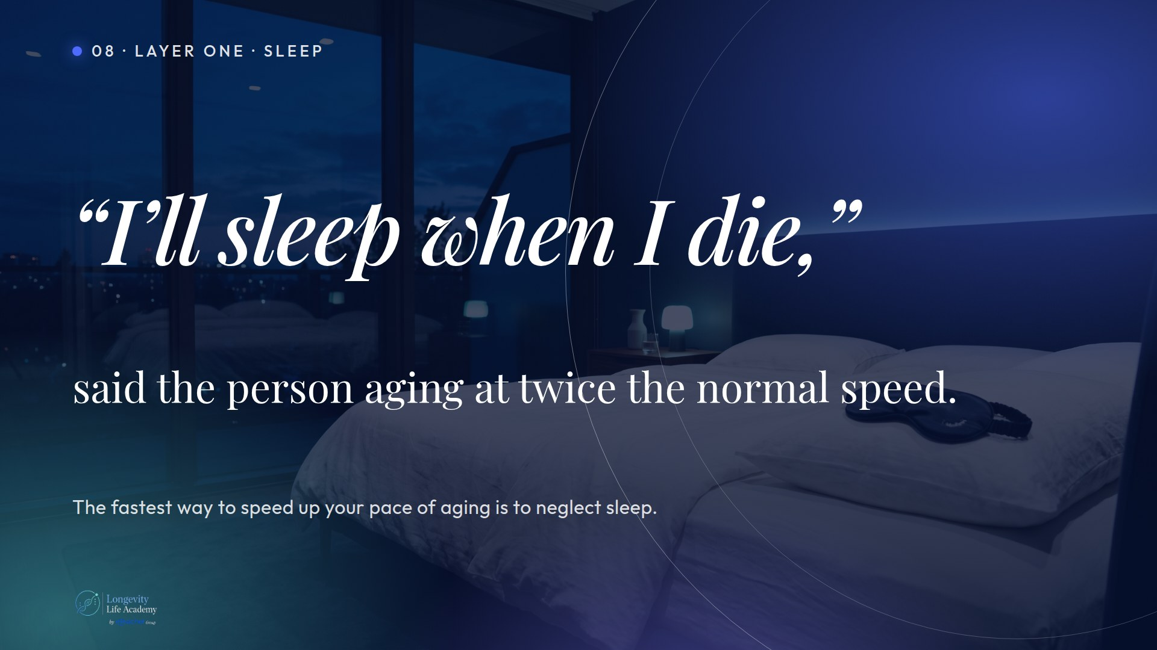
Notes:
Preserved original slide artwork, not editable text. Quote
Original dimensions: 1920 × 1080 pixels.
User-shared shortlist reference. Claude B · Protocol. Original: https://claude.ai/artifact/JWRnnvBCWXs5cdCwsGGdMb

Slide 52
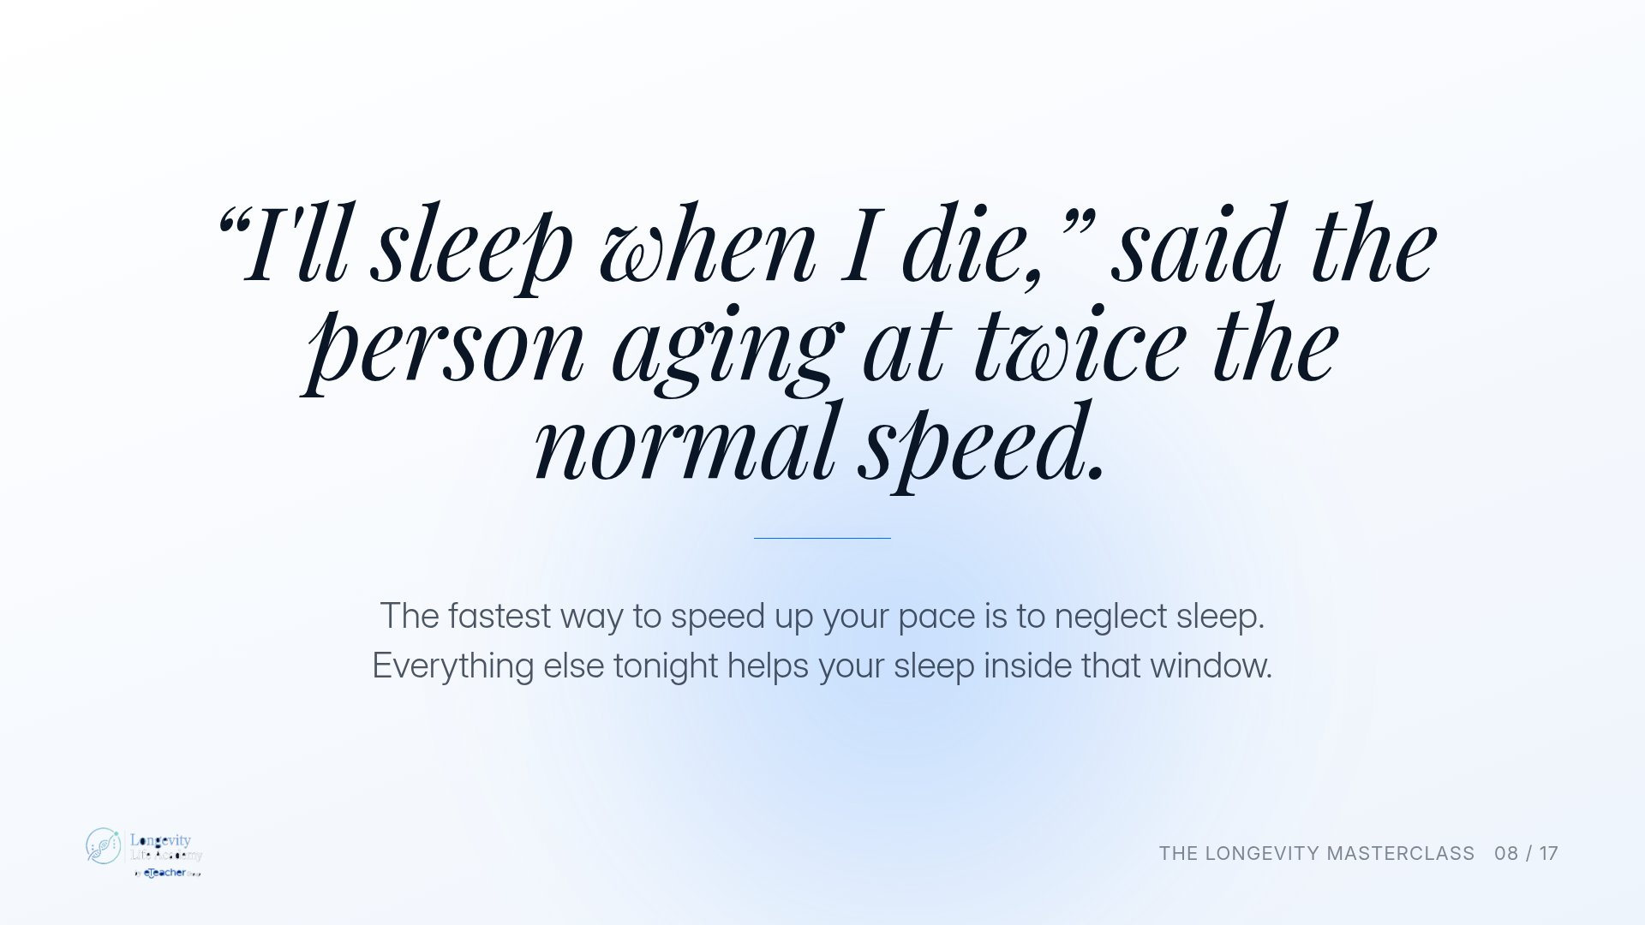
Notes:
Preserved original slide artwork, not editable text. “I'll sleep when I die,” said the person aging at twice the normal speed.
Original dimensions: 1920 × 1080 pixels.
User-shared shortlist reference. Original deck · light. Original: https://gitteromri-ux.github.io/lla-masterclass-syllabus/deck/index.html

Slide 53
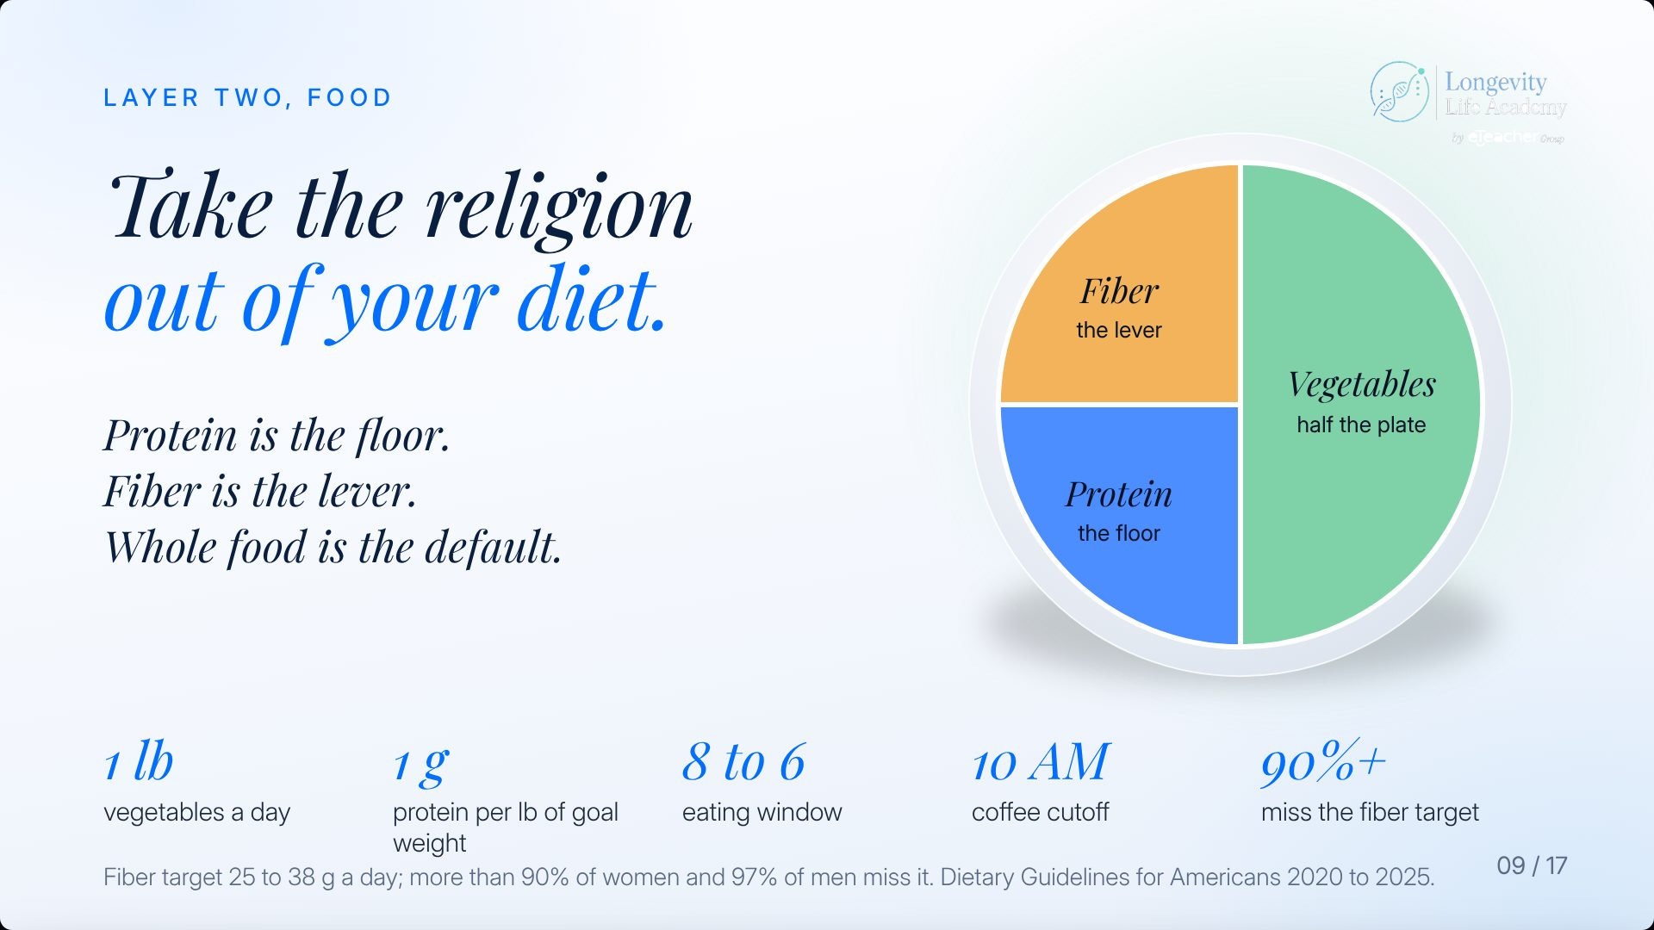
Notes:
Preserved original slide artwork, not editable text. Take the religion out of your diet.
Original dimensions: 1920 × 1080 pixels.
User-shared shortlist reference. Round 4 · v1. Original: https://gitteromri-ux.github.io/lla-masterclass-syllabus/backup-deck/rounds/r4/v1-09.jpg

Slide 54
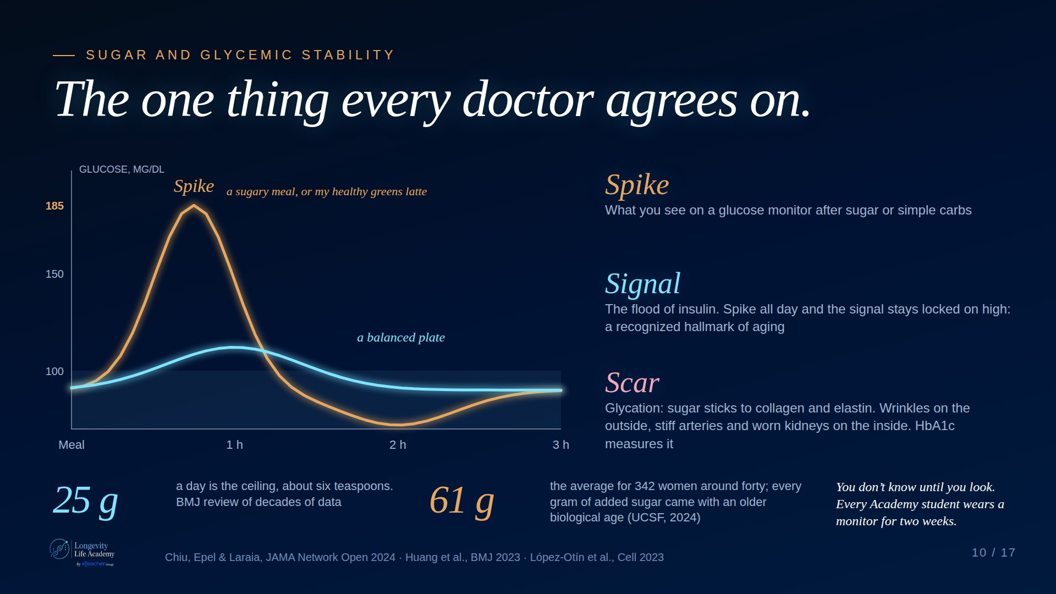
Notes:
Preserved original slide artwork, not editable text. The one thing every doctor agrees on.
Original dimensions: 1920 × 1080 pixels.
User-shared shortlist reference. Claude A · Dark. Original: https://claude.ai/artifact/DMx1Uj3YCvVhtDEXAcJRZc

Slide 55

Notes:
Preserved original slide artwork, not editable text. The one thing every doctor agrees on.
Original dimensions: 1920 × 1080 pixels.
User-shared shortlist reference. Claude A · Light. Original: https://claude.ai/artifact/DMx1Uj3YCvVhtDEXAcJRZc

Slide 56

Notes:
Preserved original slide artwork, not editable text. Sugar
Original dimensions: 1920 × 1080 pixels.
User-shared shortlist reference. Claude B · Protocol. Original: https://claude.ai/artifact/JWRnnvBCWXs5cdCwsGGdMb

Slide 57

Notes:
Preserved original slide artwork, not editable text. The one thing every diet agrees on.
Original dimensions: 1280 × 720 pixels.
User-shared shortlist reference. Round 7 · last. Original: https://gitteromri-ux.github.io/lla-masterclass-syllabus/backup-deck/rounds/r7/last-16.jpg

Slide 58

Notes:
Preserved original slide artwork, not editable text. The one thing every diet agrees on.
Original dimensions: 1920 × 1080 pixels.
User-shared shortlist reference. Round 6 · v2. Original: https://gitteromri-ux.github.io/lla-masterclass-syllabus/backup-deck/rounds/r6/v2-10.jpg

Slide 59

Notes:
Preserved original slide artwork, not editable text. The one thing every diet agrees on.
Original dimensions: 1920 × 1080 pixels.
User-shared shortlist reference. Round 4 · v1. Original: https://gitteromri-ux.github.io/lla-masterclass-syllabus/backup-deck/rounds/r4/v1-10.jpg

Slide 60
Notes:
Preserved original slide artwork, not editable text. The one thing every diet agrees on.
Original dimensions: 1920 × 1080 pixels.
User-shared shortlist reference. Archived Last version · v1. Original: https://gitteromri-ux.github.io/lla-masterclass-syllabus/backup-deck/rounds/last/v1-10.jpg

Slide 61

Notes:
Preserved original slide artwork, not editable text. Same age.
Original dimensions: 1920 × 1080 pixels.
User-shared shortlist reference. Claude A · Dark. Original: https://claude.ai/artifact/DMx1Uj3YCvVhtDEXAcJRZc

Slide 62

Notes:
Preserved original slide artwork, not editable text. Same age
Original dimensions: 1920 × 1080 pixels.
User-shared shortlist reference. Claude B · Protocol. Original: https://claude.ai/artifact/JWRnnvBCWXs5cdCwsGGdMb

Slide 63

Notes:
Preserved original slide artwork, not editable text. Same age.
Original dimensions: 1600 × 900 pixels.
User-shared shortlist reference. Deck 2 · v2.2 · dark. Original: https://gitteromri-ux.github.io/lla-masterclass-syllabus/deck2/index.html

Slide 64

Notes:
Preserved original slide artwork, not editable text. Movement portfolio
Original dimensions: 1920 × 1080 pixels.
User-shared shortlist reference. Claude B · Protocol. Original: https://claude.ai/artifact/JWRnnvBCWXs5cdCwsGGdMb

Slide 65

Notes:
Preserved original slide artwork, not editable text. Four types of movement, four parts of you.
Original dimensions: 1600 × 900 pixels.
User-shared shortlist reference. Deck 2 · v2.2 · dark. Original: https://gitteromri-ux.github.io/lla-masterclass-syllabus/deck2/index.html

Slide 66

Notes:
Preserved original slide artwork, not editable text. Four types of movement, four parts of you.
Original dimensions: 1280 × 720 pixels.
User-shared shortlist reference. Round 9. Original: https://gitteromri-ux.github.io/lla-masterclass-syllabus/backup-deck/round-9/index.html

Slide 67

Notes:
Preserved original slide artwork, not editable text. Four types of movement, four parts of you.
Original dimensions: 1280 × 720 pixels.
User-shared shortlist reference. Round 8 : Last version. Original: https://gitteromri-ux.github.io/lla-masterclass-syllabus/backup-deck/index.html

Slide 68

Notes:
Preserved original slide artwork, not editable text. Four types of movement, four parts of you.
Original dimensions: 1280 × 720 pixels.
User-shared shortlist reference. Round 7 · last. Original: https://gitteromri-ux.github.io/lla-masterclass-syllabus/backup-deck/rounds/r7/last-19.jpg

Slide 69

Notes:
Preserved original slide artwork, not editable text. Movement week
Original dimensions: 1920 × 1080 pixels.
User-shared shortlist reference. Claude B · Protocol. Original: https://claude.ai/artifact/JWRnnvBCWXs5cdCwsGGdMb

Slide 70

Notes:
Preserved original slide artwork, not editable text. My weekly longevity protocol looks like this.
Original dimensions: 1600 × 900 pixels.
User-shared shortlist reference. Deck 2 · v2.2 · dark. Original: https://gitteromri-ux.github.io/lla-masterclass-syllabus/deck2/index.html

Slide 71

Notes:
Preserved original slide artwork, not editable text. My weekly longevity protocol looks like this.
Original dimensions: 1600 × 900 pixels.
User-shared shortlist reference. Deck 2 · v2.2 · light. Original: https://gitteromri-ux.github.io/lla-masterclass-syllabus/deck2/index.html

Slide 72

Notes:
Preserved original slide artwork, not editable text. Three strength. Two zone 2. One sprint. 8,000 steps.
Original dimensions: 1920 × 1080 pixels.
User-shared shortlist reference. Round 5 · v2. Original: https://gitteromri-ux.github.io/lla-masterclass-syllabus/backup-deck/rounds/r5/v2-13.jpg

Slide 73

Notes:
Preserved original slide artwork, not editable text. What my week looks like.
Original dimensions: 1920 × 1080 pixels.
User-shared shortlist reference. Original deck · dark. Original: https://gitteromri-ux.github.io/lla-masterclass-syllabus/deck/index.html

Slide 74

Notes:
Preserved original slide artwork, not editable text. The layer people skip.
Original dimensions: 1920 × 1080 pixels.
User-shared shortlist reference. Claude A · Dark. Original: https://claude.ai/artifact/DMx1Uj3YCvVhtDEXAcJRZc

Slide 75

Notes:
Preserved original slide artwork, not editable text. Stress
Original dimensions: 1920 × 1080 pixels.
User-shared shortlist reference. Claude B · Protocol. Original: https://claude.ai/artifact/JWRnnvBCWXs5cdCwsGGdMb

Slide 76

Notes:
Preserved original slide artwork, not editable text. Julie Gibson Clark's Longevity Protocol
Original dimensions: 1920 × 1080 pixels.
User-shared shortlist reference. Claude A · Dark. Original: https://claude.ai/artifact/DMx1Uj3YCvVhtDEXAcJRZc

Slide 77
Notes:
Preserved original slide artwork, not editable text. The protocol
Original dimensions: 1920 × 1080 pixels.
User-shared shortlist reference. Claude B · Protocol. Original: https://claude.ai/artifact/JWRnnvBCWXs5cdCwsGGdMb

Slide 78

Notes:
Preserved original slide artwork, not editable text. Julie Gibson Clark's Longevity Protocol.
Original dimensions: 1600 × 900 pixels.
User-shared shortlist reference. Deck 2 · v2.2 · dark. Original: https://gitteromri-ux.github.io/lla-masterclass-syllabus/deck2/index.html

Slide 79
Notes:
Preserved original slide artwork, not editable text. Julie Gibson Clark's Longevity Protocol.
Original dimensions: 1600 × 900 pixels.
User-shared shortlist reference. Deck 2 · v2.2 · light. Original: https://gitteromri-ux.github.io/lla-masterclass-syllabus/deck2/index.html

Slide 80

Notes:
Preserved original slide artwork, not editable text. Julie Gibson Clark's Longevity Protocol.
Original dimensions: 1920 × 1080 pixels.
User-shared shortlist reference. Original deck · dark. Original: https://gitteromri-ux.github.io/lla-masterclass-syllabus/deck/index.html

Slide 81

Notes:
Preserved original slide artwork, not editable text. Julie Gibson Clark's Longevity Protocol.
Original dimensions: 1920 × 1080 pixels.
User-shared shortlist reference. Original deck · light. Original: https://gitteromri-ux.github.io/lla-masterclass-syllabus/deck/index.html

Slide 82

Notes:
Preserved original slide artwork, not editable text. You don’t need a lab. You need a notebook.
Original dimensions: 1280 × 720 pixels.
User-shared shortlist reference. Round 10. Original: https://gitteromri-ux.github.io/lla-masterclass-syllabus/backup-deck/round-10/index.html

Slide 83

Notes:
Preserved original slide artwork, not editable text. Test then buy
Original dimensions: 1920 × 1080 pixels.
User-shared shortlist reference. Claude B · Protocol. Original: https://claude.ai/artifact/JWRnnvBCWXs5cdCwsGGdMb

Slide 84

Notes:
Preserved original slide artwork, not editable text. That’s the cake.
Original dimensions: 1280 × 720 pixels.
User-shared shortlist reference. Round 9. Original: https://gitteromri-ux.github.io/lla-masterclass-syllabus/backup-deck/round-9/index.html

Slide 85

Notes:
Preserved original slide artwork, not editable text. That's the cake.
Original dimensions: 1280 × 720 pixels.
User-shared shortlist reference. Round 7 · last. Original: https://gitteromri-ux.github.io/lla-masterclass-syllabus/backup-deck/rounds/r7/last-27.jpg

Slide 86

Notes:
Preserved original slide artwork, not editable text. Healthspan to match lifespan.
Original dimensions: 1280 × 720 pixels.
User-shared shortlist reference. Round 7 · last. Original: https://gitteromri-ux.github.io/lla-masterclass-syllabus/backup-deck/rounds/r7/last-28.jpg

Slide 87

Notes:
Preserved original slide artwork, not editable text. Why. Intention. Resources.
Original dimensions: 1920 × 1080 pixels.
User-shared shortlist reference. Claude A · Dark. Original: https://claude.ai/artifact/DMx1Uj3YCvVhtDEXAcJRZc

Slide 88

Notes:
Preserved original slide artwork, not editable text. Three questions
Original dimensions: 1920 × 1080 pixels.
User-shared shortlist reference. Claude B · Protocol. Original: https://claude.ai/artifact/JWRnnvBCWXs5cdCwsGGdMb

Slide 89

Notes:
Preserved original slide artwork, not editable text. Why. Intention. Resources.
Original dimensions: 1920 × 1080 pixels.
User-shared shortlist reference. Round 5 · v2. Original: https://gitteromri-ux.github.io/lla-masterclass-syllabus/backup-deck/rounds/r5/v2-17.jpg

Slide 90
Notes:
Preserved original slide artwork, not editable text. Why. Intention. Resources.
Original dimensions: 1920 × 1080 pixels.
User-shared shortlist reference. Round 4 · v2. Original: https://gitteromri-ux.github.io/lla-masterclass-syllabus/backup-deck/rounds/r4/v2-17.jpg

Slide 91

Notes:
Preserved original slide artwork, not editable text. Why. Intention. Resources.
Original dimensions: 1920 × 1080 pixels.
User-shared shortlist reference. Original deck · dark. Original: https://gitteromri-ux.github.io/lla-masterclass-syllabus/deck/index.html

Slide 92

Notes:
Preserved original slide artwork, not editable text. Why. Intention. Resources.
Original dimensions: 1920 × 1080 pixels.
User-shared shortlist reference. Original deck · light. Original: https://gitteromri-ux.github.io/lla-masterclass-syllabus/deck/index.html

