Slide 1
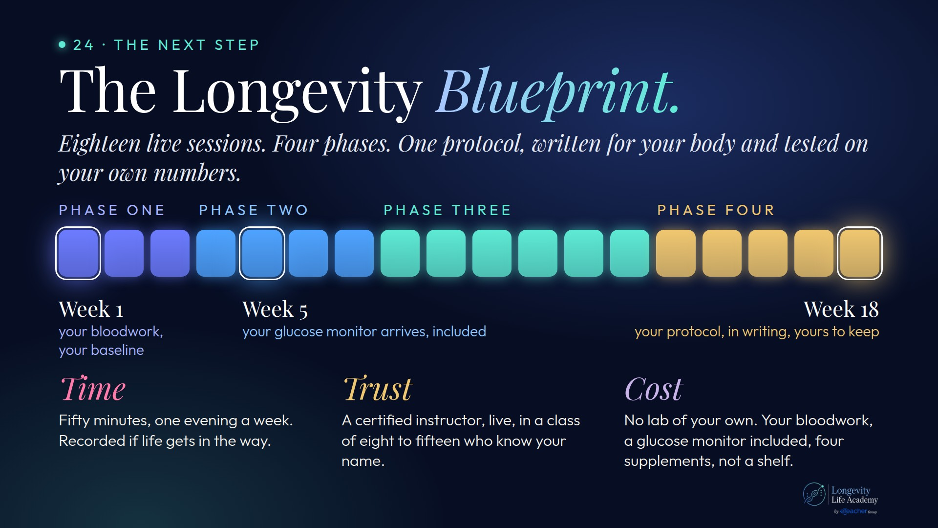
Notes:
Preserved original slide artwork, not editable text. bp-big
Original dimensions: 1920 × 1080 pixels.
Git commit b2120cbb1f07af192f8362fe758bcdc69dfe86ac; slide-canvas/closers/frames/bp-big.jpg

Slide 2
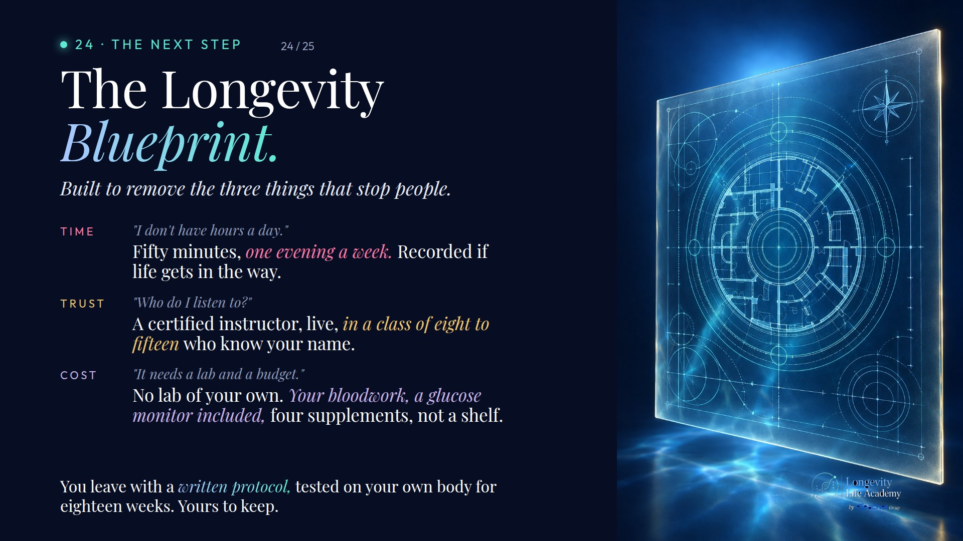
Notes:
Preserved original slide artwork, not editable text. bp-sell
Original dimensions: 1920 × 1080 pixels.
Git commit b2120cbb1f07af192f8362fe758bcdc69dfe86ac; slide-canvas/closers/frames/bp-sell.jpg

