Slide 1
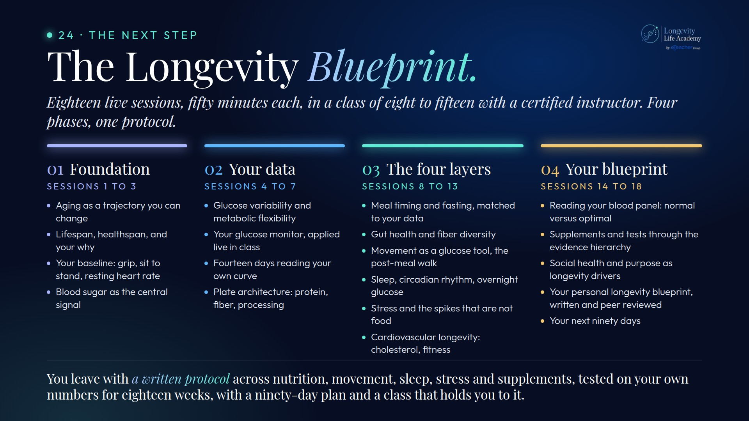
Notes:
Preserved original slide artwork, not editable text. bp-cur
Original dimensions: 1920 × 1080 pixels.
Git commit c1c4732bdd0e9c980a6b691c2c21a9c318b0a4ff; slide-canvas/closers/frames/bp-cur.jpg

