Slide 1
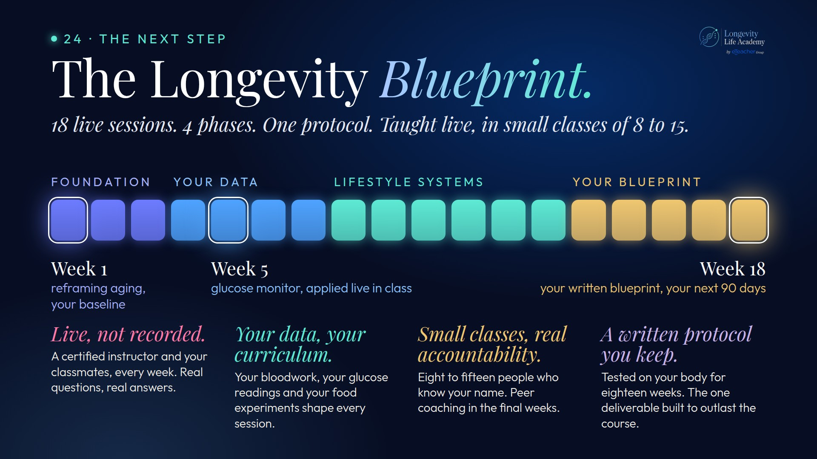
Notes:
Preserved original slide artwork, not editable text. bp-site
Original dimensions: 1920 × 1080 pixels.
Git commit e631dd85b7970b4272c9c5545404d8d6325e6b7c; slide-canvas/closers/frames/bp-site.jpg

