Slide 1
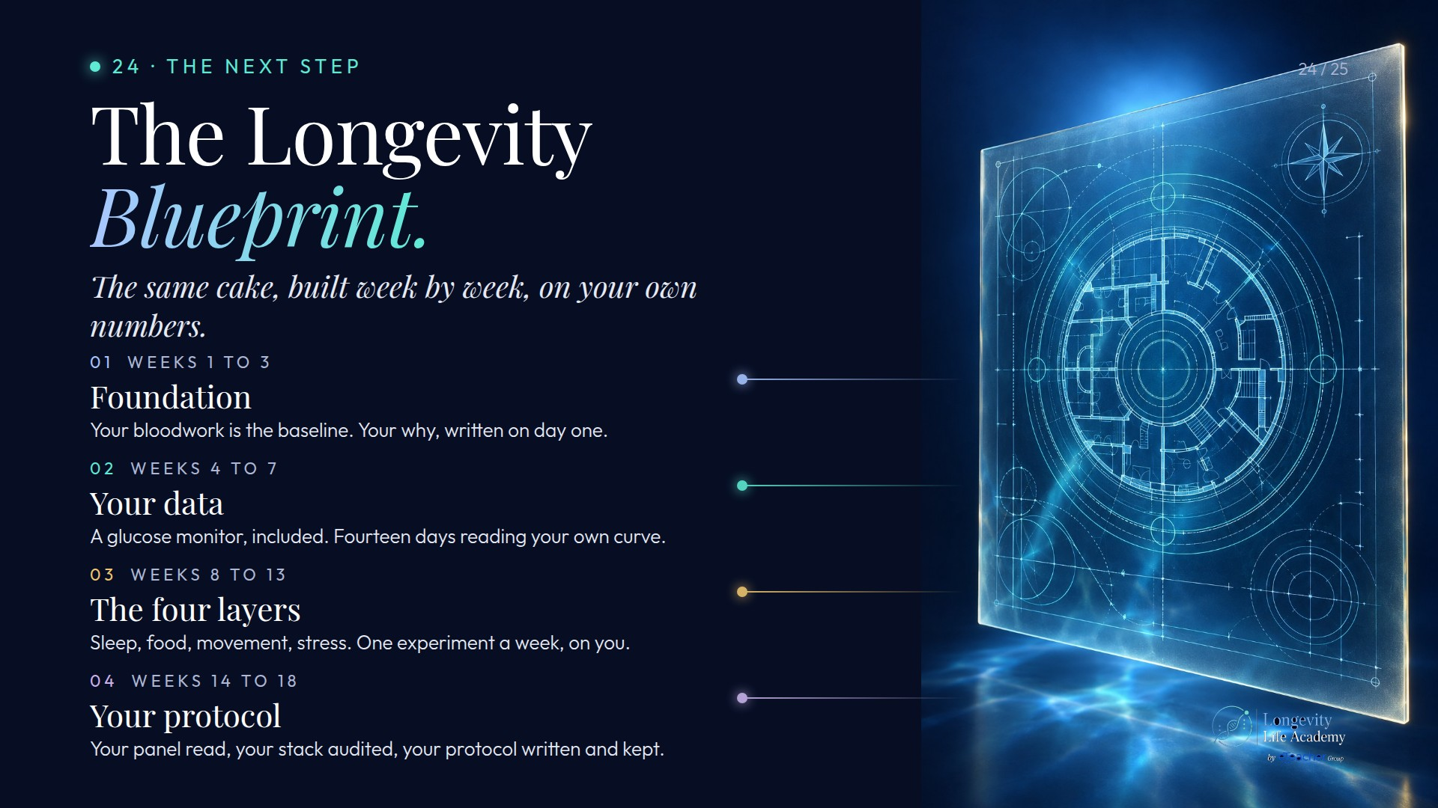
Notes:
Preserved original slide artwork, not editable text. bp-d
Original dimensions: 1920 × 1080 pixels.
Git commit fc9873086cf38909a46331569081ea49e23cc5b5; slide-canvas/closers/frames/bp-d.jpg

Slide 2
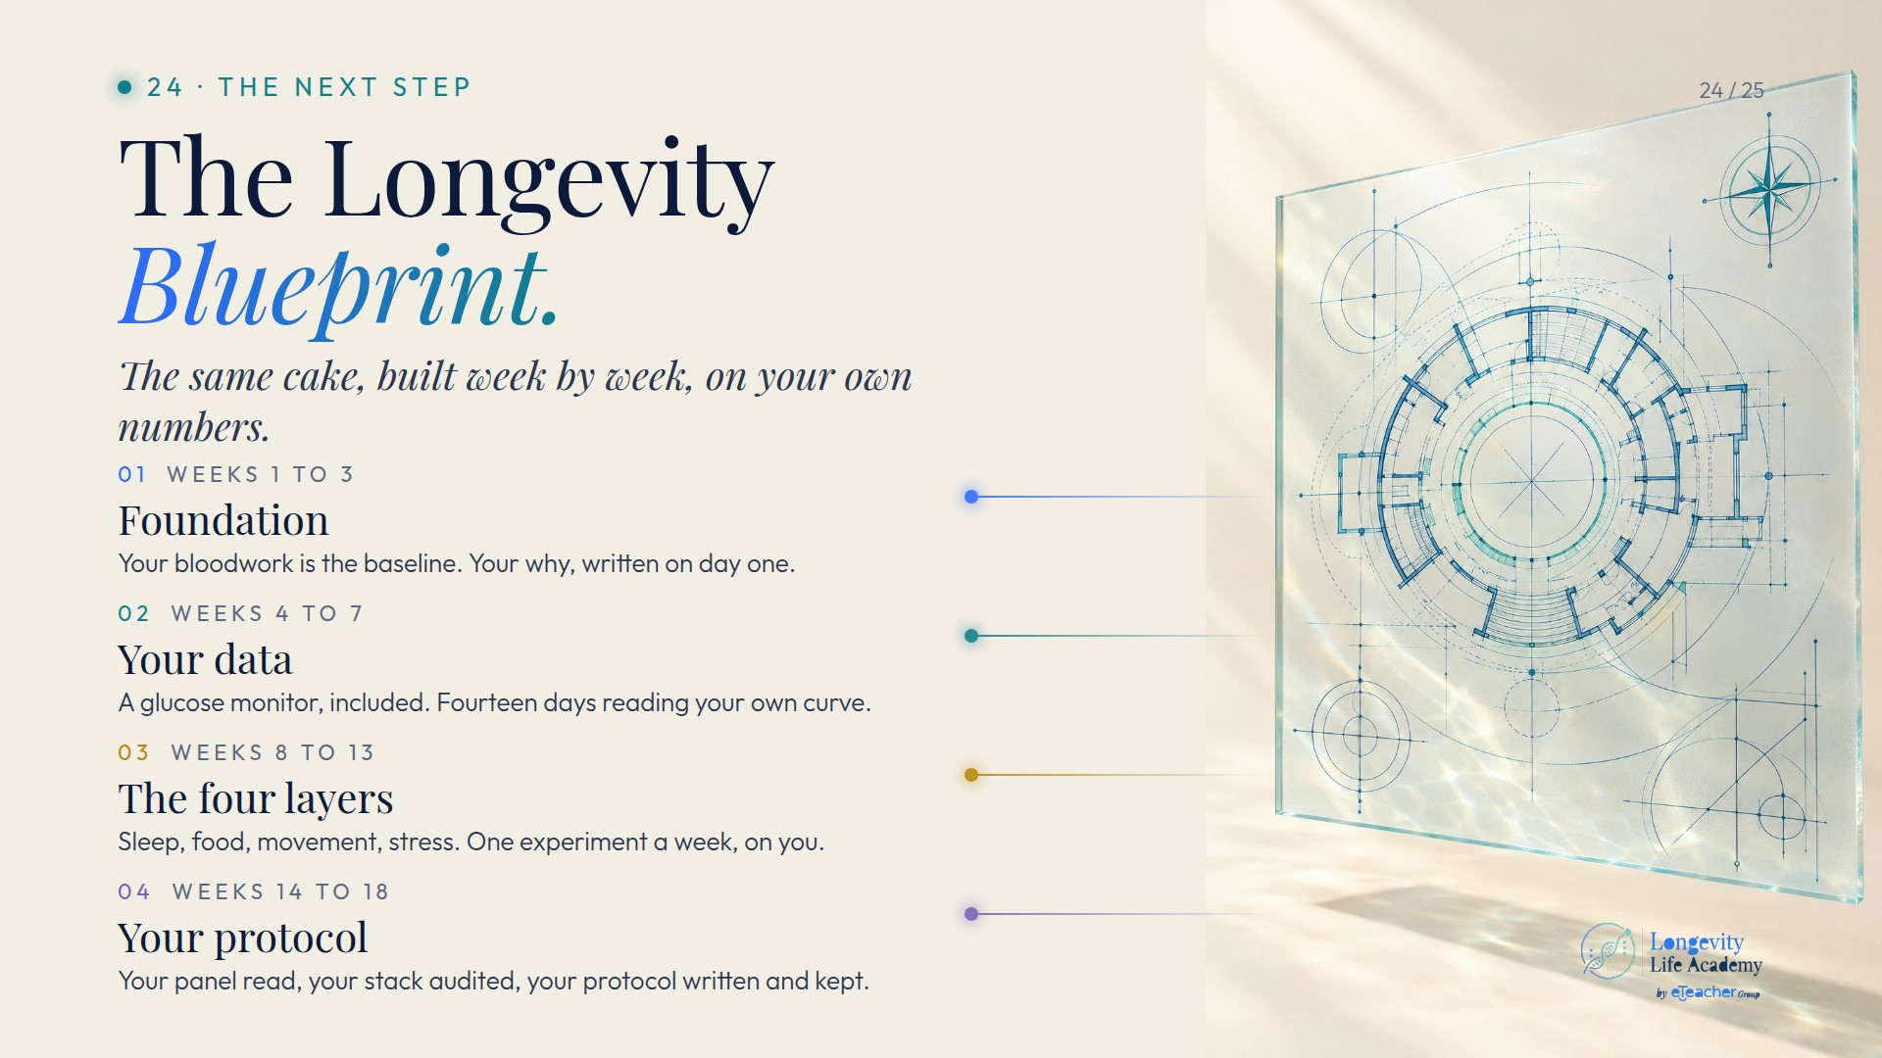
Notes:
Preserved original slide artwork, not editable text. bp-l
Original dimensions: 1920 × 1080 pixels.
Git commit fc9873086cf38909a46331569081ea49e23cc5b5; slide-canvas/closers/frames/bp-l.jpg

Slide 3
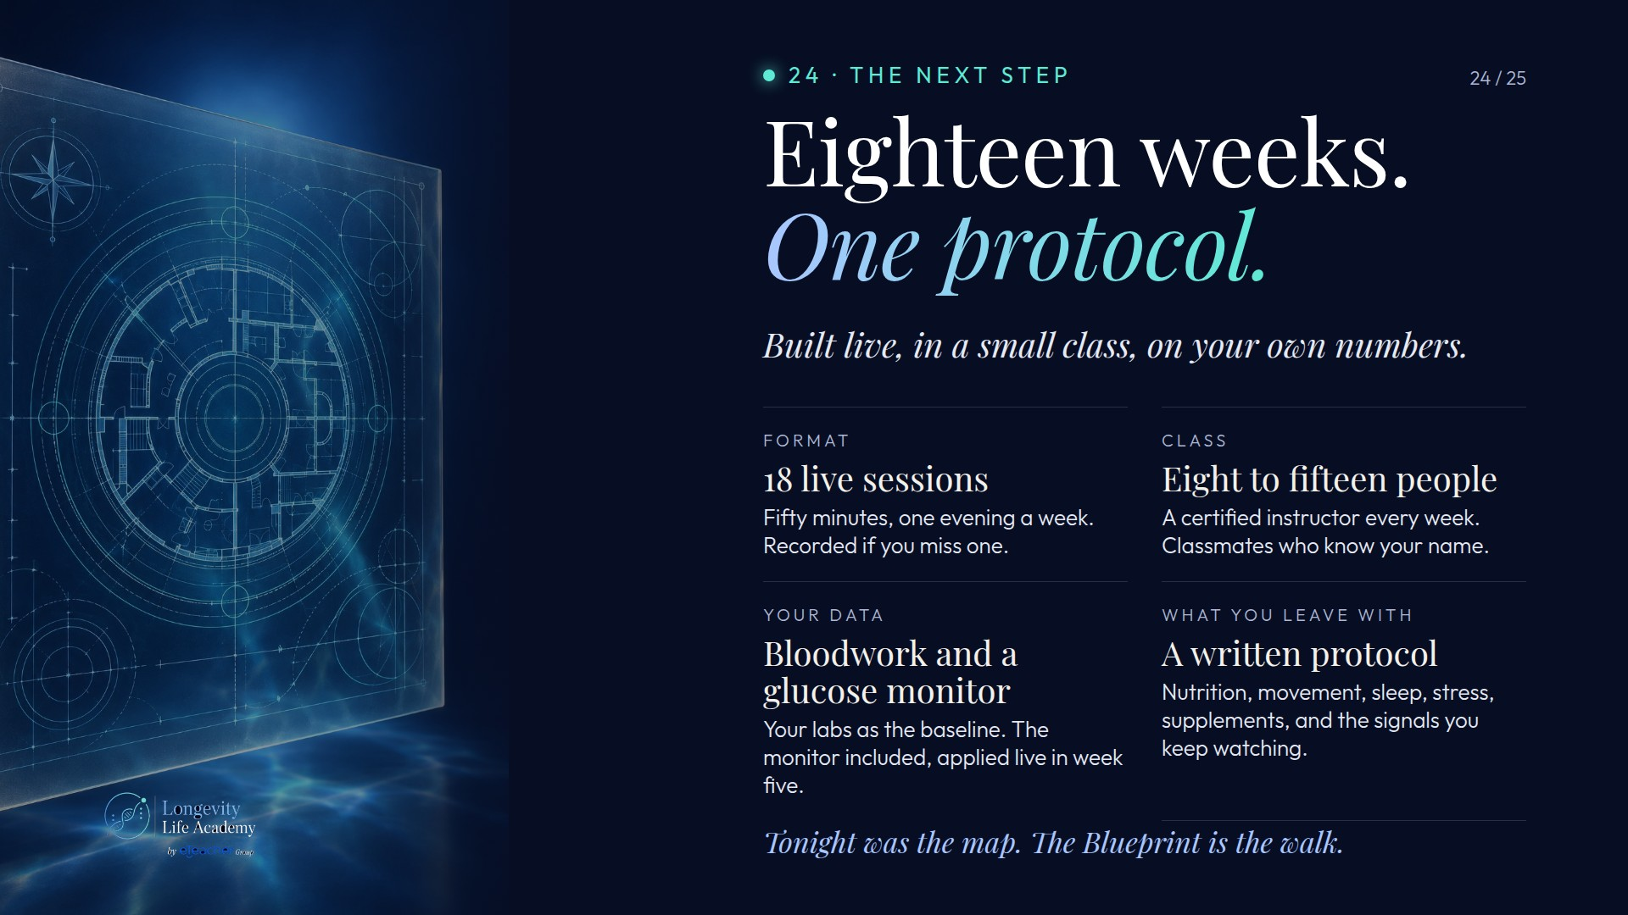
Notes:
Preserved original slide artwork, not editable text. bp-spec
Original dimensions: 1920 × 1080 pixels.
Git commit fc9873086cf38909a46331569081ea49e23cc5b5; slide-canvas/closers/frames/bp-spec.jpg

