Slide 1
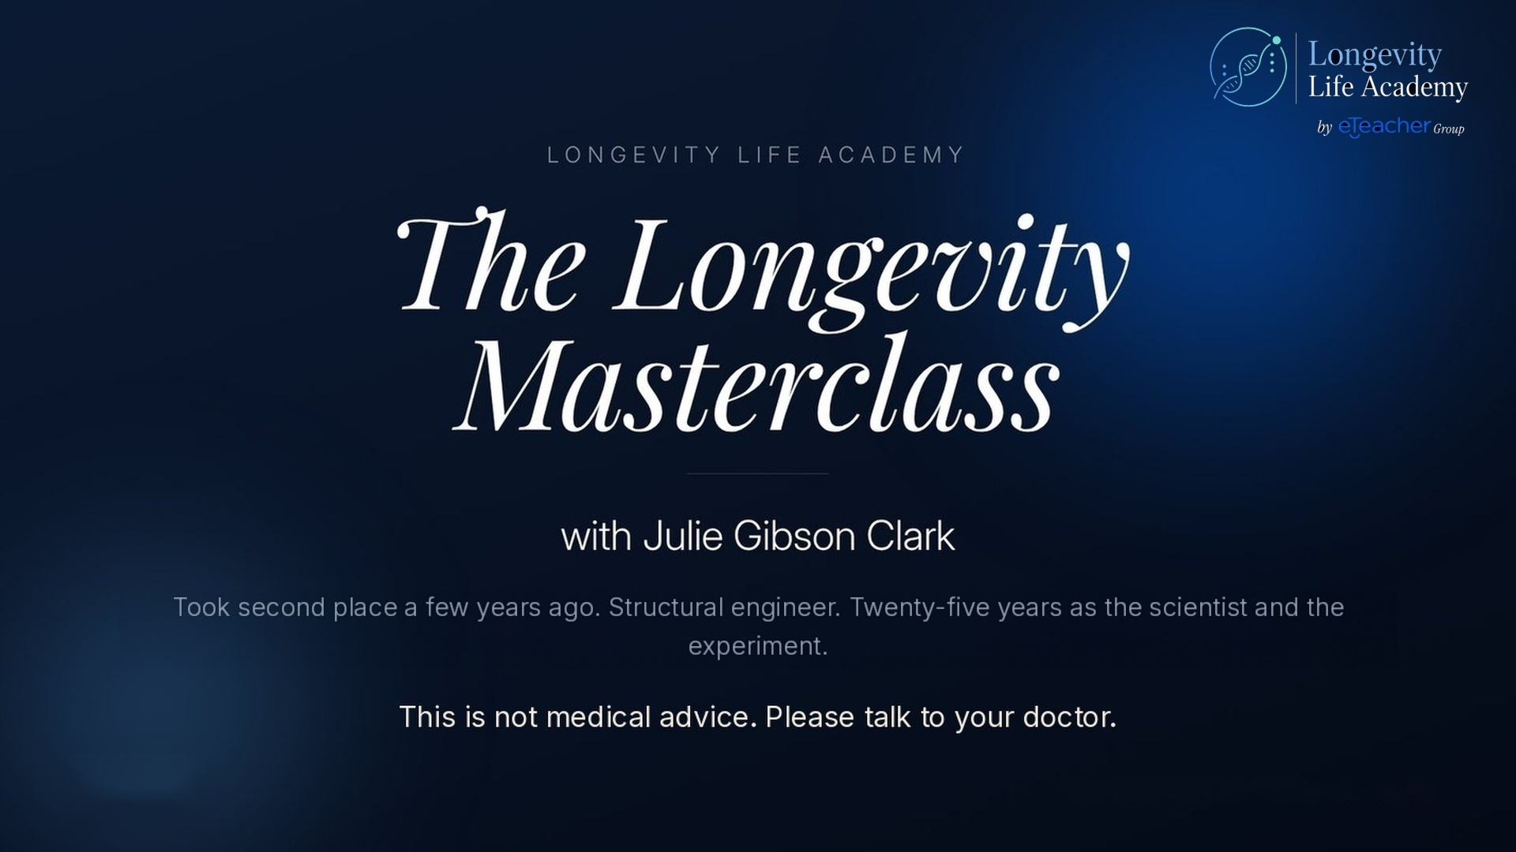
Notes:
Hi everyone, welcome. I’m Julie, and I am so honored you’re here.
I know—you clicked an ad promising something impressive, and now you’re looking at me thinking, ‘Well, she looks pretty normal.’
You're right! I am normal. And frankly, that’s why this matters.
Ok let me introduce why I’m here: A few years ago, I entered the Rejuvenation Olympics—a competition tracking rate of aging through cellular blood markers. To everyone's surprise, I took second place, finishing ahead of people spending millions of dollars on extreme protocols. I did it on a everyday budget with simple, accessible habits.
By training, I’m a structural engineer. That means I’m a natural skeptic. I don’t like spending a dime on anything I can’t test, track, and verify. So for the last 25 years, I’ve been my own scientist and my own experiment.
Before we start, two quick ground rules: First, independence matters. Other than an affiliate account with NOVOS, I currently have zero sponsorships from any brand I mention here. Second, this is my personal data journey, not medical advice. Always consult your doctor before making health changes.

Slide 2
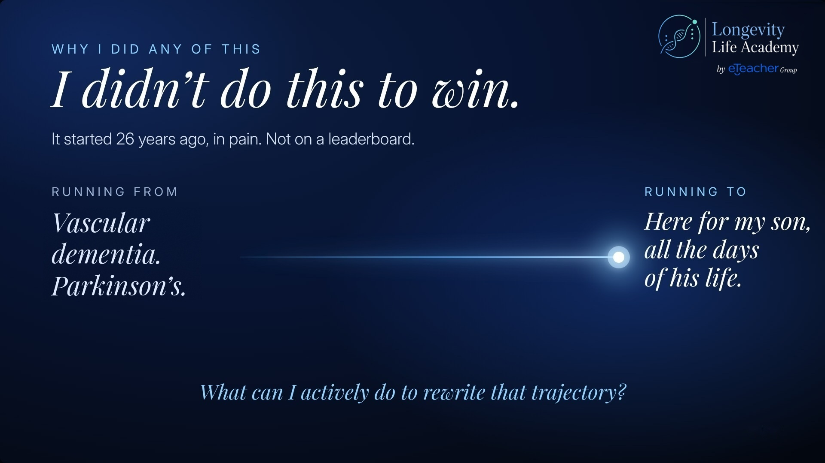
Notes:
Lets start at the beginning - why did I do any of this longevity “stuff”? Because it was NOT to be on a leaderboard or to beat billionaires at their fancy game. I set off on this “health journey” - like many others: because I was in pain and knew I needed to make changes. So in 2000, I started following a healthier path (mostly focused on diet and exercise).
But here’s when everything really clicked. In 2009, my younger brother died very suddenly and very tragically. Now at this point I’m a single mom to a 3 year old, and that’s when I realized: I’m my son’s plan AND his back up plan. I wanted to make sure I was here for all the days he needed me. And now that he’s 20, I just want to make sure I’m here for potential grand kids, and also to show him another possibility for how we age.
That’s positive vision I’m running TO.
But there’s a reality I’m also running FROM. My mom has Parkinson’s and my dad has vascular dementia. And watching them decline over the past 10 years has been a MASSIVE wake-up call. I stopped wondering whether it could happen to me and started asking a much bigger question: What can I actively do to rewrite that trajectory? I wanted a real dashboard—a way to test if the protocols I was trying today were actually moving the needle for my future.

Slide 3
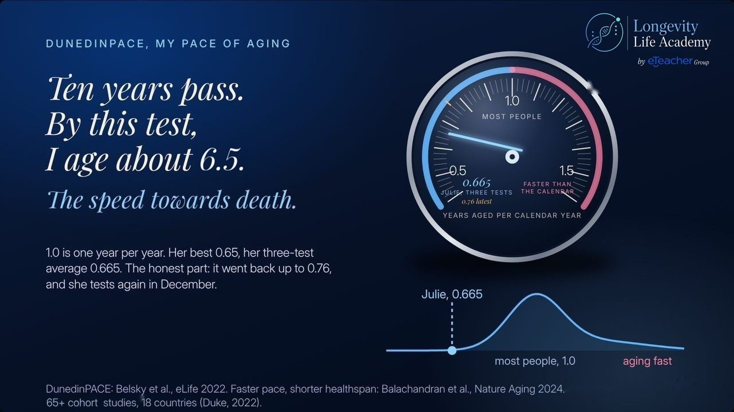
Notes:
So here’s the test I (and many scientists in the field of aging research) have settled on. It’s called the Dunedin Pace test. To be clear there are many bio age tests out there. But from what I can tell this seems to be the one scientists agree to be the most consistent and reliable.
In plain language it estimates the speed your body is aging. The scientists say “pace of aging.” I say its the “speed at which your approaching you DEATH”, because to me it's the same thing and it’s a lot harder to ignore.
A score of 1.0 means you're aging one year for every calendar year. My best score was 0.65. If you average all three of my tests, I land at 0.665.
So that means by the MATH, I’m aging about 6.5 years when the typical person ages 10. What it means by LIFE is that I am much more likely see added decades of vitality and strength and independence.
To be very clear this is NOT a vanity number or a gimmick. The test was built at Duke and Columbia by studying a group of people out of Dunedin, New Zealand. They’ve been following the cohort since birth (several of them are still alive and still being studied). It was published in 2022, and it's now being used in more than sixty-five large studies in eighteen countries. In 2024, Nature Aging reported that older adults with a faster pace on this test went on to have shorter health spans and shorter lives.
But please hear this: it's one test, and I’m one person, one body. 1 data point. That's not a clinical trial, that's a story. However, I do think it's a hopeful one.

Slide 4
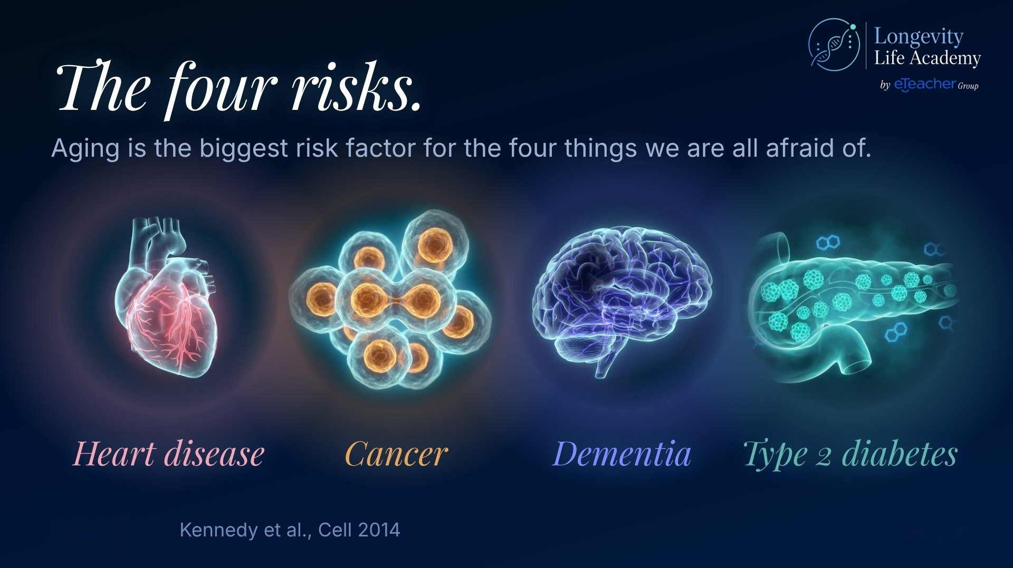
Notes:
So you know why I became focused on longevity and what test I use. But why did science and the whole world become kinda obsessed?
It turns out that aging is the biggest risk factor for the four things we're all afraid of: heart disease, cancer, dementia, and type 2 diabetes. According to geroscientists, if you slow the aging process itself, you push back all four at once. Geroscience is made up of researchers, scientists and clinicians all working to sort out what is the best way to navigate aging without all the decades of decline and dis-ease.

Slide 5
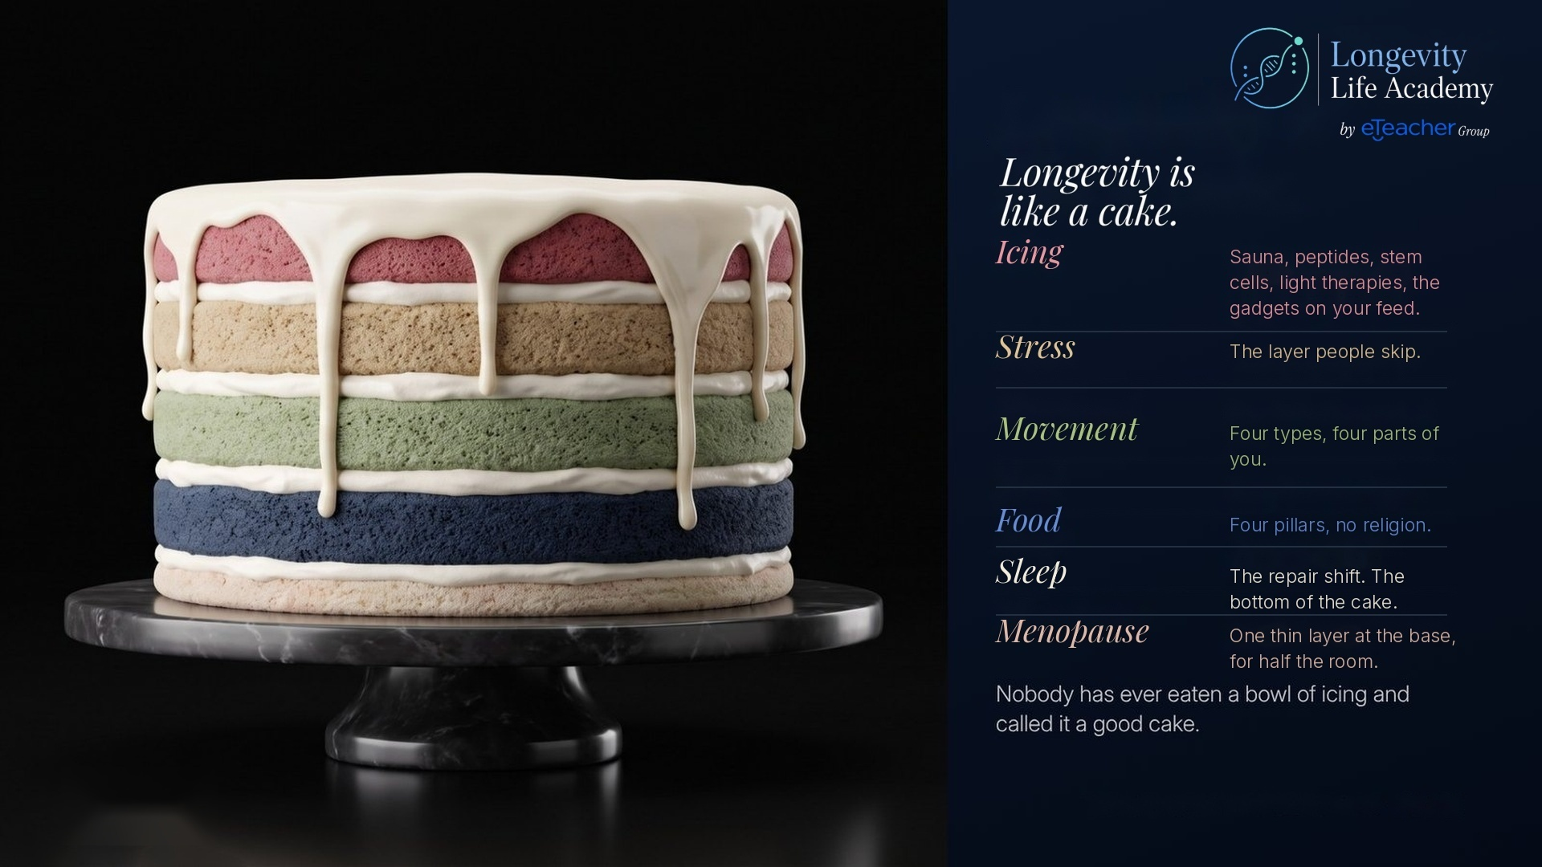
Notes:
Now because I’m me - and I’m NOT waiting until things are official, I have sorted through A LOT of that research. Here’s how I’ve come to organize it in my mind: Longevity is like a cake. Go with me here. I love baking.
This cake is four layers: sleep, food, movement, and stress management. That's where most of the focus lives. For the women here, there's one more thin layer at the bottom of the cake, peri and post menopause (we’ll touch on it, but it really needs it’s own class).
Then there’s the icing - that’s the fun stuff: sauna, the peptides, the stem cells, the light therapies, the latest gadgets and supplements that are no doubt all over your social feeds right now.
Listen, icing is delightful - I LOVE it! But nobody has ever eaten a bowl of icing and called it a good cake.

Slide 6
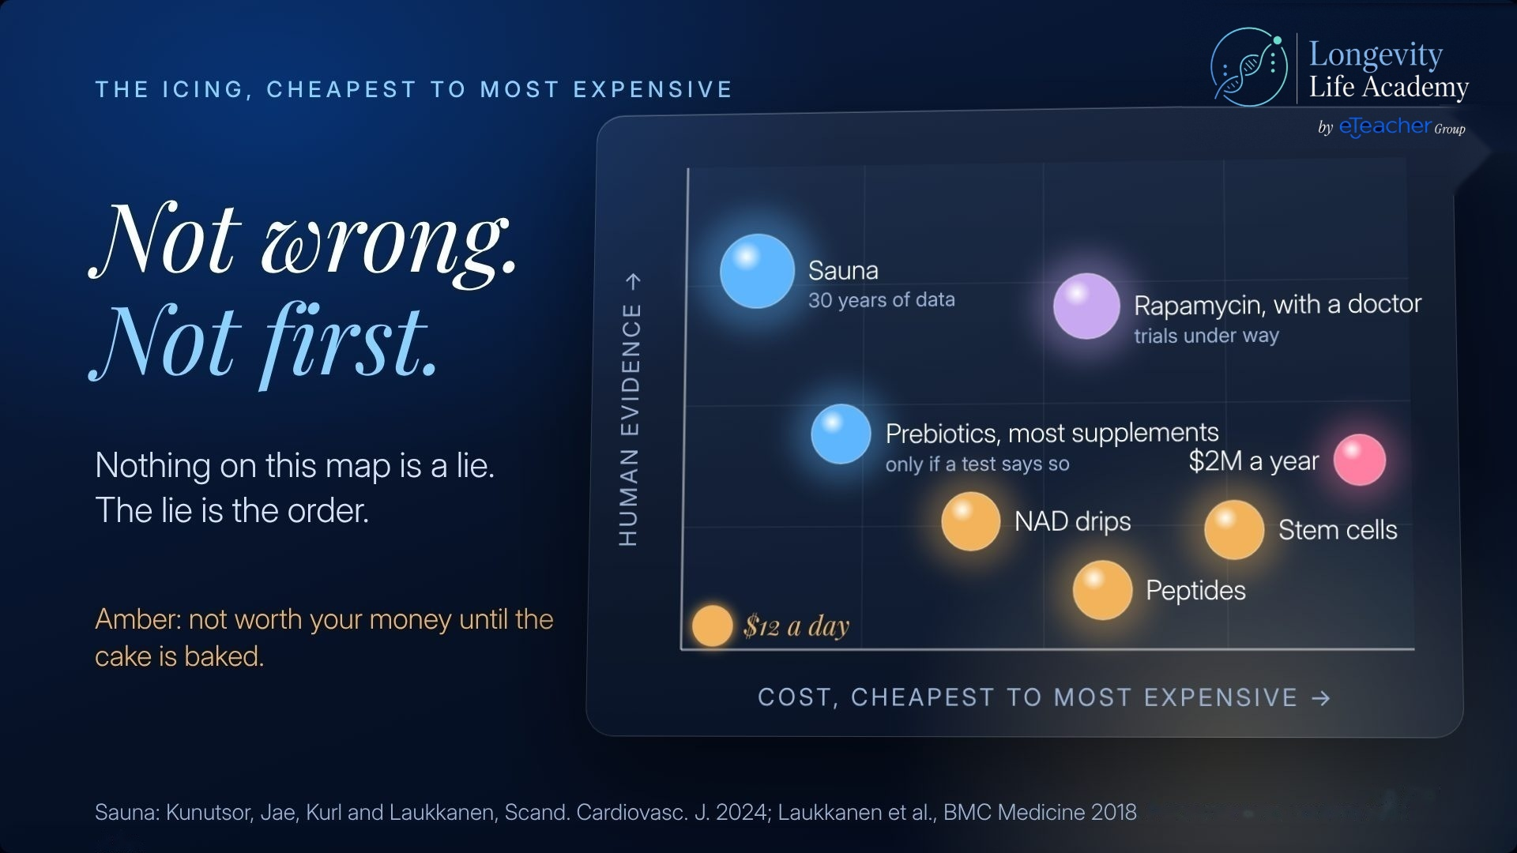
Notes:
Now, Let’s look at that icing.
I know! I just said it’s “the extra” so why are we starting there? Because it's everywhere when you start focusing on longevity. and I’ve observed that it makes people feel like they're behind if they’re not doing it. I want you to be able to RELAX, and know what it is, and how it fits into your longevity lifestyle.
This way, we can focus the rest of our time on what truly matters: that cake.
Here's the whole spectrum on one slide. Affordable on the left: sauna, prebiotics, most supplements.
Then you start spending real money as you move to the right: NAD drips, peptides, stem cells, hyperbaric oxygen therapy, rapamycin. And at the far end, a program that costs about two million dollars a year, requiring a medical team, blood transfusions and much more. You know the one I mean. We’re not going there tonight.
Let me be very clear about where I stand on these things. I'm not saying Don’t. I'm simply saying, Not first. Sleeping well, eating well, moving, and managing stress do most of the work. The therapies can be wonderful additions. But icing on nothing is just a sickening bowl of frosting.

Slide 7
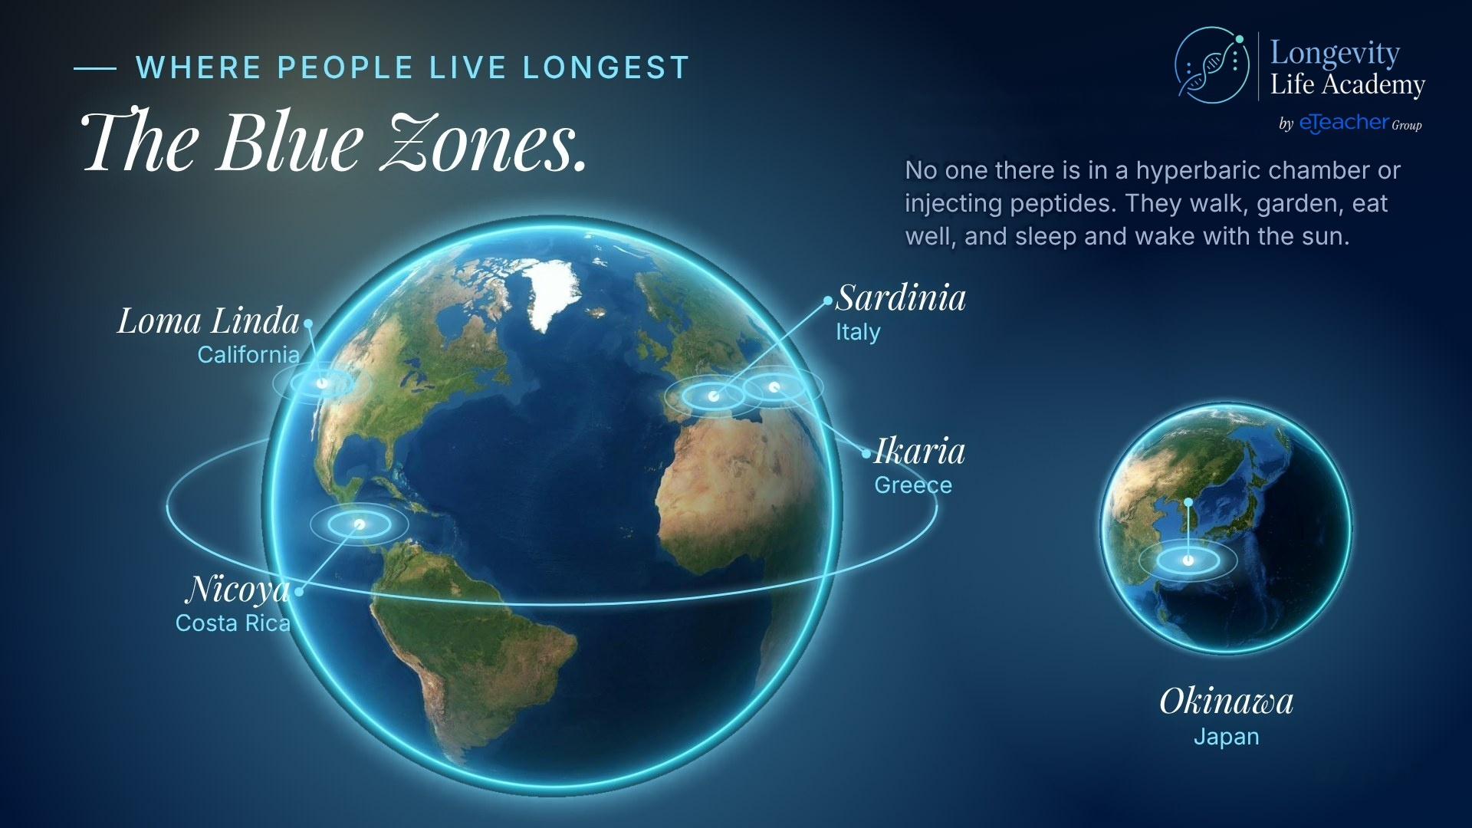
Notes:
I'll tell you how I like to think of this - especially every time I see a new therapy come up on my feed: I think of the Blue Zones, the places on earth where people live longest. And I remind myself - no one there is lying in a hyperbaric chamber or injecting peptides, or even has a gym membership. They're walking, they’re gardening, eating well, sleeping and waking with the sun, and they’re rooted in their communities. So when I look at that icing stuff, I don't feel left out.
I’d advise you to leave a lot of these out of your focus until you have a good handle on sleep, diet, movement and stress management. Notice I didn’t say “perfected” I said “good handle”on the habits. They need to be in place and growing. Not PERFECT.
For the record I do some of these things. I take a longevity supplement combination, And I LOVE the sauna. Its my motivation to get out of bed in the morning. So Again I’m not saying don’t - just not first.

Slide 8
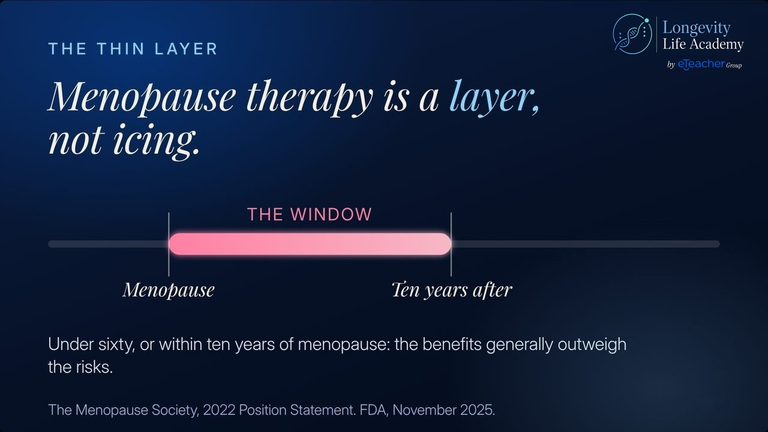
Notes:
Before we get into the main layers, one thing that could get filed under icing by mistake (at least I used to think of it like that): Menopause hormone therapy. For half of this room, menopause will change your sleep, your bones, your mood, your appetite, your energy - even the shape of your body. Sorry.
This period of life changes how well every other layer can do its job. Even with perfect sleep hygiene, it’s nearly impossible to sleep well if you’re hormones are crashing and you’re up with hot flashes. And by the same logic it goes for eating and exercise. If you find you’re doing all the right things but your scale is moving upward, you can’t sleep, or you’re suffering from low energy, please do NOT fool yourself into thinking this is simply an eat less and move more issue.
Please speak with a menopause professional.
Just know many doctors are new to this. The Menopause Society's own position, updated only recently in 2022, and I quote: “for healthy women with symptoms, who are under sixty, or within ten years of menopause, the benefits of hormone therapy generally outweigh any potential risks.” That's their sentence, not mine.
Also in November 2025 the FDA removed the black-box warnings from menopausal hormone therapy.
The only action from this slide is one line: find a doctor (or nurse practitioner) who specializes in hormone therapy and work with them to sort out what’s best for you. I know HRT has been great for me but it’s not been good for my sister. You need to work with someone who understands the latest research, your health history and your hormones.
I have found it very helpful to find a doctor through the Menopause Society. Look for the letters MSCP - meaning they’ve passed a special examine. Do not start taking hormones because you heard it in a webinar by a health influencer. Have a conversation with a knowledgable doctor, and ensure it’s right for you.

Slide 9
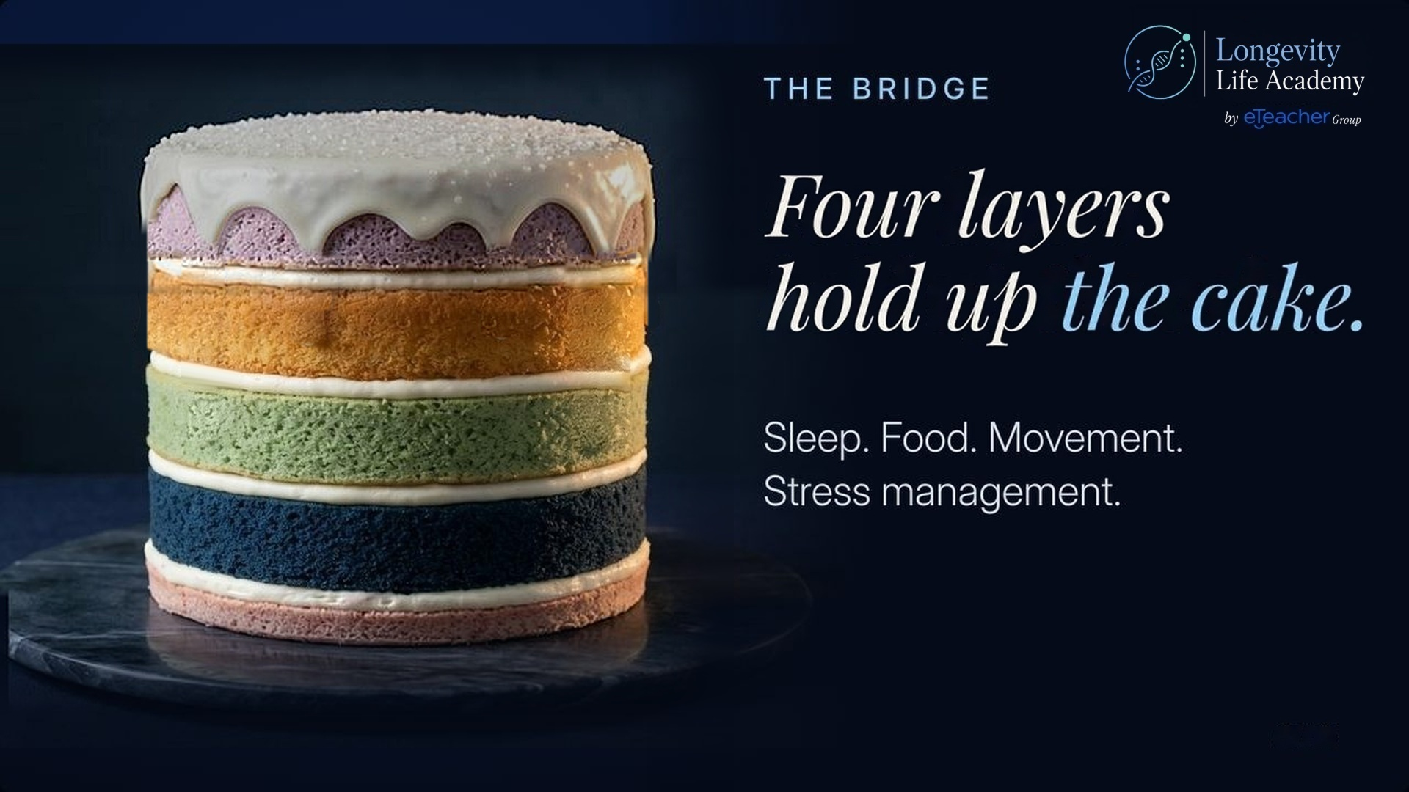
Notes:
Ok! Now with the icing made and the hormone layer discussed, lets move on to the main four layers of the cake: sleep, food, movement, and stress management. Everything in the remainder of the hour is about these very important layers.

Slide 10
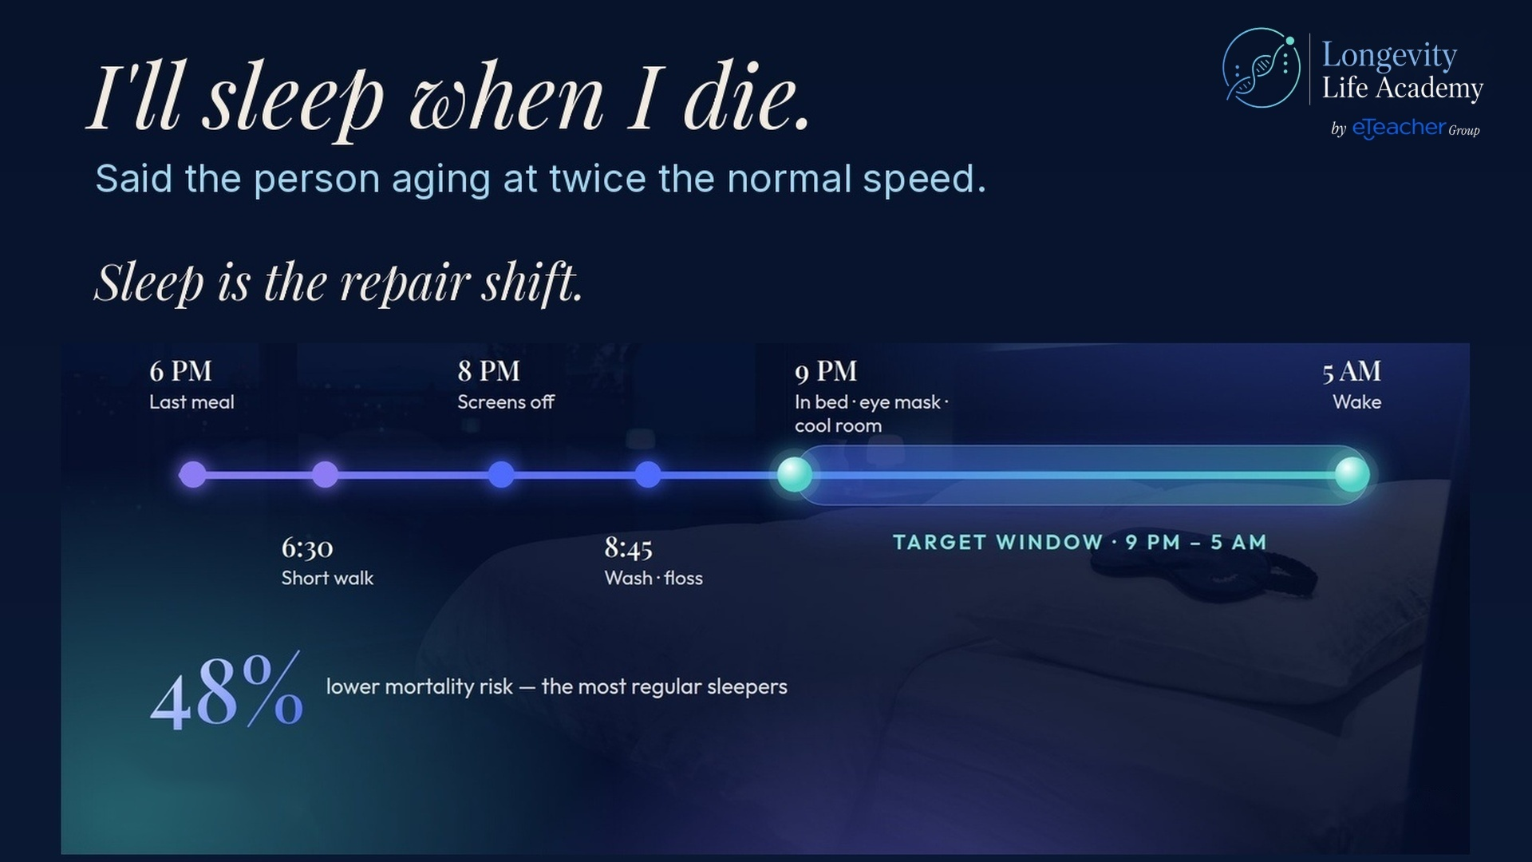
Notes:
First, at the bottom of the cake, SLEEP. I like to think of sleep as the night shift—the time your body rolls up its sleeves and gets to work on maintenance while YOU are busy dreaming.
By the way, that’s not just a poetic metaphor. Our brains actually have a built-in drainage system that flushes out the day's waste, and it mostly runs while we're asleep. In fact, just a couple of years ago, researchers managed to image these microscopic channels in LIVING people for the very first time. They call it the glymphatic system.
Now, before we go ANY further, because I’ve suffered from insomnia before, I don’t want anyone here getting into a middle-of-the-night shame spiral—thinking, “she said I need to sleep and I know I need to sleep but I can’t and now I really can’t because I’m even more stressed about not being able to sleep.” UGH and around and around it goes. I HAVE BEEN THERE
So let’s focus on what we can control: consistent sleep timing and routine.
A landmark 2023 study tracking over 60,000 adults proved that sleep regularity predicts overall health and lifespan even better than sleep duration. The most consistent bedtime sleepers saw up to a 48% drop in mortality risk.
Same bedtime, every single day.
So here are MY rules. I run the same routine nearly every night starting right after dinner: last meal at least three hours before bed, a 10-minute (or more) post-dinner walk most days, screens off one hour before sleep, brush, floss, wash my face, and into bed. I use an eye mask to block out any extra light and keep the room as cool as possible. And I’ve been running that exact same sequence every night for years. Now it’s automatic.
MY target bedtime is 8:30/9 o'clock and wake at 4:30/5. I may not sleep through all eight hours every single night, but I give myself that consistent opportunity. That’s what I can control, and I don’t stress about the nightly waking or anything else.
Now, if you have kids, evening meetings, or a partner who thinks a 9 PM bedtime is a hostage situation— don't panic! Borrow the idea of order and consistency, not my clock. Pick a schedule you can repeat, and build a wind-down routine around it. Consistency and sequence are what work—not forcing my clock onto your life.

Slide 11
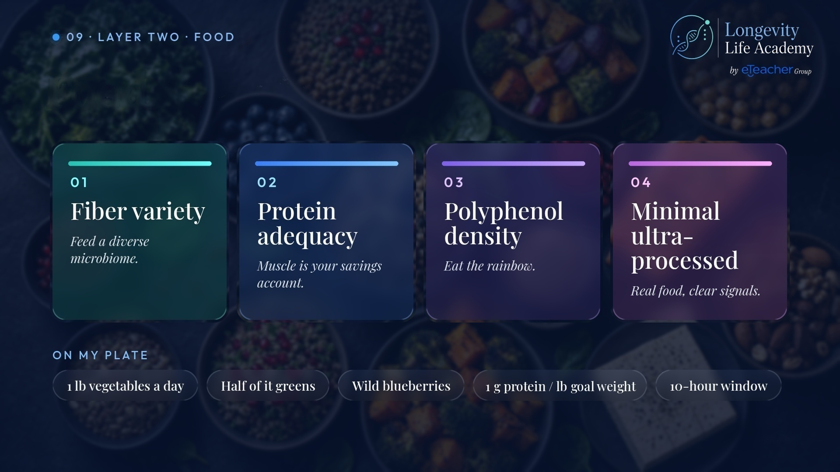
Notes:
I see four universal pillars.
Pillar Number One: Fiber Variety. It’s not just about getting enough fiber—it’s about fiber variety. You don't need to overcomplicate this or count every single bean you eat. It’s the diversity that matters. Studies show that a highly diverse microbiome is one of the clearest biological signatures of healthy aging and longevity. Different plant fibers act as unique fuels, prompting your gut to produce specialized “metabolites” that can quiet systemic inflammation, regulate metabolic health, support immune function, and protect your brain.
Pillar Number Two: Protein Adequacy. As we age, losing muscle mass is one of the single biggest threats to our independence. Our bodies become quicker at breaking down muscle, but far less efficient at building it back up. It's called anabolic resistance. So as we age, we actually need more high-quality protein in a single meal just to trigger the same muscle-building signal we got effortlessly in our twenties.
Muscle isn't just for bodybuilders. Muscle is the physical representation of your longevity savings account.
Prioritizing protein preserves your lean mass, supports immune function, and protects your physical independence as the decades roll on.
Please note, there's an active debate in the longevity space regarding animal versus plant protein—some data suggests plant protein offers unique metabolic advantages, but the science is still evolving. The key takeaway here is to focus on what best supports your body.
Pillar Number Three: Polyphenol & Micronutrient Density. This is the infamous 'eat the rainbow' moniker. And if there is to be any religion in your eating pattern let it be here: ensure you’ve got a variety of deeply colored vegetables, dark berries, leafy greens, extra virgin olive oil, green tea, even coffee in your daily diet. These are much more than just pretty colors. They’re packed with polyphenols that work on every level of your biology.
They trigger your body’s master antioxidant defenses, nourish key gut bacteria to produce restorative metabolites, keep your vascular system flexible, and protect sensitive tissues like your eyes and skin from cellular wear and tear. They are true longevity multi-taskers (and I think, guardian angels )
And Pillar Number Four: Minimize Ultra-Processed Foods. This is about prioritizing real, whole foods over industrial combinations of refined grains, added sugars, and questionable oils. Studies tracking tens of thousands of people show a direct line between high ultra-processed food intake and increased overall mortality.
Just Remember this: Real food gives your body clear signals; processed food just confuses your biology.

Slide 12
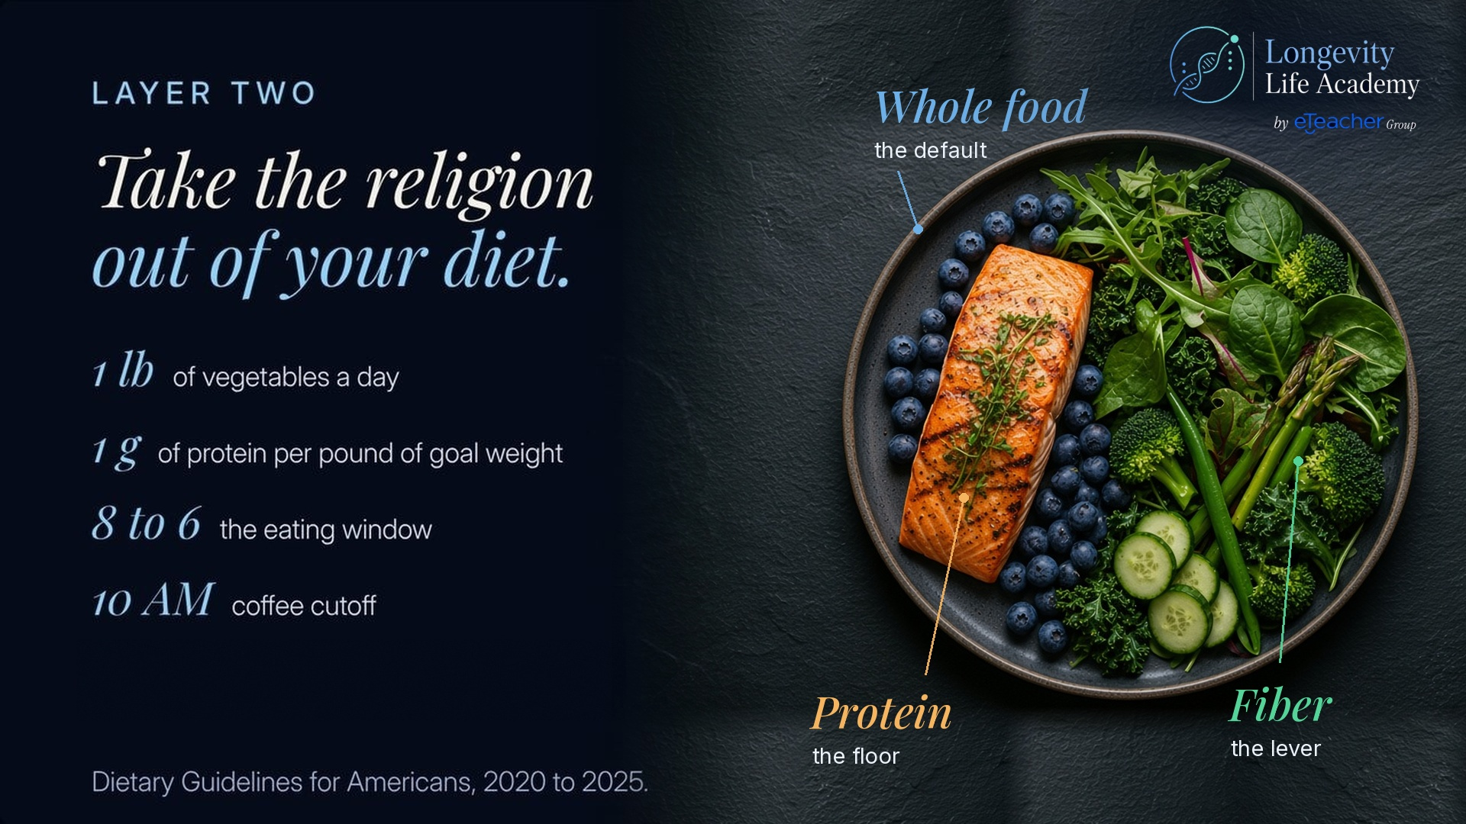
Notes:
Now on to the food layer.
Before we get into any details, I want to take the 'type' of diet completely off the table. Vegan, keto, carnivore, even Mediterranean,… it’s not about the name. I’ve done vegan. I’ve done keto. I've tried SO MANY diets I call them “try-its” now. Here’s what I’ve observed: we need to take the religion out of our diet, and stop arguing over how virtuous we are or are not because we can stick to a predetermined set of dietary commandments laid out on the internet.
Instead, let’s look at what to eat through the lens of what the longevity research says so far.
Now, how could this look in real life? Here is how I’ve resolved getting these pillars into my day-to-day. Just know it took me over a decade to apply all of this: I eat about a pound of vegetables a day—ensuring half of that is greens, and constantly varying the veggies from week to week. I eat wild blueberries or pomegranate seeds every day. I aim for one gram of protein per pound of my lean mass, and I focus more on what I’m adding, not what I’m missing. I eat within an 8-10-hour window, drink green tea, and sometimes coffee.
Please keep this in mind: It took months to put all those veggies in my day. Please start slowly. If you try to jump into a pound of vegetables and high fiber overnight, your gut is going to make you deeply regret that overreach. Please build this out gradually over months.
And to be very clear: most people don't need a doctors permission slip to eat more fruits & vegetables. However, if you're navigating a specific health condition where major dietary shifts could impact your medications (which I know is true for my niece), please coordinate with your doctor first.
Now I want to emphasize something I said: I focus on what I’m ADDING and not what I’m missing. But we need to talk about the elephant in the room…

Slide 13
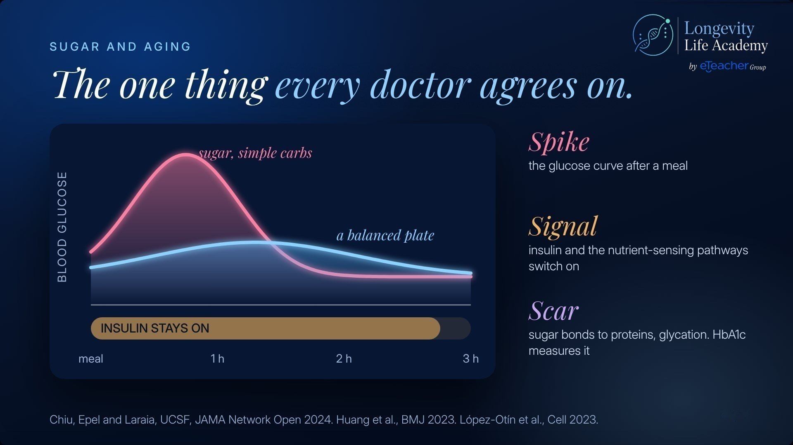
Notes:
Here’s the one thing all doctors agree on: Sugar and glycemic stability.
We just talked a lot about what we need to add to our plates, but when it comes to longevity, what we subtract also matters. Specifically, added sugar and simple carbs.
Here’s the problem it creates in three words: Spike, signal, scar.
A spike is what you see on a glucose monitor after a sugary or simple carb rich meal.
The signal is what that spike triggers in your cells: a flood of insulin. Now, insulin is essential—it’s the key that tells your cells to store energy. And intermittently that is important. But when you eat foods that spike glucose throughout the day, that insulin stays locked on high all day (and night). And now your cells function more like a garage that just keeps getting filled with excess stuff, never getting the good, healthy clean-out it desperately needs.
That chronic over-signaling is actually recognized by longevity scientists as one of the hallmarks of aging.
And then the scar. That’s a part most people don't talk about. Glucose sticks to proteins in a process called glycation.

Slide 14
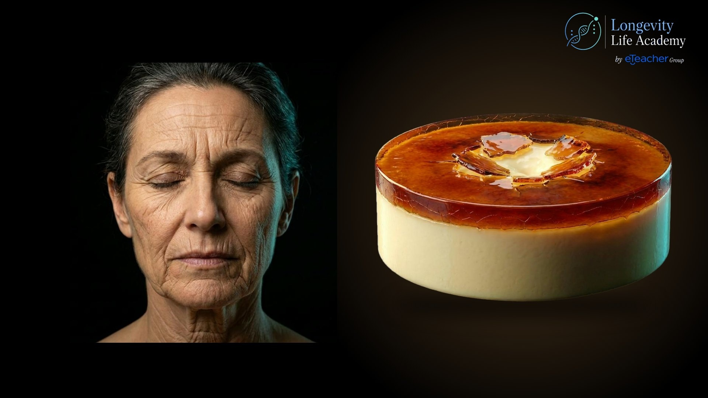
Notes:
In fact, wrinkles are the visible proof of this. Advanced Glycation End-products—literally called AGEs—are what happens when sugar cross-links with the collagen and elastin in your skin, making those proteins stiff and caramelized, much like the crispy top of a crème brûlée.
But if that stiffening is happening on your face - it’s likely happening inside your body as well. The same process is targeting your most delicate micro-vessels and tissues—stiffening your arteries, clouding the lenses of your eyes and wearing down the delicate filters in your kidneys.
There’s a very elegant test for this: HbA1c blood test. It is literally measuring the percentage of sugar stuck to the protein in your blood. It gives you a direct window into this glycation process—allowing you to see it happening before it shows up as permanent damage to your eyes, your kidneys, your arteries or your skin, and giving you the chance to turn the ship around.
Here’s where the data points to a hard ceiling: keep your added sugar to under twenty-five grams a day. That’s roughly six teaspoons
Now lets get real - no one - including me is going to cut sugar out of the rest of your life. NO ONE. I know for me, birthday cake is too precious of a tradition to scrap for watermelon cake. Sorry not gonna happen. But in it’s rightful place - once in a blue moon - it’s ok. To be clear, I’m in no way recommending you add sugar, I’m simply trying to give you a framework that makes this realistic for living and ENJOYING the world we live in.
There’s another tool you can use for this: it’s called a CGM (Continuous Glucose Monitor). And here's another confession from someone who thought she had this figured out. I wore a glucose monitor for four weeks, and I braced for pizza to be the villain. Pizza barely moved my glucose monitor. The thing that spiked it was my healthy greens latte. I’ve been adjusting an futzing ever since.
The point is, you don't know until you look. That's why every student in the Longevity Life Academy will wear a CGM for two weeks. It is VERY insightful!

Slide 15
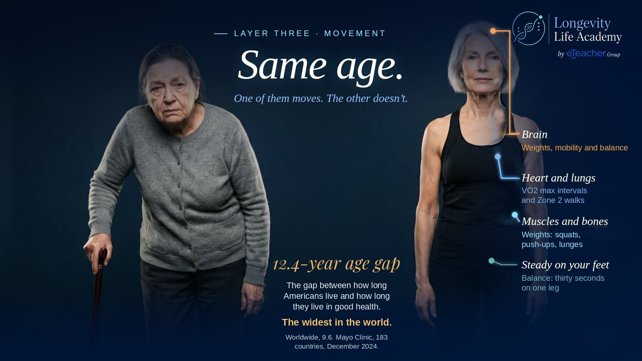
Notes:
Now lets move up to the 3rd layer: movement.
I want to start with one picture of WHY movement matters. Two people, the same age in calendar years. One goes to the ER because she’s twisted her ankle playing pickle ball and the other because she broke her hip and can’t walk any more.
NEW SLIDE
Here’s the study behind the picture. In December 2024, the Mayo Clinic measured the gap between how long people live and how long they live in good health, across 183 countries— putting a number to the years of being here, but not exactly living.
Worldwide, the average is 9.6 years—about a decade of decline. In the United States, it's 12.4 years, the widest gap in the world. Twelve and a half years, on average, at the end, in poor health.
Since I have a front row seat to this right now, let me give you a clear picture of what it looks like: that’s over a decade of being unable to get to the store, or even the bathroom alone; losing the ability to handle emails and even your phone; forgetting important details for everything from how to handle your finances to what’s happening in the lives of your grandchildren; falling in the middle of the night and needing the fire depart come help to get up—and on and on it goes ever downward.
Not everything that happens towards the end is escapable. I’m realistic. But in longevity science, exercise is widely recognized as the SINGLE most powerful intervention we have. Movement impacts nearly every hallmark of aging. The goal isn't just surviving longer; it's compressing our period of decline to almost nothing. And movement is our best defense.
So - what movement you ask?

Slide 16
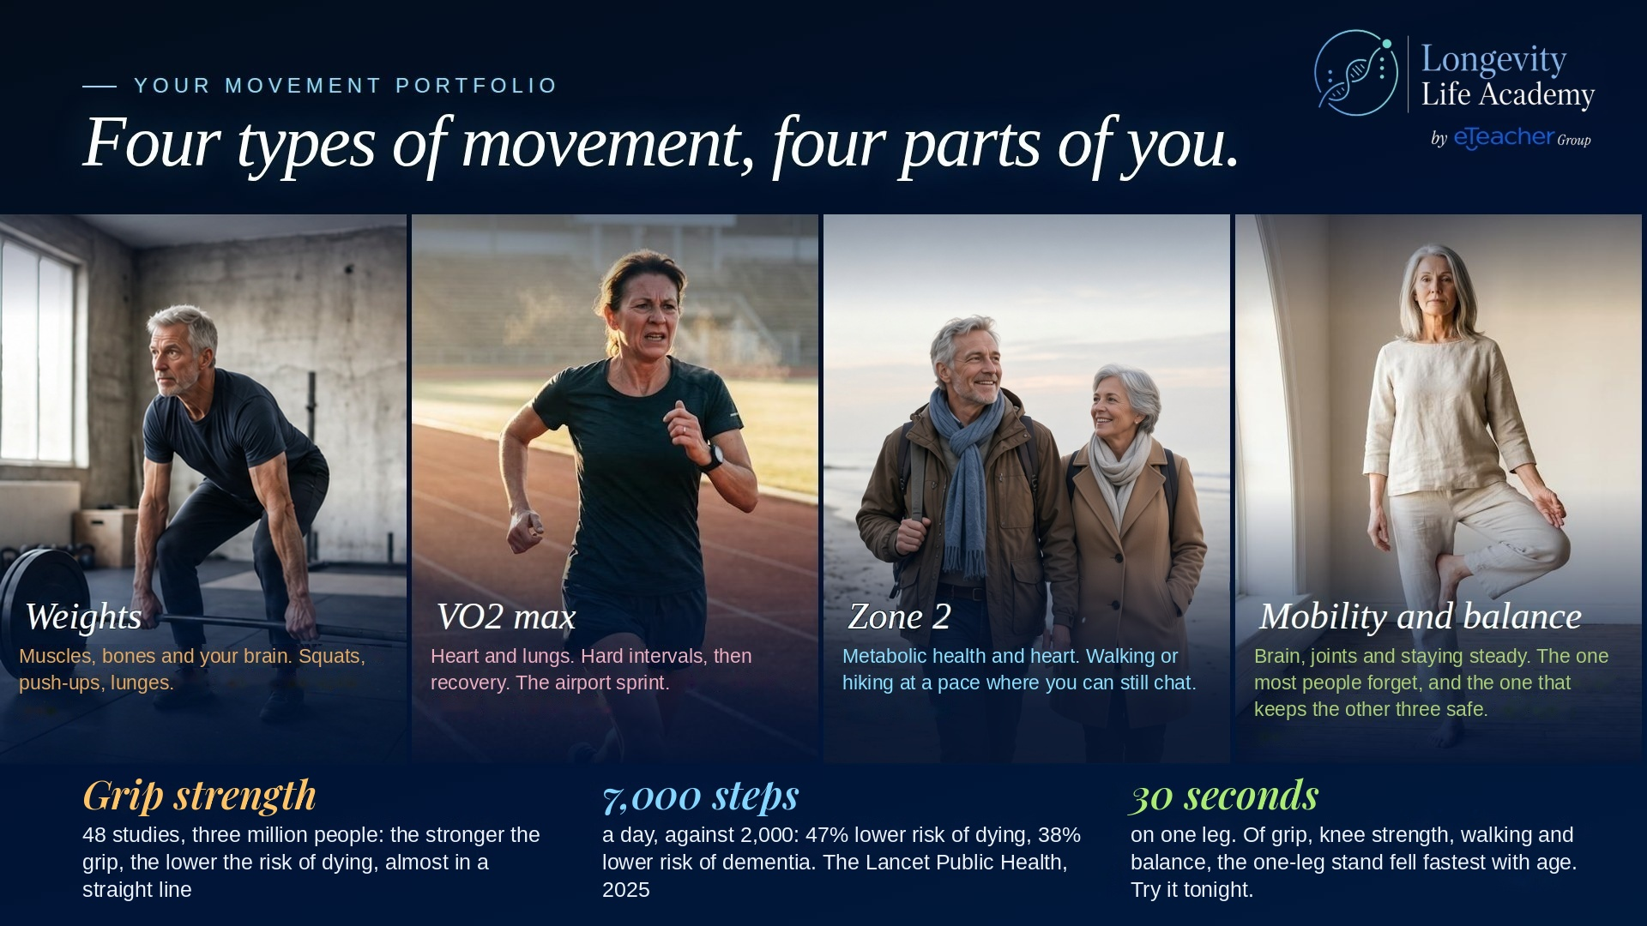
Notes:
Imagine exercise like an investment portfolio. If everything you own is in one stock, you're not diversified - you’re just optimistic—and you better pray a lot. Most people are doing one thing very well and ignoring the rest.
Here are the four areas you should have in your movement portfolio:
First, Resistance training. Making your muscles work against a load. I build mine around compound lifts—movements that use several joints at once, like squats, push-ups, and lunges. Weightlifting is for your muscles, your bones, and increasingly, scientists are realizing it's for your brain, too.
Second, VO2 Max: This is how much oxygen your body can use when you're working hard, and it naturally decreases with age, even if you’re an elite athlete. You train it by doing a set of intense cardio sprints followed by recovery sets. It sounds scary, and I'll admit it's not what gets me out of bed in the morning. But it’s the thing you need when you’re sprinting through the airport to make your connection in Detroit so you can get to Italy as planned. It’s for your heart, your lungs, and your brain.
Third, Zone 2: this Easy cardio at a conversational pace. It's walking or hiking. If you can chat with a friend while you do it, you're doing it right. It’s for your metabolic health and your heart.
And last, mobility and balance: this is Your joints moving through their full range using daily balance training, stretching or yoga. It's the one many forget, myself included. It's for your brain as much as your body, and it's the one that keeps you safe enough to keep doing the other three.
The common failure in the movement block is doing cardio-only or strength-only or yoga only. If you're a runner, add the weights and the mobility. If you're a lifter, add some cardio and some yoga. If your doing yoga - add weights and a vo2max.
Don’t take my word for it—look at the data.
First, grip strength. The stronger your grip, the lower your mortality risk. Period.
Second, steps. Taking 7,000 steps a day instead of 2,000 drops your risk of death by 47% and dementia by 38%. Just 7,000 steps—not 10,000.
And third, balance. Out of all physical markers—knee strength, walking speed, grip—standing on one leg declines fastest as we age, making it one of our clearest indicators of biological age.
Try it tonight. Shoes off, non-dominant leg, target: 30 seconds. Want an added challenge? Close your eyes and see how long you last.

Slide 17
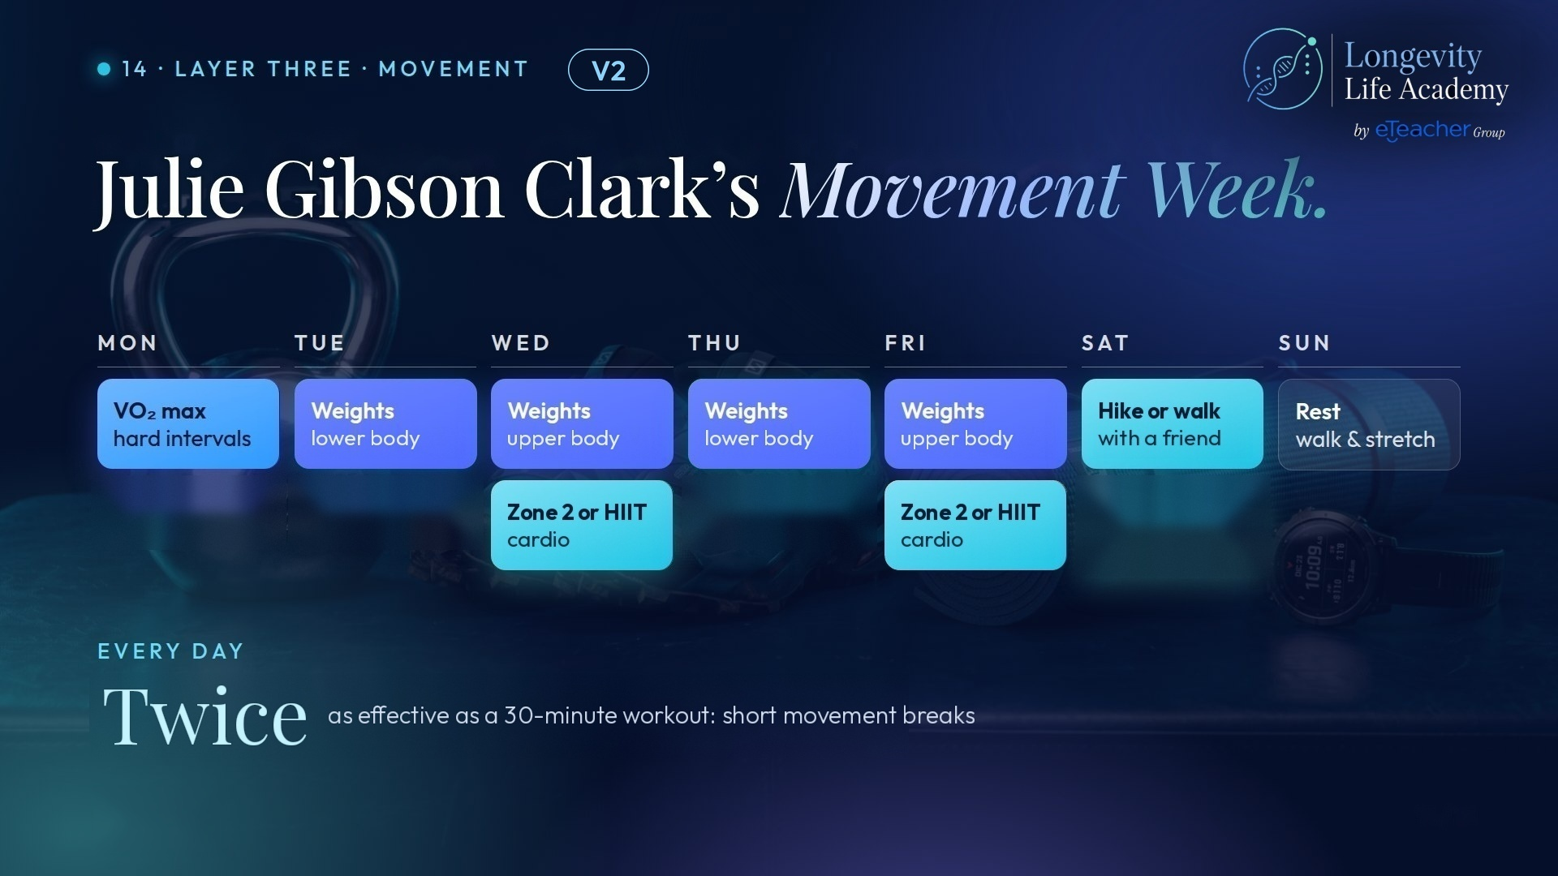
Notes:
Ok that's what my week looks like.
And I know what some of you are thinking: How on earth am I supposed to fit all of this into my life?
Please remember: just like Rome, I didn’t build this schedule in a day. This is twenty-five years of adding, subtracting, and fine-tuning what works for ME. When I’m traveling or under tight deadlines, it looks different. But the core bones are always there. This is just an example of how a diversified portfolio CAN look—not something you need to start tomorrow.
And if any of this feels overwhelming, remember: start small.
In fact, recent research shows that taking brief movement breaks—like one-minute sets of air squats scattered throughout your day—is twice as effective as doing a 30-minute workout and then sitting for the rest of day.
So take a breath. A daily walk and a few squats while your coffee brews is a fantastic place to start.
And of course—if you know you need to clear a new routine with your doctor first, please do so. You know who you are.
The goal isn't perfection on day one. The goal is simply to start moving.

Slide 18
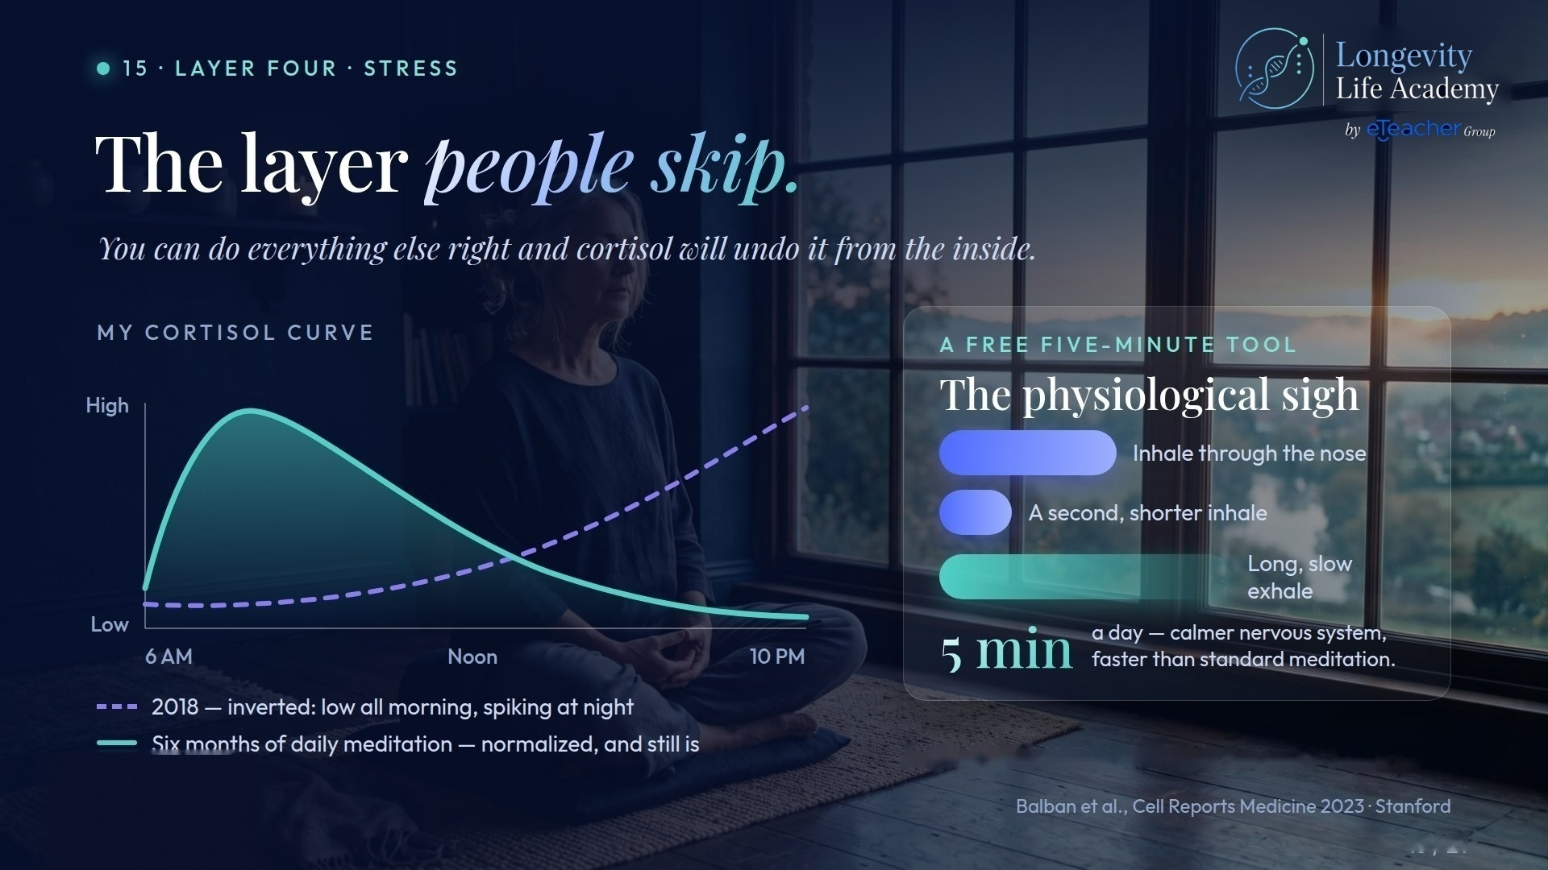
Notes:
The fourth layer is the one almost everyone skips: Stress Management.
I genuinely hate that phrase. It sounds like a mandatory HR seminar. And trying to MANAGE stress usually just creates MORE stress.
But biologically, stress is the ultimate silent saboteur. You can eat the pristine diet, lift all the weights, and hit your 7,000 steps—but if your stress architecture is broken, elevated cortisol will undo that hard work from the inside out.
I learned this the hard way back in 2018 during my divorce. The stress completely inverted my cortisol curve. Cortisol should peak in the morning to wake you up and drop at night so you can repair. Mine was rock-bottom in the morning and spiking at night. I was running on fumes.
Supplements helped temporarily, but I wanted a real fix. I committed to learning Transcendental Meditation. After six months of consistent practice, I retested my cortisol. The curve had completely normalized.
Now—I don't recommend divorce as a stress test—but it gave me undeniable data that meditation works.
TM is just what worked for me. Longevity science shows that breathwork, mindfulness, prayer, or traditional meditation all trigger that same nervous system reset. The best tool is simply the one you’ll actually do consistently.
To get you started, I want you to have a zero-cost, 5 minute tool you can use starting today. I’ve been testing a breathing exercise that has real data to support it’s use. Look for the link in the chat and on follow up emails.

Slide 19
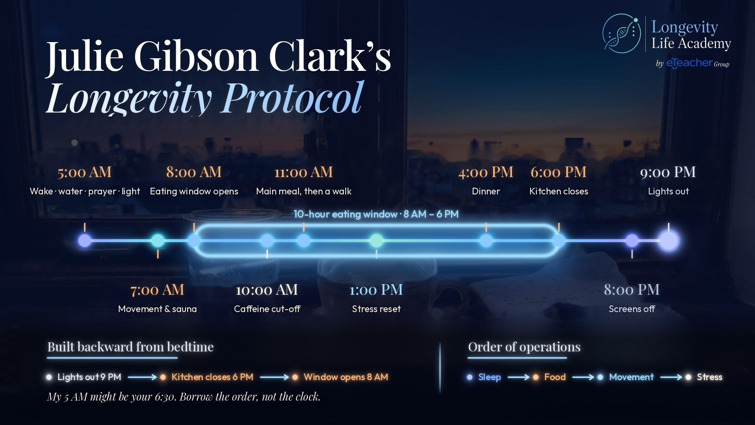
Notes:
Now let's put all four layers together into a single day, so you can see how they fit—and where they fight each other for the exact same hour on the clock.
Here is what my typical weekday schedule looks like:
5:00 AM — Wake, Water, Prayer & Light. Hydration first, then make the bed, tea and prayer, then light in my eyes when I’m on my way to the gym. Note that’s not perfect. Ideally, light should be the first thing, but it’s still dark when I wake up - so I do it when I can.
7:00 AM — Movement & Sauna. Training first, followed by the sauna. Truth bomb: thinking of the sauna is what ACTUALLY gets me out of bed at 5am
8:00 AM — Eating Window Opens. Usually its greens, protein, and berries.
9:00 AM — Caffeine Cut-off. I stop coffee and tea early so it doesn't hijack sleep later. But I’ve very sensitive to caffeine so your cut-off could look different. Most of the evidence I’ve seen says is at least 8-10 hours before bed.
11:00 AM — Main Meal & Walk. My largest meal of the day, followed by a quick walk to manage glucose. (Either on my walking pad at my desk or to the mailbox - 5-10 minutes)
1:00 PM — Stress Reset. Meditate for 20 minutes using my TM mantra
4:00 PM - Make and eat Dinner - usually greens, veggie, and protein
6:00 PM — eating window Closes. My last meal is wrapped up three full hours before bed, and I head out for a walk with calming music.
8:00 PM — Screens Off. The wind-down routine begins.
9:00 PM — Lights Out.
A couple of things to point out here: My eating window runs from 8 to 6—that’s a ten-hour window. And that timing isn't accidental. Constraining your eating window to 10 or less hours significantly improves your blood sugar.
And here's an extra secret from the metabolic data: where you place that window matters too. Studies show that shifting your eating window to earlier in the day—starting with breakfast and skipping meals late into the night—delivers even bigger improvements in insulin sensitivity because it aligns with your body's natural circadian clocks.
Now I realize it’s not always possible because of family dinner commitments. In fact when my son is home, we start dinner closer to 6pm. I’d always prioritize relationships over rules, but I want you to know what’s most effective.
If you step back and look at this schedule, you’ll notice something critical: this entire day is built backward from bedtime.
Lights out at nine dictates meals finished by six. Last meal complete by six sets the start of the eating window at eight. Sleep is the master foundation that decides every other piece of the schedule.
Now, let’s be completely honest. A 5:00 AM wake-up and a 9:00 PM bedtime can be in direct conflict with a real social life. I don't have a magic trick for that. I make choices, and sometimes those other commitments win—like when I’m traveling or out celebrating, and dinner runs until 8:30 PM. On those nights, I enjoy the people I’m with, and then I simply reset the next morning.
What’s transferable here isn't my exact clock—it’s the order of operations.

Slide 20
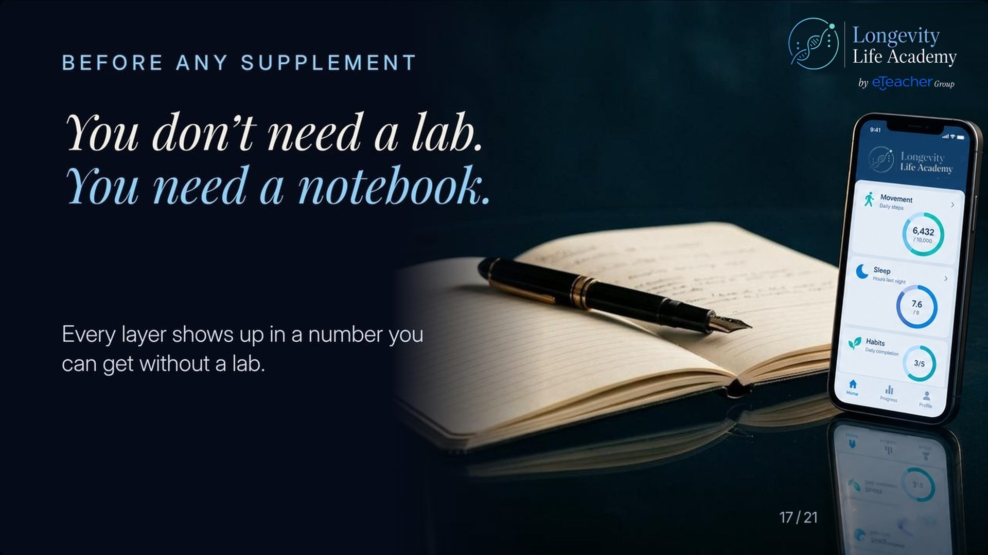
Notes:
People often think tracking your health metrics has to be expensive. It isn't.
Almost every layer of the foundation we’ve talked about today shows up in simple numbers you can measure without dropping a fortune at a high-end lab. A pencil, a basic notebook, and a modest smartwatch or phone will tell you most of what you need to know—your daily steps, your resting heart rate, your sleep duration, and soon - some wearables will give you your blood pressure.
The goal isn't to measure every single variable in your life. The goal is simply to stop guessing.

Slide 21
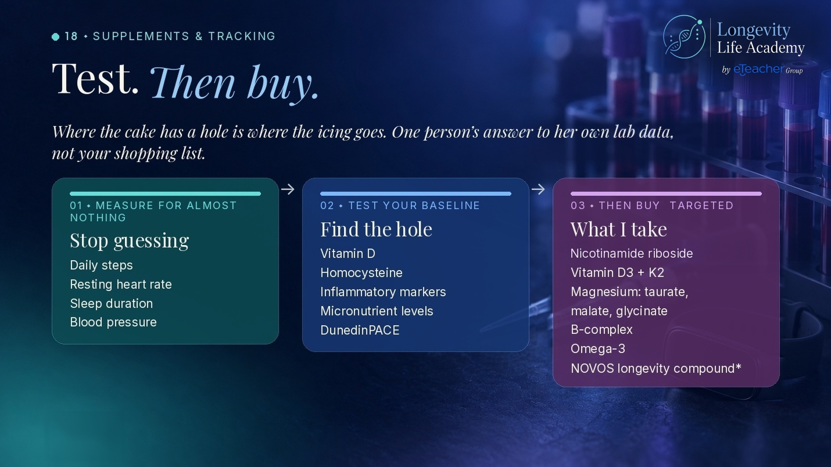
Notes:
Which brings me to supplements.
I’m keeping this section very brief on purpose, because the best supplement advice I can give you is not a recommended list. My stack is tailored strictly to my body, my genetics, and my blood work. Yours should be, too.
Here’s the blood tests I’ve used to learn what might need more of: Vitamin D, homocysteine, inflammatory markers, micronutrient levels and pace of aging. This gives me enough data to create a useful supplement list. It’s all aimed at learning where my longevity cake has a hole so I know where to put the icing.
Here's what I supplement: Nictotinamide riboside; Vitamin d3/k2; magnesium taurate, malate and glycinate; b-complex; omega-3’s; Novos longevity compound

Slide 22
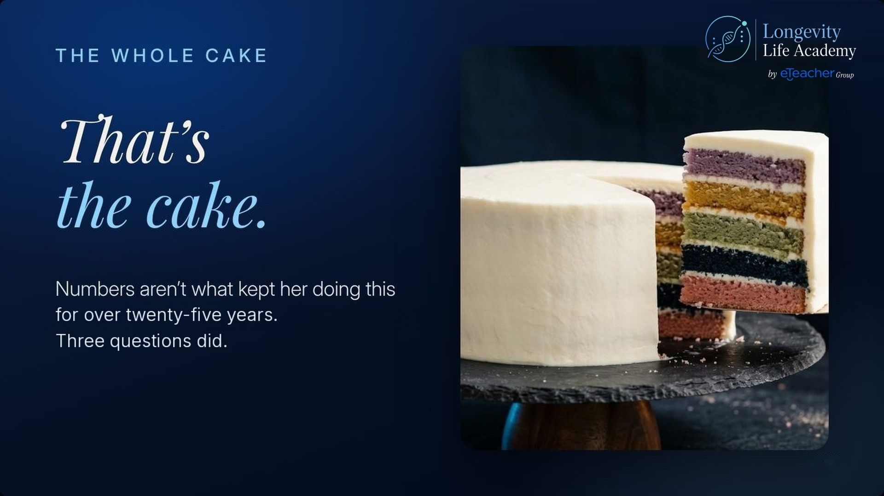
Notes:
That’s the cake.
I’ve given you a lot of information tonight, but I’ll be completely honest with you: all that “knowledge” isn’t what keeps me showing up for over twenty-five years now.

Slide 23
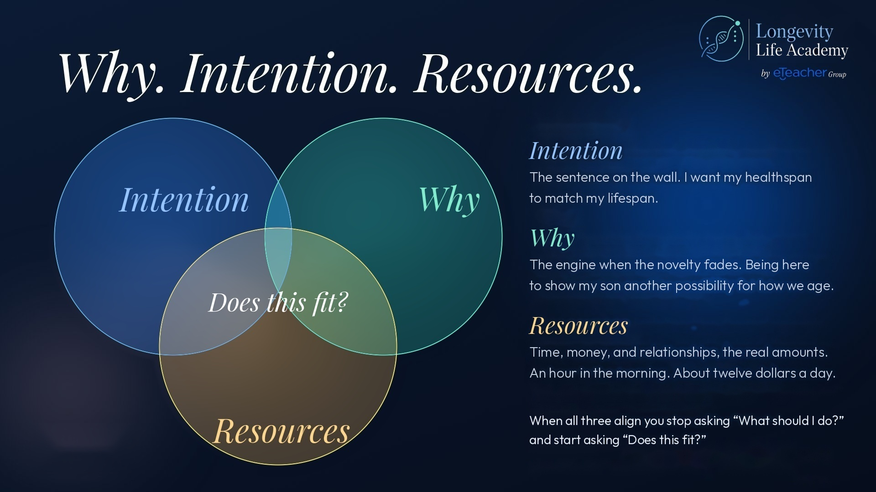
Notes:
Three questions do.
First: What’s my INTENTION? Intention is the big picture. it clearly defines where you're going. Mine is simple: I want my healthspan to match my lifespan. Remember those two lines on the graph we looked at earlier? Modern medicine spends almost all its energy pushing out lifespan. My intention—and what I want for you—is to drag that Healthspan line to meet it. Every single year I’m alive, I want to be as strong and vibrant as possible.
Second: What’s my WHY? If Intention is the destination, your Why is the feeling behind it—the emotional engine that keeps you moving long after the initial novelty wears off. Because let's be honest: after a few months, protocols just become routine. Alarm clocks ring, habits lose their shine, and life gets busy. A strong Why is what keeps you showing up when the excitement fades. For me, that’s the deep emotional blueprint we talked about earlier: being here to show my son a completely different possibility for how we age, and keeping Parkinson’s and dementia as far from my future reality as possible.
Now third: What are my RESOURCES? This is your time, money, and relationships—the real amounts you actually have, not the ones you wish you had. Mine are about an hour in the morning and roughly twelve dollars a day.
Knowing your resources help you filter out all the adverts and influencers that are going to flood your feed the moment you start getting curious about longevity. Don’t have a million-dollar budget? Great. That means you can completely let go of the peptides and stem cell rabbit-holes, and focus squarely on learning what a solid gym routine looks like for you. This knowledge will keep you laser-focused.
Have friends who want to stay healthy too? Leverage that—start a group. Don’t have that circle yet? Then know you’ll need to rely on determination and holding yourSELF accountable.
You get the idea: take stock of what you actually have, and let go of everything that doesn't overlap with your reality. Resources set the pace.
When they all align—knowing your Intention, your Why, and your Resources—you stop asking 'What should I do?' and start asking 'Does this fit?' And for me a sauna session fits. A 9:00 PM bedtime fits. That isn't willpower or strict discipline. That's three honest questions steering my focus every day.

Slide 24
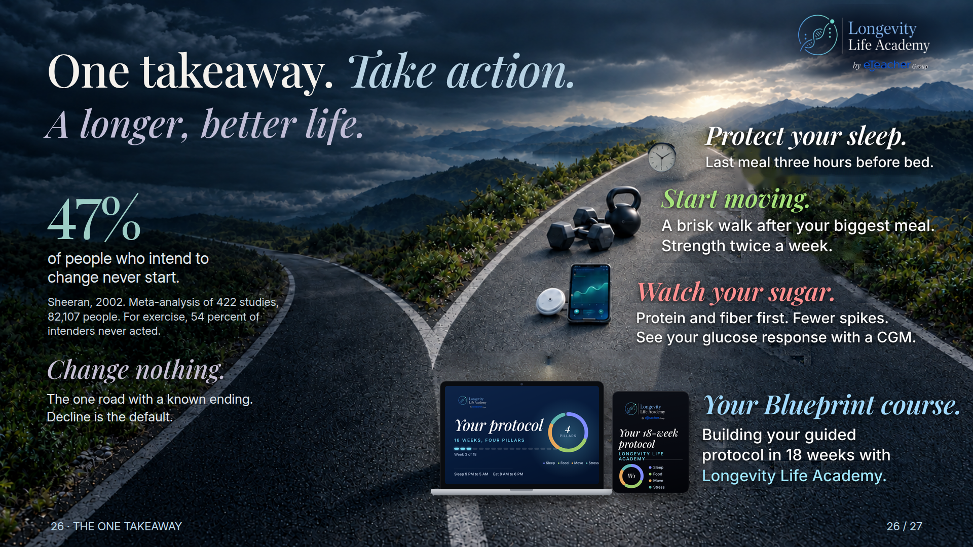
Notes:
Thank you so much for hanging in there with me today. I know sitting through a full hour of an engineer talking about cellular aging takes real endurance, so I truly appreciate your time.
But I want to leave you with one final thought.
I came across a statistic recently that blew me away: the percentage of people who actually take action after watching a presentation like this is painfully small. Frankly, that breaks my heart. I didn't spend the last 25 years running experiments on myself just to share neat trivia—I want this to actually change your life.
So I’m going to ask you for one more favor. (Pause, warm smile) I know, I know—asking for another favor after making you listen to me drone on for an hour is a lot. But hear me out:
I am begging you to pick just ONE thing today and take action.
It doesn't have to be massive. Commit to a 5-minute movement break. Add one green vegetable to dinner. Track your sleep, monitor your glucose, or sign up for our Academy class.
Tiny, consistent steps are all it takes to shift your biological trajectory. Because at the end of the day, my ultimate goal is simple: I want a whole lot of friends around when I’m 90 and still going strong. Let's do this together.

