Slide 1
LONGEVITY LIFE ACADEMY
Press Launch
Live Coverage
6
OUTLETS LIVE
Sixth online school from eTeacher Group. Six outlets live today. Two more queued.
DATELINE
PUBLIC CONTACT
DATE
STATUS
Miami, FL
Harel Tayeb, CEO
Jul 19–20, 2026
All Live · HTTP 200

Slide 2
The footprint
Six press outlets live · one media kit · two paid outlets in review
6
3
1
LIVE OUTLETS
ARTICLES ROTATED
PUBLIC KIT
HTTP 200 · content clean
Flagship · Business · Consumer
gitteromri-ux.github.io/lla-pr-kit
Live coverage roster
PR.com
BUSINESS
LIVE
PRUrgent
BUSINESS
LIVE
PRLog
BUSINESS
LIVE
IssueWire
FLAGSHIP
LIVE
PRFree
CONSUMER
LIVE
MarketPressRelease
CONSUMER
LIVE
1888 Press Release
FLAGSHIP
QUEUED
EIN Presswire
FLAGSHIP
QUEUED
LONGEVITY LIFE ACADEMY · PR LAUNCH · JUL 2026
2 / 11

Slide 3

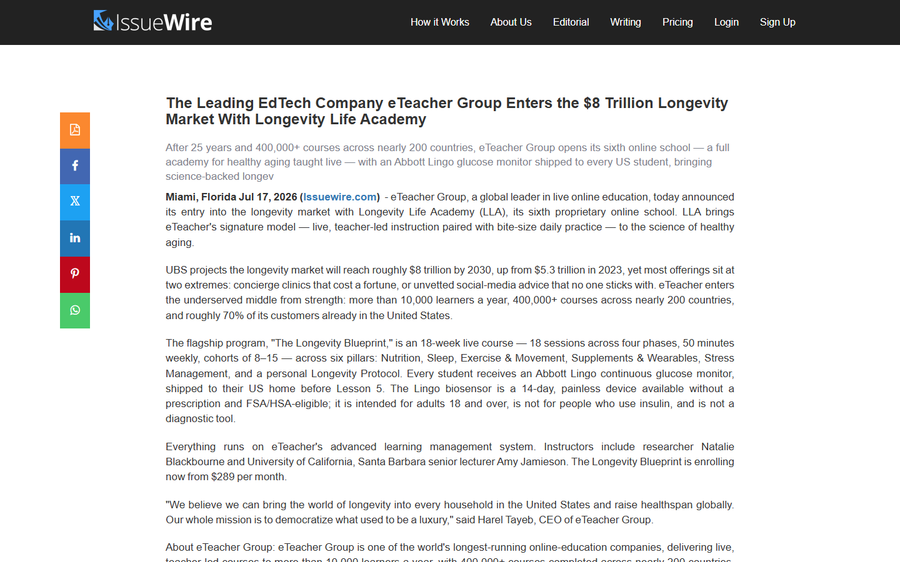
OUTLET · 01 OF 08
IssueWire
FLAGSHIP ARTICLE · ARTICLE 1
LIVE
The Leading EdTech Company eTeacher Group Enters the $8 Trillion Longevity Market With Longevity Life Academy
issuewire.com/the-leading-edtech-company-eteacher-group-enters-the-8-trillion-longevity-market...
The full launch story. After 25 years and 400,000+ courses across nearly 200 countries, eTeacher Group opens its sixth online school — a live, teacher-led academy for healthy aging, with an Abbott Lingo continuous glucose monitor shipped to every US student before Lesson 5. UBS projects the longevity market will reach roughly $8 trillion by 2030. LLA occupies the middle ground between concierge clinics and unvetted online advice — with the same live cohort model that helped 10,000+ learners a year finish what they started.
DATELINE
Miami, FL
CONTACT
Harel Tayeb, CEO
ARTICLE
Flagship — $8T Longevity Market
STATUS
Live · HTTP 200
Open live article: issuewire.com/the-leading-edtech-company-eteacher-group-enters-the-8-trillion-longevity-market...
LONGEVITY LIFE ACADEMY · PR LAUNCH · JUL 2026
3 / 11

Slide 4

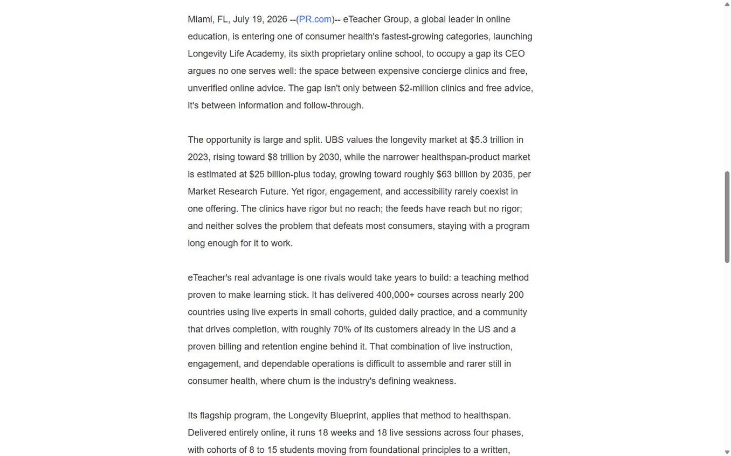
OUTLET · 02 OF 08
PR.com
BUSINESS ANGLE · ARTICLE 2
LIVE
eTeacher Group Launches Longevity Life Academy to Open the $8 Trillion Longevity Market to Everyday Americans
pr.com/press-release/973819
The business angle. Between $2-million concierge clinics and free unverified advice sits the mainstream American household no one serves well. eTeacher's edge isn't a lower price — it's a global-leading teaching engine now brought to healthspan, from $289 a month. Roughly 70% of eTeacher's customers are already in the US, with a proven billing and retention engine behind every school. Distributed to PR.com's syndication network with a full company profile page.
DATELINE
Miami, FL
CONTACT
Harel Tayeb, CEO
ARTICLE
Business — Open the Market
STATUS
Live · HTTP 200
Open live article: pr.com/press-release/973819
LONGEVITY LIFE ACADEMY · PR LAUNCH · JUL 2026
4 / 11

Slide 5


OUTLET · 03 OF 08
PRUrgent
BUSINESS ANGLE · ARTICLE 2
LIVE
eTeacher Group Launches Longevity Life Academy to Open the $8 Trillion Longevity Market to Everyday Americans
prurgent.com/2026-07-19/pressrelease476632.htm
PRUrgent picked up the business angle within hours. Miami dateline retained. Full boilerplate with Harel Tayeb, CEO of eTeacher Group as public contact. Direct syndication to PRUrgent's newsroom feed plus permanent archive at the pressrelease476632 permalink — indexed by Google within the same day.
DATELINE
Miami, FL
CONTACT
Harel Tayeb, CEO
ARTICLE
Business — Open the Market
STATUS
Live · HTTP 200
Open live article: prurgent.com/2026-07-19/pressrelease476632.htm
LONGEVITY LIFE ACADEMY · PR LAUNCH · JUL 2026
5 / 11

Slide 6


OUTLET · 04 OF 08
PRLog
BUSINESS ANGLE · ARTICLE 2
LIVE
eTeacher Group Launches Longevity Life Academy to Open the $8 Trillion Market to Everyday Americans
prlog.org/13159273-eteacher-group-launches-longevity-life-academy...
Clean replacement release. The original PRLog draft (13158509) contained legacy language that has since been eliminated across all channels — we removed it entirely and republished as 13159273 with the approved business article, correct sixth-school framing, Miami dateline, and Harel Tayeb as public contact. Full article body, tags, and pressroom entry all indexed.
DATELINE
Miami, FL
CONTACT
Harel Tayeb, CEO
ARTICLE
Business — Open the Market
STATUS
Live · HTTP 200
Open live article: prlog.org/13159273-eteacher-group-launches-longevity-life-academy...
LONGEVITY LIFE ACADEMY · PR LAUNCH · JUL 2026
6 / 11

Slide 7

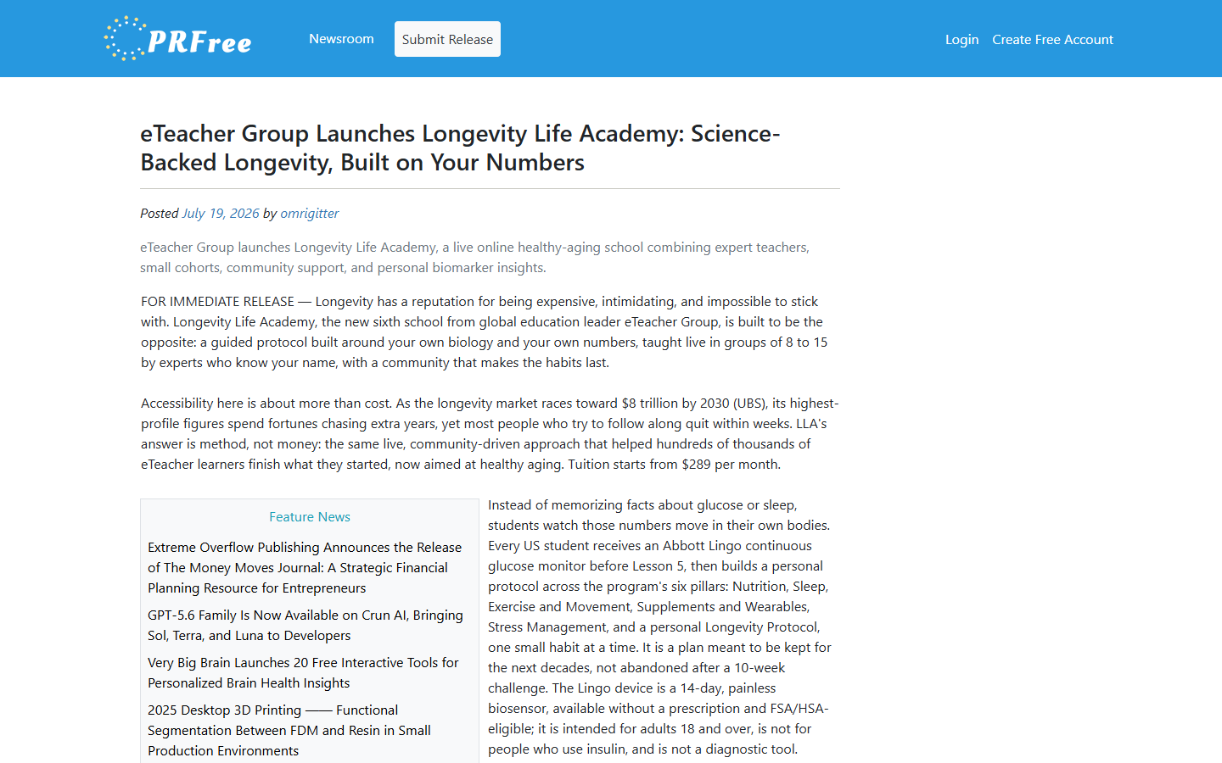
OUTLET · 05 OF 08
PRFree
CONSUMER ANGLE · ARTICLE 3
LIVE
eTeacher Group Launches Longevity Life Academy: Science-Backed Longevity, Built on Your Numbers
news.prfree.org/@omrigitter/eteacher-group-launches-longevity-life-academy...
The consumer-facing story. Longevity has a reputation for being expensive, intimidating, and impossible to stick with. LLA's answer is method, not money — the same live, community-driven approach that helped hundreds of thousands of eTeacher learners finish what they started, now aimed at healthy aging. Tuition from $289/month. Continuous glucose monitor included. Published under the @omrigitter author profile on news.prfree.org.
DATELINE
Miami, FL
CONTACT
Harel Tayeb, CEO
ARTICLE
Consumer — Built on Your Numbers
STATUS
Live · HTTP 200
Open live article: news.prfree.org/@omrigitter/eteacher-group-launches-longevity-life-academy...
LONGEVITY LIFE ACADEMY · PR LAUNCH · JUL 2026
7 / 11

Slide 8

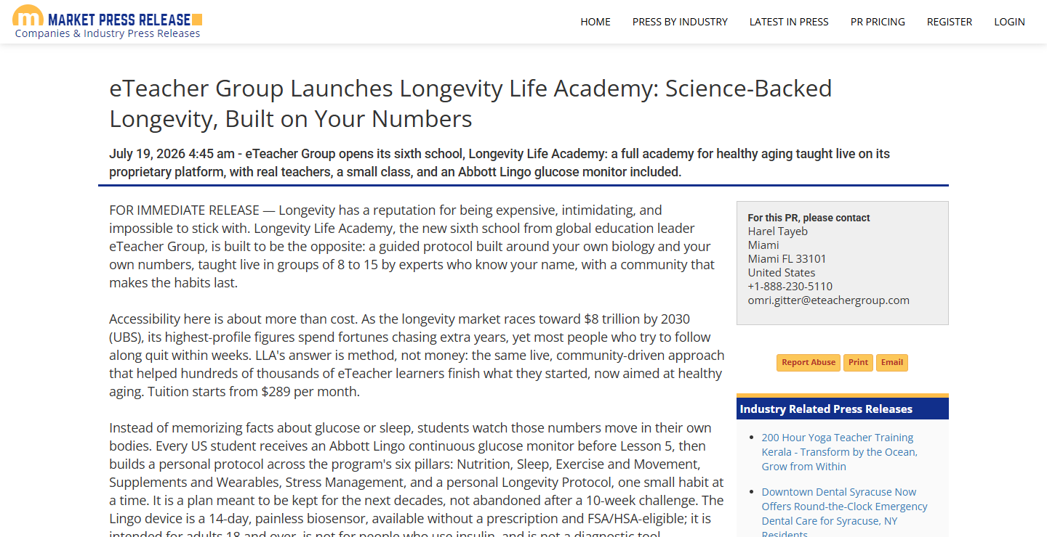
OUTLET · 06 OF 08
MarketPressRelease
CONSUMER ANGLE · ARTICLE 3
LIVE
eTeacher Group Launches Longevity Life Academy: Science-Backed Longevity, Built on Your Numbers
marketpressrelease.com/eTeacher-Group-Launches-Longevity-Life-Academy...
Newly moderated through this morning. Featured directly on the MarketPressRelease homepage under the July 19 tile. Full article body, contact block with Harel Tayeb / Miami / +1-888-230-5110, and industry-related sidebar cross-linking. Sixth-school framing appears six times in the body — clean throughout.
DATELINE
Miami, FL
CONTACT
Harel Tayeb, CEO
ARTICLE
Consumer — Built on Your Numbers
STATUS
Live · HTTP 200
Open live article: marketpressrelease.com/eTeacher-Group-Launches-Longevity-Life-Academy...
LONGEVITY LIFE ACADEMY · PR LAUNCH · JUL 2026
8 / 11

Slide 9


OUTLET · 07 OF 08
1888 Press Release
FLAGSHIP ARTICLE · ARTICLE 1
QUEUED
eTeacher Group Enters the $8 Trillion Longevity Market With Longevity Life Academy
1888pressrelease.com · PR ID 769318 · scheduled Jul 20
Submitted and accepted into 1888's FREE distribution queue as PR ID 769318, scheduled to release on Jul 20. The 1888 free tier goes live on a rolling review cycle — expected public URL will appear on the 1888pressrelease.com feed and permanent archive within the release window. Full flagship article with all approved language, Miami dateline, and Harel Tayeb / eTeacher Group as public contact.
DATELINE
Miami, FL
CONTACT
Harel Tayeb, CEO
ARTICLE
Flagship — $8T Longevity Market
STATUS
PR ID 769318 · Scheduled Jul 20
Outlet destination: 1888pressrelease.com · PR ID 769318 · scheduled Jul 20
LONGEVITY LIFE ACADEMY · PR LAUNCH · JUL 2026
9 / 11

Slide 10


OUTLET · 08 OF 08
EIN Presswire
FLAGSHIP ARTICLE · ARTICLE 1
QUEUED
eTeacher Group Enters the $8 Trillion Longevity Market With Longevity Life Academy
einpresswire.com · paid tier · editorial review
EIN Presswire is a paid tier and syndicates to Google News, AP News, USA TODAY Network, and 100+ NBC, FOX, ABC & CBS affiliates. Submission accepted and currently in EIN's editorial review queue. When approved, the release will syndicate broadly — the highest-reach outlet in this launch. Full flagship article submitted with Miami dateline and Harel Tayeb / eTeacher Group public contact.
DATELINE
Miami, FL
CONTACT
Harel Tayeb, CEO
ARTICLE
Flagship — $8T Longevity Market
STATUS
Paid tier · Editorial review
Outlet destination: einpresswire.com · paid tier · editorial review
LONGEVITY LIFE ACADEMY · PR LAUNCH · JUL 2026
10 / 11

Slide 11

MEDIA KIT
One kit. All the assets journalists need.
Logos · press releases · executive bio · fact sheet · high-res product visuals — hosted at a public URL that any reporter can open without a login.
LIVE MEDIA KIT
gitteromri-ux.github.io/lla-pr-kit
GitHub Pages
Hosted static kit
Commit c8880e6 · sanitized · HTTPS · zero login required
TOTAL LIVE
ARTICLES ROTATED
BANNED-TERM AUDIT
QUEUED PIPELINE
6 outlets + 1 kit
3 / 3 in the wild
PASSED (all outlets)
1888 · EIN Presswire
LONGEVITY LIFE ACADEMY · PR LAUNCH · JUL 2026
11 / 11

