Slide 1
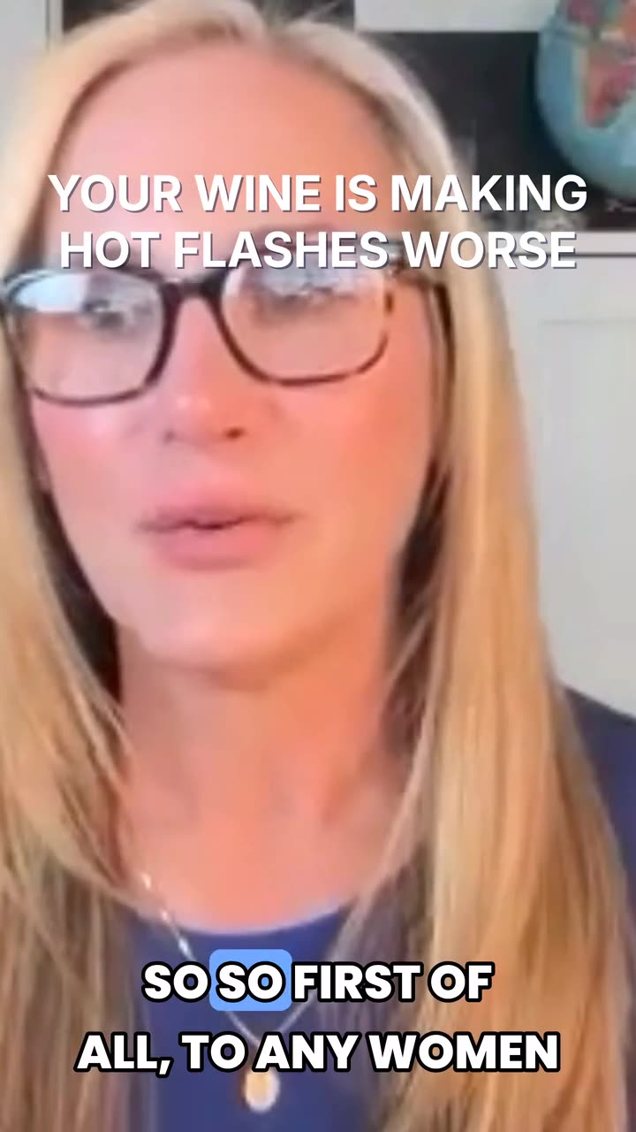
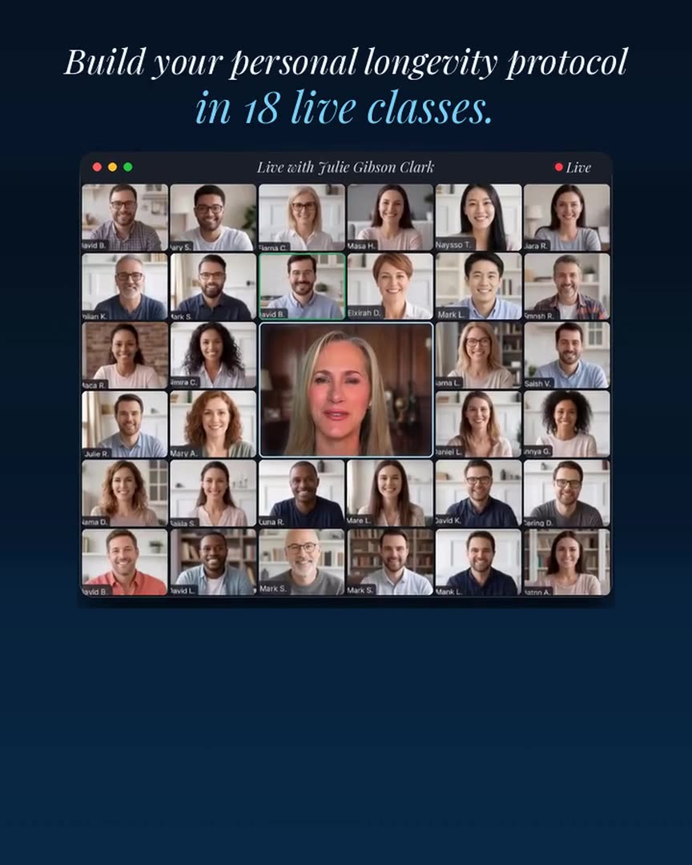
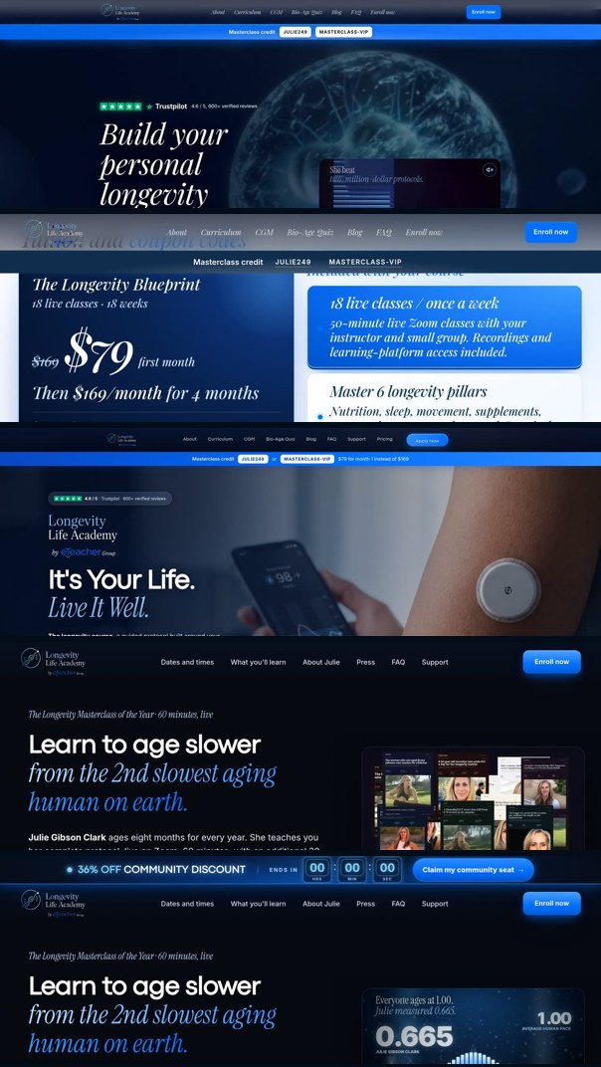
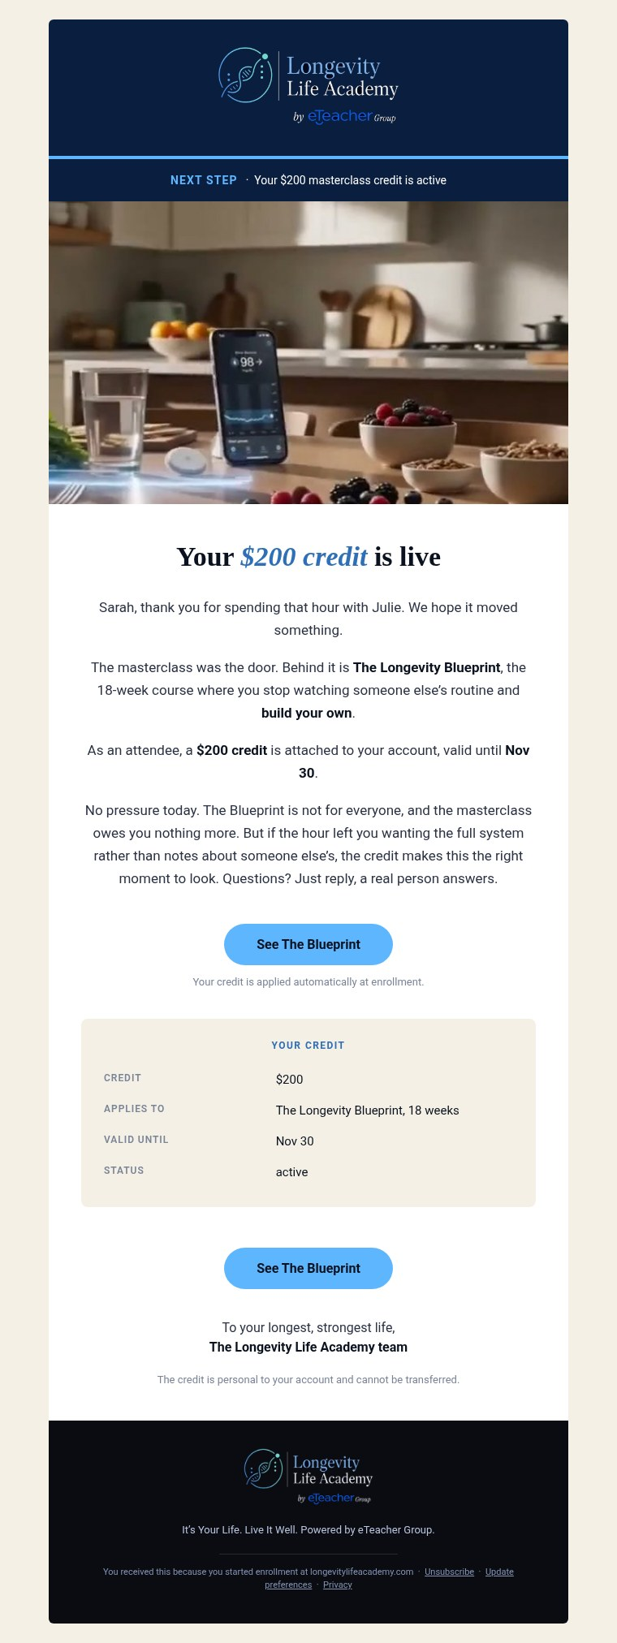
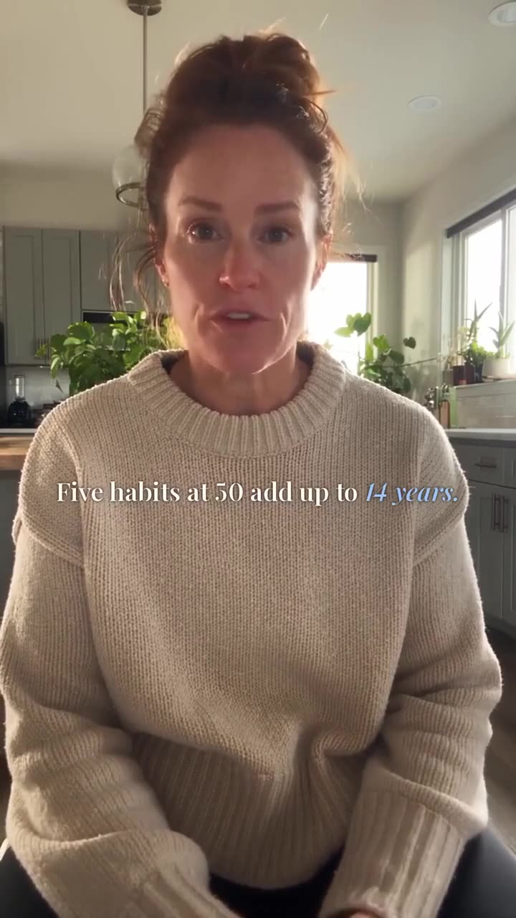
01 LONGEVITY LIFE ACADEMY, COMPANY MEETING.
What we built in Longevity.
Five pieces that work as one system.
212 paid orders
$79 to start
5 web pages
37 emails
22 new videos
212 paid orders, ActiveCampaign, 16 Sep to 2 Nov. $79 month one from pages.dev.

Slide 2
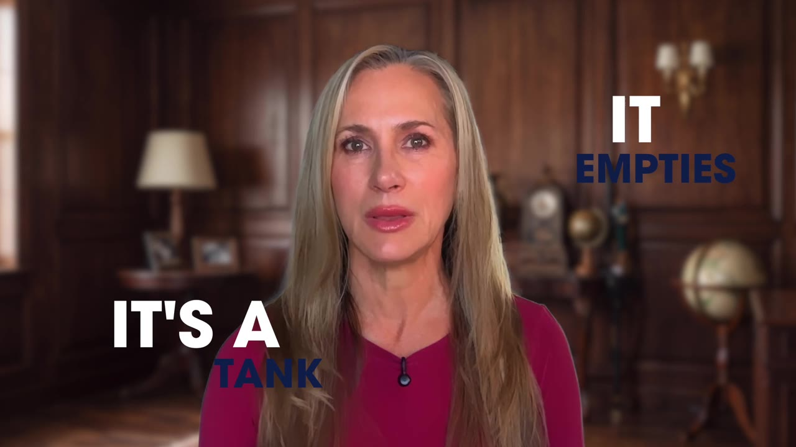
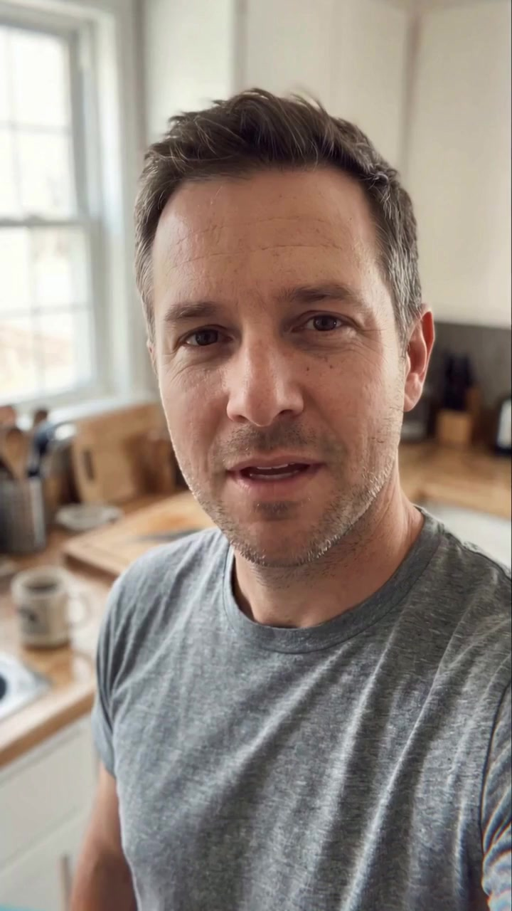
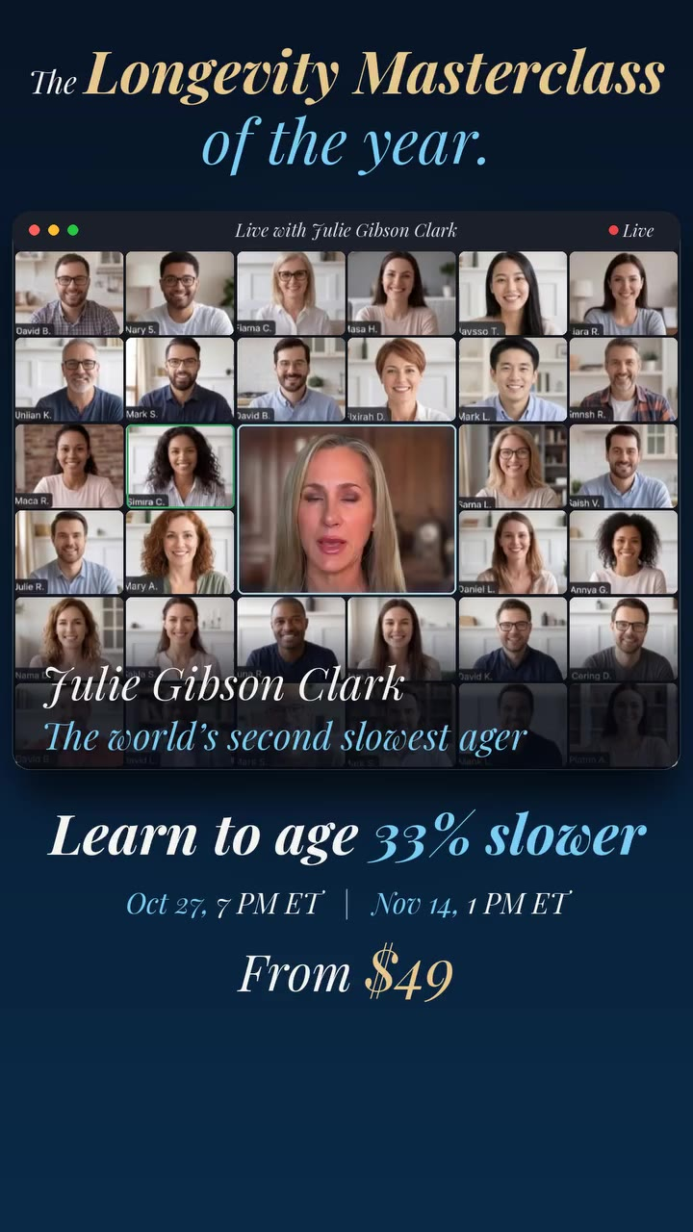
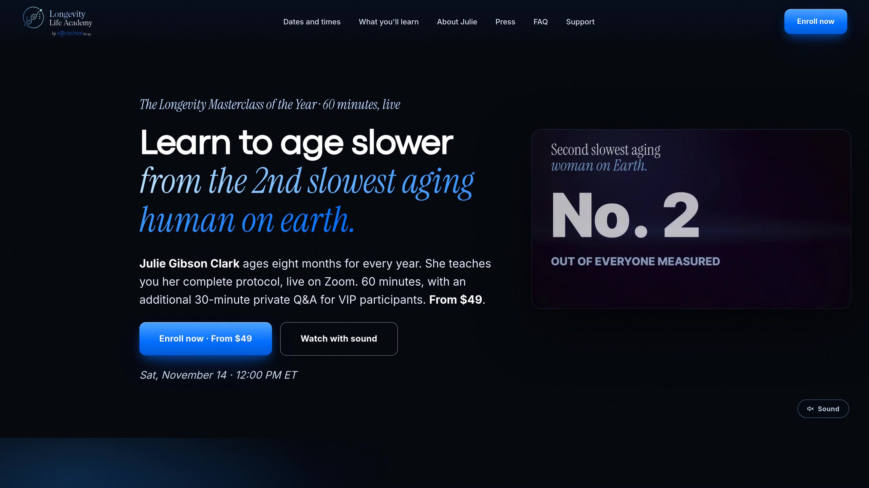
02 MASTERCLASS
OCT 27 AND NOV 14.
Learn to age slower with the second slowest aging woman on earth, Julie Gibson Clark. Longevity Life Academy Founding Faculty.
90 min VIP session with live Q&A.
Zoom grid, Julie Masterclass film, Masterclass site, man UGC, blue age 33% slower Meta reel.

Slide 3
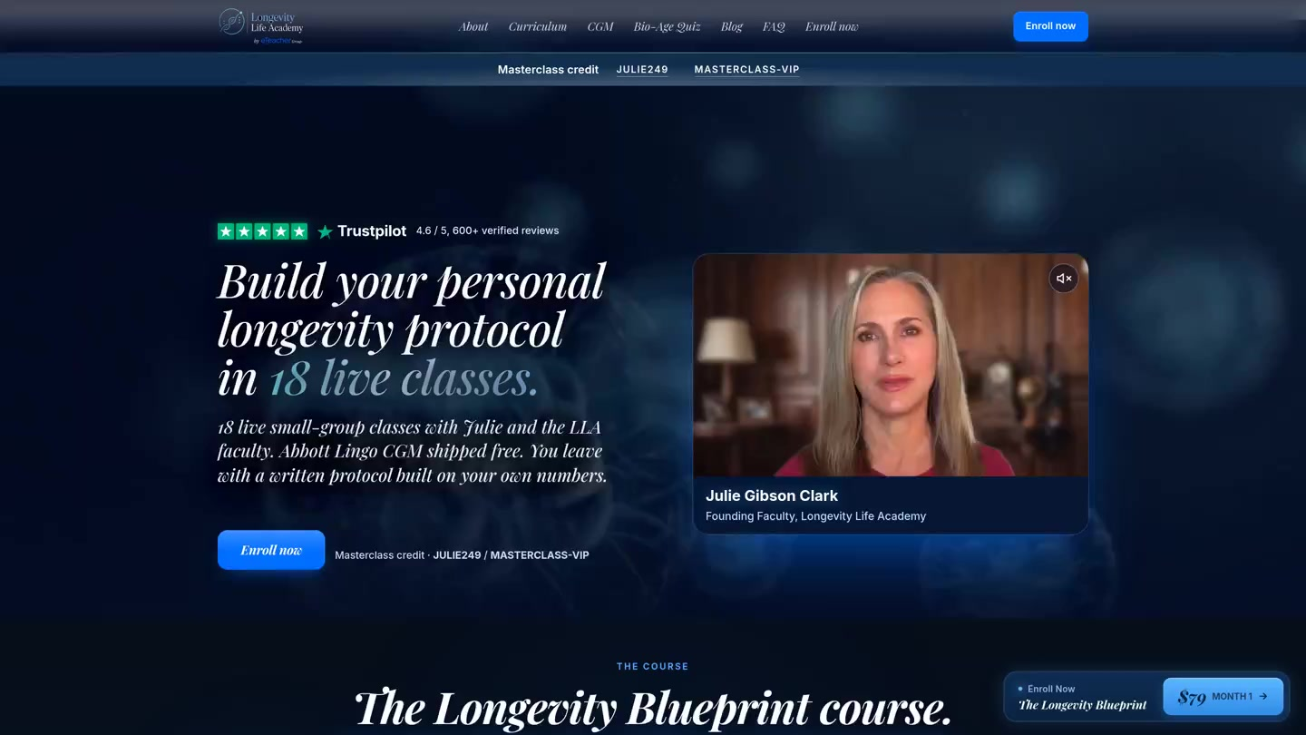
03 MASTERCLASS
Learn to age slower with Julie Gibson Clark.
PAID ORDERS
212
16 Sep to 2 Nov.
THE LIVE HOUR
60 min live + 30 min Q&A
VIP session with Julie on Zoom.
Event Blueprint sign up, 212 paid orders, 60 min live + 30 min Q&A.

Slide 4
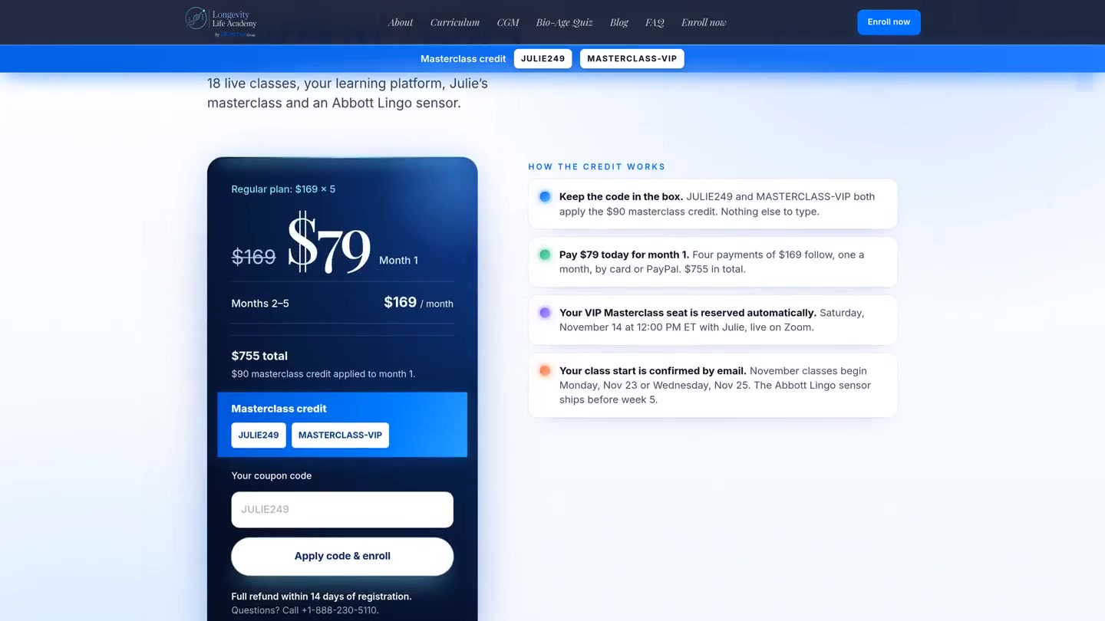
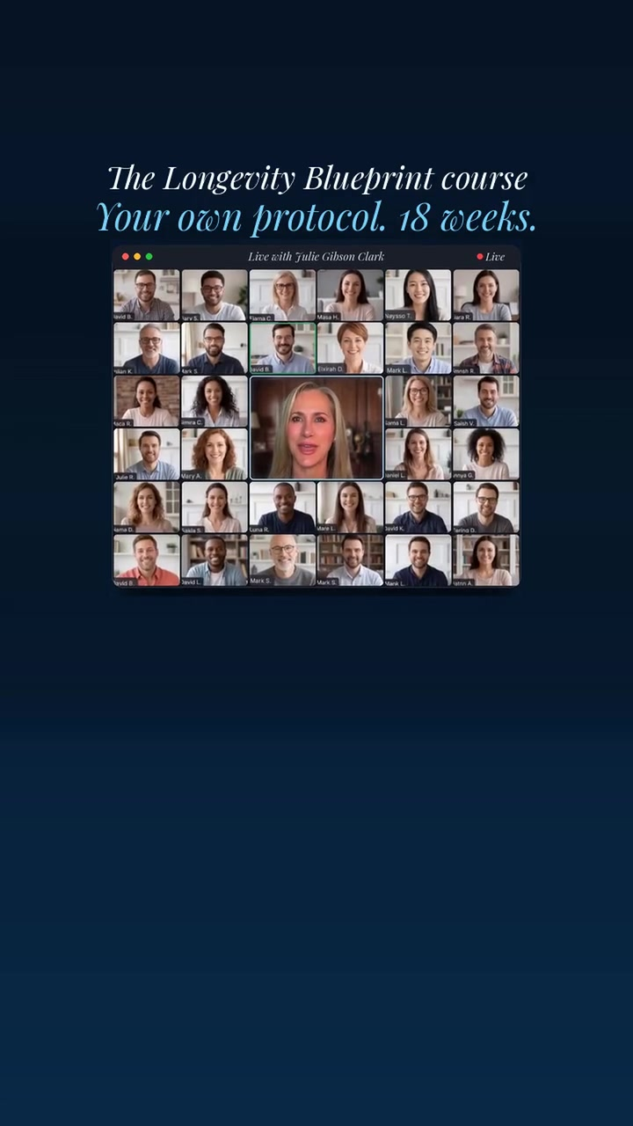
04 NOVEMBER
NOVEMBER PACKAGE. Get your tailored protocol in 18 weeks.
$79 month 1, Nov promo trial. Exclusive Masterclass VIP included, Nov 14th.
$100 cash back towards next course.
November package, pages.dev pricing and checkout, blue Blueprint reel Ad26.

Slide 5
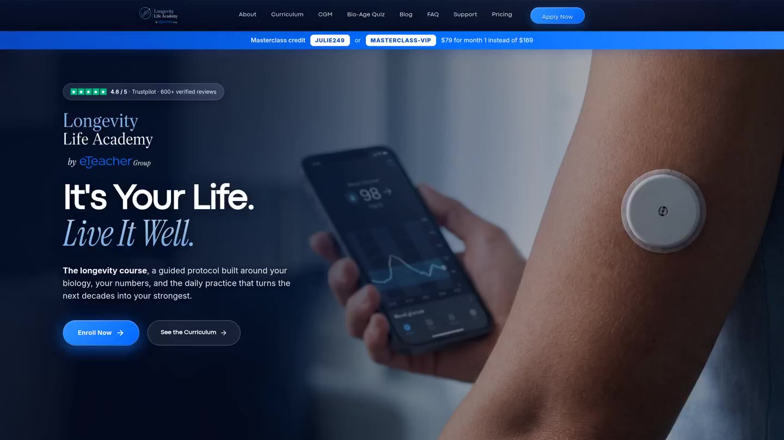
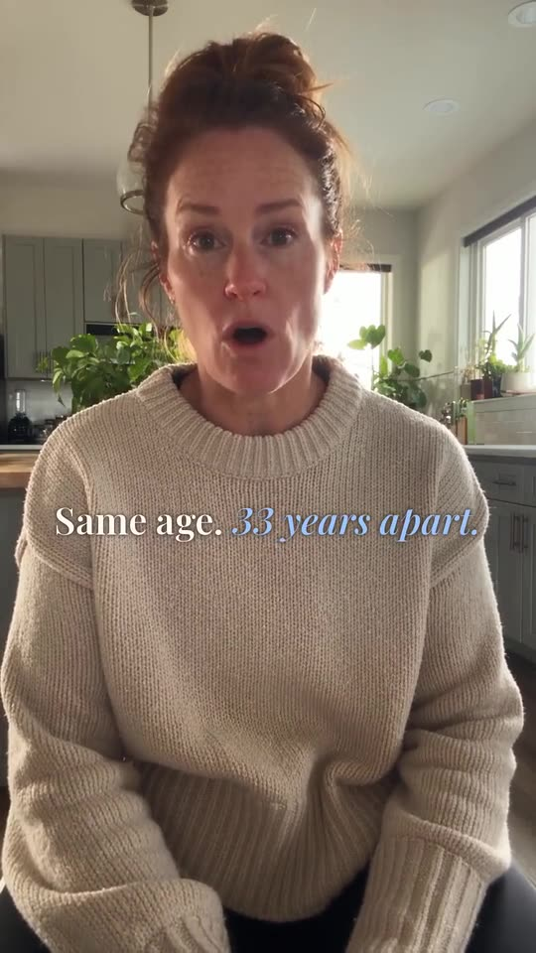
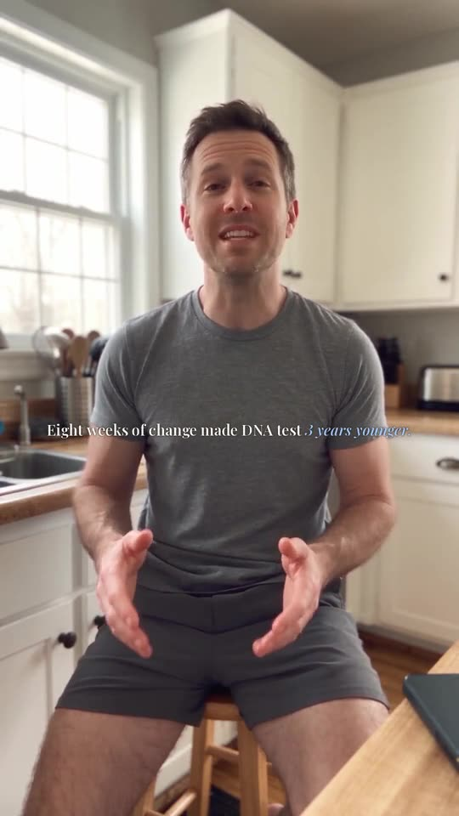
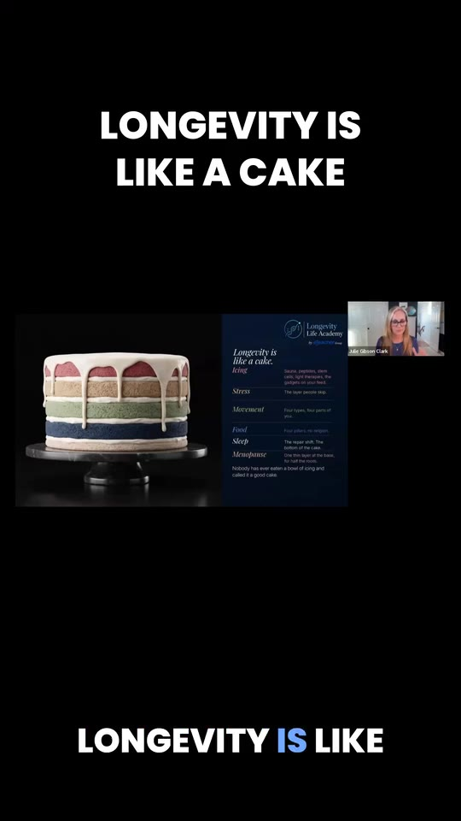
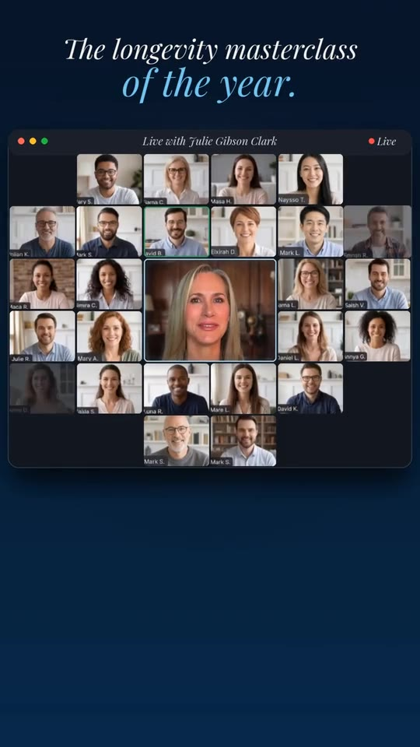
05 NOVEMBER
November creatives and the .com homepage.
.com homepage scroll, two new UGCs, Julie Cake and Sugar hooks.

