Slide 1
Middleton Fire Risk System
A Community Safety Initiative for Middleton
Presented by Akhil Deshpande | 10th Grade Capstone Project | Middleton Community
Live Dashboard: https://tritown-monitor.onrender.com/

Slide 2
Community Awareness: Fire Risk
Giving Middleton residents real-time local fire danger information
🔥
📡
⚠️
Unaware Burning
No Local Data
Increasing Risk
Residents use fire pits & campfires without knowing current danger levels
National weather services show regional data — not hyperlocal Middleton conditions
New England is seeing more drought conditions and higher fire danger each year
Result: Preventable fires occur because the community lacks actionable real-time information

Slide 3

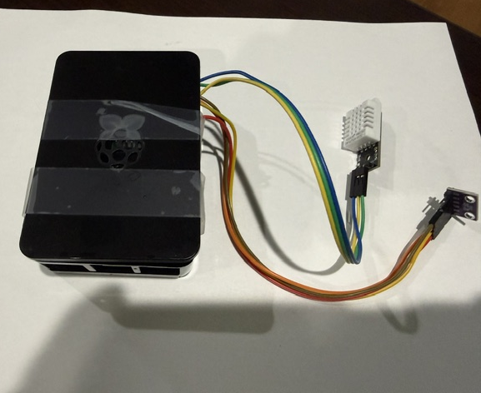
Hardware Setup

Slide 4
The Solution
How It Works
Key Facts
1. Raspberry Pi sensor reads
temperature & humidity
every 5 minutes outdoors
✅ Already built and live
✅ 100% free to operate
2. Data sent automatically
to cloud dashboard
✅ Updates every 5 minutes
✅ Works 24/7 automatically
3. Alert level calculated
based on Middleton climate
✅ No town maintenance needed
4. Community sees live
fire danger alert on
public display board
✅ Expandable to multiple sites

Slide 5
Community Alert Levels
Calibrated specifically to climate data of the device location.
🟢 LOW RISK
Good air quality. Safe conditions today.
Normal activities permitted
Humidity > 50% | Temp < 75°F
🟡 MODERATE RISK
Drying conditions developing. Avoid burning outdoors.
Caution advised for open flames
Humidity 30-50% | Temp 75-85°F
🟠 HIGH RISK
Hot and dry conditions. Stop all outdoor burning now!
No outdoor burning permitted
Humidity < 30% | Temp 85-95°F
🔴 VERY HIGH RISK
Extremely hot and dry! No burning, call 911 if fire spotted!
Emergency conditions — full ban
Humidity < 20% | Temp > 95°F

Slide 6
Live System — Working Right Now
⚠️ For awareness only. Always follow official Fire Marshall guidance and local burn bans. In emergency call 911.
🟢
LOW RISK
Good air quality. Safe conditions today.
1
24
9:04 PM
Active locations
Total readings
Last updated
Visit live: tritown-monitor.onrender.com
Scan QR code or type URL on any phone, tablet, or computer

Slide 7
Our Request to You
1
Your Expert Review
Review our alert thresholds and help us calibrate them to match official fire danger standards for Middleton
2
Your Endorsement
A letter of support from the Fire Marshall will allow us to install the display anywhere throughout the town. Ex. Flint Public Library
3
Your Guidance
Advise us on what additional data (wind speed, drought index) would make this system more useful to your department

Slide 8
Together, We Can Keep
Middleton Safe
This system is already built, already working, and already protecting our community.
All we need is your help.
🌐 tritown-monitor.onrender.com
💻 github.com/gittmaster/Middleton-monitor
📧 Akhil Deshpande
📱 978-773-0224
Akhil Deshpande | 10th Masco Grade Student | Middleton Community

