Slide 1
Final Project Presentation
LendingClub Data

Slide 2
Case Study Objective
LendingClub is the world’s largest peer-to-peer lending platform, headquartered in San Francisco.
When LendingClub receives an application, two decisions can be made:
  1) Loan gets accepted
    Fully Paid, Currently Paid, or Charged-Off
  2) Loan gets rejected
The aim is to predict if the borrower will default (Charged-Off) or pay back the loan (Fully Paid).
Algorithms/Models Applied: KNN.

Slide 3
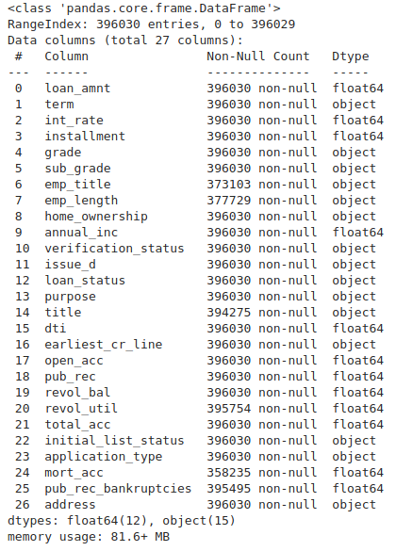
Data Source
Data source – kaggle, Lending Club Loan Defaulters Prediction.
The dataset contains 27 features and 396,030 loans that have been made, either have been Fully Paid or Charged-Off.
Two types of features: 1) relating to the borrower, 2) loan characteristics.
https://www.kaggle.com/faressayah/lending-club-loan-defaulters-prediction/notebook

Slide 4
Workflow Followed
Framed > Prepared > Analysed > Interpreted and now (hopefully) Communication
Approach:
  Exploratory Data Analysis (EDA)
  Data Wrangling: Cleansing and Feature Selection
  Machine Learning: Predictive Modelling

Slide 5
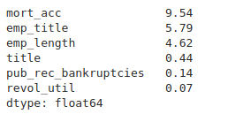
  Data Wrangling: Cleansing and Feature Selection
As illustrated below, mortgage account, employment title and employment length constituted of the highest % of NaN (missing) values.
For mortgage account, I have imputed with 0, given that circa 39% of value counts fell within this particular bracket, the median was 1, nevertheless, only represented circa 17%, the remainder distributed from 2 to 34.
I have dropped the employment title, could have further utilised EDA to impute.
Employment length imputed with the mode of 10+ years.
I have dropped the Title, could of further utilised EDA to impute.
Public record bankruptcies and revolving utility, I have imputed with 0, given the small %.

Slide 6
  Machine Learning: Predictive Modelling (v1)
KNN model_v1 – data imbalance of 80% (Fully Paid) / 20% (Charged-Off)
  Features selected based on EDA and common sense
  [“dti”, “pub_rec_bankruptcies”, “open_acc”, “total_acc”].
  Stratified - train/test split.
  Accuracy score for testing set = 69% (K=1).
  Benchmark/most frequent class (Fully Paid) = 80%.
  Best optimal value of K = next page...

Slide 7
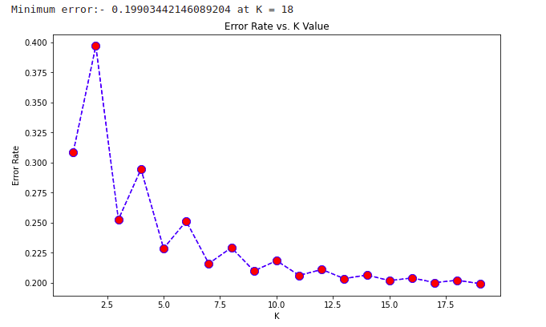
  Machine Learning: Predictive Modelling (v1) (cont.)
Optimal K value (error rate)
Determined from running a for loop from 1 – 20
Minimum error: 20% at K = 18
Proportion of cases where the prediction is wrong.

Slide 8
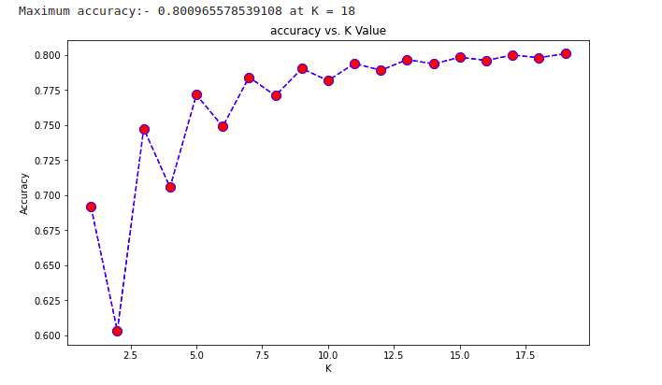
  Machine Learning: Predictive Modelling (v1) (cont.)
Optimal K value (accuracy rate)
Determined from running a for loop from 1 – 20
Maximum accuracy: 80% at K = 18
Fraction of predictions our model got right.

Slide 9
  Next Steps
Most classification algorithms will only perform optimally when the number of samples of each class is roughly the same. Highly skewed datasets, where the minority is heavily outnumbered by one or more classes, have proven to be a challenge, which is the case with the current dataset, being 80/20.
  My next steps are to:
    Re-sample
    Look at different metrics
    Exploring with different features
    Try out Logistic Regression and Decision Tree algorithms

Slide 10
Q&A
“Someone’s sitting in the shade today because someone planted a tree a long time ago” – Warren Buffett
Thank you Jack, Adam and Alex, and the wider class.

