Slide 1
CONNECT SUGGESTS / PROBLEM
An unanswered message leaves
business information out of date.
52%
of entrepreneurs did not
reply to their message
395 of 761 owners in the supplied synthetic pilot
Notes:
The challenge is getting an answer from a busy entrepreneur. In the supplied synthetic pilot, 395 of 761 owners did not reply to their message: 51.905%, rounded to 52%. Each owner received one bundled message. This describes non-response to messages, not whether the owner answers phone calls. An unconfirmed correction can leave inaccurate opening hours online. The channel groups were not a randomized experiment.
Sources: MATERIALS FROM SINCE AI (MAIN CHALLENGE)/data/pilot_decision_log_2025.csv; Transcriptions/Fonecta Q&A 2026-11-07.md, 00:00–01:00 and 02:49–03:49.
Non-response by channel: app push 47/72 (65%), email 184/313 (59%), SMS 118/241 (49%), WhatsApp 46/135 (34%).

Slide 2
SOLUTION
When an important message
goes unanswered, Connect calls.
A busy entrepreneur doesn’t have time
to answer texts and emails,
but still picks up the phone.
Notes:
A phone conversation gives the entrepreneur another way to confirm or correct opening hours. In this abridged demo exchange, the owner changes Christmas Eve to eight until one and confirms the correction. Calls are reserved for urgent unanswered requests and the policy limits repeat attempts. The ElevenLabs voice service and Yext writer are implemented; automatically connecting the message timeline to the voice service is the next integration step. The effect on customer response rates has not yet been measured.
Sources: original deck’s 7 November demo conversation; Solution/voice/README.md; Solution/voice/voice_service/policy.py; Pitch-video-plus-deck/deck-review-2026-11-08.md.
Supporting detail:
CONNECT
“Christmas Eve: seven thirty
to one, like last year?”
OWNER
“Almost. We open at eight that
day and close at one.”
“Eight to one?” “Yes, that’s right.”
Urgent updates only.
Two call attempts at most.
The owner confirms before saving.

Slide 3
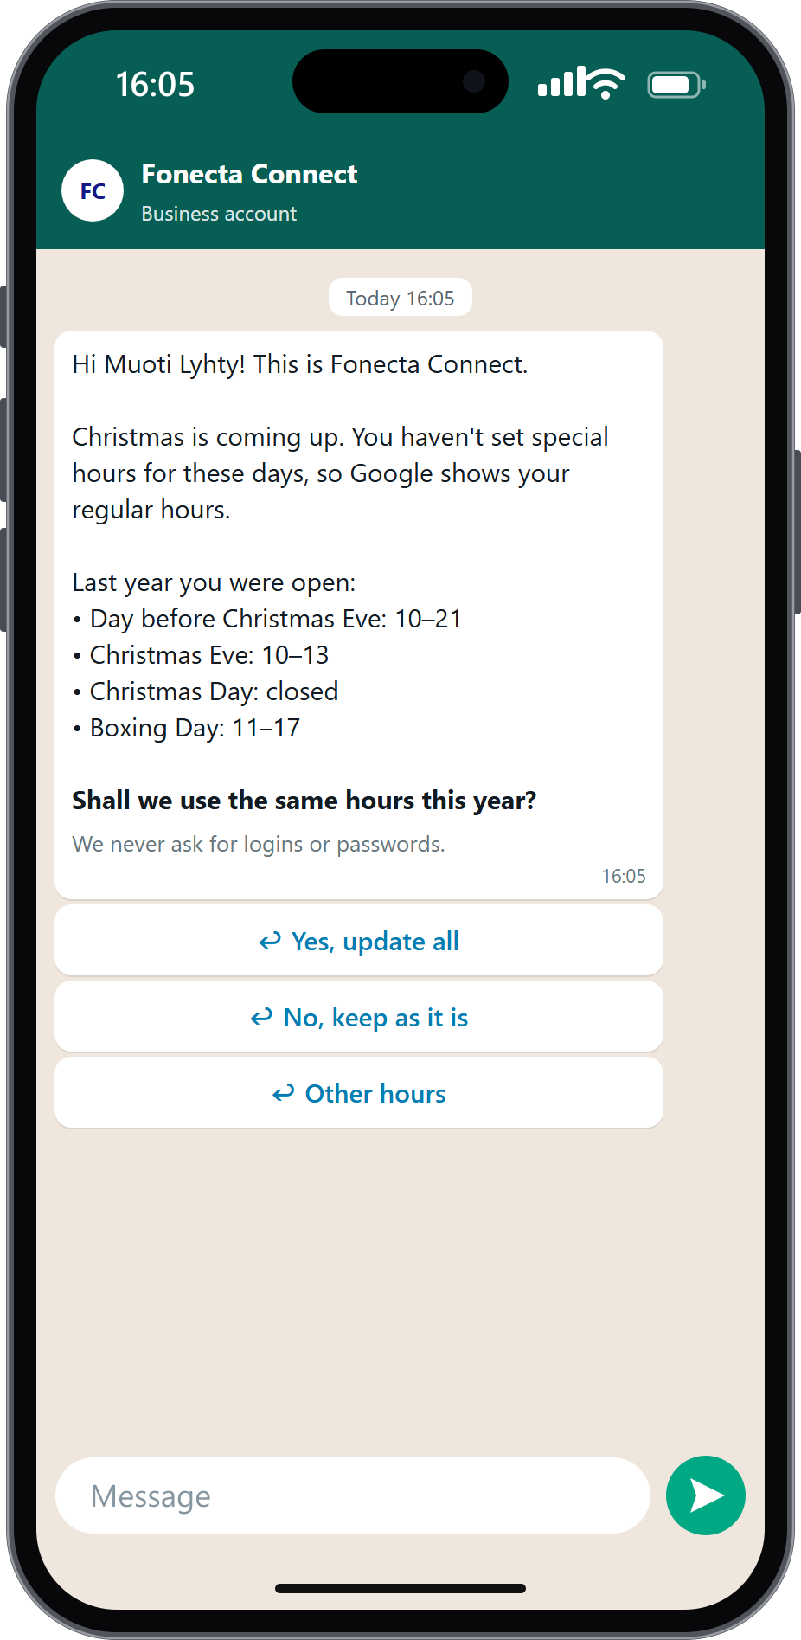
Owners approve or correct
opening hours in
the conversation.
Approve, edit or decline.
Either via text or on the phone.
Notes:
Connect prepares specific opening hours and gives the owner a clear choice: approve, decline or provide different opening hours. Recorded history supports the explanation when available. A reminder can use search activity to explain why the date matters. Owners can type naturally; clear rules and the OpenShift AI reply reader interpret the response. These are actual browser-demo screens; sending external text messages is simulated on main.
Sources: owner-page/README.md; owner-page/hours_ai.py; Solution/engine/README.md.
Supporting detail:
One clear choice
A proposal with a reason
Past opening hours support the proposal.
Search activity gives a reason to reply.
Detect / Suggest / Contact / Decide / Apply
Initial message
Reminder
Approved decisions pass to Apply: check for intervening changes, save opening hours, read them back, and support UNDO. Yext sandbox writes and undo were independently verified. Source: step5_apply/README.md and docs/live-context-integration.md.

Slide 4
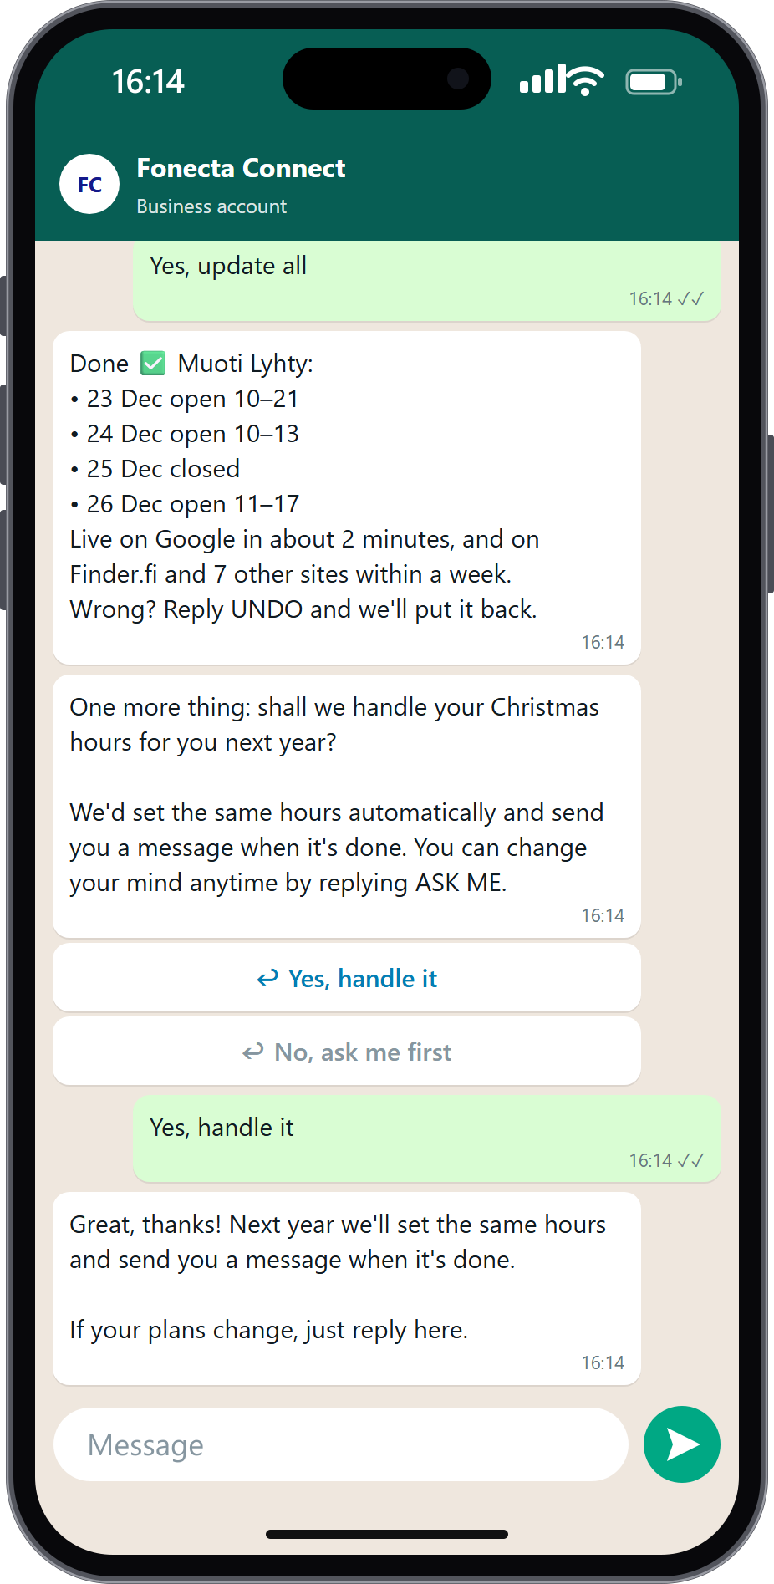
HOW IT LEARNS
The next interaction reflects
what the owner told us.
Remembers preferences.
Asks permission for next year.
Notes:
The service remembers explicit permissions and contact preferences. Owners can authorize recurring holiday updates, decline categories of suggestions and change their preferred channel by responding there. Repeated non-response can reduce contact. A new customer such as Kahvila Kipinä still receives a proposal based on calendar and shared business patterns; the message says We suggest and does not invent past decisions.
Sources: owner-page/README.md; owner-page/learning.py; docs/customer-messages.md.
Supporting detail:
Permission for next year
Fewer unwanted suggestions
Declining a category stops suggestions of that kind.
The owner’s preferred channel
Replies update the preferred contact channel.
For a business with no history
Calendar and similar-business patterns inform the proposal.

Slide 5
RESULTS
More useful opening-hour suggestions.
Three-seed mean on synthetic 2026 cross-validation; not the organisers’ hidden test.
Notes:
Our C13 model family scored 70.92 on the challenge utility measure, compared with 54.01 for the rule baseline. The C13 figure is a three-seed average on grouped 2026 cross-validation using synthetic challenge data. It is not an accuracy percentage or a hidden-test result. Evidence includes owner-entered opening hours, public calendars, reviews and shared business patterns. The owner still controls whether a proposed change is applied.
Sources: Solution/engine/metrics.json; Solution/engine/README.md.
Supporting detail:
70.92
Utility score / three-seed average
Owner history, public calendars,
reviews and similar businesses.

Slide 6
LIVE CONTEXT
Events and weather tell Connect
when to check opening hours.
An event near closing time
Fresh snow in the forecast
Ask a nearby business if its
opening hours will change.
Ask the ski rental to confirm
its opening hours.
Notes:
Live context helps Connect decide when an opening-hours check is useful. Event checks select relevant concerts, sports or festivals near hospitality businesses around closing time. Fresh Open-Meteo snowfall forecasts drive the existing ski-rental check when live mode is enabled. Both examples describe implemented triggers, not measured customer outcomes. The owner decides the opening hours; neither source invents a schedule. Sources: docs/live-context-integration.md, live_signals/README.md. Event coverage varies; attendance is unknown. Missing or expired weather data suppresses the live weather check.

Slide 7
NEXT STEPS
Business information stays current.
Owners get on with their work.
Launch to Connect customers.
Track confirmed updates, replies and opt-outs.
Improve follow-up using customer feedback.
School of Business
Eppu Rantanen / Max Minkkinen / Laura Salminen / Tuomas Kärnä
Notes:
The proposed customer value is less follow-up work for entrepreneurs and more current business information for their customers. Connect prepares a suggestion, obtains approval by text or voice and saves the approved opening hours. The next step is a production rollout to Connect customers. Track confirmed updates, replies and opt-outs, and use customer feedback to improve follow-up. This is the proposed next step, not a claim of an existing production deployment. Any retention benefit for Fonecta remains a hypothesis to test. Team: School of Business — Eppu Rantanen, Max Minkkinen, Laura Salminen, Tuomas Kärnä.

