Slide 1

Bon Voyage
an Alexa Skill by
Abbie, Adam, David, and Stephen

Slide 2
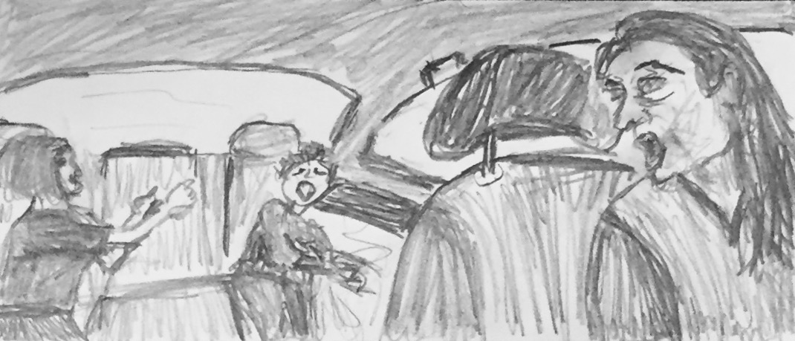
Notes:
Our clients, parents with young children, have a problem with screaming young children in a car, which can be distracting and eventually dangerous.
Our idea to address this problem is to have Alexa play kid-soothing curated and self-recorded content, on demand in a hands-free way, keeping the ride more safe for parents.
The main group of people who will benefit are parents and children.
The primary business goal our solution addresses is a potential new use case for the Alexa technology.
The primary user goals our solution supports are car safety, and a more enjoyable and overall less stressful ride.

Slide 3
What is unique to
Alexa?
Speedy, convenient,
hands-off technology

Slide 4
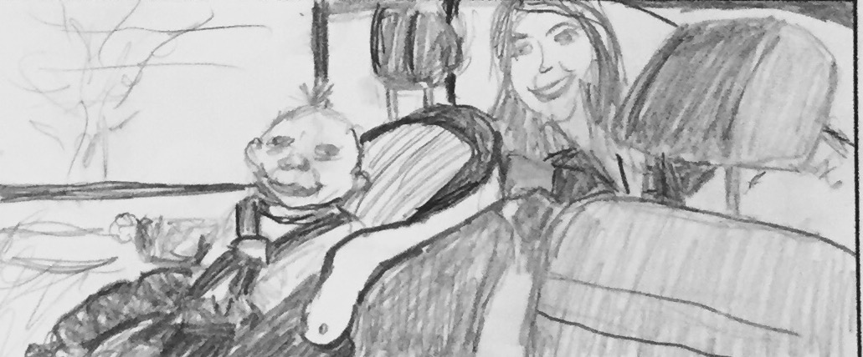

Slide 5
Use case for Amazon Echo:
at-home with multiple children
Notes:
no hands!

Slide 6
Problem
Our clients, parents with young children, have a problem with screaming young children in a car, which can be distracting and eventually dangerous.
A parent often doesn’t have a free hand when at home with multiple kids.

Slide 7
Solution
Alexa can play curated (proven to soothe children and stimulate learning like the ABCs), personalized content, hands-free, keeping the ride safer for all, or making an at-home experience more calm.
Notes:
also Huck Finn

Slide 8
MVP Demo

Slide 9
Value for customers and business
Customers - content they know they can count on
Business - a product that will appeal to parents, build on Amazon’s reputation

Slide 10
Next steps
More curated content:
By mood, author, genre
Personalized content - recommendations based on history and interest, social sharing
Smooth Sailing, Bon Voyage!

Slide 11
Questions?

