Slide 1






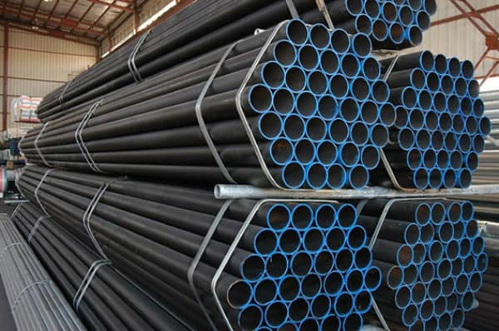
1
3%
®
Above 1,000,000
Serving Philippine Water Industry
Since 1989
Price may increase with out Prior Notice
INCHES | NET PRICE | NET PRICE
BLACK IRON | ERW – Sch. 40 Standard | SEAMLESS Sch. 40
1” | 1,188.00 | 1,435.00
1 ¼ | 1512.00 | 1,900.00
1 ½ | 1,920.00 | 2,273.00
2” | 2,487.00 | 2,945.00
2 ½ | 4,088.00 | 4670.00
3” | 5,287.00 | 6,180.00
4” | 8,064.00 | 8,895.00
5” | 11,573.00 | 12,520.00
6” | 14,560.00 | 15,780.00
NET PRICE
ERW –Light Gauge
995.00
1,362.00
1,586.00
2,145.00
2,875.00
3,825.00
5,630.00
9,075.00
12,960.00
8’’ | 19,500.00 | 23,500.00
10’’ | 32,000.00
12’’ | 41,250.00
½ | 780.00
¾ | 945.00

Slide 2
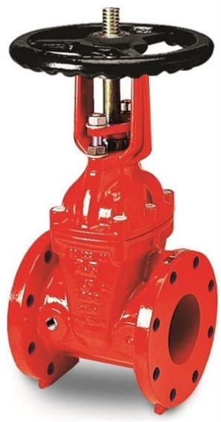
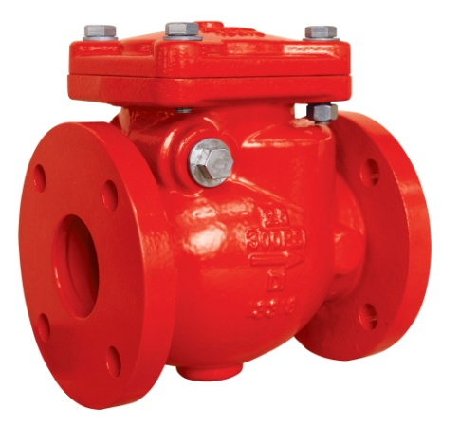
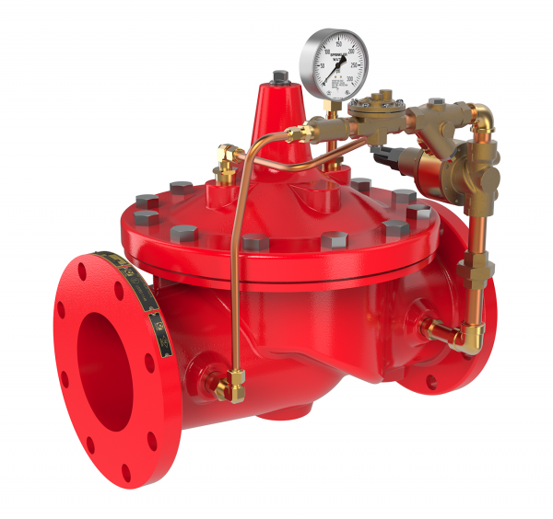
2
 | HK & QL Non- UL | KENNEDY | HYFLO or MECH UL/FM
8’’ |  | 19,000 | 30,470
6’’ |  | 9,800 | 18,715
4’’ |  | 5,800 | 12,000
3’’ |  | 4,800 | 9,000
2 ½’’ |  | 3,700 | 7,000
2’’ |  | 3,200 | 6,500
OS & Y Gate Valve
 | CLINTON Non- UL | SMITH USA | HYFLO UL/FM
8’’ | 16,700 |  | 30,500
6’’ | 9,200 |  | 18,500
4’’ | 6,800 |  | 12,000
3’’ | 4,500 |  | 9,500
2 ½’’ | 3,700 |  | 8,000
2’’ | 3,150 |  | 7,500
SWING Check Valve
 | HK & QL Non- UL | MECH 300 psi | HYFLO 300 psi
8’’ | 85,000 | 180,000 | 180,000
6’’ | 60,000 | 71,500 | 72,000
4’’ | 28,000 | 62,000 | 62,000
3’’ | 21,000 | 52,000 | 49,500
2 ½’’ | 16,500
2’’ | 12,500
Pressure Relief Valve
WAREHOUSE: 137 General Evangelista, Bagong Barrio West, Caloocan City (TOYOTA EDSA BALINTAWAK)
Telefax: +632 5018841 Tel Number: +632 7117 38 45 Mobile : +63 9292 777 888 +63 9155 588 588; +63 9308 334 455
Email Us: jetflarecorp@gmail.com & jetflaresales@gmail.com

Slide 3
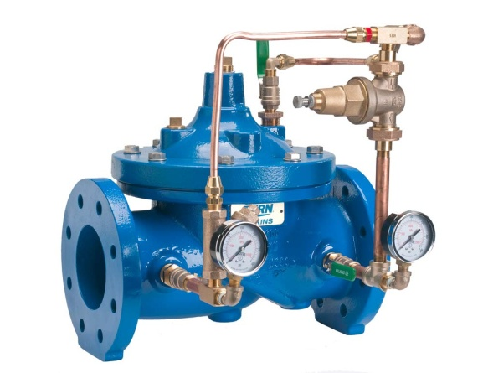
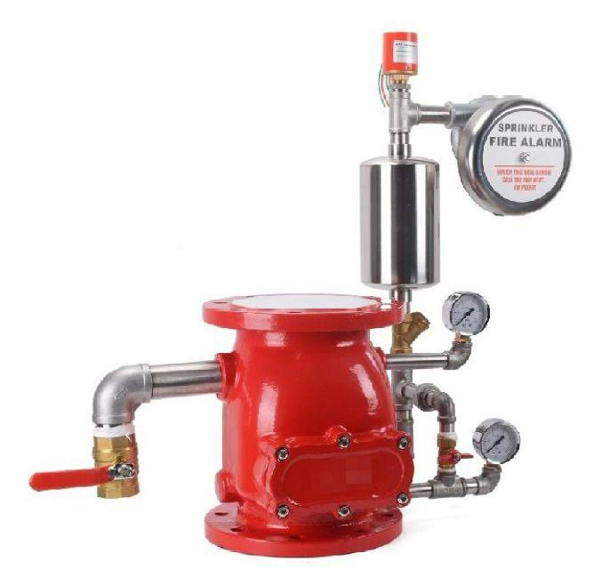
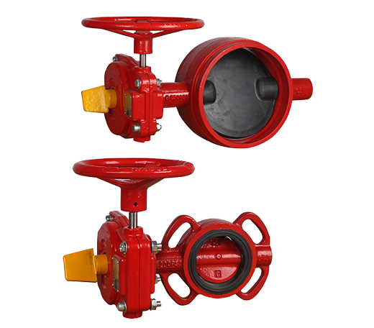
3
 | CLINTON Non- UL | MECH 300 psi | HYFLO UL/FM
8’’ | 85,000 | 188,000 | 180,000
6’’ | 60,000 | 75,000 | 75,000
4’’ | 28,000 | 65,000 | 65,000
3’’ | 21,000 | 52,000 | 52,000
2 ½’’ | 16,500
2’’ | 12,500
Pressure Reducing
Valve
 | ZJST Non- UL | CLINTON Non- UL | HYFLO UL/FM
8’’ |  | 45,000 | 70,000
6’’ | 35,000 | 37,000 | 48,000
4’’ | 24,500 | 25,000 | 32,000
3’’ | 21,500 | 22,000 | 28,000
10’’ |  |  | 95,000
12’’ |  |  | 180,000
Alarm Check Valve
 | MECH UL/FM | KENNEDY NON/UL | HYFLO UL/FM
8’’
6’’ | 12,500 | 9,500 | 12,800
4’’ | 9,500 | 8,400 | 10,000
3’’ | 7,900 | 6,700 | 8,500
2 ½’’ | 7,200 | 6,000 | 8,000
2’’
Butterfly Valve
with Tamper Switch
QUEZON CITY OFFICE: 27 Felix Manalo St. Pinagkaisahan, Cubao Quezon City
WAREHOUSE: 137 General Evangelista, Bagong Barrio West, Caloocan City (TOYOTA EDSA BALINTAWAK)
Telefax: +632 5018841 Tel Number: +632 7117 38 45 Mobile : +63 9292 777 888 +63 9155 588 588; +63 9308 334 455
Email Us: jetflarecorp@gmail.com & jetflaresales@gmail.com

Slide 4
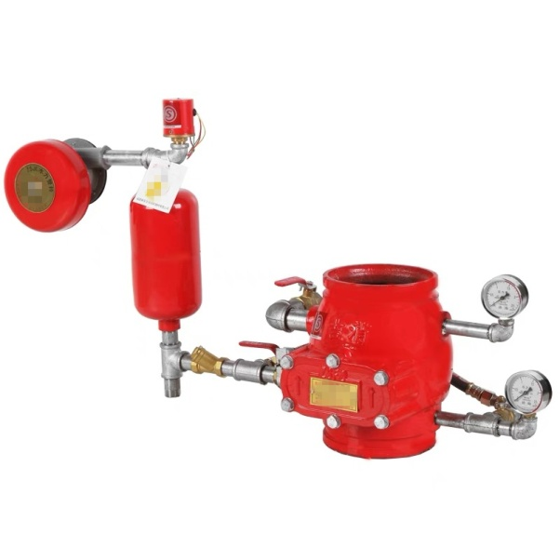

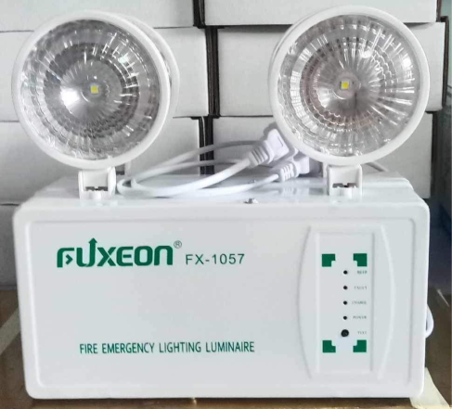
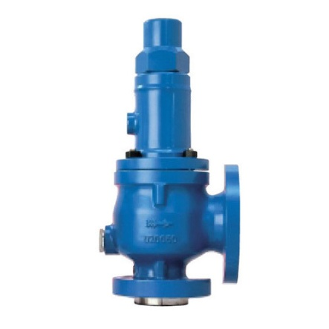
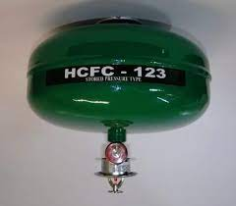
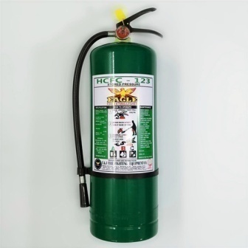
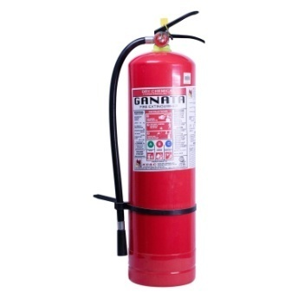
4
 | HYFLO Grooved Alarm Check
8’’ | 70,000
6’’ | 48,000
4’’ | 33,000
 | KENNEDY Grooved Alarm Check
8’’ | 48,000
6’’ | 39,000
4’’ | 27,000
Exit Sign | Emergency light
600 | 580
 | PN-25 360 PSI
6’’ | 83,250
4’’ | 50,200
3’’ | 34,500
2 ½’’ | 28,500
2’’ | 26,000
CEILING | HCFC 123
10 LBS | 6,500
20 LBS | 12,800
PILOT PRESSURE RELIEF VALVE
 | PN-40 580 PSI
6’’ | 102,675
4’’ | 69,580
3’’ | 46,000
2 ½’’ | 38,500
2’’ | 34,000
 | HCFC 123
10 LBS | 5,200
20 LBS | 9,900
50 LBS | 24,000
 | ABC
10 LBS | 1,250
20 LBS | 2,400
50 LBS | 8,500

Slide 5
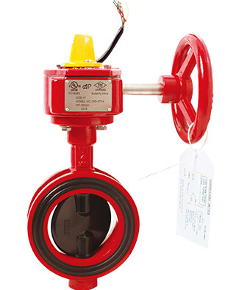

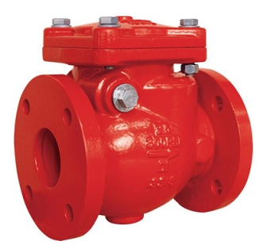
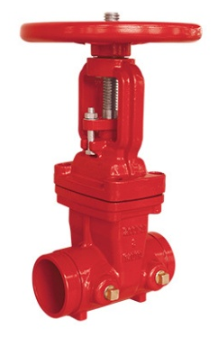
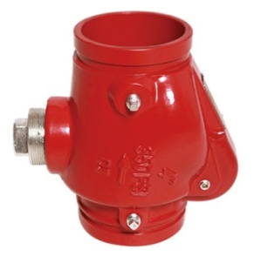
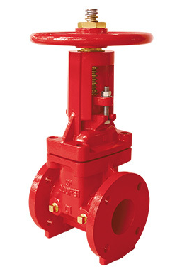
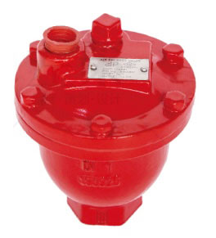
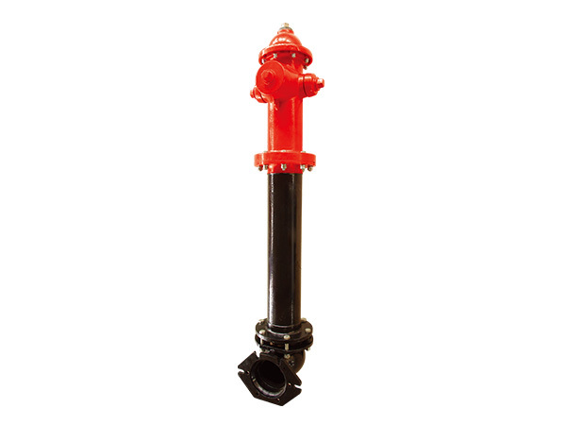
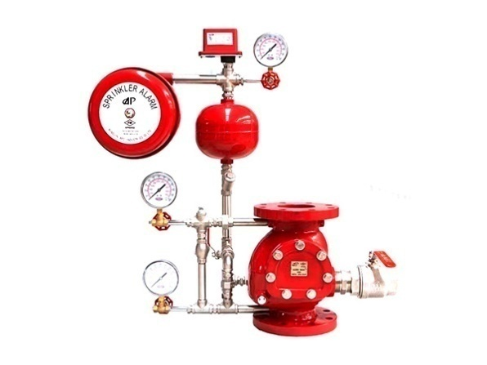
5
Butterfly Valve with
Tamper Switch
8’’ | 16,800
6’’ | 12,500
4’’ | 9,000
3’’ | 7,500
Flange Type
Check Valve - 300 PSI
8’’ | 45,000
6’’ | 24,000
4’’ | 17,000
3’’ | 12,000
2 ½ | 6,800
Grooved Type
Gate Valve - 200 PSI
6’’ | 18,500
4’’ | 12,000
3’’ | 10,800
Grooved Type
Check Valve - 350 PSI
8’’ | 16,500
6’’ | 11,330
4’’ | 6,500
3’’ | 5,200
Flange Type
Gate Valve - 300 PSI
8’’ | 38,000
6’’ | 24,300
4’’ | 14,700
3’’ | 11,000
Air Release Valve
1’’ – 7,800
21/2 | 8,800
Wet Alarm
Check Valve - 300 PSI
DRY -Fire Hydrant
6’’ - 85,000
8’’ | 108,000
6’’ | 95,000
4’’ | 75,000
3’’ | 65,000
WET-Fire Hydrant
6’’ - 92,000
5’’ | 85,000
WAREHOUSE: 137 General Evangelista, Bagong Barrio West, Caloocan City (TOYOTA EDSA BALINTAWAK)
Telefax: +632 5018841 Tel Number: +632 7117 38 45 Mobile : +63 9292 777 888 +63 9155 588 588; +63 9308 334 455
Email Us: jetflarecorp@gmail.com & jetflaresales@gmail.com

Slide 6
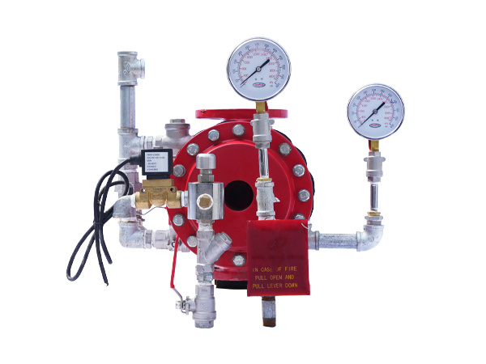
6
Grooved Type
Gate Valve - 300 PSI
6’’ | 18,500
4’’ | 12,000
3’’ | 10,800
Deluge Valve - 300 PSI
8’’ | 260,400
6’’ | 215,250
4’’ | 173,250
3’’ | 149,100
21/2 | 139,400
5’’ | 195,400

Slide 7
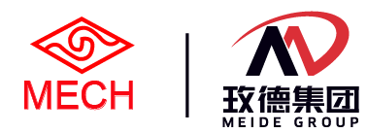


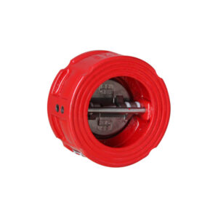

7
Butterfly Valve with
Tamper Switch
Flange Type
Check Valve - 300 PSI
6’’ | 12,500
4’’ | 9,500
3’’ | 7,800
8’’ | 30,000
6’’ | 18,900
4’’ | 12,000
3’’ | 9,000
8’’ | 16,800
Grooved Type
Gate Valve - 200 PSI
Grooved Type
Check Valve - 350 PSI
6’’
4’’
3’’
8’’ | 18,000
6’’ | 12,400
4’’ | 6,500
3’’ | 5,600
Flange Type
Gate Valve - 300 PSI
Wafer Type
Check Valve - 350 PSI
8’’ | 32,075
6’’ | 19,700
4’’ | 12,700
3’’ | 8,700
8’’ | 18,000
6’’ | 12,400
4’’ | 6,500
3’’ | 5,600
WAREHOUSE: 137 General Evangelista, Bagong Barrio West, Caloocan City (TOYOTA EDSA BALINTAWAK)
Telefax: +632 5018841 Tel Number: +632 7117 38 45 Mobile : +63 9292 777 888 +63 9155 588 588; +63 9308 334 455
Email Us: jetflarecorp@gmail.com & jetflaresales@gmail.com

Slide 8
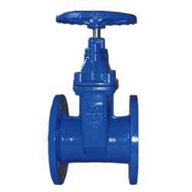
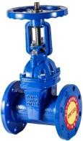
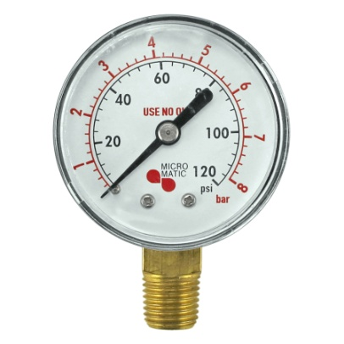
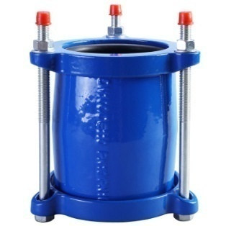
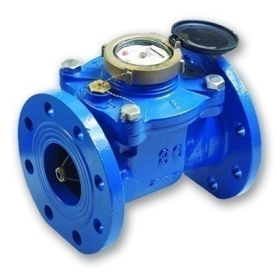
8
 | CLINTON Non- Rising Gate Valve
8’’ | 19,800
6’’ | 10,500
4’’ | 5,800
3’’ | 4,800
2 ½’’ | 3,900
2’’ | 3,200
 | CLINTON Rising Gate Valve
8’’ | 19,800
6’’ | 10,500
4’’ | 5,800
3’’ | 4,800
2 ½’’ | 3,900
2’’ | 3,200
 | Rising
12’’ | 37,915
10’’ | 29,315
 | NON RISING
12’’ | 35,335
10’’ | 27,849
AIR GUAGE | CRAFT & KENNEDY
8’’
6’’
4’’ | 550
3’’ | 450
2 ½’’ | 315
2’’ | 200
 | CLINTON GIBAULT
6’’ | 4800
4’’ | 3260
3’’ | 2400
2 ½’’ | 2100
2’’ | 1800
WATER METER | CLINTON WOLTMAN
8’’ | 61,500
6’’ | 47,500
4’’ | 23,500
3’’ 2’’ | 18,000 15,840
QUEZON CITY OFFICE: 27 Felix Manalo St. Pinagkaisahan, Cubao Quezon City
WAREHOUSE: 137 General Evangelista, Bagong Barrio West, Caloocan City (TOYOTA EDSA BALINTAWAK)
Telefax: +632 5018841 Tel Number: +632 7117 38 45 Mobile : +63 9292 777 888 +63 9155 588 588; +63 9308 334 455
Email Us: jetflarecorp@gmail.com & jetflaresales@gmail.com

Slide 9
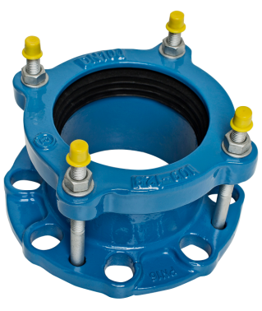
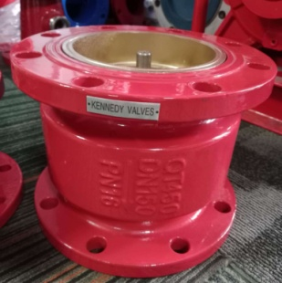
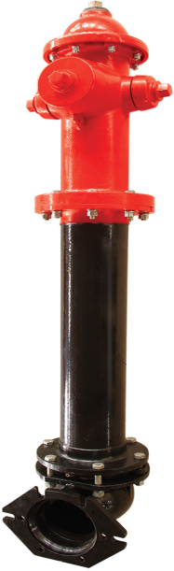
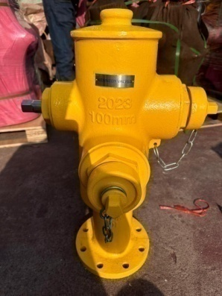

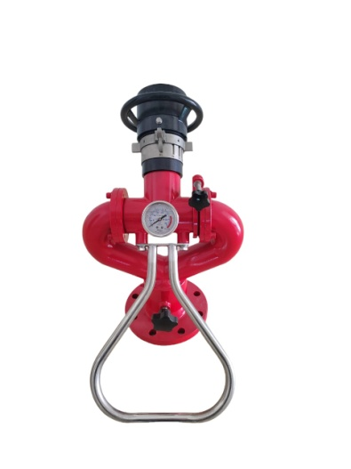
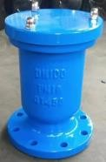
9
 | Universal Flange Adaptor
8’’ | 8,600
6’’ | 4,950
4’’ | 3,900
3’’ | 3,400
2 ½’’ | 2,950
2’’ | 2,600
 | Kennedy Vertical Check Valve
8’’ | 18,370
6’’ | 10,200
4’’ | 7,150
3’’ | 4,620
2 ½’’ | 3,850
2’’ | 3,245
10’’ | 14,585
FIRE HYDRANT HYFLO
4 X 2 ½ X 2 ½ | 28,000
6 X 2 ½ X 2 ½ | 35,000
HYDRANT KENNEDY
4 X 2 ½ X 2 ½ | 28,000
6 X 2 ½ X 2 ½ | 35,000
4’’ | 4,500
6’’ | 7,500
FLANGE TYPE | Kennedy AIR RELEASE VALVE
6’’ | 13,200
4’’ | 9,550
3’’ | 7,820
2 ½’’ | 6,850
2’’ | 5,665
FIRE WATER MONITOR
3’’ 20-40 LPM | 35,000
QUEZON CITY OFFICE: 27 Felix Manalo St. Pinagkaisahan, Cubao Quezon City
WAREHOUSE: 137 General Evangelista, Bagong Barrio West, Caloocan City (TOYOTA EDSA BALINTAWAK)
Telefax: +632 5018841 Tel Number: +632 7117 38 45 Mobile : +63 9292 777 888 +63 9155 588 588; +63 9308 334 455
Email Us: jetflarecorp@gmail.com & jetflaresales@gmail.com

Slide 10
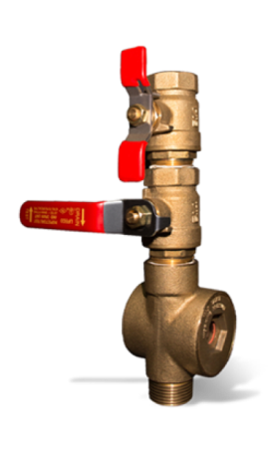
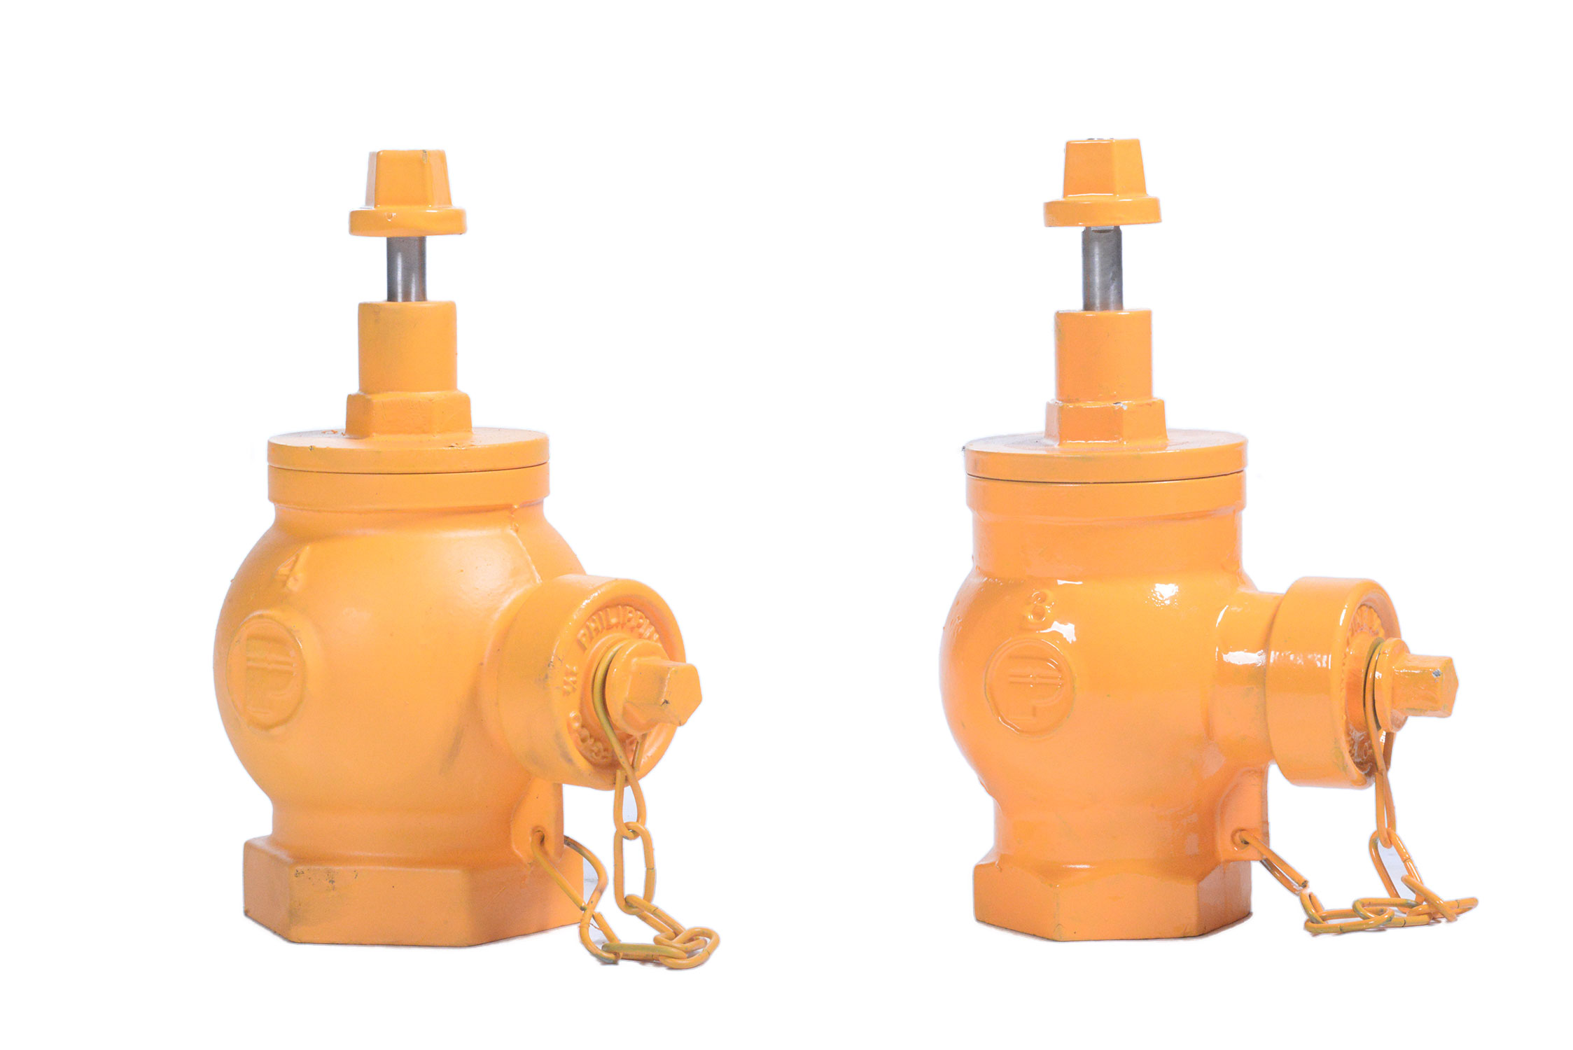
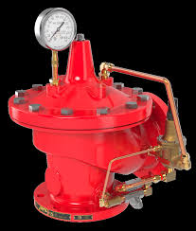
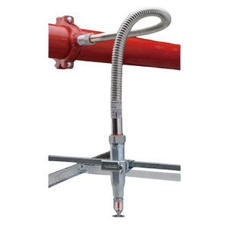
10
HYDRANT
4 X 2 ½ | 19,000
3 X 2 ½ | 17,000
Inspector test Valve BH Brand
1’’ – 4,800
CLA-VAL Relief Valve | ul/fm
3’’ | 190,000
4’’ | 220,000
6’’ | 280,000
8’’ | 410,000
Flexible sprinkler Hose
 | length | price
1’’ x ½ | 1.2 meters | 1,380.00
1’’ x ¾ | 1.5 meters | 1,650.00
1’’ x 1 | 1.8 meters | 1,800.00
Reflex Brand ul/fm
QUEZON CITY OFFICE: 27 Felix Manalo St. Pinagkaisahan, Cubao Quezon City
WAREHOUSE: 137 General Evangelista, Bagong Barrio West, Caloocan City (TOYOTA EDSA BALINTAWAK)
Telefax: +632 5018841 Tel Number: +632 7117 38 45 Mobile : +63 9292 777 888 +63 9155 588 588; +63 9308 334 455
Email Us: jetflarecorp@gmail.com & jetflaresales@gmail.com

Slide 11
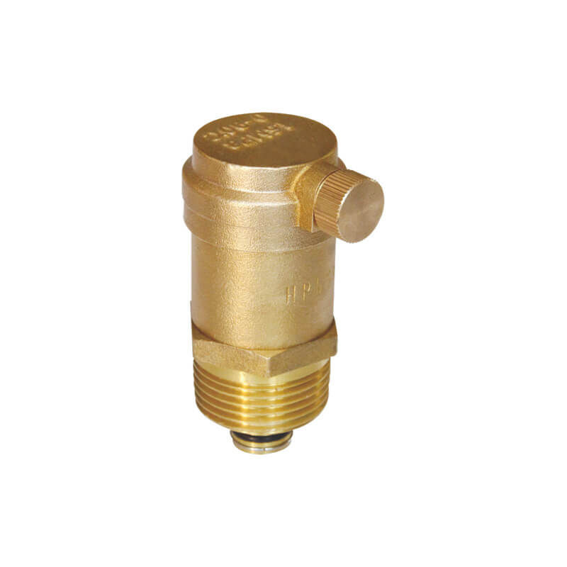
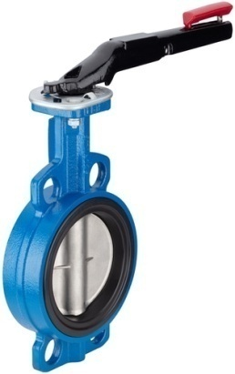
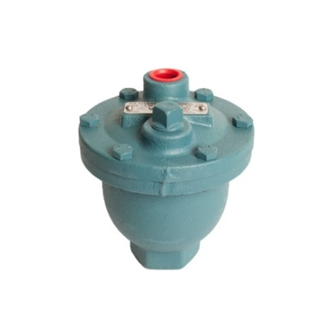


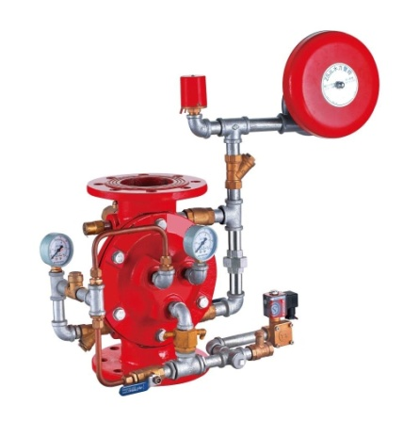
11
 | NON-UL | MECH
10’’ |  | 10,500
12’’ |  | 16,500
BUTTERFLY VALVE
Air Release Valve
½’’ -1’’ - 1800
 | KENNEDY | MECH
10’’ | 47,500 | 60,000
12’’ | 65,000 | 79,000
SWING Check Valve
VALMATIC Air Release Valve
1’’ | 6,800
230 PSI | KENNEDY | MECH
10’’ | 220,000 | 260,000
12’’ | 285,000 | 330,000
Reducing &
Relief Valve
230 PSI | KENNEDY | APC
2 ½ ’’ | 25,500 | 139,400
3’’ | 28,000 | 149,100
4’’ | 35,500 | 173,250
6’’ | 48,000 | 215,250
OS & Y | HYFLO
10’’ | 59,500
12’’ | 92,000
8’’ | 68,250 | 260,400
Deluge Valve
QUEZON CITY OFFICE: 27 Felix Manalo St. Pinagkaisahan, Cubao Quezon City
WAREHOUSE: 137 General Evangelista, Bagong Barrio West, Caloocan City (TOYOTA EDSA BALINTAWAK)
Telefax: +632 5018841 Tel Number: +632 7117 38 45 Mobile : +63 9292 777 888 +63 9155 588 588; +63 9308 334 455
Email Us: jetflarecorp@gmail.com & jetflaresales@gmail.com

Slide 12
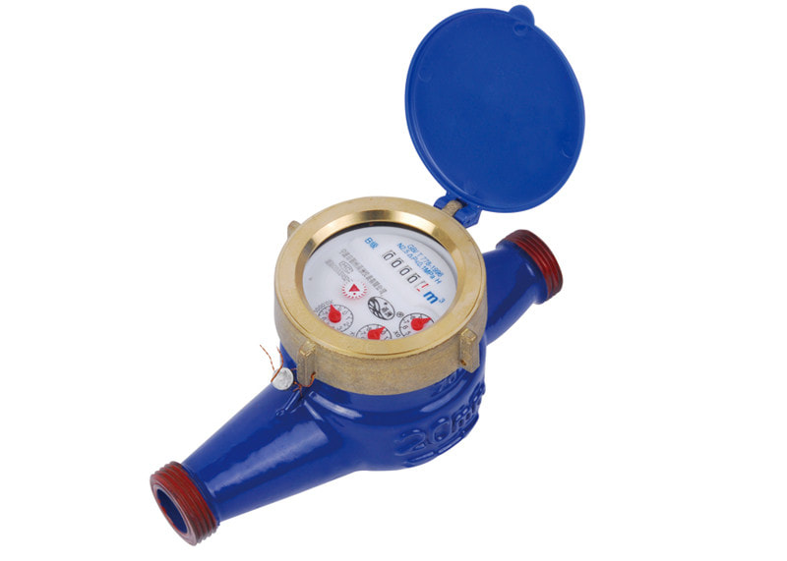
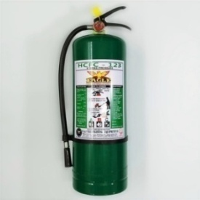
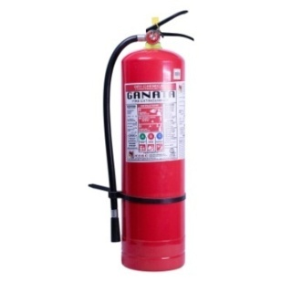
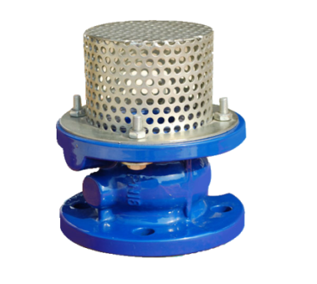
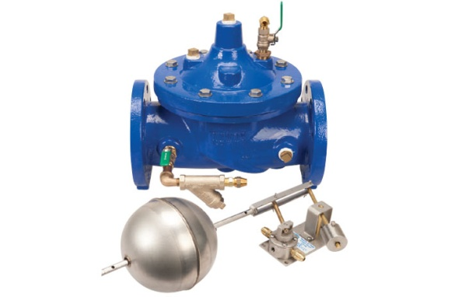
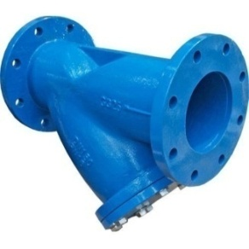
12
Empty Tank
CEILING | HCFC 123
10 LBS
20 LBS
 | WATER METER
2’’ | 7,800
1 ½ | 5,200
1 ¼ | 3,500
1’’ | 1,600
¾ | 1,400
½ | 1,100
 | HCFC 123
10 LBS | 430
20 LBS | 640
50 LBS
 | ABC
10 LBS | 310
20 LBS | 480
50 LBS
 | HYFLO
8’’ | 32,000
6’’ | 19,500
4’’ | 14,500
3’’ | 10,500
2 ½’’ | 9,500
10’’ | 43,000
 | CO2
10 LBS | 5,500
20 LBS | 8,450
100 LBS | 49,400
50 LBS | 42,000
 | HYFLO
8’’ | 34,000
6’’ | 18,500
4’’ | 14,500
3’’ | 11,500
2 ½’’ | 9,500
10’’ | 46,200
 | HYFLO
8’’ | 64,000
6’’ | 48,500
4’’ | 35,000
3’’ | 24,500
2 ½’’ | 17,500
10’’ | 76,200
12’’ | 65,000
12’’ | 95,000

Slide 13
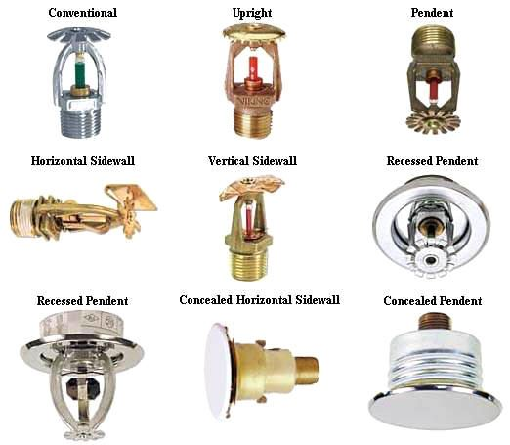


13
SPRINKLER HEADS
Red Bulb - 5mm Standard 155 F | PENDENT VIC | UPRIGHT VIC | SIDEWALL VIC
½ | 170 | 160 | 210
¾ | 365 | 350 | 410
Red Bulb - 5mm Stanard 155 F | PENDENT VIKING | UPRIGHT VIKING | SIDEWALL VIKING
½ | 180 | 170 | 220
¾ | 365 | 350 | 410
Pendent & Sidewall with plate
Red Bulb - 5mm Standard 155 F | PENDENT GLOBE | UPRIGHT GLOBE | SIDEWALL GLOBE
½ | 140 | 130 | 180
¾ | 340 | 325 | 385
Red Bulb - 3mm Quick Res. 155 F | PENDENT GLOBE | UPRIGHT GLOBE | SIDEWALL GLOBE
½ | 410 | 385 | 455
¾ | 645 | 620 | 670
CONCEALED SPRINKLER HEADS- CHINA
 | PENDENT GLOBE | PENDENT CHINA
½ | 720 | 530
CONCEALED SPRINKLER HEADS- TYCO ULFM
 | PENDENT TYCO | PENDENT
½ | 950
Green 5mm | Standard | 155 F
½ | 215 | 195 | 250
¾ | 395 | 370 | 420
Red Bulb - 5mm Standard 155 F | PENDENT NON-UL | UPRIGHT NON-UL | SIDEWALL NON-UL
½ | 120 | 95 | 145
¾ | 280 | 260 | 310
PLATE ONLY | PENDENT | SIDEWALL
½ | 30 | 30
¾ | 35 | 35
Red Bulb - 5mm | K -11.2 | VICTUALIC | VIKING
¾ |  | 475 | 485
WAREHOUSE: 137 General Evangelista, Bagong Barrio West, Caloocan City (TOYOTA EDSA BALINTAWAK)
Telefax: +632 5018841 Tel Number: +632 7117 38 45 Mobile : +63 9292 777 888 +63 9155 588 588; +63 9308 334 455
Email Us: jetflarecorp@gmail.com & jetflaresales@gmail.com

Slide 14



14
 | CLINTON Non- UL | SMITH-USA NON-UL | HYFLO/MECHUL/FM
8’’ | 7,800 |  | 9,600
6’’ | 5,000 | 5,565 | 6,075
4’’ | 2,900 | 3,700 | 4,400
3’’ | 2,550 | 3,400 | 3,900
2 ½’’ | 2,200 | 2,950 | 3,300
2’’ | 1,900 | 2,700 | 3,100
BUTTERFLY VALVE
 | CLINTON Non- UL
8’’
6’’ | 35,000
4’’ | 28,000
3’’ | 25,000
2 ½’’ | 18,500
2’’ | 17,000
 | CLINTON Non- UL
8’’ | 28,500
6’’ | 15,000
4’’ | 9,500
3’’ | 8,000
2 ½’’ | 6,500
10’’ | 35,000
MECHANICAL FLOAT VALVE
FOOT VALVE Flange type
 | CRAFT Non- UL
8’’
6’’ | 55,500
4’’ | 26,800
3’’ | 23,000
2 ½’’ | 18,500
2’’ | 17,000
 | CLINTON / SMITH
8’’
6’’ | 7,500
4’’ | 3,700
3’’ | 3,300
2 ½’’ | 2,900
2’’ | 2,400
PILOT PRESSURE RELIEF VALVE
WAFER
CHECK VALVE
QUEZON CITY OFFICE: 27 Felix Manalo St. Pinagkaisahan, Cubao Quezon City
WAREHOUSE: 137 General Evangelista, Bagong Barrio West, Caloocan City (TOYOTA EDSA BALINTAWAK)
Telefax: +632 5018841 Tel Number: +632 7117 38 45 Mobile : +63 9292 777 888 +63 9155 588 588; +63 9308 334 455
Email Us: jetflarecorp@gmail.com & jetflaresales@gmail.com

Slide 15



15
KITZ | CHECK VALVE | GATE VALVE | WYE-STRAINER
4’’ | 29,700 | 31,240
3’’ | 16,300 | 12,600
2 ½ ’’ | 12,600 | 7,500
2’’ | 5,900 | 4,000 | 9,840
1 ½’’ | 4,400 | 2,750 | 6,500
1 ¼ ’’ | 3,100 | 2,200 | 4,800
BALL VALVE
25,920
21,700
12,700
5,100
3,450
2,860
GLOBE VALVE
4,300
2,750
1,750
1’’ | 2,130 | 1,100 | 3,490 | 1,300
¾’’ | 1,280 | 980 | 2,100 | 930
½’’ | 880 | 815 | 1,584 | 785
1,550
 | EASTOP Air Release
1’’ | 3,000
11/4’’ | 3,750
11/2’’ | 3,900
2’’ | 4,000
4’’ | 6,380
3’’ | 4,200
2 ½ ’’ | 3,900
2’’ | 1,900
1 ½’’ | 1,700
1 ¼ ’’ | 1,400
FOOT VALVE
1 ’’ | 1,100
QUEZON CITY OFFICE: 27 Felix Manalo St. Pinagkaisahan, Cubao Quezon City
WAREHOUSE: 137 General Evangelista, Bagong Barrio West, Caloocan City (TOYOTA EDSA BALINTAWAK)
Telefax: +632 5018841 Tel Number: +632 7117 38 45 Mobile : +63 9292 777 888 +63 9155 588 588; +63 9308 334 455
Email Us: jetflarecorp@gmail.com & jetflaresales@gmail.com

Slide 16






16
 | CLINTON
8’’ | 28,000
6’’ | 13,500
4’’ | 10,500
3’’ | 8,500
2 ½’’ | 6,200
12’’ | 43,213
 | DOUBLE LL
4’’ | 10,700
3’’ | 5,650
2 ½’’ | 4,600
2’’ | 2,400
3/4 | 540
1/2 | 475
1/4 | 440
1 1/2 | 1,460
1 ¼ | 850
1 | 650
10’’ | 32,000
 | DOUBLE LL
4’’ | 12,000
3’’ | 7,200
2 ½’’ | 4,600
 | DOUBLE LL
4’’ | 12,000
3’’ | 7,000
2 ½’’ | 4,990
2’’ | 2,080
2’’ | 1,880
3/4 | 540
1/2 | 475
1/4 | 400
1 1/2 | 1,480
1 ¼ | 848
1 | 650/ 495
3/4 | 580
1/2 | 490
1/4 | 430
1 1/2 | 1,250
1 ¼ | 920
1 | 595
 | CLINTON
10’’ | 36,000
8’’ | 17,000
6’’ | 9,000
4’’ | 5,300
3’’ | 4,400
2 ½’’ | 3,500
 | UL/FM GIACOMINI
6’’ | 14,700
4’’ | 5,500
3’’ | 5,500
2 ½’’ | 5,500
2’’ | 3,200
QUEZON CITY OFFICE: 27 Felix Manalo St. Pinagkaisahan, Cubao Quezon City
WAREHOUSE: 137 General Evangelista, Bagong Barrio West, Caloocan City (TOYOTA EDSA BALINTAWAK)
Telefax: +632 5018841 Tel Number: +632 7117 38 45 Mobile : +63 9292 777 888 +63 9155 588 588; +63 9308 334 455
Email Us: jetflarecorp@gmail.com & jetflaresales@gmail.com

Slide 17









17
2’’ usa | 3,830
NON-UL | WYE STRAINER
2’’ | 1,900
1 ½’’ | 1,100
1 ¼’’ | 880
1 | 580
2’’ | 1,830
1 1/2 | 1,338
1 ¼ | 940
1 | 620
 | CLINTON
10’’ | 46,420
8’’ | 26,170
6’’ | 19,300
4’’ | 10,315
3’’ | 8,000
NON-UL | Safety Valve
2’’ | 9,500
1 ½’’ | 7,800
1 ¼’’ | 5,900
1 | 4,700
 | PLASTIC NOZZLE 1 1/2
 | 850
 | FIRE BALL
 | 800
 | PLASTIC NOZZLE 2 1/2
 | 2,120
 | FIRE AXE
 | 240

Slide 18










18
 | NIPLEE
1 ½ | 800
Giacomini GATE VALVE 1 1/2
3,600
2 ½ | 2,550
 | Giacomini NOZZLE
1 ½ | 1,700
Giacomini ANGLE VALVE
1 ½ - 2,700
2 ½ | 5,100
2 ½ - 5,900
Giacomini FIRE HOSE VALVE 2 1/2
4,500
ULFM | SNOOTS 2 1/2
 | 6,200
Giacomini INSPECTOR TEST VALVE 1’’
3,800
 | SNOOTS 2 1/2
 | 4,800
Giacomini Restricting ANGLE VALVE 1 1/2
2,900
 | WINTER UL/FM
 | 1,800
QUEZON CITY OFFICE: 27 Felix Manalo St. Pinagkaisahan, Cubao Quezon City
WAREHOUSE: 137 General Evangelista, Bagong Barrio West, Caloocan City (TOYOTA EDSA BALINTAWAK)
Telefax: +632 5018841 Tel Number: +632 7117 38 45 Mobile : +63 9292 777 888 +63 9155 588 588; +63 9308 334 455
Email Us: jetflarecorp@gmail.com & jetflaresales@gmail.com

Slide 19









19
ANGLE VALVE- Non UL 1 1/2
1,300
ANGLE VALVE- Non UL 2 1/2
6,500
FDC | ROUND
4’’ | 10,500
6’’ | 12,500
3’’ | 10,500
Water Flow Switch Threaded 1’’ | 2,800
 | CLINTON Non- UL | MECH UL/ FM | SYSTEM SENSOR UL/FM
6’’ | 3200 | 3800 | 6435
4’’ | 2800 | 3300 | 4600
3’’ | 2200 | 2900 | 4250
2 ½’’ | 1800 | 2,600 | 3980
 | POTTER & TEWA SPRAY UL/FM | HYFLO | SYSTEM SENSOR UL/FM
2’’-16’’ | 4,000 |  | 5500
QUEZON CITY OFFICE: 27 Felix Manalo St. Pinagkaisahan, Cubao Quezon City
WAREHOUSE: 137 General Evangelista, Bagong Barrio West, Caloocan City (TOYOTA EDSA BALINTAWAK)
Telefax: +632 5018841 Tel Number: +632 7117 38 45 Mobile : +63 9292 777 888 +63 9155 588 588; +63 9308 334 455
Email Us: jetflarecorp@gmail.com & jetflaresales@gmail.com

Slide 20



20
FIRE HOSE RACK 11/2 - 50 FT.
1000
FIRE HOSE RACK 11/2 - 100 FT.
1100
FIRE HOSE RACK 21/2 - 100 FT.
2200
FIRE HOSE- KEY CABINET 50 FT.
1,900
FIRE HOSE –KEY CABINET 100 FT.
2,050
FIRE HOSE- PUSH LOCK -CABINET 50 FT.
2,200
FIRE HOSE –PUSH LOCK -CABINET 100 FT.
2,700
50ft. Single Jacket Non – UL | 100ft. Single Jacket Non – UL | 50ft. Single Jacket UL FM | 100ft. Single Jacket UL FM
1 ½ | 1 ½ | 1 ½ | 1 ½
8,300 | 8,680 | 8,680 | 9,100
2 ½ | 2 ½ | 2 ½ | 2 ½
12,600 | 14,500 | 16,200 | 18,200
50ft. Double Jacket Non – UL | 100ft. Double Jacket Non – UL | 50ft. Double Jacket UL FM | 100ft. Double Jacket UL FM
1 ½ | 1 ½ | 1 ½ | 1 ½
10,000 | 10,500 | 11,500 | 12,000
2 ½ | 2 ½ | 2 ½ | 2 ½
14,600 | 18,500 | 17,200 | 21,000
QUEZON CITY OFFICE: 27 Felix Manalo St. Pinagkaisahan, Cubao Quezon City
WAREHOUSE: 137 General Evangelista, Bagong Barrio West, Caloocan City (TOYOTA EDSA BALINTAWAK)
Telefax: +632 5018841 Tel Number: +632 7117 38 45 Mobile : +63 9292 777 888 +63 9155 588 588; +63 9308 334 455
Email Us: jetflarecorp@gmail.com & jetflaresales@gmail.com

Slide 21

21
SINGLE JACKET 1 1/2 NON-UL FIRE HOSE 50 FT.
1,790
SINGLE JACKET 1 1/2 NON-UL FIRE HOSE 100 FT.
1,950
DOUBLE JACKET 1 1/2 NON-UL FIRE HOSE 50 FT.
2,600
DOUBLE JACKET 1 1/2 NON-UL FIRE HOSE 100 FT.
3,050
DOUBLE JACKET 2 1/2 NON-UL FIRE HOSE 100 FT.
6,100
DOUBLE JACKET 2 1/2 NON-UL FIRE HOSE 50 FT.
4,400
SINGLE JACKET 2 1/2 NON-UL FIRE HOSE 50 FT.
3,465
SINGLE JACKET 2 1/2 NON-UL FIRE HOSE 100 FT.
3,990
DOUBLE JACKET 2 1/2 UL FM – HAISHEN FIRE HOSE 100 FT.
11,500
SINGLE JACKET 1 1/2 UL FM- HAISHEN FIRE HOSE 50 FT.
5,000
SINGLE JACKET 1 1/2 UL FM- HAISHEN FIRE HOSE 100 FT.
5,800
SINGLE JACKET 2 1/2 UL FM – HAISHEN FIRE HOSE 100 FT.
9,800
DOUBLE JACKET 1 1/2 UL FM- HAISHEN FIRE HOSE 50 FT.
DOUBLE JACKET 1 1/2 UL FM – HAISHEN FIRE HOSE 100 FT.
6,900
SINGLE JACKET 1 ½ HYFLO FIRE HOSE 50 FT.
2,050
SINGLE JACKET 1 ½ HYFLO FIRE HOSE 100 FT.
2,250
DOUBLE JACKET 1 ½ HYFLO FIRE HOSE 50 FT.
2,900
DOUBLE JACKET 1 ½ HYFLO FIRE HOSE 100 FT.
3,400
SINGLE JACKET 2 ½ HYFLO FIRE HOSE 50 FT.
3,950
SINGLE JACKET 2 ½ HYFLO FIRE HOSE 100 FT.
4,800
DOUBLE JACKET 2 ½ HYFLO FIRE HOSE 50 FT.
5,500
DOUBLE JACKET 2 ½ HYFLO FIRE HOSE 100 FT.
6,800
WAREHOUSE: 137 General Evangelista, Bagong Barrio West, Caloocan City (TOYOTA EDSA BALINTAWAK)
Telefax: +632 5018841 Tel Number: +632 7117 38 45 Mobile : +63 9292 777 888 +63 9155 588 588; +63 9308 334 455
Email Us: jetflarecorp@gmail.com & jetflaresales@gmail.com

Slide 22

22
ADDRESSABLE | ASENWARE FP-100 Model | ASENWARE FP-300 Model | Kennedy
SMOKE | 1,890 | 1895 | 1050
Annunciator | 24,800 | 25850
Heat Detector | 1,900 | 1950 | 1050
Manual Call Point | 2,200 | 2150 | 1300
Horn Strobe -Siren | 2,800 | 2850 | 1400
Control Panel
1- 2 loop | 50,000 | 50,000 | 35k / 45k
3 – 4 loop | 68,000 | 63,000
In/out module | 3,200 |  | 1500
Loop Module
Zone Module
Telephone jack | 4,950
Programmer | 8,000 | 7500 | 4500
Interface module |  |  | 1500
Isolation Module |  |  | 1400
WAREHOUSE: 137 General Evangelista, Bagong Barrio West, Caloocan City (TOYOTA EDSA BALINTAWAK)
Telefax: +632 5018841 Tel Number: +632 7117 38 45 Mobile : +63 9292 777 888 +63 9155 588 588; +63 9308 334 455
Email Us: jetflarecorp@gmail.com & jetflaresales@gmail.com

Slide 23



23
PANEL | ASENWARE | HORINGLI | RED-CHINA
4 zone | 13,500 | 20,250 | 10,000
8 zone | 18,500 | 22,680 | 12,500
12 zone | 20,500 | 47,140 | 16,500
16 zone | 25,000 |  | 19,500
2 zone | 12,500 |  | 9,000
20 zone | 28,500
24 zone | 42,000
CONVENTIONAL | ASENWARE | CHINA | HORINGLI
SMOKE | 381 - 690 | 480 | 870
SMOKE | 311- 550
Heat Detector | 660 | 490 | 745
Manual Call Point | 740 | 420 | 650
Horn Strobe -Siren | 840 | 650 | 1,750
Alarm Bell | 840 | 590 | 1,060
Beam Detector | 17,500
Smoke & Heat |  | 650
Manual Pull Station | 1,765 | 850

Slide 24


24
CONTROLLERS | SHILIN BRAND | EATON - USA UL/FM
FIRE PUMP 10 HP | 17,500
15 HP | 20,000
20 HP | 25,000 | 560,000
25 HP | 30,000 | 640,000
30 HP | 37,500 | 670,000
40 HP | 50,000 | 725,000
50 HP | 60,000 | 750,000
60 HP | 70,000 | 795,000
75 HP | 87,000 | 835,000
100 HP | 110,000 | 1,065,000
JOCKEY PUMP
2 HP ( 1 phase ) | 13,500
3 HP ( 1 phase ) | 13,500
3 HP | 12,500 | 115K
4 HP | 13,000 | 115K
5 HP 5 Hp ( 3 ph- 1ph) | 13,500 15,500 | 115K
INVERTER
10 HP | 35,000
15 HP | 42,000
20 HP | 58,000
25 HP | 87,500
30 HP | 110,000
40 HP | 125,000
50 HP | 148,000
7.5 HP | 15,500 | 130,000
10 HP | 18,500 | 130,000
7.5 HP | 32,000
QUEZON CITY OFFICE: 27 Felix Manalo St. Pinagkaisahan, Cubao Quezon City
WAREHOUSE: 137 General Evangelista, Bagong Barrio West, Caloocan City (TOYOTA EDSA BALINTAWAK)
Telefax: +632 5018841 Tel Number: +632 7117 38 45 Mobile : +63 9292 777 888 +63 9155 588 588; +63 9308 334 455
Email Us: jetflarecorp@gmail.com & jetflaresales@gmail.com

Slide 25






25
FLOAT VALVE
3/4 | 2,070
1 | 3,200
1 ¼ | 6,600
1 ½ | 8,700
2 | 11,200
Flexible Connector
3/4
1 | 990
1 ¼ | 1,050
1 ½ | 1,250
2 | 1,475
Pressure Switch | Mazaki Japan | DANFOSS | Purity China
90 psi below | 2800 | 3800 | 1800
91 psi up | 2800 | 3800 | 1800
Waste Cone
5 x 3 | 15,500
4 x 6 | 18,500
4 x 3 | 14,500
Craft thermometer
1,200
Winter Gauge ¼ UL/fm
1,800

Slide 26





26
GLOBAL VISION | FLOW METER 0-1500 GPM
6’’ | 126,320
8’’ | 138,600
4’’ | 123,500
HYFLO | FLOW METER
4’’- 600 GPM | 32,000
6’’ -1400 GPM | 37,000
Blue white | FLOW METER
4’’- 420 GPM | 19,000
6’’-1000 GPM | 23,500
3’’ – 380 GPM | 28,500
2 ½ – 250 GPM | 26,500
3’’- 250 GPM | 18,000
8’’ - 2100 GPM | 55,000
M-FLEX FLEXIBLE | SINGLE BELO | DOUBLE BELO Plus 45%
12 |  | 15,650
10 |  | 12,000
8 | 7,128 | 8,165
6 | 4,640 | 5,065
5 | 3,990
4 | 2,650 | 3,022
3 | 2,090 | 2,275
MECH FLEXIBLE
7,800
4,900
3,880
3,200
2,750
2 ½ | 1,735 | 1,815
2 | 1,535 | 1,400
WAREHOUSE: 137 General Evangelista, Bagong Barrio West, Caloocan City (TOYOTA EDSA BALINTAWAK)
Telefax: +632 5018841 Tel Number: +632 7117 38 45 Mobile : +63 9292 777 888 +63 9155 588 588; +63 9308 334 455
Email Us: jetflarecorp@gmail.com & jetflaresales@gmail.com

Slide 27



27
3 HP (1P) | 26,500 | 30-40GPM @ 40 PSI
2 HP (1P) | 19,500 | 10-25GPM @ 35 PSI
TRANSFER PUMP
4 HP | 34,000 | 55 – 60 GPM @ 40 PSI 30-35 GPM @ 60 PSI
7.5 HP | 49,500 | 30-40 GPM @ 80 PSI
10 HP | 72,000 | 35- 45 GPM @ 100 PSI
1 HP (1PH) | 15,000
1.5HP (1HP) | 17,500
Duplex Controller | PRICE
1 Hp – 2Hp | 42,000
3 Hp | 48,000
5 Hp | 52,000
7.5 Hp | 98,000
10 Hp | 132,000
EBARA
TRANSFER PUMP
CONTROLLER
 | EACH | DUPLEX -CPS | TRIPLEX-CPS
3 HP | 82,600 | 148,000 | 250,000
5.5 HP | 98,500 | 172,000 | 292,000
7.5HP | 125,400 | 198,000 | 338,000
10 HP | 142,000 | 245,000 | 425,000
QUEZON CITY OFFICE: 27 Felix Manalo St. Pinagkaisahan, Cubao Quezon City
WAREHOUSE: 137 General Evangelista, Bagong Barrio West, Caloocan City (TOYOTA EDSA BALINTAWAK)
Telefax: +632 5018841 Tel Number: +632 7117 38 45 Mobile : +63 9292 777 888 +63 9155 588 588; +63 9308 334 455
Email Us: jetflarecorp@gmail.com & jetflaresales@gmail.com

Slide 28




28
GOULDS
172,000
144,500
105,000
88,000
72,000
3HP (1P) | 38,300 | 32,000
2HP (1P) | 32,720 | 26,000
75,000
51,850
VERTICAL MULTI-STAGE
20 HP |  | 132,500
15 HP | 124,000 – 132,000 | 198,000
SUBMERSIBLE
MULTI-STAGE
5hp -380/440 | 73,000
3hp -380/440 | 54,500
QUEZON CITY OFFICE: 27 Felix Manalo St. Pinagkaisahan, Cubao Quezon City
WAREHOUSE: 137 General Evangelista, Bagong Barrio West, Caloocan City (TOYOTA EDSA BALINTAWAK)
Telefax: +632 5018841 Tel Number: +632 7117 38 45 Mobile : +63 9292 777 888 +63 9155 588 588; +63 9308 334 455
Email Us: jetflarecorp@gmail.com & jetflaresales@gmail.com

Slide 29




29
ELECTRIC MOTOR ONLY
25 HP | 33,500
20 HP | 30,000
15 HP | 27,500
DESIEL ENGINE ONLY

Slide 30
30
FIRE PUMP & JOCKEY PUMP
w/ Controller – Set
END SUCTION | SPLIT CASE
HORSE POWER ELECTRIC | STREAMPLUS or EBSRAY AUSTRALIA | PURITY or ZJ – BETTER CHINA | STREAMPLUS or EBSRAY AUSTRALIA | PURITY or ZJ – BETTER CHINA
10 HP - 2 HP | 180,000 | 160,000
15 HP - 2 HP | 200,000 | 170,000
20 HP - 3 HP | 210,000 | 180,000
25 HP - 3 HP | 225,000 | 205,000
30 HP - 3 HP | 255,000 | 220,000
40 HP - 4 HP | 270,000 | 235,000 | 415,000 | 358,000
50 HP - 5 HP | 310,000 | 270,000 | 490,000 | 425,000
60 HP - 5 HP | 325,000 | 285,000 | 530,000 | 480,000
75 HP - 5 HP | 365,000 | 330,000 | 588,000 | 530,000
100 HP - 7.5 HP | 535,000 | 445,000 | 770,000 | 695,000
NOTE:
If no available Stocks China brand (lead time 45- 80 days)
QUEZON CITY OFFICE: 27 Felix Manalo St. Pinagkaisahan, Cubao Quezon City
WAREHOUSE: 137 General Evangelista, Bagong Barrio West, Caloocan City (TOYOTA EDSA BALINTAWAK)
Telefax: +632 5018841 Tel Number: +632 7117 38 45 Mobile : +63 9292 777 888 +63 9155 588 588; +63 9308 334 455
Email Us: jetflarecorp@gmail.com & jetflaresales@gmail.com

Slide 31
31
FIRE PUMP & JOCKEY PUMP
w/ Controller – Set (non- UL)
VERTICAL TURBINE | DESIEL END SUCTION
HORSE POWER ELECTRIC | USA MOTOR USA | AMERICAN TURBINE w/ TECHTOP MOTOR | STREAMPLUS or EBSRAY AUSTRALIA | PURITY or ZJ – BETTER CHINA
10 HP - 2 HP
15 HP - 2 HP
20 HP - 3 HP
25 HP - 3 HP |  |  | 395,000
30 HP - 3 HP | 925,000 | 740,000 | 415,000 | 425,000
40 HP - 4 HP | 1,020,000 | 795,000 | 460,000 | 470,000
50 HP - 5 HP | 1,295,000 | 885,000 | 585,000 | 595,000
60 HP - 5 HP | 1,460,000 | 968,000 | 675,000 | 685,000
75 HP - 5 HP | 1,660,000 | 1,080,000 | 760,000 | 770,000
100 HP - 7.5 HP | 1,925,000 | 1,160,000 | 945,000 | 955,000
NOTE:
If no available Stocks China brand (lead time 45- 80 days)
QUEZON CITY OFFICE: 27 Felix Manalo St. Pinagkaisahan, Cubao Quezon City
WAREHOUSE: 137 General Evangelista, Bagong Barrio West, Caloocan City (TOYOTA EDSA BALINTAWAK)
Telefax: +632 5018841

Slide 32
32
FIRE PUMP & JOCKEY PUMP
w/ Controller – Set
END SUCTION | SPLIT CASE
HORSE POWER ELECTRIC | CHINA -EIFEL UL-LISTED -ELECTRIC Usa -Controller |  | CHINA -EIFEL UL-LISTED -ELECTRIC Usa -Controller | AURORA UL-FM Eaton Controller
20 HP - 3 HP | 1,135,000
25 HP - 3 HP | 1,160,000
30 HP - 3 HP | 1,285,000 |  | 1,410,000
40 HP - 4 HP | 1,430,000 |  | 1,655,000
50 HP - 5 HP | 1,485,000 |  | 1,780,000
60 HP - 5 HP | 1,595,000 |  | 1,820,000
75 HP - 5 HP | 1,760,000 |  | 1,965,000
100 HP –7.5HP | 1,990,000 |  | 2,250,000
125 HP –10HP | 2,280,000 |  | 2,450,000
150 HP –10HP | 2,550,000 |  | 2,790,000
NOTE:
If no available Stocks China brand (lead time 45- 80 days)
QUEZON CITY OFFICE: 27 Felix Manalo St. Pinagkaisahan, Cubao Quezon City
WAREHOUSE: 137 General Evangelista, Bagong Barrio West, Caloocan City (TOYOTA EDSA BALINTAWAK)
Telefax: +632 5018841 Tel Number: +632 7117 38 45 Mobile : +63 9292 777 888 +63 9155 588 588; +63 9308 334 455
Email Us: jetflarecorp@gmail.com & jetflaresales@gmail.com

Slide 33
33
FIRE PUMP & JOCKEY PUMP
UL/FM Set ( Eaton Cutler Hammer Controller )
With Water Flow Meter, Pressure Relief Valve, Waste cone
HORIZONTAL SPLIT CASE | VERTICAL TURBINE
HORSE POWER ELECTRIC | AURORA UL-FM USA -ELECTRIC | AURORA UL-FM -DESIEL | AURORA PUMP US- ELECTRIC | AURORA UL-FM -DESIEL
20 HP - 3 HP | 1,380,000
25 HP - 3 HP | 1,465,000
30 HP - 3 HP | 1,598,000 |  | 2,290,000
40 HP - 4 HP | 1,780,000 | 400 GPM @ 100 PSI 3,750,000.00 | 2,505,000
50 HP - 5 HP | 1,995,000 | 500 GPM @ 100 PSI 3,750,000.00 | 2,750,000
60 HP - 5 HP | 2,290,000
75 HP - 5 HP | 2,500,000 | 750 GPM @ 100 PSI 4,050,000.00 | 3,235,000
100 HP - 7.5 HP | 3,270,000 | 1000 GPM @ 100 PSI 4,252,500.00 | 4,550,000
125 HP - 7.5 HP | 3,570,000 |  | 5,050,000
150 HP - 7.5 HP | 3,870,000 | 1000 GPM @ 140 PSI 4,252,500.00 | 5,250,000
QUEZON CITY OFFICE: 27 Felix Manalo St. Pinagkaisahan, Cubao Quezon City
WAREHOUSE: 137 General Evangelista, Bagong Barrio West, Caloocan City (TOYOTA EDSA BALINTAWAK)
Telefax: +632 5018841 Tel Number: +632 7117 38 45 Mobile : +63 9292 777 888 +63 9155 588 588; +63 9308 334 455
Email Us: jetflarecorp@gmail.com & jetflaresales@gmail.com

Slide 34
34
FIRE PUMP & JOCKEY PUMP
UL/FM Set ( Eaton Cutler Hammer Controller )
HORIZONTAL SPLIT CASE | VERTICAL TURBINE
HORSE POWER ELECTRIC |  |  | MISTISO UL- MOTOR UL-CONTROLLER PUMP – COPY AURORA | AURORA UL-FM -DESIEL
20 HP - 3 HP
25 HP - 3 HP
30 HP - 3 HP |  |  | 1,850,000
40 HP - 4 HP |  |  | 1,980,000
50 HP - 5 HP |  |  | 2,150,000
60 HP - 5 HP |  |  | 2,220,000
75 HP - 5 HP |  |  | 2,435,000
100 HP - 7.5 HP |  |  | 2,550,000
125 HP - 7.5 HP |  |  | 2,680,000
150 HP - 7.5 HP |  |  | 2,820,000
QUEZON CITY OFFICE: 27 Felix Manalo St. Pinagkaisahan, Cubao Quezon City
WAREHOUSE: 137 General Evangelista, Bagong Barrio West, Caloocan City (TOYOTA EDSA BALINTAWAK)
Telefax: +632 5018841 Tel Number: +632 7117 38 45 Mobile : +63 9292 777 888 +63 9155 588 588; +63 9308 334 455
Email Us: jetflarecorp@gmail.com & jetflaresales@gmail.com

Slide 35





35
-
FIRE PUMP | JOCKEY PUMP | CAPACITY & PRESSURE | HORIZONTAL SET
10 hp | 2 hp | 100GPM@100PSI | 130,000
15 hp | 3 hp | 150GPM@100PSI | 150,000
20 hp | 3 hp | 180GPM@100PSI | 160,000
25 hp | 3 hp | 220GPM@100PSI | 170,000
30 hp | 3 hp | 300GPM@100PSI | 190,000
40 hp | 5 hp | 400GPM@100PSI | 210,000
50 hp | 5 hp | 500GPM@100PSI | 235,000
60 hp | 5 hp | 600GPM@100PSI | 265,000
75 hp | 5 hp | 750 GPM@100PSI | 310,000
75 hp | 5 hp | 500-600 @130PSI | 310,000
100 hp | 5 hp | 750-1000 @100-125PSI | 430,000
WAREHOUSE: 137 General Evangelista, Bagong Barrio West, Caloocan City (TOYOTA EDSA BALINTAWAK)
Telefax: +632 5018841 Tel Number: +632 7117 38 45 Mobile : +63 9292 777 888 +63 9155 588 588; +63 9308 334 455
Email Us: jetflarecorp@gmail.com & jetflaresales@gmail.com

Slide 36

36
-
FIRE PUMP | Controller | CAPACITY & PRESSURE | FIRE PUMP + CONTROLLER
FIRE PUMP ONLY
85,000
92,000
110,000
118,000
128,000
135,000
145,000
10 hp | 10 hp | 100GPM@100PSI | 95,000
15 hp | 15 hp | 150GPM@100PSI | 105,000
20 hp | 20 hp | 180GPM@100PSI | 125,000
25 hp | 25 hp | 220GPM@100PSI | 135,000
30 hp | 30 hp | 300GPM@100PSI | 150,000
40 hp | 40 hp | 400GPM@100PSI | 165,000
50 hp | 50 hp | 500GPM@100PSI | 180,000
60 hp | 60 hp | 600GPM@100PSI | 205,000
160,000
205,000
205,000
75 hp | 75 hp | 500-600 @130PSI | 245,000
75 hp | 75 hp | 750 GPM@100PSI | 245,000
WAREHOUSE: 137 General Evangelista, Bagong Barrio West, Caloocan City (TOYOTA EDSA BALINTAWAK)
Telefax: +632 5018841 Tel Number: +632 7117 38 45 Mobile : +63 9292 777 888 +63 9155 588 588; +63 9308 334 455
Email Us: jetflarecorp@gmail.com & jetflaresales@gmail.com

Slide 37



37
-
FIRE PUMP | JOCKEY PUMP | VERTICAL SET | CAPACITY & PRESSURE
10 hp | 2 hp | 125,000
15 hp | 2 hp | 135,000
20 hp | 3 hp | 145,000
25 hp | 3 hp | 155,000
30 hp | 3 hp | 170,000
40 hp | 5 hp | 195,000
50 hp | 5 hp | 225,000
60 hp | 5 hp | 250,000
75 hp | 5 hp | 295,000
WAREHOUSE: 137 General Evangelista, Bagong Barrio West, Caloocan City (TOYOTA EDSA BALINTAWAK)
Telefax: +632 5018841 Tel Number: +632 7117 38 45 Mobile : +63 9292 777 888 +63 9155 588 588; +63 9308 334 455
Email Us: jetflarecorp@gmail.com & jetflaresales@gmail.com

Slide 38



38
FIRE PUMP | JOCKEY PUMP | SET
10 hp | 2 hp | 315,000
15 hp | 2 hp | 335,000
20 hp | 3 hp | 355,000
25 hp | 3 hp | 395,000
30 hp | 3 hp | 430,000
40 hp | 5 hp | 498,000
50 hp | 5 hp | 570,000
60 hp | 5 hp | 670,000
75 hp | 5 hp | 860,000
100 hp | 7.5 hp | 895,000
125 hp | 10 hp | 946,000
150 hp | 10 hp | 1,150,000
WAREHOUSE: 137 General Evangelista, Bagong Barrio West, Caloocan City (TOYOTA EDSA BALINTAWAK)
Telefax: +632 5018841 Tel Number: +632 7117 38 45 Mobile : +63 9292 777 888 +63 9155 588 588; +63 9308 334 455
Email Us: jetflarecorp@gmail.com & jetflaresales@gmail.com

Slide 39


39
FIRE PUMP | JOCKEY PUMP | SET
27 hp | 2 hp | 670,000
32 hp | 2 hp | 725,000
42 hp | 3 hp | 780,000
57 hp | 3 hp | 885,000
61 hp | 3 hp | 870,000
75 hp | 5 hp | 910,000
96 hp | 5 hp | 930,000
117 hp | 5 hp | 1,110,000
200 GPM @100PSI
250 GPM @100PSI
300 GPM @ 100PSI
400 GPM @100 PSI
500 GPM @100PSI
600 GPM @100-120 PSI
750 GPM @100 PSI
1000 GPM @100 PSI
147 hp | 5 hp | 1,380,000
1250 GPM @100 PSI
1500 GPM @100 PSI
211 hp | 7.5 hp | 1,597,000
WAREHOUSE: 137 General Evangelista, Bagong Barrio West, Caloocan City (TOYOTA EDSA BALINTAWAK)
Telefax: +632 5018841 Tel Number: +632 7117 38 45 Mobile : +63 9292 777 888 +63 9155 588 588; +63 9308 334 455
Email Us: jetflarecorp@gmail.com & jetflaresales@gmail.com

Slide 40

40
®
Serving Philippine Water Industry
Since 1989
World-class systems, design, equipment
and services…
Horizontal Split Case
Fire Pump Assembly – Electric
– Streamplus Brand Australia -
30 HP | Php 520,000.00
40 HP | Php 540,000.00
50 HP | Php 620,000.00
60 HP | Php 685,000.00
75 HP | Php 730,000.00
100 HP | Php 860,000.00
150 HP | Php 995,000.00
Accessories: Fire & Jockey Pump
Wet Alarm Check Valve, OS & Y Gate Valve,
Return Gate Valve, Pressure Relief Valve,
Check Valve, Flexible Connector, Controller
ALL RIGHTS RESERVED. PHILIPPINE COPYRIGHT 2012
© Trade marks are registered properties of their owners. Equipment and parts that we use are so marked and are made integral with
our business as such as legitimate and applicable reliable system components.

Slide 41
41
®
Serving Philippine Water Industry
Since 1989
World-class systems, design, equipment
and services…
Horizontal Split Case
Fire Pump Assembly – Electric
– PURITY CHINA BRAND-
40 HP -300gpm | Php 510,000.00
50 HP -400gpm | Php 590,000.00
60 HP -500gpm | Php 655,000.00
75 HP -600gpm | Php 610,000.00
100 HP -750gpm | Php 820,000.00
150 HP -1250gpm | Php 955,000.00
Accessories: Fire & Jockey Pump
Wet Alarm Check Valve, OS & Y Gate Valve,
Return Gate Valve, Pressure Relief Valve,
Check Valve, Flexible Connector, Controller
ALL RIGHTS RESERVED. PHILIPPINE COPYRIGHT 2012
© Trade marks are registered properties of their owners. Equipment and parts that we use are so marked and are made integral with
our business as such as legitimate and applicable reliable system components.

Slide 42

42
®
Serving Philippine Water Industry
Since 1989
World-class systems, design, equipment
and services…
World-class systems, design, equipment
and services…
Horizontal End Suction
Fire Pump Assembly- Electric
– Streamplus Brand Australia -
10 HP | Php 240,000.00
15 HP | Php 270,000.00
20 HP | Php 305,000.00
25 HP | Php 325,000.00
30 HP | Php 335,000.00
40 HP | Php 370,000.00
50 HP | Php 405,000.00
60 HP | Php 435,000.00
75 HP | Php 485,000.00
100 HP | Php 650,000.00
Accessories: Fire & Jockey Pump
Wet Alarm Check Valve, OS & Y Gate Valve,
Return Gate Valve, Pressure Relief Valve,
Check Valve, Flexible Connector, Controller
ALL RIGHTS RESERVED. PHILIPPINE COPYRIGHT 2012
© Trade marks are registered properties of their owners. Equipment and parts that we use are so marked and are made integral with
our business as such as legitimate and applicable reliable system components.

Slide 43


43
®
Serving Philippine Water Industry
Since 1989
World-class systems, design, equipment
and services…
Horizontal End Suction
and Vertical Inline
Fire Pump Assembly –
Electric– Purity Brand China -
10 HP | Php 165,000
15 HP | Php 175,000
20 HP | Php 215,000
25 HP | Php 228,000
30 HP | Php 240,000
40 HP | Php 270,000
50 HP | Php 290,000
60 HP | Php 318,000
75 HP | Php 353,000
100 HP | Php 517,500
CLOSE COUPLED
Accessories: Fire & Jockey Pump
OS & Y Gate Valve,Return Gate Valve, Pressure Relief Valve, Check Valve, Flexible Connector, Controller
ALL RIGHTS RESERVED. PHILIPPINE COPYRIGHT 2012
© Trade marks are registered properties of their owners. Equipment and parts that we use are so marked and are made integral with
our business as such as legitimate and applicable reliable system components.

Slide 44



44
10Hp /3Hp Purity – Single Phase via inverter Controller with Threaded fitting no PRV
Php -157,500.00
Php – 136,500.00 Set Only
10Hp /3Hp Streamplus
– Single Phase Controller with Threaded fitting no PRV
Php -178,500.00
Php – 157,500.00 Set Only
5Hp /3Hp Purity – Single Phase Controller with Threaded fitting no PRV
Php -135,000.00

Slide 45
45
10Hp /3Hp Purity – Single Phase via inverter Controller with flange type fitting no PRV
Php -163,000.00 -Assembly
Php – 136,500.00 Set Only
10Hp /3Hp Streamplus
– Single Phase Controller with flange type fitting no PRV
Php -187,000.00 -Assembly
Php – 157,500.00 Set Only
10Hp /3Hp PURITY
Php -181,000.00 -Assembly
Php – 152,500.00 Set Only
5Hp /3Hp Purity – Single Phase Controller with flange type fitting no PRV
Php -142,000.00

Slide 46
46
®
Serving Philippine Water Industry
Since 1989
World-class systems, design, equipment
and services…
Horizontal End Suction
and Vertical Inline
Fire Pump Assembly –
Electric– Purity Brand China -
10 HP | Php 170,000
15 HP | Php 190,000
20 HP | Php 225,000
25 HP | Php 240,000
30 HP | Php 255,000
40 HP | Php 290,000
50 HP | Php 310,000
PEJ – MODEL ( Base plate )
Accessories: Fire & Jockey Pump
OS & Y Gate Valve, Return Gate Valve, Pressure Relief Valve, Check Valve, Flexible Connector, Controller
ALL RIGHTS RESERVED. PHILIPPINE COPYRIGHT 2012
© Trade marks are registered properties of their owners. Equipment and parts that we use are so marked and are made integral with
our business as such as legitimate and applicable reliable system components.

Slide 47
47
®
Serving Philippine Water Industry
Since 1989
World-class systems, design, equipment
and services…
Horizontal End Suction
Fire Pump Assembly – Electric
– Purity Brand China -
10 HP | Php 220,000
15 HP | Php 245,000
20 HP | Php 260,000
25 HP | Php 295,000
30 HP | Php 305,000
40 HP | Php 320,000
50 HP | Php 360,000
60 HP | Php 405,000
75 HP | Php 455,000
100 HP | Php 580,000
Accessories: Fire & Jockey Pump
Wet Alarm Check Valve, OS & Y Gate Valve,
Return Gate Valve, Pressure Relief Valve,
Check Valve, Flexible Connector, Controller
ALL RIGHTS RESERVED. PHILIPPINE COPYRIGHT 2012
© Trade marks are registered properties of their owners. Equipment and parts that we use are so marked and are made integral with
our business as such as legitimate and applicable reliable system components.

Slide 48


48
®
Serving Philippine Water Industry
Since 1989
World-class systems, design, equipment
and services…
Horizontal End Suction
Fire Pump Assembly-
Diesel Engine Driven
– Streamplus Brand Australia -
25 HP – 200 GPM | Php 480,000.00
30 HP – 250 GPM | Php 498,000.00
40 HP -300 GPM | Php 532,000.00
50 HP – 500 GPM | Php 660,000.00
60 HP - 600 GPM | Php 740,000.00
75 HP | Php 820,000.00
100 HP | Php 940,000.00
40 HP -300 GPM | Php 532,000.00
Accessories: Fire & Jockey Pump
Wet Alarm Check Valve, OS & Y Gate Valve,
Return Gate Valve, Pressure Relief Valve,
Check Valve, Flexible Connector, Controller
ALL RIGHTS RESERVED. PHILIPPINE COPYRIGHT 2012
© Trade marks are registered properties of their owners. Equipment and parts that we use are so marked and are made integral with
our business as such as legitimate and applicable reliable system components.

Slide 49

50
®
Serving Philippine Water Industry
Since 1989
World-class systems, design, equipment
and services…
Horizontal Split Case
Fire Pump Assembly-
Diesel Driven
– PURITY Brand China -
125 PSI MAX | SET WITH JOCKEY ONLY
59 BHP -400 GPM | Php 750,000.00
60 BHP –500 GPM | Php 800,000.00
80 BHP - 750 GPM | Php 900,000.00
125 PSI MAX | ASSEMBLY
59 BHP -400 GPM | Php 880,000.00
61 BHP –500 GPM | Php 940,000.00
80 BHP - 750 GPM | Php 1,050,000.00
Accessories: Fire & Jockey Pump
Wet Alarm Check Valve, OS & Y Gate Valve,
Return Gate Valve, Pressure Relief Valve,
Check Valve, Flexible Connector, Controller
ALL RIGHTS RESERVED. PHILIPPINE COPYRIGHT 2012
© Trade marks are registered properties of their owners. Equipment and parts that we use are so marked and are made integral with
our business as such as legitimate and applicable reliable system components.

Slide 50


49
®
Serving Philippine Water Industry
Since 1989
World-class systems, design, equipment
and services…
Horizontal End Suction
Fire Pump Assembly-
Diesel Driven
– PURITY Brand China -
25 HP – 200 GPM | Php 430,000.00
30 HP – 250 GPM | Php 448,000.00
38 HP -300 GPM | Php 477,000.00
48 HP – 400 GPM | Php 590,000.00
58 HP - 500 GPM | Php 665,000.00
68 HP - 600 GPM | Php 735,000.00
88 HP -750 GPM | Php 800,000.00
Accessories: Fire & Jockey Pump
Wet Alarm Check Valve, OS & Y Gate Valve,
Return Gate Valve, Pressure Relief Valve,
Check Valve, Flexible Connector, Controller
ALL RIGHTS RESERVED. PHILIPPINE COPYRIGHT 2012
© Trade marks are registered properties of their owners. Equipment and parts that we use are so marked and are made integral with
our business as such as legitimate and applicable reliable system components.

Slide 51





51
GRIP ANCHOR
3/8 | 6.50
1/2 | 12.00
5/8 | 21.00
CLEVIS HANGER
2 ½ | 70.00
3 | 105
4 | 143
6 | 215
8’ | 430
U- BOLT
1/8 x 1 | 20.00
1/8 x 1 ¼ | 24.75
1/8 x 1 ½ | 29.50
3/8 x 2 | 34.00
3/8 x 2 ½ | 38.00
3/8 x 3 | 42.50
3/8 X 4 3/8 x 5 | 54.50 62.25
LOOP HANGER
3/4 | 13.00
1 | 17.00
1 ¼ | 21.25
1 ½ | 27.00
2 | 31.90
2 ½ | 38.25
3 | 48.50
4 | 58.20
6 | 90.00
3/8 x 6 | 77.40
3/8 x 8 | 128.00
1/2 x 2 ½ | 149.00
1/ 2 x 3 | 178.00
1/2 x 4 | 201.00
1/2 x 6 | 224.00
1/2 x 8 | 265.00
DYNA BOLT
3/8 | 42.00
1/2 | 49.00
5/8 | 3.00
WAREHOUSE: 137 General Evangelista, Bagong Barrio West, Caloocan City (TOYOTA EDSA BALINTAWAK)
Telefax: +632 5018841 Tel Number: +632 7117 38 45 Mobile : +63 9292 777 888 +63 9155 588 588; +63 9308 334 455
Email Us: jetflarecorp@gmail.com & jetflaresales@gmail.com

Slide 52



52
 | NUT | WASHER
3/8 | 3.00 | 2.50
1/2 | 5.00 | 4.00
5/8 | 8.00 | 7.00
3/4 | 12.00 | 8.00
BOLT NUT WASHER
3/8 x 1 | 6.10
3/8 x 1 ½ | 9.50
3/8 x 2 | 13.50
1/2 x 2 | 20.00
1/2 x 2 ½ | 23.00
1/2 x 3 | 25.00
1/2 x 4 | 32.00
Angle Bar
Nipple
1 x 1’’ | 12.00
1 ¼ x 1 | 14.75
1 ½ x 1 | 21.25
2 x 1 | 30.00
2 ½ x 1 | 55.00
3 x 1 | 75.00
4 x 1 | 106.00
6 x 1 | 145.00
1 x 3 /16 | 680.00
1 x ¼ (cm) | 790.00
1 ½ x 3/16 | 880.00
1 ½ x ¼ (cm) | 1,100.00
2 x 3/16 | 1,140.00
2 x ¼ (cm) | 1,480.00
2 ½ x 3/16 | 1,457.00
2 ½ x ¼ (cm) | 1,884.00
1/2 x 6 | 40.00
5/8 x 2 | 28.00
5/8 x 2 1/2 | 32.00
5/8 x 3 | 38.00
5/8 x 4 | 44.00
5/8 x 6 | 55.00
5/8 x 8 | 65.00
3/4 x 3 | 55.00
3/4 x 4 | 69.00
3/4 x 6 | 88.00
3/4 x 8 | 112.00

Slide 53











53
ELECTRICAL
EMT | COUPLING
1 | 25.00
1/2 | 15.00
3/4 | 20.00
CONDUIT | HANGER
1
1/2
3/4
1 1/4 | 75.00
1 1/2 | 102.00
2 | 140.00
1 1/4
1 1/2
2
FULL THREAD | ROD
3/8 | 120.00
1/2 | 138.00
5/8 | 190.00
UTILITY BOX w/ cover
65.00
FLEXIBLE HOSE
1/2 30 Meters | 650.00
3/4 | 875.00
1 | 1,400.00
1 1/4
1 1/2
SQUARE BOX 4 X 4
85.00
JUNCTION BOX
55.00
2
EMT 1 hole Clamp
½ | 15.00
¾ | 20.00
1 | 25.00
EMT 2 holes Clamp
½ | 17.00
¾ | 22.00
1 | 28.00
EMT PIPE | ROD
1/2’’ | 105.00
¾’’ | 137.00
1’’ | 225.00
STRAIGHT | CONNECTOR
1 | 35.00
1/2 | 20.00
3/4 | 28.00
1 ¼ | 360.00
1 ½ | 410.00
2’’ | 555.00

Slide 54









54
GASKET | SBR
8’’ | 135.00
6’’ | 105.00
4’’ | 85.00
3’’ | 75.00
2 ½’’ | 60.00
2’’ | 50.00
1 ½ - 1’’ | 45.00
TF WIRE SINGLE
1,780
2,200
ROYAL PACIFIC | ROYAL CORDS Rolls Per/ Mtr
No. 14 2 Wires | 4,345 55.00 /meter
No. 12 2 Wires | 6,100 70.00 /meter
No. 12 3 Wires | 7,800 90.00 /meter
No. 10 3 Wires
No. 6 3 Wires
PRIMER PAINT 1 gal. | 650.00
1 liter. | 190.00
INTERNATIONAL 1 gal. | 1,100.00
1 liter | 285.00
PAINT THINNER 1 gal. | 705.00
1 bottle | 115.00
Rubber Gasket 1/8 | 830 /meter
Rubber Gasket 3/16 | 1235 /meter
Rubber Gasket 1/4 | 1595 /meter

Slide 55


















55
DARK GLASS
20.00
CLEAR GLASS
18.00
WELDING MASK
180.00
PAINT BRUSH 2 ½ | 39.00
2’’ | 37.00
3’’ | 65.00
4’’ | 78.00
WELDING GOWN
1,240.00
HARNESS
1040.00
WELDING GLOVES
240.00
WELDING HOLDER
385.00
SAFETY SHOES
480.00
WORKINGGLOVES
38.00

Slide 56









56
Plus 5%
ITEM | PICTURE | SIZE | PCS/CTN | CTNS | Qty/pcs | U.W.(kg) | PRICE
COUPLING |  | 2" | 30 | 10 | 300 | 0.7 | 276.00
 |  | 2-1/2“ | 24 | 15 | 360 | 0.78 | 360.00
 |  | 3 | 35 | 13 | 455 | 0.92 | 480.00
 |  | 4 | 25 | 30 | 750 | 1.39 | 540.00
 |  | 6 | 10 | 30 | 300 | 2.03 | 900.00
 |  | 8 | 6 | 10 | 60 | 3.77 | 1560.00
90° ELBOW |  | 2” | 50 | 2 | 100 | 0.65 | 254.00
 |  | 2-1/2” | 32 | 5 | 160 | 0.95 | 389.00
 |  | 3 | 18 | 10 | 180 | 1.32 | 528.00
 |  | 4 | 12 | 12 | 144 | 1.87 | 699.00
 |  | 6 | 3 | 20 | 60 | 4.37 | 1317.00
 |  | 8“ | 1 | 30 | 30 | 7.85 | 3576.00
45° ELBOW |  | 3 | 24 | 2 | 48 | 1.1 | 358.00
 |  | 4 | 14 | 3 | 42 | 1.82 | 621.00
 |  | 6 | 4 | 5 | 20 | 3.62 | 1235.00
GROOVED CONCENTRIC REDUCER |  | 1-1/2“x2-1/2” | 64 | 1 | 64 | 0.39 | 140.00
 |  | 2 x 2-1/2” | 64 | 1 | 64 | 0.5 | 140.00
 |  | 2 x 3 | 64 | 1 | 64 | 0.55 | 232.00
 |  | 2 x 4 | 45 | 1 | 45 | 0.87 | 320.00
 |  | 2-1/2” x 3 | 64 | 1 | 64 | 0.68 | 232.00
 |  | 2-1/2” x 4 | 36 | 1 | 36 | 0.92 | 320.00
 |  | 2-1/2” x 6 | 20 | 1 | 20 | 1.92 | 804.00
 |  | 3 x 4 | 36 | 1 | 36 | 0.99 | 320.00
 |  | 4 x 6 | 20 | 1 | 20 | 2.19 | 804.00
 |  | 6 x 8 | 5 | 1 | 5 | 3.76 | 1270.00
GROOVED CAP FITTING |  | 2-1/2” | 64 | 1 | 64 | 0.27 | 150.00
 |  | 3 | 50 | 1 | 50 | 0.47 | 176.00
 |  | 4 | 45 | 1 | 45 | 0.7 | 250.00
 |  | 6 | 20 | 1 | 20 | 1.87 | 598.00
TEE |  | 2” | 30 | 2 | 60 | 0.93 | 374.00
 |  | 2-1/2” | 24 | 3 | 72 | 1.3 | 560.00
 |  | 3 | 12 | 4 | 48 | 1.82 | 731.00
 |  | 4 | 7 | 8 | 56 | 2.74 | 1066.00
 |  | 6 | 2 | 10 | 20 | 5.89 | 2106.00
 |  | 2-1/2” x 4 | 7 | 4 | 28 | 2.55 | 1066.00
 |  | 3 x 4 | 7 | 4 | 28 | 2.78 | 1066.00
 |  | 4 x 6 | 2 | 7 | 14 | 5.94 | 2,082.00
MECHANICAL TEE THREADED |  | 1 x 2-1/2” | 45 | 10 | 450 | 0.81 | 376.00
 |  | 1 x 3 | 36 | 10 | 360 | 0.96 | 461.00
 |  | 1 x 4 | 30 | 6 | 180 | 1.36 | 600.00
 |  | 1-1/4" x 2-1/2” | 45 | 3 | 135 | 0.91 | 560.00
 |  | 1-1/4" x 3 | 36 | 3 | 108 | 1.26 | 461.00
 |  | 1-1/4" x 4 | 30 | 4 | 120 | 1.41 | 600.00
 |  | 1-1/2“ x 2-1/2” | 36 | 2 | 72 | 0.97 | 376.00
 |  | 1-1/2“ x 3 | 36 | 2 | 72 | 1.17 | 461.00
 |  | 1-1/2“ x 4 | 25 | 2 | 50 | 1.47 | 600.00
 |  | 1-1/2“ x 6 | 15 | 2 | 30 | 2.58 | 850.00
 |  | 2 x 3 | 30 | 3 | 90 | 1.34 | 461.00
 |  | 2 x 4 | 25 | 3 | 75 | 1.6 | 600.00
 |  | 2 x 6 | 12 | 2 | 24 | 2.44 | 850.00
MECHANICAL TEE GROOVED |  | 2-1/2” x 4 | 18 | 2 | 36 | 1.87 | 706.00
 |  | 2-1/2” x 6 | 12 | 2 | 24 | 2.54 | 999.00
 |  | 3 x 4 | 18 | 3 | 54 | 2.02 | 706.00
 |  | 3 x 6 | 10 | 3 | 30 | 3.04 | 999.00
GROOVED FLANGE |  | 2” | 16 | 1 | 16 | 1.61 | 415.00
 |  | 2-1/2” | 16 | 4 | 64 | 1.89 | 718.00
 |  | 3 | 10 | 5 | 50 | 2.23 | 795.00
 |  | 4 | 10 | 5 | 100 | 2.71 | 857.00
 |  | 6 | 3 | 10 | 30 | 3.81 | 1250.00

Slide 57

57
Black Iron - Bell Reducer - Welded
SIZE | SCH. 40 | SCH. 40
 | CONCENTRIC | ECCENTRIC
3 x 1 | 748.00
1” x ¾ | 90.00 | 130.00
1 ¼” x 1” | 95.00 | 137.00
1 ½ x 1 ¼ | 96.00 | 149.00
1 ½ x 1 | 98.00 | 149.00
2” x 1 ½ | 106.00 | 161.00
2” x 1 ¼” | 120.00 | 185.00
2” x 1” | 132.00 | 204.00
2 ½” x 2” | 132.00 | 272.00
2 ½” x 1 ½” | 143.00 | 284.00
2 ½” x 1 ¼” | 160.00 | 303.00
3” x 2 ½” | 182.00 | 346.00
3” x 2” | 182.00 | 358.00
3” x 1 ½” | 748.00 | 382.00
4” x 3” | 264.00 | 407.00
4” x 2 ½” | 281.00 | 432.00
4” x 2” | 303.00 | 457.00
5” x 4” | 523.00 | 555.00
5” x 3” | 556.00 | 604.00
5” x 2 ½” | 589.00 | 678.00
5” x 2” | 616.00 | 740.00
4 x 1 ½ ‘’ | 975.00
SIZE | SCH. 40 | SCH. 40
 | CONCENTRIC | ECCENTRIC
6” x 5” | 689.00 | 1,188.00
6” x 4” | 719.00 | 1,254.00
6” x 3” | 749.00 | 1,294.00
6” x 2 ½” | 1,223.00 | 1,529.00
6” x 2” | 1,855.00 | 1,634.00
8” x 6” | 1,136.00 | 1,708.00
8” x 5” | 1,144.00 | 1,782.00
8” x 4” | 1,202.00 | 1,857.00
8” x 3” | 1,258.00 | 2,008.00
10” x 8” | 1,697.00 | 3,432.00
10” x 6” | 1,717.00 | 3,518.00
10” x 5” | 1,755.00 | 3,604.00
10” x 4” | 1,812.00 | 3,776.00
12” x 10” | 2,832.00 | 4,689.00
12” x 8” | 3,013.00 | 5,492.00
12” x 6” | 3,052.00 | 5,492.00
12” x 4” | 3,243.00 | 5,723.00
14” x 12” | 8,070.00
14” x 10” | 8,803.00
14” x 8” | 9,537.00
2 ½ x 1 | 504.00
BLADDER TANK | PRICE
2000 liters | 375,400
1500 liters | 219,600
1000 liters | 129,700
850 liters | 111,900
700 liters | 100,700
500 liters | 55,300
300 liters | 34,000
200 liters | 28,800
150 liters | 23,500
100 liters | 15,000
80 liters | 12,500
60 liters | 8,500

Slide 58

STAINLESS TANK | PRICE
10000 liters | 185,000
6500 liters | 98,000
5000 liters | 83,000
3500 liters | 68,500
2000 liters | 39,500
1000 liters | 17,500
58

Slide 59









59
TOOLS
THREADING MACHINE
½’’ - 2’’ | 37,500
½’’ – 4’’ | 60,000
GROOVING MACHINE
2- 6’’ | 78,000
2- 12’’ | 95,000
WELDING MACHINE INVERTER
- 8,500 500 - 10,500
PIPE HOLE SAW MACHINE
30,000
CUT-OFF
8,500
PIPE WRENCH
14’’ | 580.00
18’’ | 720.00
GRINDER
2,800
 | DIES
½ - ¾ | 3,500
1-2 | 3,800
2 ½ - 4 | 4,800
20’’ | 980.00
24’’ | 1,450.00
DRILL
3,500

