Slide 1
Google ads presentation
George Vamvakousis

Slide 2
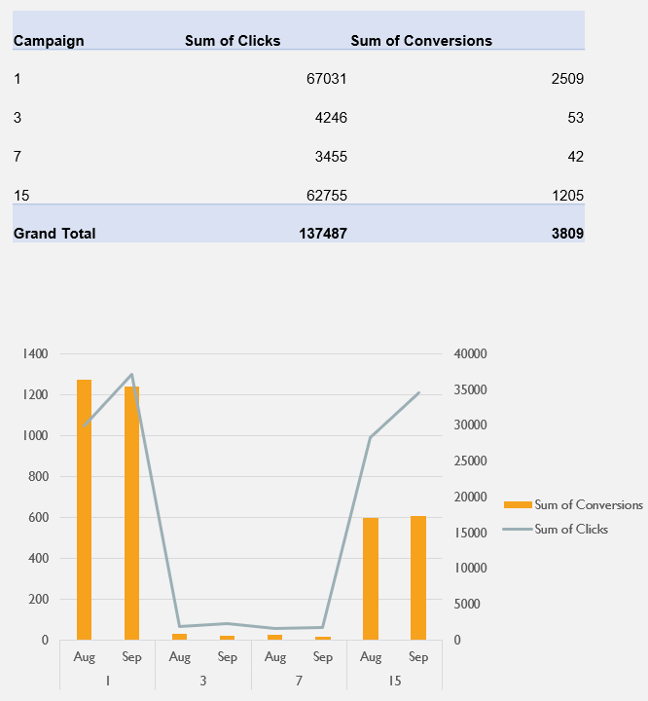
The table on the right shows us the total clicks and conversions of each campaign (1,3,7,15). As we see, the campaign-1 achieved the highest scores on both of the attributes.
The chart on the right shows us the above table. Two months is the duration of each campaign, so we used a 2-month split to have a better view of what happened. We can see that there is not a remarkable difference between the conversions on the 2 months of each campaign (August - September), but Septembers got more clicks.
Conversions & Clicks / Campaign & Month

Slide 3
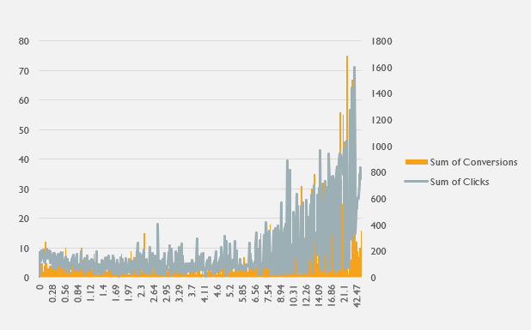
Conversions & Clicks / Cost
According to our data, the higher it was the cost of our campaign, the bigger the crowd we impressed and the crowd’s interaction with the Ad.

Slide 4
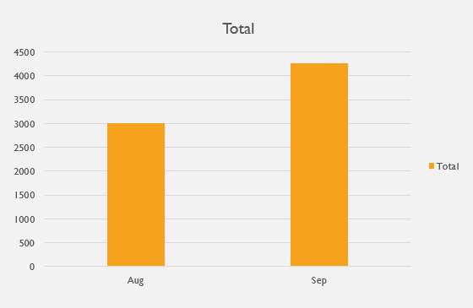
Cost/ Month
Following the previous slides, we should figure out why Septembers had better total clicks. Our previous slide showed us that as we increased the cost, we had better outcomes. The chart on the right, shows us that we spent more money at September campaigns and that is why Septembers did better.

Slide 5
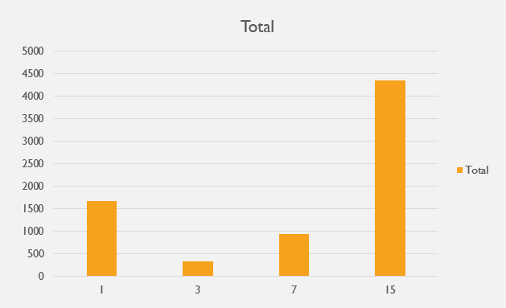
Cost / Campaign
According to what we saw on the previous slides, we would guess that the campaign who did better, would be the one who costed more. In fact, campaign-15 was almost 4 times more expensive than campaign-1, and performed slightly worse. Thus, we conclude that there is something also important that affects the campaign’s performance, as well.

Slide 6
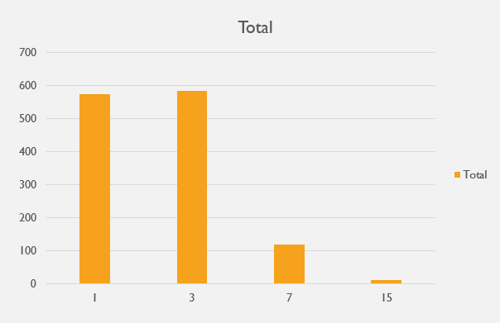
CTR / Campaign
CTR is calculated by dividing the number of users who clicked on the ad by the number of times the ad was delivered. A high CTR shows us that our campaign was impressive and created engagement with the people who saw it.
This chart shows us the reason why campaign-1 performed better than campaign-15, although it costed significantly less.
We also see that campaign-3’s content did a really good job, and we can guess that it would had done great if we invested more money on it’s promotion.

Slide 7
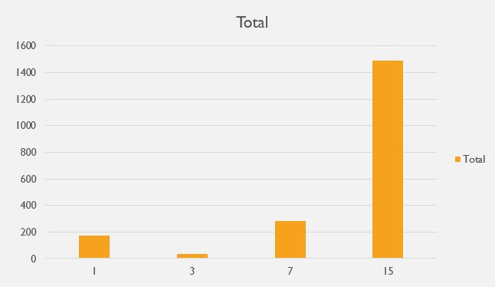
(Sum of cost/Conversion) / Campaign
CPA or Cost Per Acquisition is the cost every time a conversion happens for the advertiser and we can calculate it by dividing the sum of cost by the conversion. This chart also confirms the above slide’s conclusion.

Slide 8
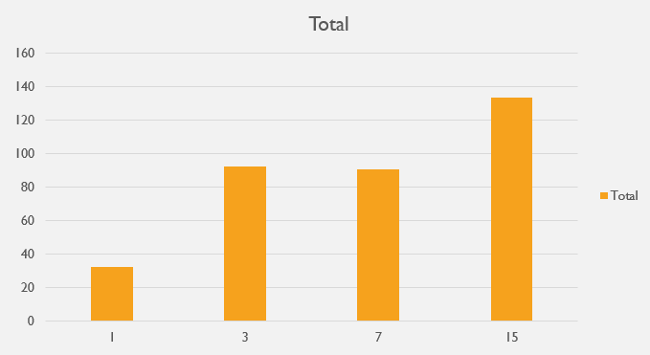
CPC / Campaign
Cost Per Click (CPC) is an online advertising revenue model that websites use to bill advertisers based on the number of times visitors click on a display ad attached to their sites. So, this chart shows us that campaign-15’s each click costed the most of all campaigns, campaign-1’s clicks were the cheapest and campaigns 3 and 7 were close, with campaign-3 being a bit more expensive.

Slide 9
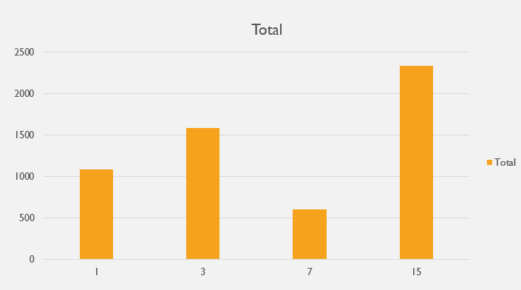
Average Position / Campaign
Campaigns with better ad quality, keywords, and landing pages are rewarded higher positions, so they get a higher average position. The chart on the right shows us the sum of the average position of each campaign.

Slide 10
improve performance
Although campaigns 1 & 3 had a stunning engagement, campaign 15 got the best Average Position. Thus, it would be interesting if we combined the way that campaign-3 approached the product on the Ads, with the marketing strategy of campaign-15.

