Slide 2
Latch:_LA_269353054_DevicePositionXOnLFAtP1;_CEID15651.4 Latch:_LA_269353055_DevicePositionYOnLFAtP1;_CEID15651.5
8*3
 | 1 | 2 | 3
1
2
3
4
5
6
7
8

Slide 3
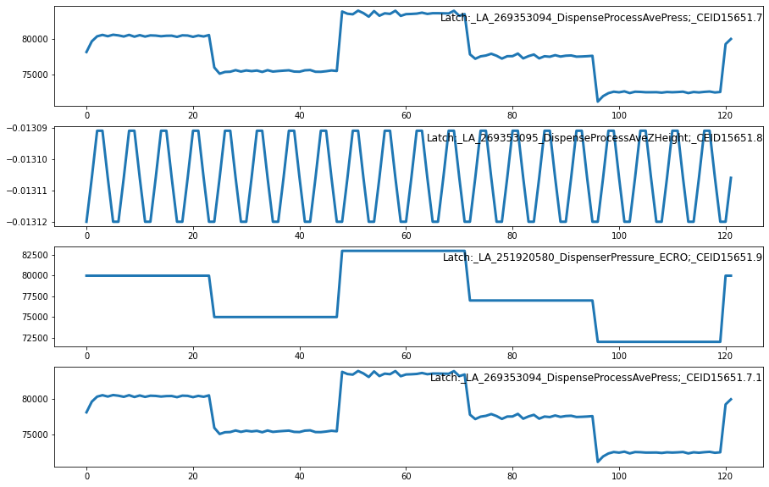

Slide 5
3 : Latch:_LA_269353094_DispenseProcessAvePress;_CEID15651.7
4 : Latch:_LA_269353095_DispenseProcessAveZHeight;_CEID15651.8
5 : Latch:_LA_251920580_DispenserPressure_ECRO;_CEID15651.9
6 : Latch:_LA_269353094_DispenseProcessAvePress;_CEID15651.7.1
7 : Latch:_LA_269353095_DispenseProcessAveZHeight;_CEID15651.8.1
8 : Latch:_LA_251920580_DispenserPressure_ECRO;_CEID15651.9.1

Slide 6
WM-811k Wafermap | Kaggle
https://www.kaggle.com/amirrezaeian/time-series-data-analysis-using-lstm-tutorial
【Python】基于多列组合删除数据框中的重复值_阿黎逸阳的博客-CSDN博客
python - List Highest Correlation Pairs from a Large Correlation Matrix in Pandas? - Stack Overflow

