Slide 2
Household power consumption
Time Series Data for Power Consumption
Columns:
Global_active_power
Global_reactive_power
Voltage
Global_intensity
Sub_metering_1
Sub_metering_2
Sub_metering_3
sub_metering_4

Slide 3
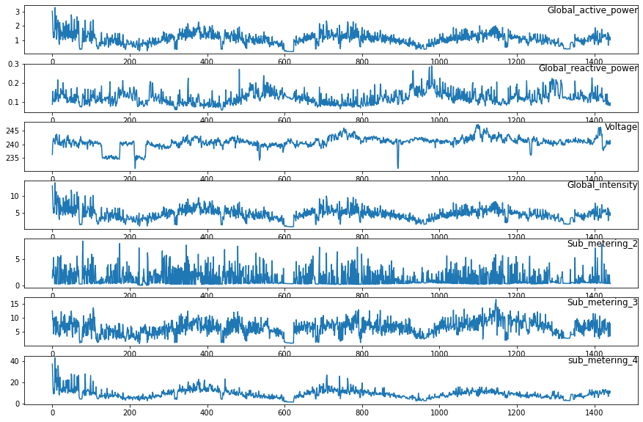

Slide 4
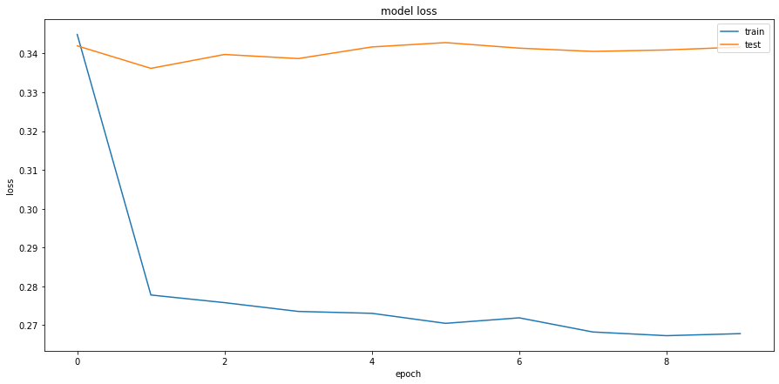
Training Curve

Slide 5
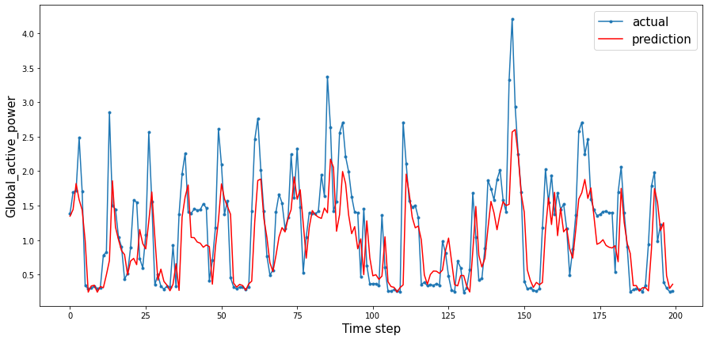
Test RMSE : 0.559

