Slide 1
Household power prediction

Slide 2
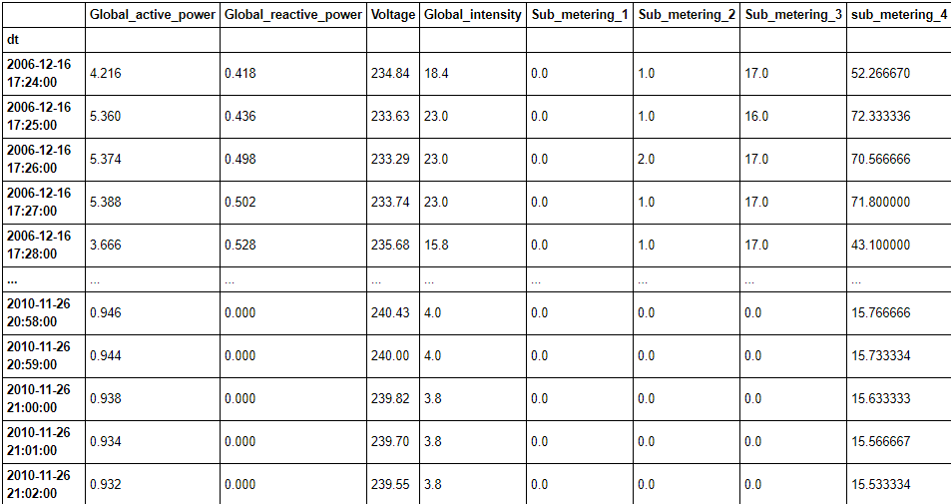
Household power consumption
Time Series Data for Power Consumption
Columns:
Global_active_power
Global_reactive_power
Voltage
Global_intensity
Sub_metering_1
Sub_metering_2
Sub_metering_3
Sub_metering_4
2075259 rows × 8 columns

Slide 3
Attribute Information
3.global_active_power: household global minute-averaged active power (in kilowatt)
4.global_reactive_power: household global minute-averaged reactive power (in kilowatt)
5.voltage: minute-averaged voltage (in volt)
6.global_intensity: household global minute-averaged current intensity (in ampere)
7.sub_metering_1: energy sub-metering No. 1 (in watt-hour of active energy). It corresponds to the kitchen, containing mainly a dishwasher, an oven and a microwave (hot plates are not electric but gas powered).
8.sub_metering_2: energy sub-metering No. 2 (in watt-hour of active energy). It corresponds to the laundry room, containing a washing-machine, a tumble-drier, a refrigerator and a light.
9.sub_metering_3: energy sub-metering No. 3 (in watt-hour of active energy). It corresponds to an electric water-heater and an air-conditioner.
10.sub_metering_3: energy sub-metering No. 4 (in watt-hour of active energy). It corresponds to an electric water-heater and an air-conditioner.

Slide 4
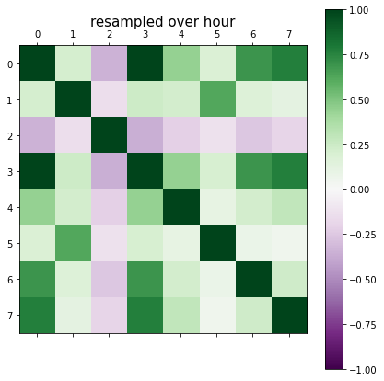
Correlation

Slide 5
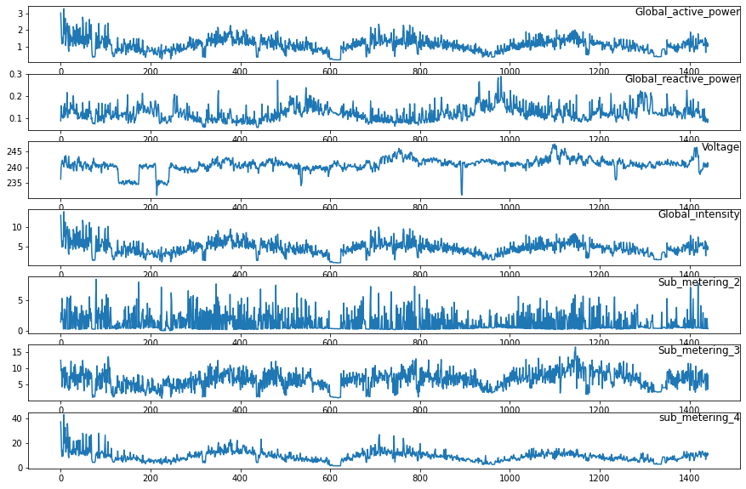
Data visualization

Slide 6
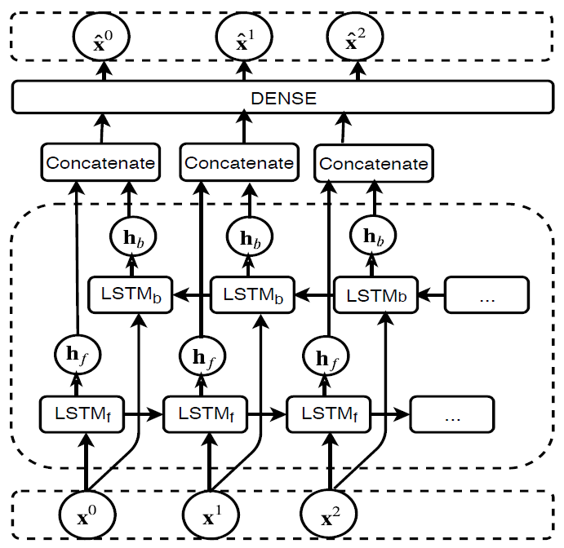
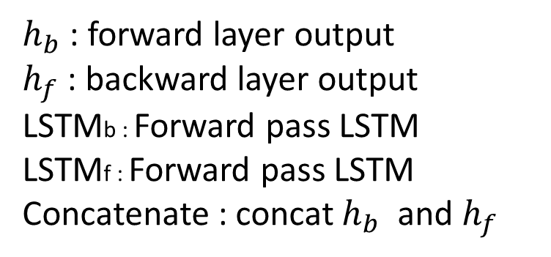
Bidirectional LSTM
$h_{b}$ : forward layer output
$h_{f}$ : backward layer output
LSTMb : Forward pass LSTM
LSTMf : Forward pass LSTM
Concatenate : concat $h_{b}$ and $h_{f}$

Slide 7
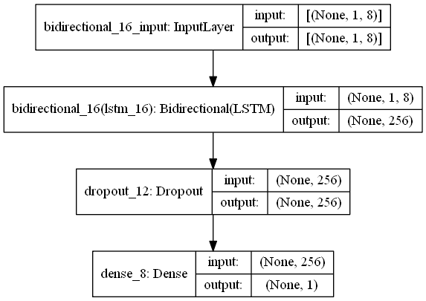
Bidirectional LSTM

Slide 8
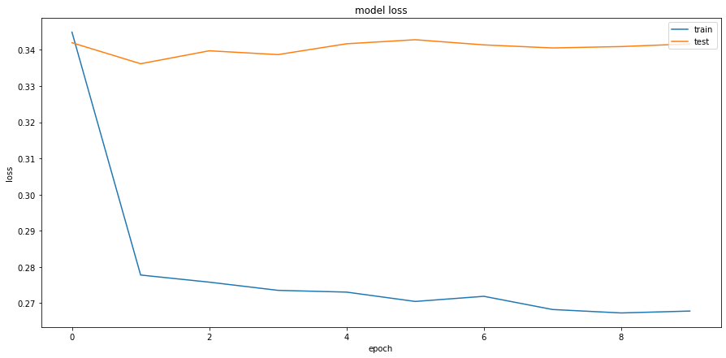
Training Curve

Slide 9
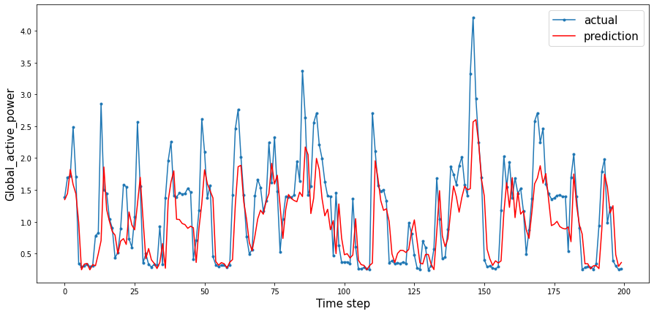
Test RMSE : 0.559

Slide 10
LSTM
ARIMA
ADD
Result

Slide 11
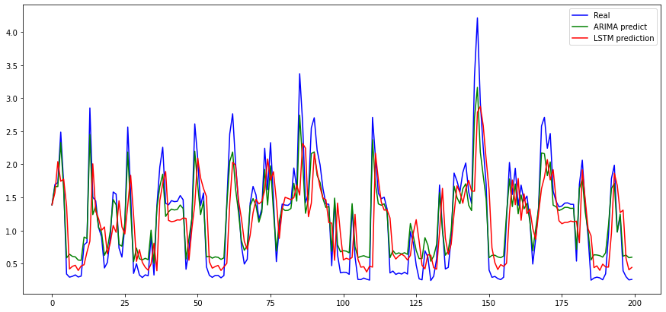
Simple ARIMA-LSTM Hybrid Model

Slide 12
Simple ARIMA-LSTM Hybrid Model
Mean = (ARIMA+LSTM)/2
ADD = (ARIMA+LSTM)

Slide 13
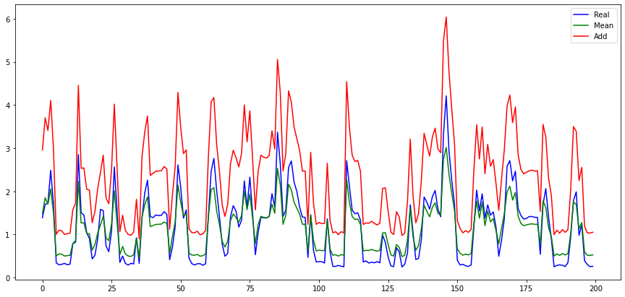
Simple ARIMA-LSTM Hybrid Model

Slide 14
Result
ARIMA Test Score: 0.41 MAE
ARIMA Test Score: 0.56 RMSE
LSTM Test Score: 0.39 MAE
LSTM Test Score: 0.56 RMSE
Hybrid model mean Test Score: 0.39 MAE
Hybrid model mean Test Score: 0.55 RMSE
Hybrid model add Test Score: 1.09 MAE
Hybrid model add Test Score: 1.29 RMSE

Slide 15
ARIMA-LSTM Hybrid Model

Slide 16
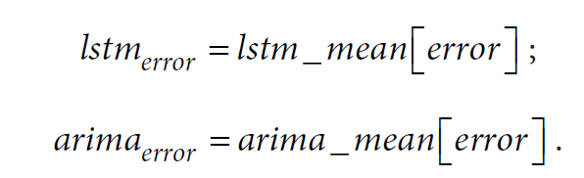
ARIMA-LSTM Hybrid Model
Hybrid Model prediction value
= linear components + nonlinear components
Calculate linear(ARIMA) error and nonlinear(LSTM) error

Slide 17
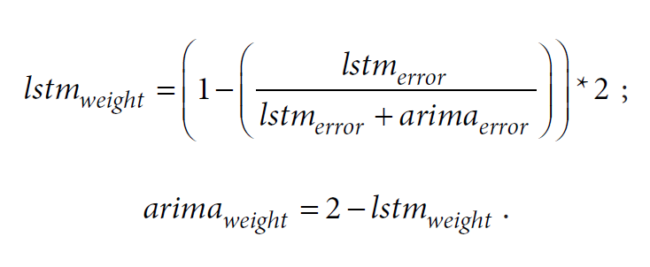
ARIMA-LSTM Hybrid Model
Calculate weight for each model:

Slide 18
ARIMA-LSTM Hybrid Model

Slide 19
ARIMA-LSTM Hybrid Model
Finally, calculate the final result

Slide 20
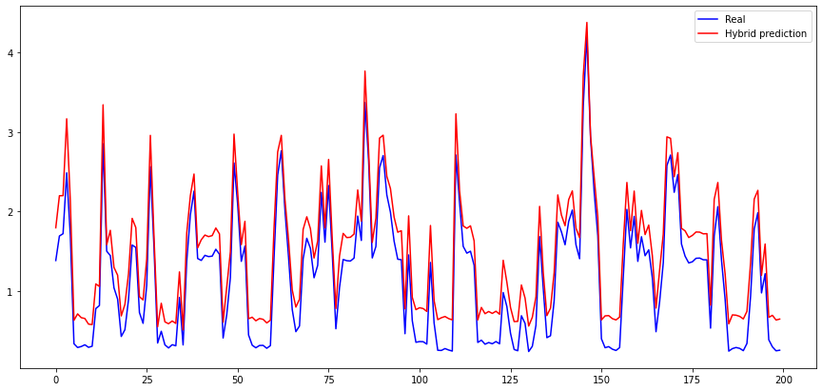
ARIMA-LSTM Hybrid Model

Slide 21
Result
Simple Hybrid model(mean) Test Score: 0.39 MAE
Simple Hybrid model(mean) Test Score: 0.55 RMSE
Simple Hybrid model(add) Test Score: 1.09 MAE
Simple Hybrid model(add) Test Score: 1.29 RMSE
Hybrid model Test Score: 0.51 MAE
Hybrid model Test Score: 0.68 RMSE

