Slide 1
Household power prediction

Slide 2
Household power consumption
Time Series Data for Power Consumption
Columns:
Global_active_power
Global_reactive_power
Voltage
Global_intensity
Sub_metering_1
Sub_metering_2
Sub_metering_3
sub_metering_4
2075259 rows × 8 columns

Slide 3
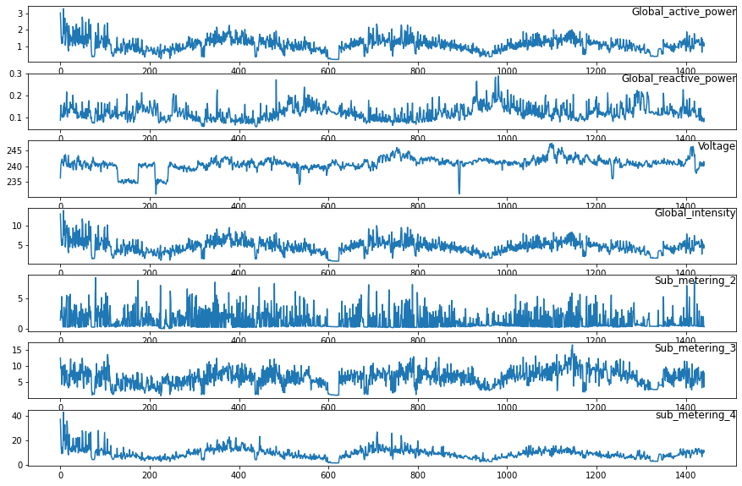
Data visualization

Slide 4
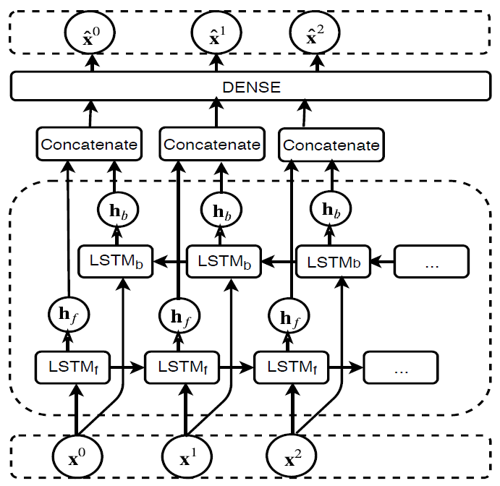
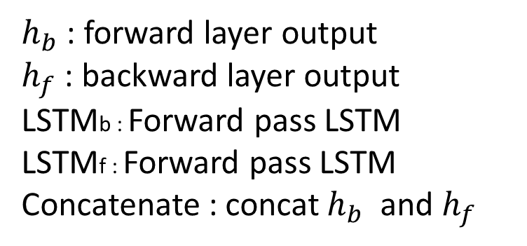
Bidirectional LSTM
$h_{b}$ : forward layer output
$h_{f}$ : backward layer output
LSTMb : Forward pass LSTM
LSTMf : Forward pass LSTM
Concatenate : concat $h_{b}$ and $h_{f}$

Slide 5
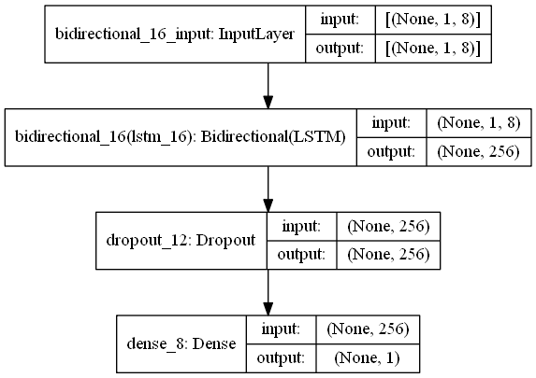
Bidirectional LSTM

Slide 6
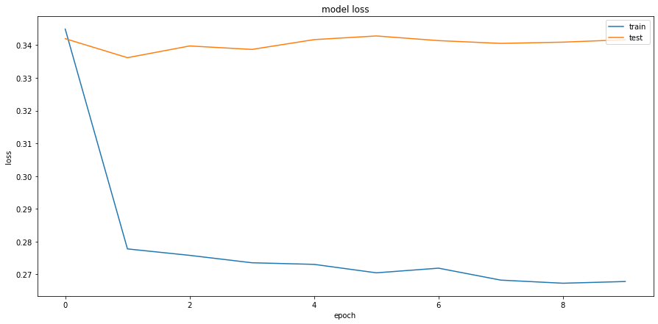
Training Curve

Slide 7
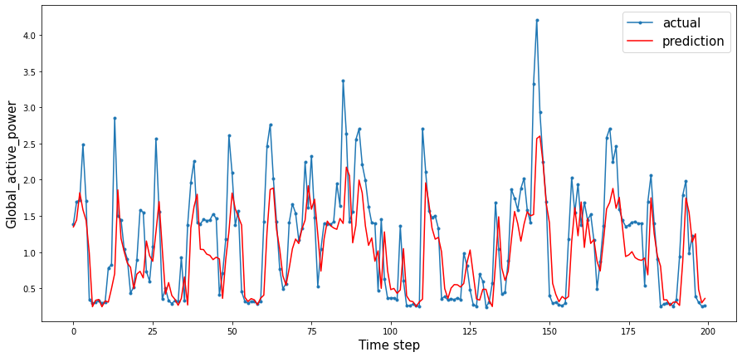
Test RMSE : 0.559

