Slide 1
Real-time Failure Prediction System
Failure Alert
Real-Time
Monitoring Data
Create Streaming Data from CSV
Implement Distributed Anomaly Prediction
Determine Anomaly Values and Estimate Failure Timestamp
Failure Timestamp
Real-Time Streaming
Distributed Failure Prediction
Server Health Management

Slide 2
AutoML
Random Search
Hyperparameter Tuning
Feature Engineering
Model Evaluation
Model Deployment
Neural Network for Searching
Online Prediction
Zabbix Server Real-Time Monitoring Data
Real-time Spark Streaming
TensorflowOnSpark Anomaly Prediction
Failure Alert

Slide 3






Inner Loop
Task 1
Environment
Policy Network($θ$)
Loss、$θ^{′}$
Task 2
Environment
Policy Network ($θ$)
Loss、$θ^{′}$
Iteration Replays
…….
…….
…….
Task n
Environment
Policy Network ($θ$)
Loss、$θ^{′}$
Meta Training
Outer Loop
Compute Surrogate Loss
Iteration Replays
Conjugate Gradient
Update Policy
Line Search
TRPO meta-optimization

Slide 5

Detection Module
DStream
Spark Streaming
DStream
HDFS
DStream
DStream
DStream
Cluster
Data Streaming

Slide 6
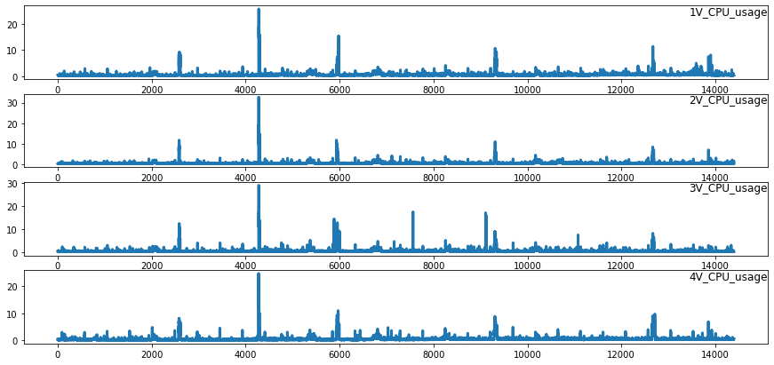

Slide 7
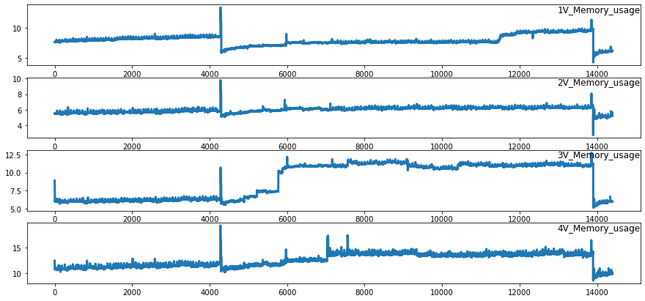

Slide 8
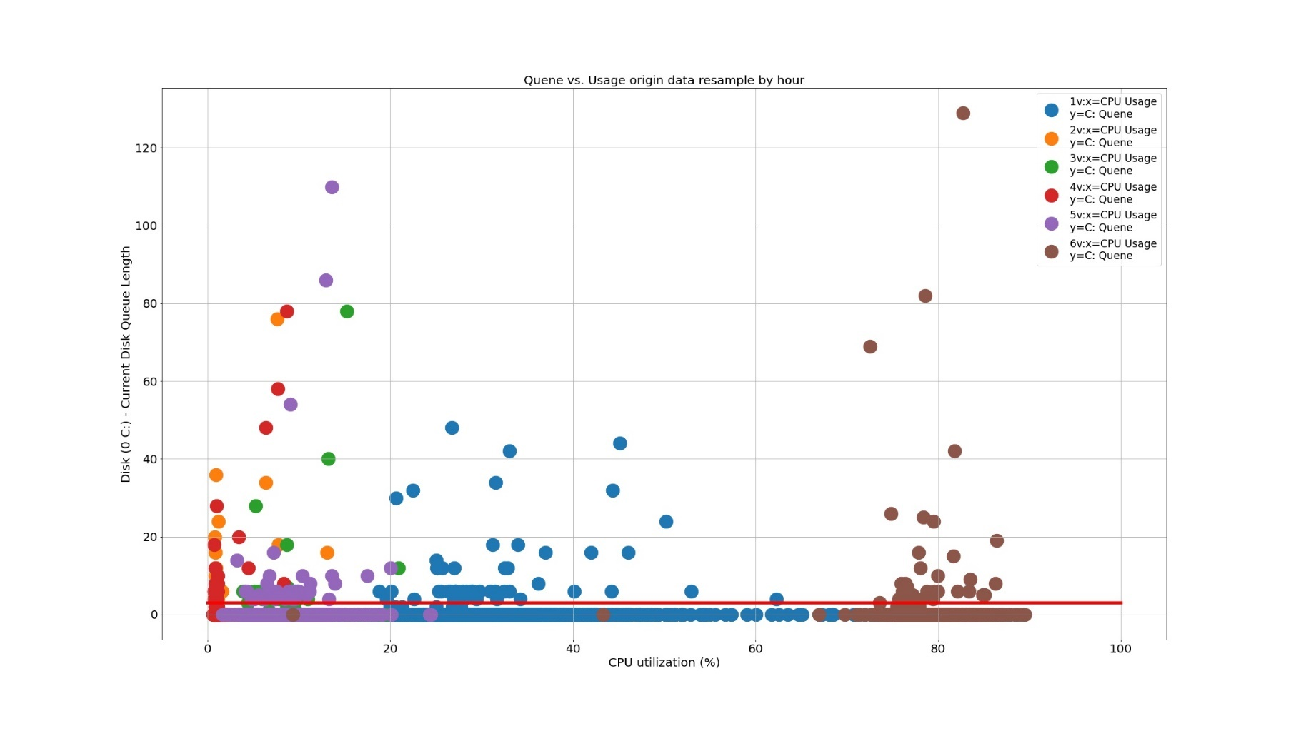

Slide 9
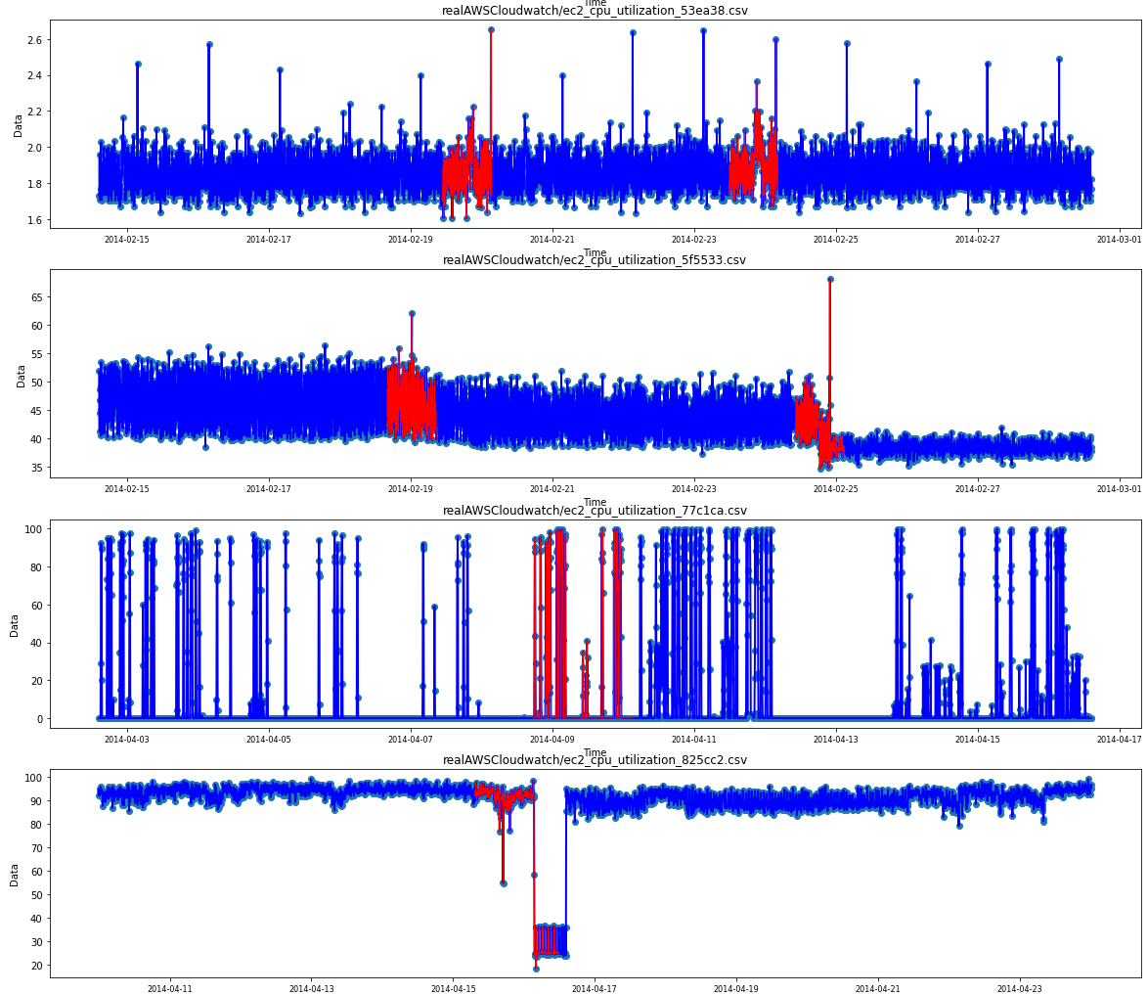

Slide 10
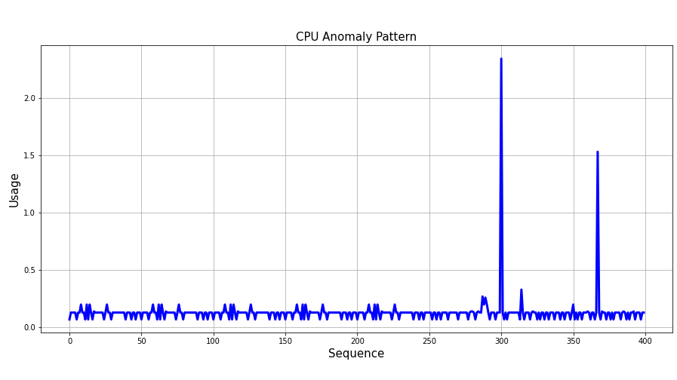
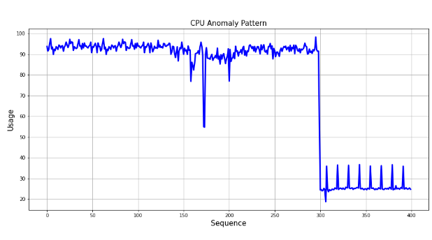
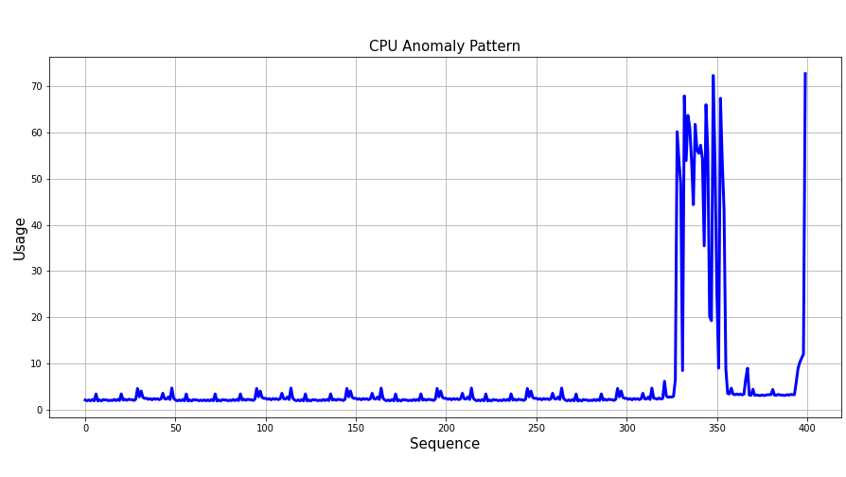
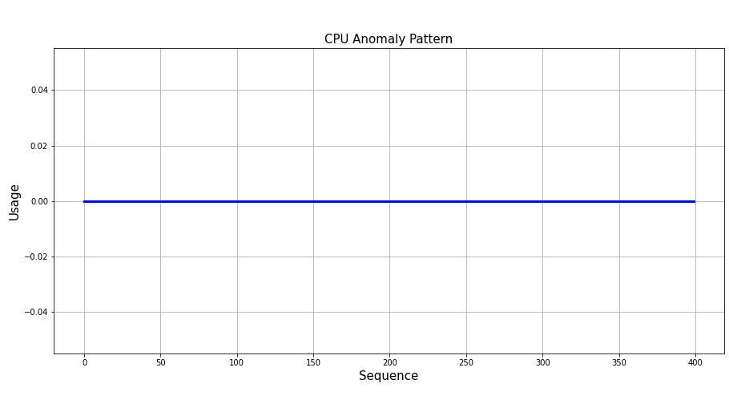

Slide 11

State
Policy Network
sample
Action
Reward
0
1
Replay Memory

