Slide 1
Real-time Failure Prediction System
Failure Alert
Real-Time
Monitoring Data
Create Streaming Data from CSV
Implement Distributed Anomaly Prediction
Determine Anomaly Values and Estimate Failure Timestamp
Failure Timestamp
Real-Time Streaming
Distributed Failure Prediction
Server Health Management

Slide 2
AutoML
Random Search
Hyperparameter Tuning
Feature Engineering
Model Evaluation
Model Deployment
Neural Network for Searching
Online Prediction
Zabbix Server Real-Time Monitoring Data
Construct Kafka Streaming Source
Real-time Spark Streaming
TensorflowOnSpark Anomaly Prediction
Failure Alert

Slide 3
Client
NameNode
DataNode
DataNode
DataNode
Hard Disk
Hard Disk
Hard Disk

Slide 4
Spark SQL
Spark Streaming
MLlib
GraphX
Spark Core
Yarn
HDFS

Slide 5
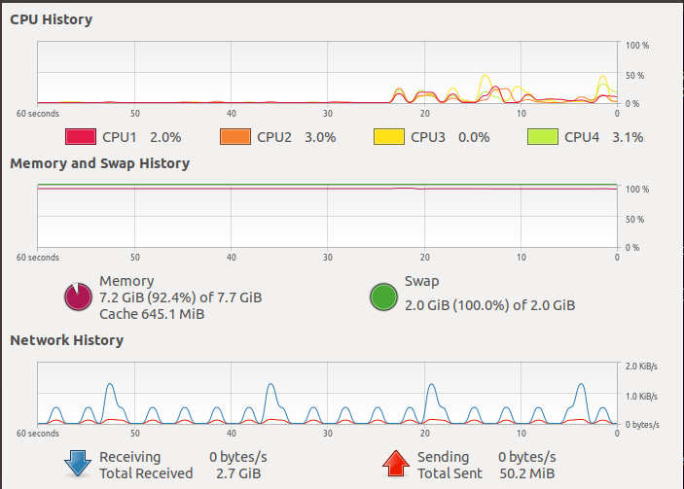

Slide 6
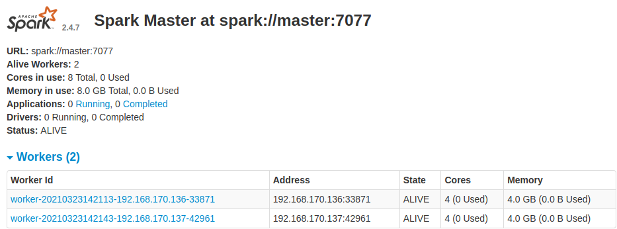

Slide 7

Detection Module
DStream
Kafka
Spark Streaming
DStream
DStream
HDFS
DStream
DStream
Cluster
Data Streaming

Slide 8
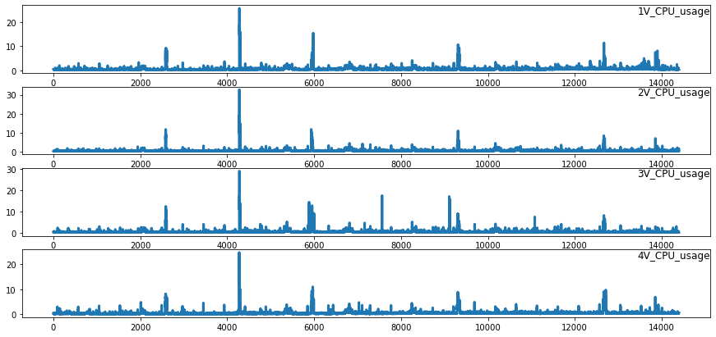

Slide 9
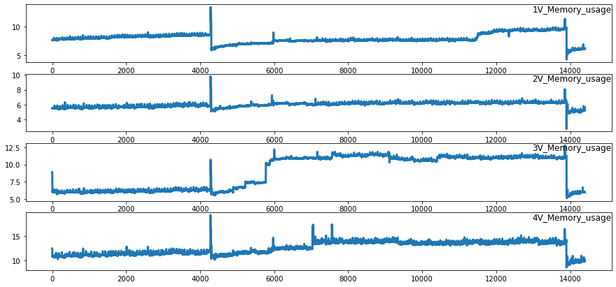

Slide 10
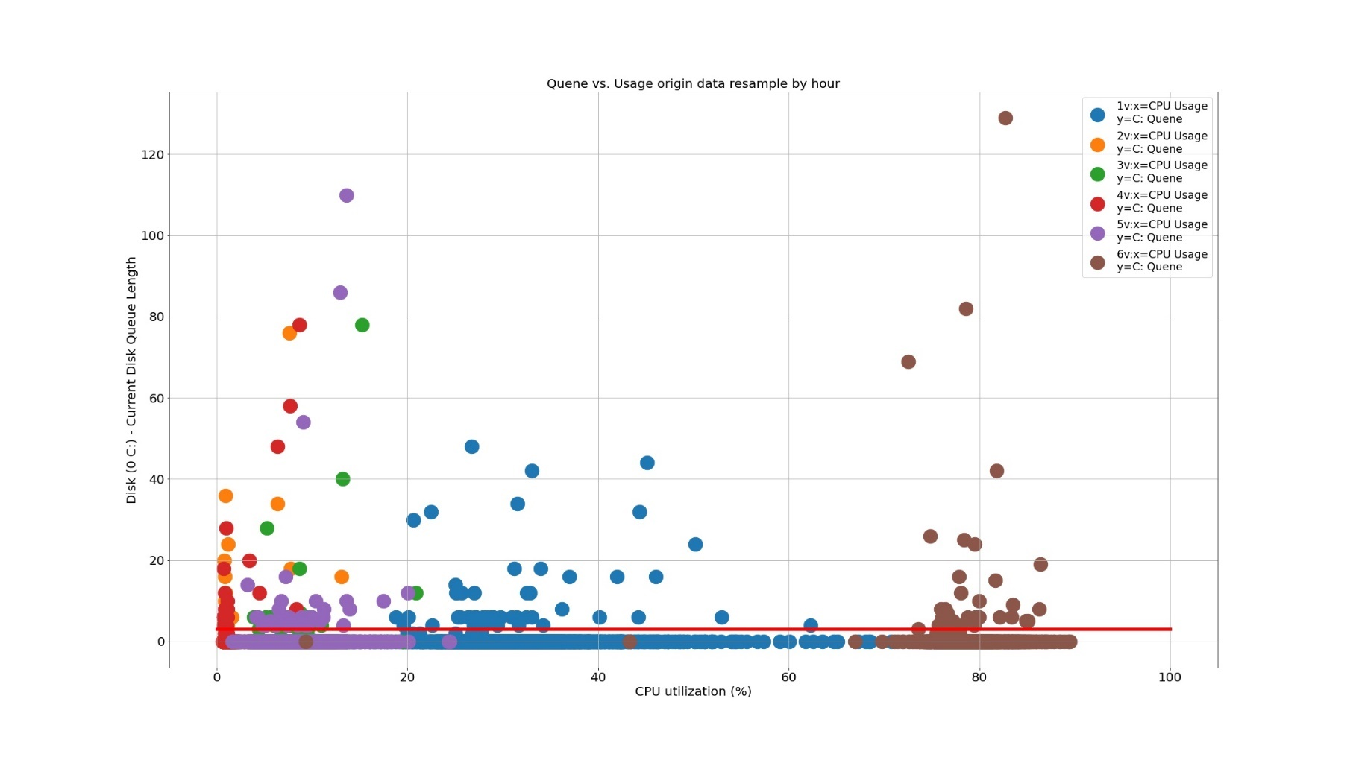

Slide 11
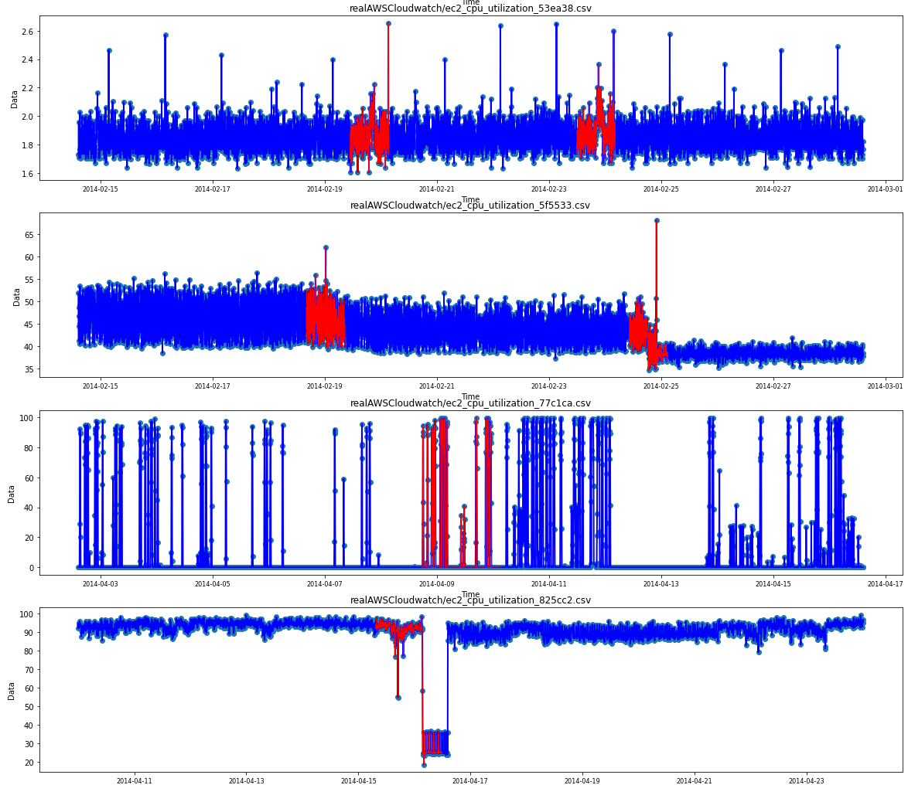

Slide 12
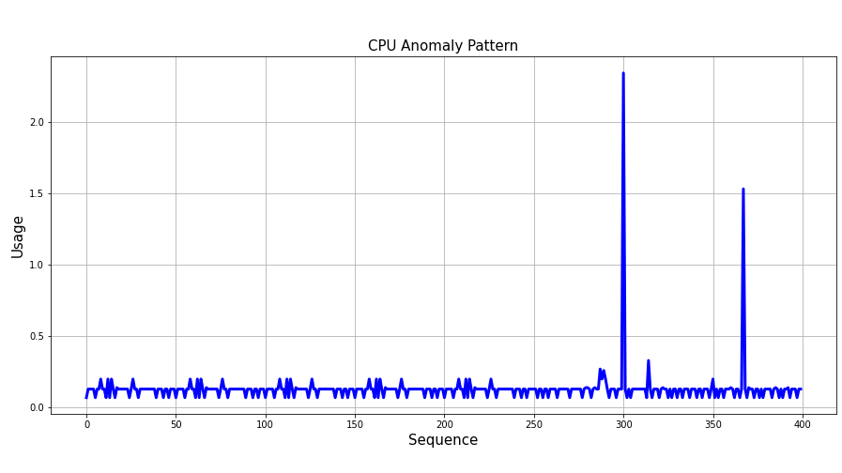
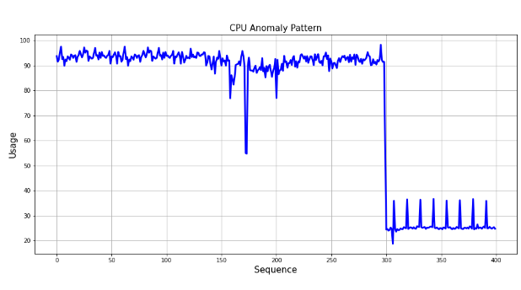
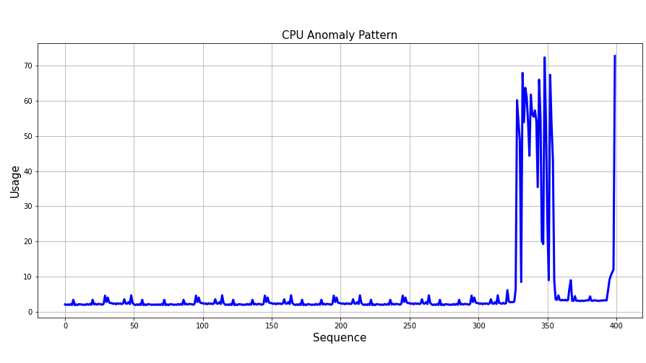
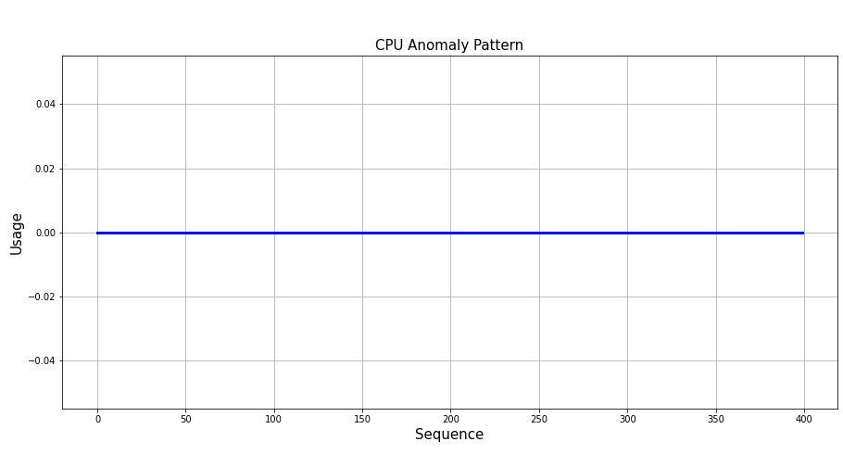

Slide 13
Latent
Space
Encoder
Decoder
Input Data
Encoded Data
Reconstructed Data

Slide 14


























Input layer
Output layer
$$X_{1}$$
Hidden layers
$${X^{′}}_{1}$$
$$W_{1}$$
$${W_{1}}^{T}$$
$$X_{2}$$
$$H_{1}$$
$$W_{2}$$
$${W_{2}}^{T}$$
$${H^{′}}_{1}$$
$${X^{′}}_{2}$$
$$X_{3}$$
$$H_{2}$$
$$C_{1}$$
$${H^{′}}_{2}$$
$${X^{′}}_{3}$$
$$X_{4}$$
$$H_{3}$$
$$C_{k}$$
$${H^{′}}_{3}$$
$${X^{′}}_{4}$$
$$X_{(n−1)}$$
$$H_{m}$$
$${H^{′}}_{m}$$
$${X^{′}}_{(n−1)}$$
$$X_{n}$$
$${X^{′}}_{n}$$
Encoder
Decoder

Slide 15
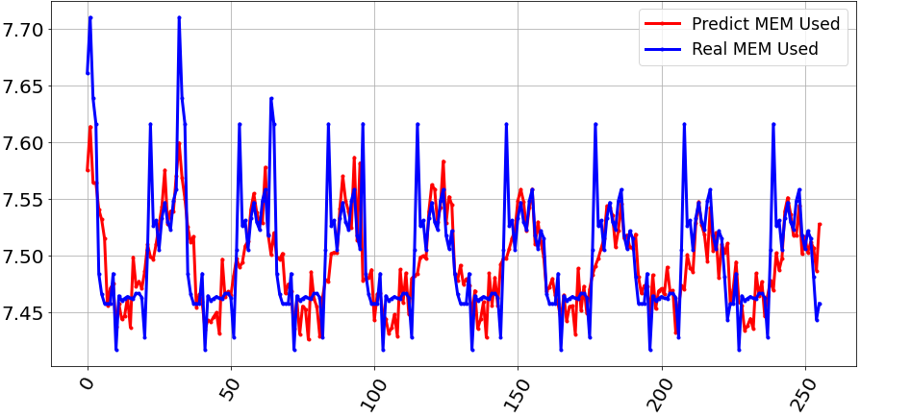

Slide 16





















$${\hat{x}}^{0}$$
$${\hat{x}}^{1}$$
$${\hat{x}}^{2}$$
$$DENSE$$
$$Concatenate$$
$$Concatenate$$
$$Concatenate$$
$$h_{b}$$
$$h_{b}$$
$$h_{b}$$
…
$${LSTM}_{b}$$
$${LSTM}_{b}$$
$${LSTM}_{b}$$
$$h_{f}$$
$$h_{f}$$
$$h_{f}$$
…
$${LSTM}_{f}$$
$${LSTM}_{f}$$
$${LSTM}_{f}$$
$$x^{0}$$
$$x^{1}$$
$$x^{2}$$

Slide 17
Spark Streaming
TensorflowOnSpark
Master
Worker
Worker
Worker
CPU0
CPU1
CPU0
CPU1
CPU0
CPU1
GPU0
GPU1
GPU0
GPU1
GPU0
GPU1

Slide 18
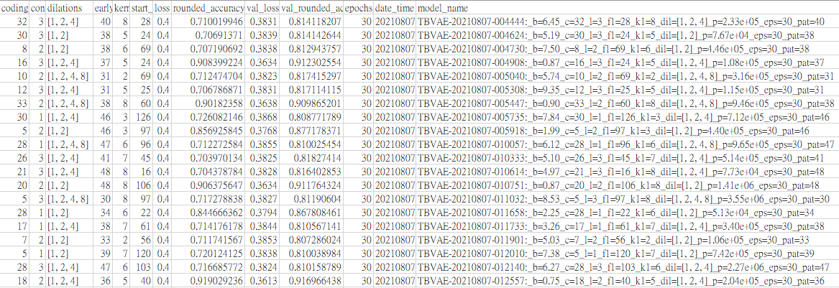

Slide 19




Gradient descent
State
$$N_{Eval}$$
$$ε$$
$$N_{Target}$$
Action
Reward
0
1
Replay Memory

Slide 20
魚骨圖2
A.雲端大數據處理平台
B.異常檢測與預測
*Hadoop
+PyOD
+Kafka
*Keras
*Spark
*Spark Streaming
-Autoencoder
*PySpark
*Tensorflow
- Deep Q Network
數據驅動的雲端應用服務之異常檢測與預測
-TensorflowOnSpark
-Neural Architecture Search
+Model Parallelism
-Microsoft NNI
-BigDL
+Hyperparameter Tuning
+Data Parallelism
-Analysis Zoo
+Autokeras
C.大規模深度學習
D. AutoML

Slide 21
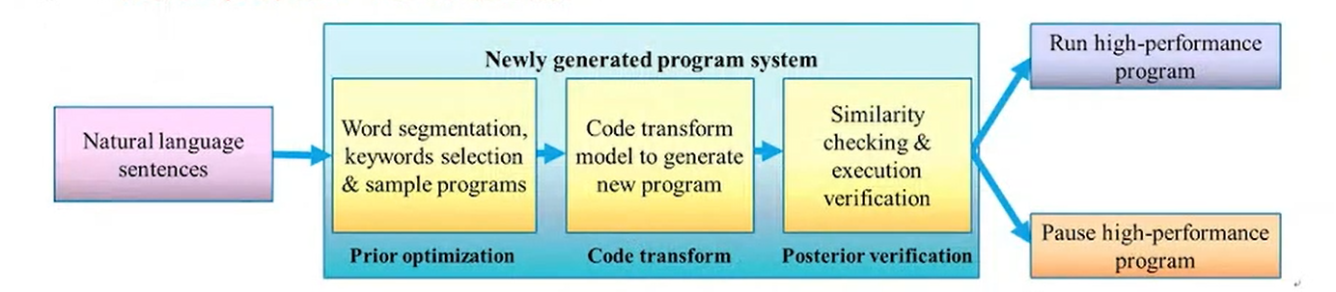
參考

Slide 22
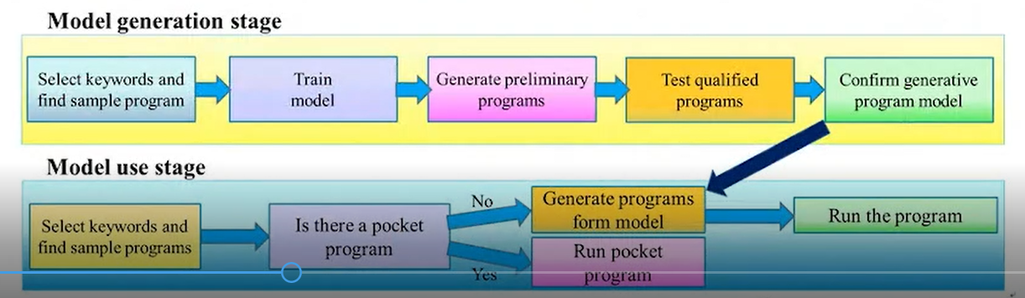
參考

