Slide 1
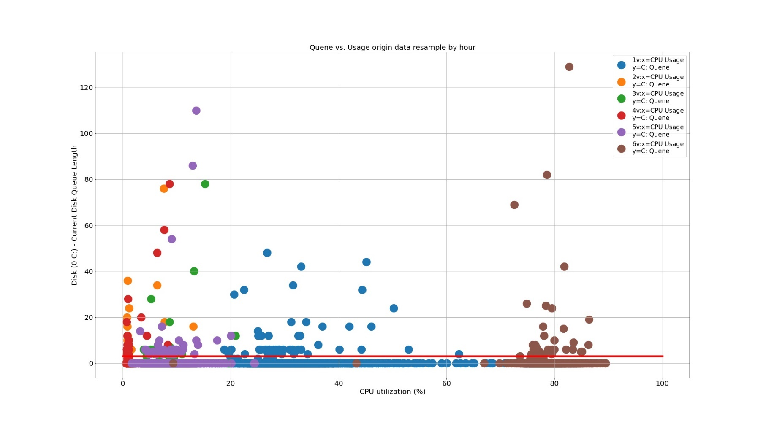
Disk Queue Length vs. CPU Usage Rate
VM1 - CPU Usage
VM2 - CPU Usage
VM3 - CPU Usage
VM4 - CPU Usage
VM5 - CPU Usage
VM6 - CPU Usage
Disk (C:) – Current Disk Queue Length
Disk Queue Length = 2
CPU Utilization (%)

Slide 2
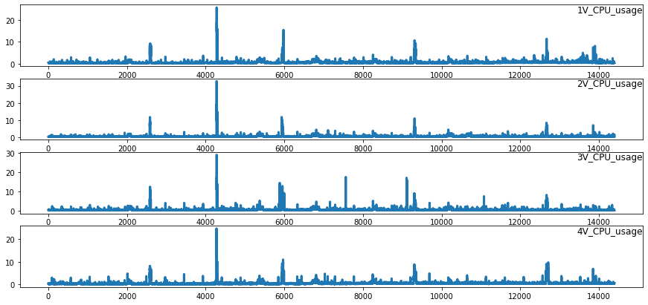
VM1 - CPU Usage
VM2 - CPU Usage
Usage Rate(%)
VM3 - CPU Usage
VM4 - CPU Usage
Timestamp

Slide 3
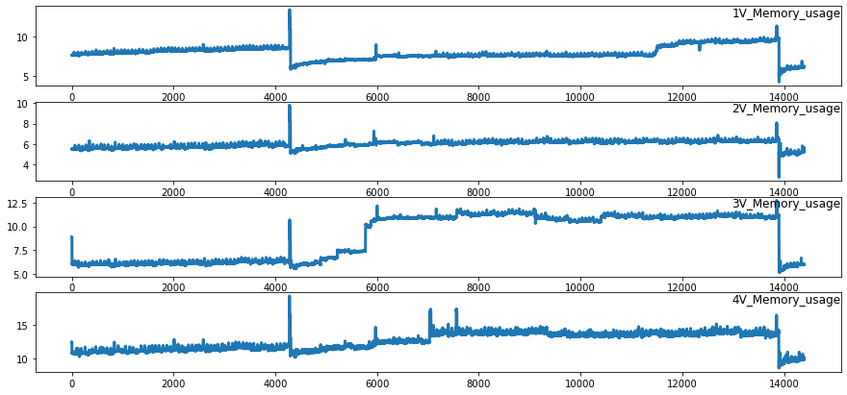
VM1 - Memory Usage
VM2 - Memory Usage
Usage Rate(%)
VM3 - Memory Usage
VM4 - Memory Usage
Timestamp

Slide 4

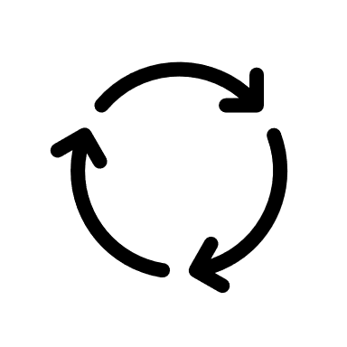
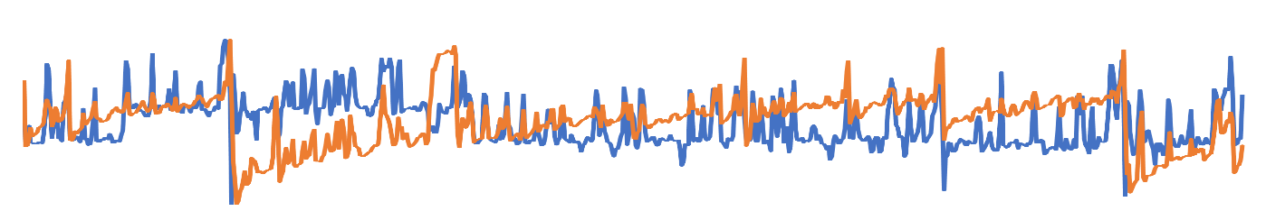
Time Series Reinforcement Learning
3. Reward
Normal or Abnormal
4. Update Parameter
2. Action
Anomaly Detection Policy Network
1. Time Series State

Slide 5
Task
Model
Task
Task
Update Model
Adapt New Dataset
Dataset
Task
New Dataset

Slide 6
HDFS
B. Feature Engineering
Resource Usage Data
A. Data Preprocessing
Unsupervised Anomaly Detector
Time Series Feature Extraction
Alert Module
C. Meta Learning
1. Meta Training
Alert Email
Task
2. Reinforcement Learning
Policy
Task
If Anomaly
Task
Action
Environment
Reward
Query
Alert
……
2. Reinforcement Learning
Task
2. Reinforcement Learning
Online Streaming Data
……
Spark Streaming
Task
Task
2. Reinforcement Learning
Streaming Data
3. Memory Replay
4. Fast Adaption
Result
Online Prediction

Slide 7
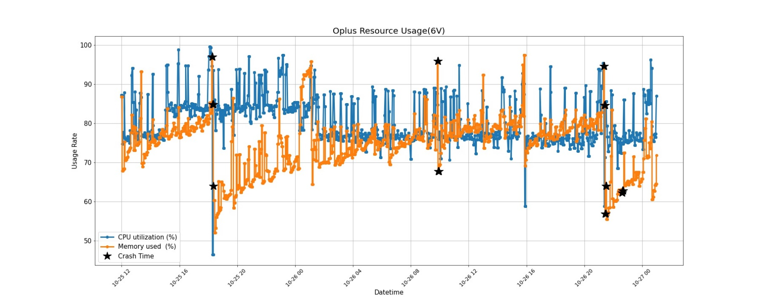

Slide 8
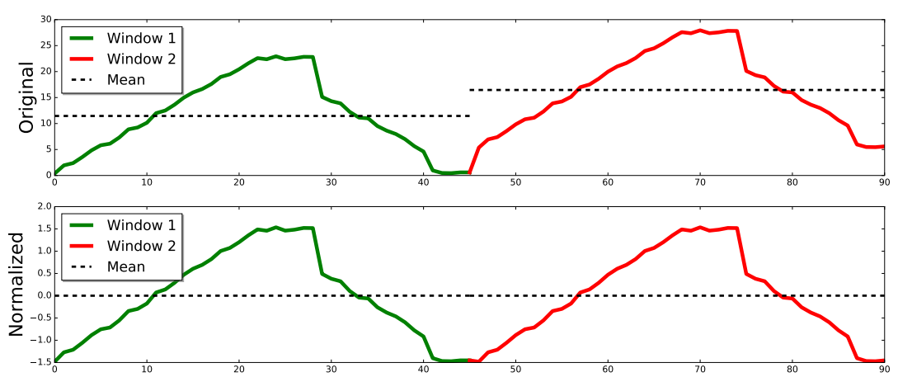

Slide 9

Labeling: 000000000111111111111100000

Slide 10
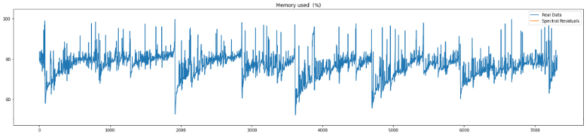


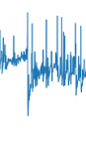


$$ε$$
0
1
State
Policy Network
Action
Reward
Replay Memory

Slide 11


random choice
copy parameters
$${Target}_{N}$$
$${Eval}_{N}$$
Replay Memory
Gradient Descent

Slide 12
HDFS
Real time Usage Data
Result
Spark Streaming
DStream
Detection Module
Real time export Usage Data
Zabbix Server agent
Alert Module
Query Alert
Datacenter

Slide 14






Inner Loop
Task 1
Policy Network($θ$)
Loss、$θ^{′}$
Environment
Task 2
Policy Network ($θ$)
Environment
Loss、$θ^{′}$
Iteration Replays
…….
…….
…….
Task n
Policy Network ($θ$)
Environment
Loss、$θ^{′}$
Meta Training
Outer Loop
Compute Surrogate Loss
Iteration Replays
Conjugate Gradient
Update Policy
Line Search
TRPO meta-optimization

Slide 15
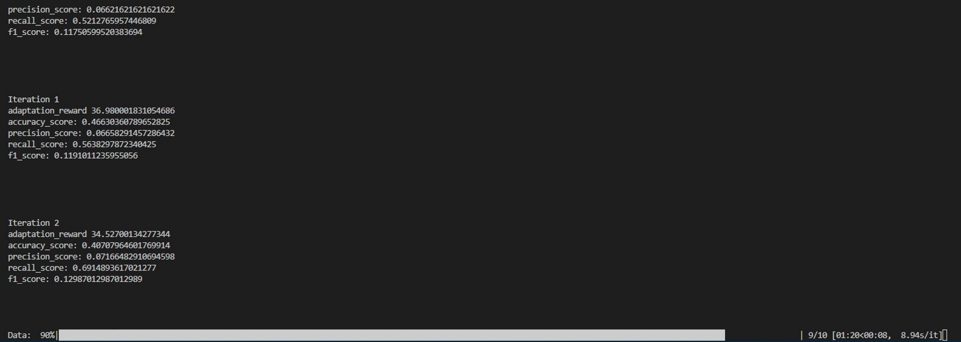

Slide 16
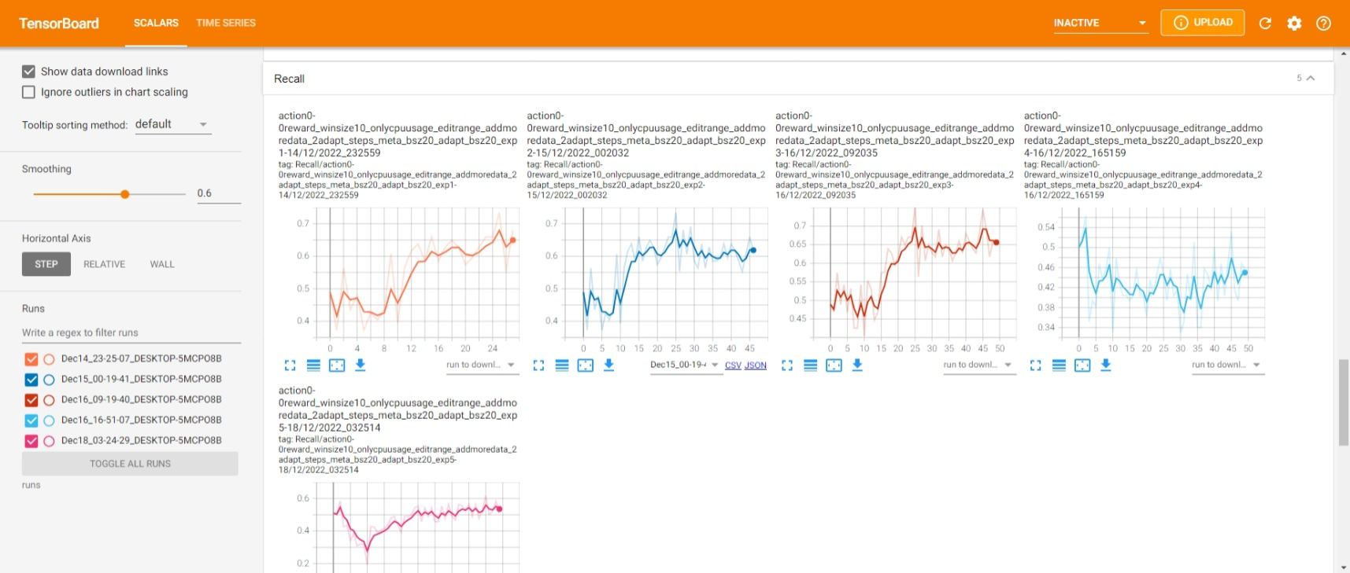

Slide 17


























Input layer
Output layer
$$X_{1}$$
$$W_{1}$$
Hidden layers
$${X^{′}}_{1}$$
$${W_{1}}^{T}$$
$$X_{2}$$
$$H_{1}$$
$$W_{2}$$
$${W_{2}}^{T}$$
$${H^{′}}_{1}$$
$${X^{′}}_{2}$$
$$X_{3}$$
$$H_{2}$$
$$C_{1}$$
$${H^{′}}_{2}$$
$${X^{′}}_{3}$$
$$X_{4}$$
$$H_{3}$$
$$C_{k}$$
$${H^{′}}_{3}$$
$${X^{′}}_{4}$$
$$X_{(n−1)}$$
$$H_{m}$$
$${H^{′}}_{m}$$
$${X^{′}}_{(n−1)}$$
$$X_{n}$$
$${X^{′}}_{n}$$
Encoder
Decoder

Slide 18
$$ε$$
0
1
State
Policy Network
Action
Reward
Replay Memory

Slide 19
random choice
copy parameters
$${Target}_{N}$$
$${Eval}_{N}$$
Replay Memory
Gradient Descent

