Slide 1

Data-driven Anomaly Detection and Prediction in Cloud Applications
指導教授: 張保榮 教授
報告人: 陳冠儒
2022/03/24

Slide 2
Outline
Background
Streaming Data Receiving Process
Failure Detection
AutoML
Software & Hardware
Dataset
Results
Future Work
Reference

Slide 3
Background
Problem:
非預期的伺服器停機總是造成重大損失。
現行的監測軟體之故障警示缺乏預判性，且難以準確檢測異常。
Goal:
提早預判故障發生，發出警告訊息提醒管理者。
多機預測時需要減少資料處理壓力。
Characteristics of Resource Usage Data:
難以預期使用者的行為
無法使用同一模型長時間的在線預測。

Slide 4
Streaming Data Receiving Process

Slide 5
TensorflowOnSpark
本專題基於Hadoop和Spark架構，從底層依序建立HDFS、Yarn、Spark
Spark SQL
Spark Streaming
MLlib
TensorflowOnSpark
Spark Core
Yarn
HDFS
Hadoop、Spark、 TensorflowOnSpark

Slide 6



Streaming Data Receiving Process
Real Time Export
Transform
Kafka
DStream
Spark Streaming
DStream
HDFS
DStream
DStream
SPARK
DStream
Cluster
Data Streaming
Detection Module
Notes:
Kafka儲存的訊息來自任意多被稱為「生產者」（Producer）的行程。資料從而可以被分配到不同的「分割區」（Partition）、不同的「Topic」下。在一個分割區內，這些訊息被索引並連同時間戳儲存在一起。其它被稱為「消費者」（Consumer）的行程可以從分割區查詢訊息。Kafka執行在一個由一台或多台伺服器組成的叢集上，並且分割區可以跨叢集結點分布。

Slide 7
Detection & Prediction Process
Spark Streaming
DStream
DStream
DStream
TensorflowOnSpark
Master
TensorflowOnSpark
Worker
TensorflowOnSpark
Worker
TensorflowOnSpark
Worker
Input Data
Output Data
CPU0
CPU1
CPU0
CPU1
CPU0
CPU1
GPU0
GPU1
GPU0
GPU1
GPU0
GPU1

Slide 8
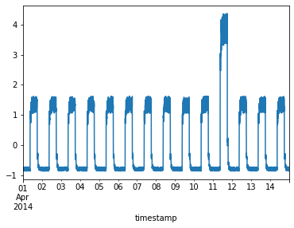
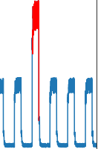
Failure Detection Using AutoEncoder
Latent
Space
Encoder
Decoder
Normal
Normal
Abnormal
Input Data
Encoded Data
Reconstructed Data
Abnormal
Training an AutoEncoder Using Semi-supervised Learning(TCN Based AE)
Notes:
異常檢測（anomaly detection）通常分為有監督和無監督兩種情形。
在無監督的情況下，我們沒有異常樣本用來學習，
而演算法的基本上假設是異常點服從不同的分佈。
根據正常數據訓練出來的Autoencoder，能夠將正常樣本重建還原，但是卻無法將異於正常分佈的數據點較好地還原，導致還原誤差較大。

Slide 9
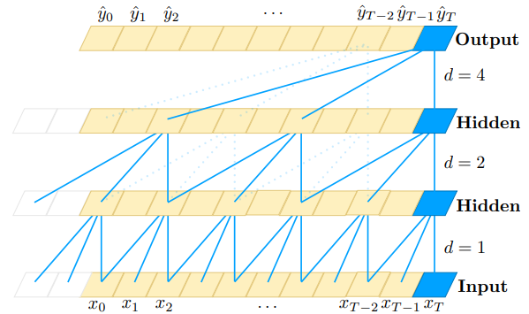
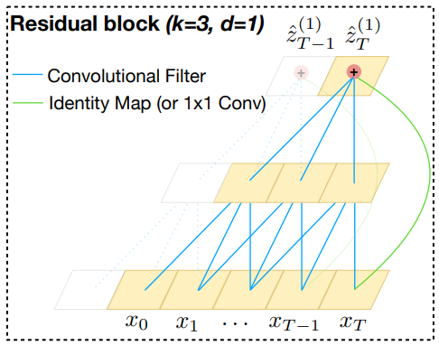
Temporal Convolution Network, TCN
A Special 1-D Convolution Network
Causal convolution
Residual block in TCN

Slide 10
AutoML

Slide 11

AutoML
Automatic
Feature Engineering
Hyperparameter Tuning
Neural Architecture Search
Model deployment

Slide 12
Dataset

Slide 13
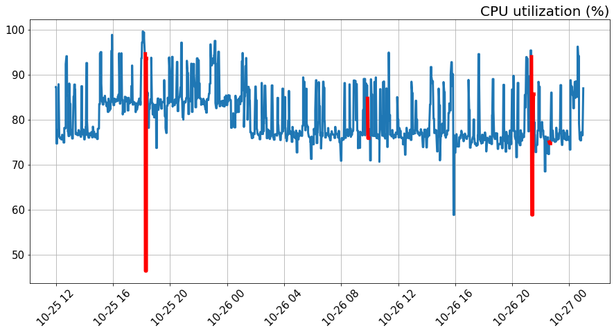
6V
Datetime: 2021-10-25~2021-10-27
Anomaly Label: C: Disk Queue >= 3
Column:
CPU utilization (%)
Memory used (%)
Disk ( C:) - % Disk saturation
Disk ( C:) - % Idle Time
Disk ( C:) - Average Disk Bytes Read
Disk ( C:) - Average Disk Bytes Total
Disk ( C:) - Average Disk Bytes Write
Disk ( C:) - Avg. Disk sec/Read (Latency)
Disk ( C:) - Avg. Disk sec/Transfer (Latency)
Disk ( C:) - Avg. Disk sec/Write (Latency)
Disk ( D:) - % Disk saturation
Disk ( D:) - % Idle Time
Disk ( D:) - Average Disk Bytes Read
Disk ( D:) - Average Disk Bytes Total
Disk ( D:) - Average Disk Bytes Write
Disk ( D:) - Avg. Disk sec/Read (Latency)
Disk ( D:) - Avg. Disk sec/Transfer (Latency)
Disk ( D:) - Avg. Disk sec/Write (Latency)

Slide 14
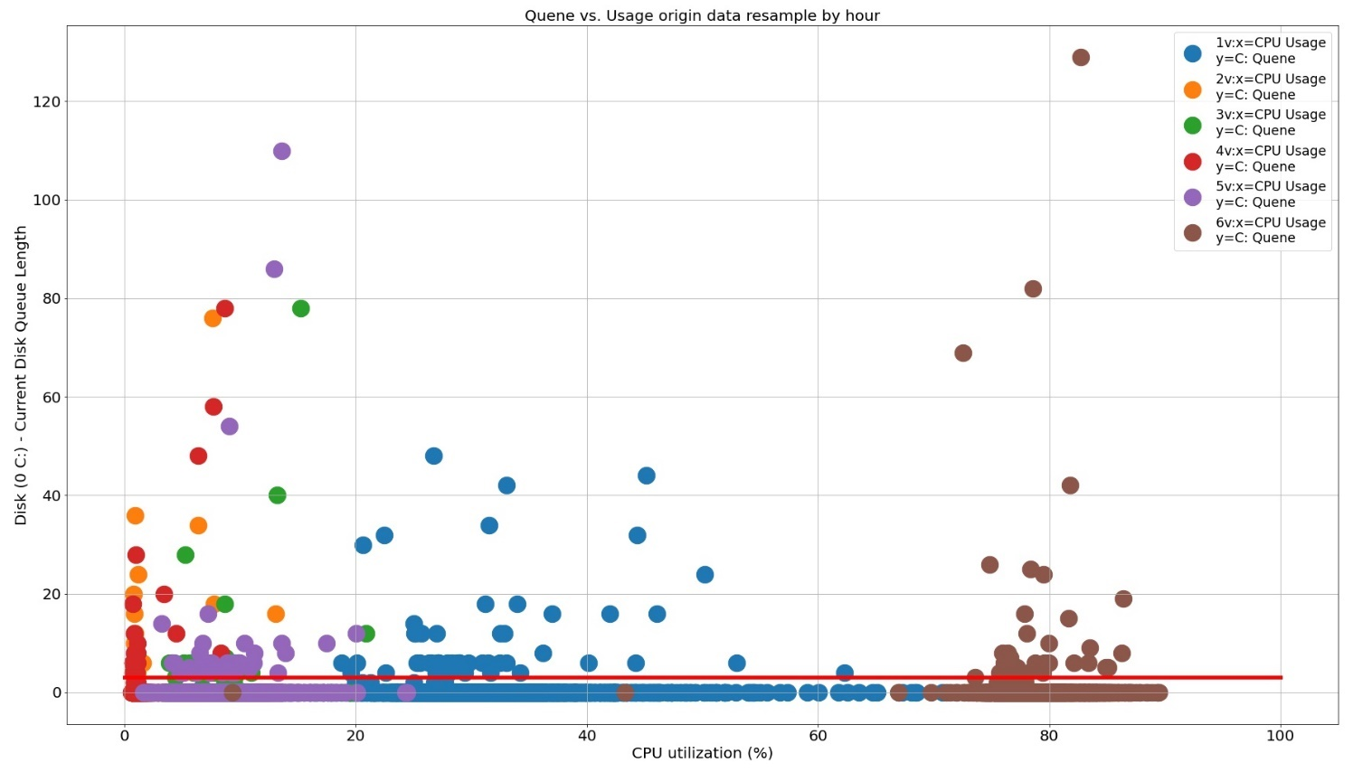
1V~6V CPU Usage vs. C: Disk Queue
LOW Utilization
HIGH Utilization

Slide 15
Software & Hardware

Slide 16
Software
ML Training
Python 3.7.9
Tensorflow 2.5
Keras
Jupyter Notebook
Matplotlib
Pandas
CUDA 11.1
CUDNN 8.05
Parallel prediction
TensorflowOnSpark 2.2.2
Python 3.7.9
Tensorflow 2.4
Hadoop 3.1.1
Spark 2.4.7
Pyspark 2.4.3

Slide 17
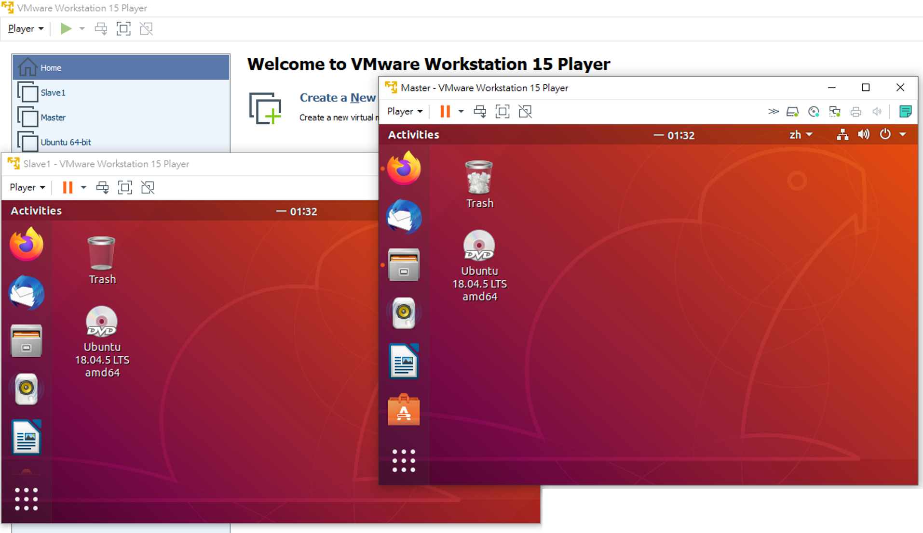

Hardware For TensorflowOnSpark
VMware Workstation 15 Player
Node | Role | Core | Memory
Master | Master/Worker | 4 | 4.0 GB
Slave1 | Worker | 4 | 4.0 GB
WORKER
MASTER
WORKER
Item | Value
MASTER | spark://master:7077
SPARK_WORKER_INSTANCES | 2
CORES_PER_WORKER | 4
TOTAL_CORES | 8
SLAVE1
MASTER

Slide 18
Results

Slide 19
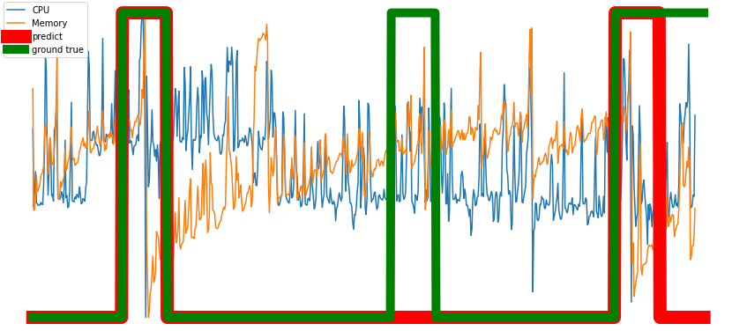
Results
TP: 2
FP: 2
TN: 11
FN: 0
Accuracy: 86.67%
Precision: 50.0%
Recall: 100.0%
F1: 66.7%
False positive
True positive

Slide 20
Results
AutoML
earlystop_patience | kernel_size_1 | latent_sample_rate | nb_stacks | start_filter_no | loss | logcosh | val_loss | val_logcosh | epochs_trained | date_time
27 | 2 | 32 | 4 | 16 | 0.070954248 | 0.070954248 | 0.072498344 | 0.072498344 | 200 | 20210928-140032
25 | 2 | 32 | 2 | 16 | 0.067486286 | 0.067486286 | 0.069354072 | 0.069354072 | 200 | 20210928-052518
27 | 5 | 32 | 4 | 16 | 0.06637574 | 0.06637574 | 0.068685934 | 0.068685934 | 200 | 20210928-124324
41 | 2 | 16 | 3 | 16 | 0.063243479 | 0.063243479 | 0.067173503 | 0.067173503 | 200 | 20210928-130438
29 | 3 | 32 | 4 | 32 | 0.060897261 | 0.060897261 | 0.066948995 | 0.066948995 | 141 | 20210928-093733
39 | 6 | 32 | 2 | 16 | 0.061153695 | 0.061153695 | 0.065996349 | 0.065996349 | 200 | 20210928-053530
33 | 3 | 16 | 4 | 32 | 0.055729765 | 0.055729765 | 0.065956272 | 0.065956272 | 177 | 20210928-024631
37 | 3 | 32 | 3 | 32 | 0.06135226 | 0.06135226 | 0.065771908 | 0.065771908 | 200 | 20210928-040217
29 | 2 | 32 | 1 | 32 | 0.061888136 | 0.061888136 | 0.06560906 | 0.06560906 | 167 | 20210928-055856
23 | 2 | 32 | 1 | 32 | 0.061408214 | 0.061408214 | 0.064132348 | 0.064132348 | 176 | 20210928-112738
33 | 7 | 16 | 2 | 16 | 0.057223879 | 0.057223879 | 0.063314125 | 0.063314125 | 185 | 20210928-060021
26 | 7 | 32 | 4 | 32 | 0.059217691 | 0.059217691 | 0.063002862 | 0.063002862 | 164 | 20210928-080924
31 | 7 | 16 | 4 | 16 | 0.057756454 | 0.057756454 | 0.062923416 | 0.062923416 | 200 | 20210928-015502
35 | 12 | 32 | 3 | 16 | 0.05735055 | 0.05735055 | 0.062871084 | 0.062871084 | 200 | 20210928-054217
Evaluation Metrics
Hyperparameter
Datetime

Slide 21
Future Work

Slide 22
Future Work
標記單一伺服器感染前狀態，並預測防止系統崩潰。
建立視覺化界面(bokeh)監控硬體狀態，整合一套完整服務的預測性維護系統 。

Slide 23
Reference
Aygun, R. Can, and A. Gokhan Yavuz. “Network Anomaly Detection with Stochastically Improved Autoencoder Based Models.” 2017 IEEE 4th International Conference on Cyber Security and Cloud Computing (CSCloud), 2017.
C. Meng, X. S. Jiang, X. M. Wei, and T. Wei, “A Time Convolutional Network Based Outlier Detection for Multidimensional Time Series in Cyber-Physical-Social Systems,” IEEE Access, vol. 8, pp. 74933–74942, 2020.
C. Zhou and R. C. Paffenroth, “Anomaly Detection with Robust Deep Autoencoders,” Proceedings of the 23rd ACM SIGKDD International Conference on Knowledge Discovery and Data Mining, 2017.
C.-W. Tien, T.-Y. Huang, P.-C. Chen, and J.-H. Wang, “Using Autoencoders for Anomaly Detection and Transfer Learning in IoT,”Computers, vol. 10, no. 7, p. 88, Jul. 2021.
D. Lunga, J. Gerrand, L. Yang, C. Layton and R. Stewart, "Apache Spark Accelerated Deep Learning Inference for Large Scale Satellite Image Analytics," in IEEE Journal of Selected Topics in Applied Earth Observations and Remote Sensing, vol. 13, pp. 271-283, 2020.

Slide 24
Reference
Z. Zou and J. Ai, "Online Prediction of Server Crash Based on Running Data," 2020 IEEE 20th International Conference on Software Quality, Reliability and Security Companion (QRS-C), 2020, pp. 7-14.
T. Wu en J. Ortiz, “RLAD: Time Series Anomaly Detection through Reinforcement Learning and Active Learning”, CoRR, vol abs/2104.00543, 2021.

Slide 25
Q&A

