Slide 1

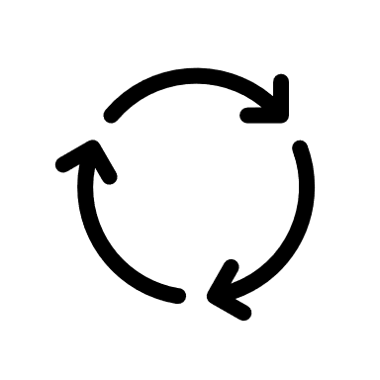
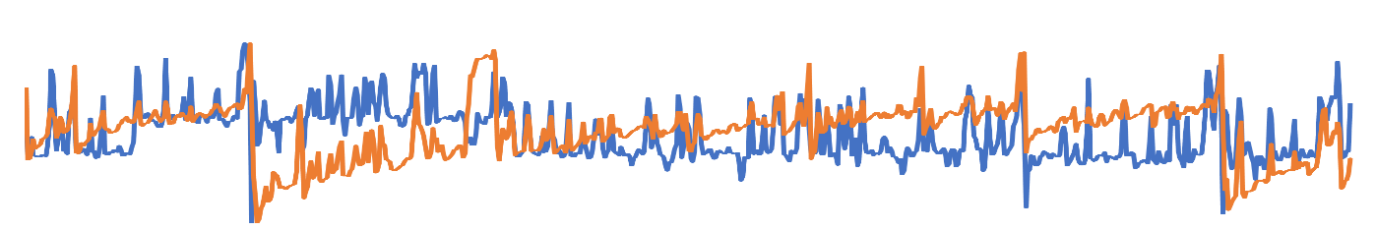
Time Series Reinforcement Learning
3. Reward
Normal or Abnormal
4. Update Parameter
2. Action
Anomaly Detection Policy Network
1. Time Series State

Slide 2
Task
Model
Task
Task
Update Model
Adapt New Dataset
Dataset
Task
New Dataset

Slide 3
HDFS
B. Feature Engineering
Resource Usage Data
A. Data Preprocessing
Unsupervised Anomaly Detector
Time Series Feature Extraction
Alert Module
C. Meta Learning
1. Meta Training
Alert Email
Task
Task
2. Reinforcement Learning
If Anomaly
Task
Policy
Query
Alert
Task
Environment
Reward
Action
Task
Online Streaming Data
Spark Streaming
Task
Task
Streaming Data
3. Memory Replay
4. Fast Adaption
Result
Online Prediction

Slide 4
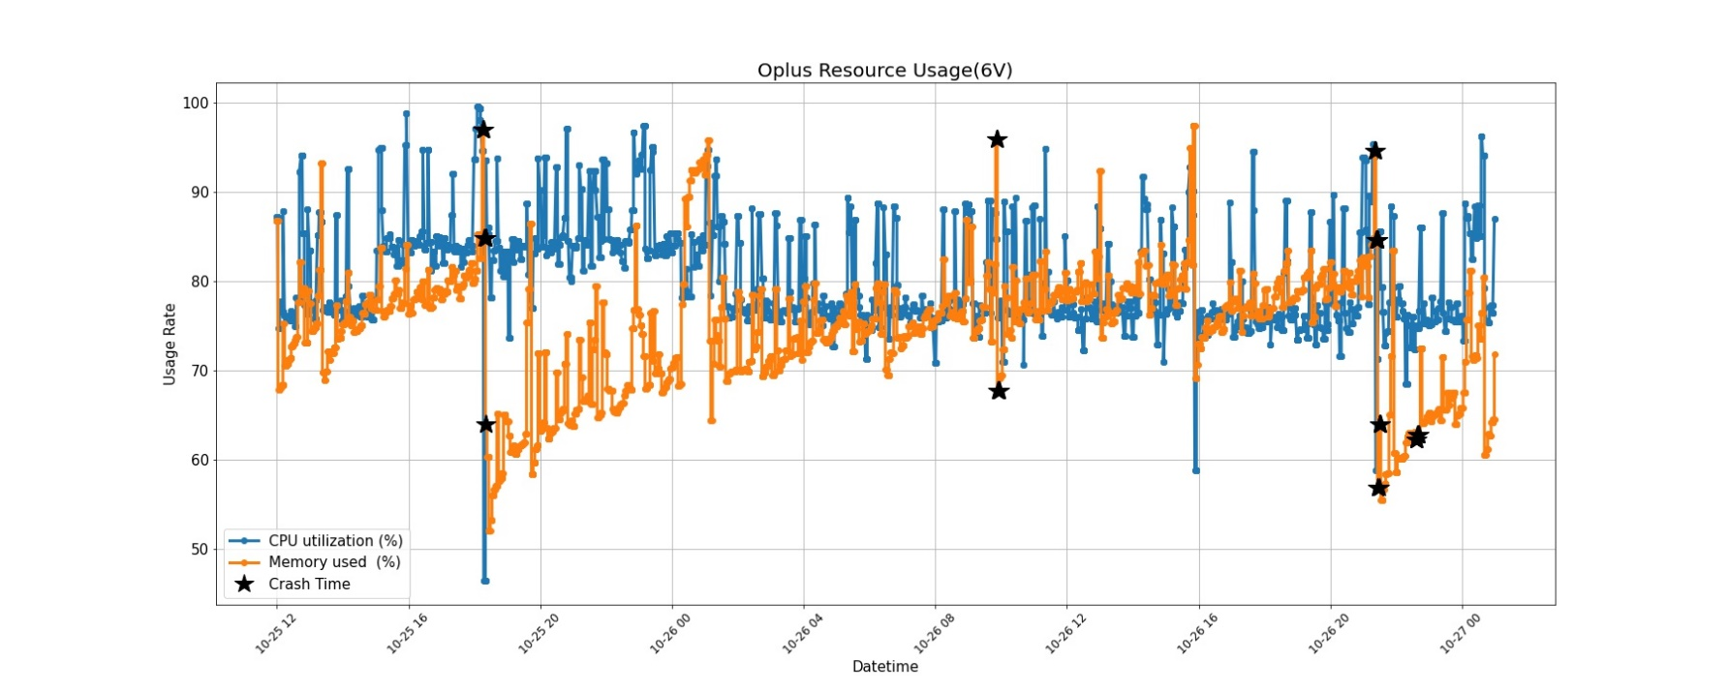

Slide 5
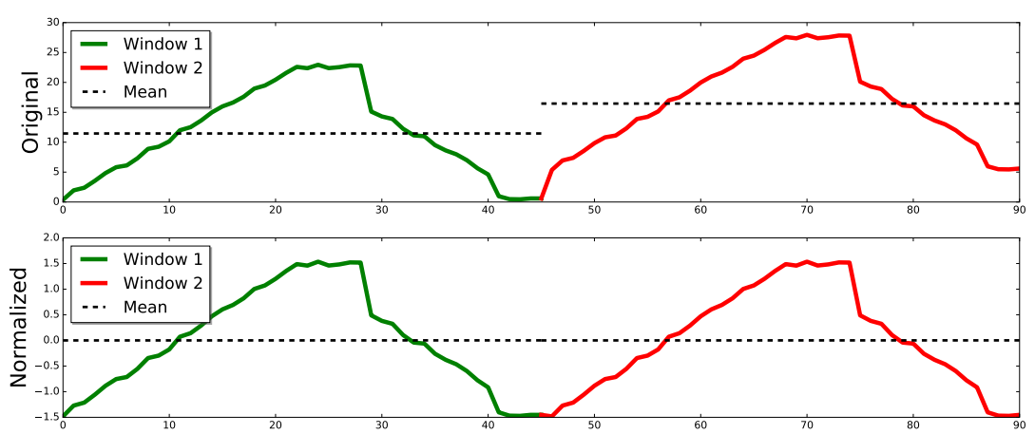

Slide 6

Labeling: 000000000111111111111100000

Slide 7
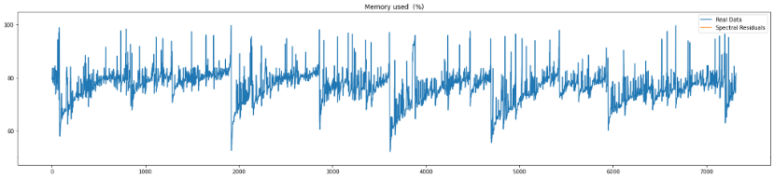


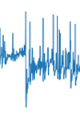


$$ε$$
0
1
State
Policy Network
Action
Reward
Replay Memory

Slide 8


random choice
copy parameters
$${Target}_{N}$$
$${Eval}_{N}$$
Replay Memory
Gradient Descent

Slide 10
HDFS
Real time Usage Data
Result
Spark Streaming
DStream
Detection Module
Real time export Usage Data
Zabbix Server agent
Alert Module
Query Alert
Datacenter

Slide 12






Inner Loop
Task 1
Policy Network($θ$)
Loss、$θ^{′}$
Environment
Task 2
Policy Network ($θ$)
Environment
Loss、$θ^{′}$
Iteration Replays
…….
…….
…….
Task n
Policy Network ($θ$)
Environment
Loss、$θ^{′}$
Meta Training
Outer Loop
Compute Surrogate Loss
Iteration Replays
Conjugate Gradient
Update Policy
Line Search
TRPO meta-optimization

Slide 13
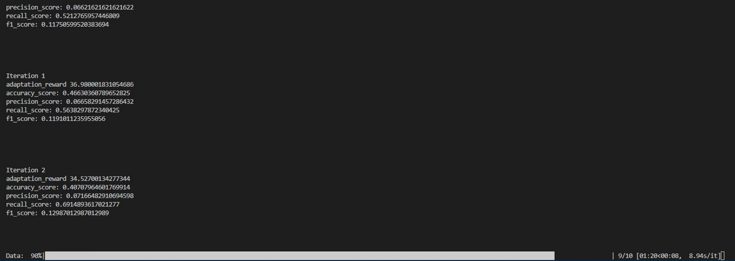

Slide 14
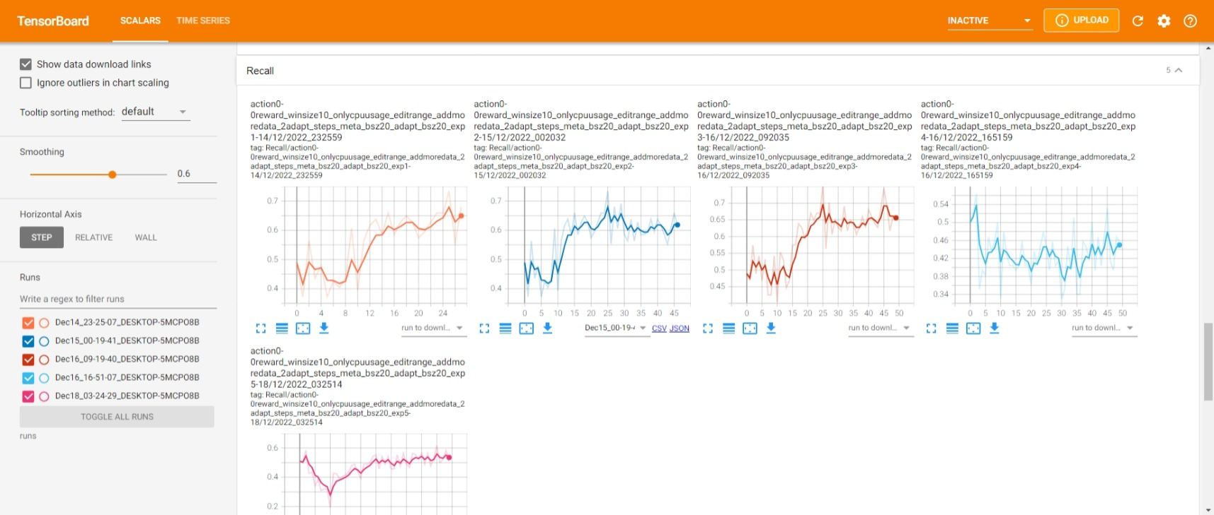

Slide 15


























Input layer
Output layer
$$X_{1}$$
$$W_{1}$$
Hidden layers
$${X^{′}}_{1}$$
$${W_{1}}^{T}$$
$$X_{2}$$
$$H_{1}$$
$$W_{2}$$
$${W_{2}}^{T}$$
$${H^{′}}_{1}$$
$${X^{′}}_{2}$$
$$X_{3}$$
$$H_{2}$$
$$C_{1}$$
$${H^{′}}_{2}$$
$${X^{′}}_{3}$$
$$X_{4}$$
$$H_{3}$$
$$C_{k}$$
$${H^{′}}_{3}$$
$${X^{′}}_{4}$$
$$X_{(n−1)}$$
$$H_{m}$$
$${H^{′}}_{m}$$
$${X^{′}}_{(n−1)}$$
$$X_{n}$$
$${X^{′}}_{n}$$
Encoder
Decoder

Slide 17
$$ε$$
0
1
State
Policy Network
Action
Reward
Replay Memory

Slide 18
random choice
copy parameters
$${Target}_{N}$$
$${Eval}_{N}$$
Replay Memory
Gradient Descent

