Slide 1
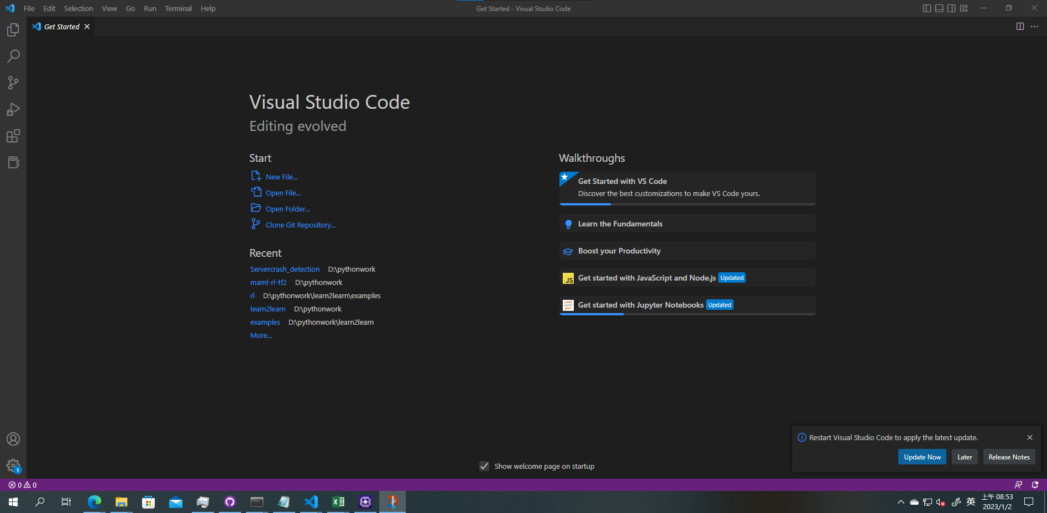

Slide 2


























Input layer
Output layer
$$X_{1}$$
$$W_{1}$$
Hidden layers
$${X^{′}}_{1}$$
$${W_{1}}^{T}$$
$$X_{2}$$
$$H_{1}$$
$$W_{2}$$
$${W_{2}}^{T}$$
$${H^{′}}_{1}$$
$${X^{′}}_{2}$$
$$X_{3}$$
$$H_{2}$$
$$C_{1}$$
$${H^{′}}_{2}$$
$${X^{′}}_{3}$$
$$X_{4}$$
$$H_{3}$$
$$C_{k}$$
$${H^{′}}_{3}$$
$${X^{′}}_{4}$$
$$X_{(n−1)}$$
$$H_{m}$$
$${H^{′}}_{m}$$
$${X^{′}}_{(n−1)}$$
$$X_{n}$$
$${X^{′}}_{n}$$
Encoder
Decoder

Slide 3

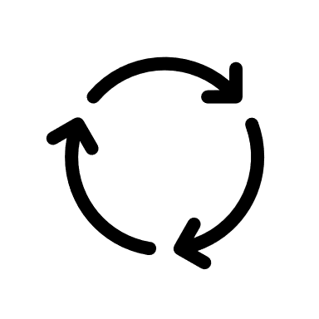
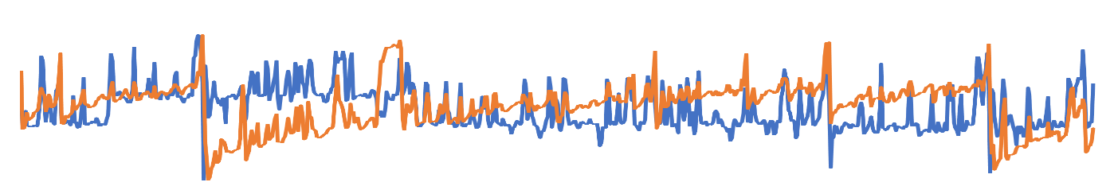
Reinforcement Learning
3. Reward
Normal or Abnormal
4. Update Parameter
2. Action
Anomaly Detection Policy Network
1. Time Series State

Slide 4


HDFS
B. Feature Engineering
Resource Usage Data
A. Data Preprocessing
Unsupervised Anomaly Detector
Time Series Feature Extraction
Alert Module
C. Meta Learning
1. Meta Training
Alert Email
2. Reinforcement Learning
Task
Policy
Task
Action
Environment
Reward
If Anomaly
Query
Task
Alert
Task
3. Memory Replay
4. Fast Adaption
Task
Online Streaming Data
Spark Streaming
D. Active Learning
1. Unlabeled Data
4. Analyst
Streaming Data
3. Selected Data
2. Anomaly Detector
Result
Online Prediction
5. Feedback
6. Deploy

Slide 5
Task
Model
Task
Task
Update Model
Adapt New Dataset
Dataset
Task
New Dataset

Slide 6
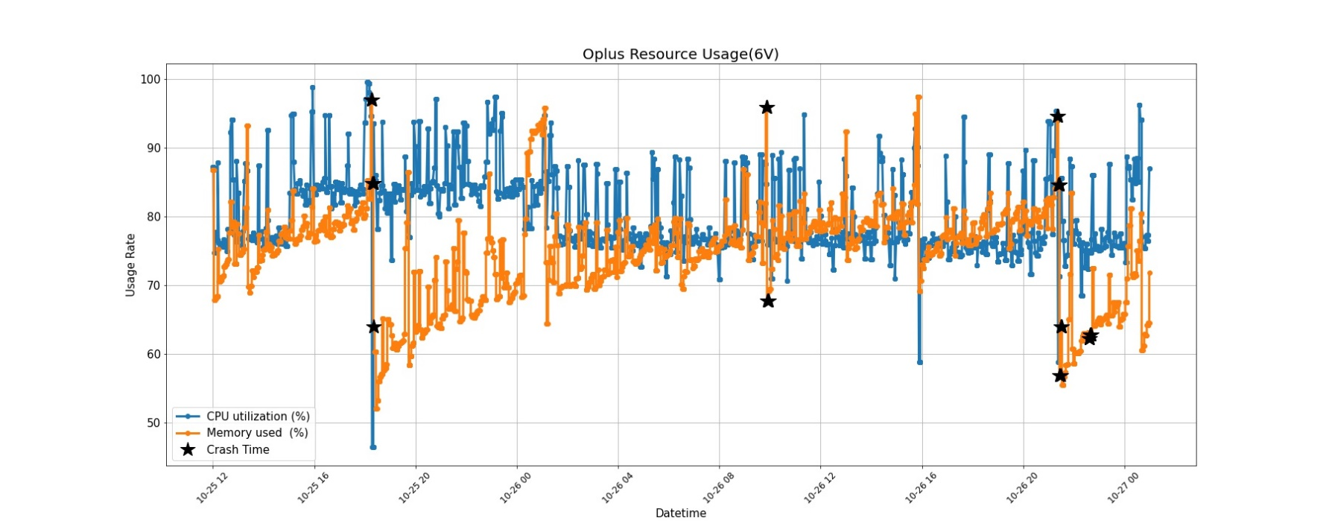

Slide 7
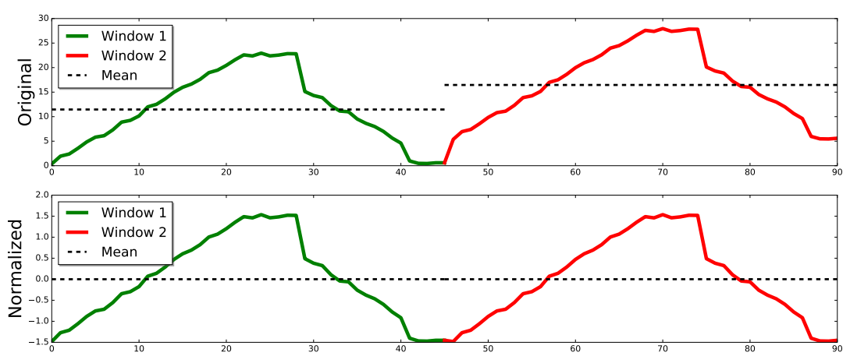

Slide 9

Labeling: 000000000111111111111100000

Slide 10
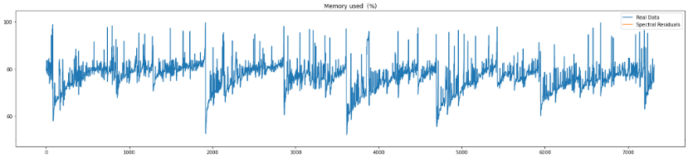


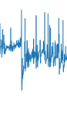


$$ε$$
0
1
State
Policy Network
Action
Reward
Replay Memory

Slide 11


random choice
copy parameters
$${Target}_{N}$$
$${Eval}_{N}$$
Replay Memory
Gradient Descent

Slide 14
HDFS
Real time Usage Data
Result
Spark Streaming
DStream
Detection Module
Real time export Usage Data
Zabbix Server agent
Alert Module
Query Alert
Datacenter

Slide 16






Inner Loop
Task 1
Policy Network($θ$)
Loss、$θ^{′}$
Environment
Task 2
Policy Network ($θ$)
Environment
Loss、$θ^{′}$
Iteration Replays
…….
…….
…….
Task n
Policy Network ($θ$)
Environment
Loss、$θ^{′}$
Meta Training
Outer Loop
Compute Surrogate Loss
Iteration Replays
Conjugate Gradient
Update Policy
Line Search
TRPO meta-optimization

Slide 17
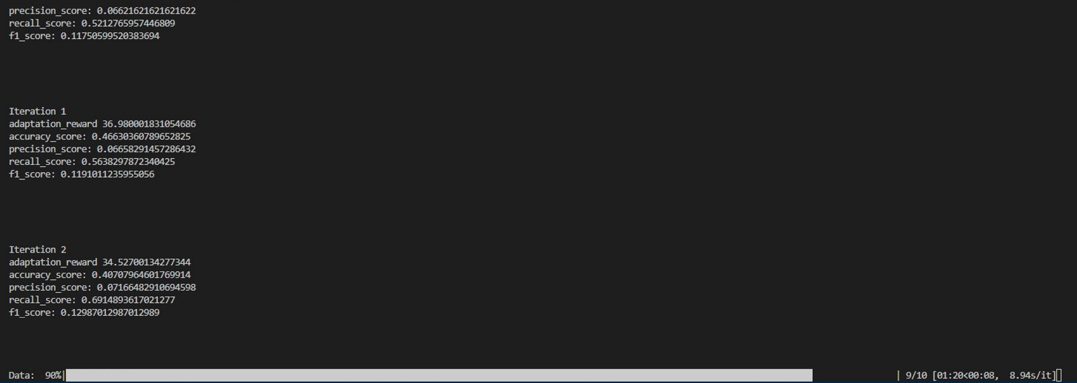

Slide 18
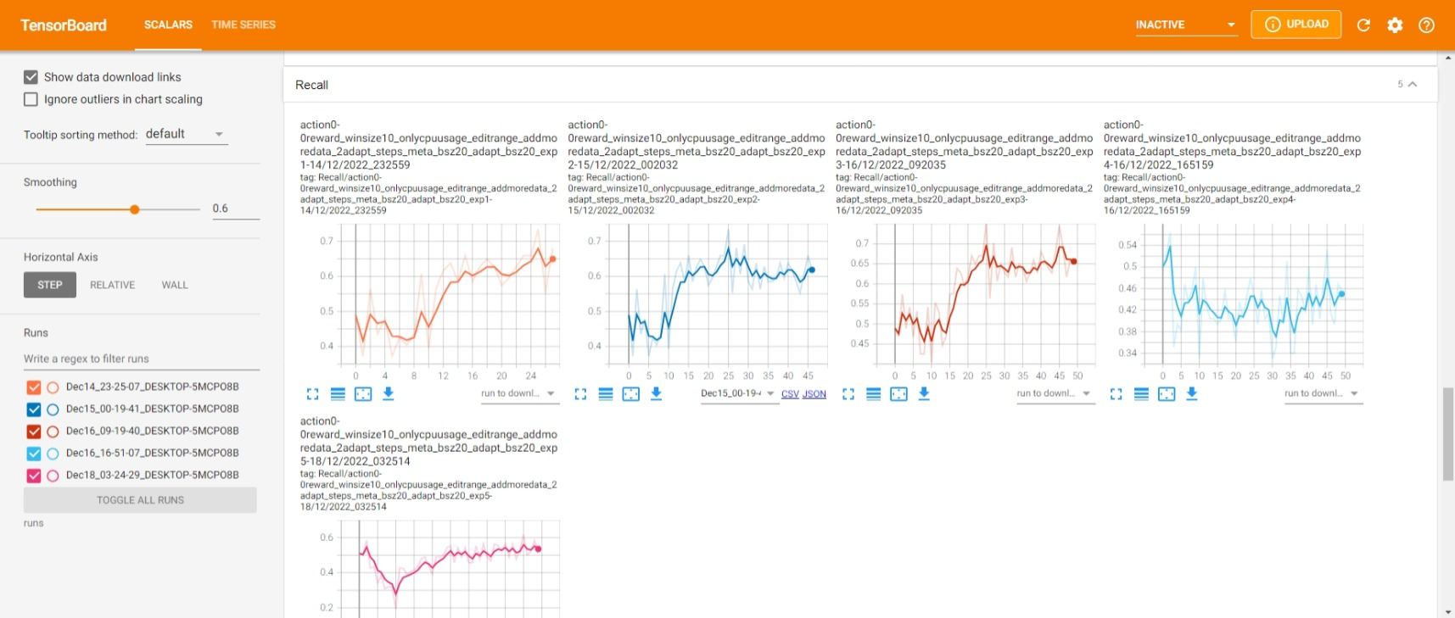

Slide 19
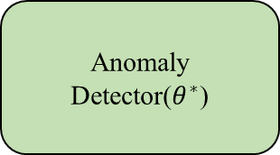
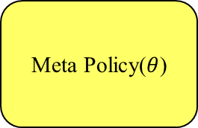
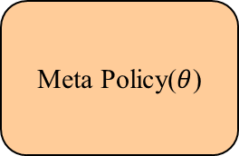
Unlabeled Data
Analyst
Meta Policy($θ$)
Meta Policy($θ$)
Feedback
Anomaly Detector($θ^{∗}$)
Query Data
Active Learning

