Slide 1




Microstrip Low Pass Filter Design with Open-Circuited Stub
Contact Us
Adnan Ahmetović- 190302079@student.ius.edu.ba;
Malik Bašović- 190302075@student.ius.edu.ba ;
Ş. Taha İmeci;
Dep. of Electrical and Electronics Engineering, International University of Sarajevo, Sarajevo, Bosnia and Herzegovina
Presented by: Adnan Ahmetovic and Malik Bašović
ICEE’21

Slide 2
Introduction
Previous Work
Design Steps
Simulation Results
Conclusion
Acknowledgement
References
Audience Questions
Outline

Slide 3
This paper presents a 2 pole 1.4GHz Butterworth microstrip low pass filter, that is designed based on the Open-circuited stub microstrip realization technique.
Low pass filters are used in communication systems to suppress spurious modes in oscillators and leakages in mixers
The work emphasis that detailed filter description and performance. The simulation results are given and parametric studies were presented in detail.
Introduction

Slide 4
The filter is designed using the FR4 substrate and the performance of the design is simulated using the Sonnet simulation tool.
At the cut-off frequency of 1.4GHz, the Open circuited stub filter produced an insertion loss of -1.909dB.
The stop-band characteristics exhibited an attenuation of -25.299dB at the stop-band frequency of 4GHz and a peak attenuation up to -37.62dB at 1.9GHz.
Introduction

Slide 5
[1] B. Chris, 1982, RF Circuit Design. NEWNES, pp-20. Indianapolis: H.W. Sams
- The Butterworth response is the flattest passband response available and contains no ripple. Butterworth filter will provide an attenuation of approximately 30 dB at a frequency equal to twice the cutoff frequency of the filter.
Previous Works

Slide 6
[II] Hunter, 2006, Theory and Design of Microwave Filters. University Press, Cambridge, pp.69-71
- to achieve an accurate filter frequency response, the transconductances and the associated parasitic capacitances of the filter building blocks cannot be varied.
Previous Works

Slide 7
[III] A. Jubril, and D. S Nyitamen., 2011, 2GHz Microstrip Low Pass Filter Design with Open-Circuited Stub pp. 1-5.
- In addition to a good compactness, the structure exhibits a simple design, very low insertion loss in the passband (L-band) of less than 0.3 dB, and it achieves a wide rejection bandwidth with a 20 dB attenuation from 5.3 to 6.3 GHz. The excellent LPF characteristics are verified through simulations and measurements where a good consistency can be observed. Such compact filter structures are expected to be used in various microwave system applications.
Previous Works

Slide 8
[IV] Tantawy, A. S., Habash, M. F., and Abdel- Rahman, A. B., " UWB bandpass filter with two band notches using T-shape resonators," 2015 32nd National Radio Science Conference (NRSC), pp. 51-56, 2015.
- The precision of the unity-gain frequencies or the time constants (ωint = 1 / τint) of the integrators forming an active filter has a great impact on the filter frequency response accuracy.
Previous Works

Slide 9
[V] H. Bohra, A. Ghosh, 2010, Design and Analysis of Microstrip Low Pass and Bandstop Filters, Pp. 2-6.
- The thin lines and the microstrip patch correspond to inductance and capacitance, respectively. The proposed meander Hi-Lo topology has been mounted on an RO4003 substrate with a relative dielectric constant εr = 3.38, thickness h = 0.813 mm and loss tangent 0.0027. The compact L-band low-pass structure has a size of (0.263λg×0.175λg) where λg = 57 mm is the wavelength at the cutoff frequency 2.85 GHz.
Previous Works

Slide 10
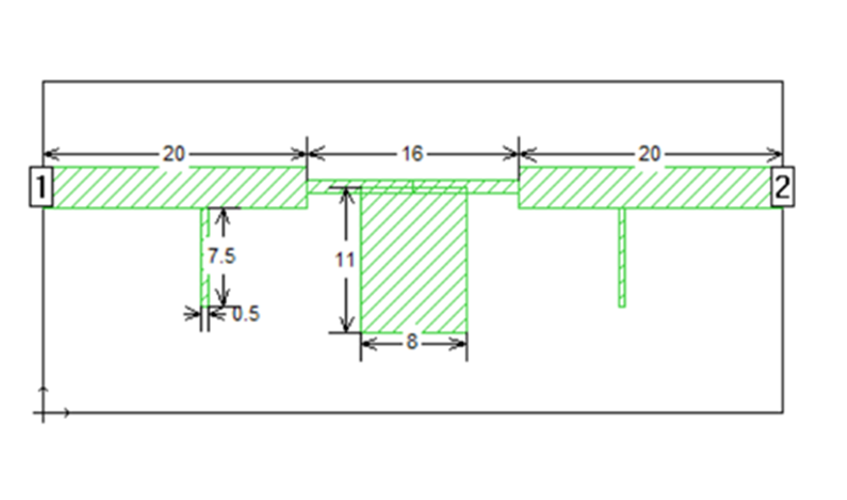
Design steps
Top view of the filter. The dimensions are in milimeters.
The design process of the microstrip low pass begins with the design of a passive low pass prototype network (i.e. LC ladder network) using the Butterworth approximation function.
The main material of this filter is FR-4 with thickness of 1.55 mm and dielectric (air) thickness is 15.0 mm.
Filters dimensions are 12.5 x 56.0 mm.

Slide 11
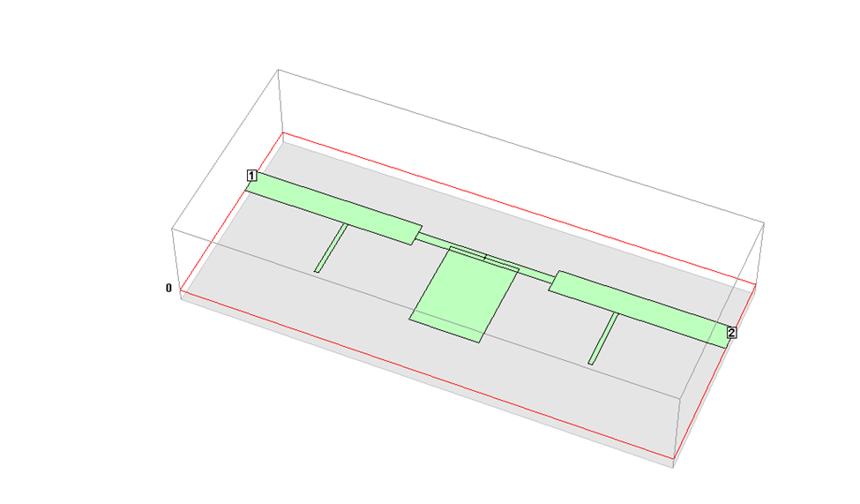

3D view of the filter

Slide 12
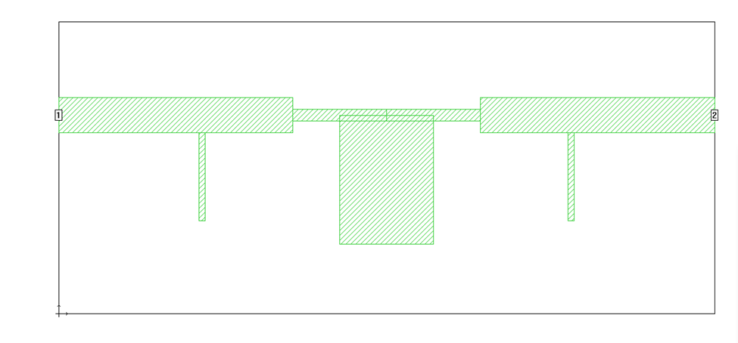
Top view of the filter

Slide 13
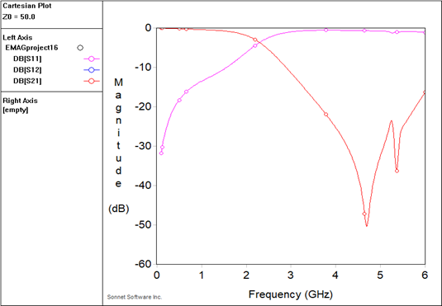
Simulation Results

Slide 14
Simulation Results
TABLE I. S-PARAMETERS WHEN THE SIZE OF TWO SMALL VERTICAL LINES IS CHANGED
Width | Length | S11 | S21 | Frequency
0.1mm | 7.5mm | -9.9 dB | -0.79 dB | 1.4 GHz
0.2 mm | 8 mm | -9.63dB | -0.63 dB | 1.48 GHz
0.5 mm | 7.5 mm | -9.81 dB | -0.81 dB | 1.56 GHz
1 mm | 8mm | -9.94 dB | -0.94 dB | 1.78 GHz

Slide 15
Simulation Results
TABLE II. CHANGING THE DIMENSIONS OF THICK VERTICAL STUB
Width | Length | S11 | Frequency
11mm | 7.5 mm | -10.13 dB | 1.4 GHz
11mm | 8 mm | -10.24dB | 1.48 GHz
10mm | 7.5mm | -10 dB | 1.56 GHz
10mm | 8 mm | -10.1dB | 1.78 GHz

Slide 16
A microstrip low pass filter is designed and analyzed using a 3D planar electromagnetic software in this paper.
According to the simulation results of Sonnet Suites, all results are satisfactory.
A parametric study was conducted by changing some parameters of the coupler. In the passband, its’ performance was very close to the lumped circuit model, while its’ stopband characteristics surpassed the design specification.
The open-circuited stub filter also provides easy tuning of the stop-band performance by varying the length of the stubs.
Conclusion

Slide 17
Acknowledgement
The success and final outcome of this project required a lot of guidance and assistance, and we are extremely privileged to have received this all along the completion of this project. All that we have done is only due to such supervision and assistance, especially from our professor Sehabeddin Taha Imeci.
We would also like to thank Sonnet Software Team for providing us an opportunity, as well as technical and licensing support, to do the project work.

Slide 18
B. Chris, 1982, RF Circuit Design. NEWNES, pp-20. Indianapolis: H.W. Sams,
I. Hunter, 2006, Theory and Design of Microwave Filters. University Press, Cambridge, pp.69-71.
D. Natarajan, A Practical Design of Lumped, Semi-lumped & Microwave Cavity Filters. Springer-Verlag Berlin Heidelberg, 2013., pp. 251-270.
References

Slide 19
Tantawy, A. S., Habash, M. F., and Abdel- Rahman, A. B., " UWB bandpass filter with two band notches using T-shape resonators," 2015 32nd National Radio Science Conference (NRSC), pp. 51-56, 2015.
H. Bohra, A. Ghosh, 2010, Design and Analysis of Microstrip Low Pass and Bandstop Filters, Pp. 2-6.
A. Jubril, and D. S Nyitamen., 2011, 2GHz Microstrip Low Pass Filter Design with Open-Circuited Stub pp. 1-5.
References

Slide 20
Audience Questions

Slide 21
Thank You

