Slide 1
Power BI Dashboard Design
Project: Sales & Financial Analysis Dashboard
Created by: G.SUNIL KUMAR REDDY

Slide 2
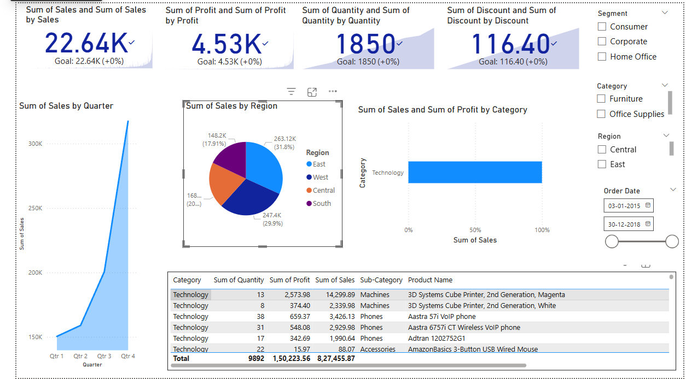
Screenshot of the Dashboard

Slide 3
Dashboard Overview
🔹 Purpose:
To visualize and analyze sales, profit, discount, and quantity data interactively.
🔹 Key Features:
- KPI Cards for Total Sales, Profit, Quantity, and Discount
- Time-series Line Chart: Sales by Quarter
- Pie Chart: Sales by Region
- Bar Chart: Sales and Profit by Category
- Slicers for Segment, Category, Region, and Date Range
- Summary Table with Product Details

Slide 4
Power BI Techniques Used
✅ Visuals:
- KPI Cards (with DAX Measures)
- Line, Pie, and Bar Charts
- Table for Drill-down Details
✅ Enhancements:
- Custom Measure Names for Clean KPIs
- Interactivity with Slicers & Date Filters
- Consistent Color Theme & Layout
- Tooltips, Data Labels, and Sorting
Outcome: A professional, insightful, and interactive business dashboard.

