Slide 1




FLIGHT AND AIRPORT ANALYTICS
SkyLens
From live AviationStack data to a desktop analytics cockpit
Python · PySide6 · pandas · Pydantic · SQLite
Notes:
OPENING (about 1 minute). Let the takeoff animation play: the plane climbs along the dashed route while the title appears letter by letter.
Say: "SkyLens turns raw, nested flight data from a live aviation API into validated, stored and analysed information that anyone can explore in a desktop dashboard or a terminal app."
Presenter controls: slide starts automatically. Press once to continue.
LIKELY VIVA QUESTION: What does the name mean? -> A lens that brings flight and airport data into focus: retrieval, validation, storage, analytics and visualisation in one tool.

Slide 2





Flight plan for today
AGENDA
01
02
03
04
05
Mission
Solution and design
The application
Proof and quality
Landing
Why SkyLens exists: the problem, objectives and scope
Pipeline, architecture, data model, API and validation
Desktop GUI, terminal app and flight conditions
Testing, verified results, challenges, limitations
Conclusion, future enhancements and questions
Slides 3–6
Slides 7–16
Slides 17–21
Slides 22–27
Slides 28–30
Notes:
AGENDA (1 minute). Five legs, like a boarding pass: Mission, Solution and Design, The Application, Proof and Quality, and the landing (conclusion and future work).
The small plane at the bottom of every slide shows how far we are along the journey.
Presenter controls: the five cards appear automatically one after another.
VIVA TIP: if the examiner wants to jump ahead, every leg starts with a full-screen section slide.

Slide 3
SkyLens at a glance
PART 01 · MISSION
SkyLens retrieves real flight and airport information from the AviationStack API, validates and cleans it, stores it in SQLite and turns it into analytics, charts and an interactive desktop dashboard.
2
14
8
front-ends on one shared core
desktop GUI sections
chart builders
DATA JOURNEY
AviationStack REST API
46
235
15k
Pydantic validation
pandas processing
SQLite storage
stored columns per flight
automated tests, all passing
lines of Python incl. tests
Analytics, charts and GUI
Notes:
AT A GLANCE (1.5 minutes). One sentence: SkyLens retrieves real flight and airport data, validates and cleans it, stores it in SQLite and turns it into analytics, charts and an interactive dashboard.
All six numbers on the right were measured from the delivered project: 2 front-ends, 9 GUI pages, 8 chart builders, 42 stored columns per flight, 65 automated tests, about 5.9 thousand lines of Python including tests.
VIVA QUESTION: Why two front-ends? -> Both sit on the same service, analytics and database code, which proves the core is UI-independent and testable. The terminal app is lightweight; the GUI is for exploration.

Slide 4




The challenge behind flight data
PART 01 · MISSION
Raw API data is not analysis-ready.
Nested, noisy responses
Strict free-tier quota
Departure, arrival, airline, flight, aircraft and live blocks, with many null fields.
About 100 requests per month, so every response must be kept and reused.
Every AviationStack record nests six blocks, and in the stored table 3,383 of 10,580 cells (32%) are empty. Before any analysis, the data must be validated, flattened and protected from duplicates.
No delay causes
Plan restrictions
The source never says why a flight is late, so the app must not guess weather.
Free plan is HTTP-only and lookup endpoints may be restricted.
Notes:
PROBLEM STATEMENT (2 minutes). Core message: raw API output is not analysis-ready.
Evidence from the project: each record nests departure, arrival, airline, flight, aircraft and live blocks. In the stored table, 2,056 of 5,586 cells (37%) are empty because many fields are legitimately null.
The four problems: nested noisy responses, strict free-tier quota (about 100 requests a month), no delay causes, and plan restrictions (HTTP only, restricted lookup endpoints).
VIVA QUESTION: Why does the quota matter for design? -> Every call is precious, so every retrieval is archived as raw JSON and persisted in SQLite; the app keeps working on stored data when the quota is gone.

Slide 5
Objectives and scope
PART 01 · MISSION
1
Retrieve real flight data from a REST API with optional filters
IN SCOPE
AviationStack /v1/flights data
Airports derived from flight records
Optional Open-Meteo weather context
CSV and JSON export of results
2
Validate and clean every record before it is trusted or stored
3
Persist results in SQLite without duplicates
Analyse airlines, airports, routes, delays and conditions
OUT OF SCOPE
4
Historical archives and delay causes
Paid endpoints such as /airports and /routes
Claiming weather caused a delay without proof
5
Deliver a terminal app and a desktop GUI on one core
Notes:
OBJECTIVES AND SCOPE (2 minutes). Left: five objectives that the project fulfils. Right: what is in scope and, just as important, what is deliberately out of scope.
Click once to reveal the scope boxes after you have explained the objectives.
Out of scope is a strength: the app never claims weather caused a delay unless the source confirms it, and never assumes paid endpoints exist.
VIVA QUESTION: Why derive airports from flights instead of calling an airports endpoint? -> The paid /v1/airports directory is not assumed to be available; the embedded airport blocks in each flight give real data from the same source.

Slide 6
Why not just call the API?
PART 01 · MISSION
RAW API RECORD · /v1/flights (trimmed)
Structure
Nested blocks become one flat row
SKYLENS ROW · flights table, 46 columns (excerpt)
{ "flight_date": "2026-10-10",
"flight_status": "scheduled",
"departure": { "airport": "Auckland International",
"iata": "AKL", "delay": null,
"scheduled": "2026-10-10T00:55:00+00:00",
"actual": null, ... },
"arrival": { "airport": "Singapore Changi",
"iata": "SIN", "gate": null, ... },
"airline": { "name": "Air New Zealand", "iata": "NZ" },
"flight": { "number": "282", "iata": "NZ282",
"codeshared": null },
"aircraft": { "registration": null, ... },
"live": null }
flight_date
2026-10-10
flight_status
scheduled
flight_iata
NZ282
Quality
Pydantic validates every record
airline_name
Air New Zealand
route
AKL-SIN (derived)
dep_airport
Auckland International
Persistence
SQLite upsert keeps one row per flight
arr_airport
Singapore Changi
dep_scheduled
2026-10-09 11:55 UTC
dep_delay_min
NULL
is_delayed
False (derived)
Insight
Statistics, charts and a dashboard
is_codeshared
False
Notes:
RAW API VS SKYLENS (2 minutes). Start with the real raw record on the left (trimmed for the slide). Click once: the nested JSON fades out and the same flight appears as one clean, flat database row.
This flight is NZ282, Auckland to Singapore, taken from the project's own archived data. The row is exactly what is stored in SQLite, including the derived route AKL-SIN and the is_delayed flag.
Then walk the four comparison rows: structure, quality, persistence, insight.
VIVA QUESTION: Is the derived route a database column? -> Yes, route, is_delayed and max_delay_min are derived during pandas processing and stored.

Slide 7


PART 02
Solution and design
From a raw API response to a trustworthy analytics core
Notes:
SECTION: SOLUTION AND DESIGN (15 seconds). Let the plane cross behind the title and the clouds. Next: the six-stage pipeline, then the layered architecture, technology stack, data model, API integration and validation.

Slide 8
One pipeline, six stages
PART 02 · SOLUTION AND DESIGN
01
Source
AviationStack
/v1/flights
02
Validate
Pydantic models
reject bad rows
03
Transform
pandas flattens and
derives route, delay
04
Store
SQLite upsert,
one row per flight
05
Analyse
Statistics and
8 chart builders
06
Present
Terminal app and
PySide6 GUI
Why this order? Validation before transformation rejects bad data early. Storage is the single source of truth, and both front-ends read the same analytics layer, so the terminal app and the GUI can never disagree.
Notes:
PROPOSED SOLUTION (2 minutes). Click once per stage so you control the pace: API, validation, processing, storage, analytics, presentation.
Key design idea: validation happens before transformation, and stored data is the single source of truth, so both front-ends always agree.
NEXT SLIDE uses the Morph transition: these same six boxes will move into the layered architecture. Do not skip the animation; it shows that the pipeline and the architecture are the same system seen from two angles.
VIVA QUESTION: Why validate before pandas? -> Rejected records are reported instead of silently fixed, so bad data never reaches storage.

Slide 9
Layered system architecture
PART 02 · SOLUTION AND DESIGN
Terminal app and desktop GUI
main_task/main.py · main_task/gui_main.py · src/gui (13 PySide6 files)
PRESENTATION
service.py
Shared refresh orchestration for both front-ends
config.py · utils.py
Settings, logging, errors
SERVICE
models.py
Pydantic validation
data_processor.py
pandas transform and dedup
analytics + visualizations
Statistics and 8 charts
DOMAIN
database.py → SQLite
flights · airports · refresh_log
data/raw · data/processed
JSON archive and CSV
DATA
api_client.py
HTTP clients with error mapping
AviationStack · Open-Meteo
External services
EXTERNAL
Notes:
ARCHITECTURE (2.5 minutes). The Morph transition just moved the six pipeline boxes into their architectural layers.
Top to bottom: presentation (terminal app and PySide6 GUI), the shared service layer, the domain layer (validation models, pandas processing, analytics and charts), the data layer (SQLite plus archived raw JSON and processed CSV) and the external systems (AviationStack and Open-Meteo).
config.py and utils.py are cross-cutting: paths, .env settings, logging and error types.
VIVA QUESTIONS: Where does business logic live? -> in src/, never in the GUI. How are GUI and terminal kept consistent? -> both call service.py, database.py and analytics.py.

Slide 10







Technology stack
PART 02 · SOLUTION AND DESIGN
Python 3.10+
PySide6 ≥ 6.6
pandas ≥ 2.0
Language and runtime
Qt desktop interface
Transformation and analytics
Pydantic ≥ 2.5
SQLite
Matplotlib ≥ 3.8
Record validation
Local persistence
Charts in the GUI and saved PNGs
requests ≥ 2.31
python-dotenv ≥ 1.0
pytest ≥ 8.0
HTTP client for the APIs
Configuration from .env
Automated test suite
Notes:
TECHNOLOGY STACK (1.5 minutes). Nine libraries, each with one clear job. Versions are the minimums from requirements.txt.
Data sources: AviationStack for flights and Open-Meteo (free, no key) for optional weather context.
VIVA QUESTIONS: Why SQLite? -> zero-setup, file-based, ideal for a single-user desktop tool and for persisting a limited API quota. Why Pydantic? -> declarative validation with clear error messages per record. Why PySide6? -> official Qt for Python bindings, native widgets and threads.

Slide 11
Data flow and deduplication
PART 02 · SOLUTION AND DESIGN
1
run_pipeline()
Extract /v1/flights with retries; archive raw JSON
NATURAL KEY
(flight_date, flight_iata,
dep_iata, arr_iata)
ON CONFLICT DO UPDATE
2
validate_batch()
Pydantic gate 1; rejects kept with reasons
3
transform_records()
Clean, localise times, derive columns; gate 2
235 → 230
4
load_batch()
Atomic upsert into SQLite on the natural key
records fetched over four successful retrievals (3 rejected, 2 repeats merged) became 230 unique rows. Every run is logged in refresh_log.
5
rebuild_airports()
Airports recomputed from all stored flights
6
verify_database() > eda.py
SQL checks, then EDA reads the database
Notes:
WORKFLOW (2.5 minutes). Follow the six steps lighting up in order: fetch, validate, flatten, store, derive airports, read.
Deduplication: the natural key is flight_date + flight_iata + dep_iata + arr_iata. The table is declared UNIQUE on that key with ON CONFLICT REPLACE, so retrieving the same flight again updates it instead of duplicating it.
Proof from the real run log: 100 + 25 + 10 = 135 records fetched over three successful refreshes, 133 unique rows in the database.
VIVA QUESTION: What happens on re-retrieval? -> the row is replaced with the newer data; the refresh_log records every attempt.

Slide 12

Project structure
PART 02 · SOLUTION AND DESIGN
Flight_Airport_Analytics/
|-- main_task/ entry points
|-- src/ core logic, 11 modules
| `-- gui/ PySide6 front end
|-- data/
| |-- raw/ archived API JSON
| `-- processed/ cleaned CSV, exports
|-- database/ flight_airport.db
|-- visualizations/ saved PNG charts
|-- tests/ pytest suite
|-- outputs/logs/ application.log
`-- .env.example requirements.txt README.md
Thin entry points
main.py and gui_main.py only start the apps; logic lives in src/.
Nothing is lost
Every retrieval is archived as raw JSON and as a timestamped CSV.
Secrets stay local
.env is git-ignored; .env.example documents every setting.
Notes:
FOLDER STRUCTURE (1.5 minutes). Entry points in main_task are thin launchers (gui_main.py is 24 lines). All logic sits in src/. Data is kept in data/raw (untouched API JSON) and data/processed (cleaned CSV). The database lives in database/. Tests are separate and run without network or API key.
Secrets: the real .env is git-ignored; .env.example is the template.
VIVA QUESTION: Why archive raw JSON? -> reproducibility and quota: a retrieved response is never lost and can be reprocessed.

Slide 13
Key modules
PART 02 · SOLUTION AND DESIGN
config.py
169 lines
api_client.py
321 lines
models.py
406 lines
Paths, .env loading, masked key, settings
AviationStack client: retries, paging, error mapping
Two Pydantic gates, rejection reports
data_processor.py
454 lines
database.py
732 lines
analytics.py
289 lines
pandas cleaning, UTC conversion, derived columns
Schema v2, atomic upsert, migration, verification
Statistics, delay metrics, flight conditions
eda.py + eda_charts.py
888 lines
pipeline.py
308 lines
gui/ package
9 files
Structured EDA, outliers, 12 figures
run_pipeline(): Extract to Verify; service.py wraps it
2,362 lines: window, pages, widgets, tables, workers
Notes:
KEY MODULES (2 minutes). Nine building blocks with real line counts from the delivered code: config 158, api_client 221, models 165, data_processor 271, database 403, analytics 289, visualizations 307, service 120, and the GUI package with nine files and about 2,360 lines.
Highlight service.py: one refresh_data() function used by both front-ends: fetch, validate, transform, store, log.
VIVA QUESTION: Where are errors defined? -> utils.py has AppError with APIError, AuthenticationError, RateLimitError, ValidationFailedError and DatabaseError.

Slide 14
Database design
PART 02 · SOLUTION AND DESIGN
flights 46 columns · 230 rows
airports 134 rows
IDENTITY
flight_date, flight_status, flight_iata, flight_icao, flight_number
iata (UNIQUE), icao, airport_name, timezone, departures, arrivals, sightings
AIRLINE
airline_name, airline_iata, airline_icao
Rebuilt from all stored flights on every load.
DEPARTURE
dep_airport, dep_iata, terminal, gate, scheduled, estimated, actual, dep_delay_min
ARRIVAL
arr_airport, arr_iata, terminal, gate, baggage, times, arr_delay_min
refresh_log 9 rows
AIRCRAFT, LIVE
registration, icao24, is_codeshared, live_latitude, longitude, altitude, speed
refreshed_at, source, fetched / valid / rejected / inserted / updated, status, duration
DERIVED
route, is_delayed, max_delay_min, duration, local hour, audit times
UNIQUE(flight_date, flight_iata, dep_iata, arr_iata)
ON CONFLICT DO UPDATE · CHECK constraints · indexes: status, airline, dep, arr
One audit row per run, failures included; rejected_records keeps each refused record.
Notes:
DATABASE DESIGN (2.5 minutes). Three SQLite tables. flights has 42 columns grouped as identity, airline, departure, arrival, aircraft and live data, and derived fields. It is UNIQUE on the natural key with ON CONFLICT REPLACE and indexed on status, airline, departure and arrival codes.
airports (76 rows) is derived from the airport blocks inside flights, with departures, arrivals and sightings counts. refresh_log (4 rows) is an audit trail with fetched, valid and stored counts and a status, including failed attempts.
Click through the three tables one by one.
VIVA QUESTION: Why derive airports? -> the free plan does not guarantee an airports endpoint; this keeps the Airports page real and consistent with the flights.

Slide 15
API integration and resilience
PART 02 · SOLUTION AND DESIGN
REQUEST
WHEN THINGS FAIL
OPEN-METEO (OPTIONAL)
GET /v1/flights
HTTP 403: provider reason shown to the user
Quota used up: RateLimitError, stored data stays usable
Bad key: AuthenticationError
Restricted endpoint: handled gracefully
Network down: readable message, no crash
Free, no key. Shows current weather for a location you set in Settings.
access_key from .env, masked in the GUI
limit: 100 by default
Filters: status, dep/arr IATA, airline, flight number
Base URL configurable; free plan is HTTP-only
20 s timeout
Guard rail
Delays are labelled weather-related only if the flight API confirms it. Weather is context, never a guess.
Notes:
API INTEGRATION (2.5 minutes). Left: the single endpoint used, /v1/flights, with optional filters. The key comes from .env and is masked in the GUI.
Middle: how failures are handled: the provider's reason is surfaced (for example HTTP 403), quota and authentication problems map to dedicated error types, restricted endpoints and HTTPS-only restrictions are handled gracefully, and the app keeps working on stored data.
Right: optional Open-Meteo weather context, informational only. The project never attributes a delay to weather unless the flight source confirms it.
Real evidence: the latest refresh in the project log failed with HTTP 403 and the app reported it clearly while keeping the 133 stored flights usable.

Slide 16
Validation and processing
PART 02 · SOLUTION AND DESIGN
PYDANTIC GATE
PANDAS TRANSFORM
Status is one of six known values
ISO dates and timestamps
Delays 0 to 2,880 minutes
Latitude −90..90, longitude −180..180
Airport IATA 3 chars, airline IATA 2
Identifiable flight; arrival after departure
Flatten nested blocks into columns
Airport-local times to true UTC
Derive route, is_delayed, duration, hour
Never impute missing delays
De-duplicate on the natural key
Second Pydantic gate on each row
Real runs: 235 records fetched, 232 passed, 3 rejected (no flight identifier). Rejections are reported, never silently fixed.
Notes:
VALIDATION AND PROCESSING (2.5 minutes). Left, the Pydantic gate: status must be one of six known values, dates must be ISO, delays cannot be negative, coordinates must be in range, IATA codes are upper-cased, and missing nested blocks are allowed where the API returns null.
Right, the pandas transformation: flatten nested blocks, parse timestamps to UTC, derive route, is_delayed and max_delay_min, drop unidentifiable rows, de-duplicate on the natural key, derive airports.
Evidence: in the real runs all 135 fetched records were valid. Nine unit tests pin the validation behaviour including bad status, bad date, negative delay and invalid latitude.
VIVA QUESTION: What if a record is bad? -> it is rejected and reported with its error, never silently repaired.

Slide 17

PART 03
The application
One shared core, two front-ends
Notes:
SECTION: THE APPLICATION (15 seconds). Now the visible side: the PySide6 desktop GUI and the terminal app on the same core.

Slide 18
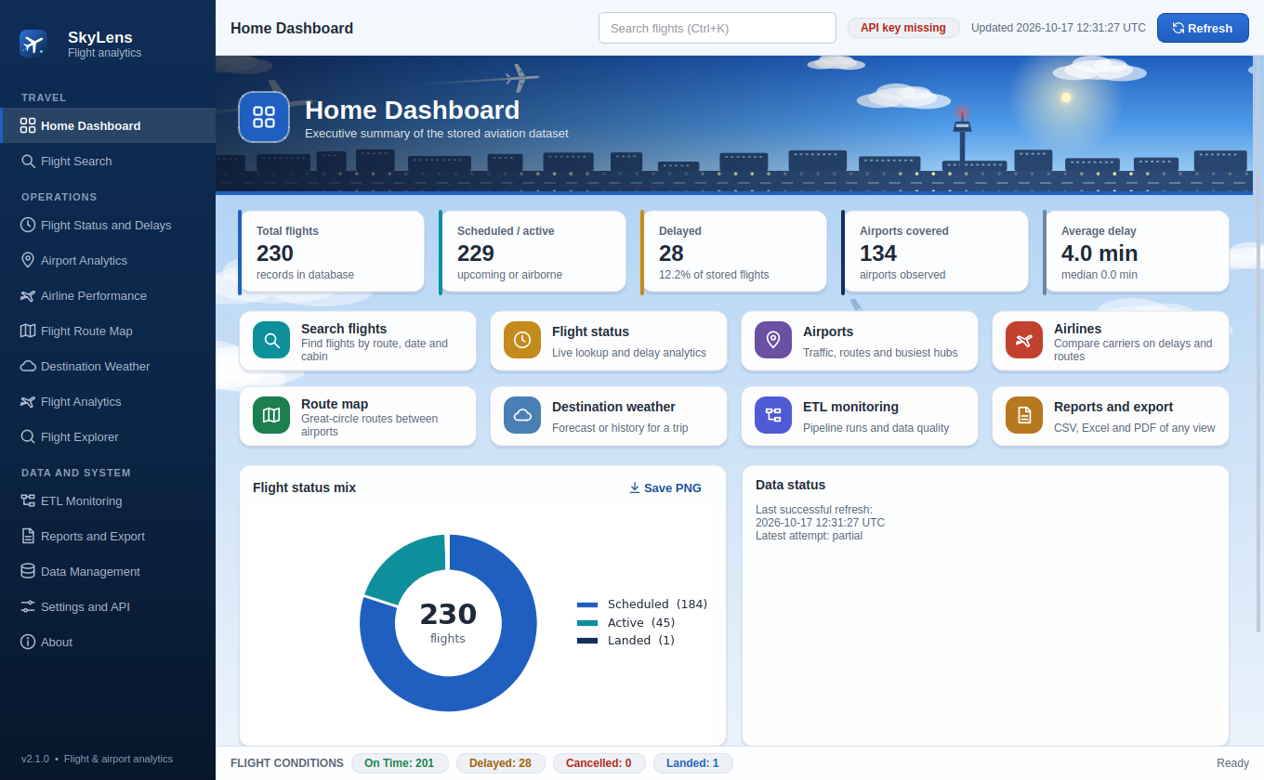
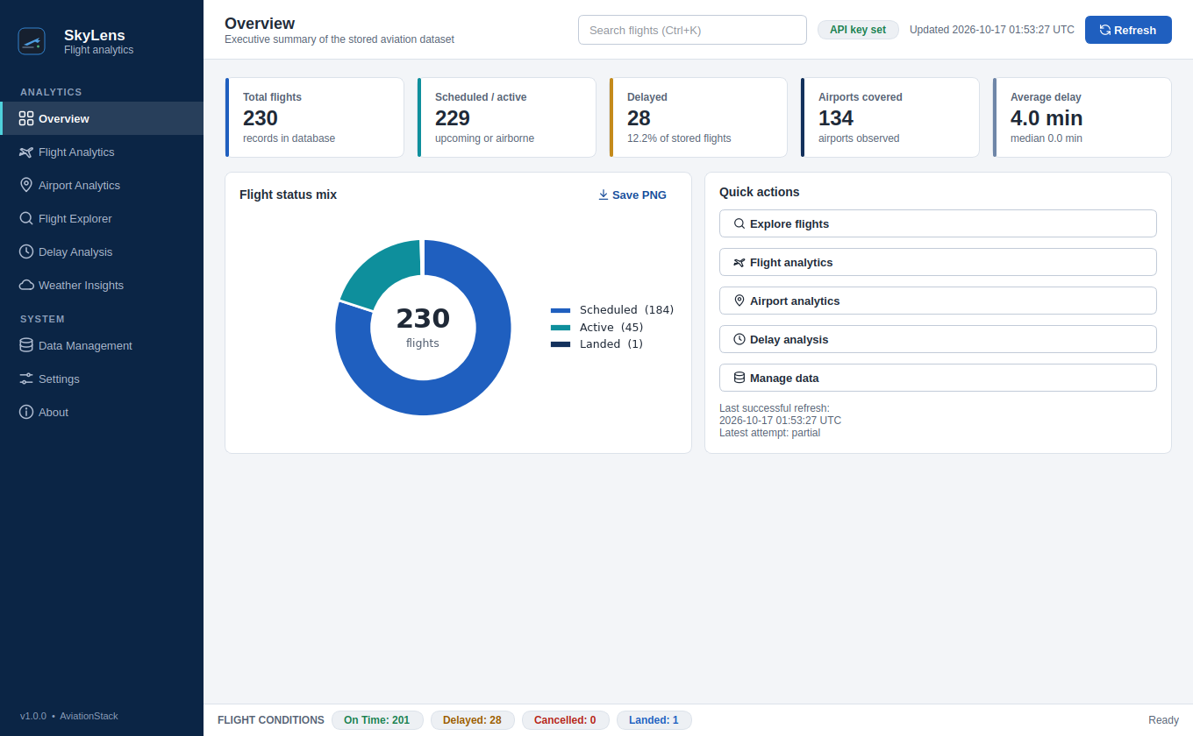
The SkyLens desktop dashboard
PART 03 · THE APPLICATION
KPI cards
Flights, scheduled, delayed, airports and average delay
1
1
Status mix
Donut of flight statuses with Save PNG
2
3
Quick-action tiles
Eight colour-coded tiles open their section
3
2
Conditions bar
On Time 201 · Delayed 28 · Cancelled 0
4
4
Notes:
DESKTOP GUI (2.5 minutes). This is a real screenshot of the running application on the stored dataset, captured headlessly from the delivered code.
Click to reveal four numbered callouts: 1 KPI cards (133 flights, 133 scheduled or active, 9 delayed, 76 airports, 2.5 min average delay); 2 the flight status donut with Save PNG; 3 quick actions; 4 the flight-conditions bar (On Time 124, Delayed 9, Cancelled 0).
Network work runs on background threads so the window never freezes.
NEXT SLIDE uses Morph: this screenshot shrinks into a gallery of the other pages.
VIVA QUESTION: How is the GUI kept responsive? -> workers.py runs tasks on background threads with callbacks on the GUI thread.

Slide 19
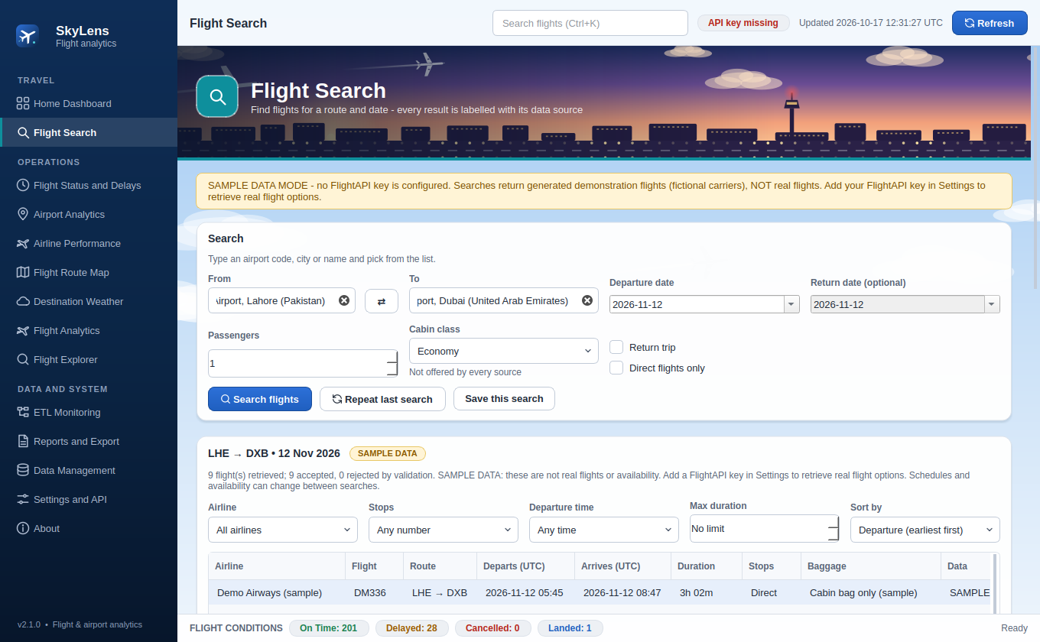
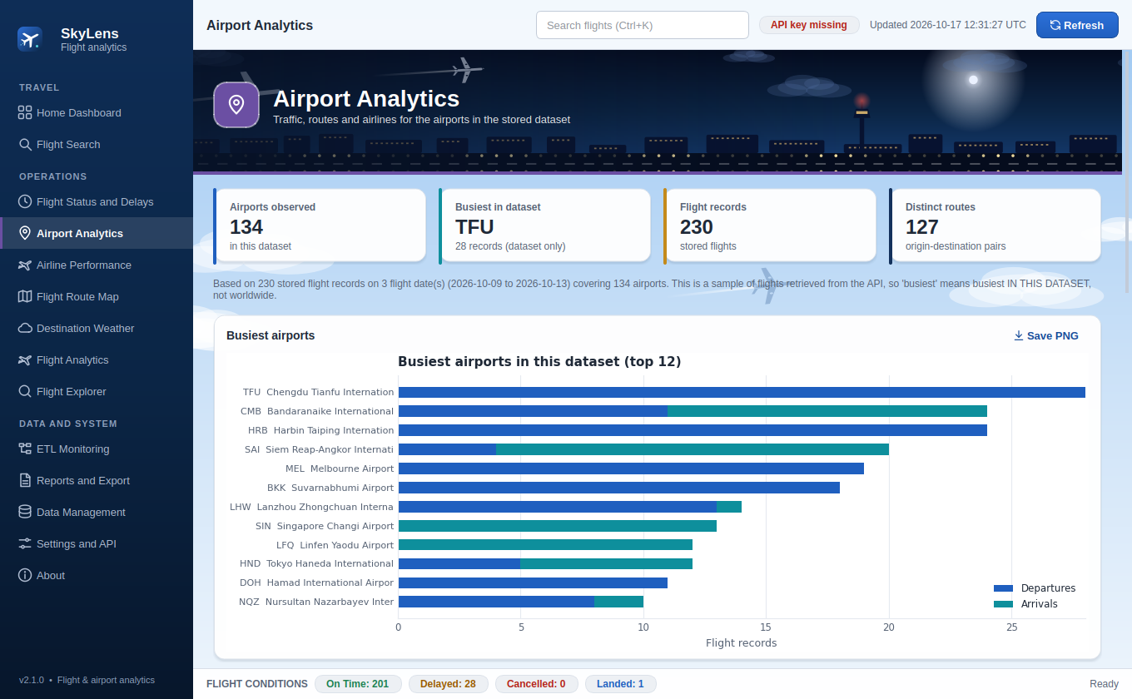
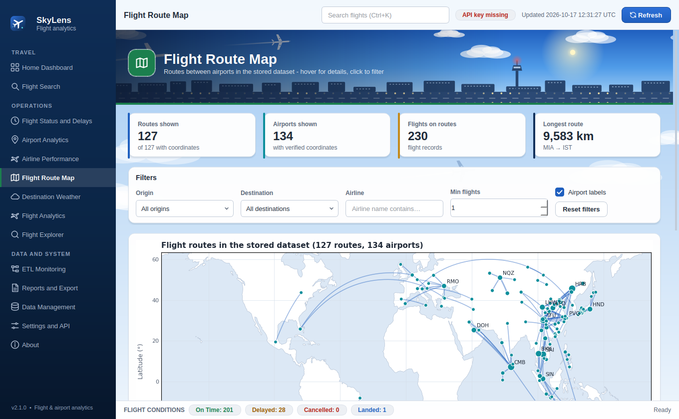
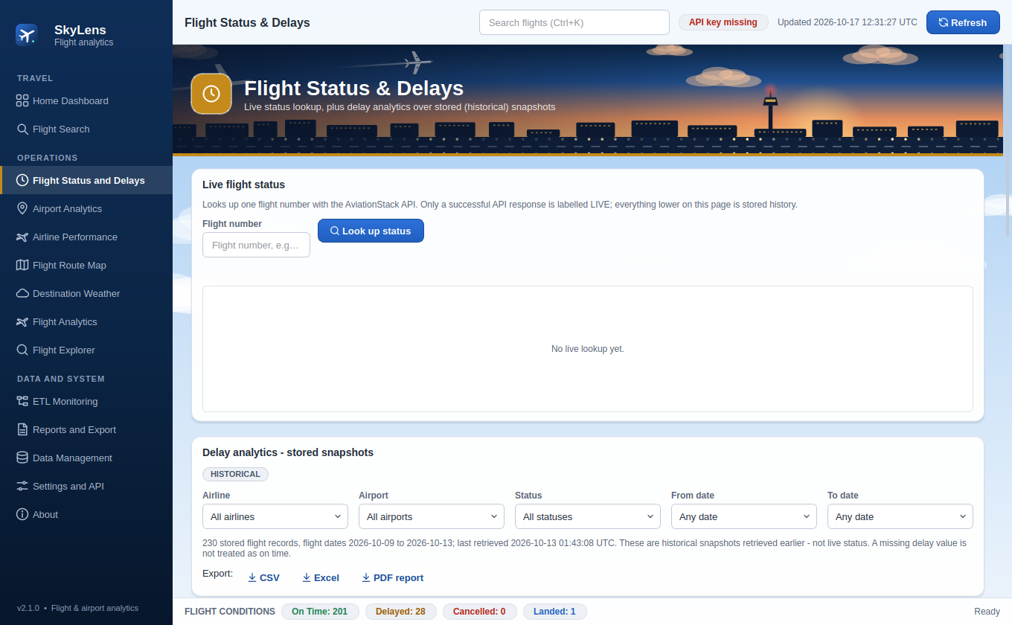
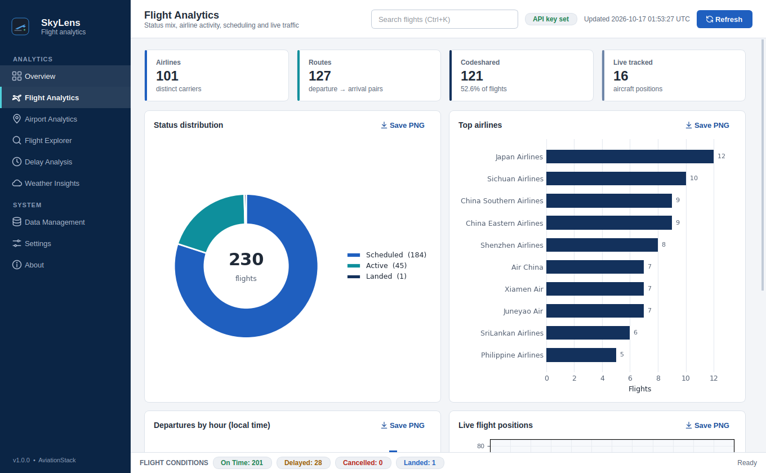
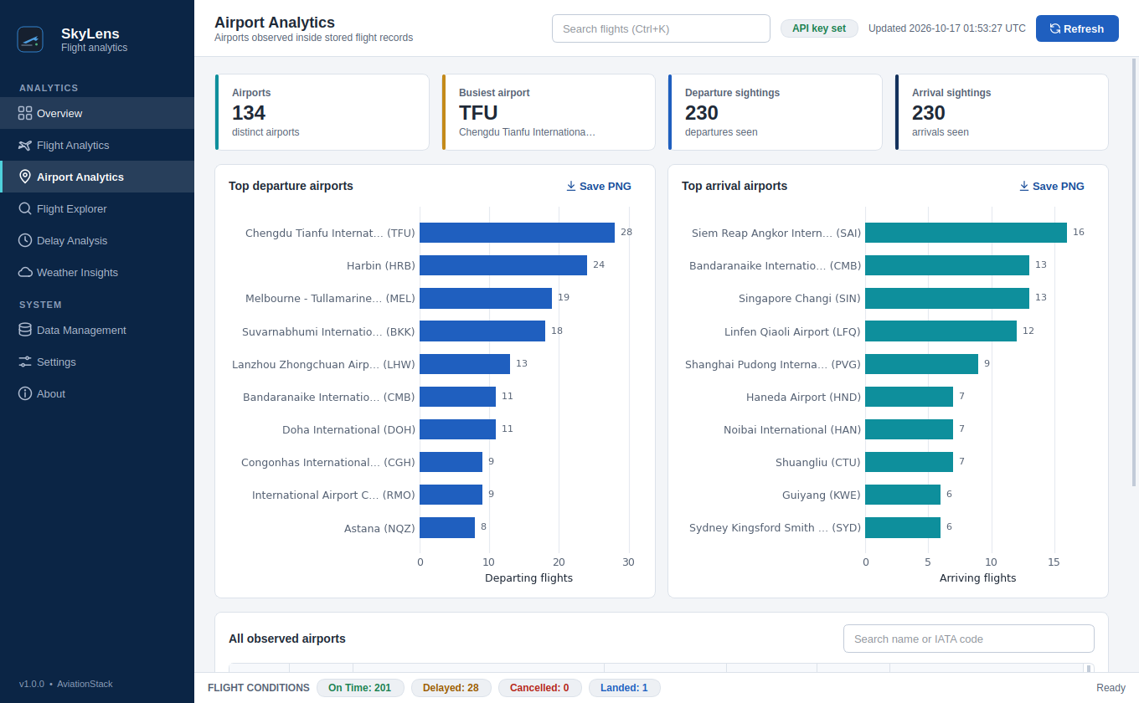
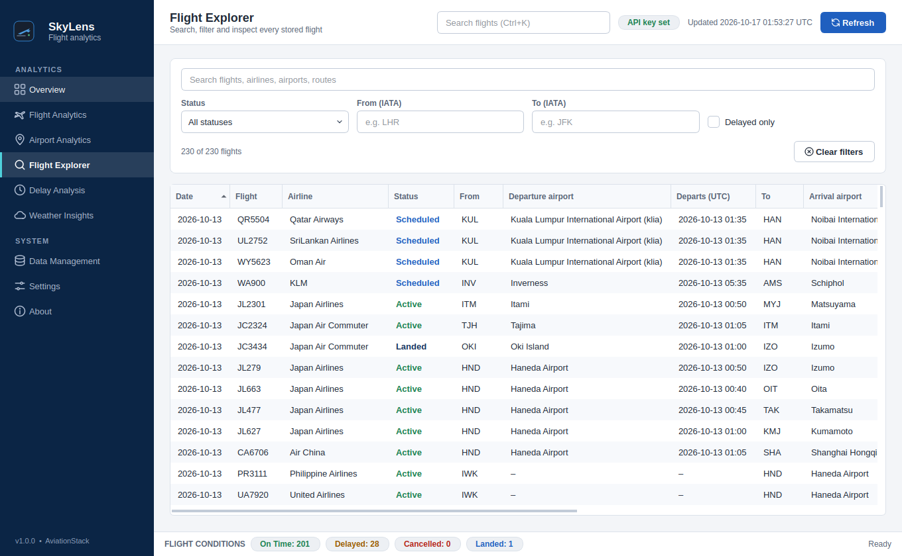
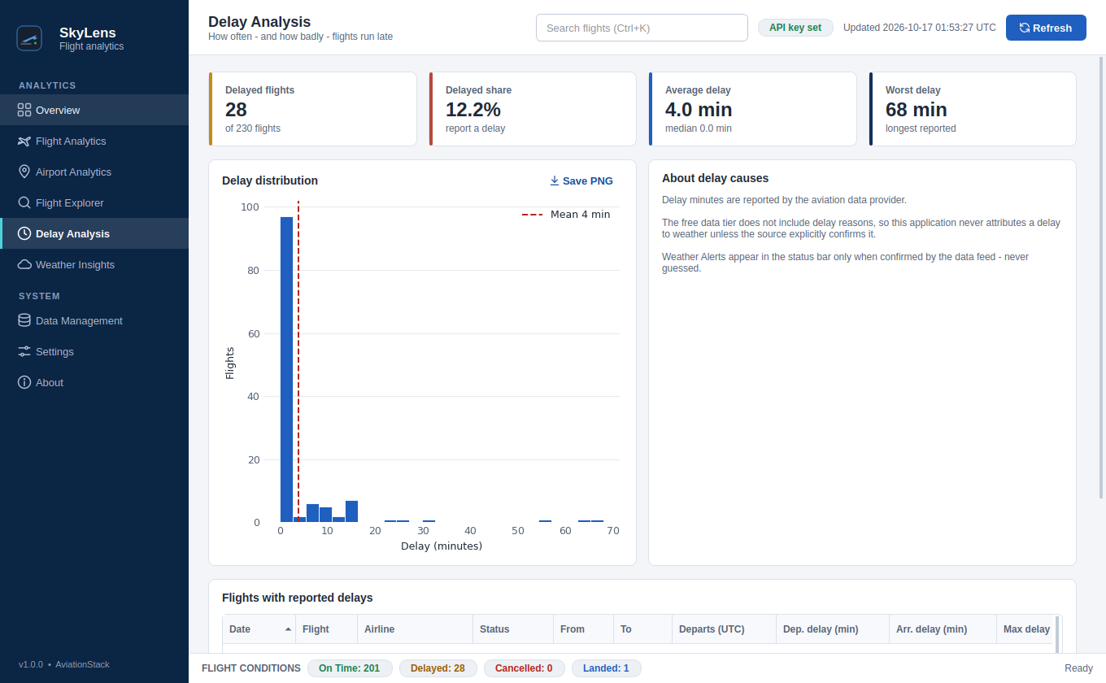
Fourteen sections, one aviation theme
PART 03 · THE APPLICATION
Home Dashboard
Flight Search
Airport Analytics
ALL FOURTEEN SECTIONS
Home Dashboard · Flight Search · Flight Status and Delays · Airport Analytics · Airline Performance · Flight Route Map · Destination Weather · Flight Analytics · Flight Explorer · ETL Monitoring · Reports and Export · Data Management · Settings and API · About
Flight Route Map
Flight Status and Delays
Notes:
GUI TOUR (2 minutes). Morph just shrank the Overview screenshot into this gallery. Walk the four analytical pages: Flight Analytics (status, top airlines, routes, hours), Airport Analytics (busiest departure and arrival airports), Flight Explorer (search, status and delay filters, sortable table) and Delay Analysis (distribution, mean delay and flights with reported delays).
All nine pages: Overview, Flight Analytics, Airport Analytics, Flight Explorer, Delay Analysis, Weather Insights, Data Management, Settings, About.
VIVA QUESTION: Does search work on the whole dataset? -> yes, it filters the stored dataset by text, status, route and delayed-only, with match counts.

Slide 20
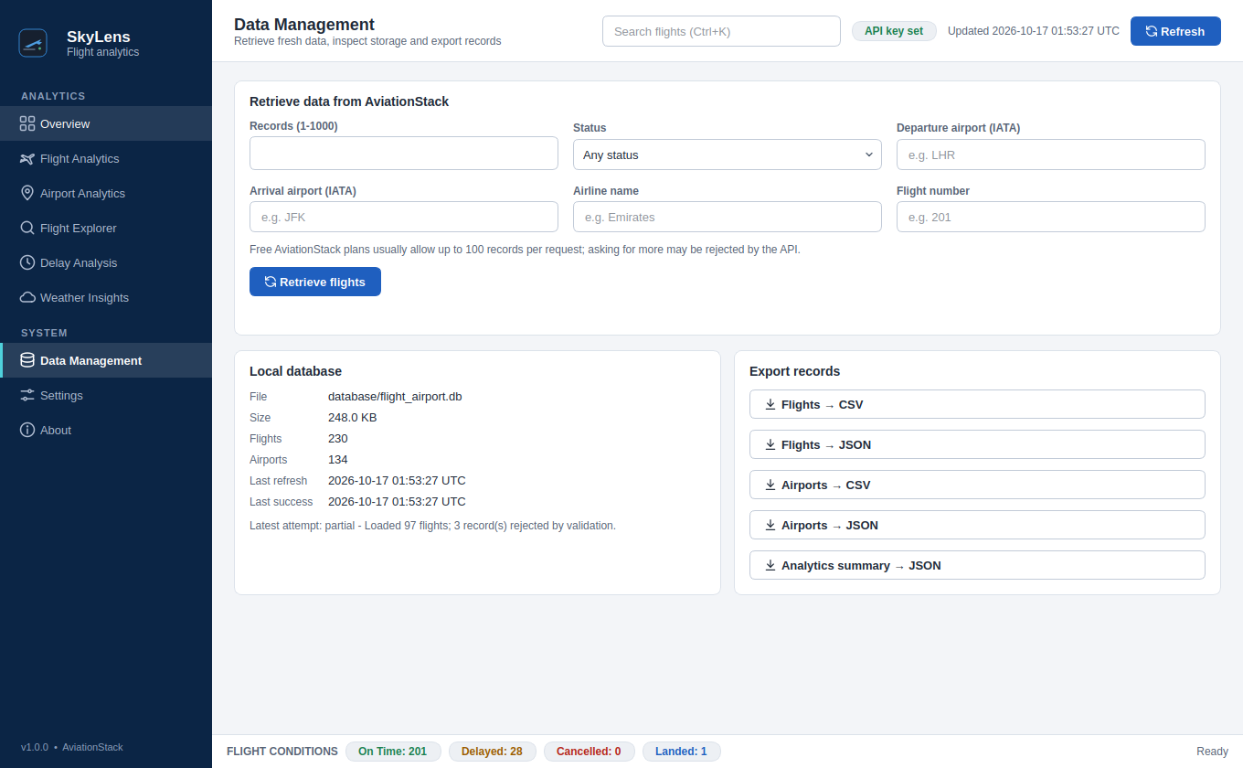
Two front-ends, one core
PART 03 · THE APPLICATION
MAIN MENU
1 Application overview
2 Retrieve / refresh aviation data
3 View flight records
4 View airport records
5 Search and filter records
6 Flight and airport statistics
7 Exploratory data analysis
8 Generate visualizations
9 Database information
10 Export records or analysis
11 Configuration / status
0 Exit
TERMINAL APP · python main_task/main.py
DESKTOP GUI · Data Management page
Validated input
Readable errors
Background threads
Masked API key
CSV and JSON export
Notes:
TWO FRONT-ENDS (2 minutes). Left: the terminal application's real main menu with 11 actions: overview, retrieve data with filters, view flights and airports, search and filter, statistics, exploratory analysis, visualisations saved as PNG, database information, export and configuration status.
Right: the GUI's Data Management page, with filtered retrieval, local database status and CSV or JSON export. The file path shown is the project-relative database location.
Both use service.py, database.py, analytics.py and visualizations.py; only the presentation differs.
VIVA QUESTION: Why keep a terminal app? -> scripting, headless servers and a minimal interface; it also demonstrates that the core is UI-independent.

Slide 21
Flight conditions and delay logic
PART 03 · THE APPLICATION
FIRST MATCH WINS
FLIGHT CONDITIONS BAR · STORED DATA
Cancelled
status is cancelled
On Time: 201
Delayed: 28
Cancelled: 0
Delayed N min
max delay is above zero
125 of 230
12.2%
Weather Alert
only if the source confirms weather
Incident / Diverted
status incident or diverted
flights carry delay data
delayed (28 flights)
On Time
status scheduled or active
4.0 min
68 min
Landed
status landed
average delay, median 0
worst reported delay
Status Unknown
anything else
Notes:
FLIGHT CONDITIONS (2.5 minutes). The status bar at the bottom of the GUI is computed from stored rows with this rule ladder, first match wins: Cancelled, Delayed N min, Weather Alert (only when confirmed), Incident or Diverted, On Time, Landed, Status Unknown.
Weather categories are unused on the free plan because the API gives no delay causes. This is deliberate honesty, not a missing feature.
Real numbers on the right come from the stored dataset: 124 On Time, 9 Delayed, 0 Cancelled; 66 of 133 flights carry delay data; 6.8% delayed; average delay 2.5 minutes with a median of 0; worst delay 65 minutes.
VIVA QUESTION: How do you avoid looping over rows? -> condition_counts() is vectorised in pandas and a test pins it against the row-level classifier.

Slide 22



Version 2.1: fares removed, interface redesigned
PART 03 · THE APPLICATION
Fares removed
Everything else kept
Safe migration
Fare display, comparison, filters, analytics, price alerts and fare APIs are gone.
Search, status, airports, airlines, map, weather, ETL and reports work as before.
Schema v4 drops the fare tables; flights, run history and saved routes are kept.
Aviation theme
Responsive
Verified
Animated sky, airliners and airport scenes; every section has its own colour.
Desktop, tablet and phone widths, a slide-in menu, no sideways scrolling.
235 tests pass, including a guard that no fare code or table remains.

Slide 23
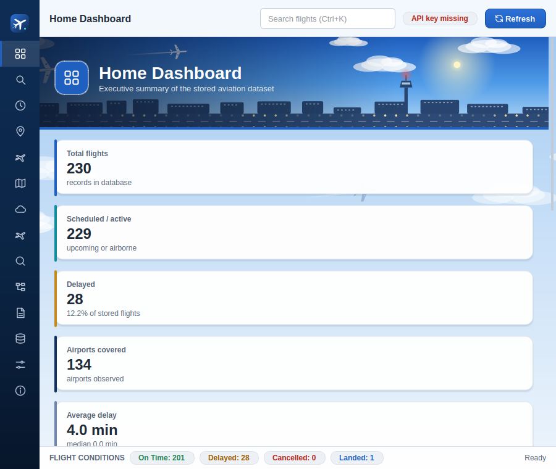
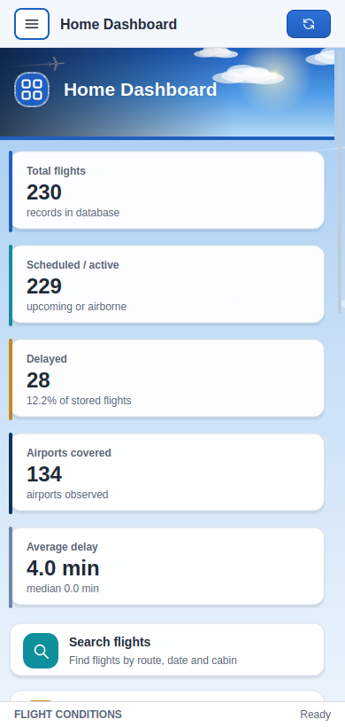
Responsive and animated
PART 03 · THE APPLICATION
Desktop: full sidebar, animated hero
Tablet: icon sidebar
Phone: slide-in menu, stacked cards

Slide 24
PART 04
Proof and quality
Tested, measured and honest about the limits
Notes:
SECTION: PROOF AND QUALITY (15 seconds). Now evidence: the test suite, the real stored results, the pipeline run history, the challenges solved and the honest limitations.

Slide 25


Testing methodology
PART 04 · PROOF AND QUALITY
235 / 235 tests passing
Fixtures, no network
Headless GUI tests
A bundled AviationStack-shaped sample. No key needed.
Real widgets on the Qt offscreen platform.
Regression pins
Edge cases
UTF-8 BOM in .env, API error bodies, connections.
Bad status, date, negative delay, empty datasets.
Notes:
TESTING (2.5 minutes). 65 automated pytest tests, all passing; I ran the suite while preparing this deck and it finished in about 6 seconds.
Distribution: GUI smoke 15, analytics 13, data processing 11, validation 9, regressions 9, database 8.
Method: a bundled AviationStack-shaped fixture, so no network or API key is needed; the GUI is driven headlessly with the Qt offscreen platform (page loading, empty states, threading, sorting, refresh workflow, shutdown); regression tests pin bugs that were fixed: .env files with a UTF-8 BOM, API error bodies, and connection handling.
VIVA QUESTION: How do you test the GUI without a screen? -> QT_QPA_PLATFORM=offscreen runs real widgets headlessly.

Slide 26
Verified results from stored data
PART 04 · PROOF AND QUALITY
230
flights
134
airports
101
airlines
127
routes
12%
delayed
Source: stored dataset, flight dates 2026-10-09 to 2026-10-13 (AviationStack free tier). Codes are IATA airport codes.
Notes:
RESULTS (3 minutes). Every figure comes from the project's own SQLite database and analytics functions; nothing is estimated.
Dataset: 133 flights, 76 airports, 81 airlines, 75 distinct routes, flight dates 2026-10-09 to 2026-10-10, 9 delayed flights (6.8%).
Charts: flight conditions 124 on time and 9 delayed; busiest departure airports Chengdu Tianfu 28, Bangkok Suvarnabhumi 14, Lanzhou 13, Colombo 11, Doha 11; busiest routes Bangkok to Siem Reap 14, Doha to Colombo 11, Tianjin to Lijiang 8.
Be careful in the viva: this is a snapshot of about two days from the free tier, so describe it as a demonstration of the analytics, not as a statistical study of global aviation.

Slide 27
Real pipeline runs
PART 04 · PROOF AND QUALITY
Run | Time (UTC) | Fetched | Valid | Stored | Status
1 | 2026-10-09 05:15 | 100 | 100 | 100 | success
2 | 2026-10-09 05:21 | 25 | 25 | 25 | success
3 | 2026-10-09 05:22 | 10 | 10 | 10 | success
4 | 2026-10-11 06:59 | 0 | 0 | 0 | failed: HTTP 403
5 | 2026-10-13 01:43 | 100 | 100 | 100 | success
235 → 230
records fetched became 230 unique flights: 3 rejected by validation, 2 repeats merged by the upsert.
HTTP 403, handled
Source: the refresh_log table of the delivered database. Each retrieval, successful or not, leaves an audit row with its counts and message.
The failed run was logged with the provider reason. The 133 flights stored at that time stayed available.
Notes:
PIPELINE RUNS (2 minutes). This table is the real refresh_log from the delivered database.
Runs 1 to 3 succeeded: 100, 25 and 10 records fetched, all valid, all stored. Together that is 135 attempted inserts, but only 133 unique flights are in the database, because the natural-key upsert replaced repeats.
Run 4 on 2026-10-11 failed with HTTP 403 and fetched nothing. The app logged it, reported the provider's reason and kept serving the 133 stored flights. That is the resilience design working on real data.
VIVA QUESTION: Why did run 4 fail? -> the API returned HTTP 403, typically a free-plan or key restriction; the log message records it and the app did not crash.

Slide 28
Challenges and solutions
PART 04 · PROOF AND QUALITY
CHALLENGE
CHALLENGE
CHALLENGE
Tiny free-tier quota
About 100 requests a month
Opaque HTTP 403 errors
Users saw no reason
.env with a UTF-8 BOM
The API key looked missing
SOLUTION
SOLUTION
SOLUTION
Every refresh is saved in SQLite; the app works on stored data.
Provider message is surfaced and logged; stored data stays usable.
Config reads utf-8-sig; a regression test pins the fix.
CHALLENGE
CHALLENGE
CHALLENGE
Frozen window risk
Network calls block the UI
Duplicate flights
Re-retrieval repeats rows
HTTP-only free plan
HTTPS requests are refused
SOLUTION
SOLUTION
SOLUTION
Background workers with callbacks on the GUI thread.
Natural-key upsert: ON CONFLICT DO UPDATE.
Configurable base URL, http:// by default.
Notes:
CHALLENGES AND SOLUTIONS (2.5 minutes). Six real engineering problems, each with the implemented answer: limited quota, provider errors, a .env BOM bug, UI responsiveness, duplicate flights, and HTTP-only access on the free plan.
Three are covered by tests: the BOM, API error bodies and the duplicate upsert.
VIVA QUESTION: What was the hardest bug? -> A .env saved with a UTF-8 BOM made the API key look missing; config now reads with utf-8-sig and a regression test pins it.

Slide 29
ETL + EDA upgrade: what it found
PART 04 · PROOF AND QUALITY
CHALLENGE
CHALLENGE
CHALLENGE
Mislabelled UTC times
Local times carry +00:00
Unidentifiable flights
3 records had no flight code
Stale airport counts
Tallies from the last batch only
SOLUTION
SOLUTION
SOLUTION
Converted to true UTC per airport timezone; proved with live.updated.
Rejected by Pydantic; the audit table keeps the reason.
Airports rebuilt from all flights inside the load transaction.
CHALLENGE
CHALLENGE
CHALLENGE
Transient API failures
Timeouts and HTTP 5xx
Re-run safety
Replace changed row ids
Key leak risk
URL inside error text
SOLUTION
SOLUTION
SOLUTION
Retries with exponential back-off; auth and quota errors fail fast.
True upsert: 0 rows inserted on a second pass over the archive.
Access key redacted from every error message; tested.

Slide 30
Honest limitations
PART 04 · PROOF AND QUALITY
A snapshot, not history
Quota-bound refresh
No delay causes
Stored flights cover three dates, 2026-10-09 to 2026-10-13.
About 100 API requests a month limits refresh frequency.
The source never explains delays, so weather labels stay unused.
Partial delay data
Few live positions
Weather needs setup
125 of 230 stored flights carry delay values.
16 of 230 flights are live-tracked, too few for a live map.
Weather Insights reads Not configured until a location is set.
Notes:
LIMITATIONS (2 minutes). Being explicit about limits is a strength in a viva.
1 The stored data is a snapshot of two flight dates, not history. 2 The free tier allows about 100 requests a month. 3 The API gives no delay causes, so weather labels stay unused. 4 Only 66 of 133 flights carry delay values. 5 None of the 133 stored flights has a live position, so the live map is empty. 6 Weather Insights shows Not configured until a location is set in Settings.
VIVA QUESTION: Does this invalidate your results? -> No; the analytics are correct for the data held. The limits define what conclusions can responsibly be drawn.

Slide 31

Conclusion
PART 05 · LANDING
SkyLens turns raw flight JSON into trustworthy, explorable insight.
Retrieved real flights through a REST API
Validated and cleaned every record
Persisted data in SQLite without duplicates
Analysed airlines, airports, routes and delays
And it is honest about what the data cannot say.
Delivered a terminal app and a desktop GUI
235 of 235 tests pass · 230 flights · 134 airports · 0 duplicates
Notes:
CONCLUSION (1.5 minutes). Restate the objectives and tick each one: retrieval, validation, persistence, analytics, two front-ends. Close with the evidence: 65 of 65 tests pass, 133 flights, 76 airports, no duplicate rows.
Key message: SkyLens turns raw flight JSON into trustworthy, explorable insight, and it is honest about what the data cannot say.

Slide 32
Future enhancements
PART 05 · LANDING
PROPOSED, NOT YET IMPLEMENTED
NEXT
THEN
LATER
LATER
Scheduled refresh
Trend analysis
Delay prediction
Live map and packaging
Periodic retrieval within the quota so history builds up.
Delay patterns by airline, airport and hour across many days.
A simple model, once enough history exists to justify it.
Plot live positions when available; ship an installer.
Notes:
FUTURE ENHANCEMENTS (1.5 minutes). These are proposals, not implemented features. Say so clearly.
Next: scheduled refresh within the quota so history accumulates. Then: trend analysis of delay patterns by airline, airport and hour across days. Later: a simple delay-prediction model, once enough history exists; richer lookup endpoints on a paid plan; a live map when positions are available; and an installer for non-technical users.
VIVA QUESTION: Why not predict delays now? -> two days of data and no delay causes cannot support a defensible model.

Slide 33

Thank you
Questions and discussion
SKYLENS · FLIGHT AND AIRPORT ANALYTICS
Notes:
CLOSING. Let the plane land while you thank the audience, then invite questions.
PREPARED VIVA ANSWERS: Why SQLite? Why Pydantic? How is deduplication done? How are API failures handled? How is the GUI tested? Why are weather labels unused? What are the limitations? What would you build next? Each is answered in the speaker notes of slides 6, 9, 11, 14, 15, 16, 23, 25, 26, 27 and 29.

