Slide 1
Fowzaan
Naan Mudhalvan Project
4/29/2024 Annual Review

Slide 2
GAN based Human-Like Face Generation
3/21/2024 Annual Review

Slide 3


AGENDA
Introduction to Generative Adversarial Networks (GANs)
Overview of the CelebA dataset and its significance in image generation tasks
Detailed exploration of GAN architecture and its components
Implementation steps for training GANs on the CelebA dataset to generate human face images
Evaluation and analysis of the generated images, discussing challenges and future directions
3/21/2024 Annual Review

Slide 4

PROBLEM STATEMENT Despite the advancements in generative models, synthesizing high-quality human face images with realistic features remains a challenging task. Existing methods often struggle to capture fine details, produce artifacts, or generate faces that are indistinguishable from real ones. This poses a significant obstacle in various domains such as entertainment, virtual reality, and computer graphics, where realistic face generation is crucial for creating immersive experiences. Therefore, there is a need to develop an effective and efficient approach for generating human face images that are both visually appealing and perceptually convincing, addressing the limitations of current techniques.

Slide 5

Project Overview: GANs for Human Face Image Generation
Introduction: Exploring Generative Adversarial Networks (GANs) for generating human face images.
Dataset: Utilizing the CelebA dataset, containing diverse celebrity face images for training and evaluation.
Methodology: Employing a GAN architecture with a generator and discriminator network for adversarial training.
Implementation Steps: Data preprocessing, model architecture design, training process, and evaluation of generated images.
Expected Outcomes: Production of high-quality synthetic face images, insights into GAN capabilities, and limitations for face generation tasks.

Slide 6

WHO ARE THE END USERS?
Entertainment Industry: Film, TV, and game developers seeking realistic character models and scenes for immersive experiences.
Virtual Reality (VR) and Augmented Reality (AR) Developers: VR/AR applications requiring lifelike avatars and environments for immersive experiences and training simulations.
Artificial Intelligence (AI) Researchers: Investigating human perception, facial recognition, and emotional expression analysis using generative models.
Creative Professionals: Graphic designers, animators, and content creators looking for high-quality digital assets and character designs.
Medical and Forensic Experts: Utilizing facial reconstruction and recognition techniques for medical diagnosis and forensic analysis.
3/21/2024 Annual Review

Slide 7

YOUR SOLUTION AND ITS VALUE PROPOSITION
Our Solution:
Implementation of Generative Adversarial Networks (GANs) for generating high-quality human face images.
Leveraging the CelebA dataset and advanced deep learning techniques to train the model.
Value Proposition:
High-Quality Image Generation: Our GAN model produces realistic human face images with fine details and natural features.
Efficiency and Scalability: Efficient training process allows for scalability and generation of large volumes of images.
Versatility: The generated images can be used across various applications, including entertainment, virtual reality, AI research, and more.
3/21/2024 Annual Review

Slide 8
THE WOW IN YOUR SOLUTION Incredibly Realistic Images: Our GAN model produces human face images that are astonishingly lifelike, exceeding expectations. Unmatched Detail and Quality: Captures fine facial details and expressions with unmatched precision, setting a new standard for image fidelity. Instantaneous Results: Delivers high-quality images instantly, revolutionizing production processes and saving valuable time. Endless Creative Possibilities: Unleashes creativity with limitless potential for storytelling, design, and innovation across industries.
3/21/2024 Annual Review

Slide 9
MODELLING
Generative Adversarial Networks (GANs):
Utilizing GAN architecture comprising a generator and discriminator network.
Generator learns to produce realistic human face images from random noise.
Discriminator distinguishes between real and generated images, providing feedback for improvement.
Training Data:
Leveraging the CelebA dataset containing over 200,000 celebrity face images.
Preprocessing includes resizing, cropping, and normalization to ensure consistency and quality.
Architecture Design:
Generator network consists of convolutional and transpose convolutional layers for image generation.
Discriminator network employs convolutional layers with leaky ReLU activation for image classification.
Training Process:
Alternating optimization of generator and discriminator networks through backpropagation.
Adversarial training encourages generator to improve its output to fool the discriminator.

Slide 10
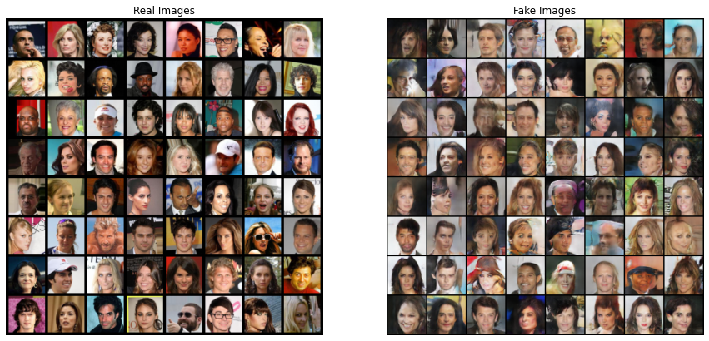
RESULTS
Demo Link
3/21/2024 Annual Review

Slide 11
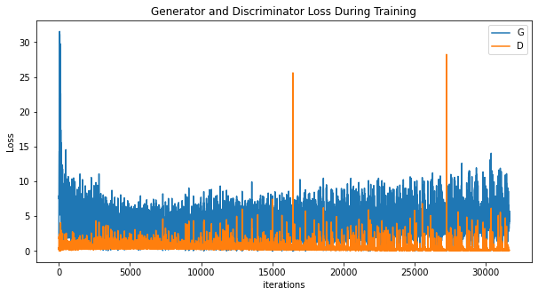
RESULTS
Demo Link
3/21/2024 Annual Review

