Slide 1

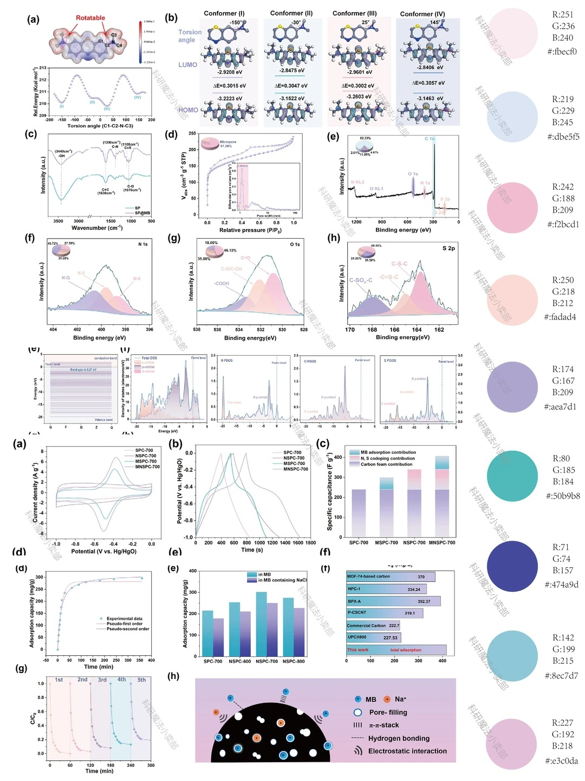
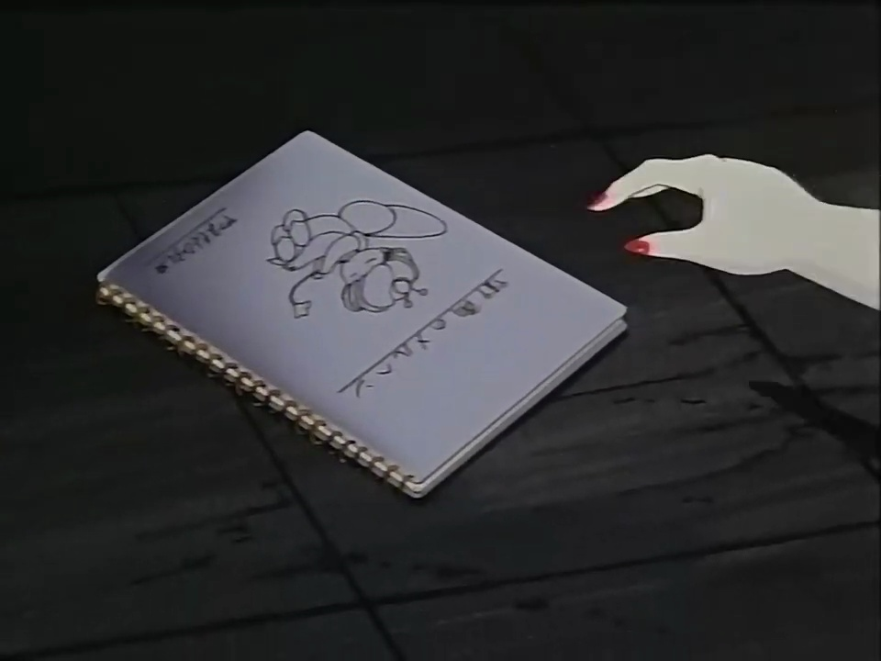
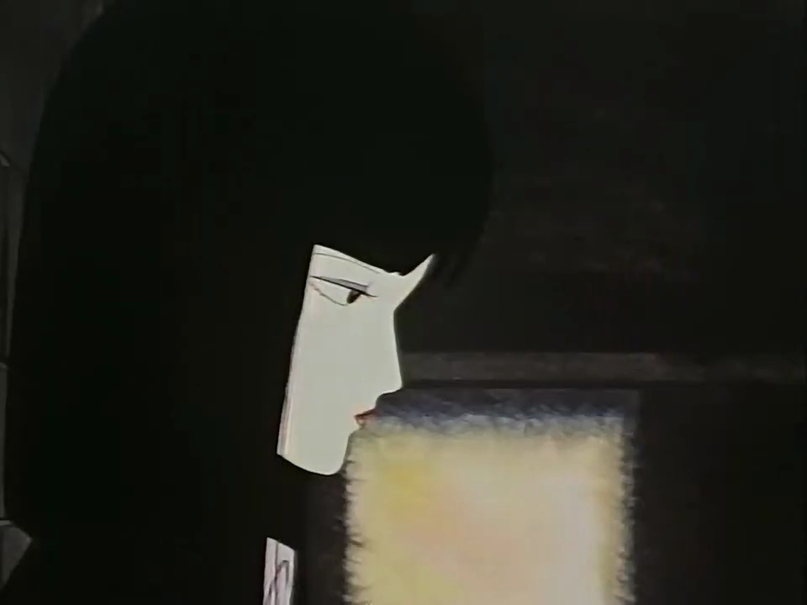
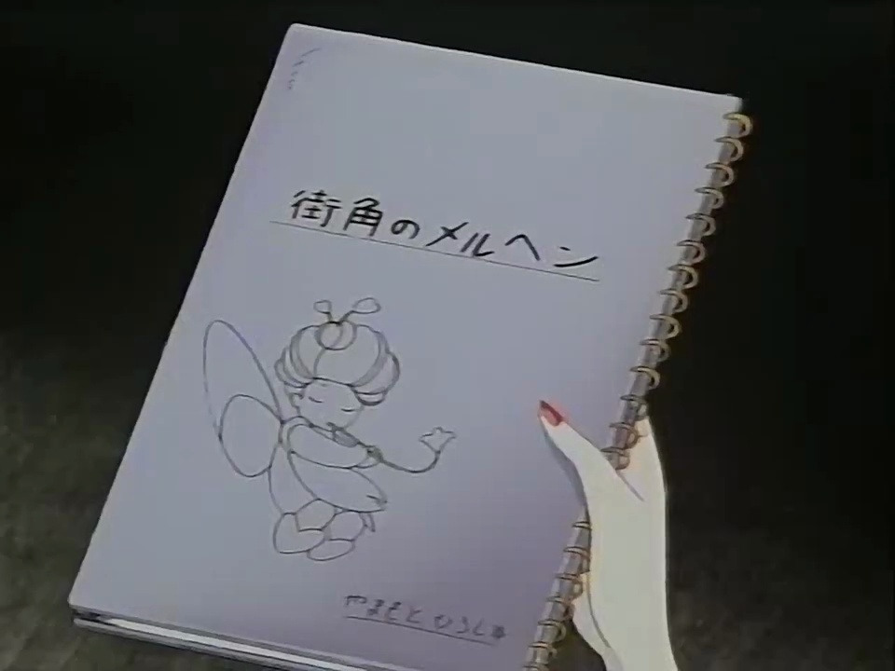
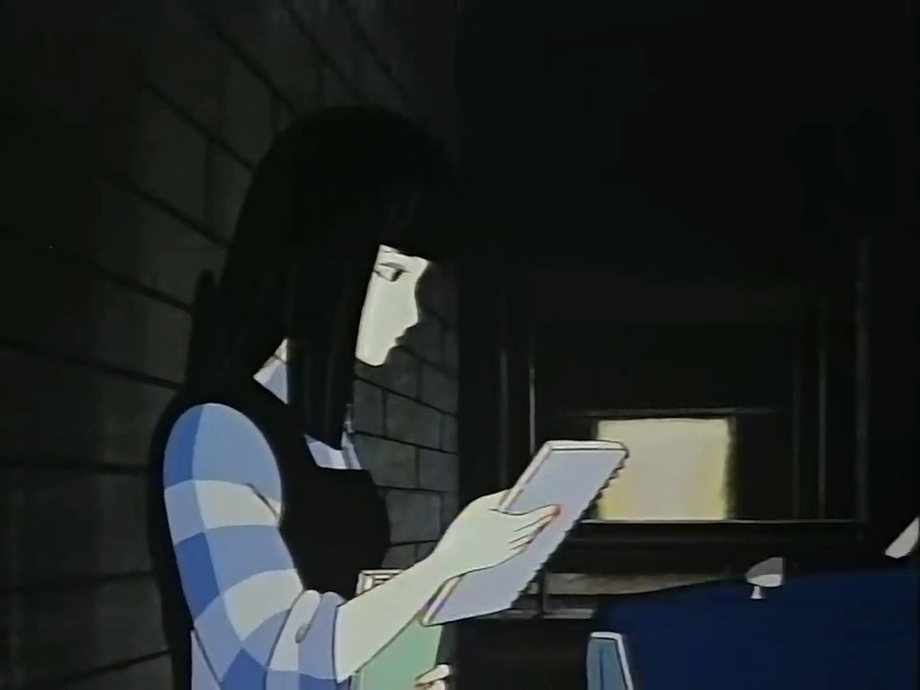

SGDAgent Reasoning Loop
Question: Why does the man follow the woman in red after they meet for the third time?
(A) He falls in love with the woman. (B) He is a spy.
(C) The woman has his phone. (D) The woman has his book.
Agent (Step 1):
Calling tool Global-Level Retrieval with query "Why does the man follow the woman in red after they meet for the third time?"
Global-Level Retrieval:
Matched Events:
  evt_0055 [23:45–24:40] score=2.93, confidence=0.84
  man, building, woman; actions: follow; support: 2 segment(s)
  evt_0025 [10:50–11:20] score=0.36, confidence=0.76
  fairy, flute; actions: holding; support: 1 segment(s)
  ……
Global evt_0055 [23:45–24:40]
Video Entity Registry
Woman
follow
Man
1. Woman 2. Man
3. Book 4. Shoe
5. Tree 6. Building
7. … …
entering
meet for
the third time
Agent (Step 2):
Calling tool Segment-Level Retrieval with query "Why does the man follow the woman in red after they meet for the third time?"
Building
Segment-Level Retrieval :
Matched Segments:
  seg_0058 [23:45–24:15] score=2.61
  entities: woman, shoe, building, man; predicates: in_front_of
  seg_0020 [07:55–08:25] score=0.38
  entities: person, tree, ledge, water; predicates: sitting_on
  ……
contain
Segment seg_0058 [23:45–24:15]
Segment seg_ 0059 [24:15–24:40]
Woman
in
front
of
Man
Man
wearing
Shoe
…
entering
finding
entering
Agent (Step 3):
Calling tool Frame-Level Retrieval with query "woman book"
Building
Shoe
Building
Tree
Frame-Level Retrieval :
Matched Frames:
  fra_0086 [35:25–35:30] score=3.62, confidence=0.98
  entities: man, book, tree; predicates: holding; Relation: (man, holding, book)
  fra_0064 [24:00–24:05] score=3.62, confidence=0.96
  entities: woman, book; predicates: holding; Relation: (woman, holding, book)
  ……
contain
Frame
Frame
Frame
fra_0064 [24:00–24:05]
fra_0065 [24:05–24:10]
fra_0086 [35:25–35:30]
…
Woman
holding
Man
behind
Man
holding
Agent (Step 4):
Calling tool Frame Inspect at ["00:24:00", "00:24:15"]:
"Why does the man follow the woman in red after they meet for the third time? "
"What object does she have that belongs to him?"
Book
Woman
under
Tree
Book
Frame Inspect:
Fine-grained Response:
The man follows the woman in red after they meet for the third time because she has a book that belongs to him. This indicates that he is likely trying to retrieve it or is concerned about its whereabouts, which motivates him to follow her.
Hierarchical Spatio-Temporal Scene Graph Representation
Agent (Step 5):
Executing Answer: (D) The woman has his book.
Long Video Input

Slide 2




SGDAgent Reasoning Loop
Question: How many white lights were on at 45:08?
Hierarchical Spatio-Temporal Scene Graph Representation
Agent (Step 1):
Calling tool Frame Inspect at ["00:45:08", "00:45:10"] with query: "How many white lights are on?"
Frame Inspect:
Fine-grained Response:
There are 34 white lights on. ( Wrong)
Video Entity Registry
1. White Lights 2. Stage
3. Colored Lights 4. White Light
5. … …
Agent (Step 2):
Calling tool Global-Level Retrieval with query: "white lights".
Global-Level Retrieval:
Matched Events:
  evt_0053 [44:35–45:30] score=2.6053, confidence=0.5975
  stage, lights; matched participant: ent_000023 = lights (confidence=0.95)
  ……
  evt_0022 [16:40–17:10] darkness, lights
  evt_0056 [47:30–48:00] lights, screens, stage
  ……
Global evt_0053 [44:35–45:30]
Lights
Stage
contain
Agent (Step 3):
Calling tool Segment-Level Retrieval with query "white lights".
Segment seg_0108 [44:35–45:05]
Segment-Level Retrieval :
Matched Segments:
  seg_0108 [44:35–45:05] score=2.4863; entities: stage, white lights, colored lights; predicates: none; matched entity: ent_000026 = white lights (confidence=0.95)
  ……
  seg_0109 [45:00–45:30] score=2.4863; entities: stage, lights; predicates: none
  seg_0184 [75:15–76:40] score=2.4316; entities: person, stage, crowd, lights
  ……
Colored Lights
Stage
White Lights
contain
Agent (Step 4):
Calling tool Frame Inspect at ["00:45:08", "00:45:09"]:
"Count individual white lights and disregard colored lights."
Frame fra_0257 [45:05–45:10]
White Light
White Light
$$×4$$
center
right
$$×10$$
Frame Inspect:
Fine-grained Response:
The images show 24 individual white lights.
10 left + 10 right + 4 center
White Light
left
Stage
$$×10$$
附录图1

Slide 3
SGDAgent Reasoning Loop
Question: Where does the girl take the vampire after the exam?
(A) A playground. (B) A home.
(C) A principal room. (D) A park.
Agent (Step 1):
Calling tool Global-Level Retrieval with query "girl take vampire after exam".
Long Video Input
Global-Level Retrieval:
Matched Events:
  evt_0071 [47:10–50:30] score=6.2420, confidence=0.8605
  bench, vampire, girl; actions: sitting_on, next_to; support: 3 segment(s)
  matched participants: ent_000032 = vampire (confidence=0.98)
  ent_000049 = girl (confidence=0.95)
  key relation: (girl, sitting_on, bench) (confidence=0.97)
  support segments: seg_0116, seg_0120, seg_0121
  ……
Global evt_0071 [47:10–50:30]
Video Entity Registry
Girl
next to
Vampire
1. Vampire 2. Girl
3. Bench 4. Tree
5. … …
sitting on
Bench
Agent (Step 2):
Calling tool Segment-Level Retrieval with query "bench vampire girl under tree".
contain
Segment-Level Retrieval :
Matched Segments:
  seg_0116 [47:55–48:25] score=10.3411
  entities: tree, person, bench; predicates: sitting_on, under
  relations: (person, sitting_on, bench), (bench, under, tree)
  seg_0120 [49:35–50:05] score=9.4169
  entities: vampire, girl, bench; predicates: sitting_on
  relation: (girl, sitting_on, bench)
  ……
Segment seg_0116 [47:55–48:25]
Segment seg_0120 [49:35–50:05]
Bench
under
Tree
Girl
together with
Vampire
…
sitting on
sitting on
Person
Bench
contain
contain
Agent (Step 3):
Calling tool Frame Inspect at ["00:48:10", "00:48:25"]:
"Describe the scene around the bench where the girl and vampire sit. Are there playground equipment, open lawn, or other indicators of park or playground?"
Frame
Frame
Frame
f_005781[48:00–48:05]
f_005782[48:05–48:10]
f_005951[49:35–49:40]
…
Person
sitting on
Bench
under
Girl
behind
Frame Inspect:
Fine-grained Response:
The bench is outdoors, flanked by trees, with shrubs and distant greenery.
There is no playground equipment.
The scene looks like a park or garden area.
Bench
sitting on
Vampire
Tree
Bench
Hierarchical Spatio-Temporal Scene Graph Representation
Agent (Step 4):
Executing Answer: (D) A park.
附录图2

Slide 4


SGDAgent Reasoning Loop
Question: What is the maximum number of Taiyaki can the machine cook at the same time?
(A) 2. (B) 3. (C) 4. (D) 6.
Video Entity Registry
Agent (Step 1):
Calling tool Global-Level Retrieval with query:
"Taiyaki machine cook at the same time".
1. Waffle-iron 2. Batter 3. Machine
4. Taiyaki-mold 5. Taiyaki 6. Person
7. Fish-shaped Pastry 8. Taiyaki-maker 9. pouring_tool
10. ……
Global-Level Retrieval:
Matched Events:
  evt_0038 [29:10-29:40] score=2.6499, confidence=0.5736
  batter, waffle_iron, machine; support: 1 segment(s)
  evt_0040 [30:00-30:30] score=2.6286
  taiyaki_mold, batter, taiyaki
  evt_0041 [30:25-30:55] score=2.6386, confidence=0.7781
  person, taiyaki, fish-shaped pastry; actions: holding
  ……
Segment
Segment
Segment
evt_0038 [29:10-29:40]
evt_0040 [30:00-30:30]
evt_0041 [30:25-30:55]
Waffle-iron
Taiyaki-mold
Person
…
The process of making Taiyaki
Batter
Taiyaki
using
Taiyaki
Machine
Batter
Fish-shaped Pastry
Agent (Step 2):
Calling tool Segment-Level Retrieval with query:
"taiyaki machine number of taiyaki can cook at the same time".
contain
contain
contain
Segment-Level Retrieval :
Matched Segments:
  seg_0073 [30:00-30:30] score=2.5423
  entities: taiyaki_mold, batter, taiyaki, taiyaki_maker, pouring_tool; predicates: none
  seg_0071 [29:10-29:40] score=2.4755
  entities: batter, waffle_iron, machine, person
  seg_0074 [30:25-30:55] score=2.5401
  entities: person, taiyaki, fish-shaped pastry, taiyaki_maker; predicates: holding
  ……
Segment
Segment
Segment
seg_0071 [29:10-29:40]
seg_0073 [30:00-30:30]
seg_0074 [30:25-30:55]
Person
Taiyaki-maker
Taiyaki-maker
…
A Taiyaki machine with molds and fish-shaped pastry
beside
Batter
Taiyaki-mold
Person
Taiyaki
Machine
in
holding
Batter
Taiyaki
Fish-shaped Pastry
Agent (Step 3):
Calling tool Frame Inspect at ["00:30:00", "00:30:30"]:
"How many taiyaki can the machine cook at the same time?".
contain
contain
Frame
Frame
Frame
fra_0266 [29:10-29:15]
fra_0268 [29:20-29:25]
fra_0286 [30:25–30:30]
…
Miscounting molds versus fish-shaped pastries
Person
Person
Person
Frame Inspect:
Fine-grained Response:
The machine can cook 6 taiyaki at the same time.
The video frames show 6 fish shapes cooking simultaneously.
Machine
Taiyaki
beside
Waffle-iron
in front of
Machine
Fish-shaped Pastry
Agent (Step 4):
Executing Answer: (D) 6.
Hierarchical Spatio-Temporal Scene Graph Representation
Long Video Input

