Slide 1
Quantitative Research in Political Science Introduction to Online Content Analysis in R
Alex Hartland
Postdoctoral Researcher
Department of European Social Research
University of Saarland
UdS SoSe2025 - Class 7 (26.05.2025)

Slide 2
Introduction
https://www.uni-saarland.de/lehrstuhl/braun/team/dr-alex-hartland.html
https://github.com/AlexDataPlatz

Slide 3
Introduction
https://www.mentimeter.com/app/presentation/alow4bfdt4w1oa5von7wfmgvymf8ino8/edit?question=82yuuq471cc8

Slide 4
Overview: Every class
Lecture
Examples
Exercises
Course adapted from materials produced by
Theresa Gessler (2022) Introduction to Text Analysis and Quanteda tutorials

Slide 5
Overview: Course
Week 1: Introduction and basic descriptives
Week 2: Dictionary methods
Week 3: Public holiday, no class
Week 4: Topic modelling
Week 5: Word embeddings
Week 6: Transformers, Large Language Models, Other Data
Week 7: Review, troubleshooting
Week 8: Presentations

Slide 6
Overview: Today
Week 1: Introduction and basic descriptives
Where does this course fit?
What kind of data?
Why analyse text?
Understanding basic terms
Producing basic descriptive statistics

Slide 7
Research Design
Research Question
Theory/ Expectations
Hypotheses
Data
Answer?

Slide 8
Data
Data
Qualitative
Quantitative
Interviews
Field notes
Archives
Surveys
Digital trace data
Primary data
Secondary data
ESS
EES
WVS
Euro-, Asian-, African-barometer
etc
GPS location
Fitness tracker
ISP/ Cell tower data
Social media
Speech
Images
Video

Slide 9
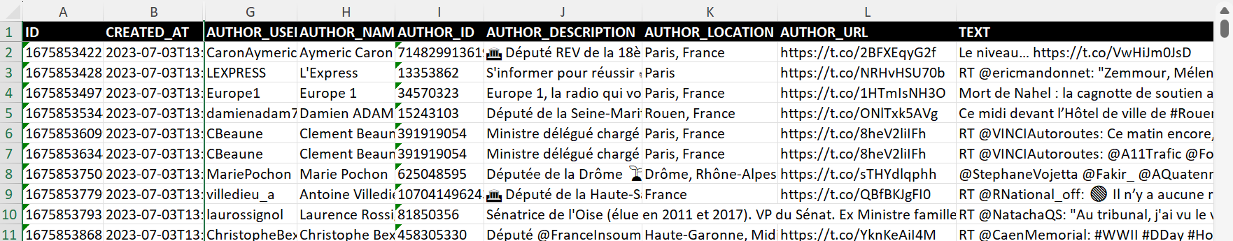
Example
Meta data
Text

Slide 10
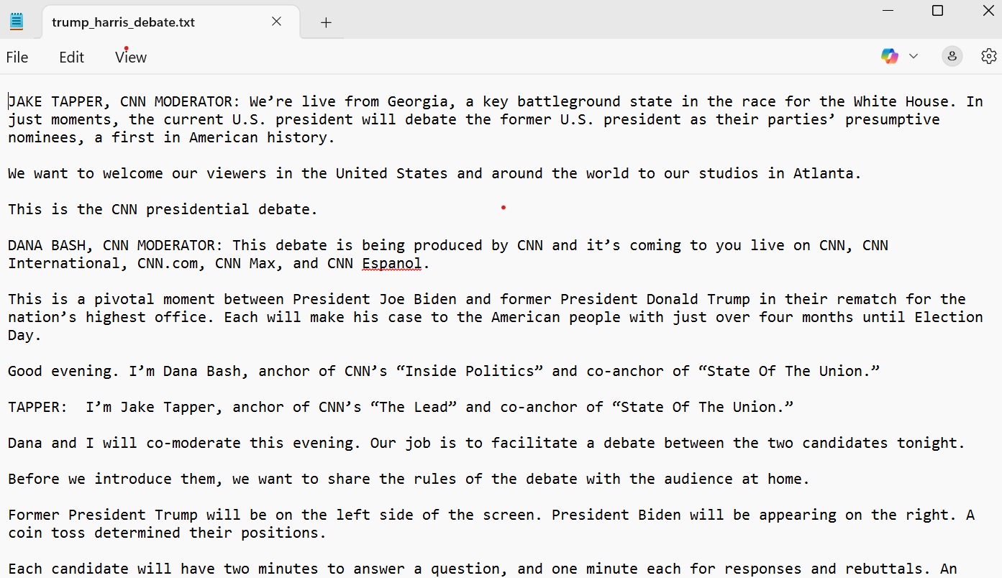
Example

Slide 11
Quantitative Text Analysis
Why quantitative text analysis?
Basic assumptions
Text represents underlying characteristics
We can represent text features, e.g. words
We can analyse these features, e.g. via frequencies

Slide 12
Quantitative Text Analysis
Why quantitative text analysis?
Let’s go straight to an example in R…

Slide 13
Quantitative Text Analysis
Do you remember the three objects we created?
Corpus
Tokens
Document Feature Matrix (dfm)
Can you describe each one?

Slide 14
Quantitative Text Analysis
Do you remember the three object we created?
Corpus- texts as strings in a data frame
Tokens- individual features in a list of vectors
Document Feature Matrix (dfm)- frequency of features per document in a matrix/ table

Slide 15
Quantitative Text Analysis
DFMs assume a ‘bag of words’ approach
They do not account for the position of words

Slide 16
Quantitative Text Analysis
What is a “bag of words” approach?
Representing each feature as an individual token
Tokens consisting of 1 document.
text1 : [1] "Over" "the" "past" "years" "," [6] "the" "availability" "of" "new" "data" [11] "through" "the" [ and 110 more ]

Slide 17
Quantitative Text Analysis
What is a “bag of words” approach?
Measuring their frequency
Documentfeature matrix of:
1 document, 71 features (0.00% sparse) and 0 docvars.
features
docs over the past years , availability of new data through text1 1 11 1 1 6 1 9 2 3 2 [ reached max_nfeat 61 more features ]

Slide 18
Quantitative Text Analysis
What is a “bag of words” approach?
Using the frequencies for:
Scaling
Classification
Sentiment analysis
Descriptive statistics

Slide 19
Quantitative Text Analysis
Further Examples
Let’s look at some descriptive analysis…

Slide 20
Quantitative Text Analysis
Next week:
Check the exercises and reading from this week
Prepare our text (“cleaning and pre-processing”)
Practice dictionary methods

Slide 21
Thank you for your attention!

