Slide 1


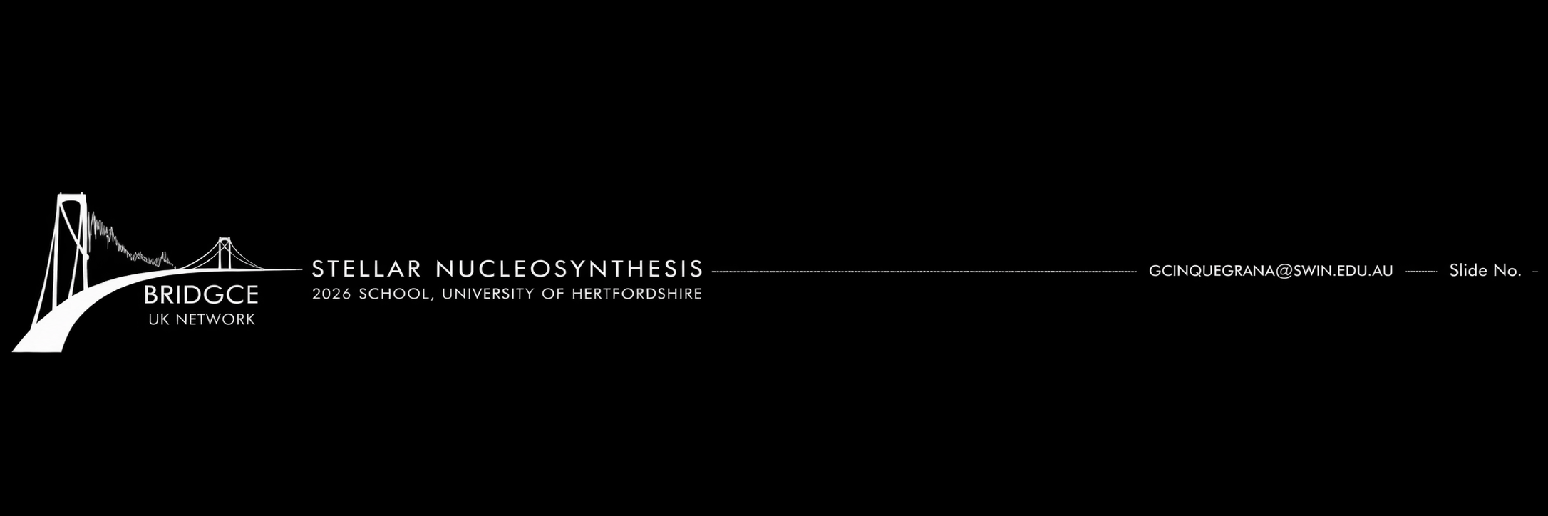

I. NUCLEOSYNTHESIS:
The stellar origins of the elements
Dr Giulia Cinquegrana
Swinburne University of Technology, Melbourne

Slide 2
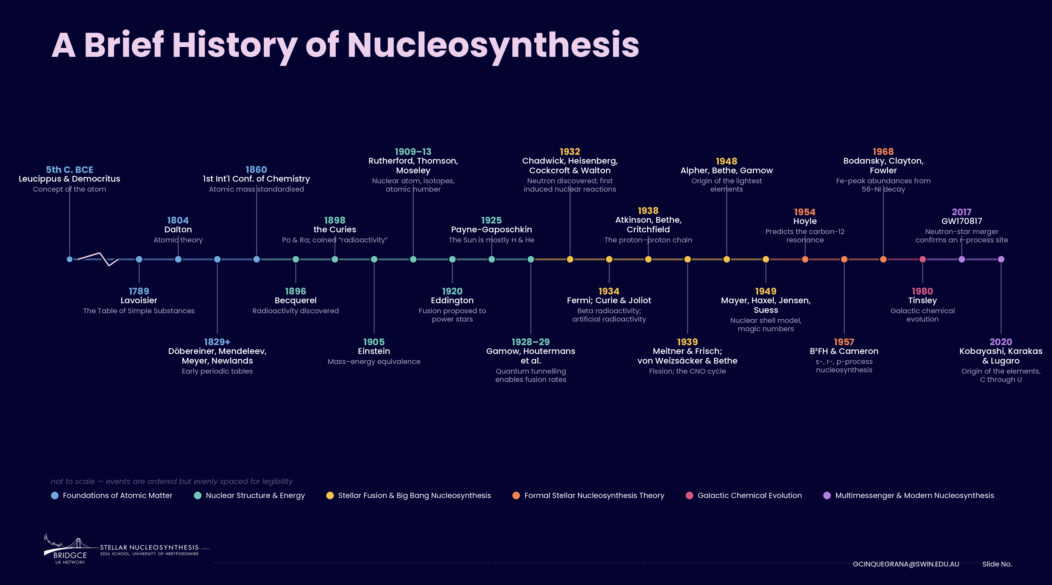
A Brief History of Nucleosynthesis
2

Slide 3
A Brief History of Nucleosynthesis
3

Slide 4
A Brief History of Nucleosynthesis
4

Slide 5
A Brief History of Nucleosynthesis
5

Slide 6
A Brief History of Nucleosynthesis
6

Slide 7
A Brief History of Nucleosynthesis
7

Slide 8
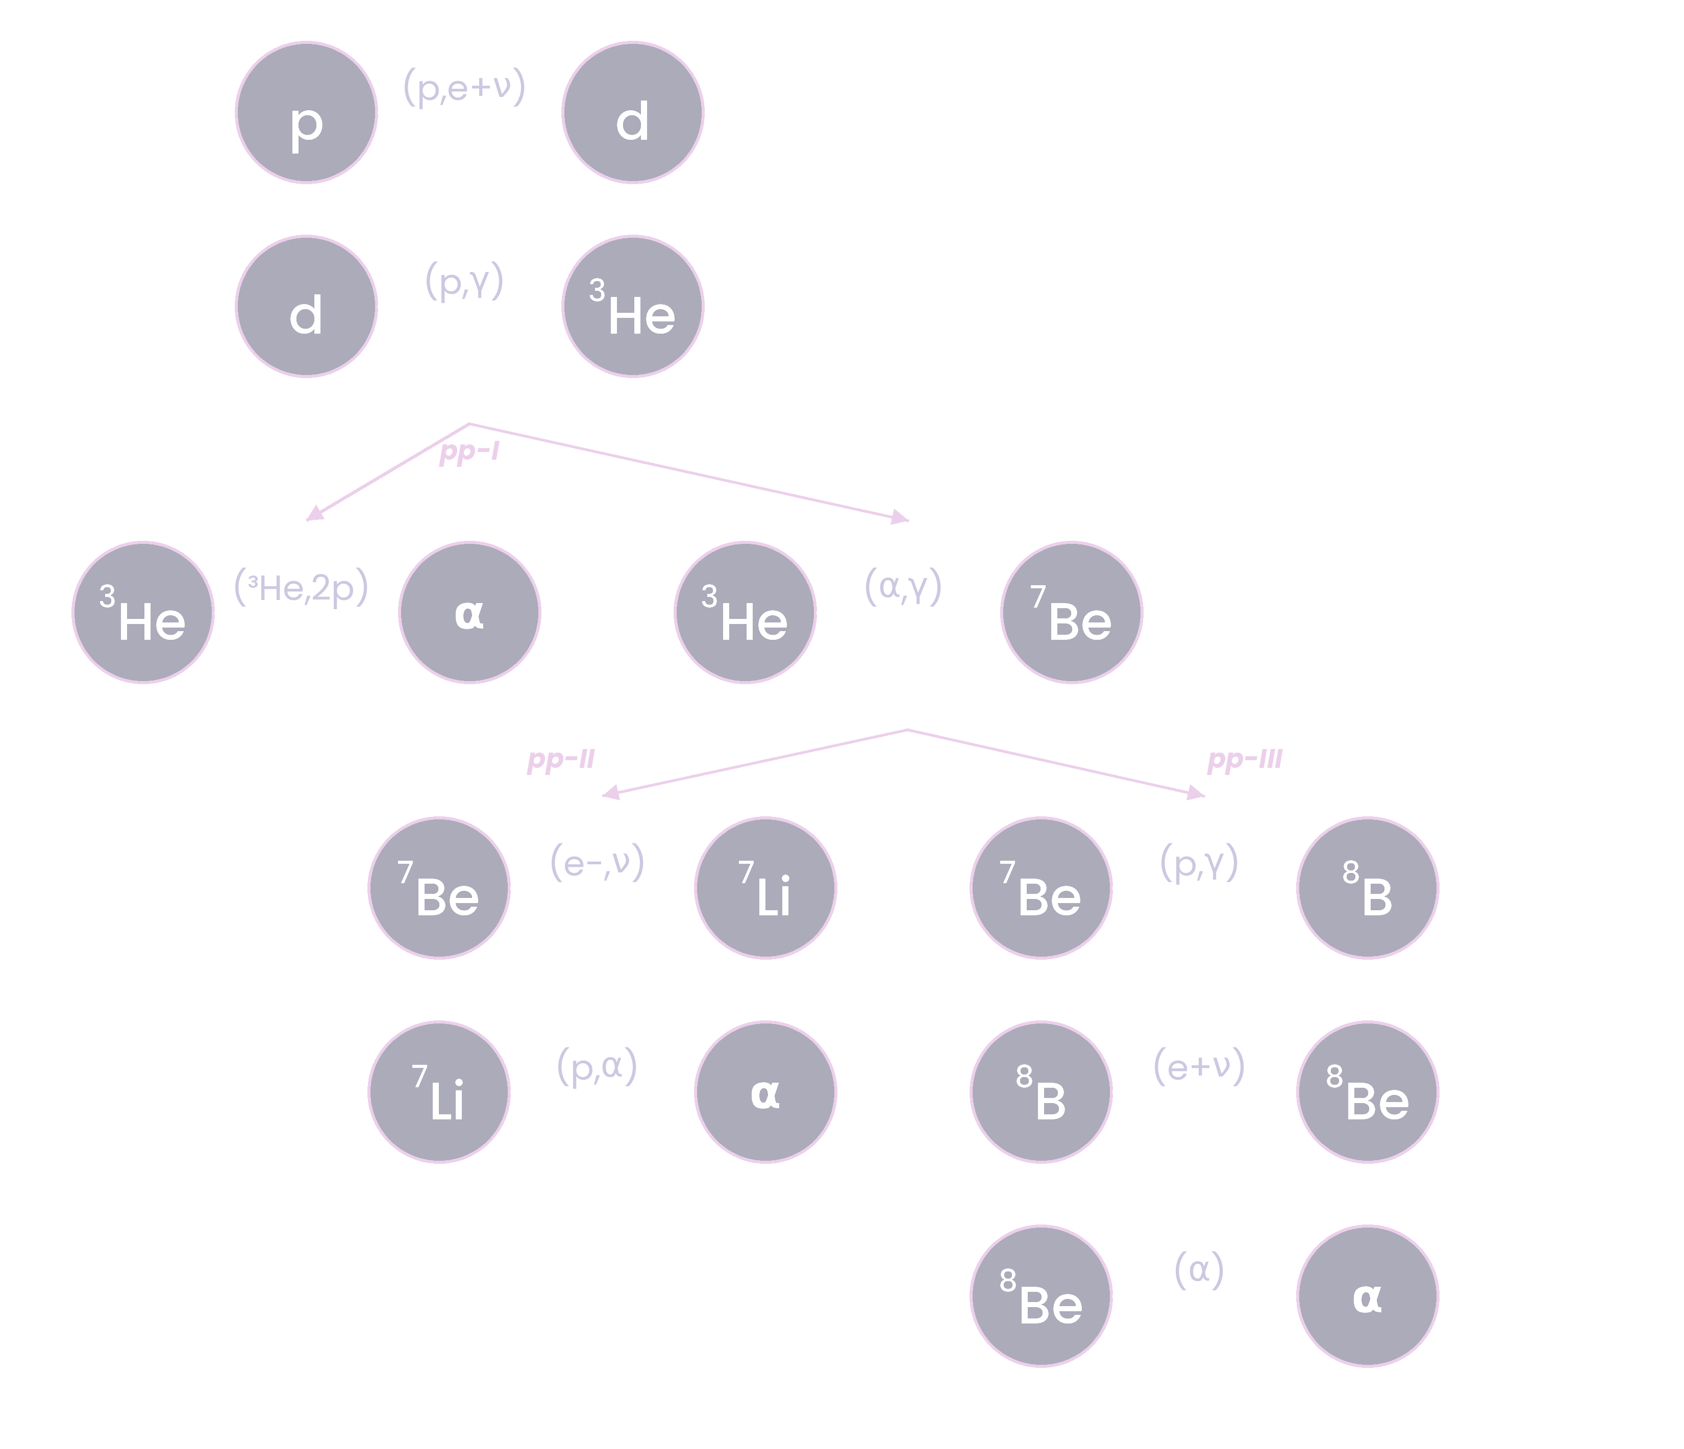
Hydrogen burning
Proton-Proton Chains
pp-I
pp-II
pp-III

Slide 9

Hydrogen burning
Proton-Proton Chains
pp-I
pp-II
pp-III
*⁷Li survives in Li-rich giants by mixing to cooler regions before capturing a proton

Slide 10
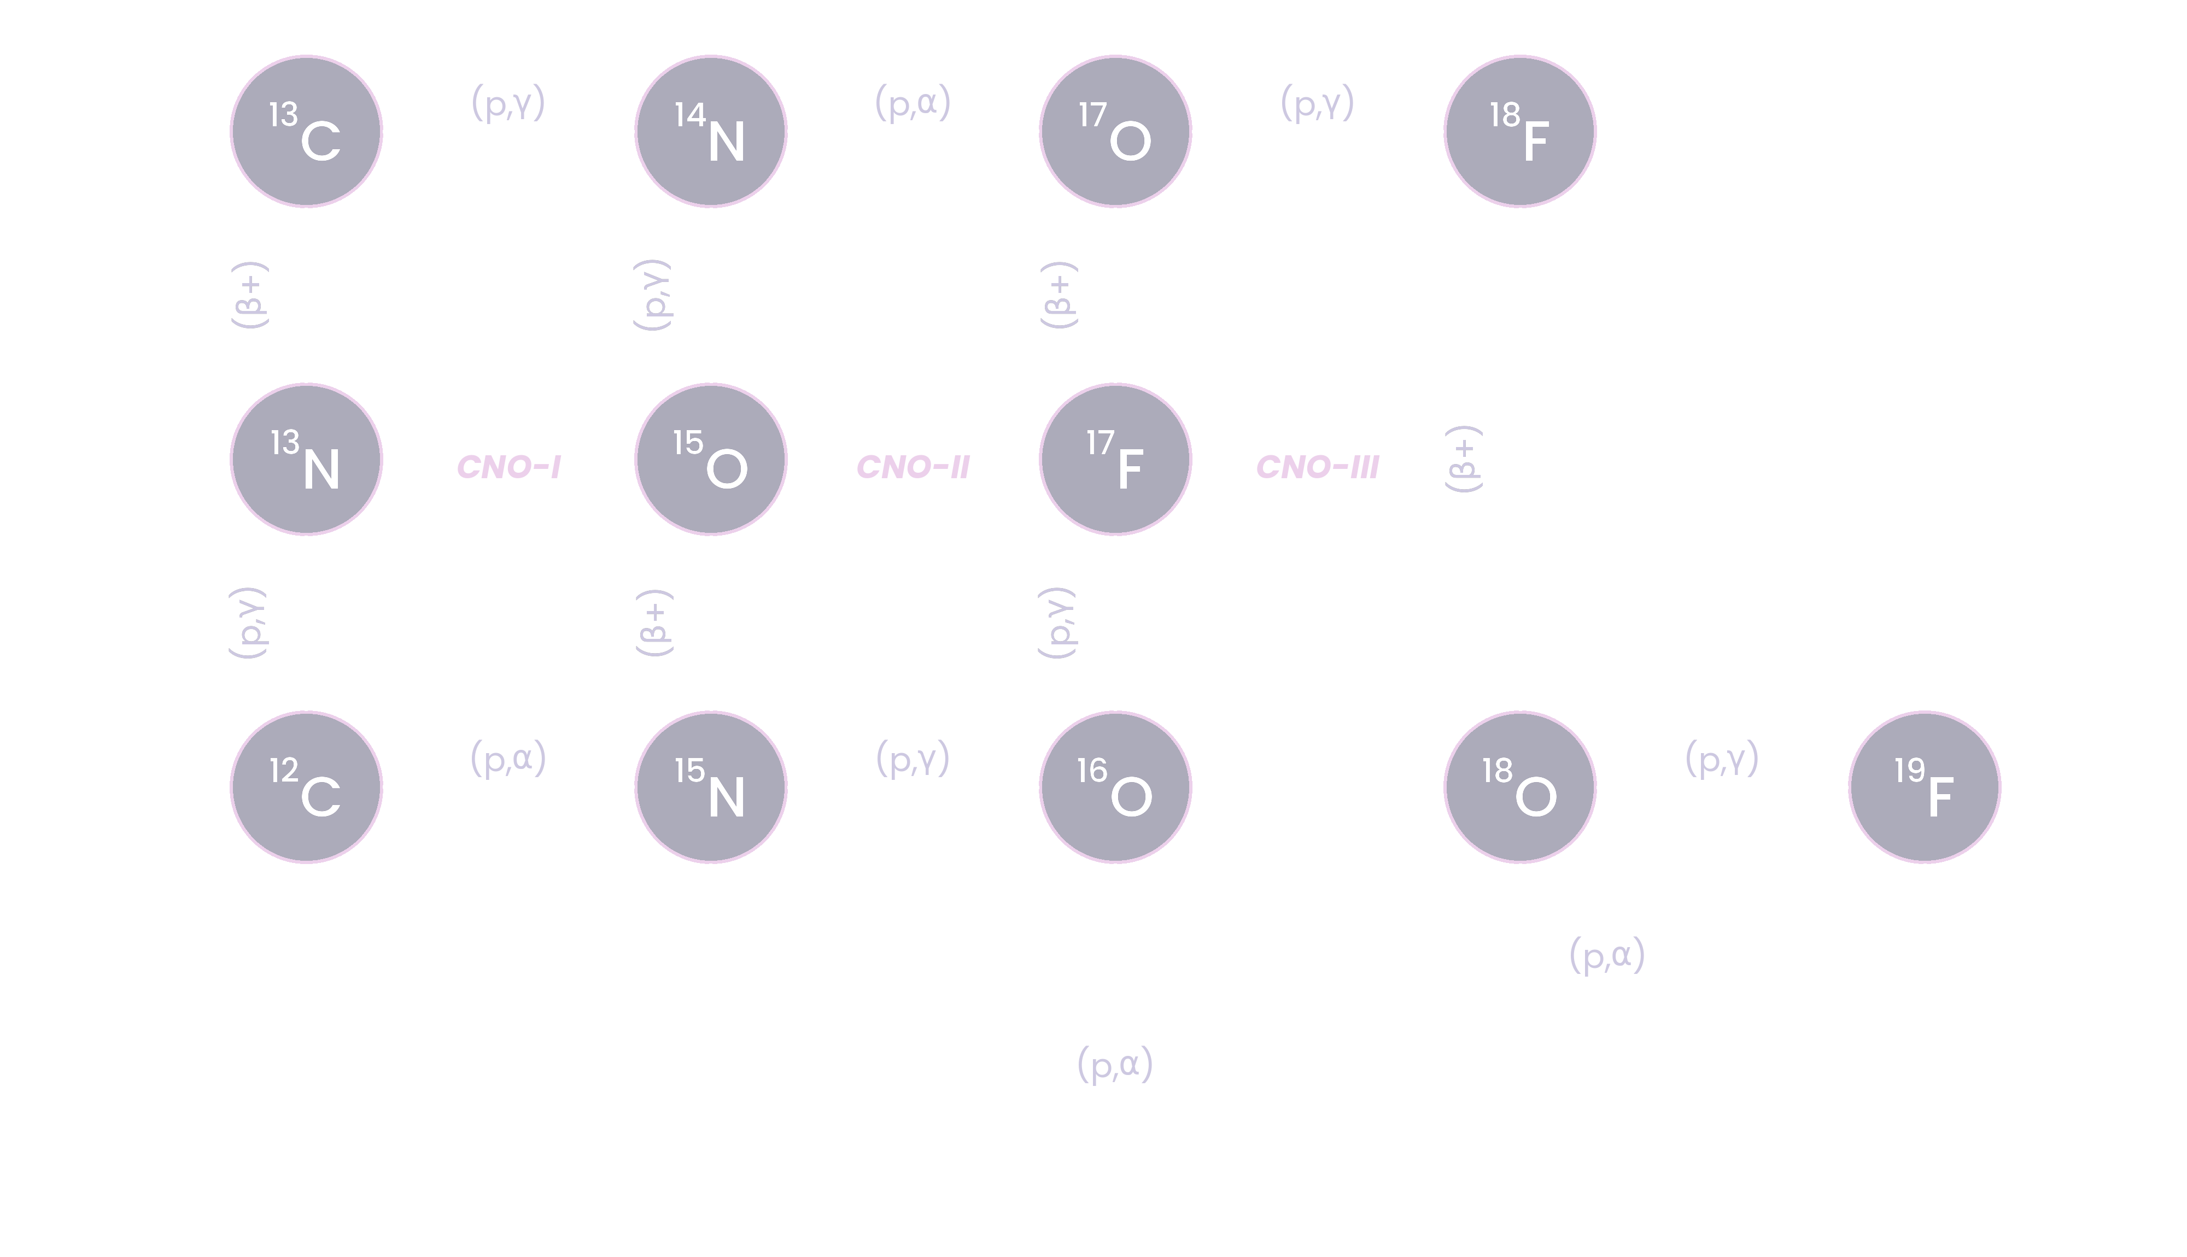


Hydrogen burning
Proton-Proton Chains
CNO Cycles
pp-I
CNO-I
CNO-II
CNO-III
pp-II
pp-III
*⁷Li survives in Li-rich giants by mixing to cooler regions before capturing a proton

Slide 11
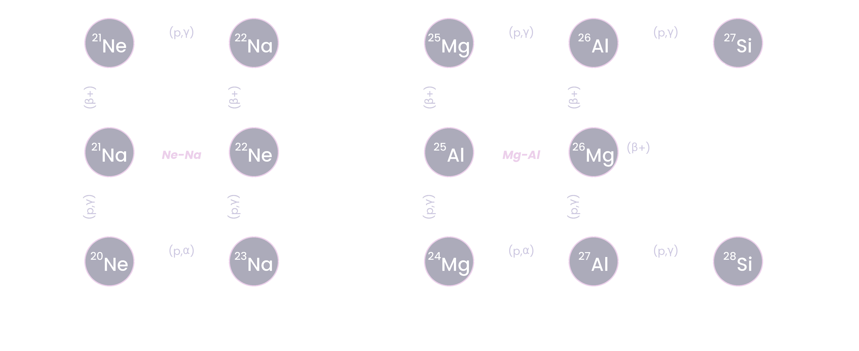


Hydrogen burning
Ne-Na Chain
Mg-Al Chain
*Ne-Na and Mg-Al chains in AGBs are responsible for the light-element anticorrelations observed in globular clusters.

Slide 12















He, C and O burning
He burning, $Tc ≳108 K$
C burning, $Tc ≳5×108 K$
O burning, $Tc ≳1.5×109 K$
$$α\left(α\right)8Be(α,γ)12C$$
$$12C\left(12C,γ\right)24Mg$$
$$16O\left(16O,γ\right)32S$$
Once there is sufficient reservoir of ¹²C,
$$12C\left(12C,α\right)20Ne$$
$$16O\left(16O,α\right)28Si$$
most probable
most probable
$$12C\left(α,γ\right)16O\left(α,γ\right)20Ne$$
$$12C\left(12C,p\right)23Na$$
$$16O\left(16O,p\right)31P$$
$12C\left(12C,2α\right)16O$
$$16O\left(16O,n\right)31S$$
$$12C\left(12C,n\right)23Mg$$
$$16O\left(16O,2α\right)24Mg$$

Slide 13
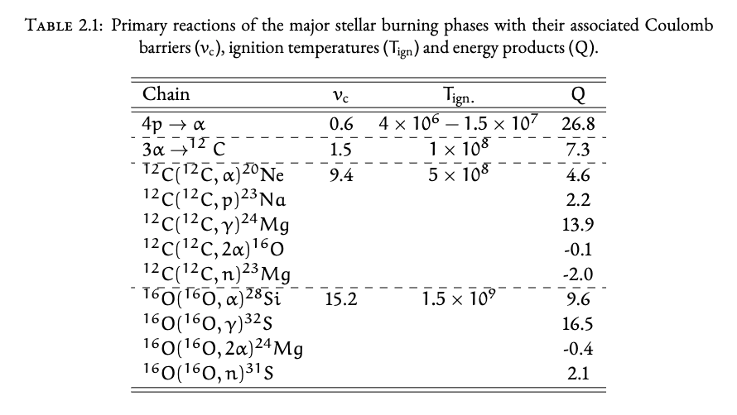










He, C and O burning
C burning, $Tc ≳5×108 K$
O burning, $Tc ≳1.5×109 K$
$$12C\left(12C,γ\right)24Mg$$
$$16O\left(16O,γ\right)32S$$
$$12C\left(12C,α\right)20Ne$$
$$16O\left(16O,α\right)28Si$$
most probable
most probable
$$12C\left(12C,p\right)23Na$$
$$16O\left(16O,p\right)31P$$
$12C\left(12C,2α\right)16O$
$$16O\left(16O,n\right)31S$$
$$12C\left(12C,n\right)23Mg$$
$$16O\left(16O,2α\right)24Mg$$

Slide 14
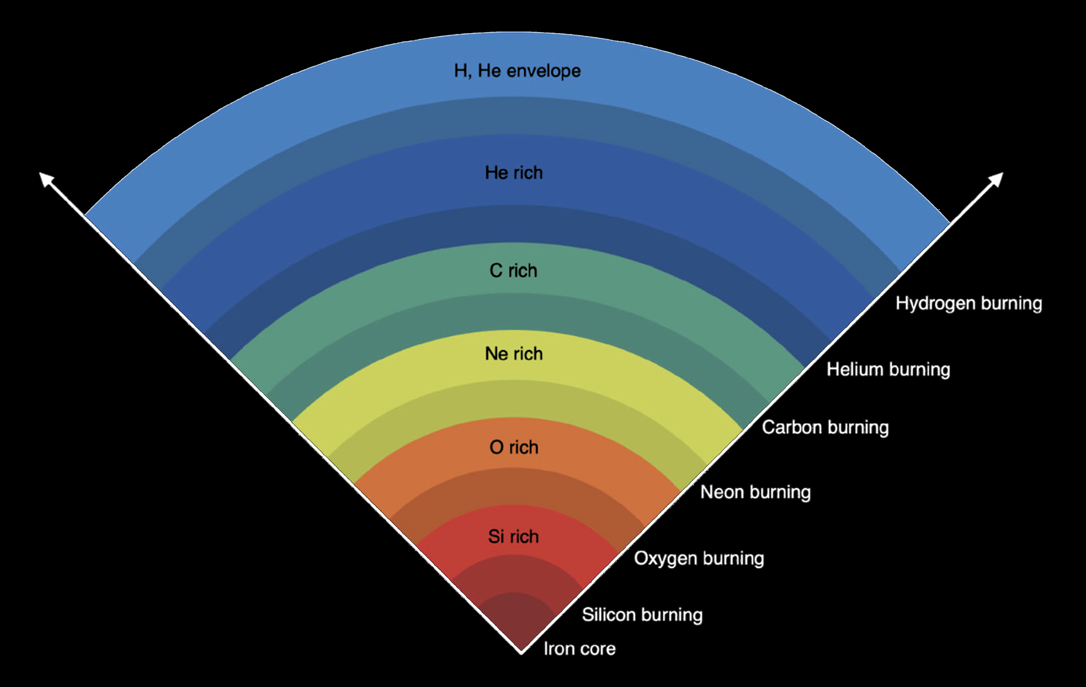

Ne & Si burning
RATE OF PHOTODISINTEGRATION: Define $r_{f}$ s the rate of forward reactions and $λ_{r}$ the reverse reaction rate. The temperature at which ${r_{f}∝λ}_{r}$ depends on the Q value of the forward reaction.
$$λ_{r}∝T_{9}^{\frac{3}{2}}e^{\left(\frac{−11.6045 Q}{T_{9}}\right)}r_{f}$$
NEON BURNING: Photodisintegration of $20Ne\left(γ,α\right)16O$ has a small Q-value of ~4 MeV, so reverse rate rivals the forward rate at ~1.5×10⁹ K (preceding O burning).
SILICON BURNING: Partial for T ~ 3×10⁹ K, complete at ~5×10⁹ K.
QSE: Small groups of nuclei reach equilibrium during the earlier stages of burning in a quasi-nuclear statistical equilibrium. An Si-group and an Fe-group are kept apart by slow reactions with small Q-values.
NSE: As the Si content approaches zero, the remaining reactions also come into equilibrium. All reactions and their isotopes are in a full nuclear statistical equilibrium via both electromagnetic & strong force.
Figure 20 from Arcones & Thielemann 2023 (AARev)

Slide 15






Explosive burning
$$5×{10}^{9} K$$
Complete Si burning of primarily former Si/O-shell material
→ If densities high, NSE is reached in a normal freezeout
→ Lower densities & higher entropy, shock wave cools before all $α$ particles recombine in an $α$-rich freezeout
$$4×{10}^{9} K$$
Incomplete Si burning
$$3.3×{10}^{9} K$$
Explosive Ne burning in O/Ne shell
$$2×{10}^{9} K$$
C burning in C/O shell
Figure 20 from Arcones & Thielemann 2023 (AARev)
$$T< 2×{10}^{9} K$$
No explosive burning

Slide 16
Elements > Fe

Slide 17
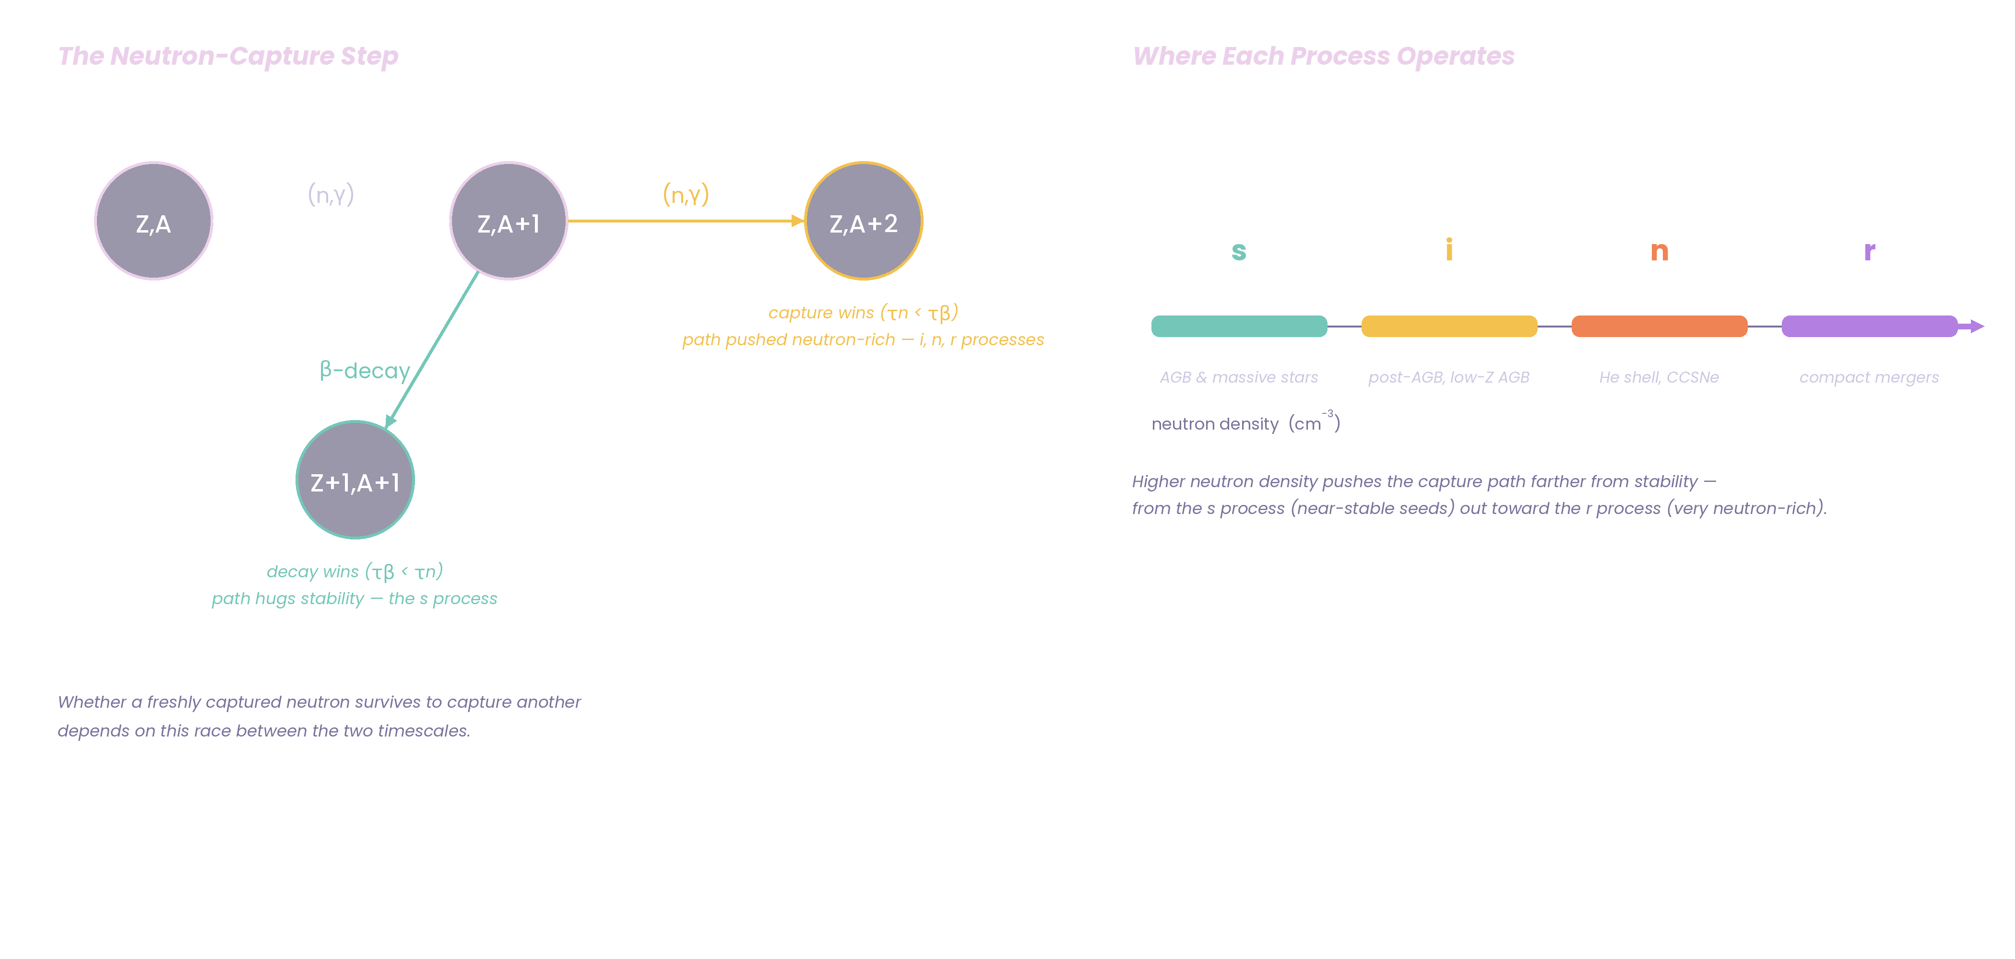
Elements > Fe
Neutron Capture Processes

Slide 18
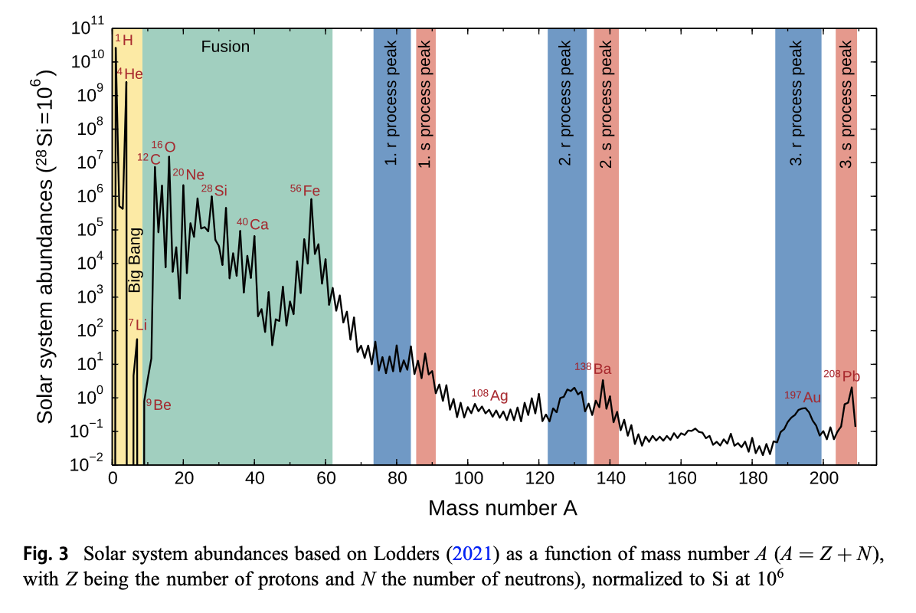
Elements > Fe
Figure 3 from Arcones & Thielemann 2023 (AARev)
Neutron Capture Processes

Slide 19
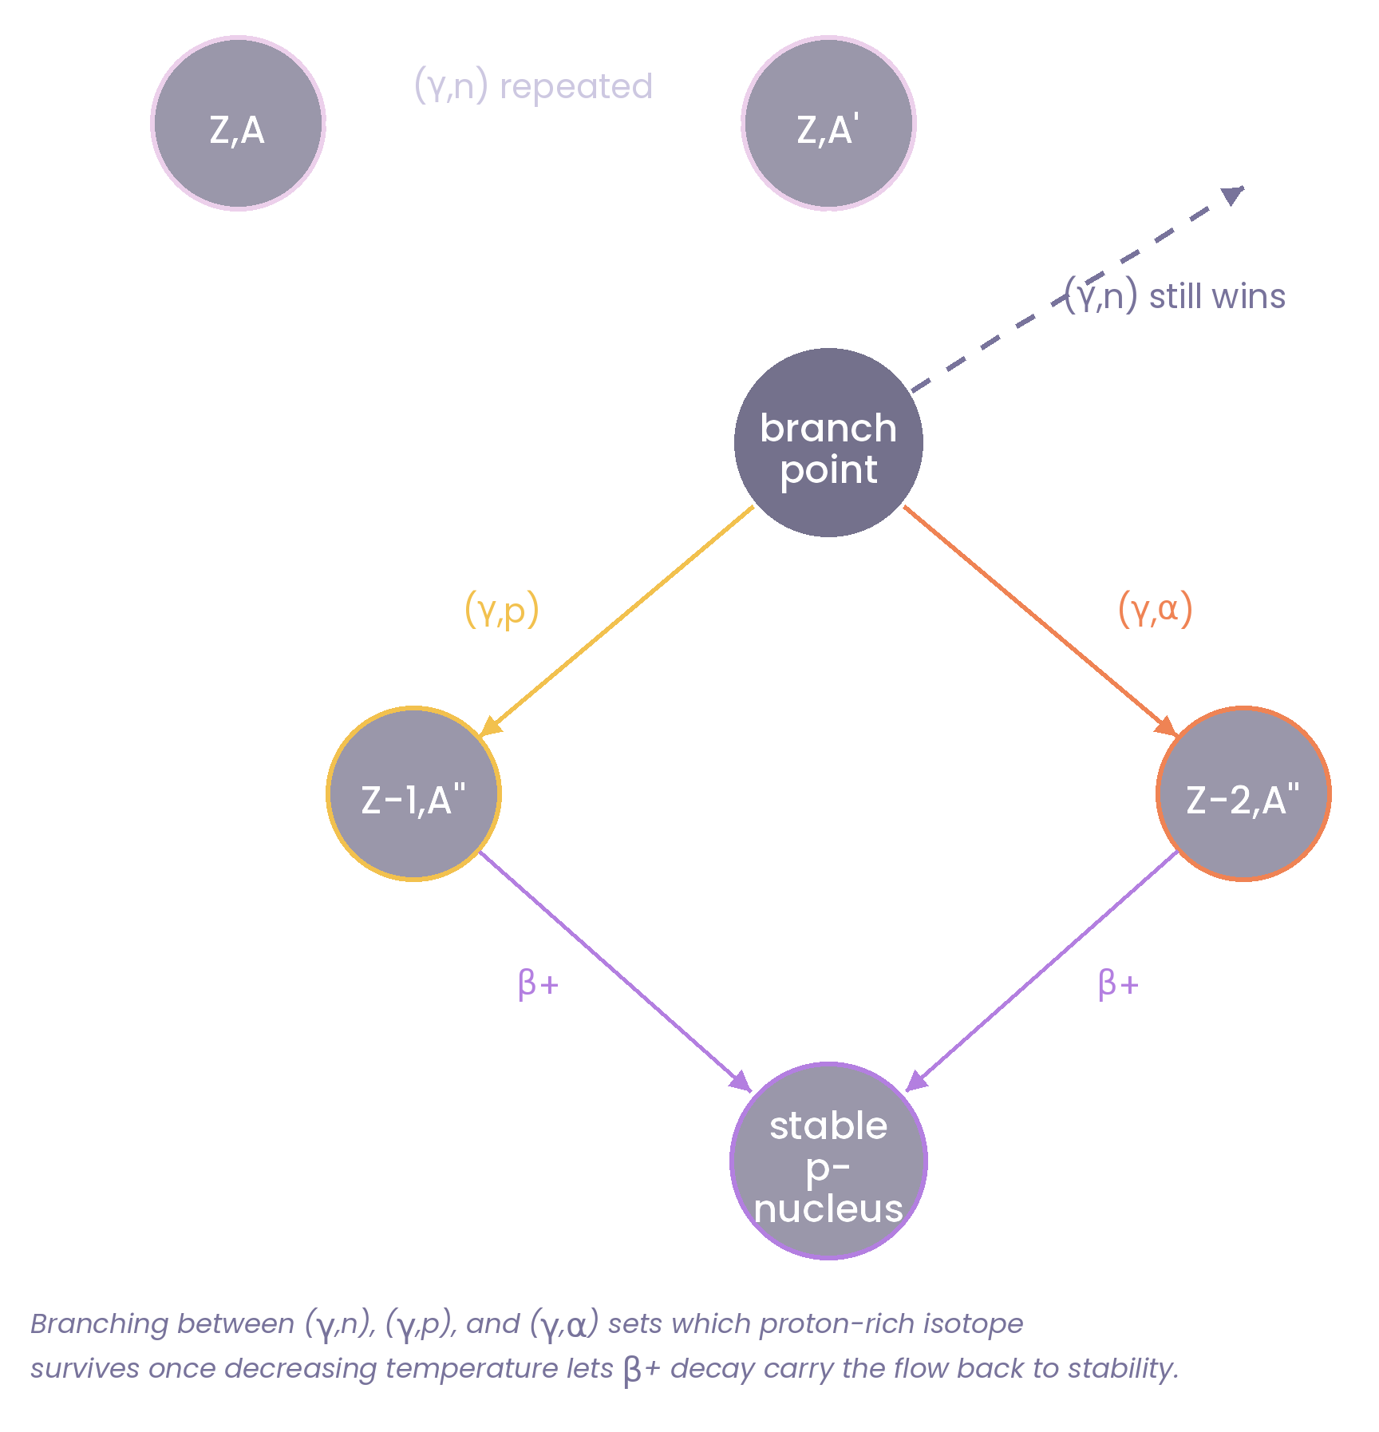
Elements > Fe
Neutron Capture Processes
P-Nuclei

Slide 20

Elements > Fe
Neutron Capture Processes
P-Nuclei

Slide 21
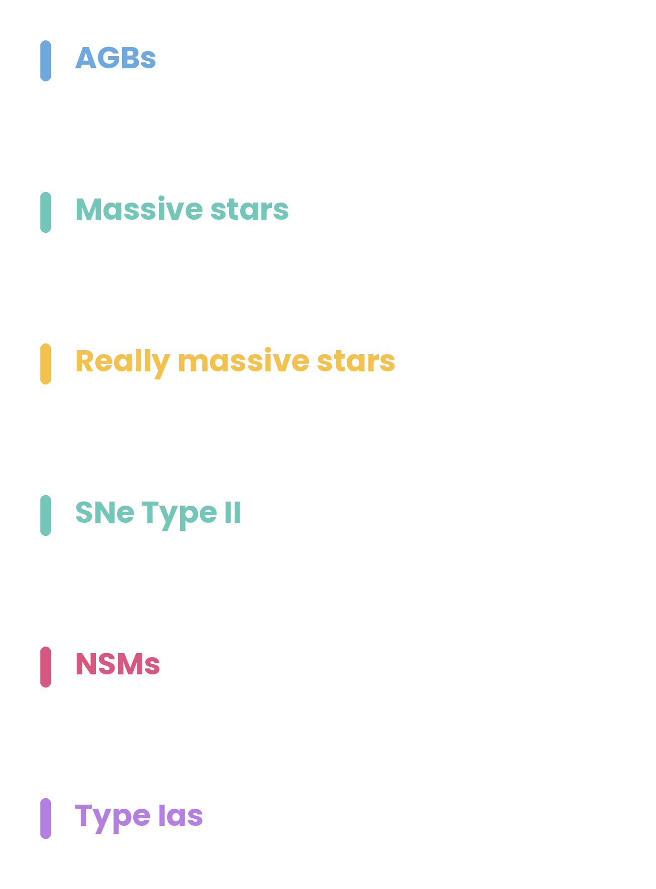

Astrophysical Sites
REGIME: 10s to 100s of periodic cycles. Double-shell burning punctuated by thermonuclear runaways from the He shell (thermal pulses). Pulses drives convective mixing between the processed region and surface (third dredge-up, 3DU). Main site of s-process. H burning can occur at envelope base (hot bottom burning, HBB).
PROGENITOR MASS: Low-mass AGBs undergo deep 3DU, many become C-rich. Dominant neutron source is ¹³C, producing 2nd- and 3rd-peak species. Intermediate-mass AGBs reach temps for HBB and convert dredged-up ¹²C to ¹⁴N. They are too hot for ¹³C source, ²²Ne activates instead. Lower neutron exposure, production mostly 1st peak.
METALLICITY IMPACT: Higher-Z AGBs are less dense, with smaller He cores at onset. Leads to weaker thermal pulses, greater mass loss, fewer cycles, so 3DU and HBB are both less efficient. The ¹³C neutron source is primary, so lower [Fe/H] means the same neutron supply is shared among fewer Fe seeds pushing flow from 1st peak toward 2nd and 3rd peak.
SIGNATURE PRODUCTS: Low mass AGBs dominant contributors to galactic budget of main s-process component (Sr to Pb) and primary C (through 3DU). Intermediate mass AGBs make primary N and Ne-Na / Mg-Al chains at lower Z, Li at higher Z via Cameron–Fowler mechanism.
REVS: Busso Gallino & Wasserburg (1999, ARAA), Herwig (2005, ARAA), Karakas & Lattanzio (2014, PASA), Lugaro et al. (2023, ARNPS)
SIGNLE OR BINARIES
BINARIES

Slide 22

Astrophysical Sites
REGIME: Sequential core/shell burning H→He→C→Ne→O→Si (onion structure), each stage hotter, denser, and shorter-lived than the last. Ends when inert Fe core exceeds Chandrasekhar-like limit and collapses. Rebounding shock can drive explosive nucleosynthesis through shells and reprocess them.
PROGENITOR MASS IMPACT: Sets how far hydrostatic burning proceeds and how hot each stage runs. At fixed $Z_{i}$, higher mass changes core composition to less He, more CNO-processed material, and greater contributions from heavier nuclei. At collapse, the resulting core compactness influences the explosion and the balance between Fe-group fallback and ejecta.
METALLICITY IMPACT: For elements below Fe, higher Zᵢ favours production of odd-Z elements over α-elements (e.g. Na, Cu) and of more neutron-rich isotopes (e.g. ²⁶Mg over ²⁴Mg). For s-process elements, as a secondary source ²²Ne (via CNO→¹⁴N→²²Ne) strengthens with increasing Z, so the weak s-process gets stronger. But when ²²Ne is instead primary (built via rotational mixing) the trend reverses and weakens at higher Z (e.g., Roberti et al. 2024 ApJSS).
SIGNATURE PRODUCTS: The dominant Galactic source of the α-elements (O, Ne, Mg, Si, S, Ar, Ca) through both hydrostatic and explosive contributions. The weak s-process (Ga up to 1st peak). Explosive Si burning supplies Fe-group and ⁵⁶Ni (smaller total than SN Ia).
REVS: Nomoto, Kobayashi & Tominaga (2013, ARAA), Arcones & Thielemann (2023, AARev)
SIGNLE OR BINARIES
BINARIES

Slide 23
Astrophysical Sites
MAGNETO-ROTATIONAL SNE:
REGIME: Core collapse of a rapidly rotating, strongly magnetised massive star. Magnetic stresses can drive an early, fast, bipolar/jet-like explosion, augmenting or replacing neutrino heating as the dominant explosion mechanism.
KEY PHYSICS: Rapid magnetic ejection can remove neutron-rich material before neutrino irradiation substantially raises Ye, providing the high neutron to seed conditions needed for a strong r-process. Nucleosynthetic outcome depends strongly on the magnetic-field strength and configuration, rotation, and neutrino irradiation.
SIGNATURE PRODUCTS: Potentially strong r-process production, reaching the 3rd r-process peak in favourable models. Also produces the usual alpha and Fe-group material and can include proton-rich / vp-process ejecta.
SEE: Reichert et al. (2021 & 2023, MNRAS), Yong et al. (2021, Nature), Nishimura, Takiwaki & Thielemann (2015, Apj)
SIGNLE OR BINARIES
BINARIES

Slide 24
Astrophysical Sites
PAIR INSTABILITY SNE:
REGIME: Very massive stars with sufficiently massive He cores. At high temperatures, photo-photon pair production reduces radiation pressure, causing the core to contract and heat.
KEY PHYSICS: The pair instability triggers explosive O burning, releasing enough energy to completely disrupt the star rather than producing core collapse. The star is disrupted before the advanced burning and neutronization characteristic of ordinary massive-star evolution can substantially modify the composition, leaving a low neutron excess.
SIGNATURE PRODUCTS: Large yields of alpha and Fe-group elements, substantial Ni56. A pronounced odd-even abundance pattern arising from the low neutron excess.
SEE: Heger & Woosley (2002 & 2005), Kasen et al. (2011, ApJ), Nomoto, Kobayashi & Tominaga (2013, ARAA)
SIGNLE OR BINARIES
BINARIES

Slide 25

Astrophysical Sites
REGIME: Merger of two neutron stars, or a neutron star and black hole. Tidal and shock forces eject neutron-star matter during the merger, while neutrino irradiation and viscous evolution drive additional outflows from the post-merger remnant/accretion disc.
BINARY MASS IMPACT: Determines the merger dynamics and the amount and composition of ejecta. Unequal-mass systems can produce more tidal, highly neutron-rich ejecta, while the total mass and mass ratio influence whether a long-lived neutron-star remnant or prompt black hole forms, and hence the subsequent disc/wind outflows.
METALLICITY IMPACT: Metallicity instead affects the binary progenitor evolution, merger population and delay-time distribution, influencing when and where NSMs enrich galaxies.
SIGNATURE PRODUCTS: Robust heavy r-process production, including the second and third peaks and potentially actinides. Extremely neutron-rich dynamical ejecta favour the heavy r-process, while higher-$Y_{e}$ neutrino-irradiated and disc outflows can produce lighter r-process nuclei and fewer lanthanides.
REVS: Wanajo et al. (2014, ApJ), Thieleman et al. (2017, ARAA), Just et al. (2015, MNRAS), Metzger (2020, LRR).
SIGNLE OR BINARIES
BINARIES

Slide 26

Astrophysical Sites
REGIME: Thermonuclear disruption of a degenerate C/O white dwarf through near-Chandrasekhar or sub-Chandrasekhar channels. Burning propagates through the star via deflagration, detonation, or both.
KEY PHYSICS: At $T≳7$GK, C/O burning reaches NSE. Density sets the freeze-out regime: high-density burning produces neutron-rich stable Fe-group nuclei through electron captures; normal freeze-out favours $56Ni$, while $α$-rich freeze-out produces nuclei such as Zn. At $4.5 − 7$GK, incomplete burning produces Si–S–Ar–Ca.
WD MASS IMPACT: More massive WDs reach higher densities and burn more completely to NSE; lower-mass WDs leave more unburnt intermediate-mass elements. Chandrasekhar-mass models produce more stable neutron-rich Fe-group material relative to $56Ni$ than sub-Chandrasekhar models; both channels appear necessary to span observed Fe-group ratios.
METALLICITY IMPACT: Acts through $22Ne$, scaling the neutron excess with $Z$. Higher metallicity therefore favours more neutron-rich stable Fe-group isotopes and less $56Ni$.
SIGNATURE PRODUCTS: Dominant source of Fe-group elements, including$56Ni$, which powers the SN Ia light curve, and intermediate-mass elements (Si, S, Ar, Ca). Balance between $56Ni$and stable Fe-group isotopes constrains the explosion density, metallicity, and WD mass.
REVS: Ruiter & Seitenzahl (2025, A&ARv); Keegans et al. (2023, ApJS 268, 8); Sim et al. (2011, IAU Symp. 281); Bulla et al. (2016, MNRAS)
SIGNLE OR BINARIES
BINARIES
Notes:
such as $54Fe$, $58Ni$, and Mn

Slide 27
Takeaways
NUCLEOSYNTHESIS IS A PHYSICAL PROBLEM: The elements are set by the interplay of temperature, density, composition, reaction rates, and timescale — determining which reactions can compete and whether material reaches equilibrium.
MASS & METALLICITY MATTER– BUT NOT IN THE SAME WAY EVERYWHERE: Stellar mass and metallicity shape stellar structure, burning conditions, and evolutionary timescales. Metallicity also sets the initial composition, neutron excess and abundance of seed nuclei.
THE HEAVIEST ELEMENTS REQUIRE EXTREME CONSITIONS: Beyond Fe, neutron captures dominate: s-process → sustained neutron exposure; r-process → extreme neutron densities and rapid neutron captures; p-processes → proton-rich or photodisintegration environments.
THE ABUNDANCE OF AN ELEMENT IS THE SUM OF ITS ASTROPHYSICAL ORIGINS: No single site produces the periodic table. Different sites contribute different isotopes, in different proportions, under different physical conditions.

