Slide 1




III. NUCLEI ON THE AGB:
From light element nucleosynthesis to the s- and i-processes
Asymptotic Giant Branch
Dr Giulia Cinquegrana
Swinburne University of Technology, Melbourne

Slide 2
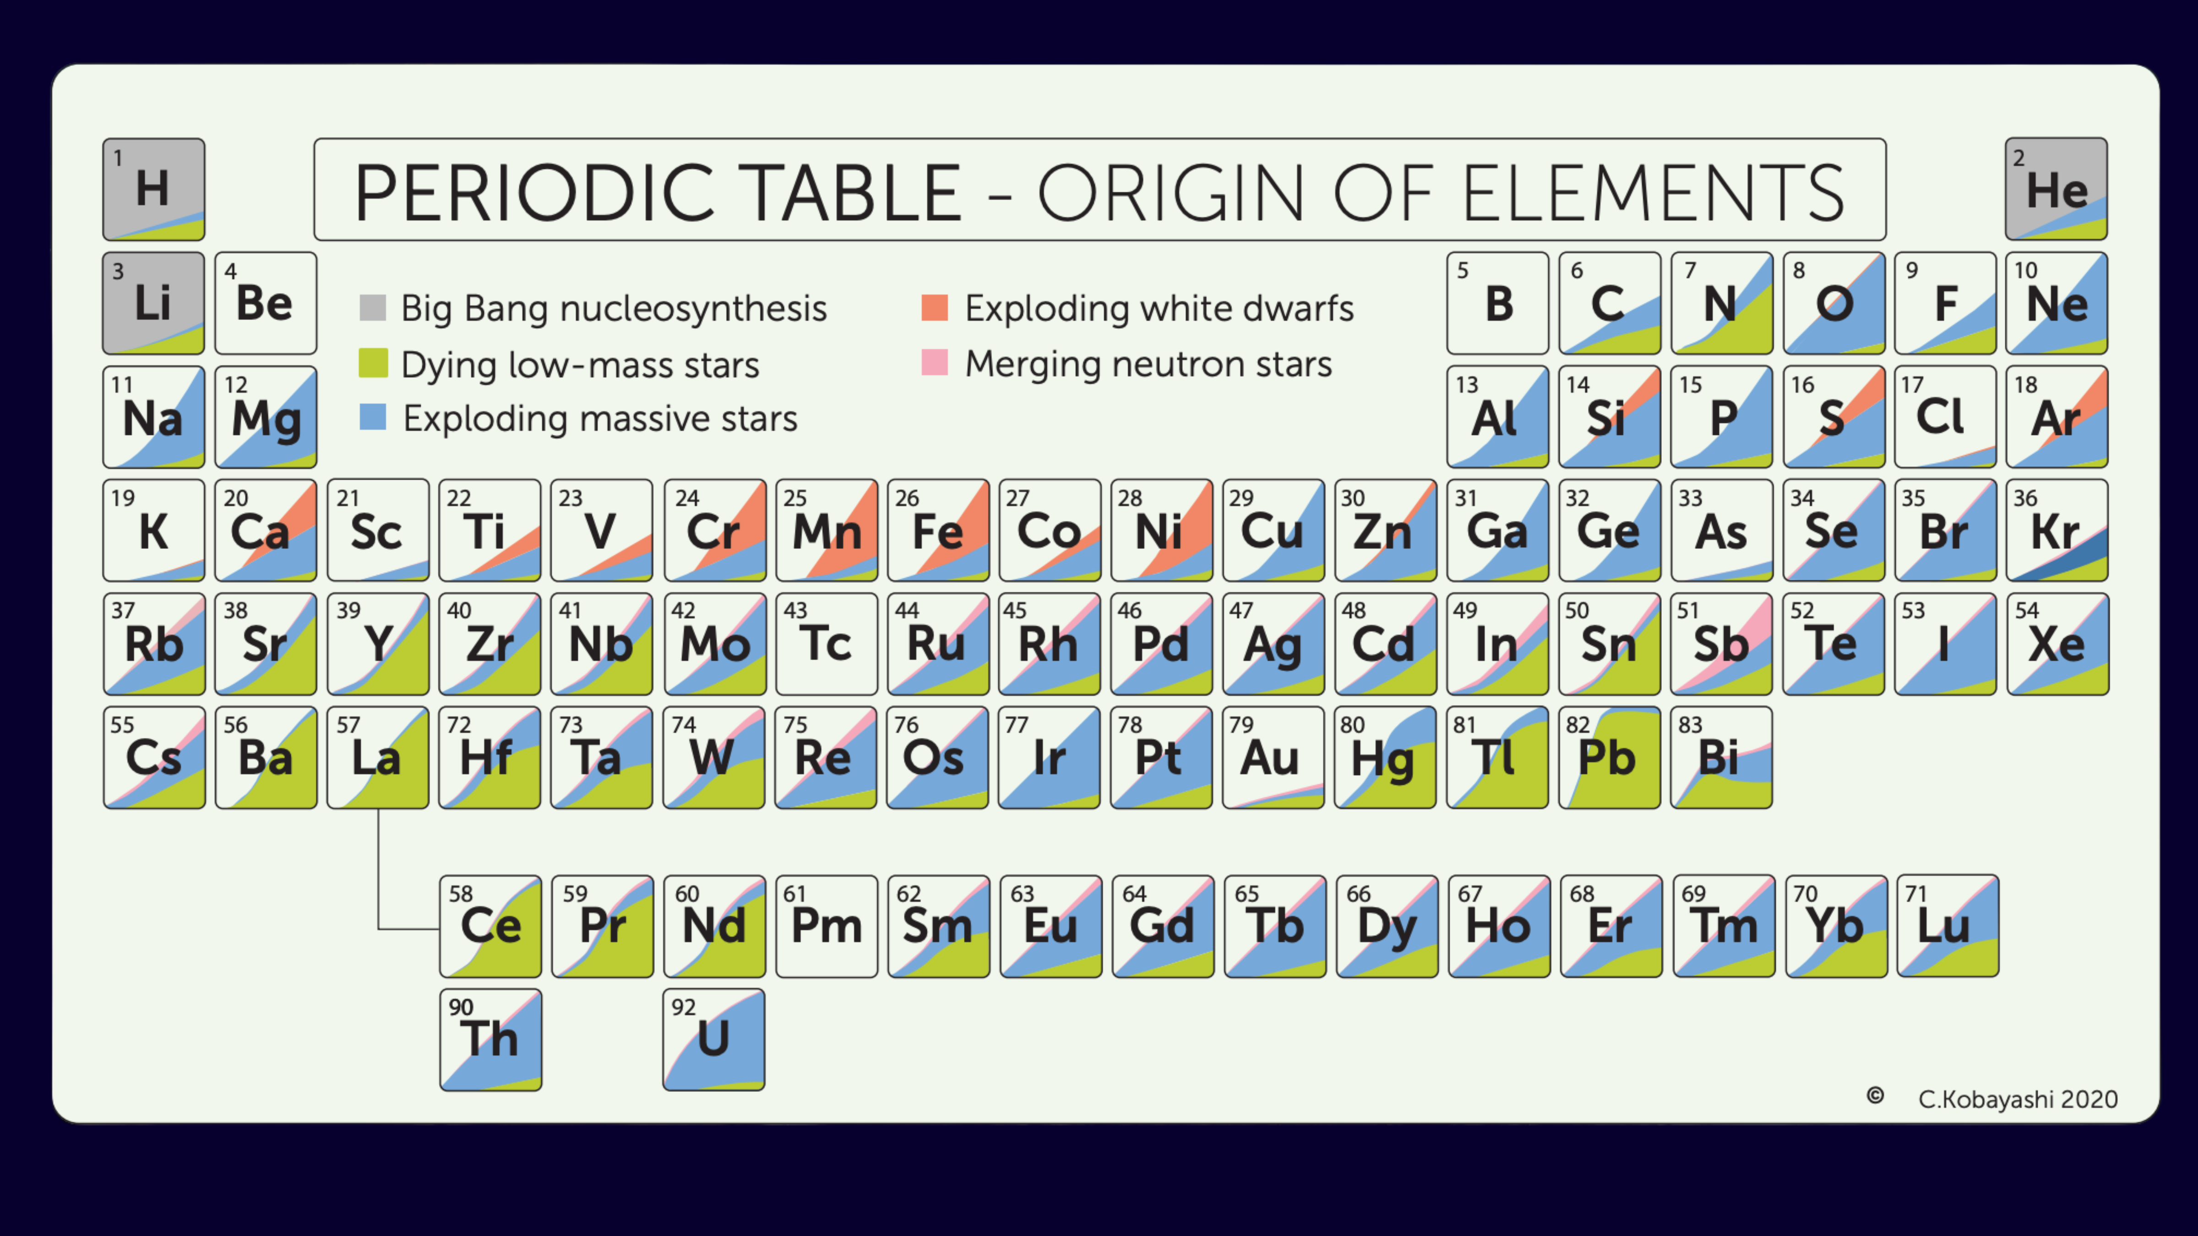

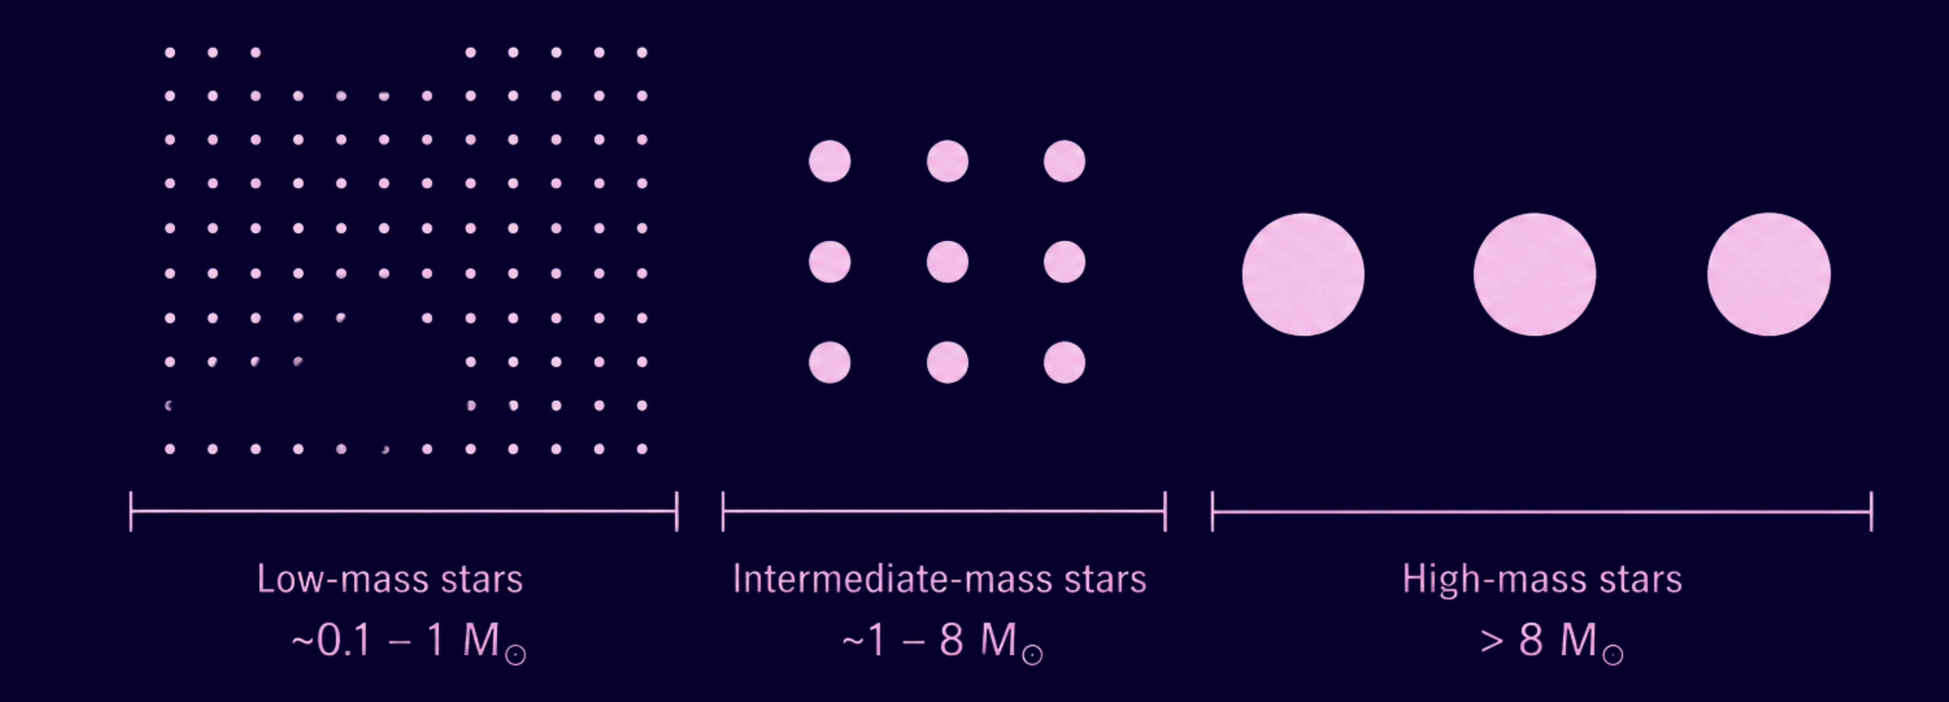
AGB Stars Matter For Chemical Evolution
Kobayashi, Karakas & Lugaro 2020 (ApJ)
ABUNDANT: Evolutionary endpoint for low- and intermediate-mass stars (LIMS).
LONG-LIVED: Extended lifetimes allow repeated cycles of nucleosynthesis and mixing.
EFFICIENT POLLUTERS: Strong AGB winds return large amounts of processed material to the ISM.
SENSITIVE: Their yields depend strongly on mass and metallicity, producing distinctive abundance signatures.
CHEMICAL ENRICHMENT: LIMS produce significant amounts of C, N, and heavy elements from Sr to Pb through neutron-capture nucleosynthesis.

Slide 3
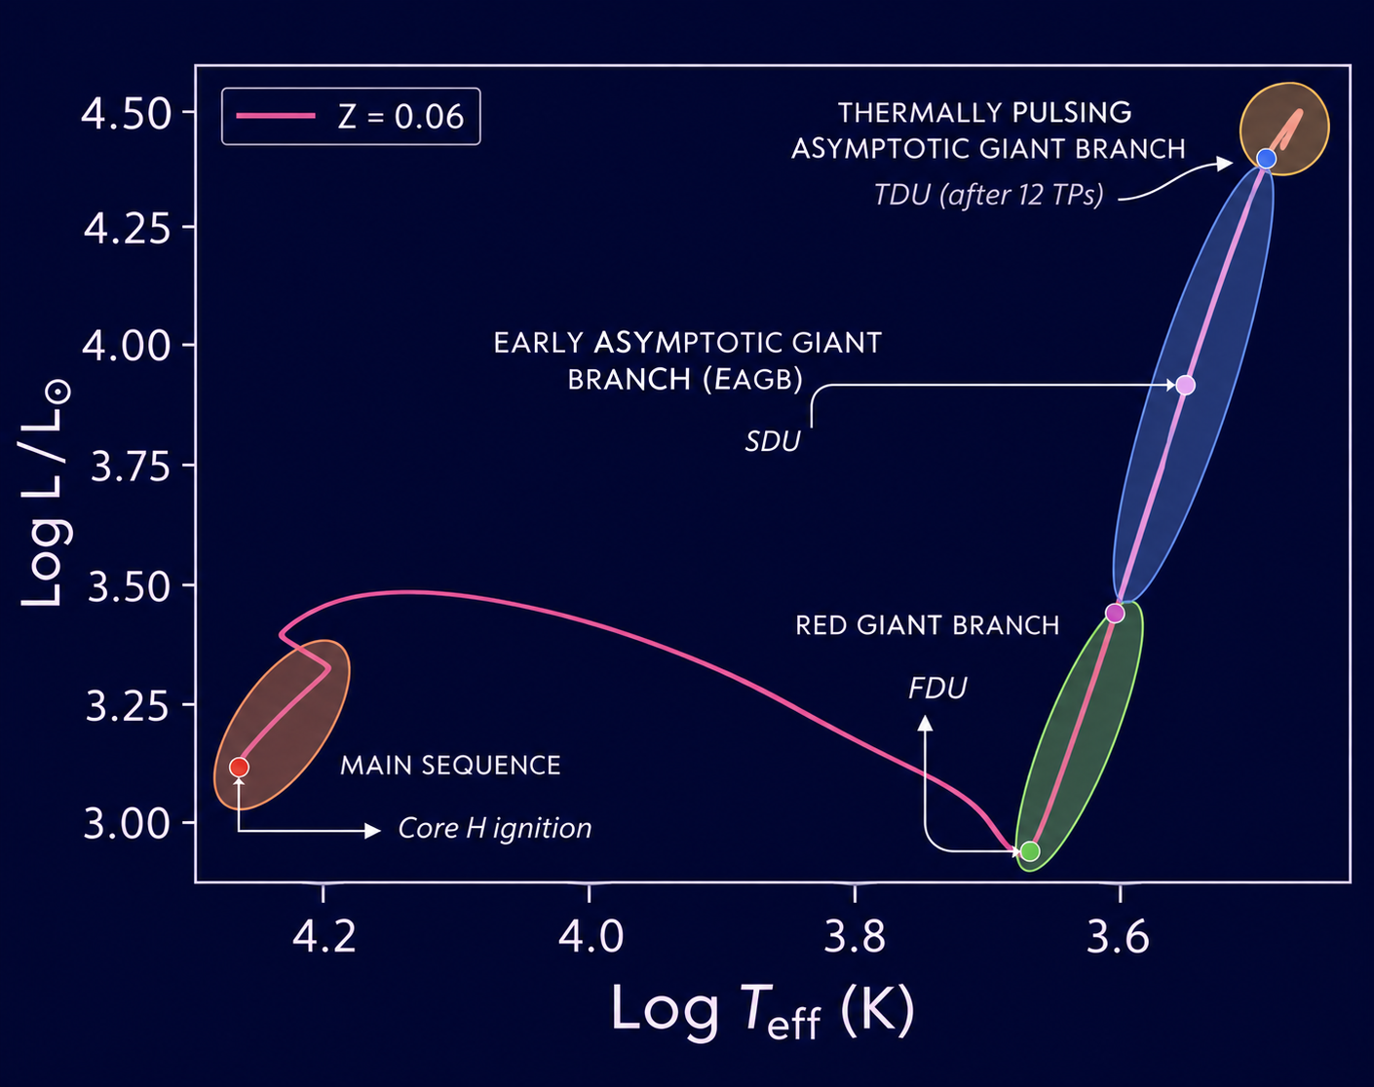
AGB Structure
Cinquegrana & Karakas 2022 (MNRAS)
POST CORE He BURNING: Star contracts but is not massive enough to ignite C burning. Instead, ignites He burning shell below pre-existing H burning shell.
EARLY AGB: He shell burns progressively itself thinner in mass until it is thermally unstable (the thin shell instability).
THERMAL PULSE: Thermonuclear runaway produces a flash originating from the He-shell. This drives an expansion of the outer layers.
AFTER THE PULSE: He burning subsides and star contracts. Sufficiently massive stars reignite H-burning and enter the TP-AGB.

Slide 4
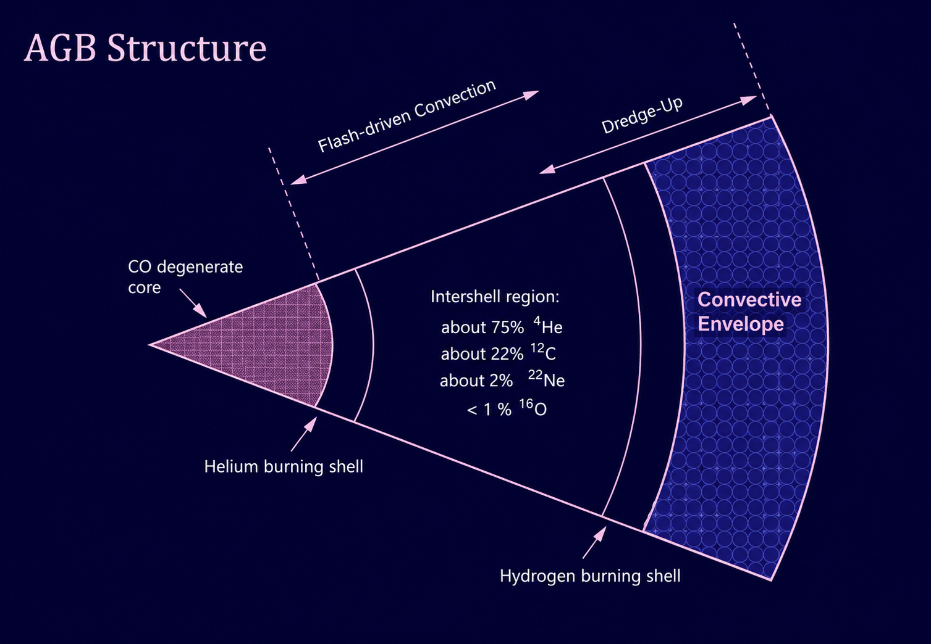
AGB Structure
POST CORE He BURNING: Star contracts but is not massive enough to ignite C burning. Instead, ignites He burning shell below pre-existing H burning shell.
EARLY AGB: He shell burns progressively itself thinner in mass until it is thermally unstable (the thin shell instability).
THERMAL PULSE: Thermonuclear runaway produces a flash originating from the He-shell. This drives an expansion of the outer layers.
AFTER THE PULSE: He burning subsides and star contracts. Sufficiently massive stars reignite H-burning and enter the TP-AGB.
Figure 14 from Karakas & Lattanzio 2014 (Dawes Rev, PASA)

Slide 5
The Thermal Pulse Cycle
THERMAL PULSE: He-burning shell becomes thermally unstable. A brief flash from the He-shell drives a convective zone through the intershell.
POWER DOWN: He-shell burning rapidly subsides. The star expands and the H-burning shell may be temporarily extinguished.
THIRD DREDGE UP: The convective envelope moves inward into the He-rich intershell, mixing He-burning products and s-process material to the surface.
INTERPULSE: H-burning shell reignites and provides most of the stellar luminosity. Pressure builds up on the He shell until the next thermal pulse.
Figure 14 from Karakas & Lattanzio 2014 (Dawes Rev, PASA)

Slide 6
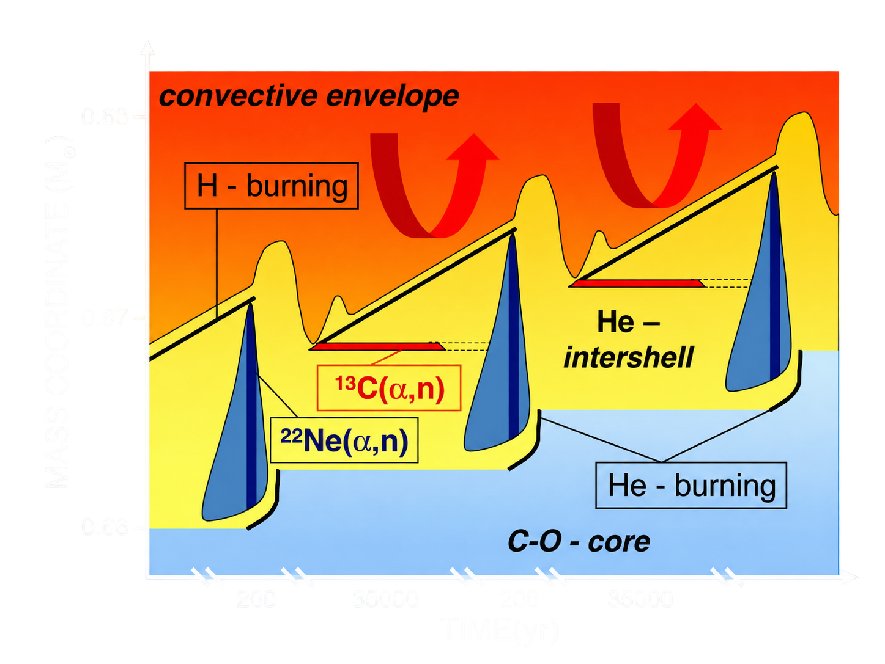
The Thermal Pulse Cycle & the s-process
Figure 1 from Wallner et al. 2016 (Phys. Rev. C)
SOURCES OF FREE NEUTRONS:
¹³C (α, n) ¹⁶O: Operates at ~100 MK, producing low neutron densities over long timescales.
²²Ne (α, n) ²⁵Mg:Activated at >300 MK, producing high neutron densities in short bursts.
MAIN SITES OF CAPTURE:
¹³C pocket: Neutrons released radiatively during the interpulse period, providing the largest neutron exposure.
He-flash convection zone: Neutrons released during thermal pulses, producing a brief, high-density neutron burst.

Slide 7
The Thermal Pulse Cycle
Figure 1 from Wallner et al. 2016 (Phys. Rev. C)
THERMAL PULSE → POWER DOWN → THIRD DREDGE UP →INTERPULSE → REPEAT (?)
CYCLE EVOLVES: Each pulse alters the core, envelope, temperature, composition, and mass-loss rate, changing subsequent nucleosynthesis.
MASS RETURNED TO ISM: Strong stellar winds progressively remove the envelope, ejecting repeatedly processed and mixed material throughout the TP-AGB.
MASS & METALLICITY DEPENDENCE: M_{ZAMS} and Z_{i} determine the number and strength of pulses, 3DU efficiency, ¹³C-pocket formation, and HBB activation.

Slide 8
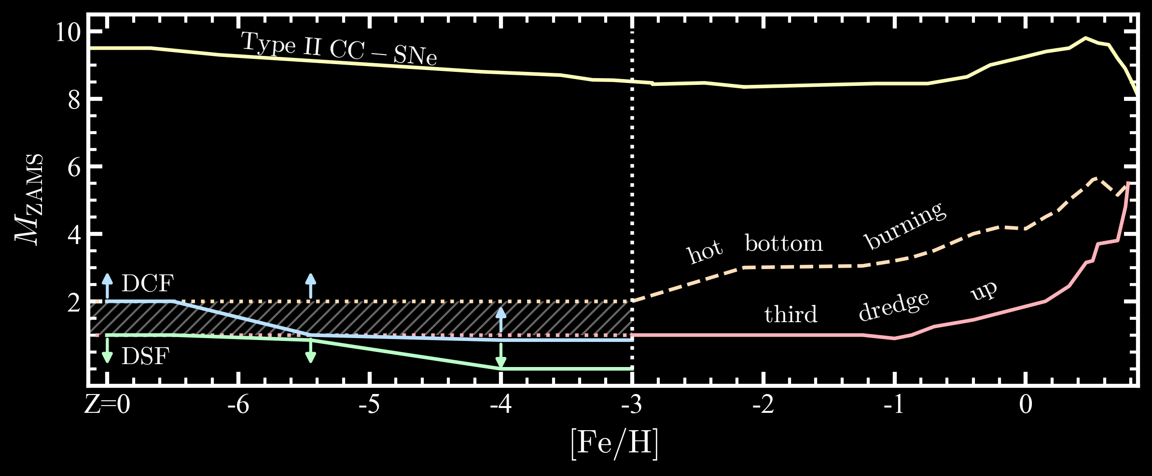
M_{ZAMS} & Z_{i} vs the Thermal Pulse Cycle
Campbell & Lattanzio 2008 (A&A): Z_{i} = 0, -6.5 ≤ [Fe/H] ≤ -3
Karakas et al. 2018 (MNRAS): [Fe/H] = -0.7
Karakas 2010 (MNRAS): -2.15 ≤ [Fe/H] ≤ +0.15
Karakas & Lugaro 2016 (ApJ): -0.3 ≤ [Fe/H] ≤ +0.15
Cinquegrana & Karakas 2022 (MNRAS): +0.46 ≤ [Fe/H] ≤ +0.85

Slide 9
M_{ZAMS} & Z_{i} vs the Thermal Pulse Cycle
Campbell & Lattanzio 2008 (A&A): Z_{i} = 0, -6.5 ≤ [Fe/H] ≤ -3
Karakas et al. 2018 (MNRAS): [Fe/H] = -0.7
Karakas 2010 (MNRAS): -2.15 ≤ [Fe/H] ≤ +0.15
Karakas & Lugaro 2016 (ApJ): -0.3 ≤ [Fe/H] ≤ +0.15
Cinquegrana & Karakas 2022 (MNRAS): +0.46 ≤ [Fe/H] ≤ +0.85

Slide 10
M_{ZAMS} & Z_{i} vs the Thermal Pulse Cycle
Increasing mass (thresholds vary with metallicity)

Slide 11
M_{ZAMS} & Z_{i} vs the Thermal Pulse Cycle
Type II CC-SNe
ONe WD or EC-SNe
> 80 MK
Hybrid C/O + ONe WD
70-80 MK
50 MK
40-50 MK
40-50 MK
300 MK
source
100 MK
episodes
pulses
C/O WD
He WD
Type II core collapse supernovae progenitors
Ignite central carbon on the early AGB [super AGBs]
Temperatures sustain Mg-Al & Ne-Na chains at the base of the envelope
Ignite carbon off-centre on the early AGB
Temperatures … full CNO cycle at the base of the envelope
Temperatures … CN cycle at the base of the envelope
Temperatures can sustain p-p chains at base of the convective envelope during interpulse periods
Temperatures during third dredge up are too high to preserve ¹³C pocket
Temperatures reached to activate ²²Ne neutron source during thermal pulses
Peak neutron exposure from ¹³C neutron source
Can form a ¹³C pocket during third dredge up & reach temperatures to activate ¹³C source during interpulse periods
Minimum mass to undergo third dredge up mixing episodes
Massive enough to undergo more than 5 thermal pulses
Minimum core mass to enter the thermally pulsing AGB
Below here, stars only enter the early AGB
Increasing mass (thresholds vary with metallicity)

Slide 12
M_{ZAMS} & Z_{i} vs the Thermal Pulse Cycle
Type II CC-SNe
ONe WD or EC-SNe
> 80 MK
Hybrid C/O + ONe WD
70-80 MK
50 MK
40-50 MK
40-50 MK
300 MK
source
100 MK
episodes
pulses
C/O WD
He WD
Type II core collapse supernovae progenitors
Ignite central carbon on the early AGB [super AGBs]
Temperatures sustain Mg-Al & Ne-Na chains at the base of the envelope
Ignite carbon off-centre on the early AGB
Temperatures … full CNO cycle at the base of the envelope
Temperatures … CN cycle at the base of the envelope
Temperatures can sustain p-p chains at base of the convective envelope during interpulse periods
Temperatures during third dredge up are too high to preserve ¹³C pocket
Temperatures reached to activate ²²Ne neutron source during thermal pulses
Peak neutron exposure from ¹³C neutron source
Can form a ¹³C pocket during third dredge up & reach temperatures to activate ¹³C source during interpulse periods
Minimum mass to undergo third dredge up mixing episodes
Massive enough to undergo more than 5 thermal pulses
Minimum core mass to enter the thermally pulsing AGB
Below here, stars only enter the early AGB
Increasing mass (thresholds vary with metallicity)

Slide 13
M_{ZAMS} & Z_{i} vs the Thermal Pulse Cycle
Type II CC-SNe
ONe WD or EC-SNe
> 80 MK
Hybrid C/O + ONe WD
70-80 MK
50 MK
40-50 MK
40-50 MK
300 MK
source
100 MK
episodes
pulses
C/O WD
He WD
Type II core collapse supernovae progenitors
Ignite central carbon on the early AGB [super AGBs]
Temperatures sustain Mg-Al & Ne-Na chains at the base of the envelope
Ignite carbon off-centre on the early AGB
Temperatures … full CNO cycle at the base of the envelope
Temperatures … CN cycle at the base of the envelope
Temperatures can sustain p-p chains at base of the convective envelope during interpulse periods
Temperatures during third dredge up are too high to preserve ¹³C pocket
Temperatures reached to activate ²²Ne neutron source during thermal pulses
Peak neutron exposure from ¹³C neutron source
Can form a ¹³C pocket during third dredge up & reach temperatures to activate ¹³C source during interpulse periods
Minimum mass to undergo third dredge up mixing episodes
Massive enough to undergo more than 5 thermal pulses
Minimum core mass to enter the thermally pulsing AGB
Below here, stars only enter the early AGB
Increasing mass (thresholds vary with metallicity)

Slide 14
M_{ZAMS} & Z_{i} vs the Thermal Pulse Cycle
Type II CC-SNe
ONe WD or EC-SNe
> 80 MK
Hybrid C/O + ONe WD
70-80 MK
50 MK
40-50 MK
40-50 MK
300 MK
source
100 MK
episodes
pulses
C/O WD
He WD
Type II core collapse supernovae progenitors
Ignite central carbon on the early AGB [super AGBs]
Temperatures sustain Mg-Al & Ne-Na chains at the base of the envelope
Ignite carbon off-centre on the early AGB
Temperatures … full CNO cycle at the base of the envelope
Temperatures … CN cycle at the base of the envelope
Temperatures can sustain p-p chains at base of the convective envelope during interpulse periods
Temperatures during third dredge up are too high to preserve ¹³C pocket
Temperatures reached to activate ²²Ne neutron source during thermal pulses
Peak neutron exposure from ¹³C neutron source
Can form a ¹³C pocket during third dredge up & reach temperatures to activate ¹³C source during interpulse periods
Minimum mass to undergo third dredge up mixing episodes
Massive enough to undergo more than 5 thermal pulses
Minimum core mass to enter the thermally pulsing AGB
Below here, stars only enter the early AGB
Increasing mass (thresholds vary with metallicity)

Slide 15
M_{ZAMS} & Z_{i} vs the Thermal Pulse Cycle
Campbell & Lattanzio 2008 (A&A): Z_{i} = 0, -6.5 ≤ [Fe/H] ≤ -3
Karakas et al. 2018 (MNRAS): [Fe/H] = -0.7
Karakas 2010 (MNRAS): -2.15 ≤ [Fe/H] ≤ +0.15
Karakas & Lugaro 2016 (ApJ): -0.3 ≤ [Fe/H] ≤ +0.15
Cinquegrana & Karakas 2022 (MNRAS): +0.46 ≤ [Fe/H] ≤ +0.85

Slide 16
M_{ZAMS} & Z_{i} vs the Thermal Pulse Cycle
Campbell & Lattanzio 2008 (A&A): Z_{i} = 0, -6.5 ≤ [Fe/H] ≤ -3
Karakas et al. 2018 (MNRAS): [Fe/H] = -0.7
Karakas 2010 (MNRAS): -2.15 ≤ [Fe/H] ≤ +0.15
Karakas & Lugaro 2016 (ApJ): -0.3 ≤ [Fe/H] ≤ +0.15
Cinquegrana & Karakas 2022 (MNRAS): +0.46 ≤ [Fe/H] ≤ +0.85

Slide 17
M_{ZAMS} & Z_{i} vs the Thermal Pulse Cycle
OPACITY (κ): ↑ Z_{i} → ↑ κ → energy escapes less efficiently → cooler, less luminous star
MEAN MOLECULAR WEIGHT (μ): ↑ Y_{i} with Z_{i} → ↑ μ → contraction and heating → hotter, more luminous star
ENERGY GENERATION RATES (ϵ_{nuc}): Changes with composition and burning mode → alters core temperature, density and luminosity
MASS LOSS RATES: ↑ Z_{i} → stronger mass loss → lower stellar mass, changing the subsequent evolution

Slide 18
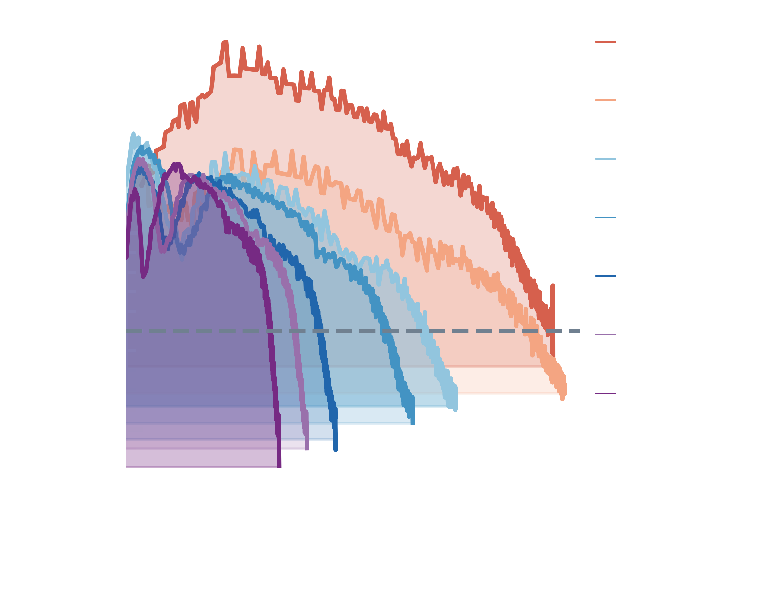
Z_{i} & Thermal Pulses
d/r: the He-burning shell's thickness over its outer radius — across the TP-AGB (t₀ to t₀+Δt), for models spanning 2.1 Z⊙ down to 1/4.3 Z⊙.
STABILITY CRITERION: the shell is thermally unstable (can trigger a pulse) when d/r < χ_ρ/4, which for an ideal gas gives d/r ≲ 1/4 — the dashed line marks this threshold.
METALLICITY PATTERN: higher-Z models sustain a thicker shell (higher, longer-lived d/r) across more pulses; lower-Z models thin faster and drop below the threshold earlier in the TP-AGB. lower metallicity means lower opacity and a more compact, higher-density core/shell structure, so the He shell burns down and thins relative to its radius more rapidly, driving d/r below 1/4 sooner.

Slide 19
Z_{i} & Third Dredge Up
METALLICITY CONTROLS TDU: He-burning shell becomes thermally unstable. A brief flash from the He-shell drives a convective zone through the intershell.
CARBON ENRICHMENT: At low Z_{i}, less initial oxygen means less carbon is needed to reach C/O >1.
DOUBLE EFFECT: Low metallicity both enhances dredge-up and makes carbon-star formation easier; at high Z, TDU is weaker while more carbon is required.

Slide 20
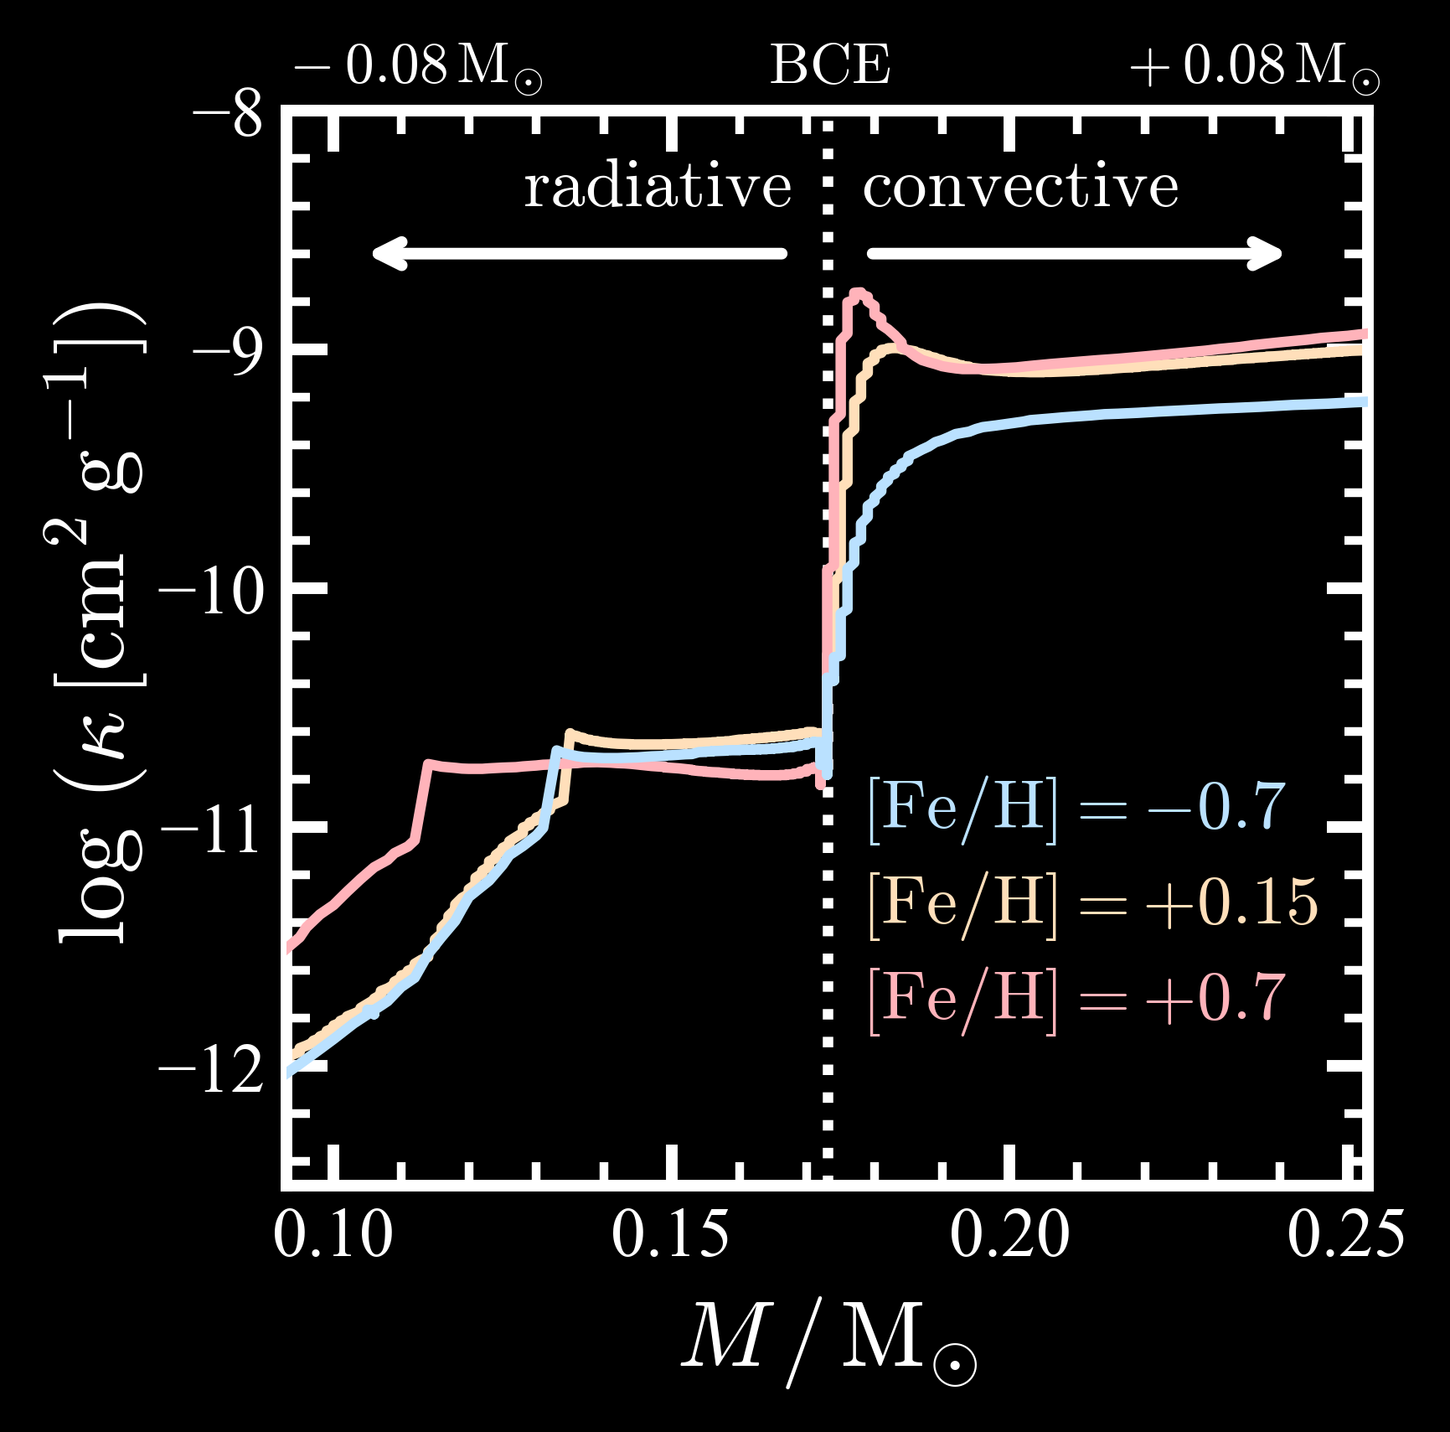
Z_{i} & Hot Bottom Burning
HIGHER Zi → COOLER HBB: At fixed initial mass, the maximum temperature at the base of the convective envelope generally decreases with increasing metallicity.
MASS THRESHOLD SHIFTS: HBB therefore requires higher initial masses at higher $Z$, with the hottest, most massive models reaching the strongest H-burning conditions.
NUCLEOSYNTHESIS CHANGES: As T_{BCE} increases, burning at the base of the connective envelope progresses from CN cycling (≥ 50 MK) toward full CNO and Ne–Na/Mg–Al cycling (≥ MK).

Slide 21
Z_{i} & Opacity vs Mean Molecular Weight
finish

Slide 22
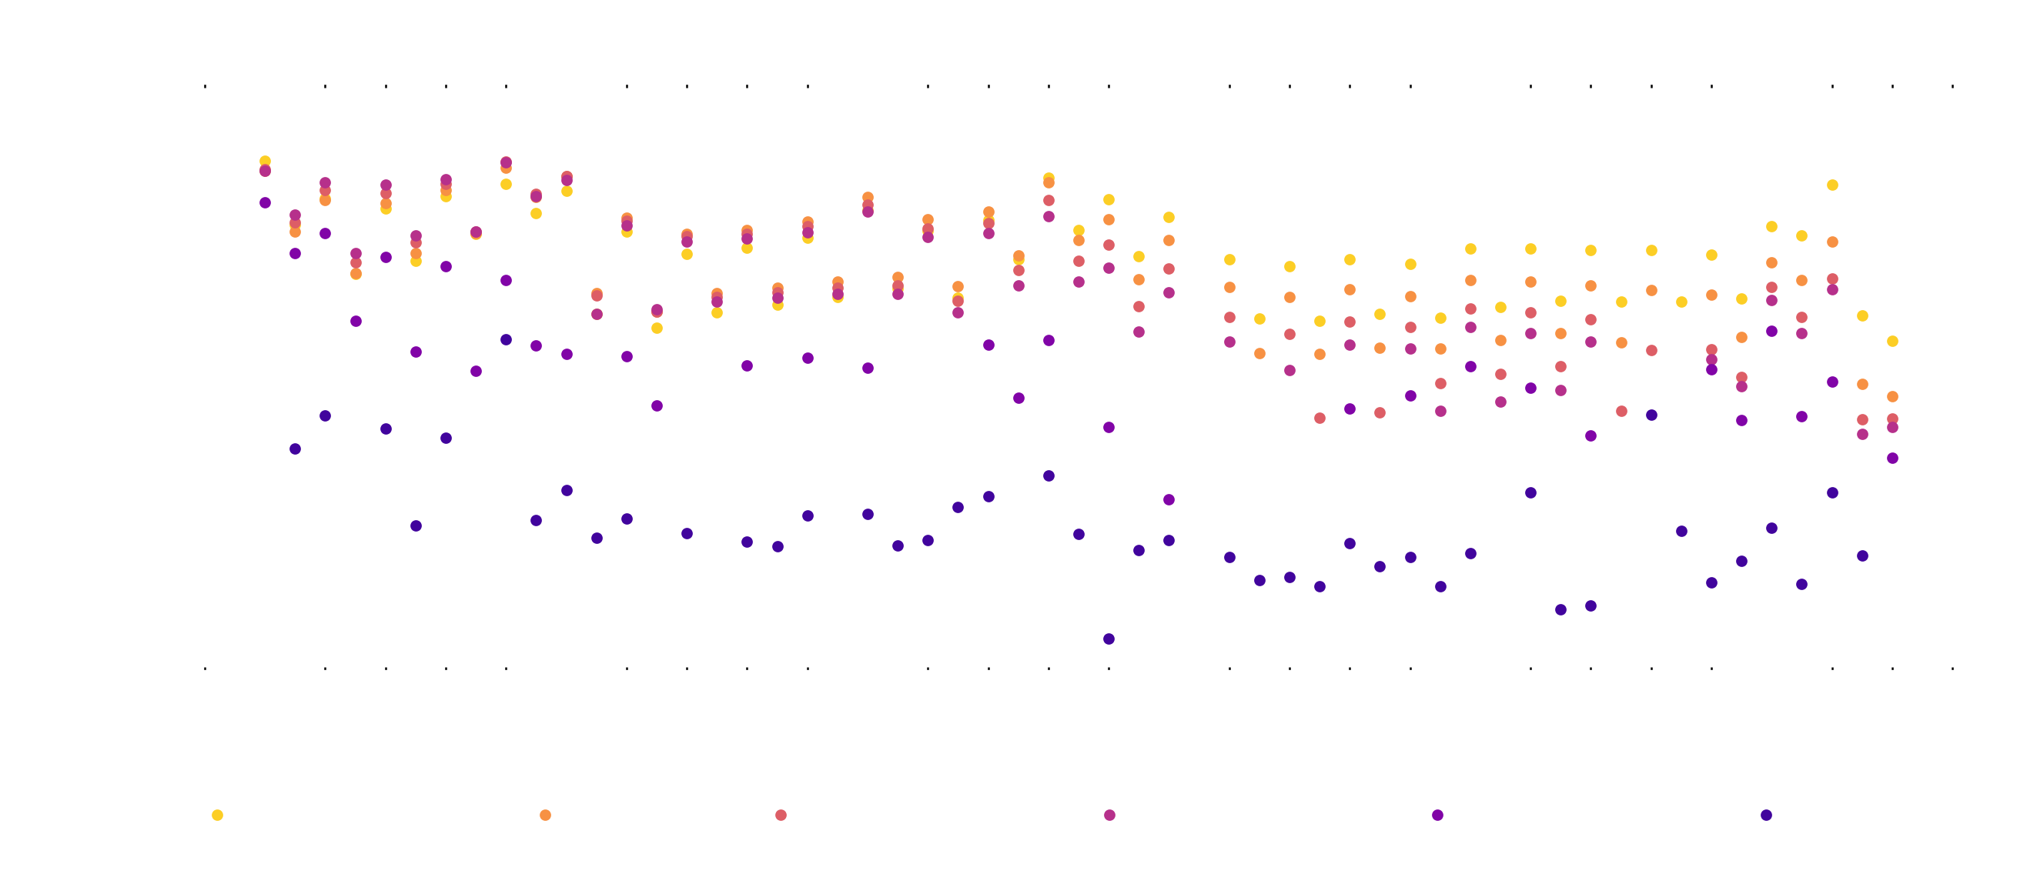
Z_{i} & Slow Neutron Capture Processes

Slide 23
M_{ZAMS} & Z_{i} vs the Thermal Pulse Cycle
Campbell & Lattanzio 2008 (A&A): Z_{i} = 0, -6.5 ≤ [Fe/H] ≤ -3
Karakas et al. 2018 (MNRAS): [Fe/H] = -0.7
Karakas 2010 (MNRAS): -2.15 ≤ [Fe/H] ≤ +0.15
Karakas & Lugaro 2016 (ApJ): -0.3 ≤ [Fe/H] ≤ +0.15
Cinquegrana & Karakas 2022 (MNRAS): +0.46 ≤ [Fe/H] ≤ +0.85

Slide 24
Proton Ingestion Episodes (PIEs)
LOW METALLICITY: In Z_{i}=0 and EMP stars, the He-burning convection zone can reach into the H-rich layer, mixing protons into hot He-burning material. Without CNO catalysts, H burning relies on the slower pp chains, producing a cooler, more diffuse H shell and a weaker entropy barrier to He-flash convection.
MULTIPLE SITES: Proton ingestion can occur at different evolutionary stages and in different stellar environments. Two well-known cases are the Dual Core Flash (DCF) during the RGB core-He flash and the Dual Shell Flash (DSF) during the early TP-AGB in intermediate-mass stars.
RUNAWAY FEEDBACK: Ingested protons react with abundant ¹²C, triggering ¹³C production and an H-burning flash. The additional energy can drive further proton ingestion before the convective region eventually splits into separate H- and He-burning zones.
Need figure

Slide 25
Nucleosynthesis during PIEs
¹⁶O PRODUCTION: ¹²C(p,γ)¹³N(β⁺)¹³C(α,n)¹⁶O converts most of the He-flash ¹²C into ¹⁶O. This is a key signature distinguishing PIE pollution from ordinary 3DUP.
CNO EQUILIBRIUM: A competing channel builds ¹⁴N via the CN cycle, leaving diagnostic ¹²C/¹³C ratios as low as ~4–5.
FREE NEUTRON RELEASE: The same ¹³C(α,n)¹⁶O reaction liberates neutrons (Y_{n} ~ 10⁻¹³–10⁻¹⁶). With ¹⁴N still scarce in this metal-poor material, the usual neutron poison is weak.
HEAVY-ELEMENT NUCLEOSYNTHESIS: Suppressed poisoning allows captures onto heavier nuclei (Sr, Ba, Pb), making PIEs a candidate s-/i-process site in the early universe.
Need figure

Slide 26
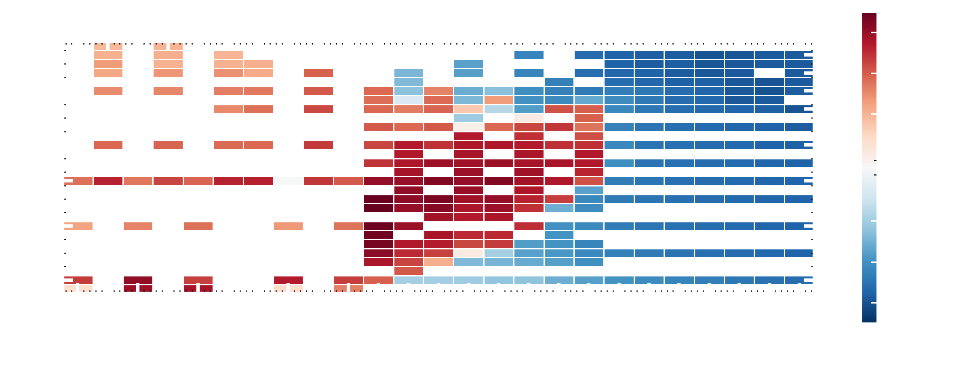
Carbon Yields Across M_{ZAMS} & Z_{i}
Gil-Pons et al. 2022 (A&A): 10⁻¹⁰ ≤ [Fe/H] ≤ 10⁻⁶
Gil-Pons et al. 2021 (A&A): [Fe/H] = -3.15
Campbell & Lattanzio 2008 (A&A): Z_{i} = 0, -6.5 ≤ [Fe/H] ≤ -3
Doherty et al. 2014a,b (MNRAS): -2.15 ≤ [Fe/H] ≤ +0.15
Karakas 2010 (MNRAS): -2.15 ≤ [Fe/H] ≤ +0.15
Karakas et al. 2018 (MNRAS): [Fe/H] = -0.7
Karakas & Lugaro 2016 (ApJ): -0.3 ≤ [Fe/H] ≤ +0.15
Cinquegrana & Karakas 2022 (MNRAS): +0.46 ≤ [Fe/H] ≤ +0.85

Slide 27
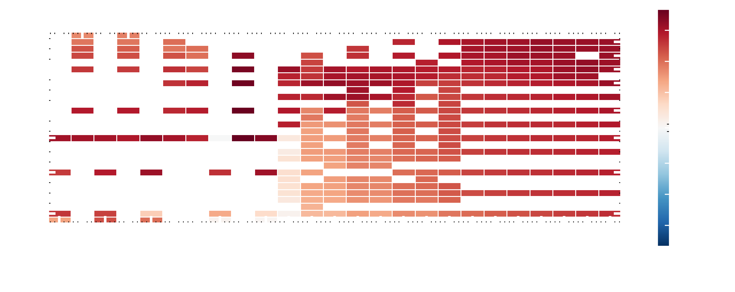
Nitrogen Yields Across M_{ZAMS} & Z_{i}
Gil-Pons et al. 2022 (A&A): 10⁻¹⁰ ≤ [Fe/H] ≤ 10⁻⁶
Gil-Pons et al. 2021 (A&A): [Fe/H] = -3.15
Campbell & Lattanzio 2008 (A&A): Z_{i} = 0, -6.5 ≤ [Fe/H] ≤ -3
Doherty et al. 2014a,b (MNRAS): -2.15 ≤ [Fe/H] ≤ +0.15
Karakas 2010 (MNRAS): -2.15 ≤ [Fe/H] ≤ +0.15
Karakas et al. 2018 (MNRAS): [Fe/H] = -0.7
Karakas & Lugaro 2016 (ApJ): -0.3 ≤ [Fe/H] ≤ +0.15
Cinquegrana & Karakas 2022 (MNRAS): +0.46 ≤ [Fe/H] ≤ +0.85

Slide 28
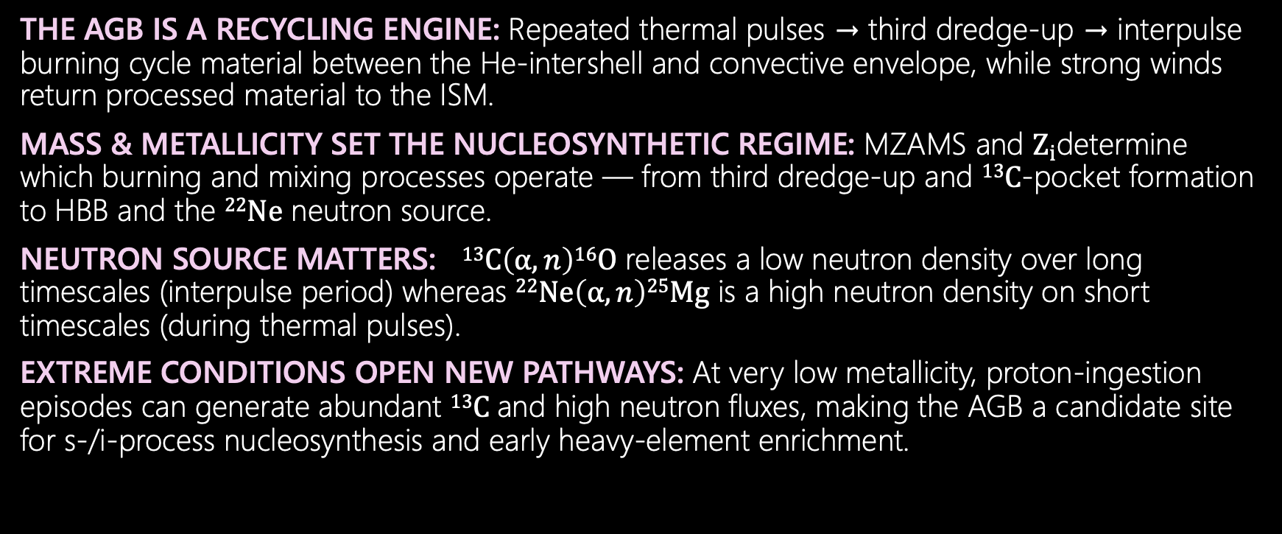
Final Notes
THE AGB IS A RECYCLING ENGINE: Repeated thermal pulses → third dredge-up → interpulse burning cycle material between the He-intershell and convective envelope, while strong winds return processed material to the ISM.
MASS & METALLICITY SET THE NUCLEOSYNTHETIC REGIME: MZAMS​ and $Z_{i}$determine which burning and mixing processes operate — from third dredge-up and $13C$-pocket formation to HBB and the $22Ne$ neutron source.
NEUTRON SOURCE MATTERS: $13C\left(α,n\right)16O$ releases a low neutron density over long timescales (interpulse period) whereas $22Ne\left(α,n\right)25Mg$ is a high neutron density on short timescales (during thermal pulses).
EXTREME CONDITIONS OPEN NEW PATHWAYS: At very low metallicity, proton-ingestion episodes can generate abundant $13C$and high neutron fluxes, making the AGB a candidate site for s-/i-process nucleosynthesis and early heavy-element enrichment.

