Slide 1


I. NUCLEOSYNTHESIS:
The stellar origins of the elements

Slide 2
II. NUCLEI ON THE AGB:
Light element nucleosynthesis to s- and i-processes
Asymptotic Giant Branch

Slide 3
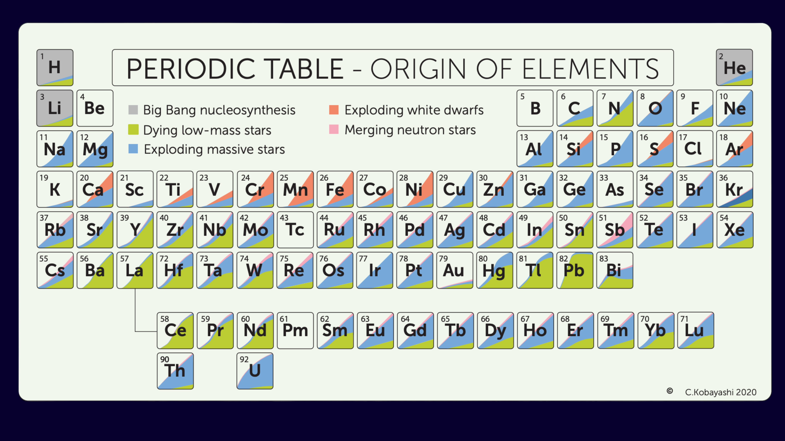
AGB stars matter for chemical evolution
LIGHT ELEMENTS:
H burning: N, Na, Al. He burning: C, O, Ne.
HEAVY ELEMENTS:
Sr, Y, Zr (1st s-process peak); Cs, Ba, La, Hf (2nd peak), Pb (3rd peak). These abundance peaks correspond to magic neutron numbers, which produce particularly stable nuclei.
INITIAL MASS FUNCTION:
For a Kroupa style IMF, there are roughly 100 low-mass stars for every 20 intermediate-mass and 4 massive stars.

Slide 4

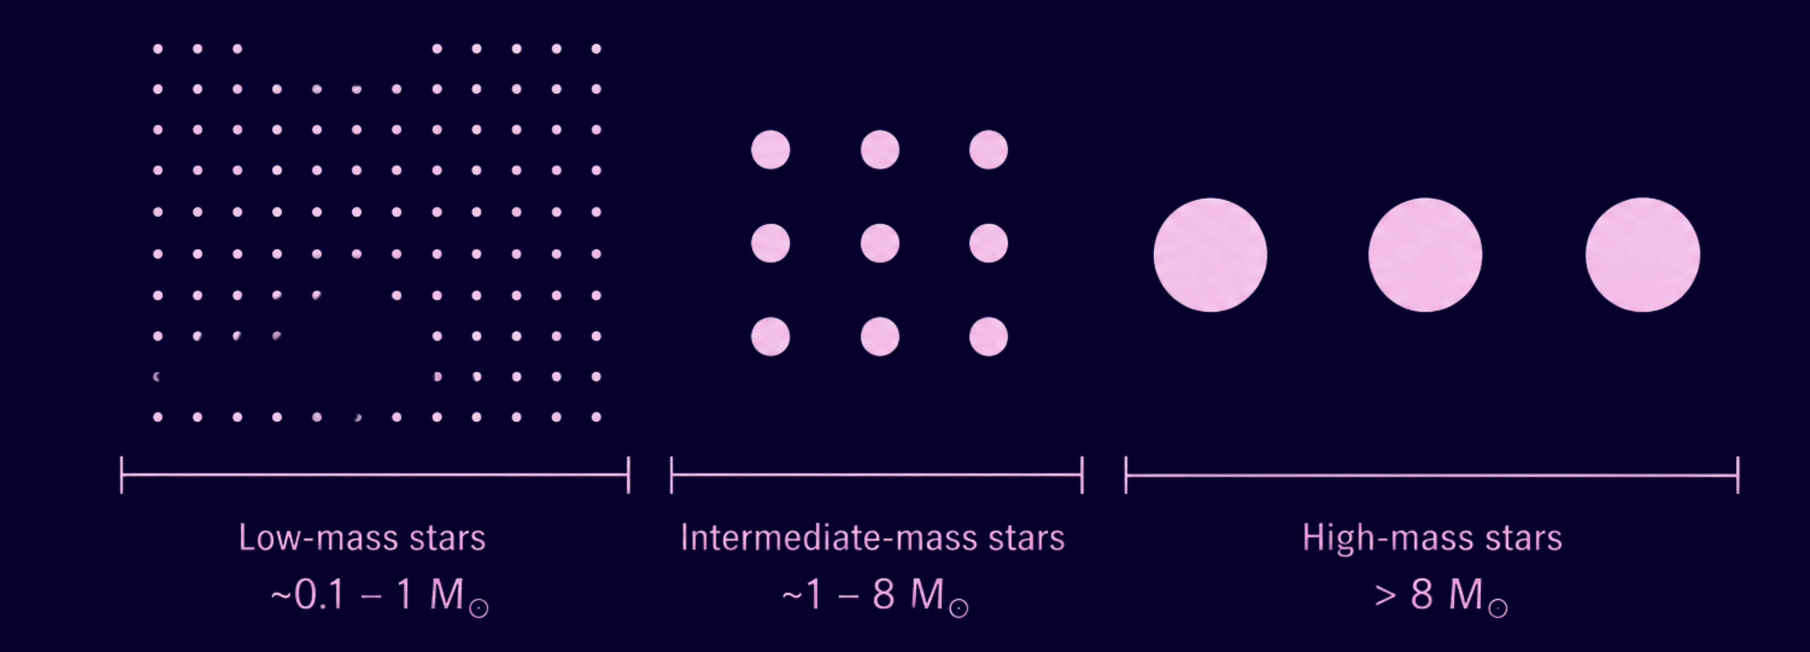
AGB stars matter for chemical evolution
LIGHT ELEMENTS:
H burning: N, Na, Al. He burning: C, O, Ne.
HEAVY ELEMENTS:
Sr, Y, Zr (1st s-process peak); Cs, Ba, La, Hf (2nd peak), Pb (3rd peak). These abundance peaks correspond to magic neutron numbers, which produce particularly stable nuclei.
INITIAL MASS FUNCTION:
For a Kroupa style IMF, there are roughly 100 low-mass stars for every 20 intermediate-mass and 4 massive stars.

Slide 5
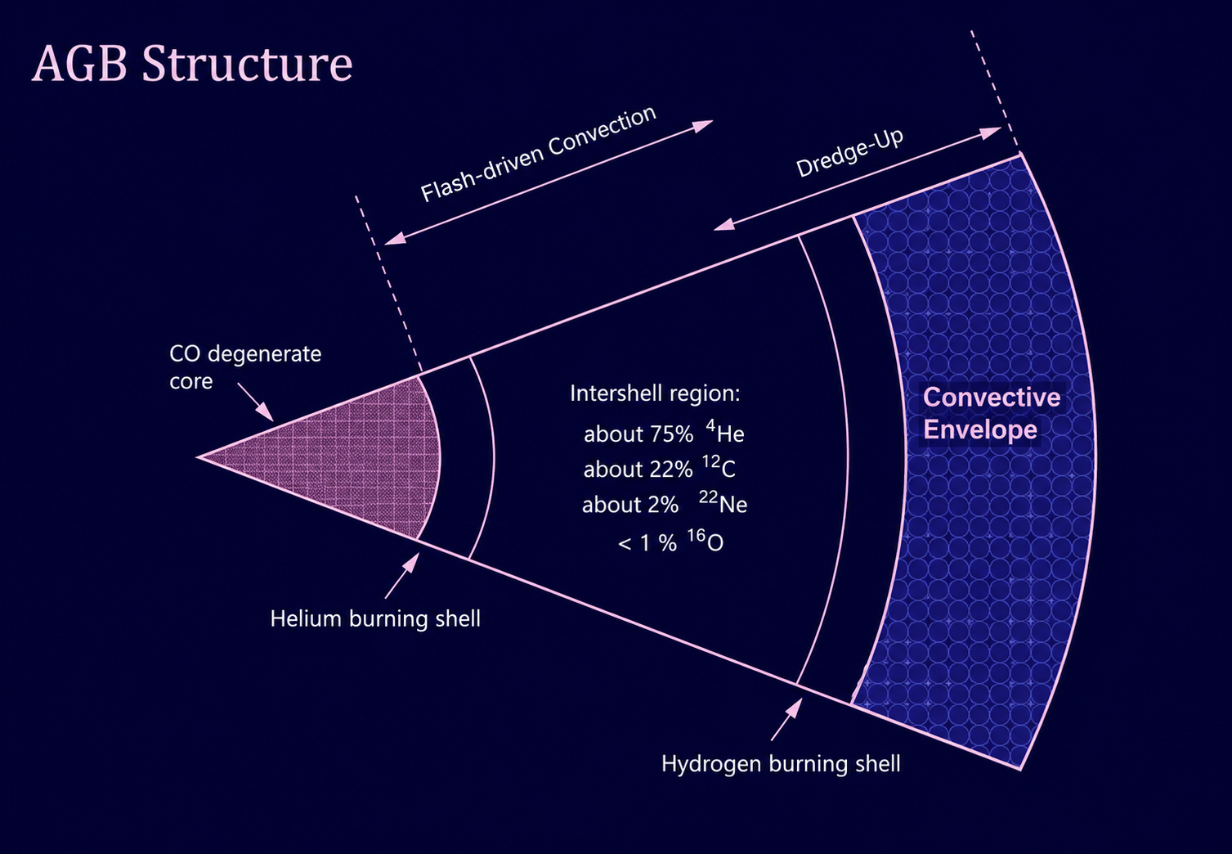
AGB structure
POST CORE He BURNING:
Star contracts but is not massive enough to ignite C burning. Instead, ignites He burning shell below pre-existing H burning shell.
EARLY AGB:
He shell burns progressively itself thinner in mass until it is thermally unstable (the thin shell instability).
THERMAL PULSE:
Thermonuclear runaway produces a flash originating from the He-shell. This drives an expansion of the outer layers.
AFTER THE PULSE:
He burning subsides and star contracts. Sufficiently massive stars reignite H-burning and enter the TP-AGB.

Slide 6
The thermally pulsing AGB cycle
1. THERMAL PULSE:
He-burning shell becomes thermally unstable. A brief flash from the He-shell drives a convective zone through the intershell.
2. POWER DOWN:
He-shell burning rapidly subsides. The star expands and the H-burning shell may be temporarily extinguished.
3. THIRD DREDGE UP:
The convective envelope moves inward into the He-rich intershell, mixing He-burning products and s-process material to the surface.
4. INTERPULSE PHASE:
H-burning shell reignites and provides most of the stellar luminosity. Pressure builds up on the He shell until the next thermal pulse.

Slide 7
Surface enrichment from dredge up
Show theory and obs evidence here

Slide 8
Light element nucleosynthesis
Including HBB

Slide 9
Neutron sources on the AGB

Slide 10
The slow neutron capture (s-)process

Slide 11
Intermediate neutron capture (i-)process

Slide 12
Stellar models to yields
Cumulative effect of the TP-AGB
Mass and metallicity: how does it effect the yields?

Slide 13
III. STELLAR YIELDS:
An introduction

