Slide 1
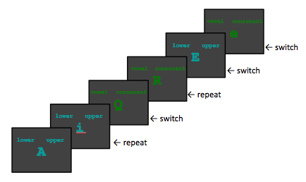
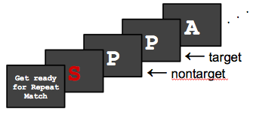
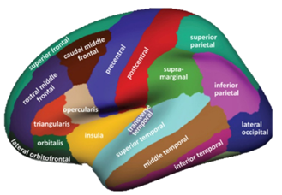
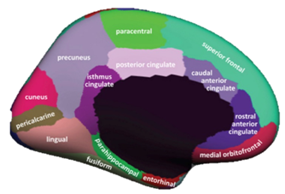
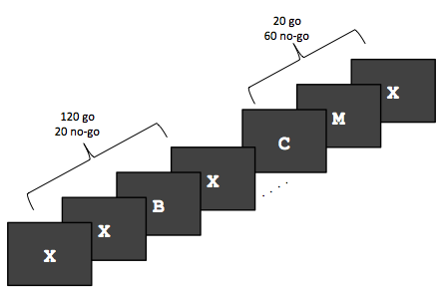
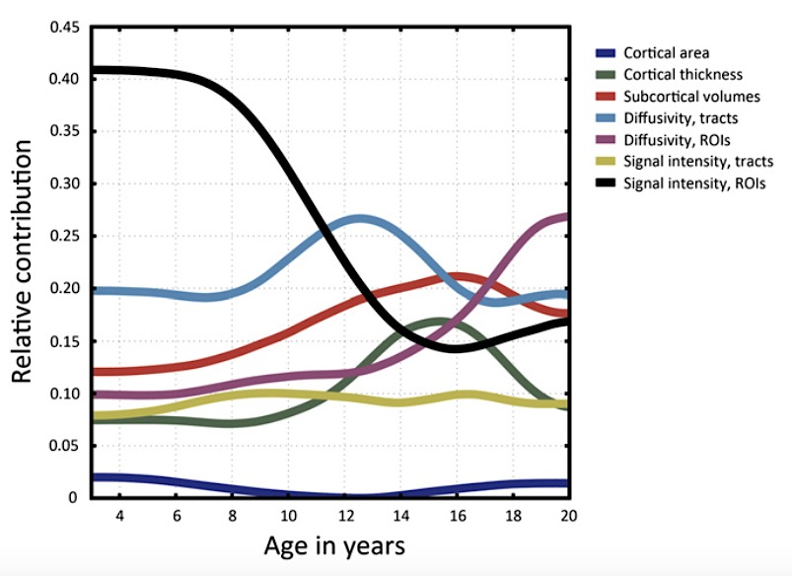
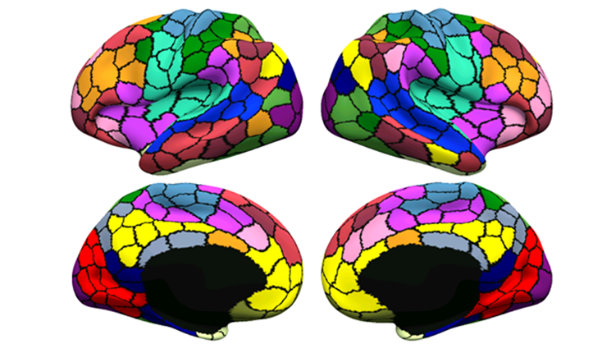
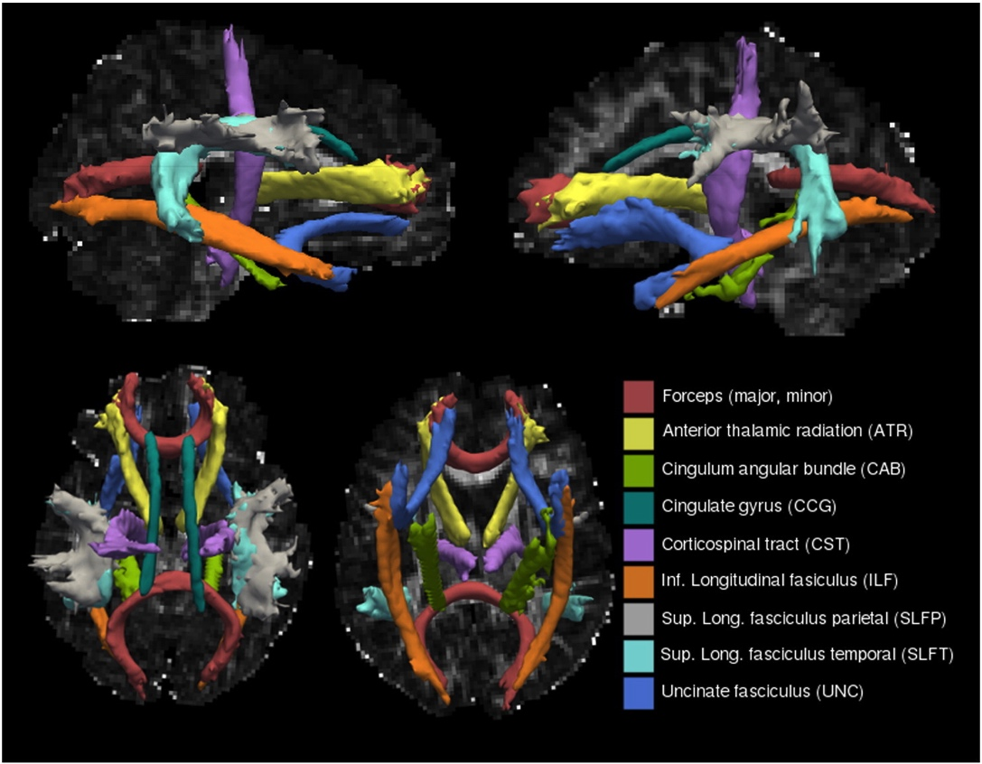

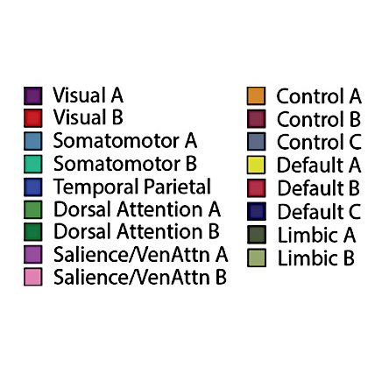
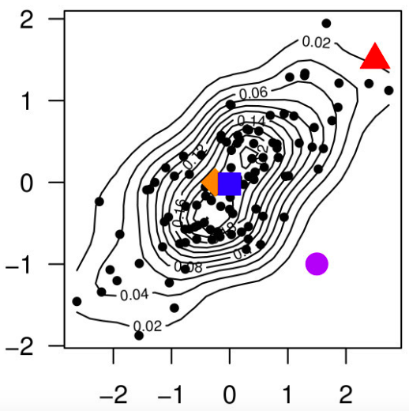
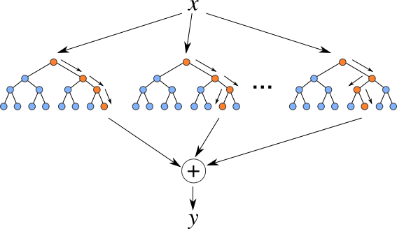
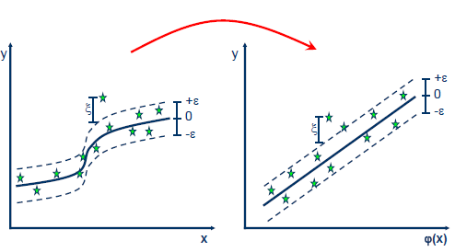
Multimodal predictive modeling in healthy cognitive aging
Giulia Baracchini¹, Daniel Nichol¹, Jenny Rieck¹, Bradley Buchsbaum^{1,2}, Cheryl Grady^{1,2}
¹ Rotman Research Institute, Baycrest Centre, Toronto ON ² University of Toronto, Toronto ON
Background & Aim of the Study
Methods
Large-scale lifespan studies have progressively become common in the cognitive neuroscience of aging allowing the application of predictive and machine learning models;
Yet, the majority of these studies do not include functional neuroimaging measures during cognitive tasks (e.g., Brown et al., 2012; Liem et al., 2016);
Different neural and behavioral measures are thought to peak at different time points over the lifespan (e.g., Raz & Rodrigue, 2006; Zonneveld et al., 2019);
Being able to trace neural and behavioral trajectories in healthy aging might provide meaningful insights in the early detection and prevention of aging-related pathological conditions;
Participants
Measures
93 healthy adults → only included complete cases across all measures
Inhibition
Shifting
Updating
(Miyake et al., 2000)
 | Age Range | Mean Age (in years) | N | % Females | Education | MMSE
Younger | 20-35 | 26.5 | 29 | 55.2% | 17.4 | 28.8
Middle-aged | 36-60 | 49.1 | 35 | 62.9% | 16.7 | 29.1
Older | 61-86 | 69.8 | 29 | 55.2% | 16.4 | 28.6
The aim of this study is to define such trajectories in the context of cognitive control. While we initially are trying to predict age from our multimodal measures, our final goal is to extend our analyses to the prediction of behavior.
Study Design
(Brown et al., 2012)
Our Workflow (R; MATLAB)
Results
a. Outlier Detection
± 3SD from mean
Nested Cross-validation
GLM PCA + LASSO
1. Data Cleaning
2. Mean Centering and Scaling
3. Run Algorithm
hyperparameter(s) optimization
N = 93
b. Skewness detection (log transform):
|max value – min value| > 20
(Kuhn & Johnson, 2013)
Outer Loop
Define folds (10)
x50 times
Training Set
[ 1 2 4 5 6 7 8 9 10 ]
Test Set
[ 3 ]
Inner Loop
x10 times / resampling
Average
Training Set
[ 1 4 5 6 7 8 9 10 ]
Test Set
[ 2 ]
10 models
10 hyperparameters
MODEL SELECTION:
Hyperparameter(s) tuning
MODEL EVALUATION:
Generalization; Mean Absolute Error
Mean Absolute Error across 50 repetitions across 93 subjects: 10.05 years
Mean Absolute Error across 50 repetitions across 93 subjects: 8.25 years
Discussion
Comparison all algorithms
Support Vector Regression
PLS Regression RF Regression
These methods might only represent a small subset of all available models but their distinct natures provide us with a broad understanding of how to best deal with these types of data;
We find that Partial Least Squares Regression and Support Vector Regression consistently outperform the other models by showing the smallest mean absolute error. While these methods seem to work on our data, it is hard to readily interpret what is driving each of the models;
We are currently testing whether such preliminary results hold with a larger sample and with a different criterion (age → behavior); yet, we do acknowledge that algorithm performance might vary based on the data (Wolpert & Macready, 1997);
Our data might not be considered “big enough” to reliably apply machine learning methods (Smith & Nichols, 2018), however our results might serve as a reference point for future studies examining the trajectories and biomarkers of healthy brain aging.
Mean Absolute Error across 50 repetitions across 93 subjects: 7.37 years
Mean Absolute Error across 50 repetitions across 93 subjects: 7.35 years
Mean Absolute Error across 50 repetitions across 93 subjects: 8.80 years
gbaracchini@research.baycrest.org

