Slide 1

WHAT IS sentiment analysis?
Dr Giulia Grisot

Slide 2
SENTIMENT ANALYSIS
+1
+0.9
“This book is fantastic! It tells wonderful and beautiful things…”
“In those days, sadness shadowed my heart”
-0.5
-1

Slide 3
SENTIMENT ANALYSIS
“[…] is the field of study that analyses people’s opinions, sentiments, appraisals, attitudes, and emotions towards entities and their attributes expressed in written text. The entities can be products, services, organizations, individuals, events, issues, or topics”
(Liu, 2015)

Slide 4
SENTIMENT ANALYSIS
SA and cognitive literary studies
Jacobs, A. M., Schuster, S., Xue, S., and Lüdtke, J. (2017). What’s in the brain that ink may character… A quantitative narrative analysis of Shakespeare’s 154 sonnets for use in (Neuro-)cognitive poetics. Scientific Study of Literature, 7(1): 4-51.
SA for the study of secondary literature
Mellmann, K. and Du, K. (2018). “Sentimentanalyse in Unstrukturierten Texten (Am Bsp. Literaturgeschichtlicher Rezeptionsanalyse).” In DHd 2018 Konferenzabstracts, 305–8. Cologne: Universität zu Köln.
SA for the study of social reading
Rebora, S. and Pianzola F. (2018). A New Research Programme for Reading Research: Analysing Comments in the Margins on Wattpad. DigitCult - Scientific Journal on Digital Cultures, 3(2): 19–36
SA for Italian language
Sprugnoli, R., Tonelli, S., Marchetti, A., and Moretti, G. (2016). Towards sentiment analysis for historical texts. Digital Scholarship in the Humanities, 31(4): 762-772.
SA for German language
Zehe, A., Becker, M., Jannidis, F., and Hotho, A. (2017). Towards Sentiment Analysis on German Literature. In Joint German/Austrian Conference on Artificial Intelligence (Künstliche Intelligenz). Cham: Springer, pp. 387-394.
SA for emotional arcs (again)
Reagan, A. J., Mitchell, L., Kiley, D., Danforth, C. M., and Dodds, P. S. (2016). The emotional arcs of stories are dominated by six basic shapes. EPJ Data Science, 5(1): 31.

Slide 5
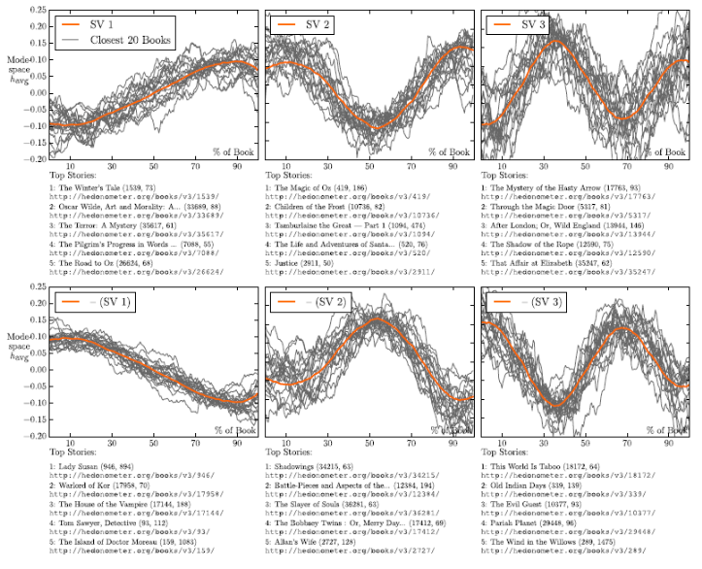
Andrew J Reagan et al. 2016. “The emotional arcs of stories are dominated by six basic shapes.” EPJ Data Science

Slide 6
SENTIMENT ANALYSIS - CRITICAL ASPECTS
From a theoretical point of view:
Jockers called his software «syuzhet», referring to Russian formalism (see Vladimir Propp) and narratology (the “science of narration”)
However, traditional narratological studies (see Gérard Genette, Mieke Bal, et al.) do not consider emotions at all
Only Patrick Colm Hogan wrote a book on Affective Narratology (2012), but looking at much more complex phenomena than “plot arcs”
From a practical point of view:
Emotions are subjective (of course!), so their measurement can be unreliable
SA software are generally unstable: you modify a few parameters, and you get completely different results

Slide 7
SENTIMENT ANALYSIS A (SIMPLE) TAXONOMY
Three defining elements:
the emotion theory adopted by the tool
the technique to accomplish the analysis
the emotion resources

Slide 8
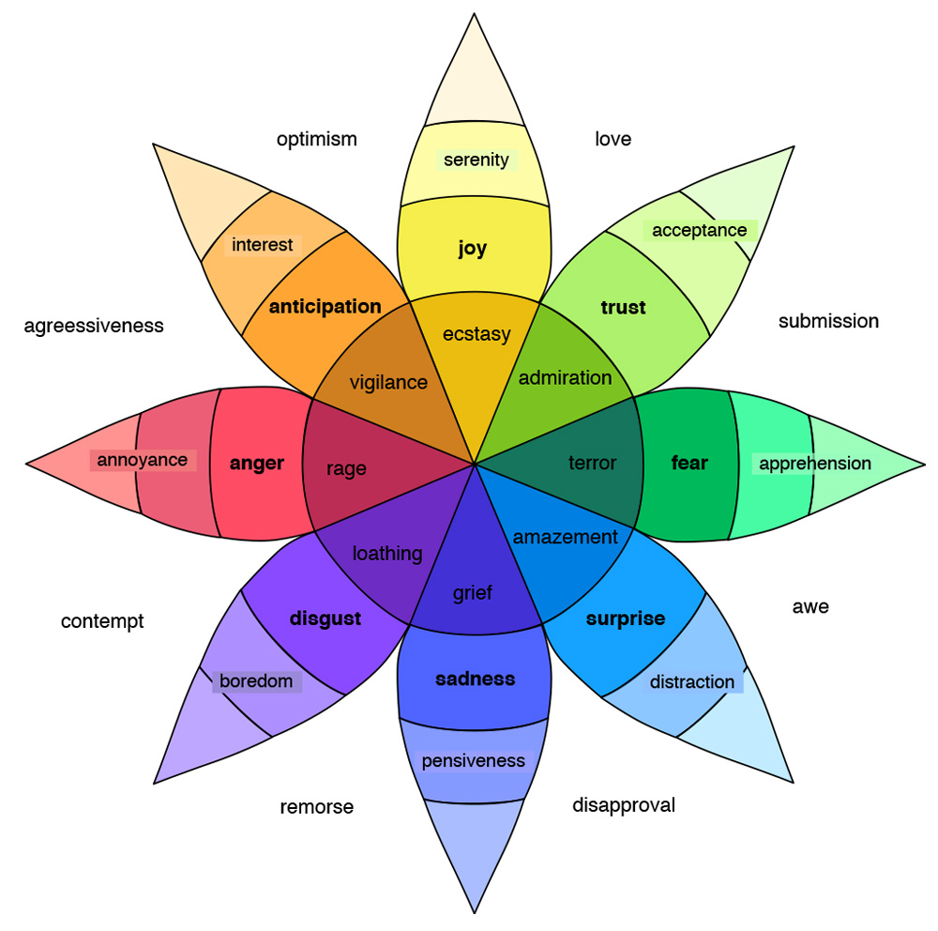
EMOTION THEORIES: 1. Plutchik’s eight basic emotions

Slide 9
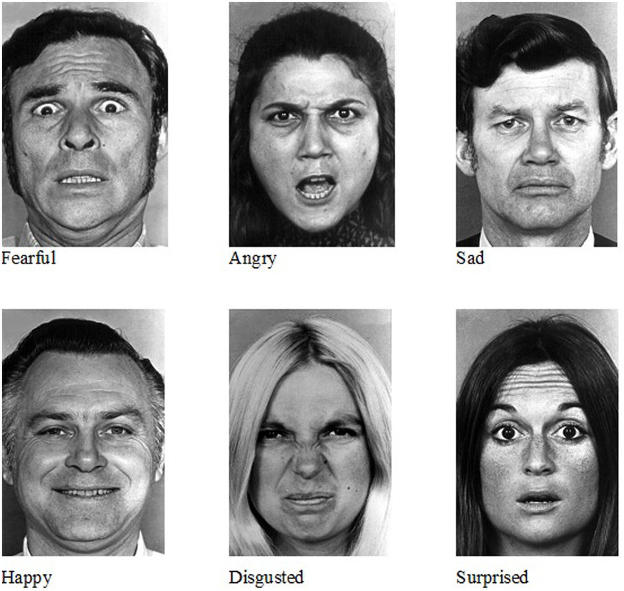
EMOTION THEORIES: 2. Ekman’s Theory of (Six) Basic Emotions

Slide 10
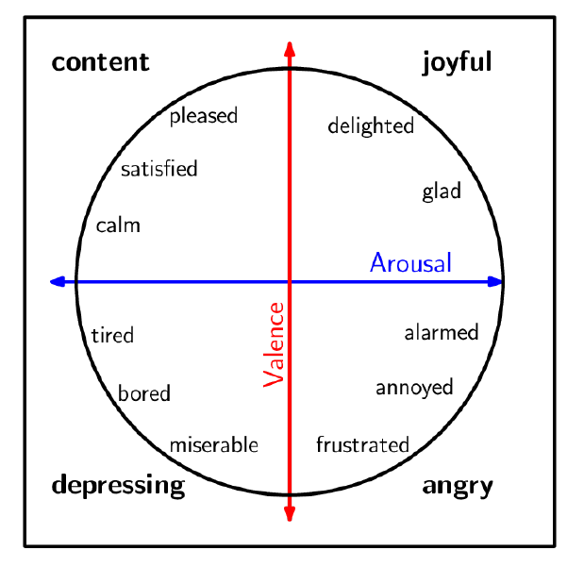
EMOTION THEORIES: 3. Russel’s Circumplex Model

Slide 11
SA – How it works
English Word | Arabic Translation (Google Translate) | Basque Translation (Google Translate) | Positive (Valence) | Negative (Valence)
aback | الى الوراء | aback | 0 | 0
abacus | طبلية تاج | abako | 0 | 0
abandon | تخلى | alde batera utzi | 0 | 1
abandoned | مهجور | abandonatu | 0 | 1
abandonment | هجر | abandono | 0 | 1
abate | انحسر | abate | 0 | 0
abatement | انحسار | murrizteko | 0 | 0
abba | أبا | abba | 1 | 0
abbot | رئيس الدير | abade | 0 | 0
abbreviate | اختصر | laburtu | 0 | 0
abbreviation | الاختصار | laburdura | 0 | 0
abdomen | بطن | abdominalak | 0 | 0
abdominal | البطن | sabeleko | 0 | 0
abduction | اختطاف | urrunketa | 0 | 1
aberrant | شاذ | aberranteari | 0 | 1
aberration | انحراف | aberrazio | 0 | 1
abeyance | abeyance | etena | 0 | 0
abhor | مقت | gaitzesten | 0 | 1
abhorrent | مشمئز | nazkagarria | 0 | 1
Approach 1: e.g. Syuzhet (Jockers, 2015)
Sentiment Dictionary
NRC-Emotion-Lexicon-v0.92
(Mohammad and Turney, 2013)

Slide 12
SA - HOW IT WORKS
Approach 1: e.g. Syuzhet (Jockers, 2015)
Sentiment Dictionary
Text
He was a happy man
He was a sad and boring man
Sentiment
+1
-2

Slide 13
SA - HOW IT WORKS
Approach 2: e.g. SEANCE (Crossley et al., 2017)
Sentiment Dictionary
Negation Detector
Text
Sentiment
+2
…and many other values!
He was neither sad
nor boring

Slide 14
SA – How it works
Number | Index | Variable description | POS | Negation Filtered | examples (not POS specific)
1 | filename | name of source file | NA | NA | NA
2 | nwords | number of words in source file | NA | NA | NA
3 | Admiration/Awe_GALC | Admiration/Awe | All | No | admir*, ador*, awe*, dazed, dazzl*
4 | Amusement_GALC | Amusement | All | No | amus*, fun*, humor*, laugh*, play*
5 | Anger_GALC | Anger | All | No | anger, angr*, cross*, enrag*, furious
6 | Anxiety_GALC | Anxiety | All | No | anguish*, anxi*, apprehens*, diffiden*, jitter*
7 | Beingtouched_GALC | Beingtouched | All | No | affect*, mov*, touch*
8 | Boredom_GALC | Boredom | All | No | bor*, ennui, indifferen*, languor*, tedi*
9 | Compassion_GALC | Compassion | All | No | commiser*, compass*, empath*, pit*,
10 | Contempt_GALC | Contempt | All | No | contempt*, denigr*, deprec*, deris*, despi*
11 | Contentment_GALC | Contentment | All | No | comfortabl*, content*, satisf*
12 | Desperation_GALC | Desperation | All | No | deject*, desolat*, despair*, desperat*, despond*
13 | Disappointment_GALC | Disappointment | All | No | comedown, disappoint*, discontent*, disenchant*, disgruntl*
14 | Disgust_GALC | Disgust | All | No | abhor*, avers*, detest*, disgust*, dislik*
15 |  | Dissatisfaction | All | No | dissatisf*, unhapp*
16 | Envy_GALC | Envy | All | No | envious*, envy*

Slide 15
SA - HOW IT WORKS
Approach_3: Transformers Pipelines (HuggingFace)
Machine
Learning
Model
e.g.: https://huggingface.co/cardiffnlp/twitter-roberta-base-sentiment-latest
Text
Sentiment
+2
He was neither sad
nor boring

Slide 16
SA RESOURCES
CROWDSOURCING
Sentiment dictionaries
manually encoded (by experts, or via crowdsourcing)
automatically created
Annotated datasets
for aspect-based SA
for machine learning
Issue 1.
“The task and compensation may attract cheaters (who may input random information) and even malicious annotators (who may deliberately enter incorrect information).”
Solution: control questions
Issue 2.
Disagreement between different annotators
Solution: majority rule
See NRC Lexicon (Mohammad and Turney, 2013)

Slide 17
AUTOMATIC
See SentiArt (Jacobs, 2019)
Seed words
(60 positive, 60 negative, and basic emotions)
Emotion Dictionary
(for all words in a language!)
Distances between all words and seed words in the Word embedding model
Word embedding model
(specific in terms of language and period)

Slide 18
ANNOTATED DATASETS
Question:
Are emotions expressed by single words, or by parts of a text? (sentences, clauses, expressions...)

Slide 19
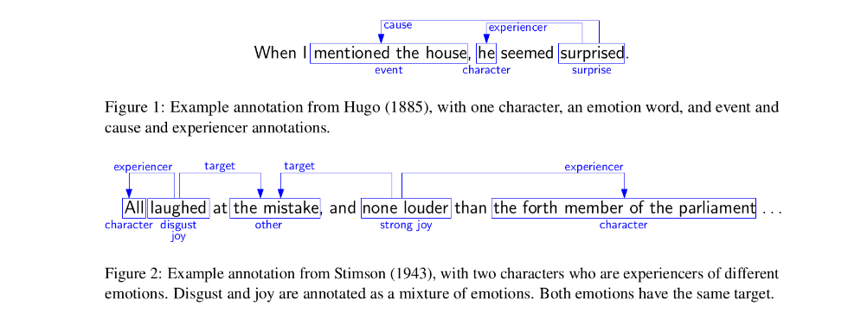
ASPECT-BASED SA
See REMAN Dataset (Kim & Klinger, 2018), 1720 sentences from novels in English (downloaded from Project Gutenberg)

Slide 20

ASPECT-BASED SA

Slide 21
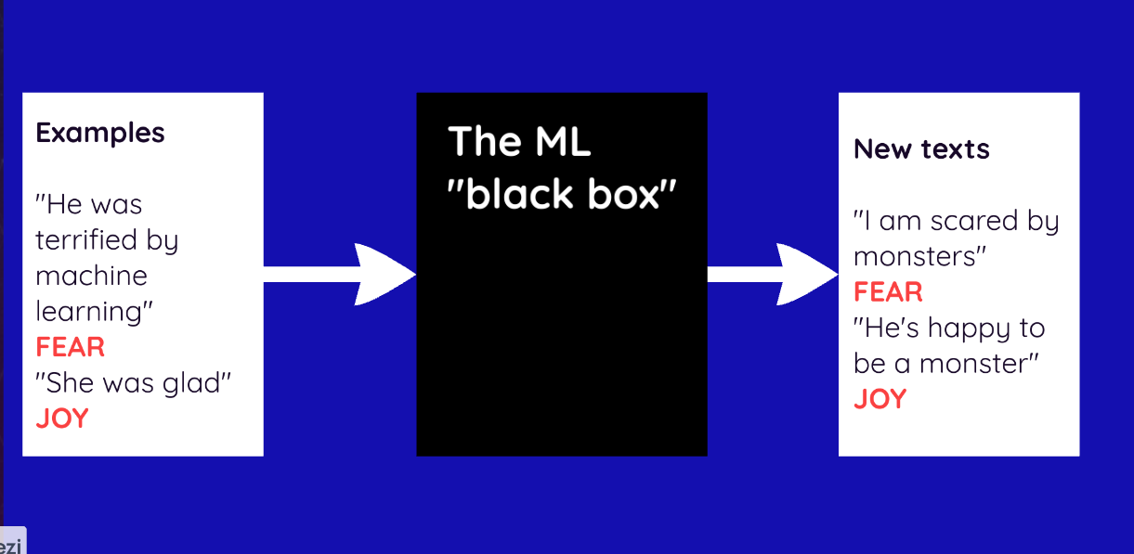
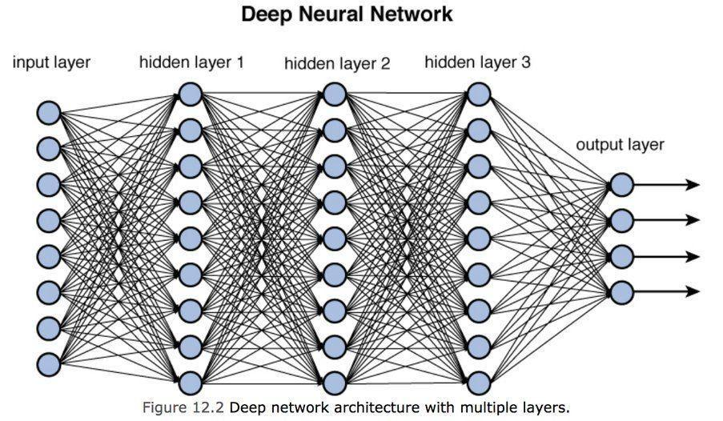
MACHINE LEARNING
Annotated sentences are used to train machine learning algorithms

Slide 22
MACHINE LEARNING
Annotated sentences are used to train machine learning algorithms

