Slide 1

sentiment analysis with R (Rstudio)
Dr Giulia Grisot
11/03/2024

Slide 2
Today’s workshop
Prerequisites
Basic understanding of R programming
Familiarity with text mining and natural language processing concepts
RStudio installed on your computer
Access to internet

Slide 3
What is sentiment analysis?
Sentiment Analysis is a subfield of Natural Language Processing (NLP) that involves determining the emotional/sentiment value of a text. It's used to gain an understanding of the attitudes, opinions, and emotions expressed within a text or corpus of texts.
In the context of Digital Humanities, sentiment analysis can be used to understand human behaviour in digital spaces, analyse texts from books, social media, blogs, websites, and other digital platforms to extract useful insights.
Sentiment analysis is, in short, the process of extracting the emotional value of a text. In its most simple form, it accounts for either positive or negative sentiment. However, more complex models can account for a wider range of emotions, such as joy, anger, sadness, and fear.
In this workshop, we will have a look at how sentiment analysis can be performed with R.

Slide 4
So, how does SENTIMENT ANALYSIS work?
+1
+0.9
“This book is fantastic! It tells wonderful and beautiful things…”
“In those days, sadness shadowed my heart”
-0.5
-1

Slide 5
SENTIMENT ANALYSIS applications
SA for the study of historical texts
Sprugnoli, R., Tonelli, S., Marchetti, A., and Moretti, G. (2016). Towards sentiment analysis for historical texts. Digital Scholarship in the Humanities, 31(4): 762-772.
SA and cognitive studies
Jacobs, A. M., Schuster, S., Xue, S., and Lüdtke, J. (2017). What’s in the brain that ink may character… A quantitative narrative analysis of Shakespeare’s 154 sonnets for use in (Neuro-)cognitive poetics. Scientific Study of Literature, 7(1): 4-51.
SA and social reading
Rebora, S. and Pianzola F. (2018). A New Research Programme for Reading Research: Analysing Comments in the Margins on Wattpad. DigitCult - Scientific Journal on Digital Cultures, 3(2): 19–36
SA for political discourse
Thakur, N. (2023). Sentiment analysis and text analysis of the public discourse on Twitter about COVID-19 and MPox. Big Data and Cognitive Computing, 7(2), 116.
SA in literary studies
Reagan, A. J., Mitchell, L., Kiley, D., Danforth, C. M., and Dodds, P. S. (2016). The emotional arcs of stories are dominated by six basic shapes. EPJ Data Science, 5(1): 31.

Slide 6
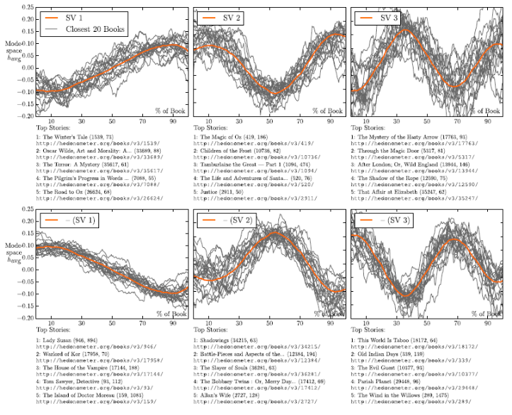
SENTIMENT ANALYSIS applications

Slide 7
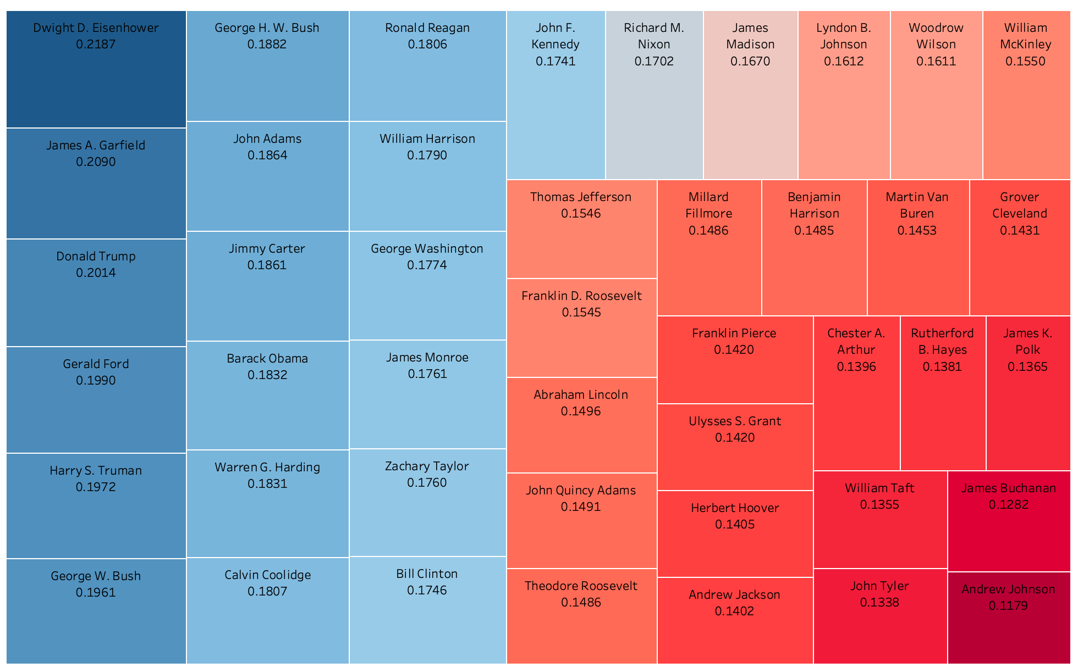
SENTIMENT ANALYSIS applications
https://towardsdatascience.com/analysis-of-presidential-speeches-throughout-american-history-bb088d36d7dd

Slide 8
SENTIMENT ANALYSIS A (SIMPLE) TAXONOMY
Three defining elements:
the emotion theory adopted by the tool
the technique to accomplish the analysis
the emotion resources

Slide 9
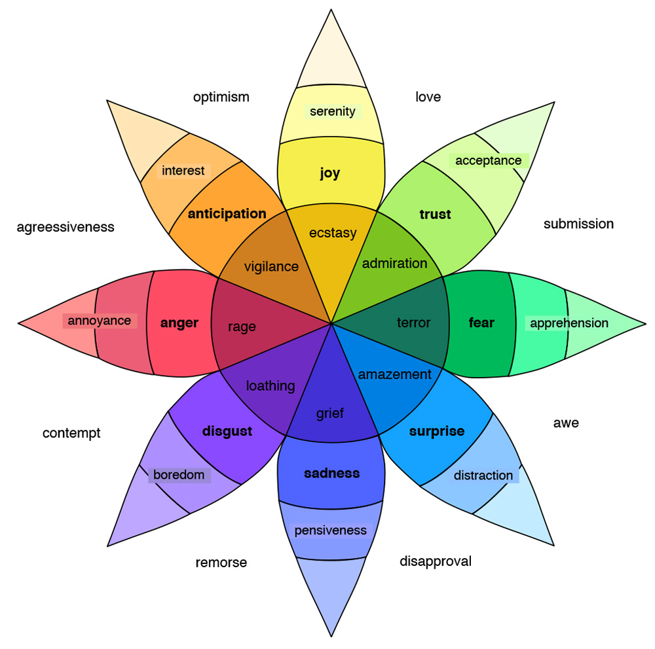
EMOTION THEORIES: 1. Plutchik’s eight basic emotions

Slide 10
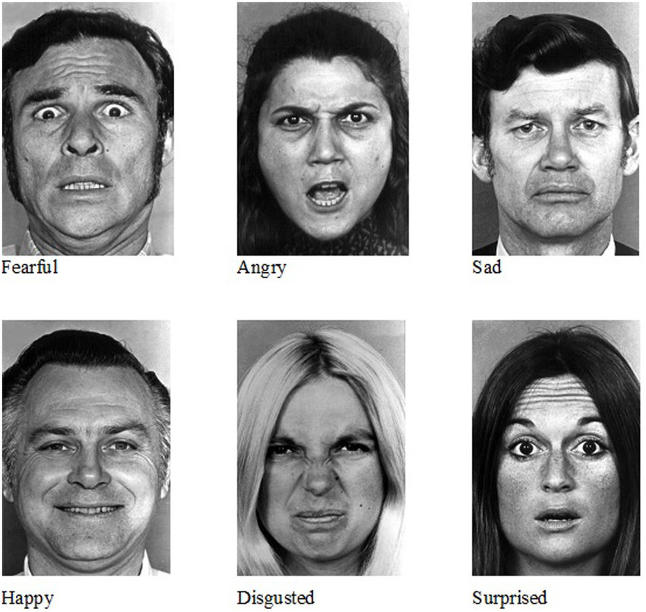
EMOTION THEORIES: 2. Ekman’s Theory of (Six) Basic Emotions

Slide 11
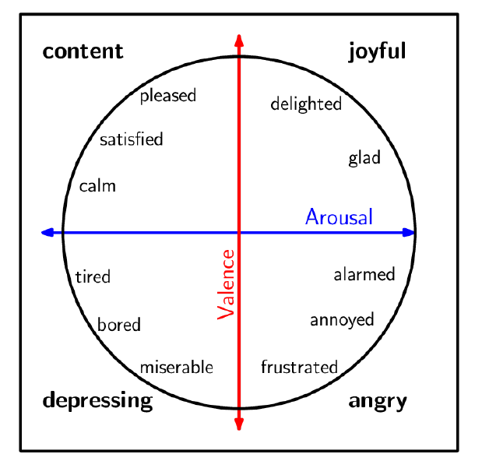
EMOTION THEORIES: 3. Russel’s Circumplex Model

Slide 12
SA – How it works
English Word | Arabic Translation (Google Translate) | Basque Translation (Google Translate) | Positive (Valence) | Negative (Valence)
aback | الى الوراء | aback | 0 | 0
abacus | طبلية تاج | abako | 0 | 0
abandon | تخلى | alde batera utzi | 0 | 1
abandoned | مهجور | abandonatu | 0 | 1
abandonment | هجر | abandono | 0 | 1
abate | انحسر | abate | 0 | 0
abatement | انحسار | murrizteko | 0 | 0
abba | أبا | abba | 1 | 0
abbot | رئيس الدير | abade | 0 | 0
abbreviate | اختصر | laburtu | 0 | 0
abbreviation | الاختصار | laburdura | 0 | 0
abdomen | بطن | abdominalak | 0 | 0
abdominal | البطن | sabeleko | 0 | 0
abduction | اختطاف | urrunketa | 0 | 1
aberrant | شاذ | aberranteari | 0 | 1
aberration | انحراف | aberrazio | 0 | 1
abeyance | abeyance | etena | 0 | 0
abhor | مقت | gaitzesten | 0 | 1
abhorrent | مشمئز | nazkagarria | 0 | 1
Approach 1: e.g. Syuzhet (Jockers, 2015)
Sentiment Dictionary
NRC-Emotion-Lexicon-v0.92
(Mohammad and Turney, 2013)

Slide 13
SA - HOW IT WORKS
Approach 1: e.g. Syuzhet (Jockers, 2015)
Sentiment Dictionary
Text
He was a happy man
He was a sad and boring man
Sentiment
+1
-2

Slide 14
SA - HOW IT WORKS
Approach 2: e.g. SEANCE (Crossley et al., 2017)
Sentiment Dictionary
Negation Detector
Text
Sentiment
+2
…and many other values!
He was neither sad
nor boring

Slide 15
SA – How it works
Number | Index | Variable description | POS | Negation Filtered | examples (not POS specific)
1 | filename | name of source file | NA | NA | NA
2 | nwords | number of words in source file | NA | NA | NA
3 | Admiration/Awe_GALC | Admiration/Awe | All | No | admir*, ador*, awe*, dazed, dazzl*
4 | Amusement_GALC | Amusement | All | No | amus*, fun*, humor*, laugh*, play*
5 | Anger_GALC | Anger | All | No | anger, angr*, cross*, enrag*, furious
6 | Anxiety_GALC | Anxiety | All | No | anguish*, anxi*, apprehens*, diffiden*, jitter*
7 | Beingtouched_GALC | Beingtouched | All | No | affect*, mov*, touch*
8 | Boredom_GALC | Boredom | All | No | bor*, ennui, indifferen*, languor*, tedi*
9 | Compassion_GALC | Compassion | All | No | commiser*, compass*, empath*, pit*,
10 | Contempt_GALC | Contempt | All | No | contempt*, denigr*, deprec*, deris*, despi*
11 | Contentment_GALC | Contentment | All | No | comfortabl*, content*, satisf*
12 | Desperation_GALC | Desperation | All | No | deject*, desolat*, despair*, desperat*, despond*
13 | Disappointment_GALC | Disappointment | All | No | comedown, disappoint*, discontent*, disenchant*, disgruntl*
14 | Disgust_GALC | Disgust | All | No | abhor*, avers*, detest*, disgust*, dislik*
15 |  | Dissatisfaction | All | No | dissatisf*, unhapp*
16 | Envy_GALC | Envy | All | No | envious*, envy*

Slide 16
SA - HOW IT WORKS
Approach_3: Transformers Pipelines (HuggingFace)
Machine
Learning
Model
e.g.: https://huggingface.co/cardiffnlp/twitter-roberta-base-sentiment-latest
Text
Sentiment
+2
He was neither sad
nor boring

Slide 17
SA RESOURCES
CROWDSOURCING
Sentiment dictionaries
manually encoded (by experts, or via crowdsourcing)
automatically created
Annotated datasets
for aspect-based SA
for machine learning
Issue 1.
“The task and compensation may attract cheaters (who may input random information) and even malicious annotators (who may deliberately enter incorrect information).”
Solution: control questions
Issue 2.
Disagreement between different annotators
Solution: majority rule
See NRC Lexicon (Mohammad and Turney, 2013)

Slide 18
AUTOMATIC
See SentiArt (Jacobs, 2019)
Seed words
(60 positive, 60 negative, and basic emotions)
Emotion Dictionary
(for all words in a language!)
Distances between all words and seed words in the Word embedding model
Word embedding model
(specific in terms of language and period)

Slide 19
ANNOTATED DATASETS
Question:
Are emotions expressed by single words, or by parts of a text? (sentences, clauses, expressions...)

Slide 20
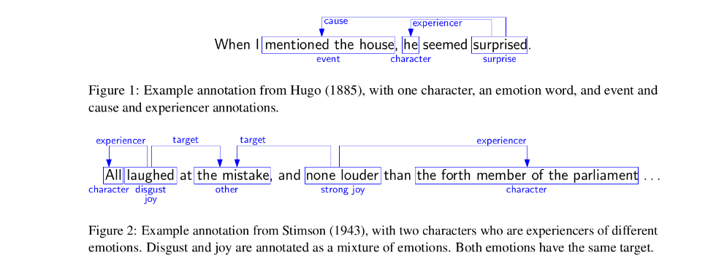
ASPECT-BASED SA
See REMAN Dataset (Kim & Klinger, 2018), 1720 sentences from novels in English (downloaded from Project Gutenberg)

Slide 21

ASPECT-BASED SA

Slide 22
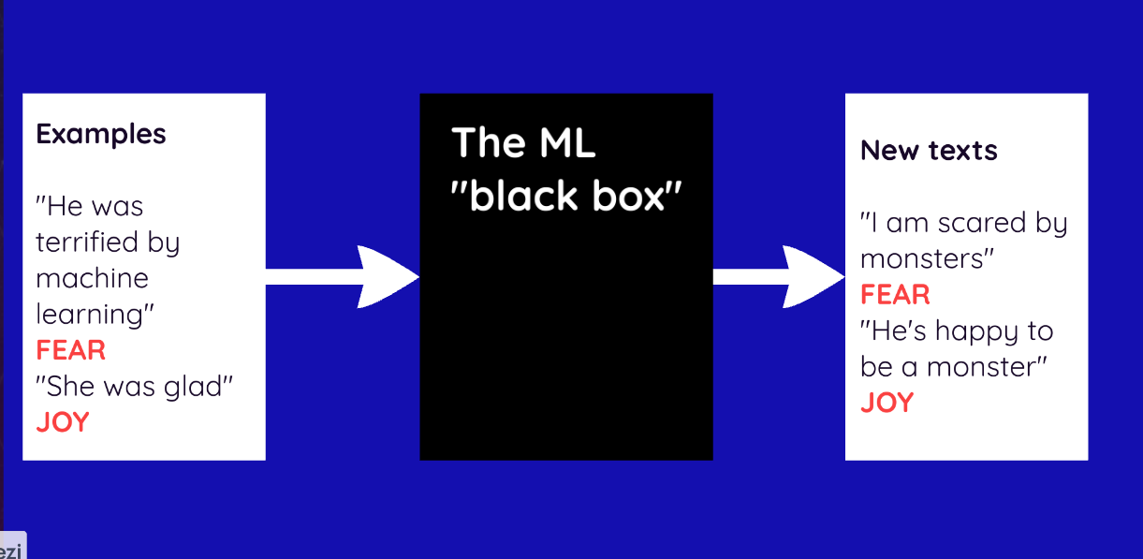
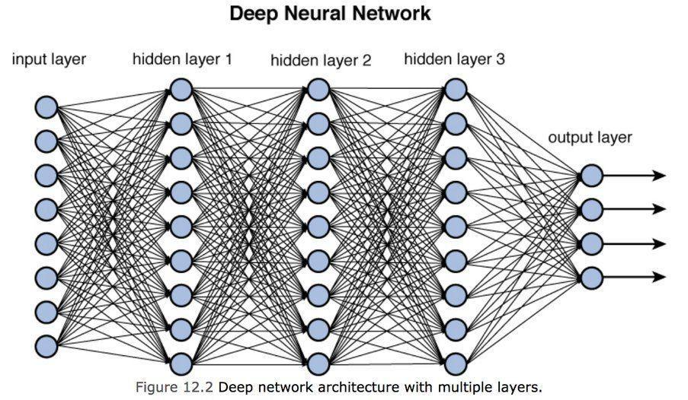
MACHINE LEARNING
Annotated sentences are used to train machine learning algorithms

Slide 23
MACHINE LEARNING
Annotated sentences are used to train machine learning algorithms

Slide 24
SENTIMENT ANALYSIS - CRITICAL ASPECTS
Subjectivity: Sentiment analysis algorithms may struggle to accurately interpret nuanced or ambiguous language, leading to subjective interpretations of sentiment. Context, tone, sarcasm, and cultural nuances can significantly impact the accuracy of sentiment analysis.
Ambiguity and Polysemy: Words often have multiple meanings depending on context, which can lead to misinterpretations in sentiment analysis. For example, the word "sick" could be interpreted positively (e.g., "That's sick!") or negatively (e.g., "I feel sick") depending on the context.
Irony and Sarcasm: Sentiment analysis algorithms may have difficulty detecting irony, sarcasm, or other forms of figurative language, leading to inaccurate sentiment analysis results. For instance, a statement like "Great, another Monday!" might be sarcastic but could be interpreted as positive sentiment by an algorithm.
Context Sensitivity: The meaning of a statement can change based on the surrounding context, which may not always be captured by sentiment analysis algorithms. Without understanding the broader context, sentiment analysis may produce misleading results.
Data Bias: Sentiment analysis models are trained on large datasets, which may contain biases inherent in the data, such as demographic biases, cultural biases, or biases introduced through the labeling process. These biases can affect the generalizability and fairness of sentiment analysis results.
Language Complexity: Sentiment analysis becomes more challenging with languages that exhibit complex grammatical structures, ambiguous word meanings, or lack of standardized spelling and grammar rules. This complexity can reduce the accuracy of sentiment analysis for such languages.
Domain Specificity: Sentiment analysis models trained on general datasets may not perform well when applied to specific domains or industries with unique terminology, jargon, or sentiment expressions. Domain-specific customization or fine-tuning of models may be necessary for accurate sentiment analysis in specialized contexts.
Temporal Dynamics: Sentiments can change over time due to evolving trends, events, or public opinion. Static sentiment analysis models may not capture these temporal dynamics, leading to outdated or inaccurate sentiment predictions.

