Slide 1

Text Analysis with R
Introduction, Corpus Analysis, and Sentiment Analysis
Dr Giulia Grisot
The University of Manchester

Slide 2
Why This, Why Now?
Explosion of digitised texts
Too much to read manually
What can we learn from patterns across texts?
Applicable across humanities and social sciences
Computational methods of discovering and extracting information from unstructured text data
Other names: distant reading, macroanalysis, algorithmic criticism
Advancement of computational text analysis depends on the amount of digitised texts
Notes:
We are in an era where text is being digitised at scale. This allows us to ask new types of questions about language, culture, history, and ideas.

Slide 3
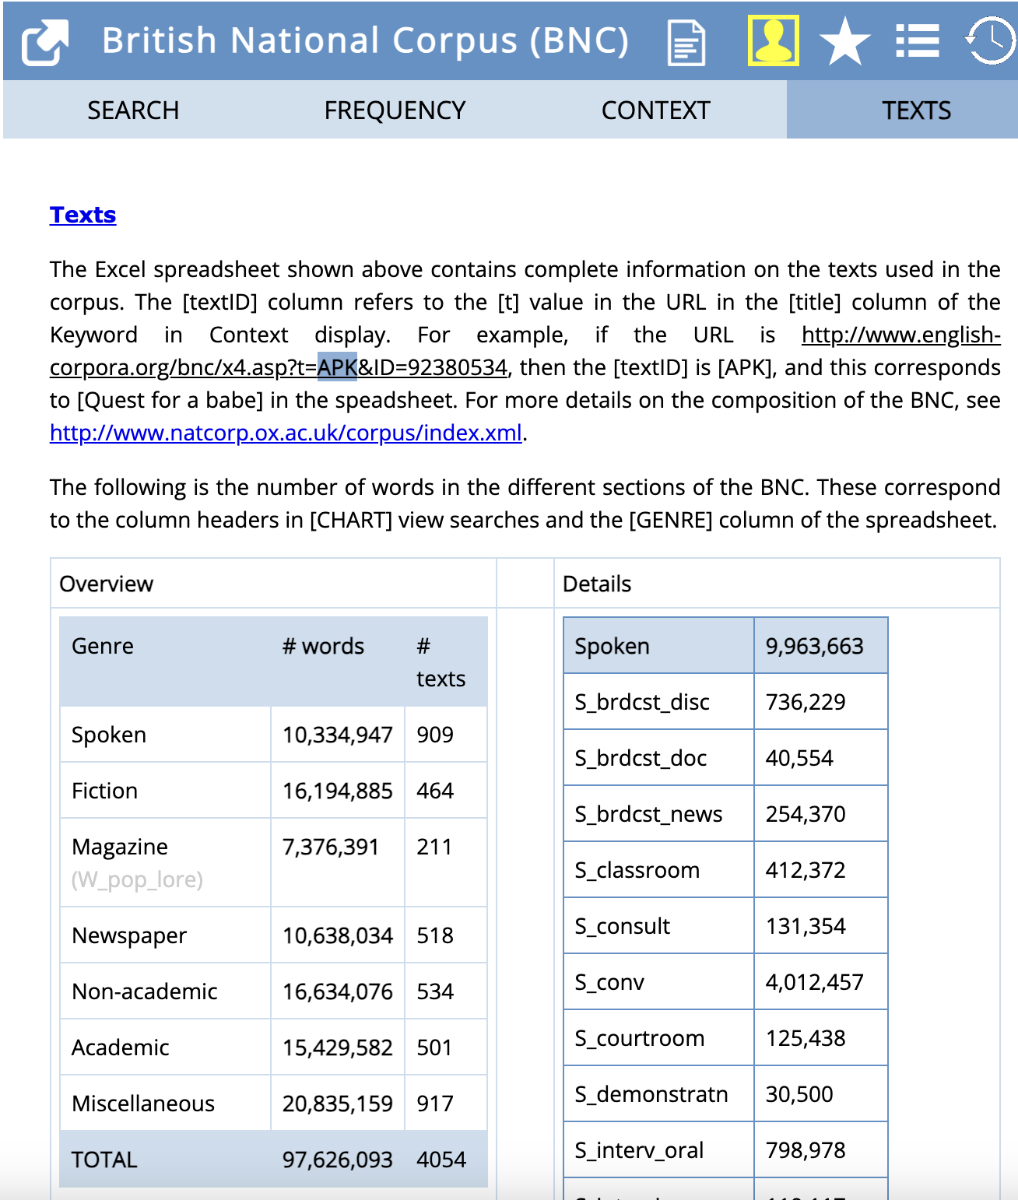
What is a corpus?
The word corpus comes from Latin (“body”) - plural is corpora
A corpus is a body of naturally occurring language
‘generally assembled with particular purposes in mind, […] and representative of some language or text type.” (Leech 1992)
A corpus is a collection of
machine-readable
authentic texts (including transcripts of spoken data) which is
sampled to be
representative of a particular language or language variety.” (MXT 2006: 5)

Slide 4
Types of Corpora
General Corpus
Specialized corpus
A general corpus is a collection of texts from different genres (i.e. academic, business, legal, newspapers, social media posts, etc.) and registers (i.e. spoken and written).
For example, if you want to know the most frequent words in American English, you would better use a general corpus of American English.
One example of a general corpus is the Brown Corpus.
A specialized corpus is a collection of texts from one genre and one register.
If you want to know the most frequently used words in academic discourse, then you need a specialized corpus of academic discourse.
One example of a specialized corpus is the BioScope Corpus.

Slide 5
Types of Corpora
synchronic corpus
diachronic corpus
represents language samples collected at one point (or period) in time and aim to reflect the state of language use during that one period (monitor corpora are typically synchronic).
contains language samples collected across different points in time so that changes in the use of language can be studied.

Slide 6

What is Not a corpus
A list of words
These are building blocks of language
A text archive / A random collection of texts
It is not representative
A collection of citations
A short quotation which contains a word or phrase that is the reason for its selection
A single text is not a corpus
Intending to be read in different ways
The Web is not a corpus
Its dimensions unknown, constantly changing, not designed from a linguistic perspective
Sinclair (2005)

Slide 7
What is a corpus for?
A corpus is made for the study of language in a broad sense
To test existing linguistic theory and hypotheses
To generate and verify new linguistic hypotheses
Beyond linguistics, to provide textual evidence in text-based humanities and social sciences subjects
Research purpose is reflected in a well-designed corpus
https://users.ox.ac.uk/~martinw/dlc/chapter1.htm

Slide 8
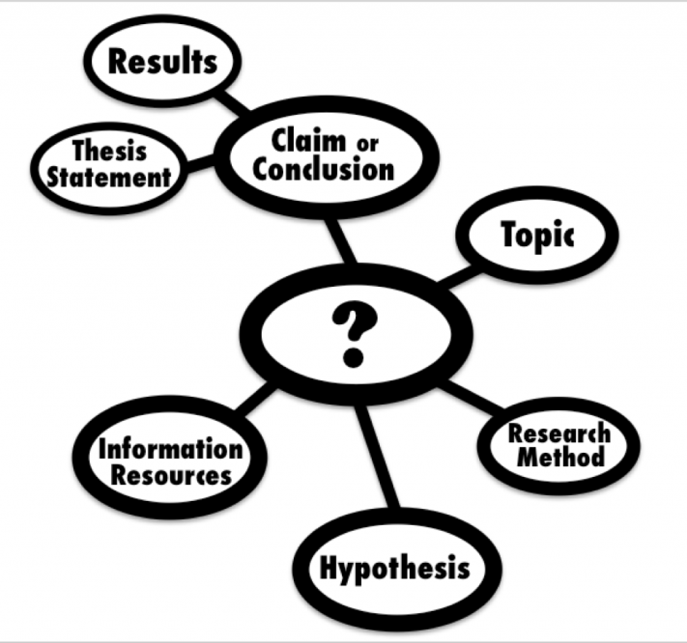
Ask corpora the right questions
Corpus linguistics as a methodology is only one of the (many) ways of doing things – “doing linguistics”
The usefulness of corpora depends upon the research question being investigated
“They are invaluable for doing what they do, and what they do not do must be done in another way.” (Hunston 2002: 20)
This Photo by Unknown Author is licensed under CC BY

Slide 9
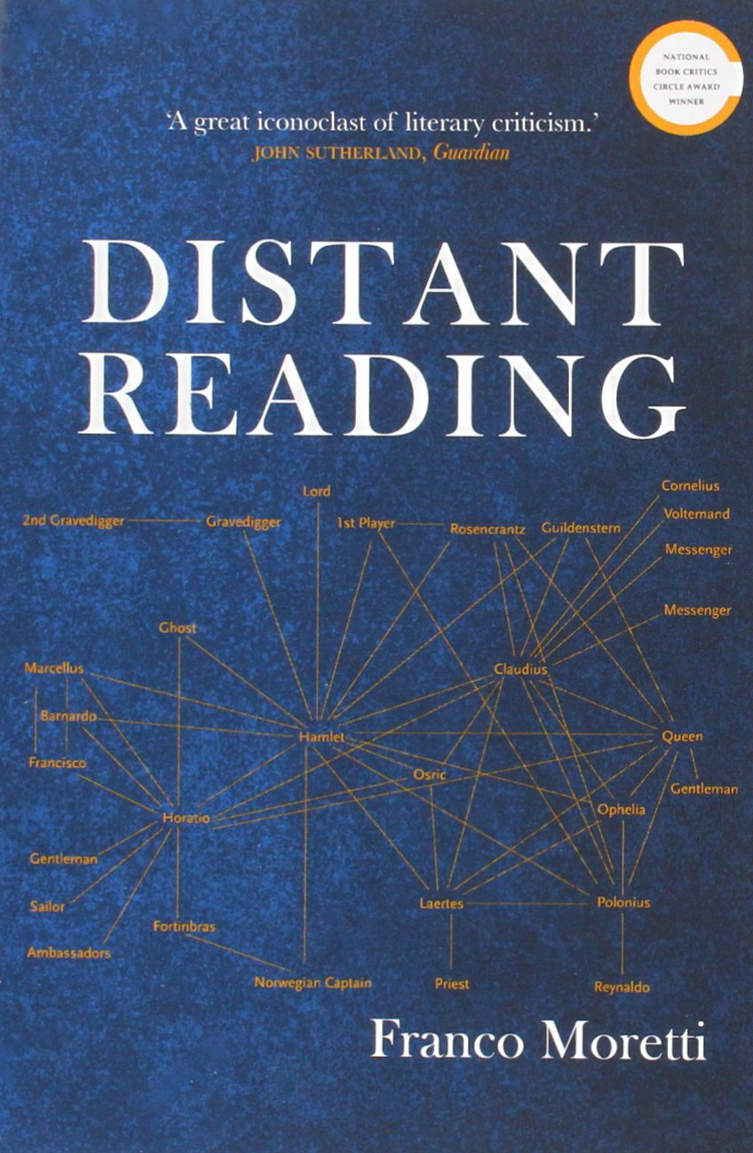
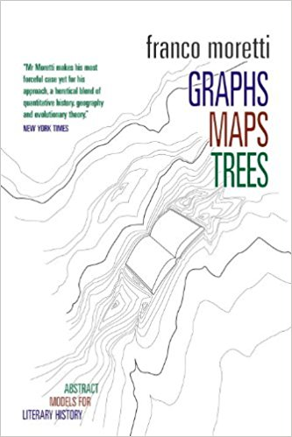
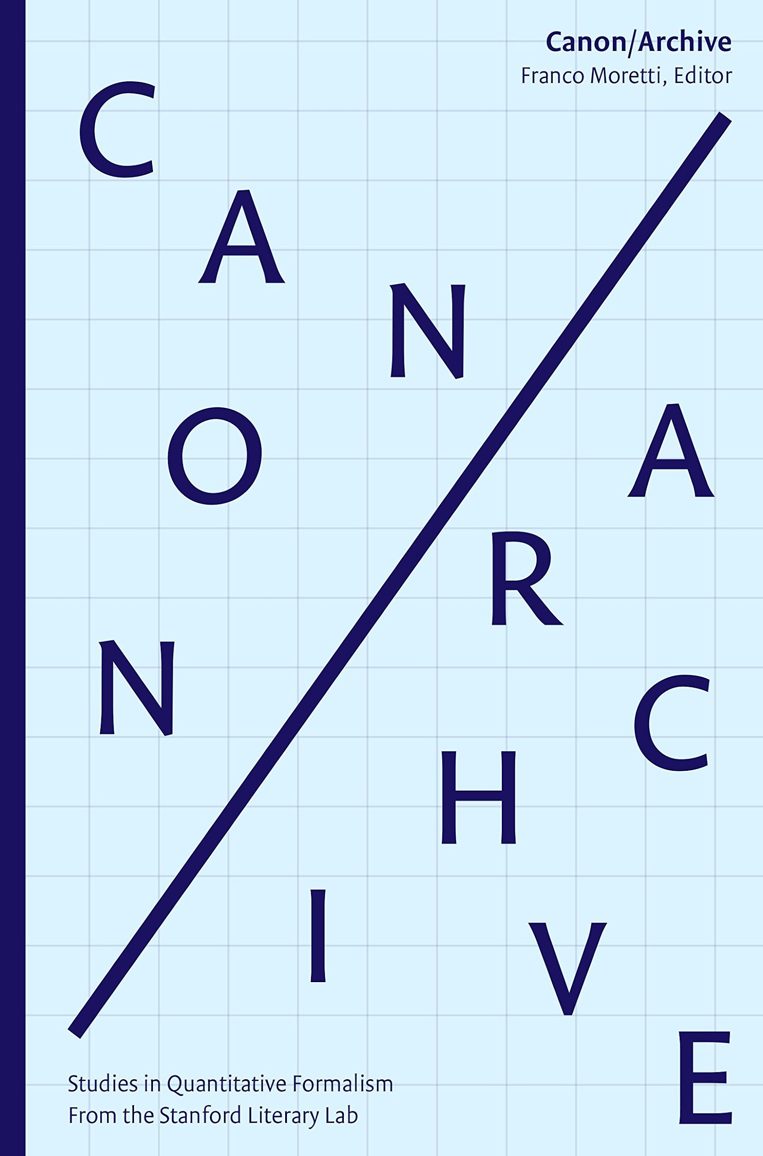
What is Distant Reading?
“Instead of reading texts in the traditional way – so-called close reading –, he [Moretti] invites to count, to graph and to map or, in other words, to visualize them” (Jänicke et al., 2015)
Coined by Franco Moretti in 2000
Emphasis on the study of literary history and the relationships between texts rather than the minute examination of individual texts
contrast to close reading
Set of practices to study literature/literary history ‘at a larger scale’:
Challenge to literary historians’ claims about synchronic coverage
Rely on digital sources (archives)
Build on computational tools/resources
Complementary to close reading

Slide 10

From Close Reading to Distant Reading
Close reading
A method of literary analysis that emphasises the close examination of a text -- often focusing on its individual words, phrases, and sentences – and on the search for an interpretation/meaning, often within a literary movement
Distant reading
An approach that uses computational methods to analyse large datasets of texts in order to identify patterns and trends across a corpus.

Slide 11
Criticisms to distant reading
Lack of context:
historical, cultural, and social context; miss important nuances and subtleties
Lack of interpretation
not able to provide meaningful interpretation; reductionist
Bias in the data:
corpora may not be representative; availability of digital texts is still limited to texts that are in the public domain or that have been digitized
Limited scope:
best suited for analysing patterns and trends; less effective for the close examination
Lack of creativity:
provide scholars with pre-defined patterns and trends to work with, rather than encouraging them to develop their own interpretations of the texts
Notes:
Lack of context: Critics argue that distant reading methods are not able to take into account the historical, cultural, and social context of the texts being analysed. By focusing on quantitative data, distant reading methods may miss important nuances and subtleties in the texts.
Lack of interpretation: Some critics argue that distant reading methods are not able to provide meaningful interpretation of the texts being analysed. They see the method as reductionist, focusing on data and statistics rather than on the complexity of literary texts.
Bias in the data: Distant reading methods rely on large datasets of texts, which may not be representative of the literary corpus as a whole. For example, the availability of digital texts is still limited to texts that are in the public domain or that have been digitized by libraries and archives. This can lead to bias in the data and a lack of representation of certain literary traditions or authors.
Limited scope: Distant reading methods are best suited for analysing patterns and trends across large datasets of texts. They are less effective for the close examination of individual texts.
Lack of creativity: Some critics argue that distant reading methods stifle creativity by providing scholars with pre-defined patterns and trends to work with, rather than encouraging them to develop their own interpretations of the texts.

Slide 12
What Can We Ask?
WHO could use it?
How ideas/concepts evolve (e.g. 'freedom’, ‘crisis’)
What's typical for a genre or author?
Sentence structure changes?
Similarity across periods?
Emotional value of certain features of the text
Historians: discourse over time
Linguists: syntax and variation
Sociologists: sentiment, ideology
Literary scholars: genre, narrative
Notes:
These questions were often impossible to ask before digital tools. Now they’re central to our research methods.

Slide 13

Distant reading approaches
NLP / Text Analysis / Corpus Analysis / Computational Literary Studies

Slide 14

NATURAL LANGUAGE PROCESSING (NLP)
Corpus analysis
Sentiment Analysis
Topic Modeling
Stylometry

Slide 15
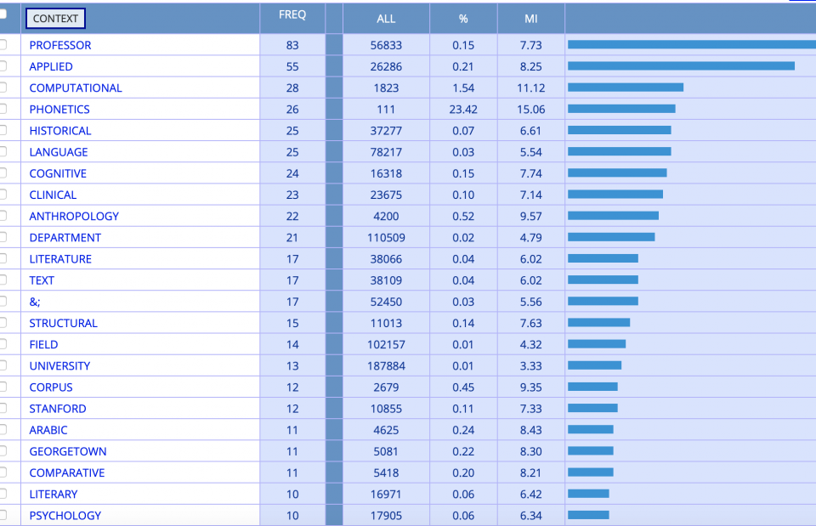
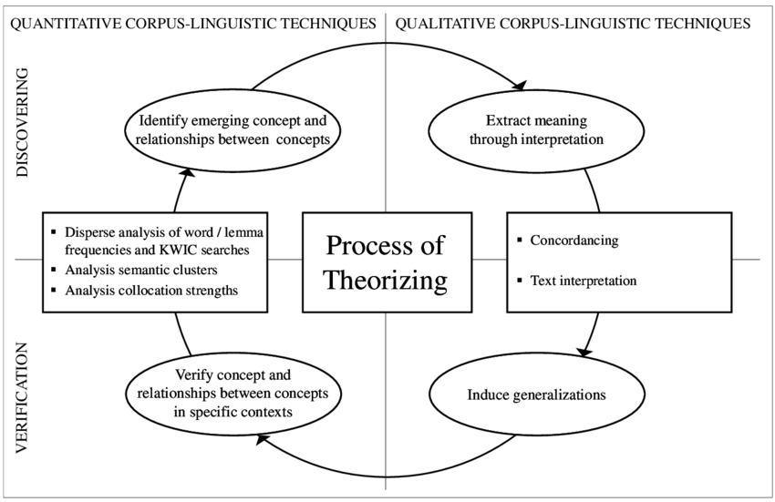
Corpus Analysis
How does it work?
Frequency counts = count occurrence of words/tokens/lemmas - search for and spot key words and phrases
RStudio / Posit Cloudances = words that occur around specific terms
Collocation analysis = identify and extract terms within a corpus that are associated (or, in other words, that collocate) with any other particular word. This allows one to examine how words are used in context.

Slide 16
Word Frequencies: Caveats
Frequency of words does not equal significance
Most frequently occurring words are often the least significant in terms of meaning
“Stopwords” (articles, prepositions, …) often excluded from analysis
Unless compared with something, a wordcount gives us nothing
Therefore: temporal comparison or comparison between documents/corpora
Text analysis requires an ethnographic understanding of the texts under consideration
Who wrote them? Why?
What themes and patterns would one expect?
What narratives/voices might have been suppressed?
Iterative process: query, results, look back at texts to decide which results may be meaningful

Slide 17
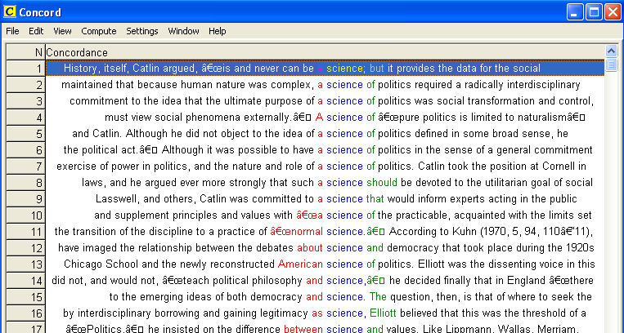
KWIC concordance in R

Slide 18
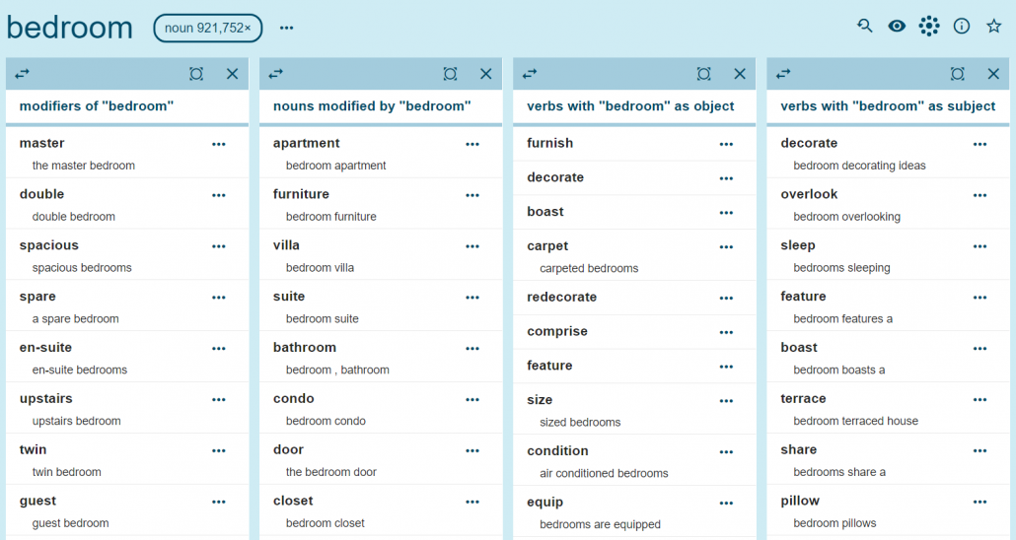
COLLOCATIONS

Slide 19
Tools in this course
RStudio / Posit Cloud tidyverse + tidytext data wrangling and tokenisation
quanteda for concordances and corpus analysis
syuzhet + sentimentr lexicon-based sentiment analysis
precomputed .RData objects for heavy steps
Course repository GitHub + local files
Open the .Rproj before running scripts
readtext / readxl GitHub + local files
import text and spreadsheet data
jockers_stopwords.txt
transparent stopword choices
ELTeC sample corpuspreloaded for faster in-class work
R scripts 01-04
run in sequence; inspect objects as you go

Slide 20
NATURAL LANGUAGE PROCESSING (NLP)
Corpus analysis
Sentiment Analysis
Topic Modeling
Stylometry

Slide 21
Sentiment analysis
Sentiment analysis can be used to:
understand human behaviour in digital spaces
analyse texts from books, social media, blogs, websites, and other digital platforms
analyse opinions and cultural representations
study the evolution of language and sentiment over time
In short, the process of extracting the emotional value of a text.
not to be confused with the emotions the reader may feel when reading a text

Slide 22
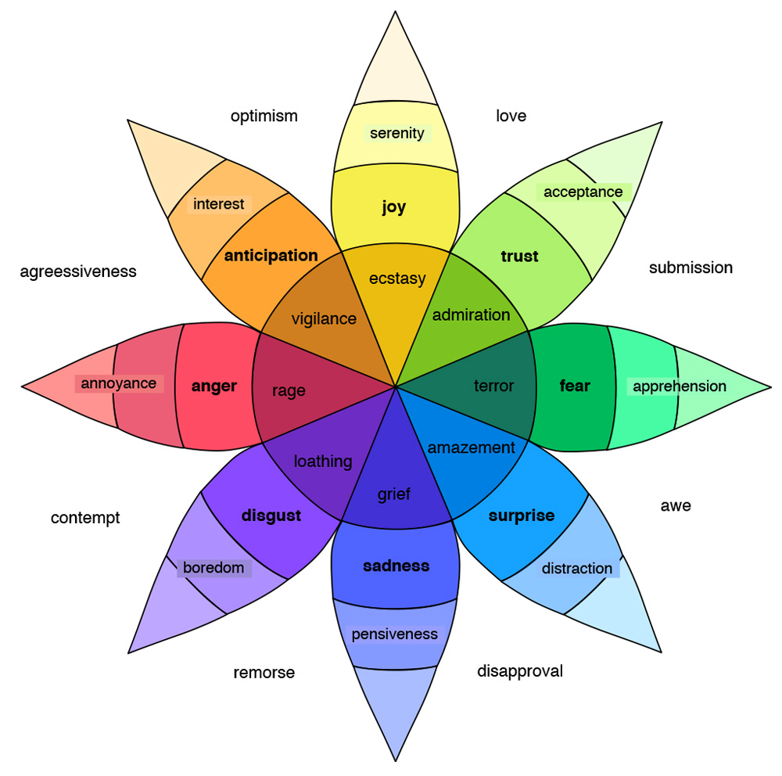
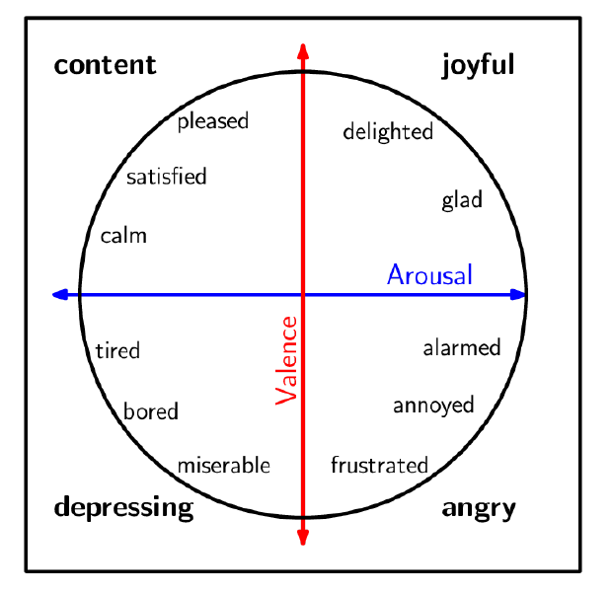
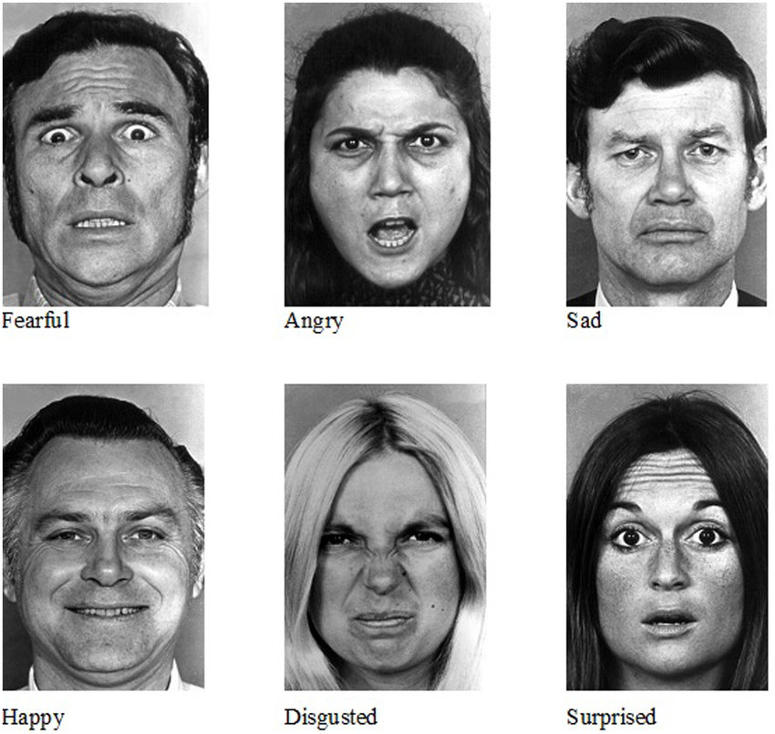
Emotions/sentiment models

Slide 23
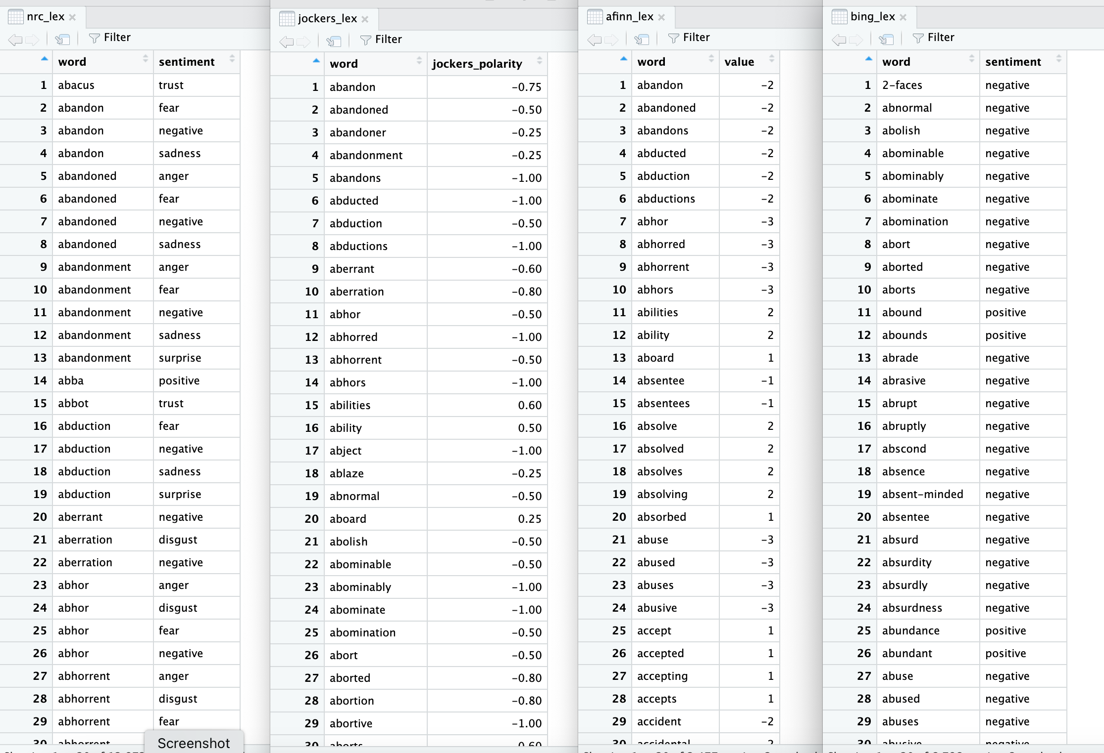

Slide 24
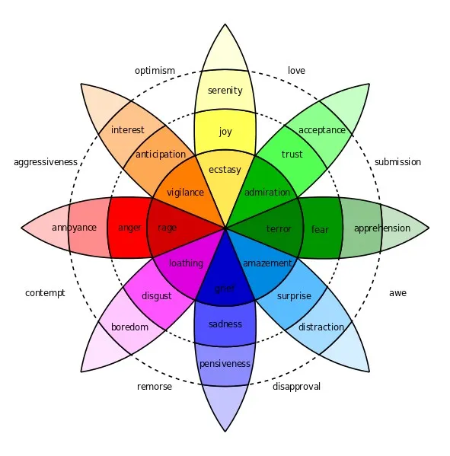
SENTIMENT ANALYSIS
+1
+0.9
“This book is fantastic! It tells wonderful and beautiful things…”
“In those days, sadness
shadowed my heart”
-0.5
-1

Slide 25
NATURAL LANGUAGE PROCESSING (NLP)
Corpus analysis
Sentiment Analysis
Topic Modeling
Stylometry

Slide 26
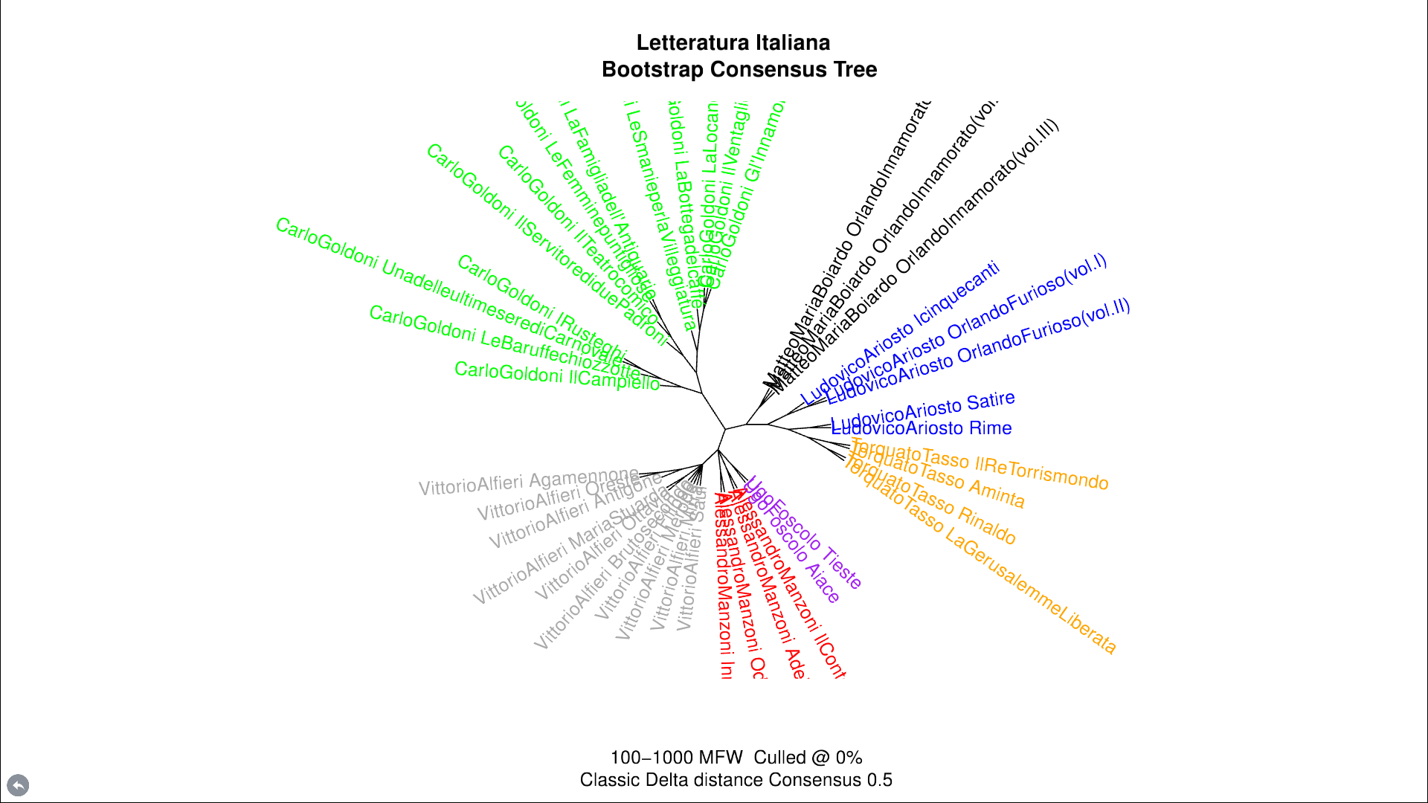
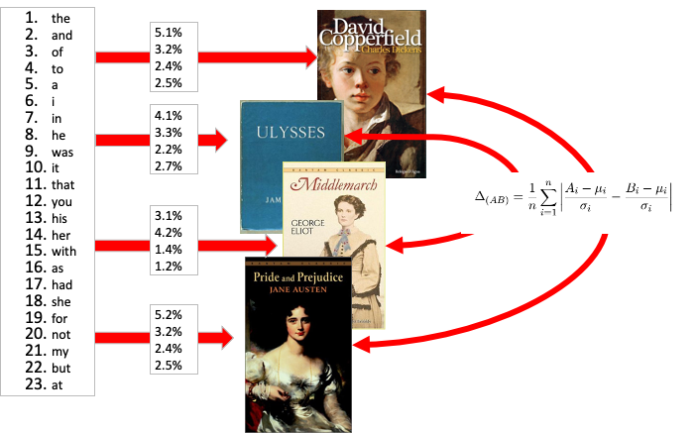
STYLOMETRY

Slide 27
NATURAL LANGUAGE PROCESSING (NLP)
Corpus analysis
Sentiment Analysis
Topic Modeling
Stylometry

Slide 28
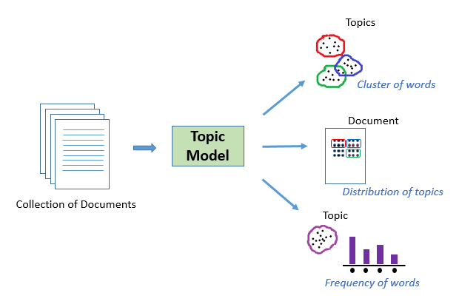
TOPIC MODELS
Topic models are statistical models used to discover abstract topics or themes within a collection of documents.
They help uncover latent patterns and structures in large text corpora without prior knowledge of the topics.
Topic models view each document as a mixture of topics, where a topic is a distribution over words.
By analysing word co-occurrences across documents, topic models identify common themes and group words that frequently appear together.

Slide 29
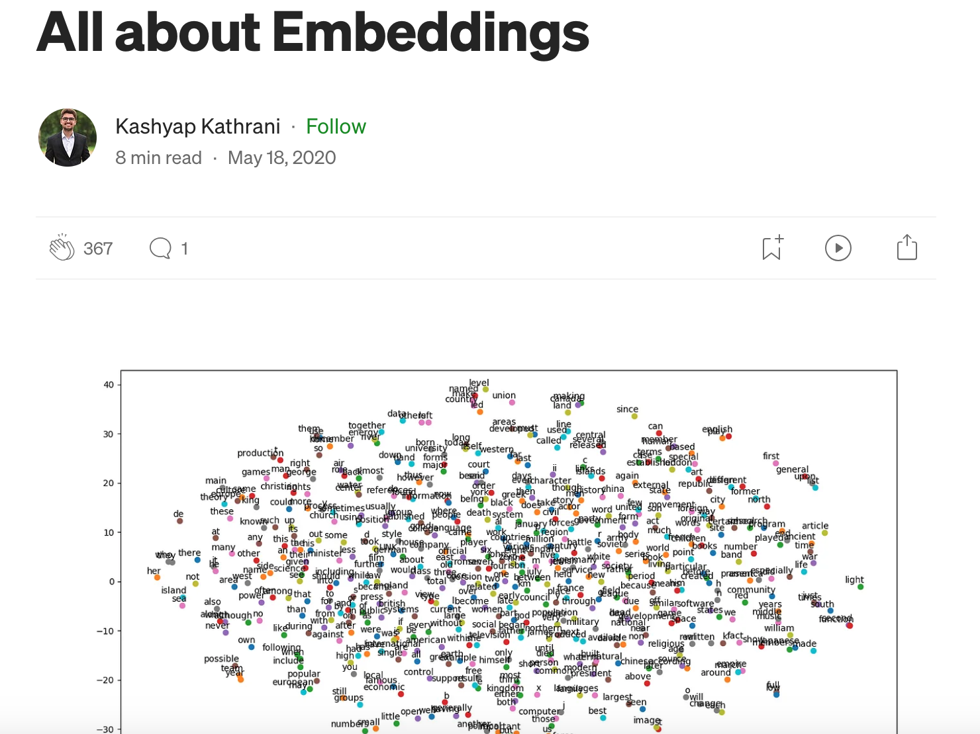
Word Vectors
Word vectors are mathematical representations of words.
They capture the semantic meaning of words by mapping them to high-dimensional numerical vectors.
These vectors encode relationships between words based on their context in a corpus of text.
https://medium.com/@kashyapkathrani/all-about-embeddings-829c8ff0bf5b

Slide 30
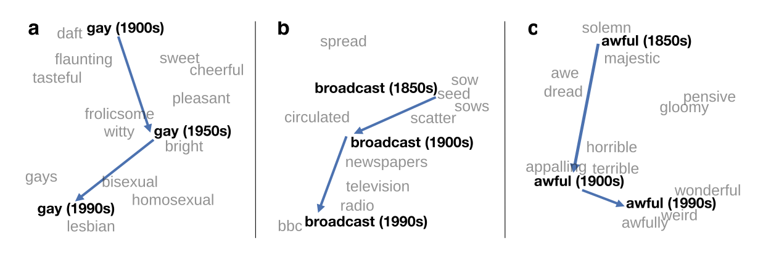
Word vectors

Slide 31
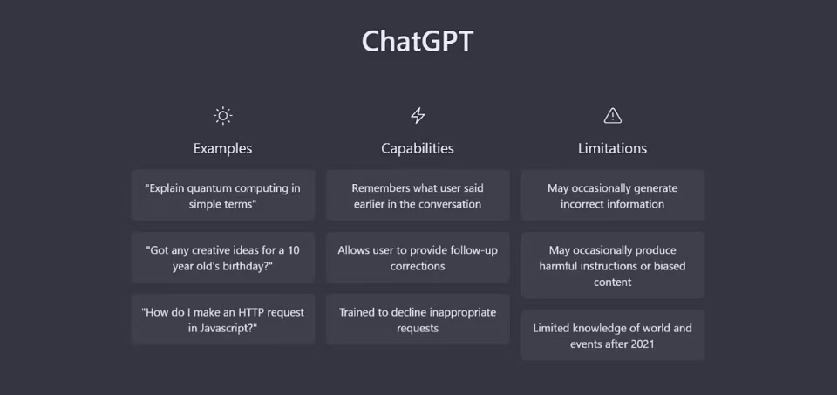
DERIVATIONS

Slide 32
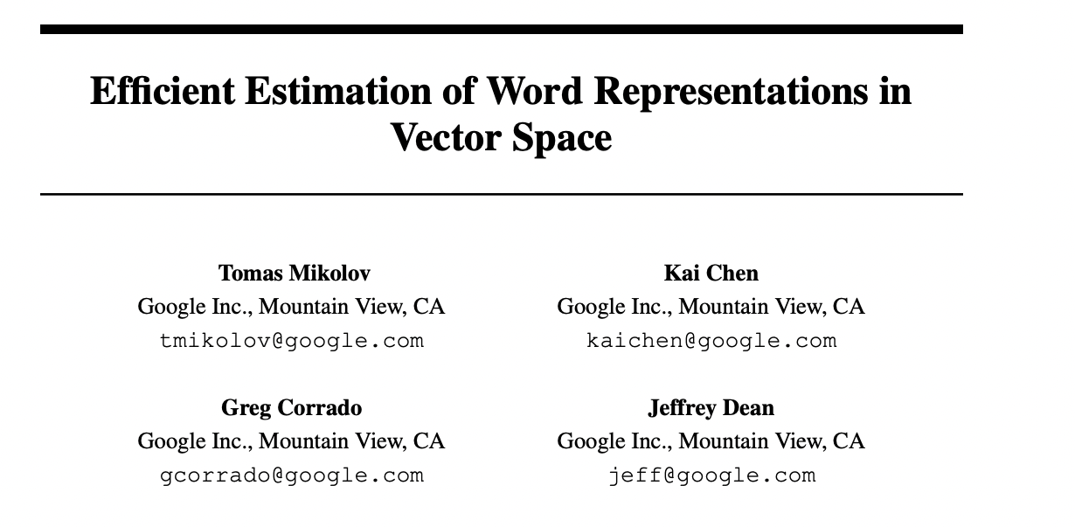
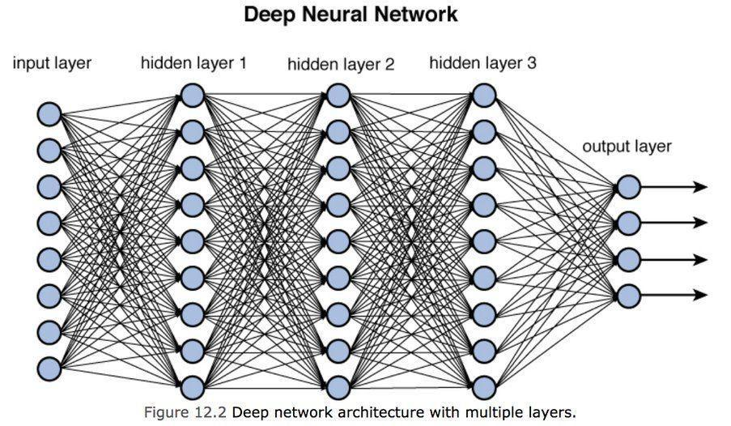
MACHINE LEARNING & WORD EMBEDDINGS
“try to guess the …. word in this sentence”
0.124
1.436
1.003
0.561
1.543
0.443
1.514
1.610
0.443
1.514
1.610
0.443
https://arxiv.org/abs/1301.3781

Slide 33
Getting Started
Consider whether you really need computational text analysis
Can you easily read the texts yourself?
Consider whether and where you can obtain text data
Think about how to compose your corpus: criteria and representativeness
Be aware that you can build complex arguments with simple methods
Contrast vocabulary of different corpora (e.g. which words are overrepresented?)
Trace the frequency of particular words or phrases
Cluster features that tend to be associated (topic modelling)

Slide 34
Conclusion
Computational Text Analysis = computational methods for discovering and extracting information from text data
Word frequencies: counting frequency with which certain words are mentioned in document or collection of documents (corpus)
Frequency of words does not equal significance
Unless compared with something, a wordcount gives us nothing
Requires an ethnographic understanding of texts under consideration
Word similarities: word embeddings are numerical representation of texts where words mentioned closer together appear closer together
Distant reading: Application of text analysis in study of literature less about computers than about new ideas about modelling and interpretation
Limitations and critiques:
Computational text analysis remains crude compared to human reading
Archives always limited and biased
But: fear of text analysis displacing other approaches likely unfounded

Slide 35
References
Antoniak, M., Mimno, D., & Levy, K. (2019). Narrative Paths and Negotiation of Power in Birth Stories. Proceedings of the ACM on Human-Computer Interaction, 3(CSCW), 1–27. https://doi.org/10.1145/3359190
Dobson, J. E. (2019). Critical Digital Humanities: The Search for a Methodology. University of Illinois Press. https://doi.org/10.5406/j.ctvfjd0mf
Garg, N., Schiebinger, L., Jurafsky, D., & Zou, J. (2018). Word embeddings quantify 100 years of gender and ethnic stereotypes. Proceedings of the National Academy of Sciences, 115(16). https://doi.org/10.1073/pnas.1720347115
Huang, Y., Guo, D., Kasakoff, A., & Grieve, J. (2016). Understanding U.S. regional linguistic variation with Twitter data analysis. Computers, Environment and Urban Systems, 59, 244–255. https://doi.org/10.1016/j.compenvurbsys.2015.12.003
Jockers, M. L. (2013). Macroanalysis: Digital methods and literary history. University of Illinois Press.
Jurafsky, D., Chahuneau, V., Routledge, B. R., & Smith, N. A. (2016). Linguistic Markers of Status in Food Culture: Bourdieu’s Distinction in a Menu Corpus. Journal of Cultural Analytics. https://doi.org/10.22148/16.007
Kozlowski, A. C., Taddy, M., & Evans, J. A. (2019). The Geometry of Culture: Analyzing the Meanings of Class through Word Embeddings. American Sociological Review, 84(5), 905–949. https://doi.org/10.1177/0003122419877135
Ascari, M. (2014). The Dangers of Distant Reading: Reassessing Moretti’s Approach to Literary Genres. Genre: Forms of Discourse and Culture, 47(1), 1–19.
Heuser, R., Moretti, F., & Steiner, E. B. (2016). The emotions of London. Literary Lab.
Moretti, F. (2013). Distant reading (2015th ed.). Verso.
Nicoletti, L., & Sarva, S. (n.d.). When Women Make Headlines. The Pudding. Retrieved 31 October 2024, from https://pudding.cool/2022/02/women-in-headlines/
Piper, A. (2018). Enumerations: Data and Literary Study. University of Chicago Press. https://doi.org/10.7208/chicago/9780226568898.001.0001
So, R. J. (2021). Redlining Culture: A Data History of Racial Inequality and Postwar Fiction. Columbia University Press. https://doi.org/10.7312/so--19772
So, R. J., & Roland, E. (2020). Race and Distant Reading. PMLA/Publications of the Modern Language Association of America, 135(1), 59–73. https://doi.org/10.1632/pmla.2020.135.1.59
Underwood, T. (2019). Distant horizons: Digital evidence and literary change. The University of Chicago Press.

