Slide 1
Texts as Data
Introduction to Text Analysis with R
Dr Giulia Grisot
The University of Manchester

Slide 2
Opening Questions
What happens when we treat text as data?
What do we gain, and what do we risk losing, when we do so?
Texts can be read closely, but they can also be counted, compared, modelled, and visualised.
Notes:
Let’s start with two deceptively simple questions:
What happens when we treat text as data?
What do we gain – and what do we risk losing – when we do so?
Today’s session explores those questions historically, conceptually, and methodologically. We’ll trace how scholars moved from close reading individual works to analysing entire libraries, and how digital tools allowed literature to become a domain for quantitative exploration.
Today we will look briefly into the early history of textual data and the epistemological shift from text to data. We will discuss how quantitative approaches reveal linguistic and social trends, how scholars like Jockers and Underwood build interpretation from scale, and where “distant reading” meets critical and ethical reflection.

Slide 3
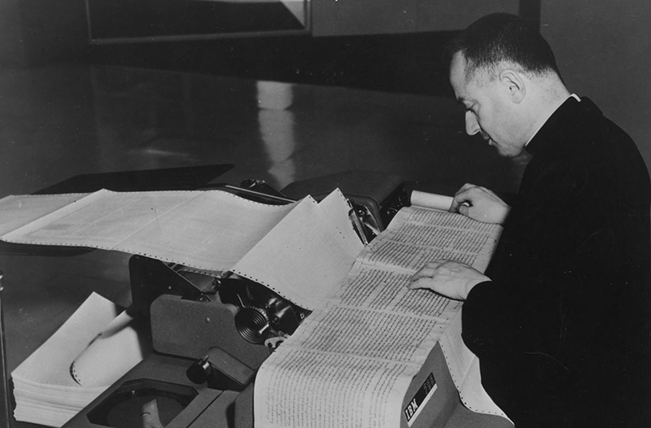
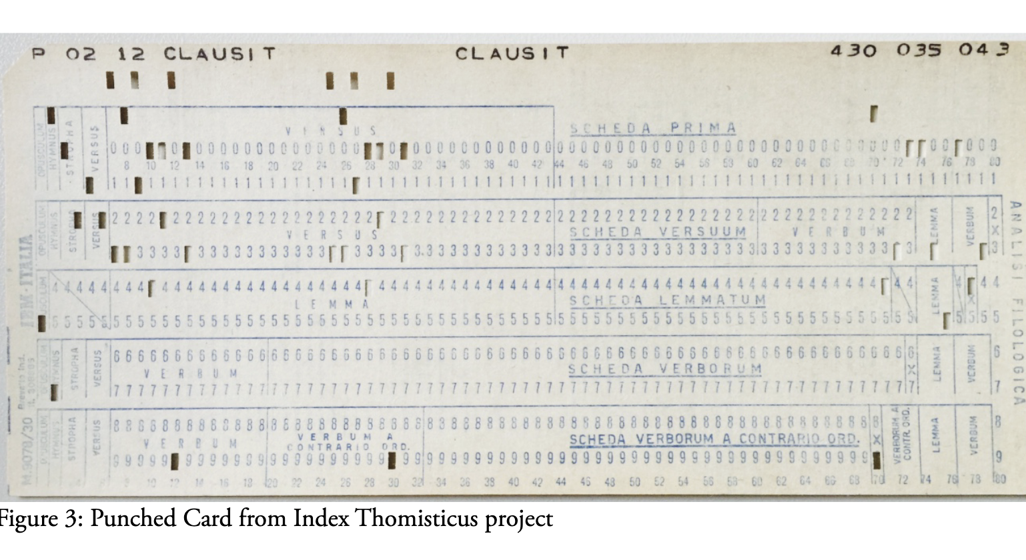
A Long History
Computational text analysis begins from an old scholarly impulse:
concordances
indexes
comparison across passages
attention to repetition and distribution
Father Roberto Busa's Index Thomisticus is an early landmark.
Notes:
The idea of treating language as data is not new. Long before machine learning or Python scripts, humanists were already quantifying text.
In the 1940s, Jesuit scholar Father Roberto Busa began compiling the Index Thomisticus, a complete concordance of Aquinas’s works. It was a monumental project – 11 million words – and Busa’s collaboration with IBM in 1949 is often cited as the birth of Digital Humanities.
Busa wasn’t interested in numbers for their own sake. He wanted to understand the philosophical meaning of words through their distribution and context. His work anticipated what we now call text mining – seeing pattern and repetition as interpretive evidence.

Slide 4
From Concordance to Corpus
Digitised collections → possible to work with thousands or millions of texts.
Texts become
searchable
machine-readable
structured by metadata
Conceptual turn: texts are no longer only read; they are processed.
Notes:
Fast-forward half a century. By the 1990s and 2000s, digitised collections such as Google Books made millions of texts searchable. The individual concordance had evolved into the corpus – a machine-readable body of texts large enough to model linguistic or cultural change.
This shift marks a key conceptual turn: texts are no longer only read; they are processed. And with that, “text as data” becomes both a methodological promise and a philosophical provocation.

Slide 5
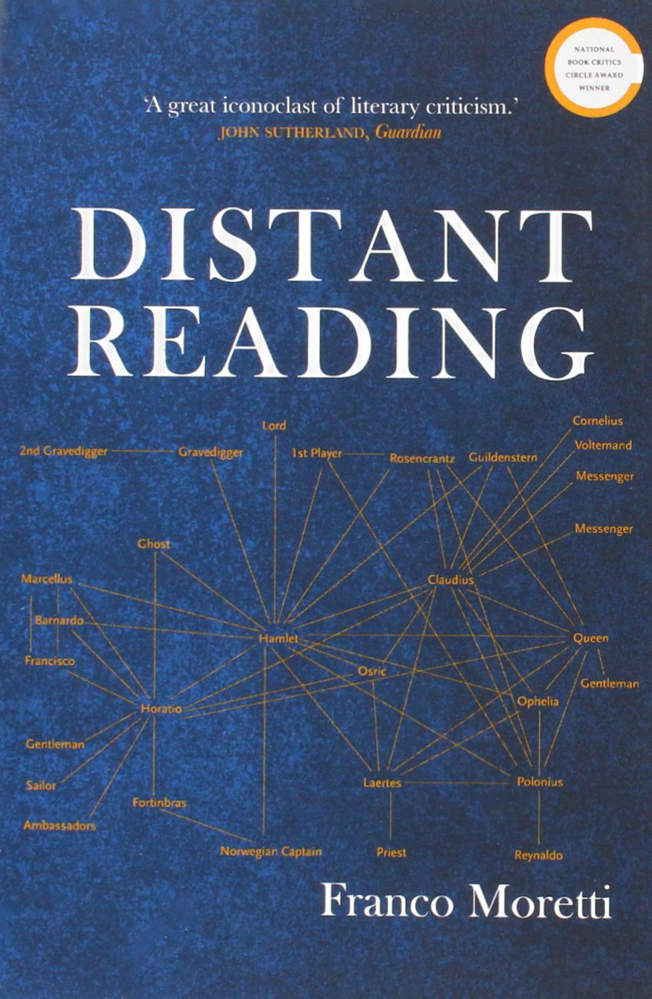
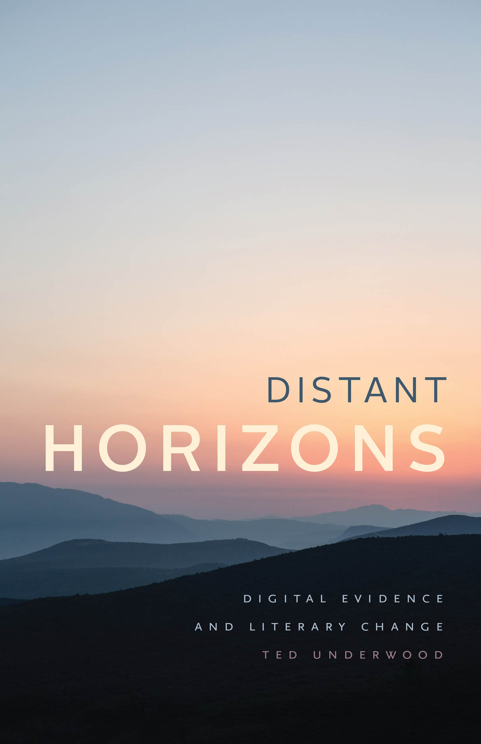
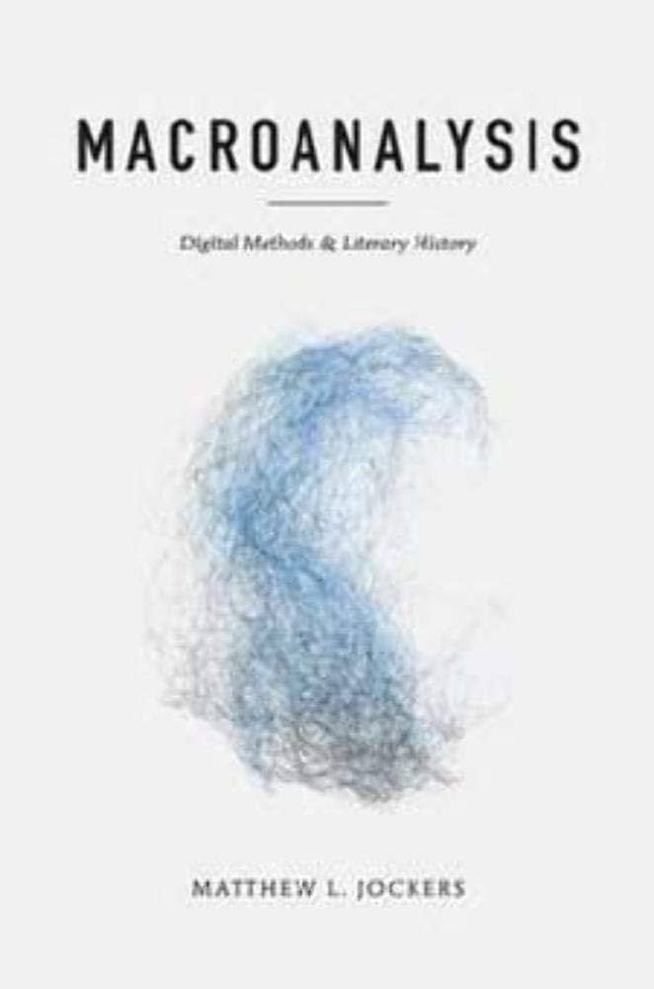
Close Reading and Distant Reading
Close reading studies particular passages in detail.
Distant reading studies patterns across many texts.
movement between pattern, question, example, interpretation.
Notes:
This brings us to one of the central tensions in Digital Humanities – the relationship between close and distant reading.
Close reading, as practiced in literary studies, privileges depth: it values ambiguity, voice, and nuance. Distant reading privileges breadth: it seeks generalisation, trend, and structure.
Neither is sufficient on its own. The future, as Jockers and Underwood both suggest, lies in scalable reading – moving fluidly between the individual text and the aggregated corpus.
Underwood (2019) frames this beautifully in Distant Horizons:
“The challenge is not to abandon interpretation for measurement, but to learn to interpret patterns that only become visible at scale.” (Underwood 2019, p. 8)
That’s the intellectual horizon of this lecture.

Slide 6
The Shift to Measurement
Computational analysis often turns qualitative questions into measurable proxies.
How is industrial London represented?
How often do terms such as factory, smoke, street, or crowd appear?
A proxy is not a replacement for interpretation.
Notes:
When we talk about text as data, we’re shifting from interpretation to measurement – but not abandoning interpretation. Instead, we’re translating qualitative questions into quantitative proxies.
For example:
Instead of asking, How does Dickens represent industrial London? we might ask, How often do words associated with “factory” or “smoke” appear across Dickens’s novels?
Instead of reading one Bildungsroman, we might examine a hundred and ask, When does the language of “self-discovery” peak historically?
This is what Matthew Jockers (2013) calls macroanalysis – “distant reading” made operational through data. He writes:
“the sheer quantity of available data makes the traditional practice of close reading untenable as an exhaustive or definitive method of evidence gathering. Something important will inevitably be missed. The same argument, however, may be leveled against the macroscale; from thirty thousand feet, something important will inevitably be missed.” (Jockers 2013, p. 9)

Slide 7
Computational Results Are Not Neutral
Results are shaped by corpus design, digitisation, OCR, preprocessing, metadata, tools, algorithms, and assumptions.
Patterns reveal repetition, absence, comparison, and change.
They can also hide context, irony, polysemy, marginal voices, and archival bias.
Notes:
Outputs are constructed evidence and need methodological explanation.
Computational results do not simply emerge from the text itself; they are produced through a chain of choices made before, during, and after analysis.
Start with the corpus.
What texts were included, excluded, digitised, or lost? A result can look objective, but it may reflect the shape of the archive, the availability of digitised material, the quality of OCR, or the way metadata categories were assigned.
Then consider preprocessing.
Decisions about spelling normalisation, tokenisation, stop words, lemmatisation, and named-entity recognition all affect what the tool can count or compare. These choices can make some patterns more visible while pushing others out of view.
The same applies to tools and algorithms. A topic model, frequency list, network graph, or classifier is not neutral evidence on its own. Each method has assumptions about what counts as similarity, difference, importance, or signal. Those assumptions need to be explained to the audience.
Computational methods can reveal repetition, absence, comparison, and change at scales that are difficult to see manually. But they can also obscure irony, ambiguity, polysemy, marginal voices, and archival bias if the researcher treats the output as self-evident.
The result is not the argument. The result is an invitation to ask better interpretive questions, check the evidence, and explain the method that produced it.

Slide 8
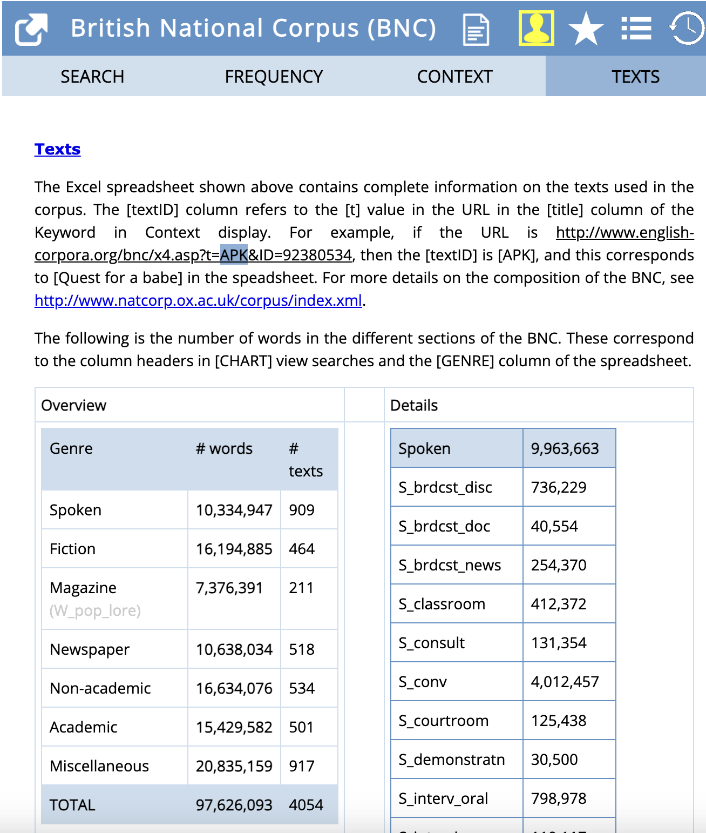
What Is a Corpus?
A corpus is a body of naturally occurring language, assembled for a purpose.
It is usually
machine-readable
made of authentic texts
sampled deliberately
representative
E.g. of a defined language, genre, period, community, etc

Slide 9
Types of Corpora
General corpus
Broad language patterns across genres and registers.
Specialised corpus
One genre, domain, community, or text type.
Synchronic corpus
represents language samples collected at one point in time
diachronic corpus
contains language samples collected across different points in time

Slide 10
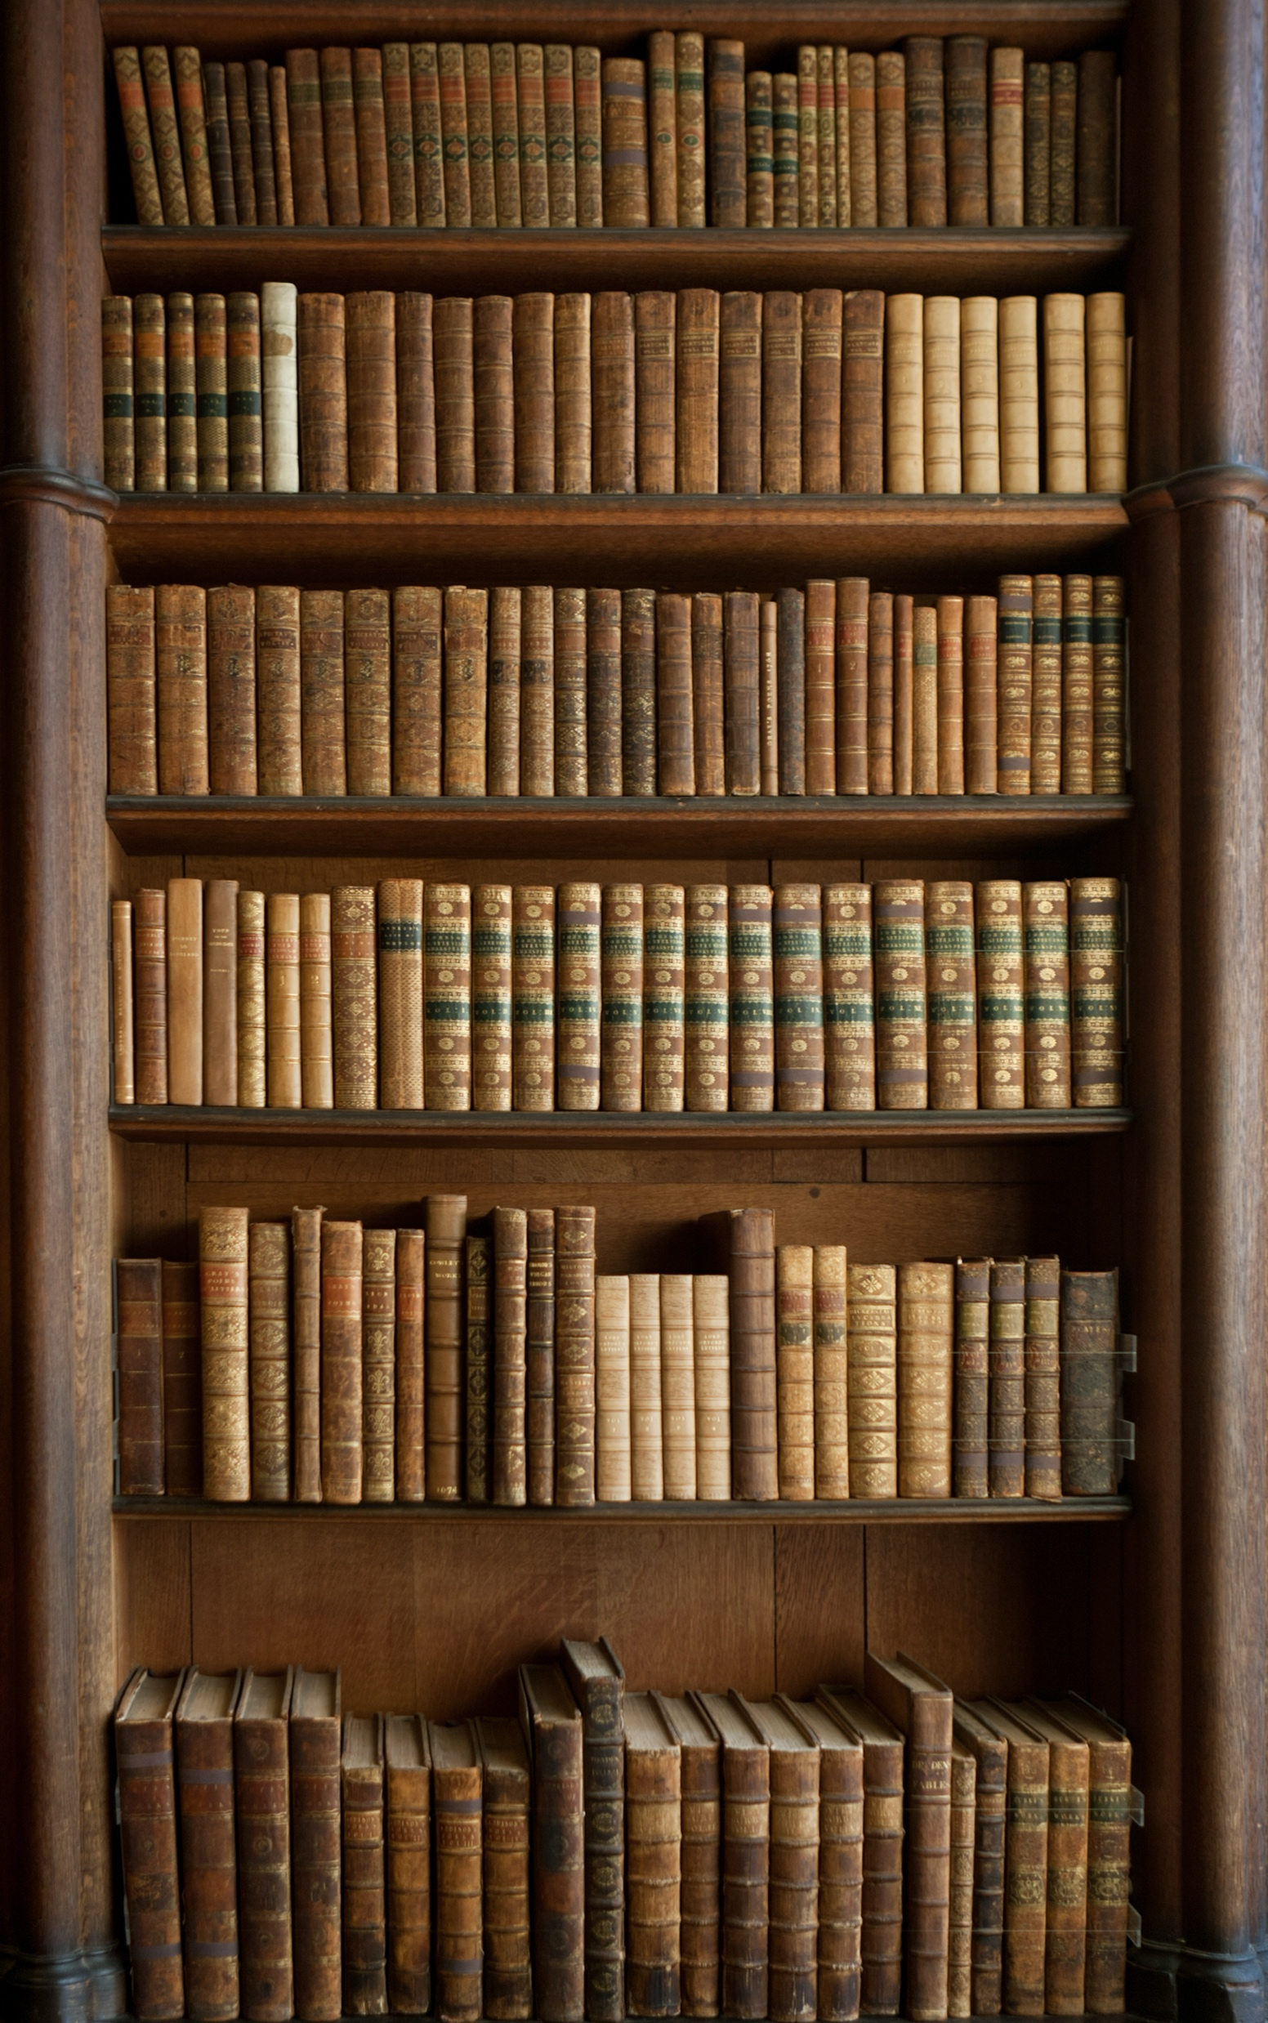
What Is Not a Corpus?
A list of words is not a corpus: no textual context.
A random folder of files is not a corpus: no sampling logic.
A set of quotations is not a corpus: already selected because they contain something.
The whole web is not a stable corpus: undefined and constantly changing.

Slide 11
Corpus Choices Shape Results
Corpus data can be natural, contextualised, quantitative, and useful for finding differences that intuition alone may miss.
Corpora rarely explain what is observed.
Findings are true first of all in that corpus.
Generalisation depends on representativeness.
Missing texts and archival bias can be amplified by computational methods.
Notes:
Ask Corpora the Right Questions
Corpora are useful when the question depends on pattern, comparison, or scale.
They are less useful when the question depends on a few passages that can already be read closely.
Simple methods can support complex arguments when the question is well designed.

Slide 12
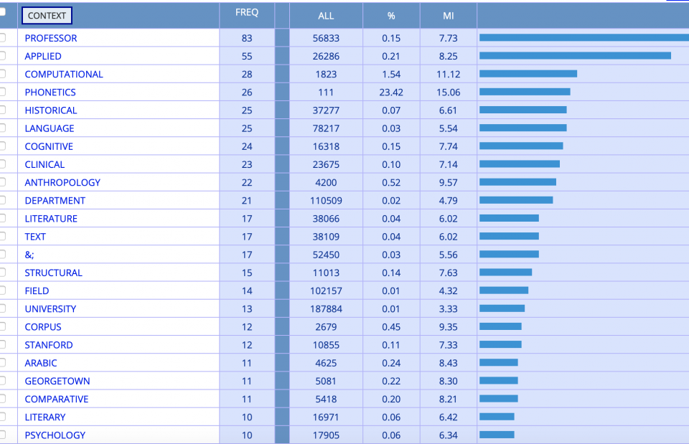
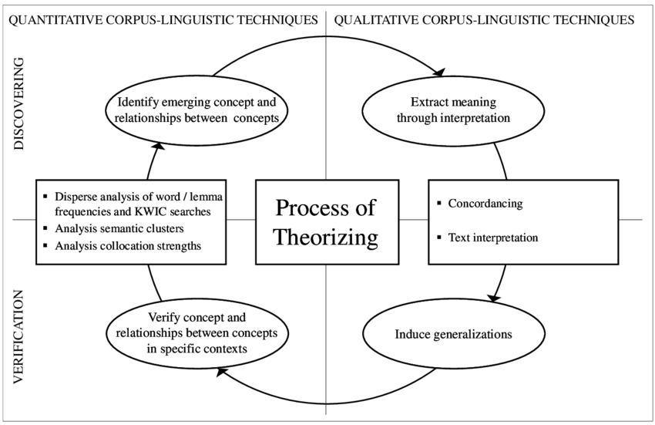
Counting and Context
Core methods
Frequencies: what appears often?
Keywords: what is unusually common in one group?
Concordances and KWIC: where does a word appear?
Collocations: which words tend to appear together?
Notes:
counting is only useful when it is paired with context. These methods are not separate from interpretation; they are ways of organising evidence so that interpretive questions can be asked more carefully.
Simple counts show what appears often in a corpus. They can be a helpful first orientation, but frequency alone does not tell us importance or meaning. A common word may be central, formulaic, or simply a feature of genre.
Keywords take the next step by comparing one group of texts against another. The question is not just what appears often, but what appears unusually often in this corpus, period, author, genre, or archive compared with a reference set.
Concordances and KWIC views bring the reader back to context. They show each occurrence of a word with the words around it, allowing us to check whether a pattern is consistent, ambiguous, ironic, or dependent on a particular phrase or setting.
Collocations help identify words that tend to appear together. This is useful for studying associations, repeated formulas, semantic fields, or changes in discourse. But collocation is a prompt for close reading, not a final conclusion.
These methods move us from counting words to interpreting patterns. The strongest analysis combines the distant view of distribution with the close view of context.

Slide 13

NATURAL LANGUAGE PROCESSING (NLP)
Corpus analysis
Sentiment Analysis
Topic Modeling
Stylometry
Notes:
NLP is the broad family of computational methods that tries to process language in ways that preserve some of its structure, meaning, and variation.
Corpus analysis is the foundation: we gather a defined set of texts, prepare them consistently, and ask what patterns appear across the collection. The important point is that the corpus is designed, not neutral, so results always depend on what has been included and how it has been cleaned.
Sentiment analysis attempts to classify tone or emotional orientation. It can be useful for large-scale comparisons, but in humanities materials it must be handled carefully because irony, genre, historical vocabulary, and context can easily confuse automated scores.
Stylometry looks for measurable features of style, such as word frequencies, sentence length, function words, or recurring patterns. It is often used for authorship attribution, genre comparison, or tracking stylistic change over time.
Topic modeling groups words that tend to occur together and suggests broad themes within a corpus. It is exploratory rather than definitive: topics need to be interpreted, named, checked against sample passages, and connected back to the research question.
NLP gives us ways to scale up interpretation, but every output still needs human judgement. The method can reveal patterns; the scholar has to decide what those patterns mean.

Slide 14
Ethics and Attribution
Respect copyright limits.
Avoid uploading sensitive data into online tools.
Cite tools, corpora, packages, and data sources.
Ask whose texts are missing or over-represented.
Consider whether the method could amplify harm or bias.
Notes:
Even with publicly available texts, remember:
Respect copyright limits (if working beyond public domain).
Avoid uploading sensitive data (personal diaries, emails) into online tools.
Cite tools and data sources just as you would cite texts or articles.
Voyant provides a “Citation” tab you can copy into your bibliography.

Slide 15
Key concepts
Computational Text Analysis / Text Mining = computational methods of discovering and extracting information from text data
Word frequencies: counting frequency with which certain words are mentioned in document or collection of documents (corpus)
Frequency of words does not equal significance
Unless compared with something, a wordcount gives us nothing
Requires an ethnographic understanding of texts under consideration
Word similarities: word embeddings are numerical representation of texts where words mentioned closer together appear closer together
Distant reading: Application of text mining in study of literature less about computers than about new ideas about modelling and interpretation
Limitations and critiques:
Text mining remains crude compared to human reading
Archives always limited and biased
But: fear of text mining displacing other approaches likely unfounded

Slide 16
References
Antoniak, M., Mimno, D., & Levy, K. (2019). Narrative Paths and Negotiation of Power in Birth Stories. Proceedings of the ACM on Human-Computer Interaction, 3(CSCW), 1–27. https://doi.org/10.1145/3359190
Dobson, J. E. (2019). Critical Digital Humanities: The Search for a Methodology. University of Illinois Press. https://doi.org/10.5406/j.ctvfjd0mf
Garg, N., Schiebinger, L., Jurafsky, D., & Zou, J. (2018). Word embeddings quantify 100 years of gender and ethnic stereotypes. Proceedings of the National Academy of Sciences, 115(16). https://doi.org/10.1073/pnas.1720347115
Huang, Y., Guo, D., Kasakoff, A., & Grieve, J. (2016). Understanding U.S. regional linguistic variation with Twitter data analysis. Computers, Environment and Urban Systems, 59, 244–255. https://doi.org/10.1016/j.compenvurbsys.2015.12.003
Jockers, M. L. (2013). Macroanalysis: Digital methods and literary history. University of Illinois Press.
Jurafsky, D., Chahuneau, V., Routledge, B. R., & Smith, N. A. (2016). Linguistic Markers of Status in Food Culture: Bourdieu’s Distinction in a Menu Corpus. Journal of Cultural Analytics. https://doi.org/10.22148/16.007
Kozlowski, A. C., Taddy, M., & Evans, J. A. (2019). The Geometry of Culture: Analyzing the Meanings of Class through Word Embeddings. American Sociological Review, 84(5), 905–949. https://doi.org/10.1177/0003122419877135
Ascari, M. (2014). The Dangers of Distant Reading: Reassessing Moretti’s Approach to Literary Genres. Genre: Forms of Discourse and Culture, 47(1), 1–19.
Heuser, R., Moretti, F., & Steiner, E. B. (2016). The emotions of London. Literary Lab.
Moretti, F. (2013). Distant reading (2015th ed.). Verso.
Nicoletti, L., & Sarva, S. (n.d.). When Women Make Headlines. The Pudding. Retrieved 31 October 2024, from https://pudding.cool/2022/02/women-in-headlines/
Piper, A. (2018). Enumerations: Data and Literary Study. University of Chicago Press. https://doi.org/10.7208/chicago/9780226568898.001.0001
So, R. J. (2021). Redlining Culture: A Data History of Racial Inequality and Postwar Fiction. Columbia University Press. https://doi.org/10.7312/so--19772
So, R. J., & Roland, E. (2020). Race and Distant Reading. PMLA/Publications of the Modern Language Association of America, 135(1), 59–73. https://doi.org/10.1632/pmla.2020.135.1.59
Underwood, T. (2019). Distant horizons: Digital evidence and literary change. The University of Chicago Press.

