Slide 1
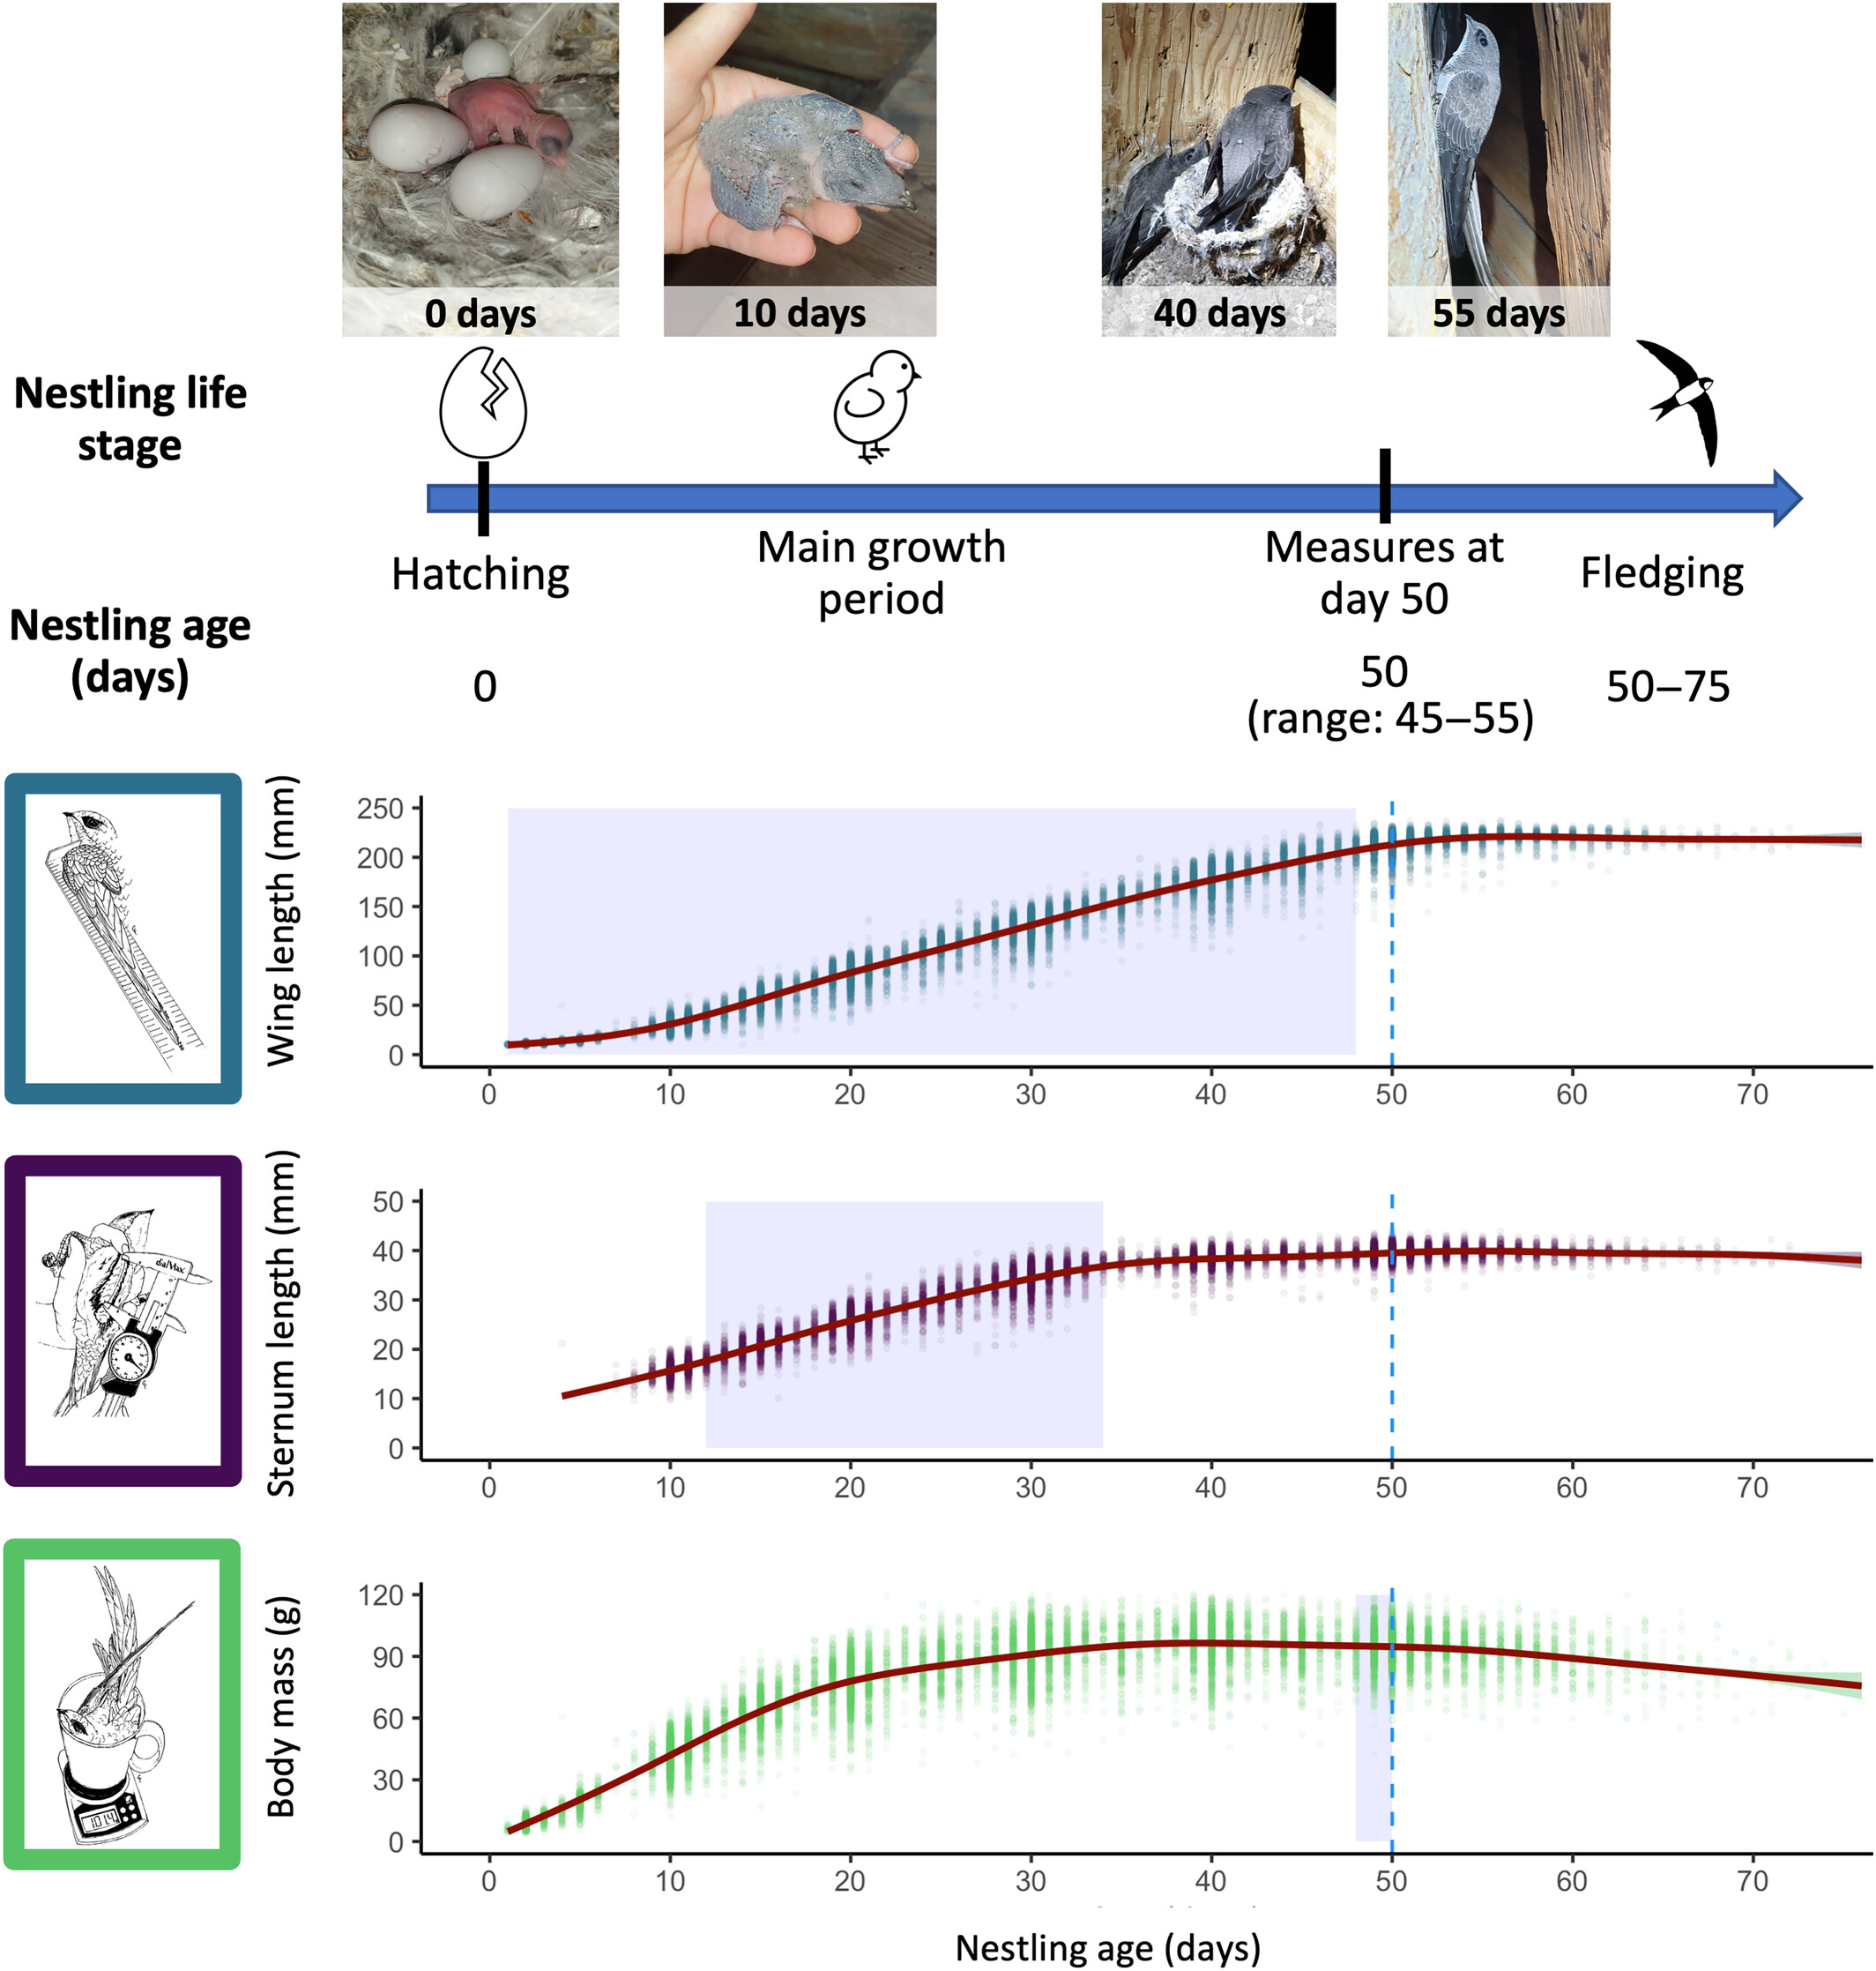
Trait‐specific sensitive developmental windows: Wing growth best integrates weather conditions encountered throughout the development of nestling Alpine swifts
Ecology and Evolution, Volume: 14, Issue: 6, First published: 06 June 2024, DOI: (10.1002/ece3.11491)
Notes:
Developmental trajectories, from hatching to fledging, of nestling Alpine swifts. Dots represent individual measurements of wing and sternum length and body mass of nestlings measured between 1999 and 2023, and smooth lines represent the average growth pattern of nestlings. The sensitive developmental windows during which weather conditions most affected the phenotype at 50 days (see Section 3) are highlighted with a purple background. N = 15,866 measures from 3194 nestlings for wing length, 12,662 measures from 2887 nestlings for sternum length and 15,968 from 3188 nestlings for body mass.
IF THIS IMAGE HAS BEEN PROVIDED BY OR IS OWNED BY A THIRD PARTY, AS INDICATED IN THE CAPTION LINE, THEN FURTHER PERMISSION MAY BE NEEDED BEFORE ANY FURTHER USE. PLEASE CONTACT WILEY'S PERMISSIONS DEPARTMENT ON PERMISSIONS@WILEY.COM OR USE THE RIGHTSLINK SERVICE BY CLICKING ON THE 'REQUEST PERMISSIONS' LINK ACCOMPANYING THIS ARTICLE. WILEY OR AUTHOR OWNED IMAGES MAY BE USED FOR NON-COMMERCIAL PURPOSES, SUBJECT TO PROPER CITATION OF THE ARTICLE, AUTHOR, AND PUBLISHER.

