Slide 1


Git & GitHub
I was never taught how to do this
Mariana Montes
19/10/2021

Slide 2
What is Git?
Git is a version control system
Keep track of the different stages of your work
Create branches for side projects without affecting the main work
Free and open source
Typically: command line

Slide 3
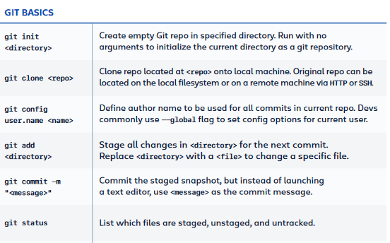
Git command line - cheatsheet
For the longest time I just kept the cheatsheet close by every time I used git
There is no repo. Create a folder for a project and set up git on it.
There is a repo, yours or not, and you copy it into your machine.
Tell git who you are.
Step 1: stage a change.
Step 2: commit your changes (and explain why).
Get an overview of (not) staged & commited files.

Slide 4
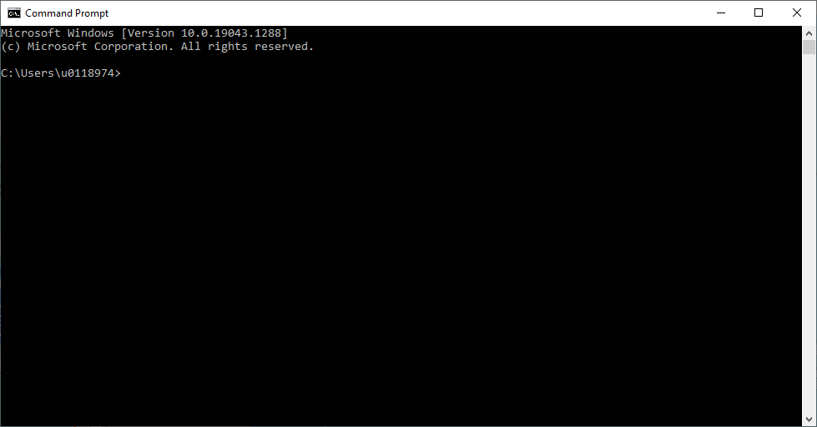
Command line?
You definitely have one, regardless of your OS (might be called “Terminal”)
There are also other integrations (shown in later slides)

Slide 5

What is GitHub?
GitHub is an online platform to host and share git repositories.
Online back-up of your repositories
Collaborate and publish
Alternatives: GitLab, BitBucket...
Integration with command line, but also Desktop Application

Slide 6
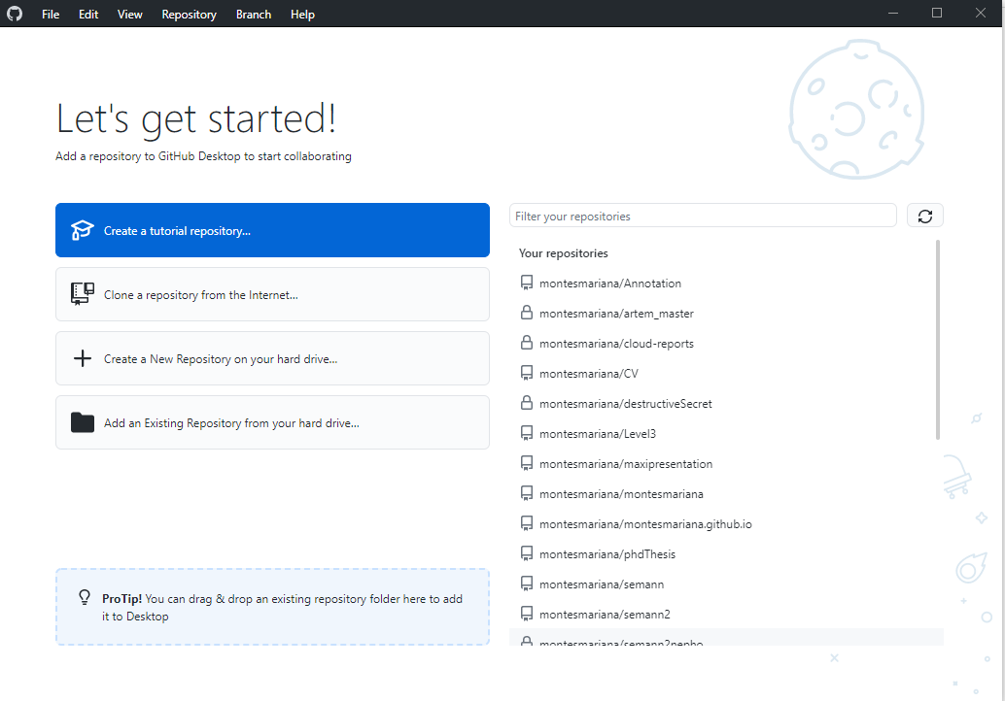
GitHub Desktop
This is the Windows version but it is also available for Mac.
= git clone
I used this for quite a while before I was comfortable enough with the command line (for which I used the cheatsheet a lot).
= git init

Slide 7
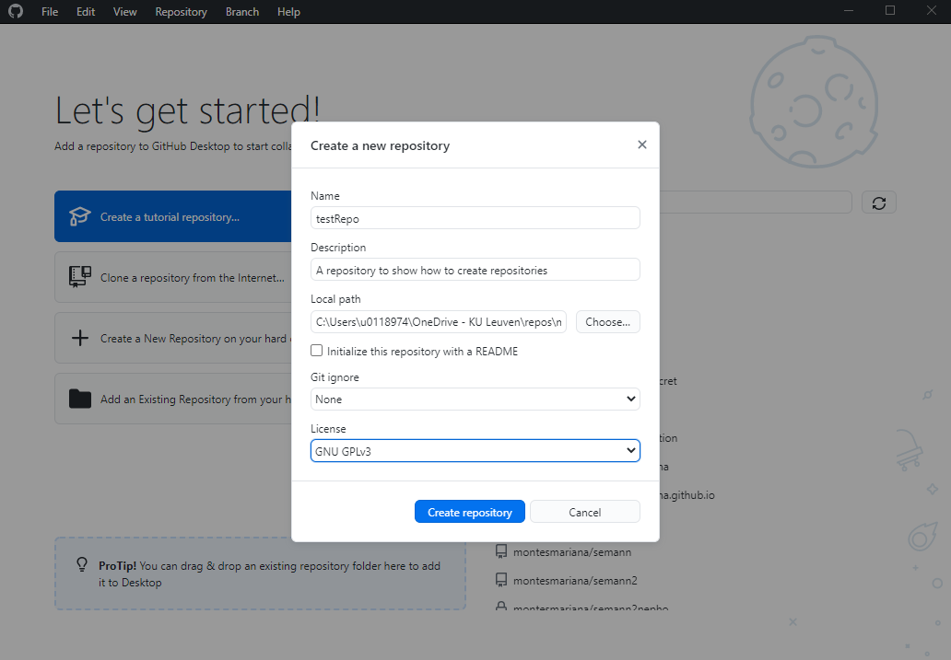
GitHub Desktop
name of the repository
location in your computer
create a README file
license (‘copyright’)

Slide 8
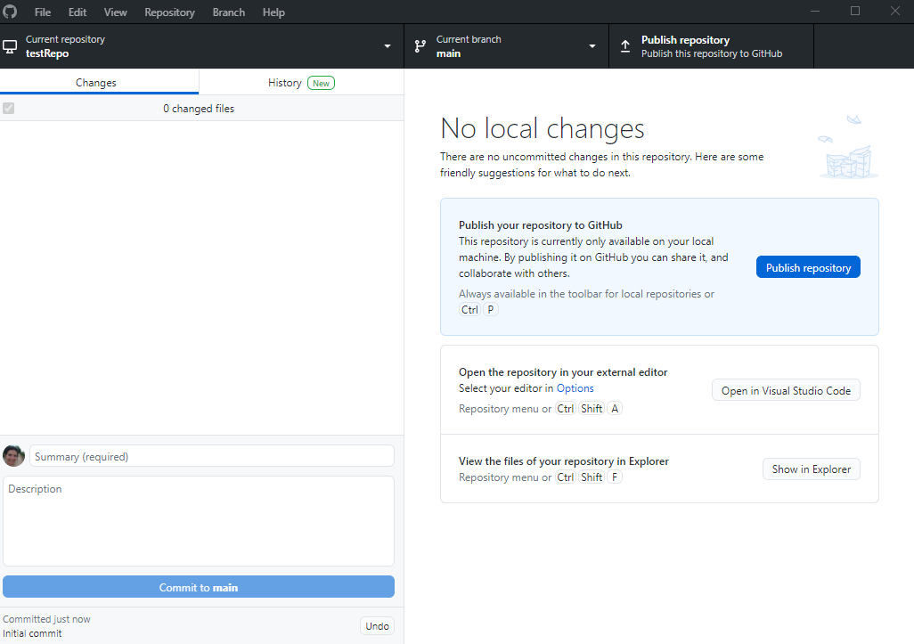
name of the repository

Slide 9
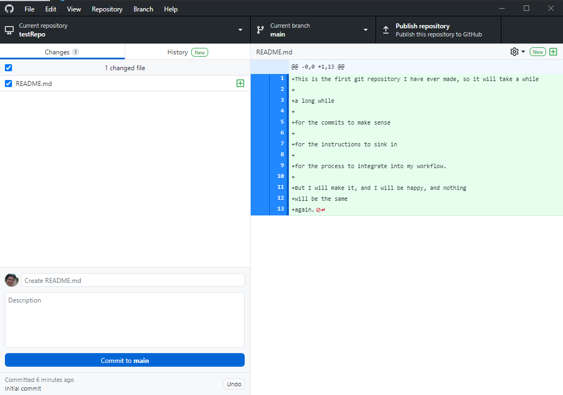
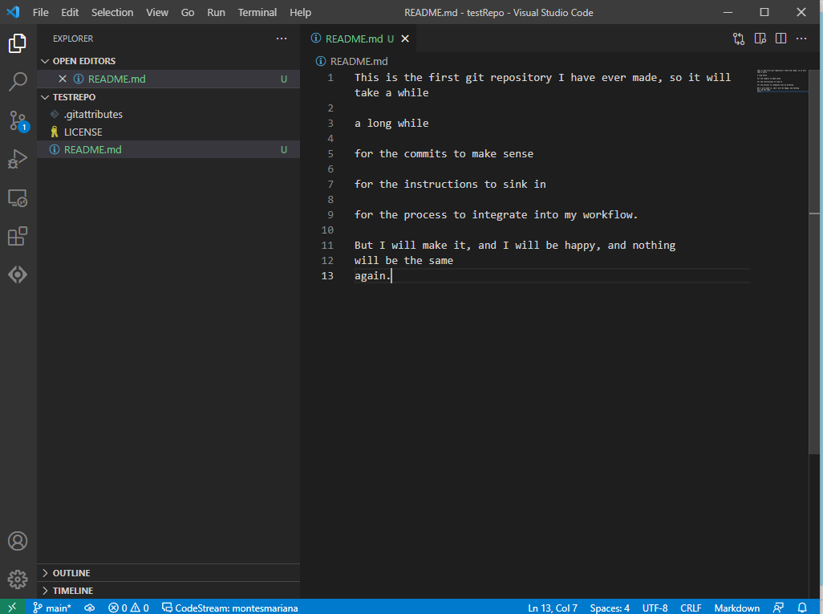
git add README.md
git commit –m “Create README.md”

Slide 10
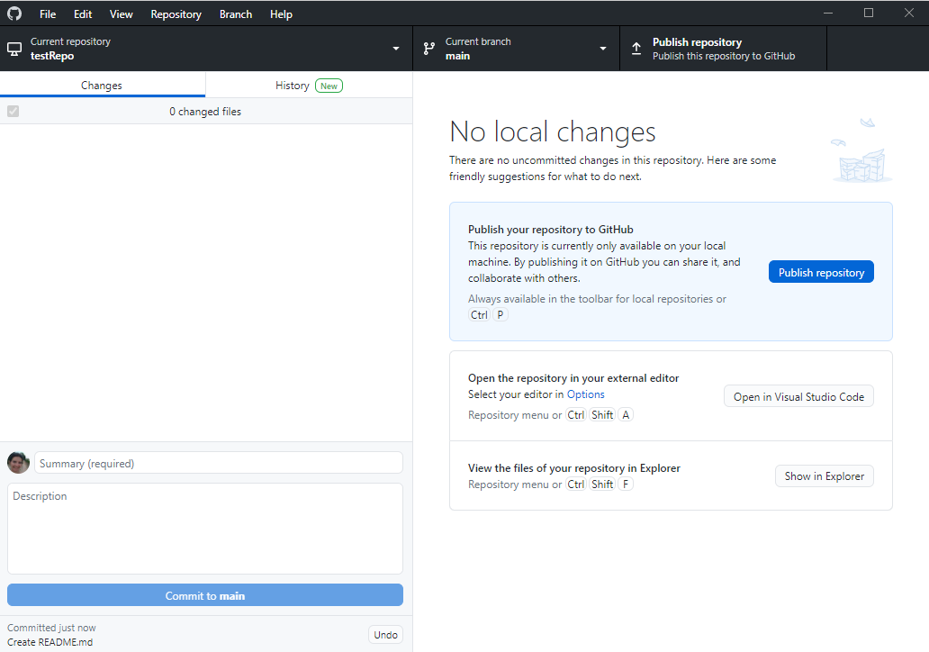
After committing
git push

Slide 11
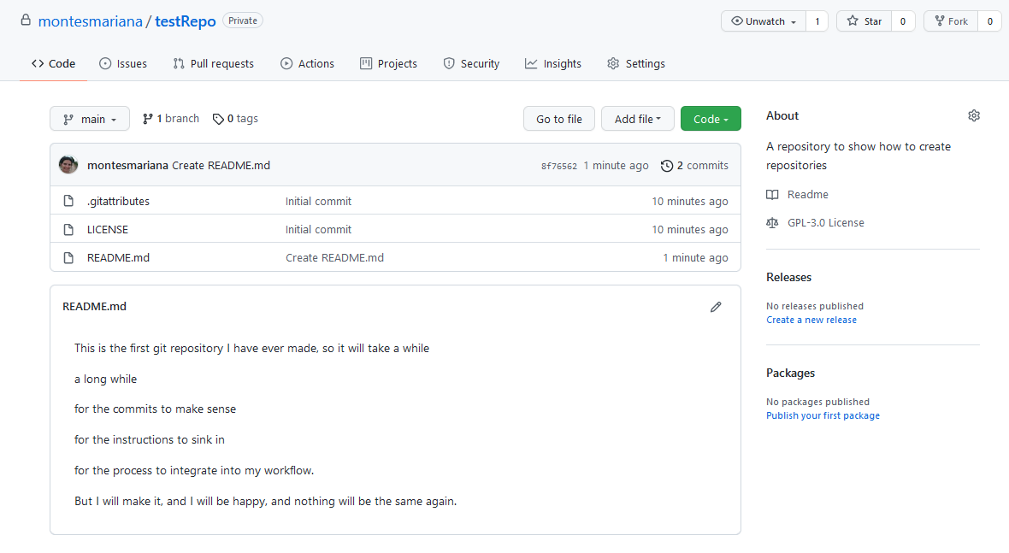
After publishing (= pushing)

Slide 12
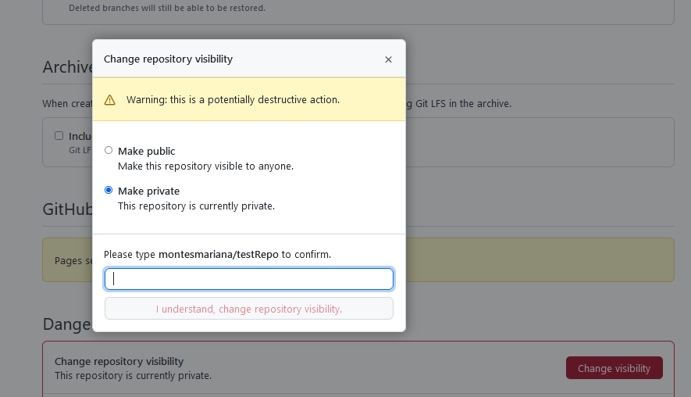
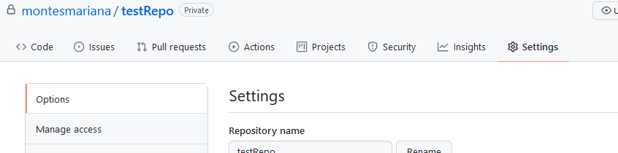
Sharing: make public or invite other users

Slide 13
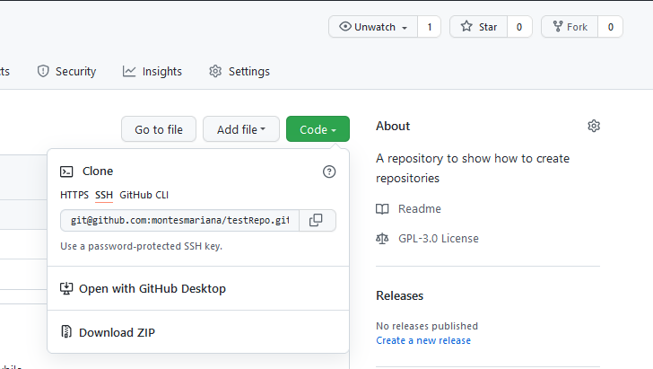
The other side of sharing: cloning & forking

Slide 14

The never-ending cycle: pulling/fetching
“Fetch origin” in Github Desktop, “git pull” in console...
Before staging/committing/pushing changes, pull to update your version
especially if you collaborate
And that’s it!

Slide 15
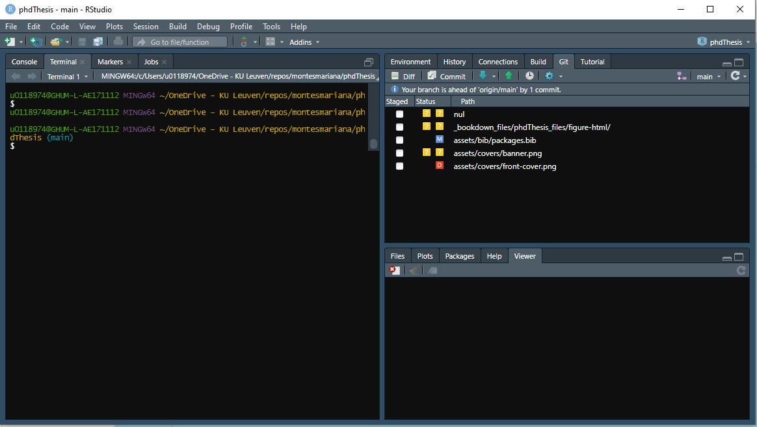
Git(Hub) & R Studio

Slide 16
Git(Hub) & VS Code

Slide 17
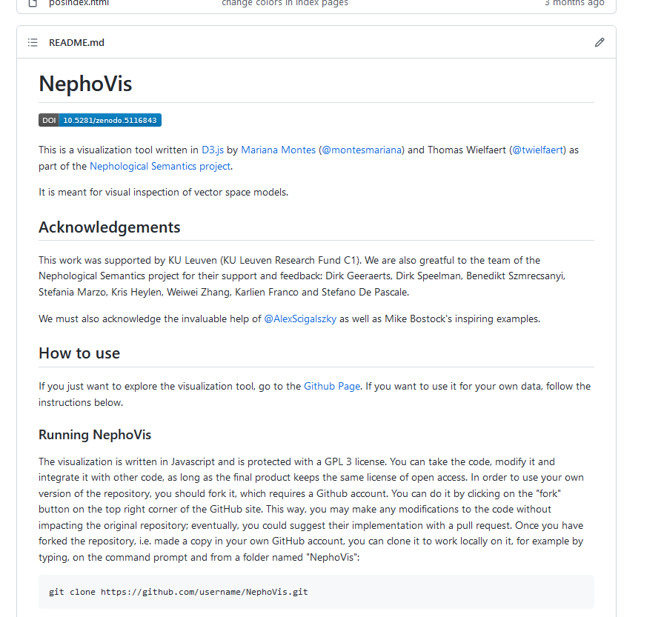
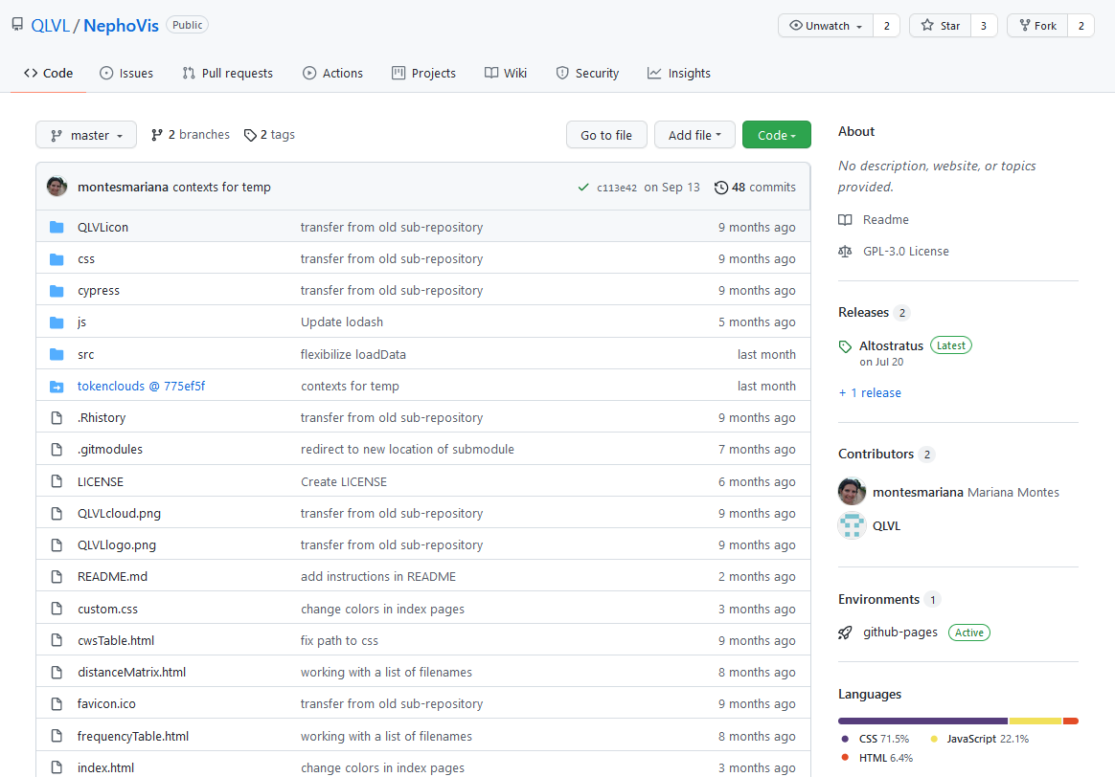
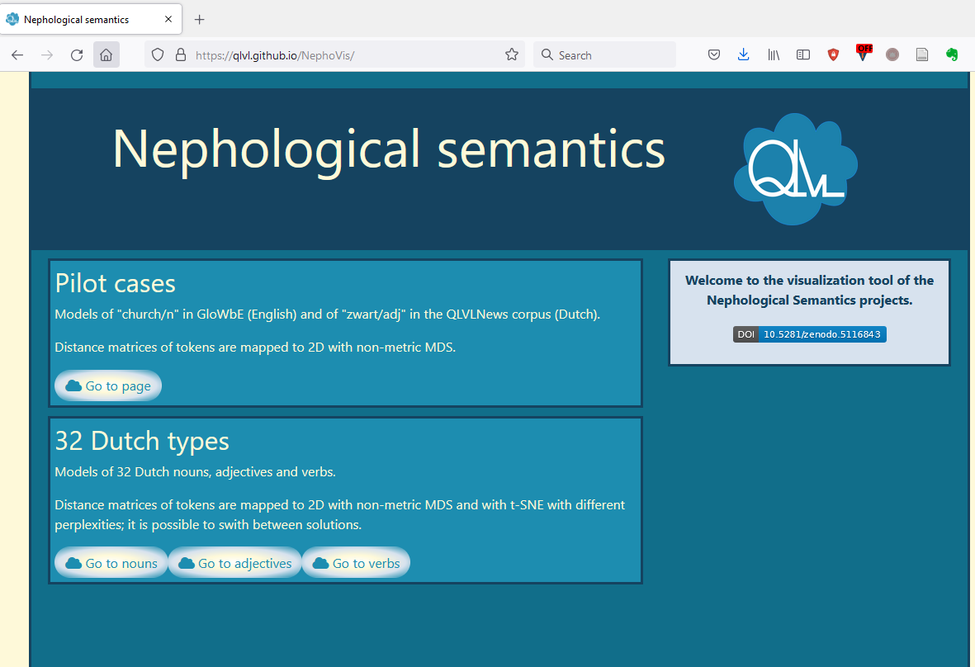
GitHub pages

Slide 18
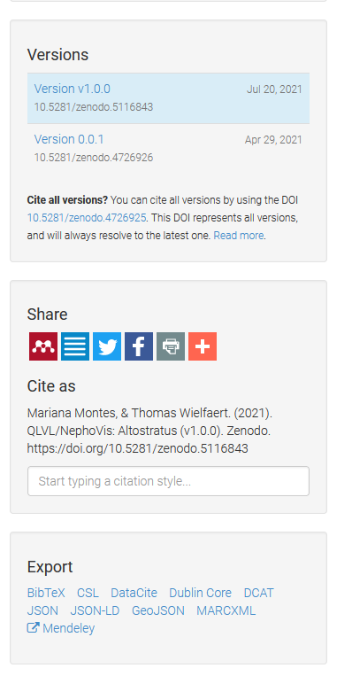
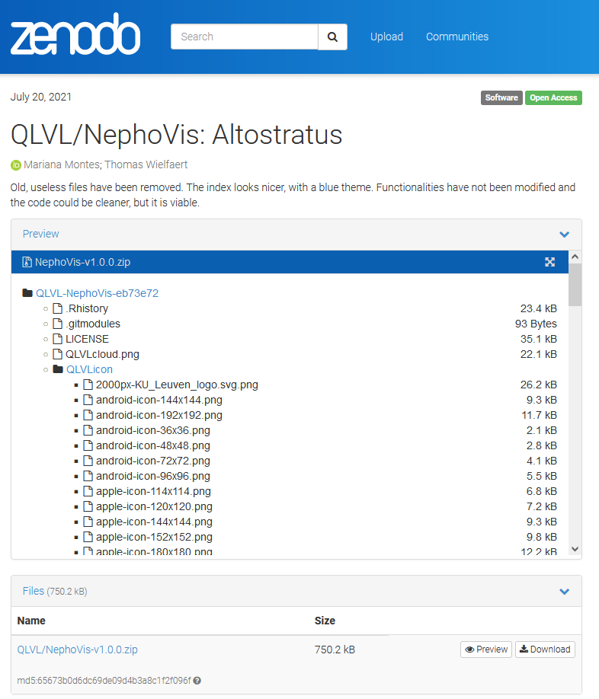
Zenodo: citing with DOI
Add a .cff file to make your work citable

Slide 19
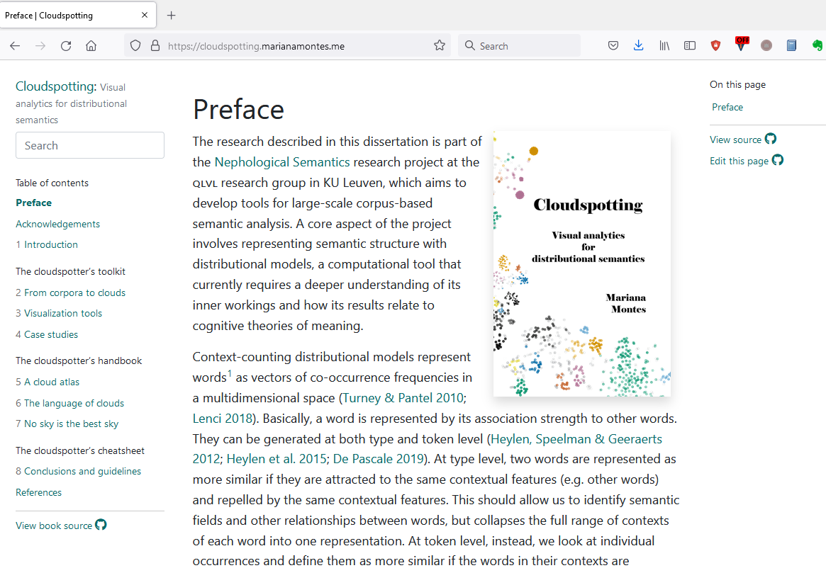

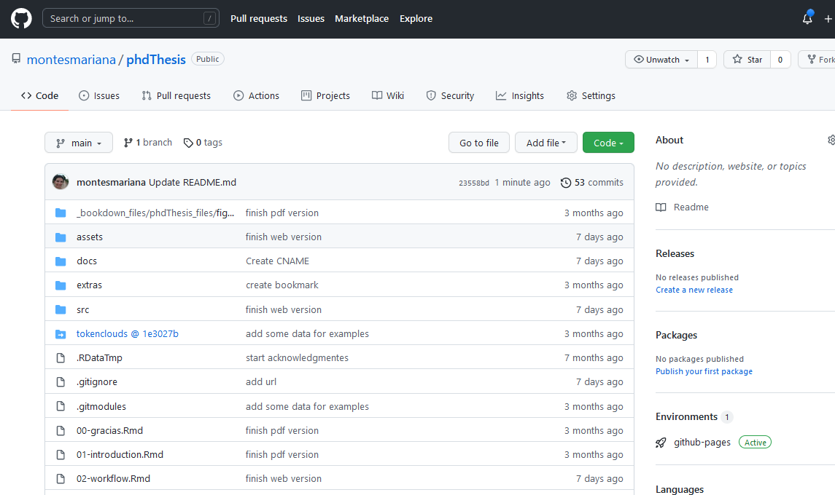
+ bookdown (also blogdown, xaringan...)

Slide 20
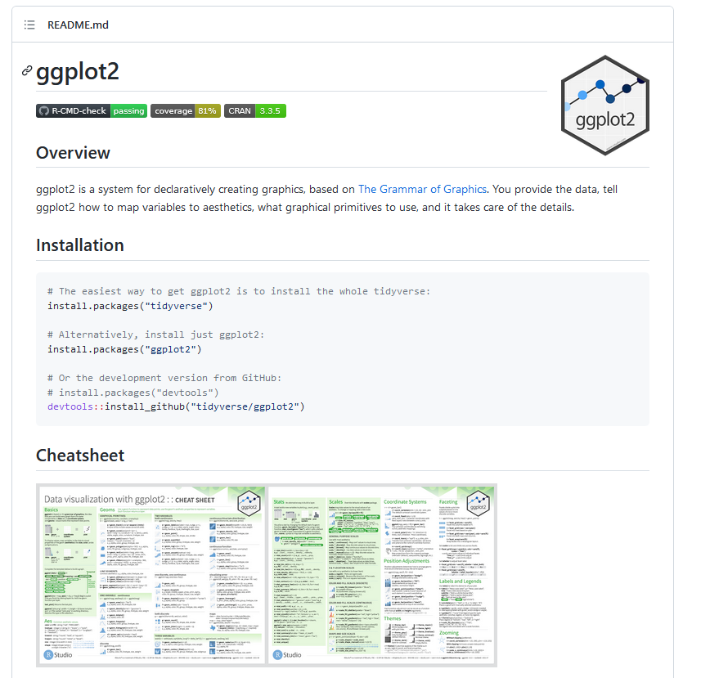
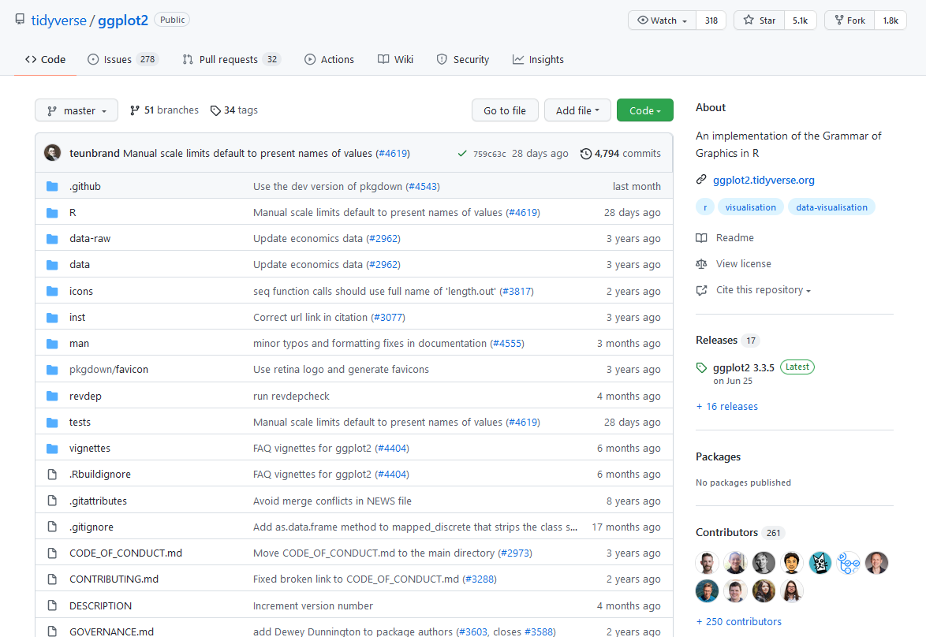
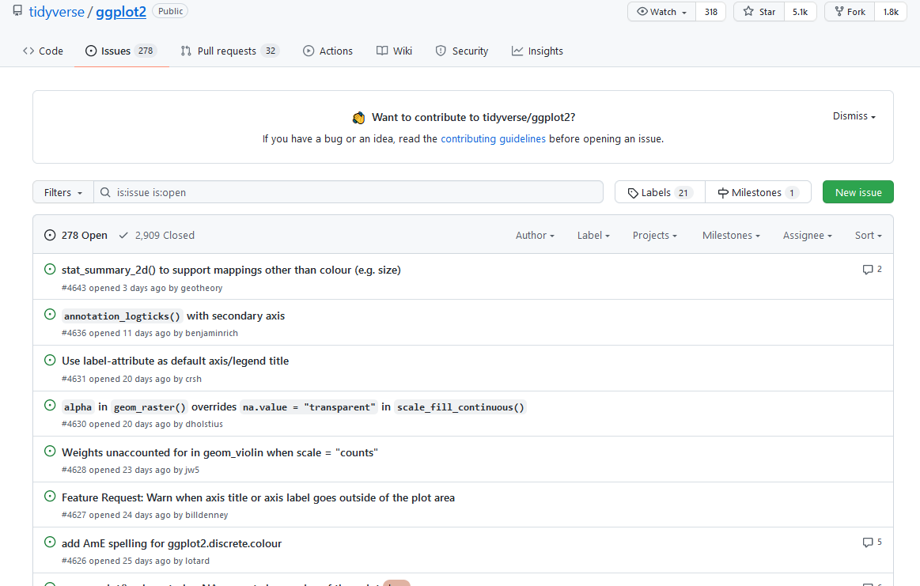
Community
I wish I had felt more comfortable interacting with developers, commenting packages...

