Slide 1
Galois/Counter Mode
(GCM)

Slide 2
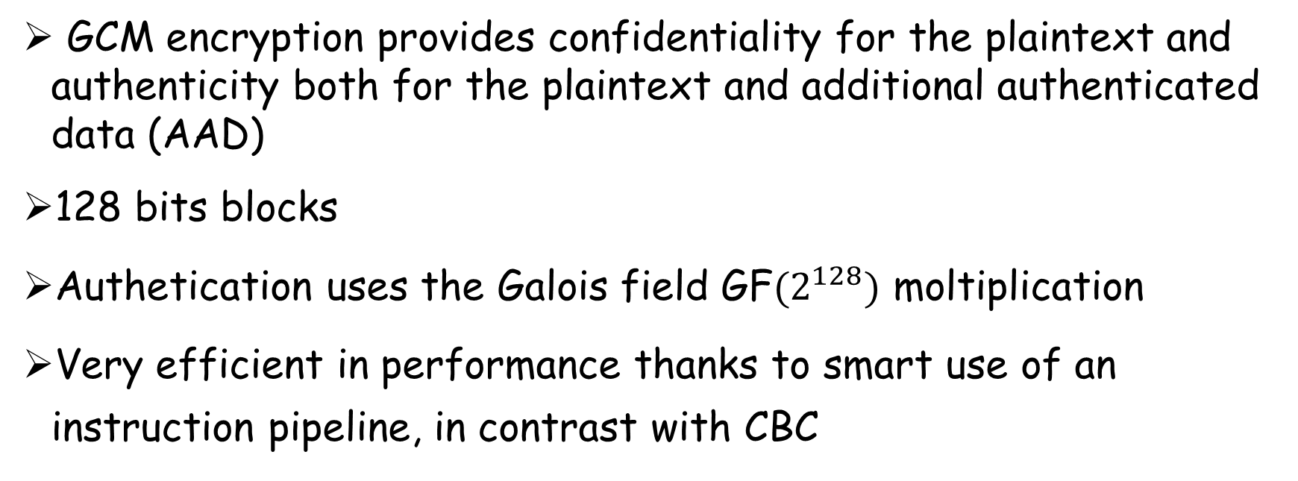
Galois/Counter Mode
GCM is an operating mode for symmetric-key cryptographic block ciphering
GCM encryption provides confidentiality for the plaintext and authenticity both for the plaintext and additional authenticated data (AAD)
128 bits blocks
Authetication uses the Galois field GF$(2^{128})$ moltiplication
Very efficient in performance thanks to smart use of an instruction pipeline, in contrast with CBC
Giulia Muscarà

Slide 3
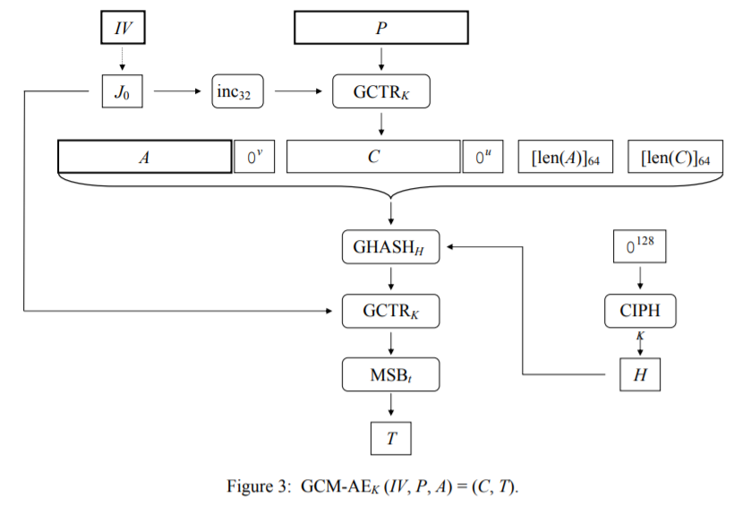
GCM Encryption
The hash subkey for the GHASH function is generated by applying the block cipher to the “zero" block
The pre-counter block (J₀) is generated from the IV, which is padded with the minimum number of ‘0' bits such that the length of the resulting string is a multiple of 128 bits
The 32-bit incrementing function is applied to the pre-counter block to produce the initial counter block for an invocation of the GCTR function on the plaintext, providing in output the ciphertext
The concatenation of additional data, C and the 64-bit representations of their lengths are hashed and then encrypted using the GCTR function to produce the authentication tag T
Giulia Muscarà

Slide 4
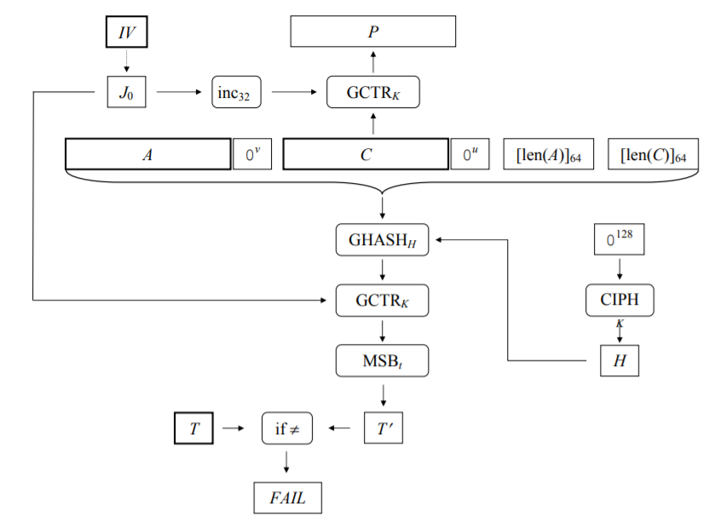
GCM Decryption
The hash subkey for the GHASH function is generated by applying the block cipher to the “zero” block, while J₀ is built and padded as for the authenticated encryption function
The 32-bit incrementing function is applied to the pre-counter block to produce the initial counter block to apply GCTR function on the ciphertext, providing in output the plaintext
The concatenation of the additional authenticated data, C and the 64-bit representations of their lengths are hashed and then encrypted using the GCTR function to produce the authentication tag T’
T’ is finally compared to the received authentication tag T and if they do not match, it means the message was compromised and FAIL is returned instead of P
Giulia Muscarà

Slide 5

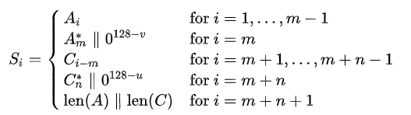
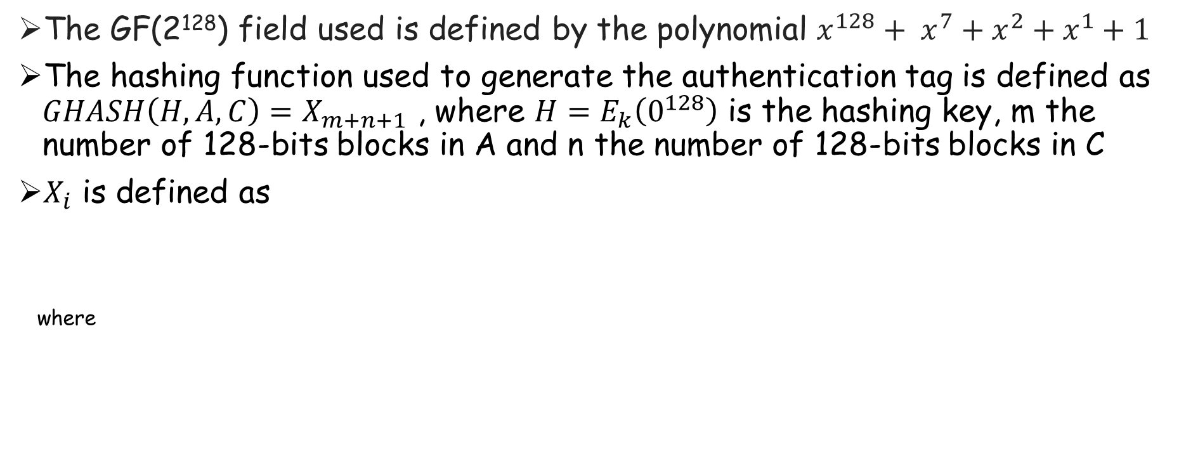
GCM Maths
The GF(2¹²⁸) field used is defined by the polynomial $x^{128}+ x^{7}+x^{2}+x^{1}+1$
The hashing function used to generate the authentication tag is defined as $GHASH\left(H,A,C\right)=X_{m+n+1}$ , where $H=E_{k}\left(0^{128}\right)$ is the hashing key, m the number of 128-bits blocks in A and n the number of 128-bits blocks in C
$X_{i}$ is defined as
where
Giulia Muscarà

Slide 6
GCM Properties
Both gcm encryption and decryption can be parallelized and pipelined, as each block is encrypted/decrypted independently from the others
For the same reason, if one bit of a block is compromised, the error does not propagate and does not affect other blocks
Each counter can be pre-processed before encryption/decryption start
The initialization vector can be of any lenght, so the requirement of using different ivs can be easily satisfied
It is able to provide authentication to messages that do not need to be encrypted with no modifications, working like an incremental MAC
Giulia Muscarà

