Slide 1
MMS
Media Management System

Slide 2
Main functionalities
Ingest of Media Contents
Digital Asset Management
Editing/processing functionalities
Workflow management
Transcoding engine
Multiple interfaces
Recording application

Slide 3
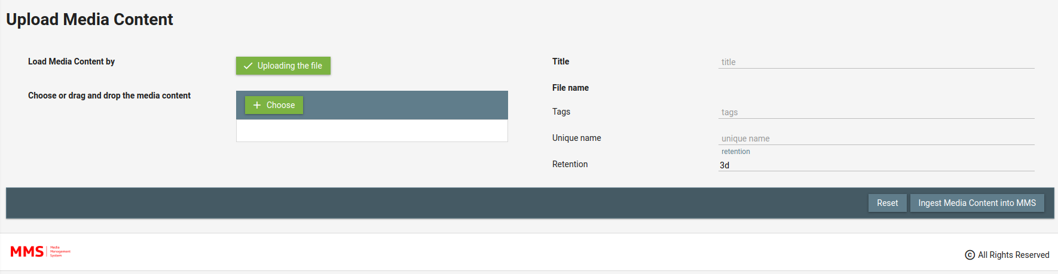
Ingest of Media Contents
Live Stream Cloud Ingest (UDP, RTP, SRT, HTTP HLS, ecc)
Direct HD SDI Ingest
H264, H265, …
Format agnostic
Multi resolution ingest
Live-VOD scalability: unlimited
Editing/Export/Publishing of Media Contents

Slide 4
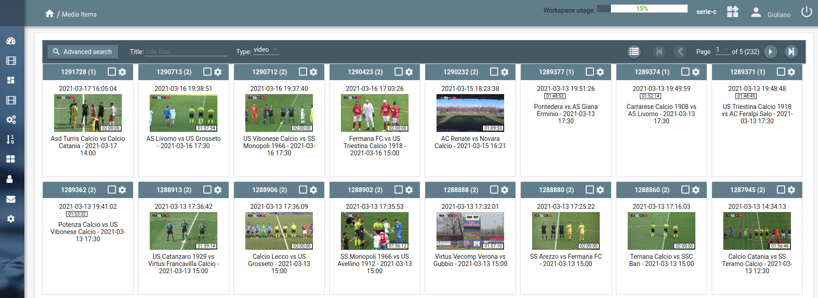
Digital Asset Management
Management of Video, Audio, Images
Search of media contents by Title, Tag, Description, …
User Data can be associated to any Media Content
Media contents are organized in Workspaces (Media Storages)
A Workspace can be shared with other Users

Slide 5
Editing/processing functionalities
Video-Audio Cut and Concat (Frame Accurate)
Image crop
Face detection (ex: thumbnails generation) and learning
Face recognition
Audio extraction/Processing
Video-Audio Slow Down
Video Slide show
Picture in Picture
Overlay of image-text
Live Mosaic
Live Proxy
Change file format
Frame extraction/Processing
Count-down video creation
Motion JPEG
Media Cross References
POST on Facebook
POST on YouTube
FTP delivery
HTTP callback
Email-notification

Slide 6
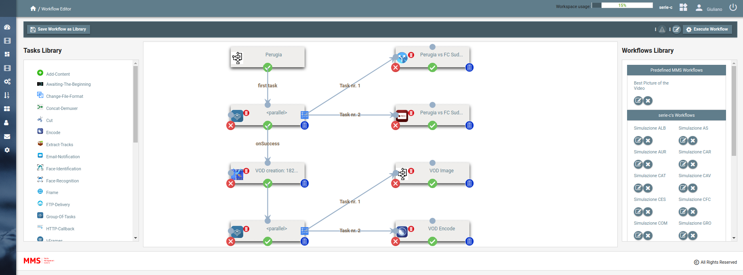
Workflow management
Workflow defined by the user
Library of predefined Task
Task Library can be extendable
Parallel execution of multiple Workflows
Management of synchronous and asynchronous Tasks
Definition of Workflows by API
Definition of Workflows by Web Interface

Slide 7
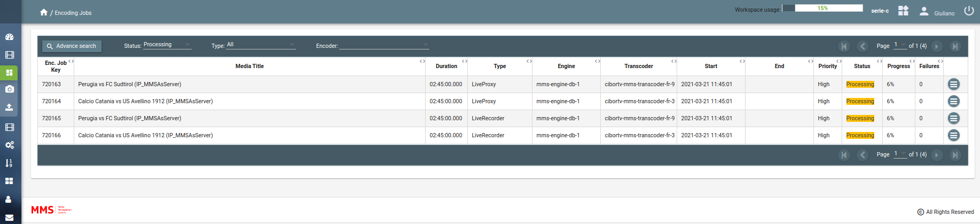
Transcoding engine
ffmpeg used by default
Possible integration with third party transcoders
H264/H265/… Input/Output
MXF OP1a Input (necessaria licenza per Output)
Management of array of transcoders
Management of encodings by priorities
Load balancing of Transcoders

Slide 8
Multiple interfaces
REST API: integration of all MMS functionalities
Java MMS REST API Library
Java MMS Workflow Library
Secure Content delivery (token by path or parameter, TTL, max retries)
Users’ rights management (integration with Active Directory available)
WEB interface

Slide 9
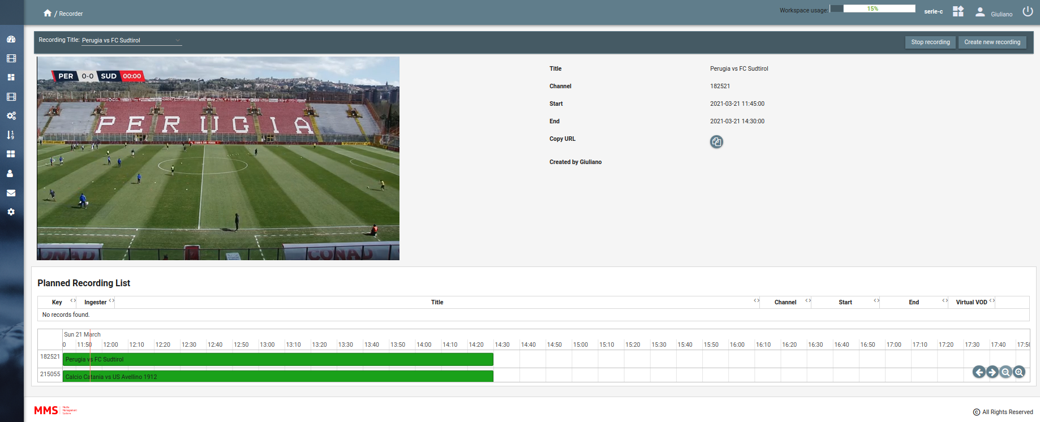
Recording application
Easy way to record IP live feed (UDP, RTP, SRT, HTTP HLS, ecc)
Preview of each recording
VOD available during the recording up to 10 seconds from real time
Scheduling of recording

