Slide 1
MMS
Media Management System
mms.technical.support@cloud-mms.com
https://mms-gui.cloud-mms.com/catramms
https://app.swaggerhub.com/apis-docs/giulianoc/MediaManagementService

Slide 2
Main functionalities
Digital Asset Management
Workflow management
Editing/processing functionalities
Media Contents
Recording application
Transcoding engine
Multiple interfaces

Slide 3
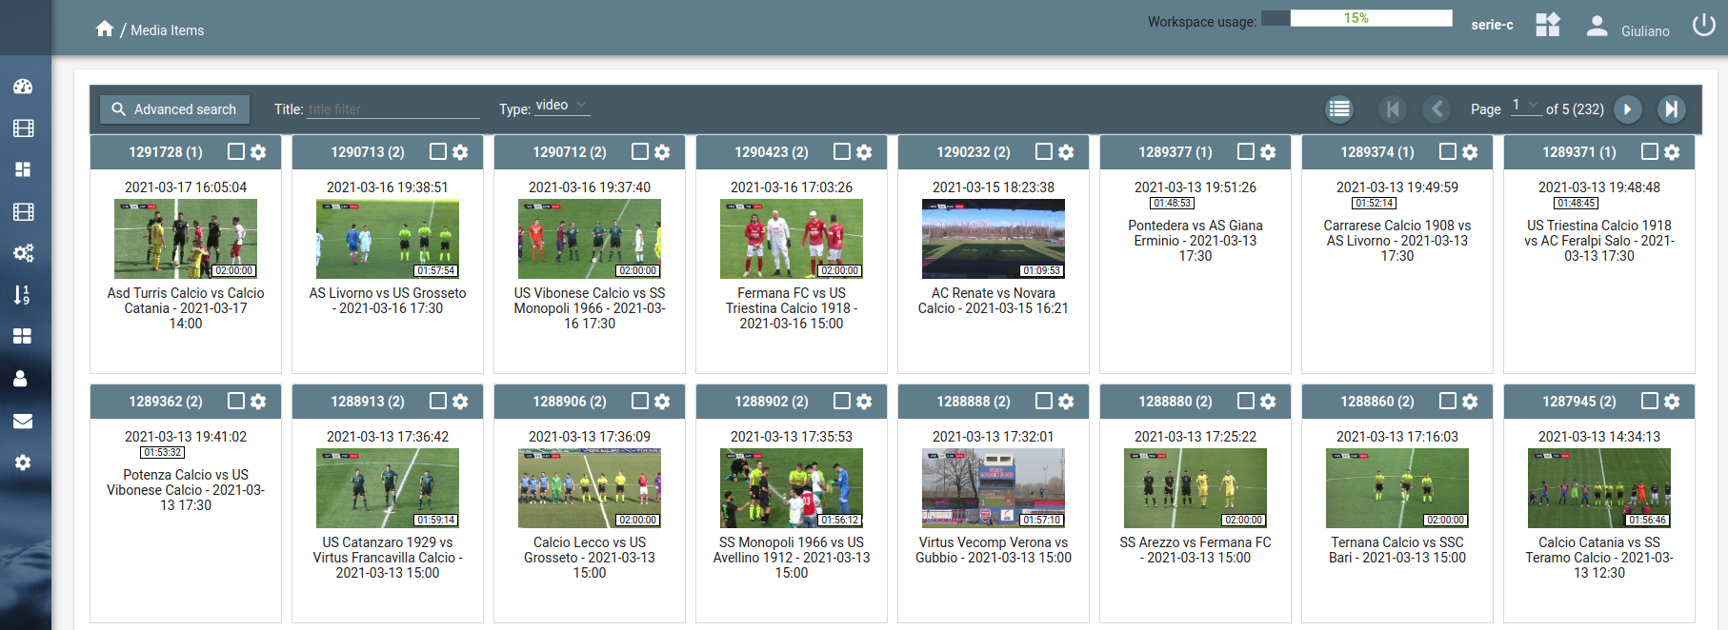
Digital Asset Management (1/2)
MMS is the cloud option to centralize and organize your Media Content: Video, Audio, Images
MMS thumbnail Media Items view is very visual and easily accessible, no matter the size of your media library, MMS helps you to keep it manageable
List view is also available to help you to sort media contents based on information such as title and upload date

Slide 4
Digital Asset Management (2/2)
MMS does not require any IT support
MMS allows you to group Media Contents in Workspaces. For example you might have a Workspace to save all the News Media Contents accessible only by the News Editorial Team, same can be done for other type of contents like Sports, ...
Upload of Media Contents is done easily by drag and drop or providing a URL to upload the content. In caso of videos too large it is also possible to upload the content spliting it in chunks
Metadata can be associated to each media content: title, tags, description and any user data information.
Metadata can be used to will help you to find the media contents

Slide 5
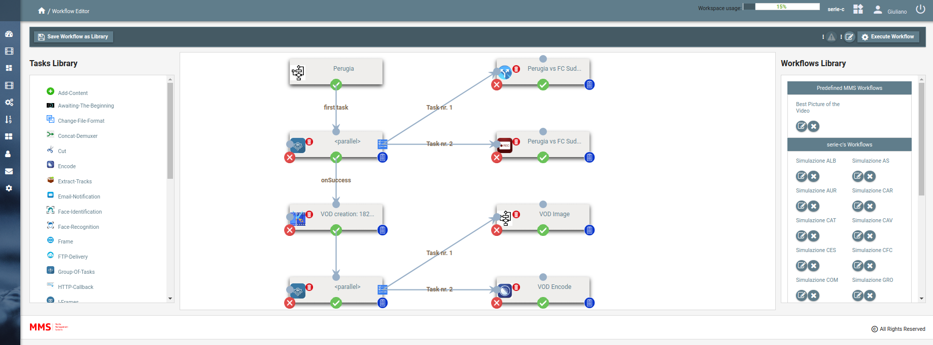
Workflow management
Workflow defined by the user
Library of predefined Task
Task Library can be extendable
Parallel execution of multiple Workflows
Management of synchronous and asynchronous Tasks
Definition of Workflows by API
Definition of Workflows by Web Interface

Slide 6
Editing/processing functionalities
Video-Audio Cut and Concat (Frame Accurate)
Image crop
Face detection (ex: thumbnails generation) and learning
Face recognition
Audio extraction/Processing
Video-Audio Slow Down
Video Slide show
Picture in Picture
Overlay of image-text
Live Mosaic
Live Proxy
Change file format
Frame extraction/Processing
Count-down video creation
Motion JPEG
Media Cross References
POST on Facebook
POST on YouTube
FTP delivery
HTTP callback
Email-notification

Slide 7
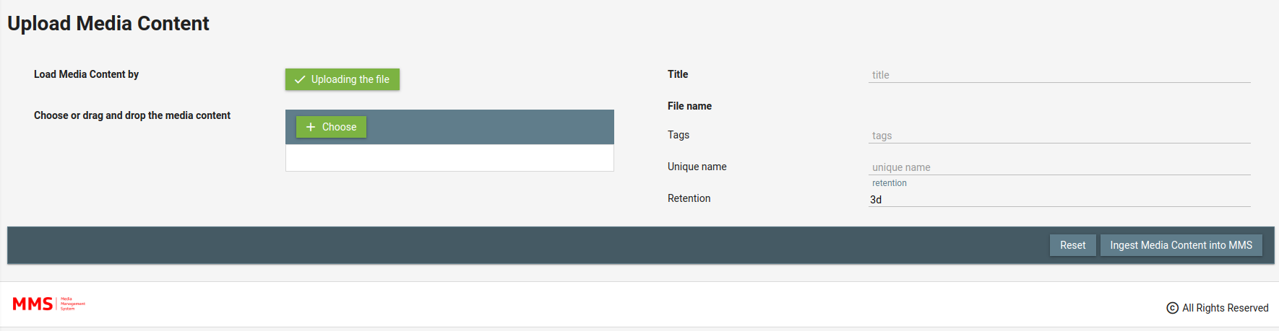
Media Contents
Live Stream Cloud Ingest (UDP, RTP, SRT, RTMP, HTTP HLS, ...)
Direct HD SDI Ingest
H264, H265, …
Multi resolution ingest
Live-VOD scalability: unlimited
Live2VOD capabilities: use of live streams to provide VOD catch up
Editing/Export/Publishing of Media Contents

Slide 8
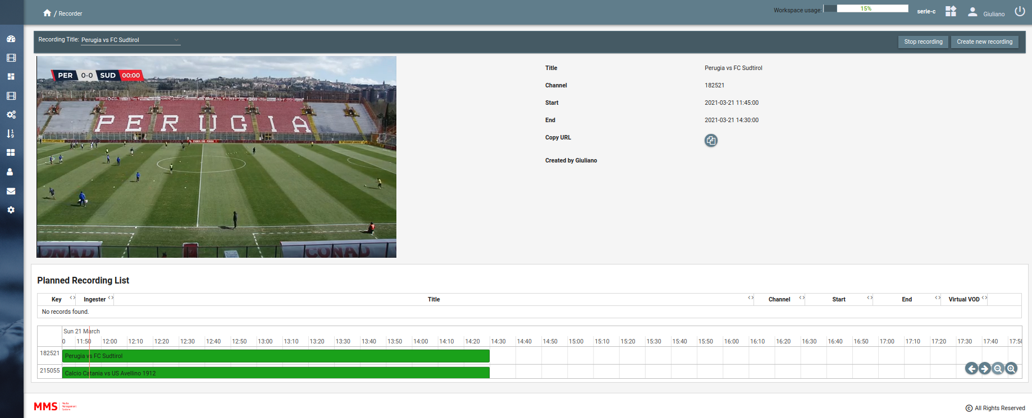
Recording application
Easy way to record IP live feed (UDP, RTP, SRT, RTMP, HTTP HLS, ecc)
Preview of each recording
VOD available for editing during the recording up to 10 seconds from real time
Scheduling of recording

Slide 9
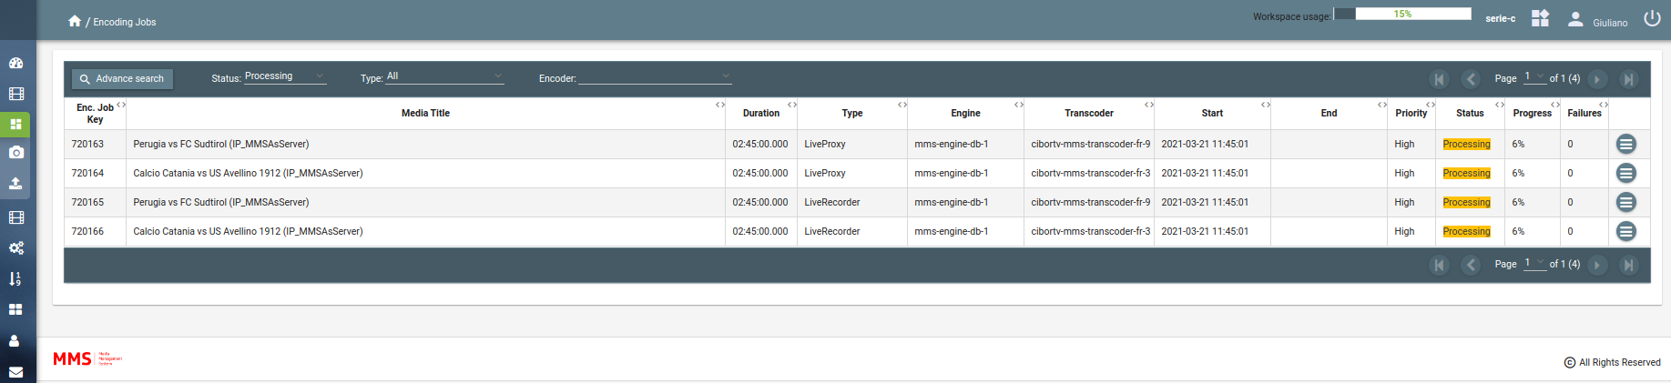
Transcoding engine
ffmpeg open source used by default
Possible integration with third party transcoders
H264/H265/… Input/Output
Management of array of transcoders
Management of encodings by priorities
Load balancing of Transcoders

Slide 10
Multiple interfaces
REST API: integration of all MMS functionalities
Java MMS REST API Library
Java MMS Workflow Library
Secure Content delivery (token by path or parameter, TTL, max retries)
Users’ rights management (native or integration with Active Directory available)
WEB interface

