Slide 1
The Infrastructure as Code; the naked truth

Slide 2
#CodeGen
#dotnetconf

Slide 3

Main sponsor

Slide 4






Community sponsors

Slide 5
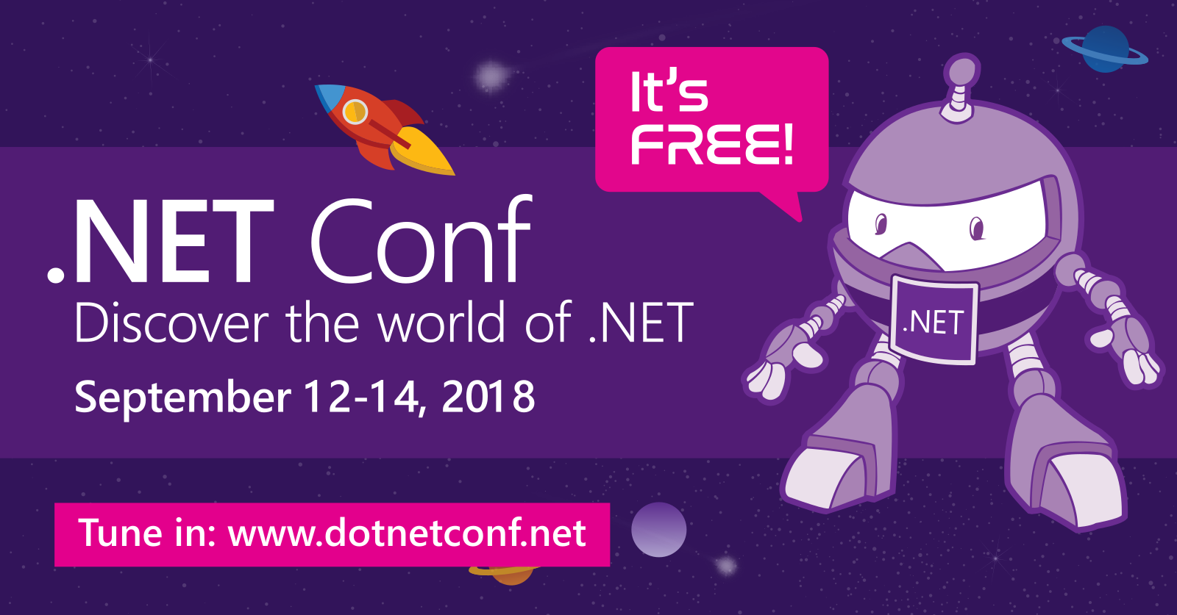
Local Event

Slide 6
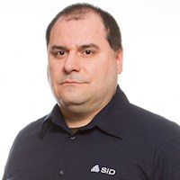
The Infrastructure as Code; the naked truth
@giulianolatini
giulianolatini
GIULIANO LATINI
giulianolatini

Slide 11
giulianolatini
@giulianolatini
giulianolatini

