Slide 1
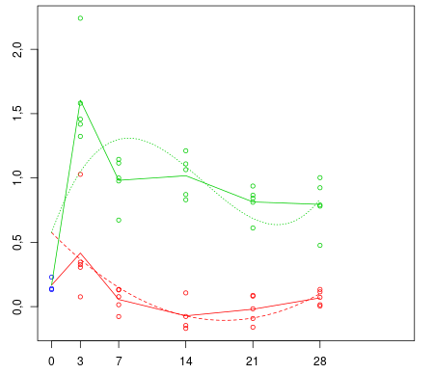
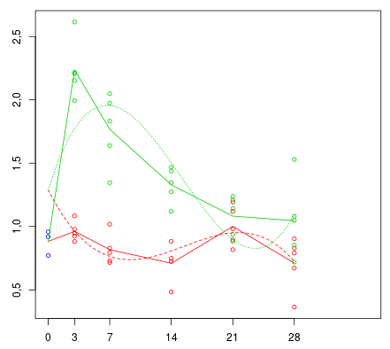
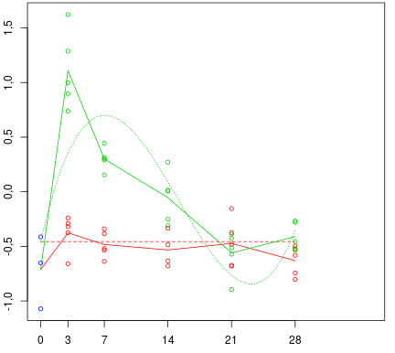
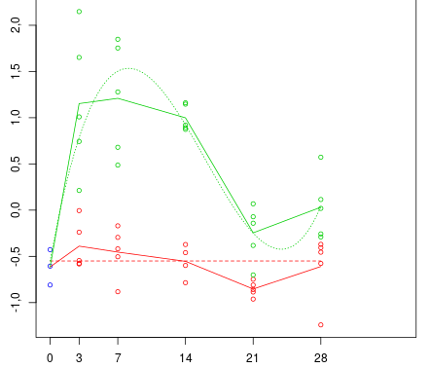
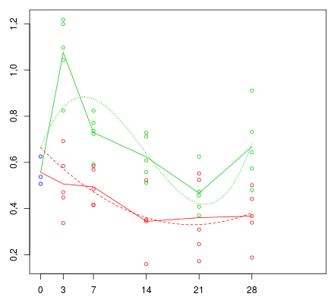
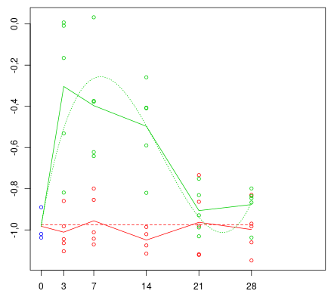
CD68 – cluster 2
CD86 – cluster 1
CD80 – cluster 1
Expression
ApoE – cluster 2
IL13R - 𝜶 1 – cluster 2
IL13R - 𝜶 2 – cluster 2
Days after treatment

