Slide 1
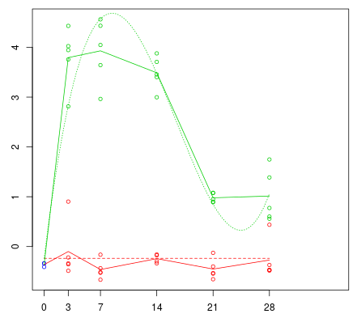
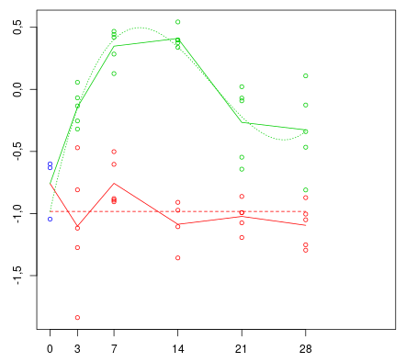
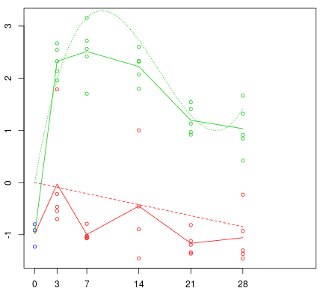
MMP7 – Cluster 2
MMP14 – Cluster 4
MMP12 – Cluster 2
Expression
Days after treatment
Bleomycin
Control

