Slide 1
Analysis and testing of SPHINCS algorithm
Sicurezza dei sistemi informatici - Giulia Milan

Slide 2
SPHINCS is a stateless post-quantum hash-based signature scheme
https://sphincs.org/

Slide 3
Outline
Post-quantum cryptography
Hash-based signatures
SPHINCS
Test in TLS use case scenario
Possible improvements

Slide 4
Post-quantum cryptography
Standard asymmetric cryptography
It relies on hard problems:
integer factorisation problem (RSA)
discrete logarithm problem (DSA, ECDSA)
A hard problem can not be solved in polynomial time by a classical computer.
If these problems turn out to be solvable in a polynomial time the security of standard cryptography algorithms is broken.
Notes:
macchina di turing determinisitica

Slide 5
Post-quantum cryptography
Quantum computing and Shor’s algorithm
1980 - Quantum computing
Introduction of the idea of quantum computers
Machines that exploit quantum mechanical phenomena to solve mathematical problems that are considered difficult or intractable for standard computers
1994 - Shor’s algorithm
Invention of the Shor’s quantum algorithm
Algorithm which factors large numbers in polynomial time, assuming the availability of a quantum computer
Until now the largest integer factored is 21
Notes:
In letteratura

Slide 6
Post-quantum cryptography
Standard cryptography threats
Many organisations such as Google and IBM are racing to create practical quantum computers
With a large-scale quantum computer, it will be possible to break many of the public-key cryptosystems currently used in our applications
This would compromise the confidentiality and integrity of all digital communications on the Internet
We do not know when today’s classic cryptography will be actually broken
It is difficult and time-consuming to pull and replace existing cryptography from production software
Notes:
So construction of quantum computers is real
RSA DSA ECDSA
The main problem is that the actual integration of such schemes in PKI protocols and use-cases can be challenging for today’s Internet, because of the key size overhead and the significant latency related to the heavy computational performance of these schemes

Slide 7
Post-quantum cryptography
Need of PQC and its goals
Develop new cryptosystems that need to be resistant to an attacker equipped with a quantum computer.
They should:
rely on different hard mathematical problems than standard cryptography
resistant to being solved by a large-scale quantum computer
be secure against both a quantum and a classical computer
interoperate with existing communications protocols and networks
Notes:
Assumendo una potenza computazionale limitata dell’attaccante
Urgent need for developing new

Slide 8
Post-quantum cryptography
PQC projects
2016 - IETF Open Quantum Safe project
developing and prototyping quantum-resistant cryptography
implementing algorithms inside the liboqs library
2016 - NIST Post-quantum crypto project
select proposed PQC algorithms
second round of the standardization process
9 signature algorithms and 17 key exchange schemes
SPHINCS+ is one of the digital signature algorithms in the second round of standardization
Notes:
Many organizations have been involved in the development of pqc: NIST, IETF, ETSI
are studied for now

Slide 9
Post-quantum cryptography
PQC algorithms
Many classes of mathematical problems and strategies that are conjectured to be quantum resistant exists.
There exists different categories of PQ cryptosystems:
Multivariate cryptography
Lattice-based cryptography
Code-based cryptography
Hash-based cryptography
Notes:
To construct public key cryptosystems
polinomi non lineari
problemi di ottimizzazione su lattici
error correcting codes
hash functions

Slide 10
Hash-based signatures
Main characteristics
Uses hash functions for digitally signing documents
Its security is based entirely on hash function properties
It does not rely on the hardness of mathematical problems
Therefore, if the underlying function turns out to be breakable in the future, it can be easily replaced with a new hash function
The only security assumption is the second preimage or collision resistance of the hash function
This assumption is necessary for any digital signature scheme, but all other schemes require also additional security assumptions

Slide 11
Hash-based signatures
Main primitives
Cryptographic hash functions
One-time signatures (OTS)
Few-time signatures (FTS)
Merkle trees
Notes:
Hash-based signature schemes are constructed upon the following main primitives:
Merkle trees for creating Many-time signatures

Slide 12
Hash-based signatures
Main primitives
Cryptographic hash functions
One-time signatures (OTS)
Few-time signatures (FTS)
Merkle trees
Signature specific properties of authentication, integrity and non-repudiation are provided mainly by the cryptographic hash function chosen.

Slide 13
Hash-based signatures
Main primitives
Cryptographic hash functions
One-time signatures (OTS)
Few-time signatures (FTS)
Merkle trees
Security of hash-based signatures (HBS) is based on the correct implementations of the last three building blocks.

Slide 14
Hash-based signatures
High level structure
In OTS and FTS schemes:
The public key is a commitment of the secret key
The signature of a message consists of revealing some information of the secret key from which the verifier can recompute the commitment
A signing key can only be used to sign respectively a single or few messages securely
These schemes are combined with Merkle tree structures to produce a many-time signature scheme:
Basic binary tree
Every node is a hash of its children
The root is the public key
The leaves are the hashes of the OTS or FTS public keys
Notes:
main advantages of OTS
1. they may be constructed from any one-way function;
2. the algorithms of signing and verification are very fast and cheap to compute, comparing to standard public-key signatures.

Slide 15
Hash-based signatures
Stateful property
In general, HBS are based on OTS:
the signer needs to ensure that the OTS private key is never reused
keep track of a state
most of HBS strongly relies on iterating over signing keys in order
the state could be represented by some information on how many signatures were already made with the key
Practically, it can be difficult to deal with a state
the state management requirement is not acceptable for many applications
To overcome these limitations, stateless signature schemes have been proposed, such as SPHINCS.
Notes:
For instance when sharing a private key on different servers that wish to sign messages concurrently, one has to synchronise all of them or security is broken

Slide 16
SPHINCS
Stateless post-quantum hash-based signature scheme (2016)
Main components:
Stateless hypertree construction
Binary hash trees
WOTS+
HORST

Slide 17
SPHINCS
Stateless post-quantum hash-based signature scheme
Main components:
Stateless hypertree construction
Binary hash trees
WOTS+
HORST
SPHINCS relies upon a hypertree structure, which is a generalisation of the first stateless construction proposed by Goldreich.

Slide 18
SPHINCS
Stateless post-quantum hash-based signature scheme
Main components:
Stateless hypertree construction
Binary hash trees
WOTS+
HORST
Binary hash trees are used to create the hypertree structure. These trees are similar to the classical Merkle trees, with some changes.

Slide 19
SPHINCS
Stateless post-quantum hash-based signature scheme
Main components:
Stateless hypertree construction
Binary hash trees
WOTS+
HORST
The intermediate nodes of the hypertree are WOTS+ trees, that are one-time signature schemes.
Each WOTS+ tree signs the public key of the next tree. The last WOTS+ tree signs with a WOTS+ signature the HORST public key.

Slide 20
SPHINCS
Stateless post-quantum hash-based signature scheme
Main components:
Stateless hypertree construction
Binary hash trees
WOTS+
HORST
The leaves of the hypertree are HORST trees. HORST are HORS, few-time signature schemes, combined with trees.
The usage of a FTS instead of a OTS is preferred since their security decreases gradually with the multiple usage of the few-time key, while in OTS this would cause a complete break in security.

Slide 21
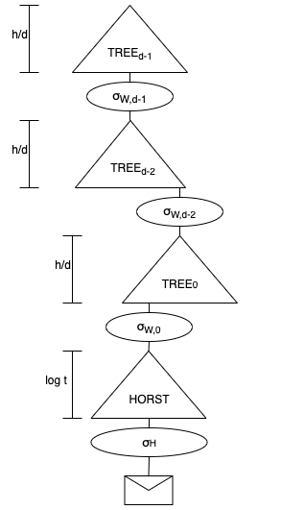
SPHINCS
Stateless post-quantum hash-based signature scheme
Main components:
Stateless hypertree construction
Binary hash trees
WOTS+
HORST
The structure of a SPHINCS signature:
Notes:
signature ha: i, R1, sigmaH, sigmaQ0, AuthA0, ….sigmaWd-1,AuthAd-1)

Slide 22
SPHINCS
Stateless post-quantum hash-based signature scheme
Designed so that the security of the algorithm can be based on weak standard-model assumptions of the underlying cryptographic hash function
It exploits a randomised tree-based structure, in which indexes are selected randomly rather than sequentially
However, the stateless property has some downsides with respect to stateful schemes:
Increase in signing time
Increase in signature size
Notes:
This is essential for many real-world scenarios, as the one previously mentioned of distributed servers, where continuously updating a stateful key pair is often impossible.

Slide 23
SPHINCS
Enhanced version SPHINCS+ (2019)
Main improvements:
FORS instead of HORST
Multi-target attack protection and tweakable hash functions
Tree-less WOTS+ public key compression
Verifiable index selection
NIST current proposals of SPHINCS+ variants:
Usage of SHAKE256, SHA-256 or Haraka hash functions
Distinction of “robust” and “simple” variants, with simpler instantiations of the tweakable hash functions
Notes:
Haraka is not a NIST-approved hash function, and since it is new it needs further analysis. We specify SPHINCS+-Haraka as third signature scheme to demonstrate the possible speed-up by using a dedicated short-input hash function.
The basic idea is to use a different hash function for each call. Moreover, each hash function call is keyed with a different key and applies different bitmasks. Keys and bitmasks are generated by a pseudo random function from an address specifying the context of the call and a public seed. Since this procedure is complex, the goal is to abstract away the details of how exactly nodes are computed, through hash function calls, from the high- level construction of the SPHINCS+ scheme. To get this abstraction they introduced the notion of tweakable hash functions, that in addition to the input value take as inputs a public seed and an address. Therefore, to mitigate the multi-target attack, SPHINCS uses two pseudo random functions, a keyed hash function and several tweakable hash functions.
These schemes are realised instantiating the SPHINCS+ construction respectively with SHAKE256, SHA-256 and Haraka hash functions.The robust variant is exactly the SPHINCS+ construction explained so far. The simple variants instead have simpler instantiations of the tweakable hash functions: they use pure random oracle instantiations in order to omit the calls to pseudo random functions in order to generate bitmasks.
For this reason, “simple” variants are faster than “robust” ones, achieving a speed-up of about a factor of three.

Slide 24
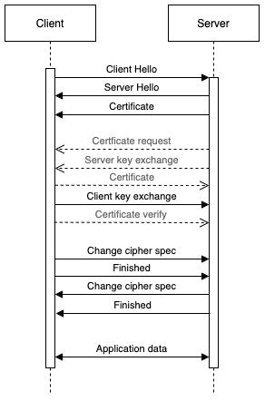
Test in TLS use case scenario
TLS handshake in a nutshell
Cipher suite negotiation phase
Authentication phase
Key agreement phase
(Certificate verify from server)
Final phase
*
*We consider a classic web scenario in which the client is not authenticated:
authentication phase comprehends only the server authentication
done with X.509 certificates
Notes:
In TLS, digital signatures are used during the authentication phase in order to authenticate the parties. Then, during the key agreement phase, a key exchange mechanism is used to establish a shared secret, which can then be used in symmetric cryptography. This means that, for security against a future quantum adversary, we should incorporate post-quantum authentication and post-quantum key exchange in those phases.
For what concerns the client authentication, the considerations would be the same as the ones for the server authentication.

Slide 25
Test in TLS use case scenario
SPHINCS+ integration
“Client Hello” and “Server Hello” messages will negotiate the PQ signature algorithm.
TLS extension for specifying signature algorithms.
Cipher suite negotiation phase
Authentication phase
Key agreement phase
(Certificate verify from server)
Final phase

Slide 26
Test in TLS use case scenario
SPHINCS+ integration
Server will send its PQ certificate or its chain of certificates:
New Algorithm Identifiers for X.509
Add the PQ public key of the subject and the specific PQ signature algorithm used
Certificate is signed by the issuer using his PQ private key
Cipher suite negotiation phase
Authentication phase
Key agreement phase
(Certificate verify from server)
Final phase
Increase of the size of the single certificate, and so the size of the certificate chain
TLS fragmentation of records to split packets before sending them
Notes:
The addition of the PQ public key and signature to the certificate will increase the size of the single certificate, and so the size of the certificate chain
This is not a problem since, as it happens normally in TLS, when a certificate chain exceeds a certain length, of 16 KB, TLS will exploit the fragmentation of records to split packets before sending them.

Slide 27
Test in TLS use case scenario
SPHINCS+ integration
Cipher suite negotiation phase
Authentication phase
Key agreement phase
Certificate verify from server
Final phase
New step introduced in addition to the standard schema.
The server will sign the transcripts of the handshake and transmit a post-quantum “Certificate verify” message.
The message contains a PQ signature which the client will verify along with the signatures in the certificate chain.

Slide 28
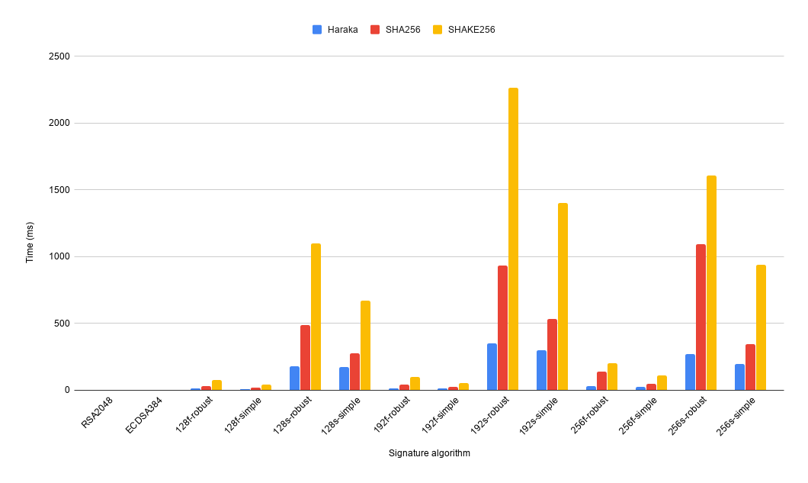
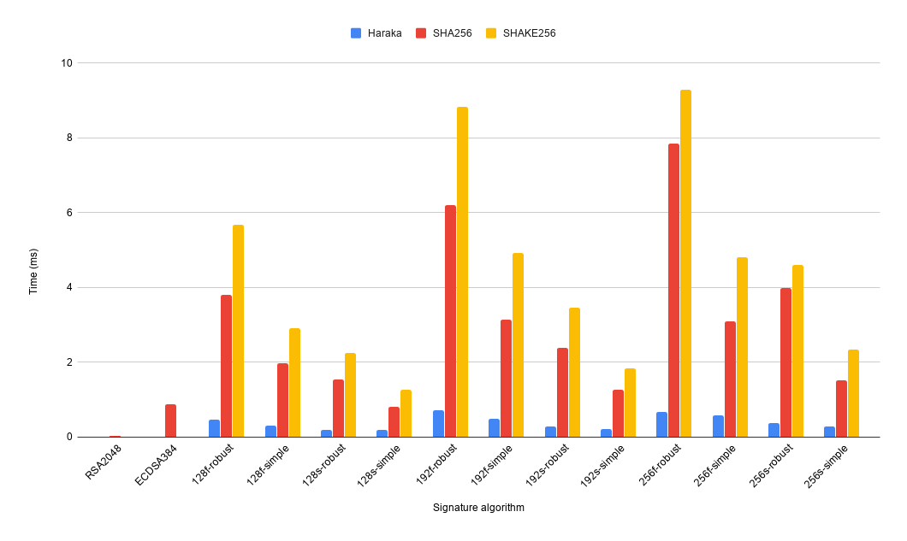
Testbed I with liboqs test suite
Sign
Verify
Average times for Sign and Verify operations for RSA, ECDSA and SPHINCS+:
Sign: RSA (0.533 ms), ECDSA (1.01 ms), SPHINCS+ Haraka (129.68 ms)
Verify: RSA (0.02 ms), ECDSA (0.87 ms), SPHINCS+ Haraka (0.39 ms)
Performances heavily rely on the velocity of the underlying hash function
SPHINCS+ variants with Haraka have times comparable to ECDSA values
Other SPHINCS+ variants are significantly slower compared to RSA and ECDSA
Notes:
To evaluate them, all SPHINCS+ variants were taken into consideration. SPHINCS+ has 36 variants, built with different combination of parameters and different hash functions.
Haraka as the hash function

Slide 29
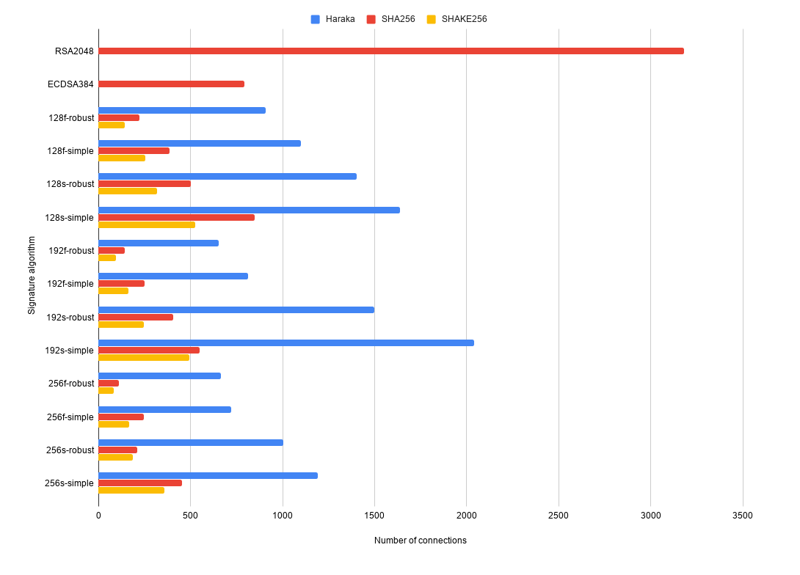
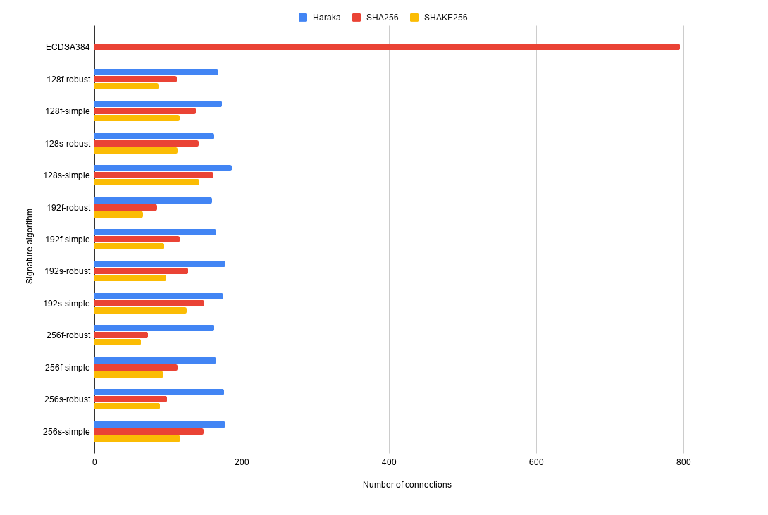
Testbed II with OpenSSL 1.1.1
DH
NTRU
Number of TLS connections per second for RSA, ECDSA and SPHINCS+ with DH and NTRU key exchange:
DH: RSA (3180), ECDSA (794), SPHINCS+ Haraka (1136)
NTRU: ECDSA with DH (794), SPHINCS+ Haraka (171)
Average number of connections with SPHINCS+ in 1 second is less than half of connections with RSA
SPHINCS+ variants with Haraka perform better than ECDSA
Other SPHINCS+ variants have lower values than ECDSA
A standard TLS handshake is 4 times faster than a post-quantum handshake

Slide 30
Test in TLS use case scenario
Considerations
Huge overhead introduced by SPHINCS+ variants by “sign” and “verify” operations:
Haraka hash function provides TLS connections comparable to ECDSA ones
Remaining hash functions make SPHINCS+ authentication much slower than RSA and ECDSA authentication mechanisms
Acceptable for non-interactive applications, when there is the need for long term security and for stateless schemes
For interactive applications, like TLS, further algorithmic improvements to these schemes could enable deployment on a broader scale
Significant overhead introduced by adding a PQ key exchange in TLS handshake time
A standard DH handshake with ECDSA is still more than 4 times faster than the NTRU handshake with any SPHINCS+ variant
Notes:
most of the sphincs+ variants

Slide 31
Possible improvements
For testing SPHINCS+
In general, results of tests reflect state-of-art results.
Note that for all tests in the TLS use case scenario:
A single certificate was issued and sent from the server to the client with a self-signed certificate:
For more data, use longer certificate chains with intermediate Certification Authorities
Significant impact on the total handshake time
Significant impact on the number of connection established per second
Only SPHINCS+ was tested as a PQ signature algorithm:
For more data, compare SPHINCS+ also to other signature schemes
Computation of overhead with respect to other PQ signatures, if present

Slide 32
Possible improvements
For improving the deployment of SPHINCS+
For deployment on a broader scale:
Faster hardware implementations and algorithmic improvements
More studies on the security of SPHINCS+ scheme:
Most of studies refer to the previous version SPHINCS:
Fault injection attacks targeting SPHINCS but expanded to SPHINCS+
Differential power analysis attack only for SPHINCS
Real world scenario integrations:
Supported but not directly integrated inside OpenSSL and OpenSSH
Integration in VPN applications like OpenVPN
Notes:
IPSec

