Slide 1
Alma Mater Studiorum – Università di Bologna
SCHOOL OF ECONOMICS, MANAGEMENT AND STATISTICS
-Forlì Campus-
Master’s Degree programme in Economics and Management
Business and Administration - International Curriculum
CRISIS AND RECOVERY IN A START-UP. THE CASE OF THE SLOVAK COMPANY SYNCULARIO
CANDIDATE:
GIULIO CAMUFFO
SUPERVISOR:
RAFFAELE CORRADO
Academic Year 2021/2022
Notes:
Good morning everyone. Today I’m going to present my final dissertation which is about the Crisis and recovery in a start-up. The case of the Slovak Company Synculario

Slide 2





Synculario
Synculario (trade name: Synculario j.s.a.) is a start-up co-founded on March 15, 2018, by Rastislav Brenčič, which is the current CEO.
Headquartered in Jarošova 2961/1, 831 03, Bratislava (Slovakia).
Being a B2B services company that operates in the IT employment placement sector, it’s an intermediary between the job demand (candidates) and job supply (clients).
The main sources of revenues are body shops (temporary placement) and permanent placements.
The company most important departments are Recruitment, which hire candidates interested in the company’s intermediary service, and Sales, which place candidates to client companies.
Notes:
-First of all, Synculario is a start-up based in Bratislava (Slovakia), co-founded on March 2018 by Rastislav Brenčič, which is the current CEO.
-It’s a B2B services company which operates in the IT employment placement sector and then, it’s an intermediary between the people who are looking for a job (job demand) and the firms who are looking for workers (job supply).
-The main sources of revenues come from the two main services that the company offer (body shops and permanent placements) and therefore, the most important departments are Recruitment, where recruiters hire candidates interested in the company’s services, and Sales, where sales representative place candidates to client companies

Slide 3
Thesis Purpose
In 2022, the company encountered its biggest crisis that was initiated by the previous administration. The goal of this research is to investigate the root causes of the crisis and to examine the measures taken by the new administration during the ongoing restructuring process.
January 2022
August 2022
September 2022
December 2022
2023
Previous Administration
First symptoms and peak of the crisis
New Administration
Crisis effects and Restructuring process
Notes:
The thesis uses an empirical approach based on an internship experience. The goal is to identify and understand the root causes that have led Synculario to face in 2022 its biggest crisis since its foundation, and which solutions have been adopted so far. You can see here a timeline which show the two most important periods related to the crisis and the restructuring process connected to the previous and new administration.

Slide 4

Theoretical Framework
START-UP
CRISIS
RESTRUCTURING
Notes:
-As a theoretical framework permeating the research, it is important to emphasise these three concepts. Synculario is in fact a start-up, hence a small and young organisation characterised by flexibility and dynamism in reacting to market changes and with great potential for growth.
-This start-up is facing a crisis, hence a negative situation characterised by insecurity and instability, more or less unexpected, which has repercussions on the financial, organisational and reputational side of a company.
-Finally, the company is currently undergoing a restructuring process to recover from the crisis, so an act aimed at re-establishing a balanced situation or improving it to achieve higher levels of efficiency, following different strategies.

Slide 5

Research Questions
Based on the typological classification of crisis from the literature and the factors that caused it in the specific, what type of crisis is Synculario facing?
Which are the internal and external factors that led the start-up to a crisis in 2022?
Which solutions have been adopted so far to solve the crisis?
Based on the typological classification of restructuring from the literature and the restructuring process put in practice so far, what type of restructuring process is Synculario implementing?
Notes:
Therefore, given the objective of the study and the theoretical framework, the research questions aim to: identify the most important factors that have led to the crisis; identify which solutions have been adopted to solve the crisis so far; identify the type of crisis faced and the type of restructuring process implemented thanks to the literature and the empirical analysis.

Slide 6

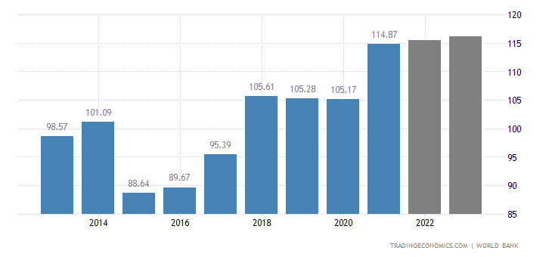
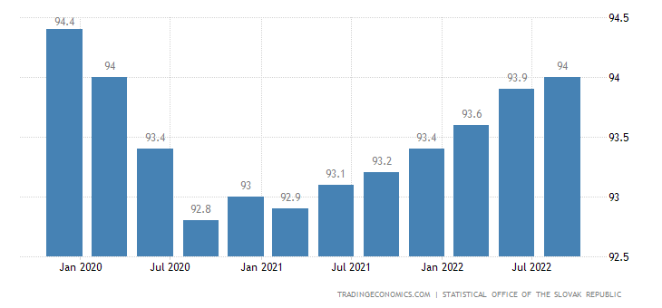
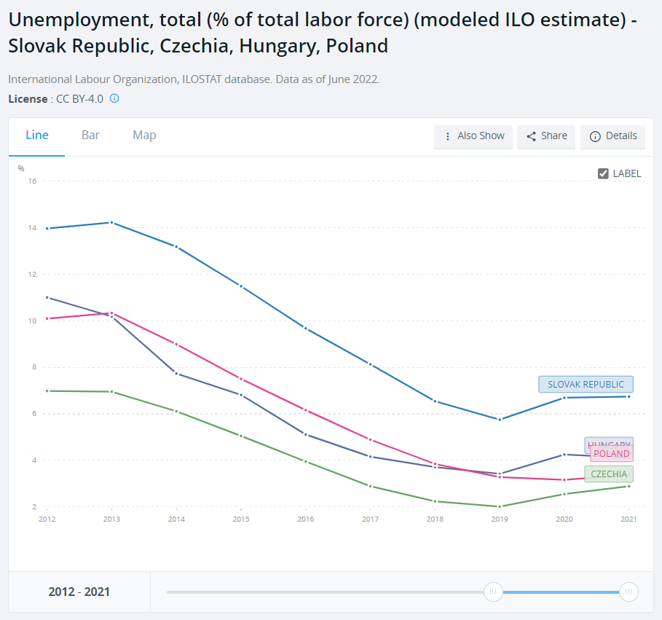
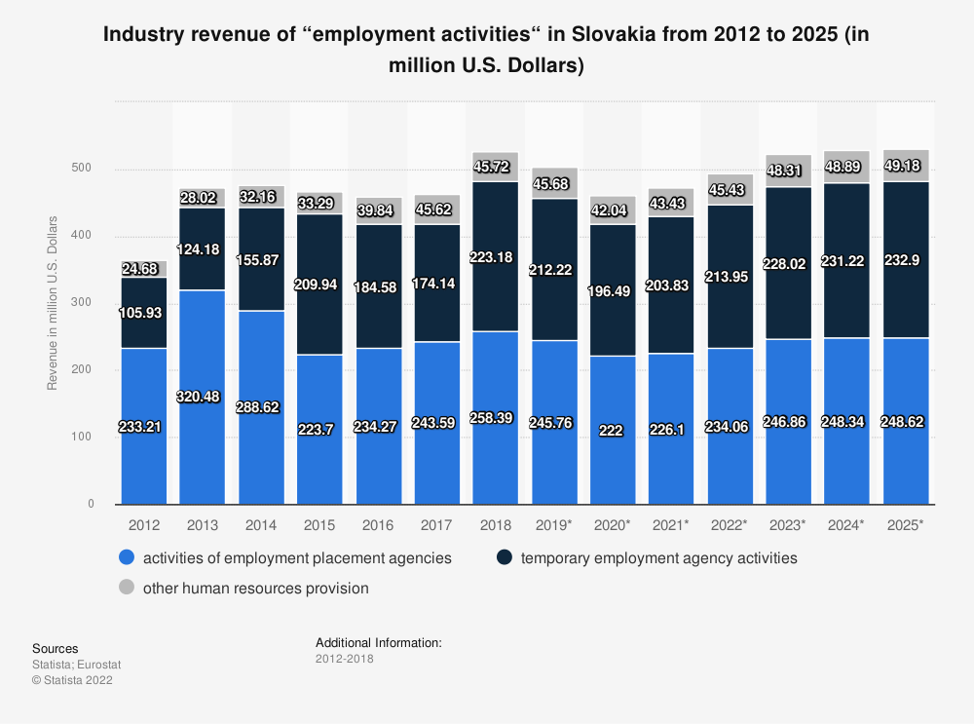
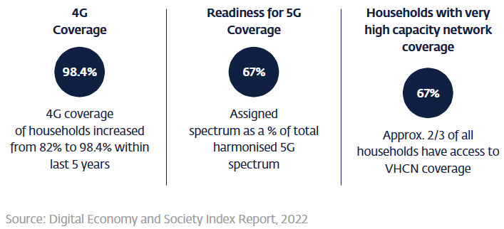
Slovakia Overview
1st in the Digital/Technological skills among Visegrad group countries (Poland, Czech, Hungary, Slovakia)
4% ICT share on the total employment (>100,000 job opportunities and a 58% growth of employees in the sector between 2017 and 2022)
5% ICT’s contribution to Slovakia’s GDP
Slovakia GDP
Slovakia Labour Participation Rate
Source: Statistical Office of the Slovak Republic, 2021, IMD World Digital Competitiveness Ranking 2021, SARIO Calculations based on Finstat, 2021
Visegrad Group Unemployment Rate
ICT technologies integration in Slovakia
Employment Placement activities in Slovakia (Nace N78)
Notes:
For what concerns an overview of Slovakia, as you can see the GDP is steadily growing from 2016 and is expected to keep on growing. Despite the pandemic in 2020, a positive trend is followed also by the labour participation rate. The unemployment rate of Slovakia it’s the highest among the Visegrad countries (which are Slovakia, Poland, Hungary, Czechia), and from 2020 the rates of all the group are growing. It’s relevant to mention that the ICT sector in Slovakia it’s particularly relevant and it contributes for a 4% share of total employment (it counts for more than one hundred thousand job opportunities and there was a 58% increase of employees in the sector between 2017 and 2022. Finally, it contributes for a 5% to Slovak GDP. In addition, ICT technologies integration in the country is increasing, as you can see from the 4G and 5G coverage percentages, which are quite high and this is a highly correlated factor with more advanced technology infrastructures, that in turn could create more demand for IT-related jobs. Finally, thanks to a cross-sectional study between Statista and the Statistical Office of the Slovak Republic, it can be seen that the employment placement market in which Synculario operates, corresponding to Nace Code N78, is an overall growing sector since 2012 and is expected to grow further in the coming years.

Slide 7
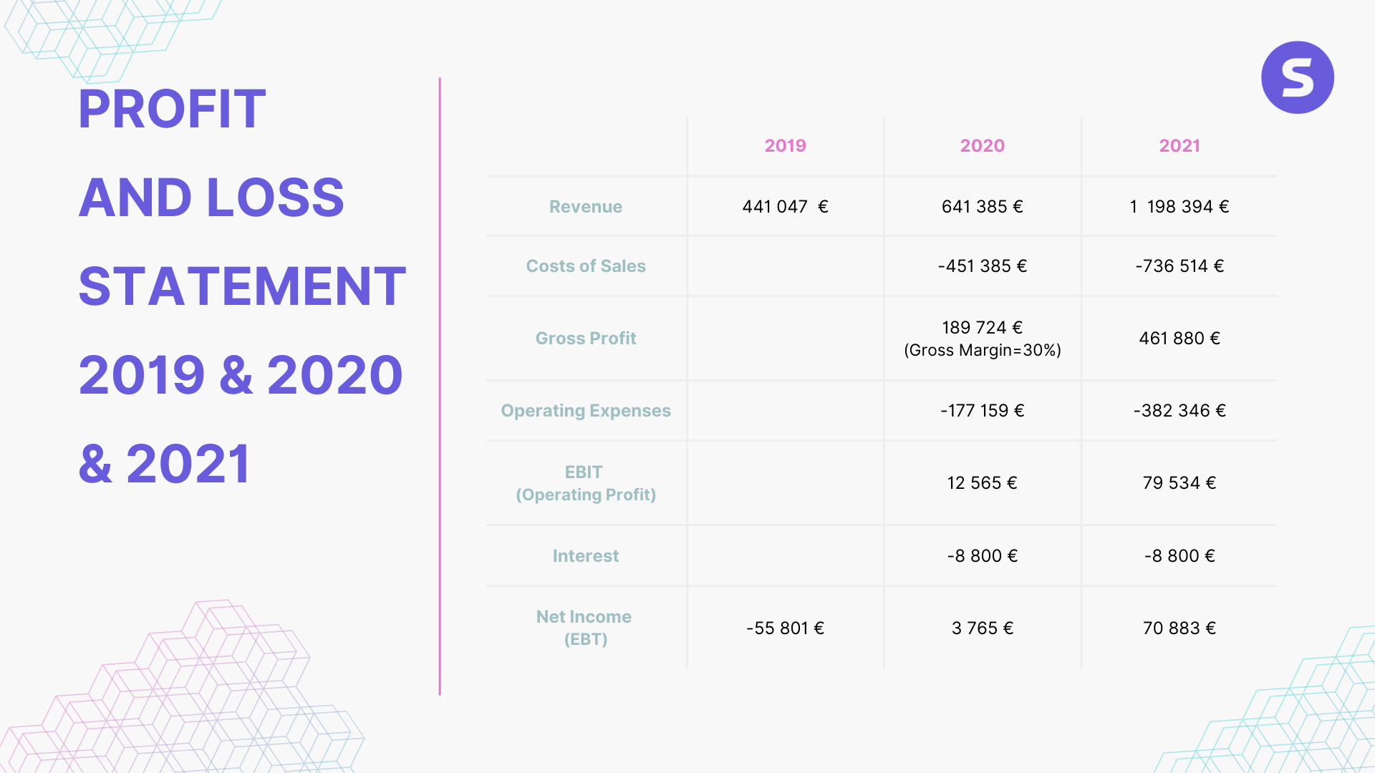
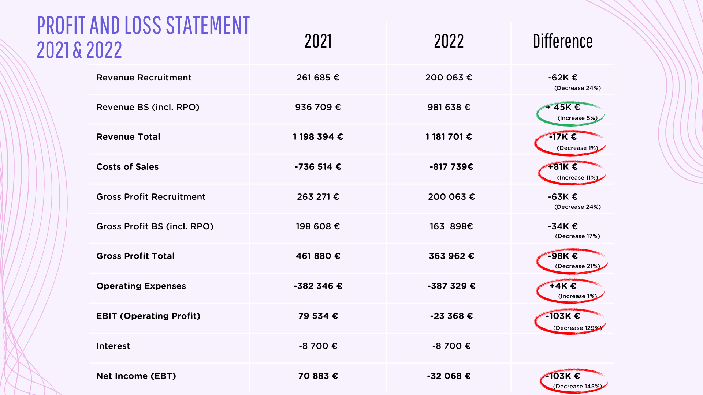
Synculario Financial Performance Overview
2019-2022
Changes in Revenues: 2019 / 2020 = +49%; 2020 / 2021 = +87%
Changes in Gross Profit: 2020 / 2021 = +143%
Changes in Net Income: 2019 / 2020 = +107%; 2020 / 2021 = +1,782%
Changes in Revenues: 2021 / 2022 = -1%
Changes in Gross Profit: 2021 / 2022 = -21 %
Changes in Net Income: 2021 / 2022 = -145%
Notes:
Now, To show you the financial details of Synculario crisis, these are two recent extracts from the company's P&L shown during some Business Reviews in 2022. As you can see, all indicators from 2019 to 2020 improved, while those from 2020 to 2021 increased exponentially, as shown by the increase in Gross Profit of 143% or the huge increase in Net Income of 1,782%. On the contrary, from 2021 to 2022, the main indicators all follow the opposite trend, contracting by a considerable amount, as shown by the reduction of Net Income by 145% even to a negative value, lower than the Net Income reached in 2020.

Slide 8




Empirical Analysis: the 8 crisis’ factors (1)
Personnel cutbacks and internship shortfall
Overreliance on Postova Banka
Hiring overload of junior positions without mentoring
Lack of control by the parent, 26HOUSE, and principal -agent issue
Notes:
From the empirical approach applied and a careful historical reconstruction of events, 8 key factors emerged that combined together have caused the crisis and its effects. These factors are:
Personnel cutbacks due to employees’ leaving and layoffs before September 2022, and the low focus on the internship program
An overreliance on only one client (Postova Banka) and lack of diversification
A Hiring overload of junior recruiters from January to July 2022 without mentoring and training
A Lack of control by the parent company of Synculario, 26HOUSE, and principal-agent issue

Slide 9




Empirical Analysis: the 8 crisis’ factors (2)
Failed management change (from traditional to agile)
Business expansion failure in Kosice
Unsustainable sales and recruitment strategy focus on permanent placements solutions
Market growth and competitors reaction impact (TITANS and Coolpeople)
Notes:
Failed attempt to switch management style, from traditional to agile, in July 2022
Failed business expansion in Kosice, the second most important city in Slovakia
Unsustainable sales and recruitment strategy with too much focus on permanent placement rather than body shop
Growth of the N78 market which has strengthen the competition as well (like for TITANS and Coolpeople)

Slide 10
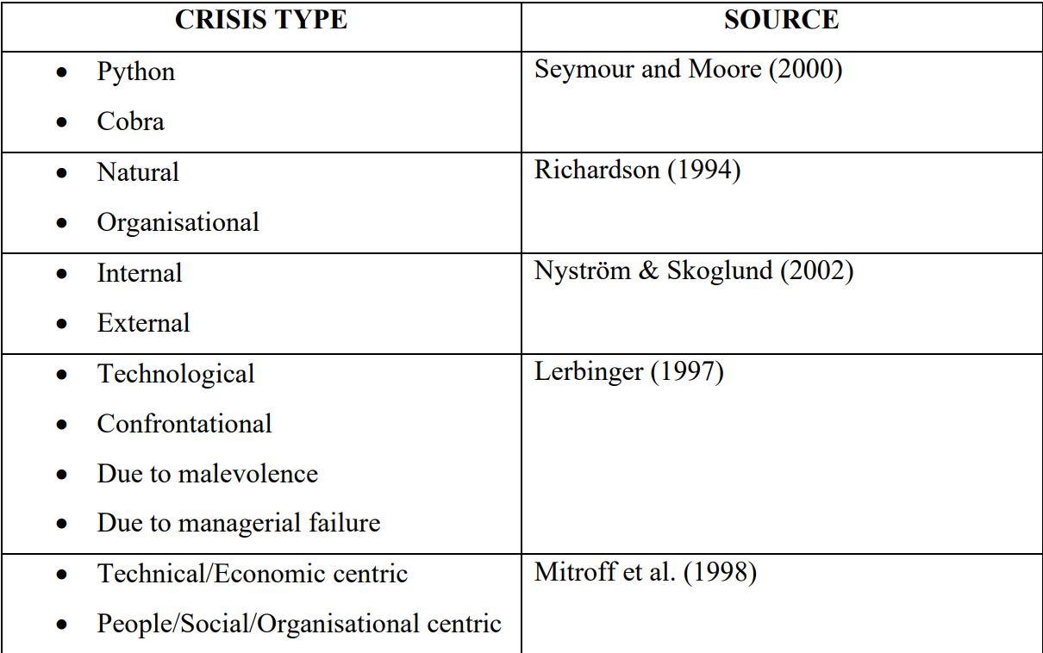
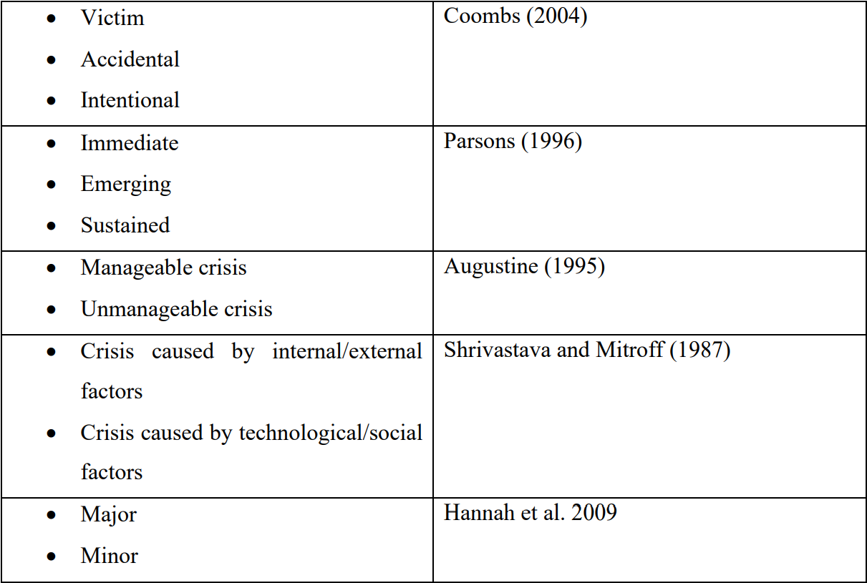
Synculario’s Crisis
KEYWORDS TO IDENTIFY SYNCULARIO’S CRISIS
Major crisis.
Caused by internal factors.
With organisational origins.
Emerging and gradual crisis that might have been handle before.
Characterized by feeling of ambiguity, insecurity and instability.
Result of series of strategic missteps, wrong decisions and specific circumstances.
Result of poor and bad management.
Intentional and only to a small extent accidental.
Notes:
Thus, considering the literature and the 8 factors just analysed, the start-up crisis can be summarised as follows. Its’ the Major and biggest crisis faced by the start-up since its foundation in 2018. It has an internal and organisational origin and it started as an Emerging and gradual crisis that might have been handle during its first symptoms, before April 2022. It’s characterized by feeling of ambiguity, insecurity and instability and it is the result of a series of strategic missteps, poor management, wrong decisions and specific circumstances (like the convergence of all the 8 factors together). It can be considered Intentional and only to a small extent accidental because there might be ambiguous effects from the Russia and Ukraine war, because high unemployment may benefit the employment placement sector, but this is not certain.

Slide 11
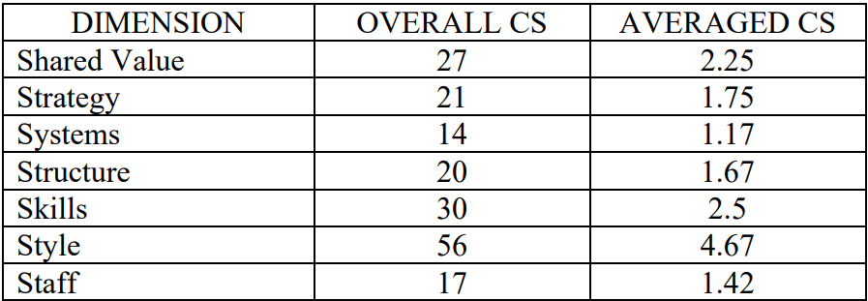
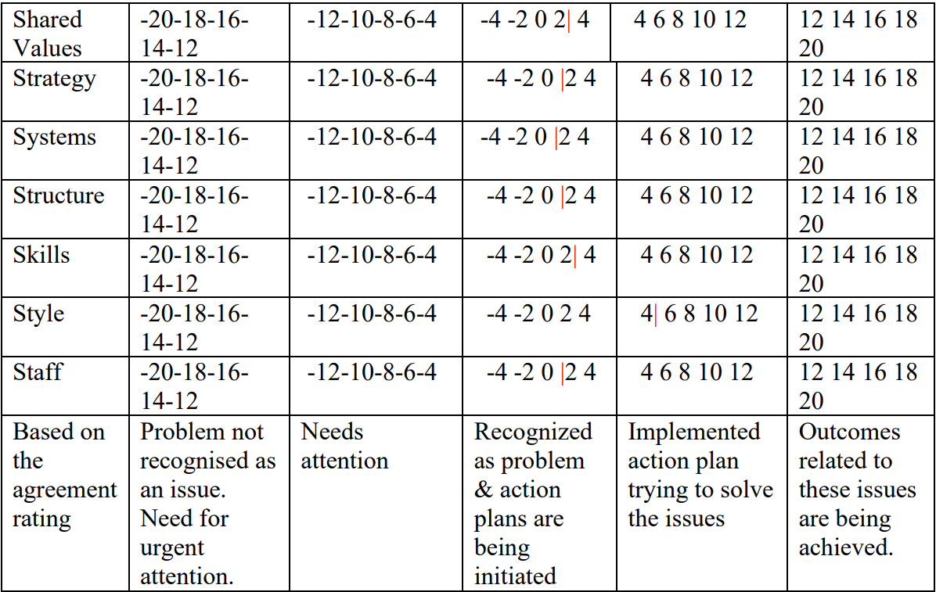
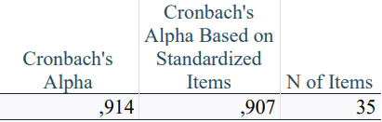

McKinsey 7S Strategic Readiness Survey
35 questions, divided in 7 groups (7S) of 5 questions each
Agreement Rating from 1 (strongly disagree) to 5 (strongly agree)
Computational value: 1 = – 2; 2 = – 1; 3 = 0; 4 = +1; 5 = +2
12 respondents out of 14 (85.7% response rate). The management (2 people) has been voluntarily excluded from the survey to avoid biases
Output of the survey represent the internal perception of the company and of the management itself
Style obtained the highest averaged overall composite score (4.67), while Systems and Staff the lowest score, <1.5 (1.17 and 1.42 respectively)
From SPSS:
High reliability
Notes:
Therefore, in order to understand from an internal perspective which critical dimensions were most affected by the crisis and poor management of the previous administration, the McKinsey 7S Strategic Readiness Survey was conducted. It consisted of 35 questions, divided into 7 groups (7S) of 5 questions each. There were 12 respondents out of 14 (86% response rate). 2 people from the management have been voluntarily excluded from the survey to avoid biases. The respondents had to enter for each answer an Agreement Rating scale of 5 values from 1 (strongly disagree) to 5 (strongly agree). For computational purposes each value of the scale from 1 to 5, was equal to a number ranging from -2 to +2, to calculate the overall composite score. This score per each dimension has been divided by the total number of respondents (12) to obtain the averaged overall composite score. The interpretation sheet retrieved from the literature was needed to understand the level of criticality of each dimension looking at the averaged overall composite score and in which range this score fell. Style obtained the highest score, while Systems and Staff the lowest. The survey is highly reliable, given the high Cronbach's alpha indicator obtained from the reliability analysis on SPSS.

Slide 12





McKinsey 7S Survey’s Output
Style
Organisational culture, mindset and mutual respect adopted and shared by the staff are the key strengths of the company
Systems
Negligence, lack of experience and an efficient training system to develop talent once hired
Inefficiencies due to use of disjointed non-integrated software
Lack of functional corporate website
Need for streamlining and automating the operational flow for faster results
Staff
Poor management style by the previous CEO and administration
Employees’ size reduction in August 2022
Resistant attitudes to change
Lack of focus and enhancement of the internship program
Notes:
As for the Style dimension: Organisational culture, mindset and mutual respect adopted and shared by the staff are the key strengths of the company. Such a high score is the result of the perceived difference between the previous and new administration.
Then, for what concerns Systems, such a low score was due mainly to -“Negligence, lack of experience and an efficient training system, to develop talent once hired → Poor training of junior positions → Poor performance” - Inefficiencies due to use of disjointed non-integrated software (Outlook, Excel, Sharepoint, Canva, Recru, Google Drive, Word, etc.)
- Lack of functional corporate website
- Need for streamlining and automating the operational flow for faster results
On the Staff side, the low score was due to:
-Poor management style by the previous CEO and administration
- A lot of employees left the company in August 2022
-Resistant attitudes and behaviours from two senior figures belonging to the previous administration
-Lack of focus and enhancement of the internship program, as the interns didn’t have guidelines, tasks and responsibilities

Slide 13

Restructuring Process and Solutions Adopted
Systems
Leveraging the parent-subsidiary synergies with the implementation of the ERP Odoo
Staff
Replacement of the previous CEO in 2022 and replacing of the two senior figures in 2023
More responsibilities to the interns and involvement into business’ dynamics, less and only Czech or Slovak interns to provide more support and better training
Technological
Delayering
Synculario’s Restructuring
Downsizing
Managerial
Notes:
Regarding the restructuring process from September to December 2022 and the solutions adopted, for the Systems dimension the parent-subsidiary synergies will allow for the implementation of the ERP Odoo to overcome the previous inefficiencies, with the use of a unique integrated software, a more efficient website and a better database and CRM and automate some operational steps. Synculario is planning to fully implement Odoo during 2023.
Among the solutions adopted for the Staff: The previous CEO left the company in September 2022 and the company is planning to replace the two senior figures in 2023 which were showing resistance attitudes. Also, more responsibilities and involvement into business’ dynamics will be provided to the interns, with the selection of less interns only from Czechia or Slovakia to provide more support and better training, to officially hire them at the end of the period
In addition, considering the solutions adopted and the ongoing restructuring process, Synculario’s restructuring adopted is a mix of a managerial, technological, downsizing and delayering strategies.

Slide 14


Limitations and Future Research
LIMITATION 1: lack of key performance indicators (KPIs) and performance management during the crisis in 2022
LIMITATION 2: very limited theoretical framework on start-up crises
LIMITATION 3: time limitation imposed on data collection (from September 2022 to December 2022)
Need for further theoretical development in the area of start-up crises
Need for better internal reporting mechanisms to be put in place
Need for the creation of a contingency plan for future crises
Development of complex software or database with combination of different dependent variables associated to the most popular crisis’ causes
Notes:
Nevertheless some limitations have been encountered for this research: at first, the lack of key performance indicators (KPIs) and performance management during the crisis made hard to track all the events; the theoretical framework on startup crises is very limited and the time limitation was imposed on data collection, which was the duration of the internship from September 2022 to December 2022
-----------------------------------------------------------------------------------------------------------------------
So, to conclude, this study highlighted some key points:
… The need for further theoretical development in the area of startup crises to identify more accurate types of crises through case histories with clearer types of exits.
….The need for better internal reporting mechanisms to be put in place. transparency and accountability might improve with a better flow of information between the Board and shareholders.
….The need for the creation of a contingency plan for future crises, to improve its resilience and reduce the impact of any crises that may occur
… and the possible Development of complex software or database with combination of different dependent variables to identify the main causes of business crises, allowing for more targeted approaches to be used for each situation

Slide 15
Ďakujem! (Thank you!)
Notes:
thank you all for the attention and a special mention to my Supervisor, Raffaele Corrado, for all the support. Thank you so much

